Slide 1
TCFD 氣候相關財務揭露與En-ROADS 氣候變遷模擬 (Task Force on Climate-Related Financial Disclosures (TCFD) and En-Roads Interactive)
永續數據分析 (Sustainability and ESG Data Analytics)
1122ESGDA05
DM4, NTPU (N4084) (Spring 2024) Fri, 10, 11, 12 (18:30-21:15) (臺北大學民生校區 305)
戴敏育 教授
Min-Yuh Day, Ph.D, Professor
Institute of Information Management, National Taipei University
https://web.ntpu.edu.tw/~myday
https://meet.google.com/miy-fbif-max
2024-03-29

Slide 2
課程大綱 (Syllabus)
週次 (Week) 日期 (Date) 內容 (Subject/Topics)
1 2024/02/23 永續數據分析概論 (Introduction Sustainability and ESG Data Analytics)
2 2024/03/01 環境、社會與治理 (ESG) 淨零數位轉型 (Environmental, Social, and Governance (ESG) in Net-Zero Digital Transformation)
3 2024/03/08 永續與ESG 資料科學 (Data Science for Sustainability and ESG)
4 2024/03/15 永續數據分析個案研究 I (Case Study on Sustainability and ESG Data Analytics I)
5 2024/03/22 Web 3.0 和大數據分析在金融科技、綠色永續金融 (Web 3.0 and Big Data Analysis in Fintech, Green and Sustainable Finance)

Slide 3
課程大綱 (Syllabus)
週次 (Week) 日期 (Date) 內容 (Subject/Topics)
6 2024/03/29 TCFD 氣候相關財務揭露與En-ROADS 氣候變遷模擬 (Task Force on Climate-Related Financial Disclosures (TCFD) and En-Roads Interactive)
7 2024/04/05 放假 (No Classes)
8 2024/04/12 期中報告 (Midterm Project Report)
9 2024/04/19 ESG數據的收集、分析和視覺化 (ESG Data Gathering, Analysis, and Visualization)
10 2024/04/26 ESG數據報告 (ESG Data Reporting); 企業永續報告書 (Corporate Sustainability Reports)

Slide 4
課程大綱 (Syllabus)
週次 (Week) 日期 (Date) 內容 (Subject/Topics)
11 2024/05/03 ESG數據驗證 (ESG Data Verification)
12 2024/05/10 永續數據分析個案研究 II (Case Study on Sustainability and ESG Data Analytics II)
13 2024/05/17 能源之星報告與數據揭露 (Energy Star Reporting and Data Disclosure)
14 2024/05/24 人工智慧物聯網在ESG永續應用 (Artificial Intelligence of things (AIoT) in ESG and Sustainability Applications)
15 2024/05/31 生成式AI於永續評等和報告生成 (Generative AI for ESG Rating and Reporting Generation)
16 2024/06/07 期末報告 (Final Project Report)

Slide 5
Task Force on Climate-Related Financial Disclosures (TCFD) and En-Roads Interactive

Slide 6
Outline
Task Force on Climate-Related Financial Disclosures (TCFD)
En-Roads Interactive Platform
Integrating TCFD and En-Roads for ESG Data Analysis

Slide 7
Sustainability and ESG Data Analytics

Slide 8
Task Force on Climate-Related Financial Disclosures (TCFD)

Slide 9
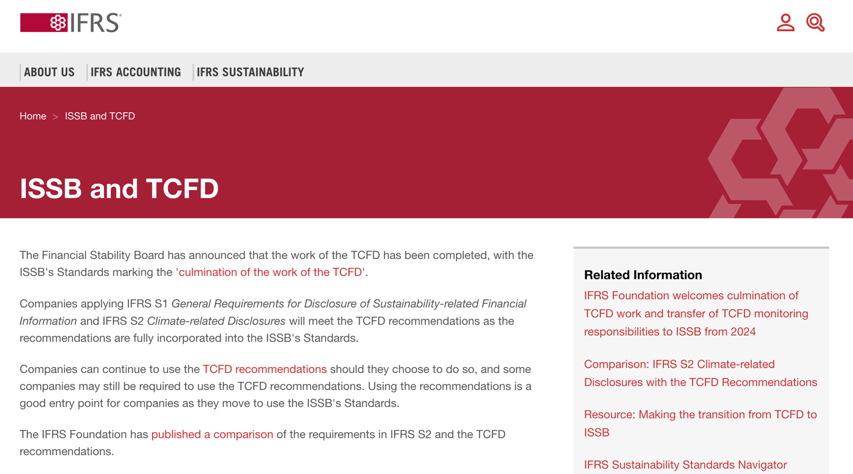
TCFD (Task Force on Climate-related Financial Disclosures)
https://www.ifrs.org/sustainability/tcfd/
https://www.fsb-tcfd.org/

Slide 10
Task Force on Climate-Related Financial Disclosures (TCFD)
Introduce climate change as a financial risk
Importance of transparency and informed decision-making
Task Force on Climate-Related Financial Disclosures (TCFD)

Slide 11
What is TCFD?
The origins of TCFD by the Financial Stability Board (FSB) in 2015
The voluntary nature of TCFD recommendations
The objectives of TCFD
improve transparency and support informed decision-making by investors

Slide 12
The Four Core TCFD Recommendations
Governance
Board oversight of climate risks and opportunities
Strategy
Describing climate-related risks and opportunities for the company
Risk Management
How the company identifies, assesses, and manages climate risks
Metrics and Targets
Disclosing relevant metrics and targets for climate performance

Slide 13
Benefits of TCFD Implementation
Attract sustainable investor
Improve risk management
Enhance brand reputation
Foster long-term financial resilience

Slide 14
Challenges of TCFD Implementation
Resource constraints
Data availability and quality
Integrating climate considerations into existing processes

Slide 15
En-Roads Interactive

Slide 16
The En-ROADS Climate Solutions Simulator
https://www.climateinteractive.org/en-roads/

Slide 17
En-Roads Interactive Platform
En-Roads
A free, online platform for climate scenario modeling
En-Roads’s value in exploring pathways to a sustainable future

Slide 18
Getting Started with En-Roads
Step-by-step guide to navigating the En-Roads platform
En-Roads Key functionalities:
Selecting climate policies and socioeconomic factors
Visualizing climate impacts (temperature, sea level rise, etc.)

Slide 19
Exploring Climate Scenarios with En-Roads
En-Roads platform's capabilities through real-world examples:
Analyzing the impact of different emissions reduction pathways.
Exploring the consequences of inaction on climate change.
How En-Roads can inform investment decisions.

Slide 20
En-Roads for Business Sustainability
How businesses can leverage En-Roads for:
Identifying climate risks specific to their operations.
Setting science-based emissions reduction targets.
Assessing the effectiveness of climate mitigation strategies.

Slide 21
Integrating TCFD and En-Roads for ESG Data Analysis

Slide 22
Integrating TCFD and En-Roads for ESG Data Analysis
The Link Between TCFD and En-Roads
How TCFD helps identify climate-related risks and opportunities.
How En-Roads can be used to quantify those risks and opportunities.

Slide 23
ESG Data Analysis with TCFD and En-Roads
Environmental, Social, and Governance (ESG) data.
Practical framework for ESG data analysis using TCFD recommendations and En-Roads outputs.
Case study
How a company can use this approach

Slide 24
Benefits of Integrated Approach (TCFD and En-Roads)
The advantages of combining TCFD and En-Roads for ESG analysis:
More comprehensive understanding of climate-related risks.
Data-driven decision-making for sustainability.
Improved ESG performance reporting.

Slide 25
Summary
Task Force on Climate-Related Financial Disclosures (TCFD)
En-Roads Interactive Platform
Integrating TCFD and En-Roads for ESG Data Analysis

Slide 26
References
Cino Robin Castelli, Cyril Shmatov (2022), Quantitative Methods for ESG Finance, Wiley
Simon Thompson (2023), Green and Sustainable Finance: Principles and Practice in Banking, Investment and Insurance, 2nd Edition, Kogan Page.
Chrissa Pagitsas (2023), Chief Sustainability Officers At Work: How CSOs Build Successful Sustainability and ESG Strategies, Apress.
TCFD (Task Force on Climate-related Financial Disclosures): https://www.fsb-tcfd.org/
En-Roads Climate Interactive: https://www.climateinteractive.org/en-roads/
Min-Yuh Day (2024), Python 101, https://tinyurl.com/aintpupython101

