Slide 1









Introduction to Artificial Intelligence in Finance and Quantitative Analysis
Artificial Intelligence in Finance and Quantitative Analysis
1142AIFQA01
MBA, IM, NTPU (M5147) (Spring 2026) Tue 5, 6, 7 (13:10-16:00) (B3F17)
University Ambassador
Certified Instructor
Min-Yuh Day, Ph.D, Professor
Institute of Information Management, National Taipei University
https://web.ntpu.edu.tw/~myday
https://meet.google.com/miy-fbif-max
2026-02-24

Slide 2











Prof. Min-Yuh Day
University Ambassador
Certified Instructor
Director, Information Management, NTPU
Director, Intelligent Financial Innovation Technology, IFIT Lab, IM, NTPU
Director, Fintech and Green Finance Center (FGFC), NTPU
Division Director, Sustainable Development, Sustainability Office, NTPU
Visiting Scholar, IIS, Academia Sinica
Ph.D., Information Management, NTU
Artificial Intelligence, Agentic AI, ESG and Green Financial Technology, Big Data Analytics, Electronic Commerce

Slide 3
Course Syllabus National Taipei University Academic Year 114, 2nd Semester (Spring 2026)
Course Title: Artificial Intelligence in Finance and Quantitative Analysis
Instructor: Min-Yuh Day
Course Class: MBA, IM, NTPU (3 Credits, Elective)
Details
EMI Course (3 Credits, Elective, One Semester) (M5147)
Time & Place: Tue, 5, 6, 7, (13:10-16:00) (B3F17)
Google Meet: https://meet.google.com/miy-fbif-max
https://meet.google.com/miy-fbif-max

Slide 4
Course Objectives
Understand the fundamental concepts and research issues of Artificial Intelligence in Finance and Quantitative Analysis.
Equip with Hands-on practices of Artificial Intelligence in Finance and Quantitative Analysis.
Conduct information systems research in the context of Artificial Intelligence in Finance and Quantitative Analysis.

Slide 5
Course Outline
This course introduces the fundamental concepts, research issues, and hands-on practices of AI in Finance and Quantitative Analysis.
Topics include:
Introduction to Artificial Intelligence in Finance and Quantitative Analysis
AI in FinTech: Metaverse, Web3, DeFi, NFT, Generative AI and Agentic AI for Financial Innovation Applications
Investing Psychology and Behavioral Finance
Event Studies in Finance
Finance Theory and Data-Driven Finance
Financial Econometrics
AI-First Finance
Deep Learning in Finance; Reinforcement Learning in Finance; Generative AI and Agentic AI in Finance
Algorithmic Trading; Risk Management; Trading Bot and Event-Based Backtesting
Industry Practices of AI in Finance and Quantitative Analysis
Case Study on AI in Finance and Quantitative Analysis

Slide 6
Core Competence
Exploring new knowledge in information technology, system development and application 80 %
Internet marketing planning ability 10 %
Thesis writing and independent research skills 10 %

Slide 7
Four Fundamental Qualities
Professionalism
Creative thinking and Problem-solving 40 %
Comprehensive Integration 40 %
Interpersonal Relationship
Communication and Coordination 10 %
Teamwork 5 %
Ethics
Honesty and Integrity 0 %
Self-Esteem and Self-reflection 0 %
International Vision
Caring for Diversity 0 %
Interdisciplinary Vision 5 %

Slide 8
College Learning Goals
Ethics/Corporate Social Responsibility
Global Knowledge/Awareness
Communication
Analytical and Critical Thinking

Slide 9
Department Learning Goals
Information Technologies and System Development Capabilities
Internet Marketing Management Capabilities
Research capabilities

Slide 10
Syllabus
Week Date Subject/Topics
1 2026/02/24 Introduction to Artificial Intelligence in Finance and Quantitative Analysis
2 2026/03/03 AI in FinTech: Metaverse, Web3, DeFi, NFT, Generative AI and Agentic AI for Financial Innovation Applications
3 2026/03/10 Investing Psychology and Behavioral Finance
4 2026/03/17 Event Studies in Finance
5 2026/03/24 Case Study on AI in Finance and Quantitative Analysis I
6 2026/03/31 Finance Theory and Data-Driven Finance

Slide 11
Syllabus
Week Date Subject/Topics
7 2026/04/07 Make-up holiday for NTPU Sports Day (No Classes)
8 2026/04/14 Midterm Project Report
9 2026/04/21 Financial Econometrics
10 2026/04/28 AI-First Finance
11 2026/05/05 Industry Practices of AI in Finance and Quantitative Analysis
12 2026/05/12 Case Study on AI in Finance and Quantitative Analysis II

Slide 12
Syllabus
Week Date Subject/Topics
13 2026/05/19 Deep Learning in Finance; Reinforcement Learning in Finance; Generative AI and Agentic AI in Finance
14 2026/05/26 Algorithmic Trading; Risk Management; Trading Bot and Event-Based Backtesting
15 2026/06/02 Final Project Report I
16 2026/06/09 Final Project Report II

Slide 13
Teaching Methods and Activities
Lecture
Discussion
Practicum

Slide 14
Evaluation Methods
Individual Presentation 60 %
Group Presentation 10 %
Case Report 10 %
Class Participation 10 %
Assignment 10 %

Slide 15
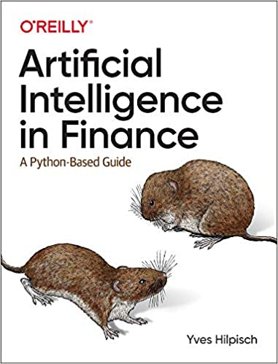
Required Texts
Yves Hilpisch (2020), Artificial Intelligence in Finance: A Python-Based Guide, O’Reilly Media.
Source: https://www.amazon.com/Artificial-Intelligence-Finance-Python-Based-Guide/dp/1492055433

Slide 16
Reference Books
Stefan Jansen (2020), Machine Learning for Algorithmic Trading: Predictive models to extract signals from market and alternative data for systematic trading strategies with Python, 2nd Edition, Packt Publishing.
Aurélien Géron (2022), Hands-On Machine Learning with Scikit-Learn, Keras, and TensorFlow: Concepts, Tools, and Techniques to Build Intelligent Systems, 3rd Edition, O’Reilly Media.
Hariom Tatsat, Sahil Puri, Brad Lookabaugh (2020), Machine Learning and Data Science Blueprints for Finance: From Building Trading Strategies to Robo-Advisors Using Python, O'Reilly Media
Chris Kelliher (2022), Quantitative Finance With Python: A Practical Guide to Investment Management, Trading, and Financial Engineering, Chapman and Hall/CRC.
Simon Thompson (2023), Green and Sustainable Finance: Principles and Practice in Banking, Investment and Insurance, 2nd Edition, Kogan Page.
Cino Robin Castelli, Cyril Shmatov (2022), Quantitative Methods for ESG Finance, Wiley
Abdullah Karasan (2021), Machine Learning for Financial Risk Management with Python: Algorithms for Modeling Risk, O’Reilly Media.
Yves Hilpisch (2018), Python for Finance: Mastering Data-Driven Finance, 2nd Edition, O'Reilly Media.
Denis Rothman (2024), Transformers for Natural Language Processing and Computer Vision - Third Edition: Explore Generative AI and Large Language Models with Hugging Face, ChatGPT, GPT-4V, and DALL-E 3, 3rd ed. Edition, Packt Publishing
Thomas R. Caldwell (2025), The Agentic AI Bible: The Complete and Up-to-Date Guide to Design, Build, and Scale Goal-Driven, LLM-Powered Agents that Think, Execute and Evolve, Independently published

Slide 17
Other References
Paolo Sironi (2016), FinTech Innovation: From Robo-Advisors to Goal Based Investing and Gamification, Wiley.
Yves Hilpisch (2020), Financial Theory with Python: A Gentle Introduction, O’Reilly Media.
Yves Hilpisch (2020), Python for Algorithmic Trading: From Idea to Cloud Deployment, O’Reilly Media.
Yuxing Yan (2017), Python for Finance: Apply powerful finance models and quantitative analysis with Python, Second Edition, Packt Publishing.

Slide 18
Yves Hilpisch (2020), Artificial Intelligence in Finance: A Python-Based Guide, O’Reilly
Source: https://www.amazon.com/Artificial-Intelligence-Finance-Python-Based-Guide/dp/1492055433

Slide 19
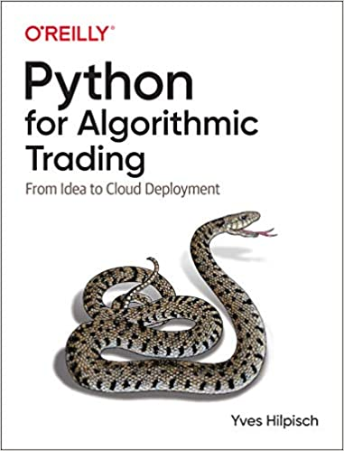
Yves Hilpisch (2020), Python for Algorithmic Trading: From Idea to Cloud Deployment, O’Reilly
Source: https://www.amazon.com/Python-Algorithmic-Trading-Cloud-Deployment/dp/149205335X

Slide 20
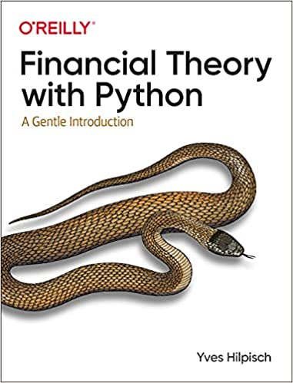
Yves Hilpisch (2021), Financial Theory with Python: A Gentle Introduction, O’Reilly
Source: https://www.amazon.com/Financial-Theory-Python-Gentle-Introduction/dp/1098104358

Slide 21
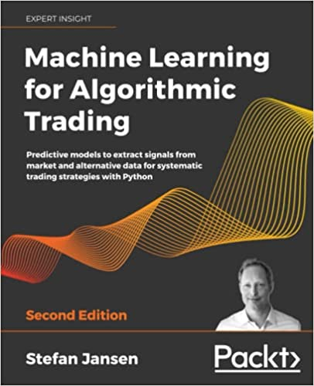
Stefan Jansen (2020), Machine Learning for Algorithmic Trading: Predictive models to extract signals from market and alternative data for systematic trading strategies with Python, 2nd Edition, Packt Publishing.
Source: https://www.amazon.com/Machine-Learning-Algorithmic-Trading-alternative/dp/1839217715/

Slide 22
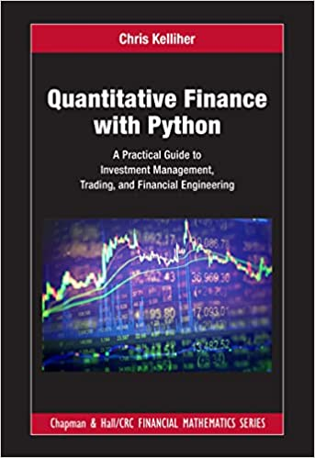
Chris Kelliher (2022), Quantitative Finance With Python: A Practical Guide to Investment Management, Trading, and Financial Engineering, Chapman and Hall/CRC.
Source: https://www.amazon.com/Quantitative-Finance-Python-Engineering-Mathematics/dp/1032014431/

Slide 23
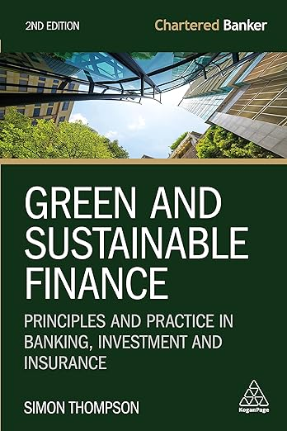
Simon Thompson (2023), Green and Sustainable Finance: Principles and Practice in Banking, Investment and Insurance, 2nd Edition, Kogan Page
Source: https://www.amazon.com/Green-Sustainable-Finance-Principles-Investment/dp/1398609242/

Slide 24
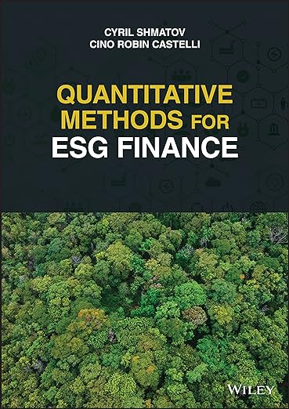
Cino Robin Castelli, Cyril Shmatov (2022), Quantitative Methods for ESG Finance, Wiley
Source: https://www.amazon.com/Quantitative-Methods-Finance-Robin-Castelli/dp/1119903807/

Slide 25
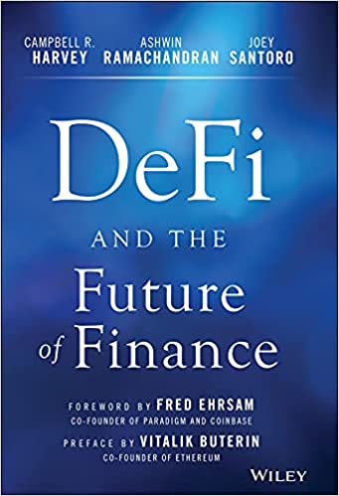
Campbell R. Harvey, Ashwin Ramachandran, Joey Santoro, Fred Ehrsam (2021), DeFi and the Future of Finance, Wiley
Source: https://www.amazon.com/DeFi-Future-Finance-Campbell-Harvey-ebook/dp/B09DJV2QLC

Slide 26
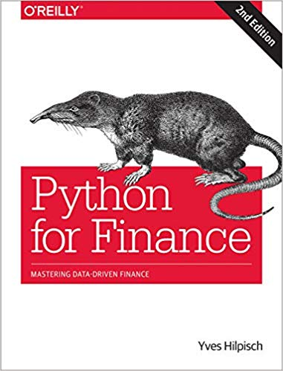
Yves Hilpisch (2018), Python for Finance: Mastering Data-Driven Finance, O'Reilly
Source: https://www.amazon.com/Python-Finance-Mastering-Data-Driven/dp/1492024333

Slide 27
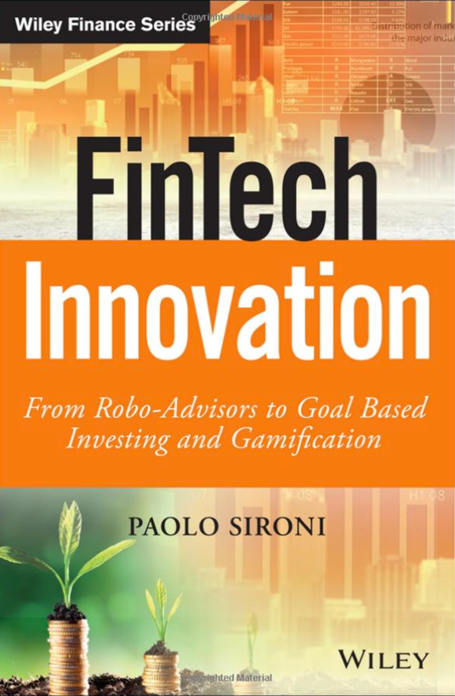
Paolo Sironi (2016) FinTech Innovation: From Robo-Advisors to Goal Based Investing and Gamification, Wiley
Source: https://www.amazon.com/FinTech-Innovation-Robo-Advisors-Investing-Gamification/dp/1119226988

Slide 28
Doron Kliger and Gregory Gurevich (2014), Event Studies for Financial Research: A Comprehensive Guide, Palgrave Macmillan
Source: https://www.amazon.com/Event-Studies-Financial-Research-Comprehensive/dp/1137435380/

Slide 29
Yuxing Yan (2017), Python for Finance: Apply powerful finance models and quantitative analysis with Python, Second Edition, Packt Publishing
Source: https://www.amazon.com/Python-Finance-powerful-quantitative-analysis/dp/1787125696

Slide 30
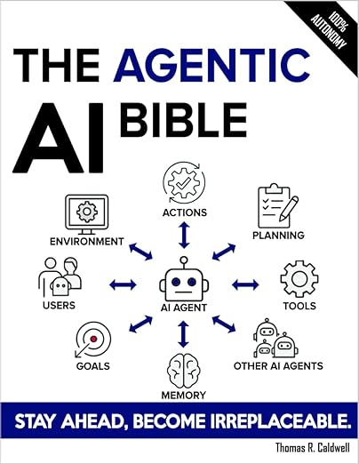
Thomas R. Caldwell (2025), The Agentic AI Bible: The Complete and Up-to-Date Guide to Design, Build, and Scale Goal-Driven, LLM-Powered Agents that Think, Execute and Evolve, Independently published
Source: https://www.amazon.com/Agentic-Bible-Up-Date-Goal-Driven/dp/B0FL21R86Q

Slide 31
Artificial Intelligence (AI)

Slide 32
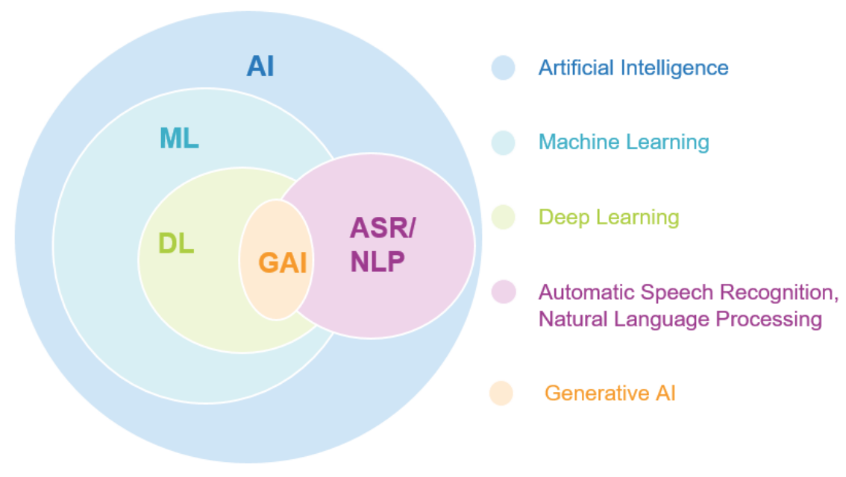
AI, ML, DL, Generative AI
Source: Jeong, Cheonsu. "A Study on the Implementation of Generative AI Services Using an Enterprise Data-Based LLM Application Architecture." arXiv preprint arXiv:2309.01105 (2023).

Slide 33
Generative AI, Agentic AI, Physical AI
Physical AI
Self-driving cars
General robotics
Agentic AI
Coding assistants
Customer service
Patient care
Generative AI
Digital marketing
Content creation
Perception AI
Speech recognition
Deep recommender systems
Medical imaging
2012 AlexNet
Deep learning breakthrough
Source: NVIDIA (2025), GTC March 2025 Keynote with NVIDIA CEO Jensen Huang, https://www.youtube.com/watch?v=_waPvOwL9Z8

Slide 34
Generative AI
Computing
Generative AI
Data
Algorithms

Slide 35
Generative AI, Agentic AI, Physical AI
New Economic Paradigm Shift:
From Creation to Execution
Physical AI
(Actuation)
Real-world Interaction & Execution
Autonomous Synergy
Generative AI
(Creation)
Content & Idea Synthesis
Agentic AI
(Orchestration)
Workflow & Decision Automation

Slide 36
The Future of AI From Tools to Agents: The Rise and Autonomy of Agentic AI
Narrow AI
(Tool)
Agentic AI
(Autonomous System)
AGI
(Artificial General Intelligence)
Goal-Oriented Behavior, Autonomous Decision-Making, Multi-Step Workflows, Self-Improvement within Parameters
Executes Specific Tasks, Content Generation
Connecting Multimodal GenAl to Future AGI

Slide 37
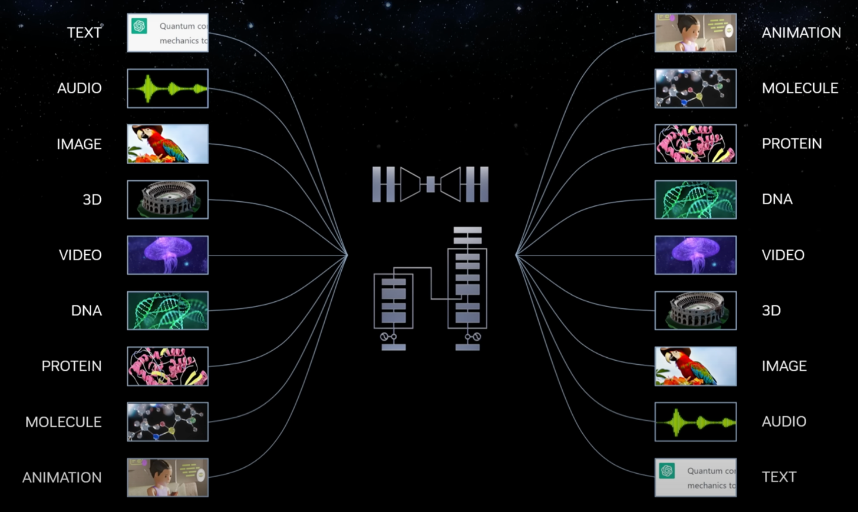
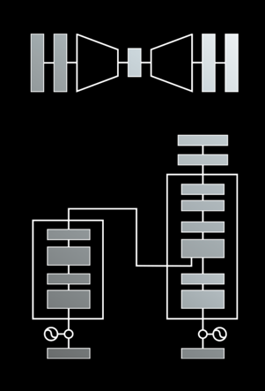
Modular Modalities
Where Can The Transformer Fit?
Source: NVIDIA DLI (2025), Rapid Application Development with Large Language Models (LLMs), https://learn.nvidia.com/courses/course-detail?course_id=course-v1:DLI+S-FX-26+V1

Slide 38
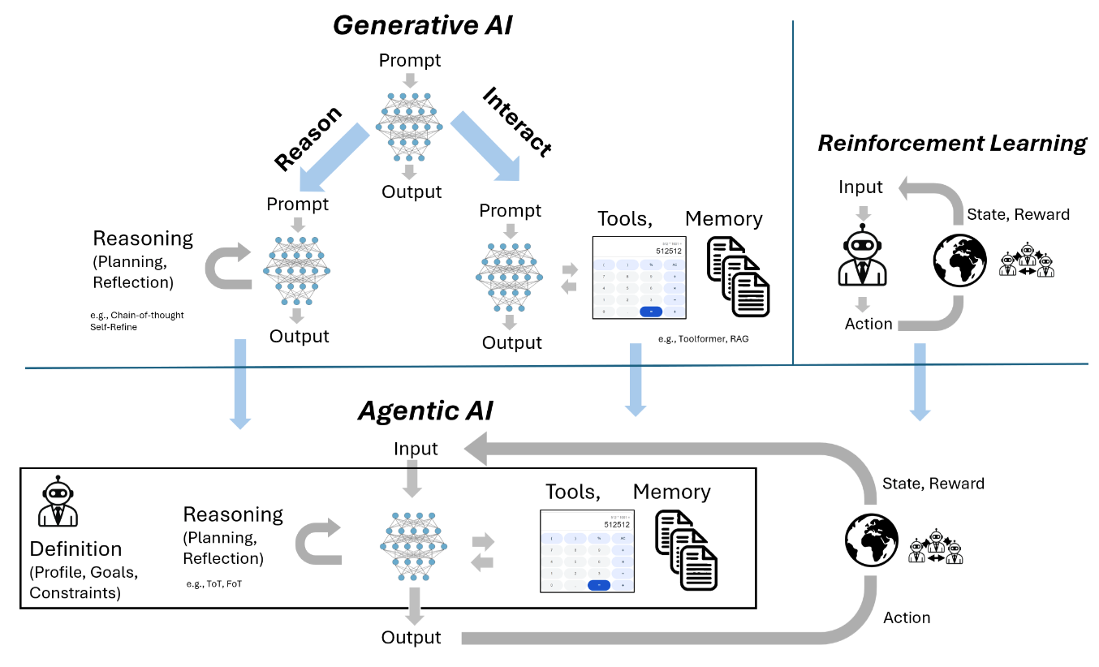
From Generative AI to Agentic AI
Source: Schneider, Johannes. "Generative to Agentic AI: Survey, Conceptualization, and Challenges." arXiv preprint arXiv:2504.18875 (2025).

Slide 39
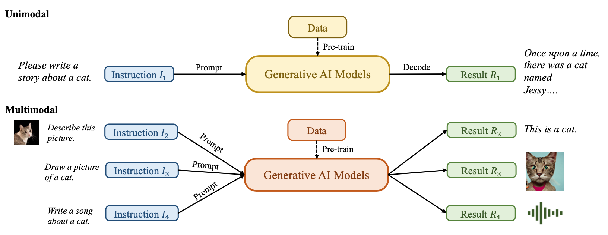
Generative AI (Gen AI) AI Generated Content (AIGC)
Source: Yihan Cao, Siyu Li, Yixin Liu, Zhiling Yan, Yutong Dai, Philip S. Yu, and Lichao Sun (2023). "A Comprehensive Survey of AI-Generated Content (AIGC): A History of Generative AI from GAN to ChatGPT." arXiv preprint arXiv:2303.04226.

Slide 40
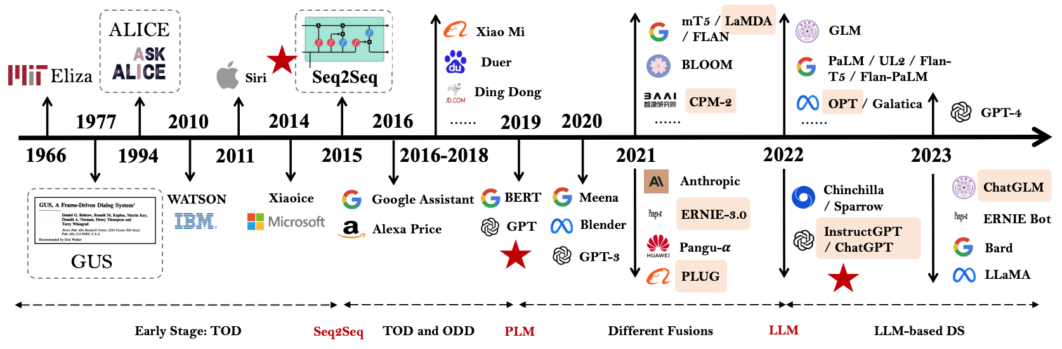
The Development of LM-based Dialogue Systems 1) Early Stage (1966 - 2015) 2) The Independent Development of TOD and ODD (2015 - 2019) 3) Fusions of Dialogue Systems (2019 - 2022) 4) LLM-based DS (2022 - Now)
Task-oriented DS (TOD), Open-domain DS (ODD)
Source: Wang, Hongru, Lingzhi Wang, Yiming Du, Liang Chen, Jingyan Zhou, Yufei Wang, and Kam-Fai Wong. "A Survey of the Evolution of Language Model-Based Dialogue Systems." arXiv preprint arXiv:2311.16789 (2023).

Slide 41
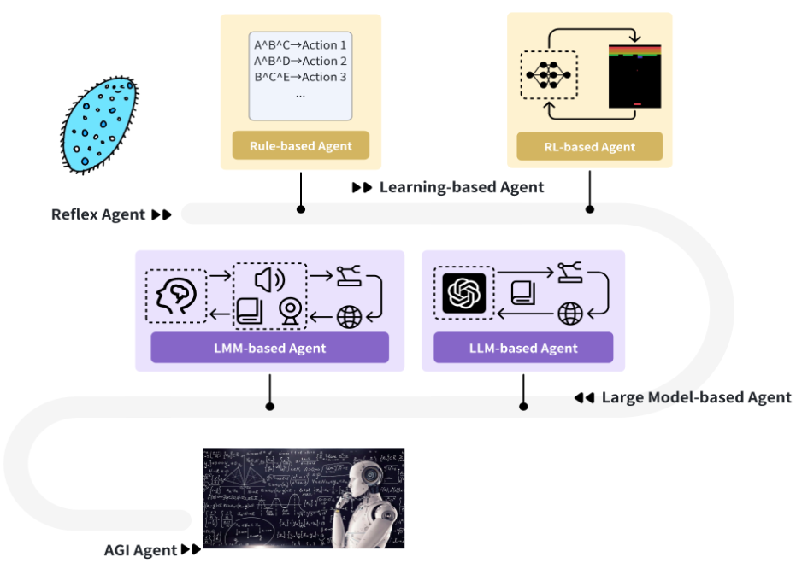
Intelligent Agents Roadmap
Source: Cheng, Yuheng, Ceyao Zhang, Zhengwen Zhang, Xiangrui Meng, Sirui Hong, Wenhao Li, Zihao Wang et al. "Exploring large language model based intelligent agents: Definitions, methods, and prospects." arXiv preprint arXiv:2401.03428 (2024).

Slide 42
AI Agents
Traditional AI Agents
Simple reflex agents
Model-based reflex agents
Goal-based agents
Utility-based agents
Learning agents
Evolution of AI Agents
LLM-based Agents
Multi-modal agents
Embodied AI agents in virtual environments
Collaborative AI agents

Slide 43
Definition of Artificial Intelligence (A.I.)

Slide 44
Artificial Intelligence “… the science and engineering of making intelligent machines” (John McCarthy, 1955)
Source: https://digitalintelligencetoday.com/artificial-intelligence-defined-useful-list-of-popular-definitions-from-business-and-science/

Slide 45
Artificial Intelligence “… technology that thinks and acts like humans”
Source: https://digitalintelligencetoday.com/artificial-intelligence-defined-useful-list-of-popular-definitions-from-business-and-science/

Slide 46
Artificial Intelligence “… intelligence exhibited by machines or software”
Source: https://digitalintelligencetoday.com/artificial-intelligence-defined-useful-list-of-popular-definitions-from-business-and-science/

Slide 47
4 Approaches of AI
Thinking Humanly | Thinking Rationally
Acting Humanly | Acting Rationally
Source: Stuart Russell and Peter Norvig (2020), Artificial Intelligence: A Modern Approach, 4th Edition, Pearson

Slide 48
4 Approaches of AI
2. Thinking Humanly: The Cognitive Modeling Approach | 3. Thinking Rationally: The “Laws of Thought” Approach
1. Acting Humanly: The Turing Test Approach (1950) | 4. Acting Rationally: The Rational Agent Approach
Source: Stuart Russell and Peter Norvig (2020), Artificial Intelligence: A Modern Approach, 4th Edition, Pearson

Slide 49
AI Acting Humanly: The Turing Test Approach (Alan Turing, 1950)
Knowledge Representation
Automated Reasoning
Machine Learning (ML)
Deep Learning (DL)
Computer Vision (Image, Video)
Natural Language Processing (NLP)
Robotics
Source: Stuart Russell and Peter Norvig (2020), Artificial Intelligence: A Modern Approach, 4th Edition, Pearson

Slide 50
FinTech

Slide 51
Financial Technology

Slide 52
FinTech

Slide 53
Financial Technology FinTech
“providing financial services by making use of software and modern technology”
Source: https://www.fintechweekly.com/fintech-definition

Slide 54
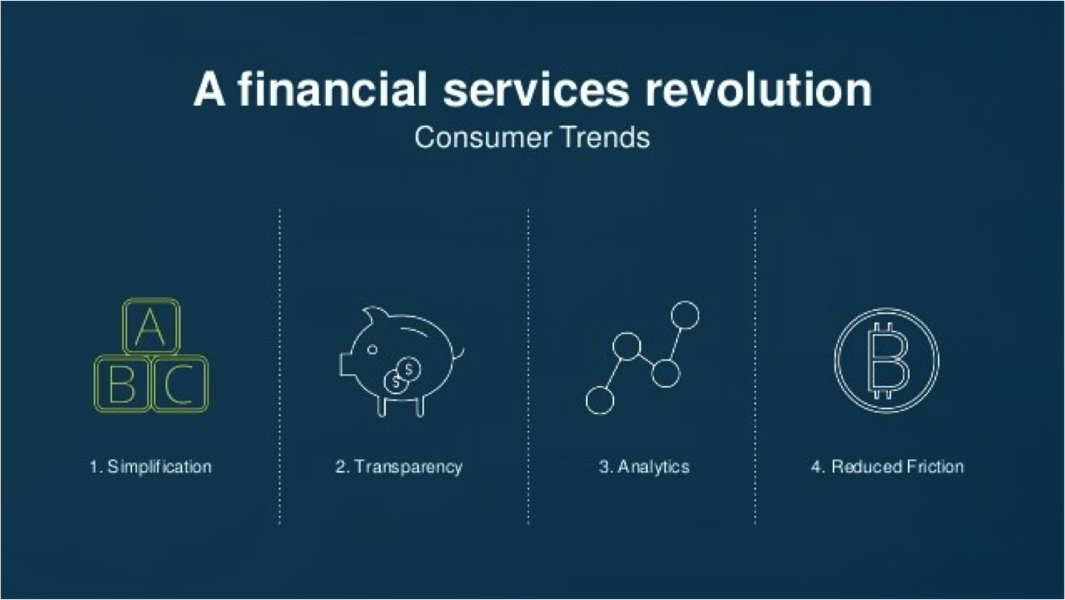
Financial Revolution with Fintech
Source: http://www.hedgethink.com/fintech/european-fintech-top-100/

Slide 55
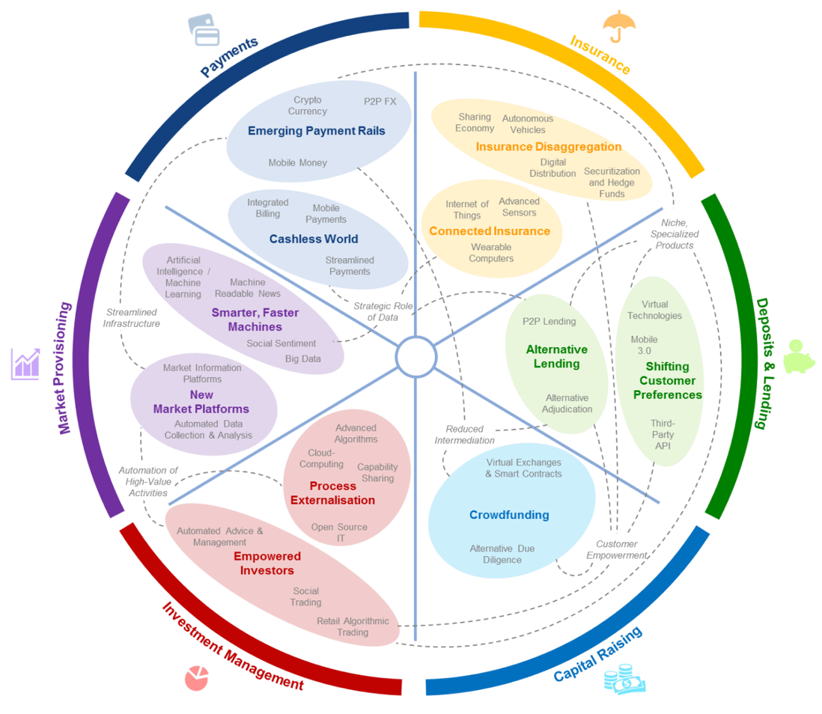
FinTech: Financial Services Innovation
Source: http://www3.weforum.org/docs/WEF_The_future__of_financial_services.pdf

Slide 56
FinTech: Financial Services Innovation 1. Payments 2. Insurance 3. Deposits & Lending 4. Capital Raising 5. Investment Management 6. Market Provisioning
Source: http://www3.weforum.org/docs/WEF_The_future__of_financial_services.pdf

Slide 57
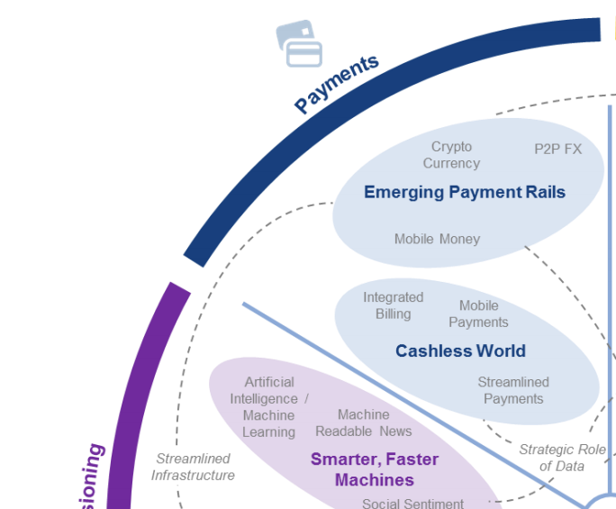
FinTech: Payment
1
Source: http://www3.weforum.org/docs/WEF_The_future__of_financial_services.pdf

Slide 58
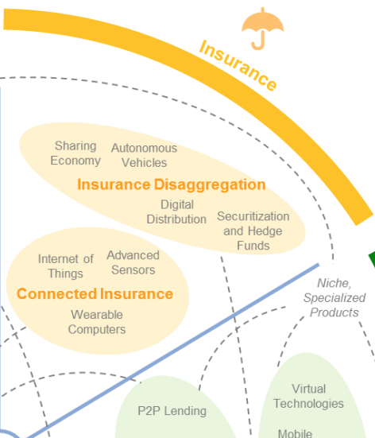
FinTech: Insurance
2
Source: http://www3.weforum.org/docs/WEF_The_future__of_financial_services.pdf

Slide 59
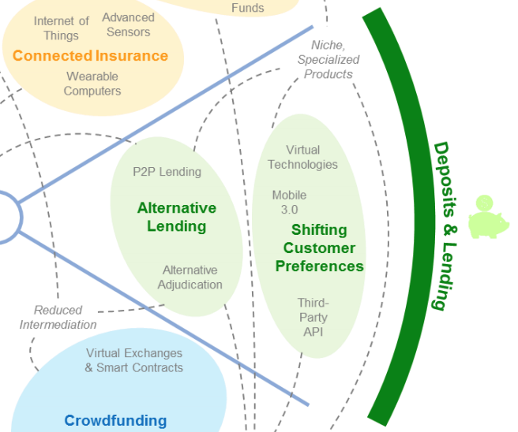
FinTech: Deposits & Lending
3
Source: http://www3.weforum.org/docs/WEF_The_future__of_financial_services.pdf

Slide 60
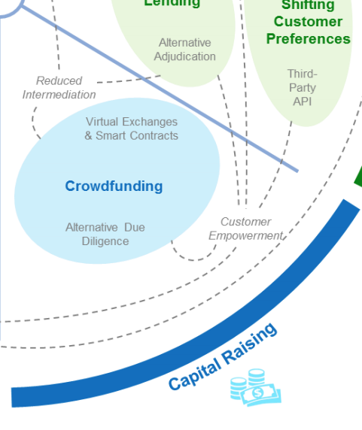
FinTech: Capital Raising
4
Source: http://www3.weforum.org/docs/WEF_The_future__of_financial_services.pdf

Slide 61
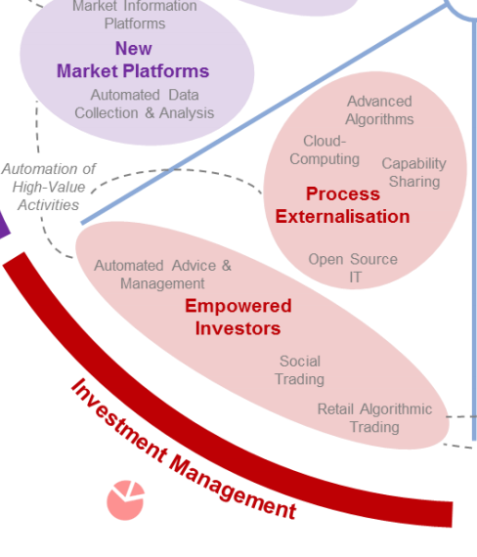
FinTech: Investment Management
5
Source: http://www3.weforum.org/docs/WEF_The_future__of_financial_services.pdf

Slide 62
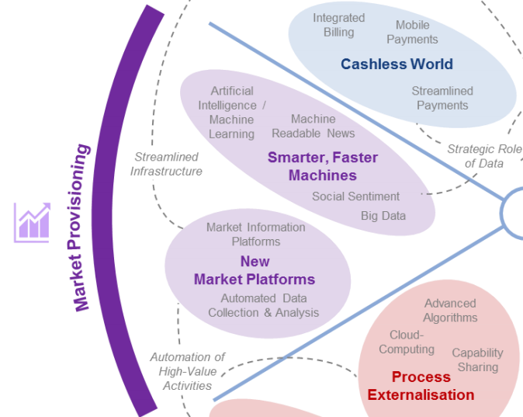
FinTech: Market Provisioning
6
Source: http://www3.weforum.org/docs/WEF_The_future__of_financial_services.pdf

Slide 63
AI in FinTech

Slide 64
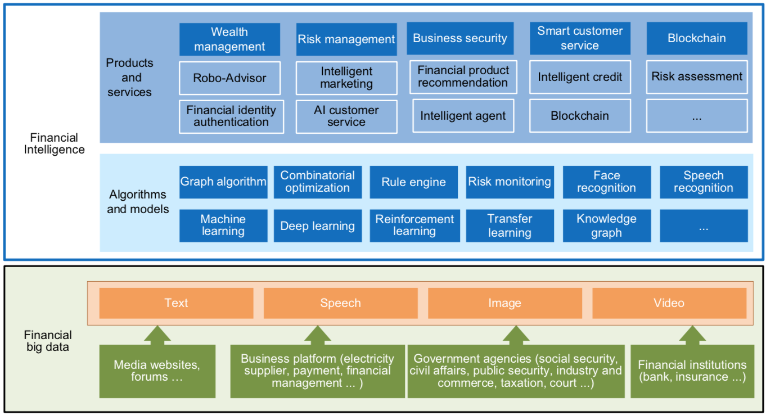
FinBrain: when Finance meets AI 2.0 (Zheng et al., 2019)
Source: Xiao-lin Zheng, Meng-ying Zhu, Qi-bing Li, Chao-chao Chen, and Yan-chao Tan (2019), "Finbrain: When finance meets AI 2.0." Frontiers of Information Technology & Electronic Engineering 20, no. 7, pp. 914-924

Slide 65
AI 2.0
a new generation of AI based on the novel information environment of major changes and the development of
new goals.
Yunhe Pan (2016), "Heading toward artificial intelligence 2.0." Engineering 2, no. 4, 409-413.

Slide 66
Technology-driven Financial Industry Development
Development stage | Driving technology | Main landscape | Inclusive finance | Relationship between technology and finance
Fintech 1.0 (financial IT) | Computer | Credit card, ATM, and CRMS | Low | Technology as a tool
Fintech 2.0 (Internet finance) | Mobile Internet | Marketplace lending, third-party payment, crowdfunding, and Internet insurance | Medium | Technology-driven change
Fintech 3.0 (financial intelligence) | AI, Big Data, Cloud Computing, Blockchain | Intelligent finance | High | Deep fusion
Source: Xiao-lin Zheng, Meng-ying Zhu, Qi-bing Li, Chao-chao Chen, and Yan-chao Tan (2019), "Finbrain: When finance meets AI 2.0." Frontiers of Information Technology & Electronic Engineering 20, no. 7, pp. 914-924

Slide 67
Deep learning for financial applications: Topic-Model Heatmap
Source: Ahmet Murat Ozbayoglu, Mehmet Ugur Gudelek, and Omer Berat Sezer (2020). "Deep learning for financial applications: A survey." Applied Soft Computing (2020): 106384.

Slide 68
Deep learning for financial applications: Topic-Feature Heatmap
Source: Ahmet Murat Ozbayoglu, Mehmet Ugur Gudelek, and Omer Berat Sezer (2020). "Deep learning for financial applications: A survey." Applied Soft Computing (2020): 106384.

Slide 69
Deep learning for financial applications: Topic-Dataset Heatmap
Source: Ahmet Murat Ozbayoglu, Mehmet Ugur Gudelek, and Omer Berat Sezer (2020). "Deep learning for financial applications: A survey." Applied Soft Computing (2020): 106384.

Slide 70
Stock Market Movement Forecast: Phases of the stock market modeling
Source: O. Bustos and A. Pomares-Quimbaya (2020), "Stock Market Movement Forecast: A Systematic Review." Expert Systems with Applications (2020): 113464.

Slide 71
Green Finance and Sustainable Finance

Slide 72
Evolution of Sustainable Finance Research
Topic
SDGs: Sustainable Development Goals
SDGs
Innovative Financial Instrument
Impact Investing
ESG: Environmental, Social, and Governance
CSR: Corporate Social Responsibility
Conscious Capitalism
Climate Financing
Carbon Financing
Green Financing
Ethical Investing
Socially Responsible Investing
1986
1995
2005
2015
2020
Source: Kumar, S., Sharma, D., Rao, S., Lim, W. M., & Mangla, S. K. (2022). Past, present, and future of sustainable finance: Insights from big data analytics through machine learning of scholarly research. Annals of Operations Research, 1-44.

Slide 73
AI for Environmental, Social, and Governance (AI4ESG)
Source: Nenad Tomašev, Julien Cornebise, Frank Hutter, Shakir Mohamed, Angela Picciariello, Bec Connelly, Danielle Belgrave et al. (2020) "AI for social good: unlocking the opportunity for positive impact." Nature Communications 11, no. 1: 1-6.

Slide 74
AI for Social Good (AI4SG)
Source: Nenad Tomašev, Julien Cornebise, Frank Hutter, Shakir Mohamed, Angela Picciariello, Bec Connelly, Danielle Belgrave et al. (2020) "AI for social good: unlocking the opportunity for positive impact." Nature Communications 11, no. 1: 1-6.

Slide 75
Sustainability SDGs CSR ESG

Slide 76


















Sustainable Development Goals (SDGs)
Source: https://sdgs.un.org/goals

Slide 77
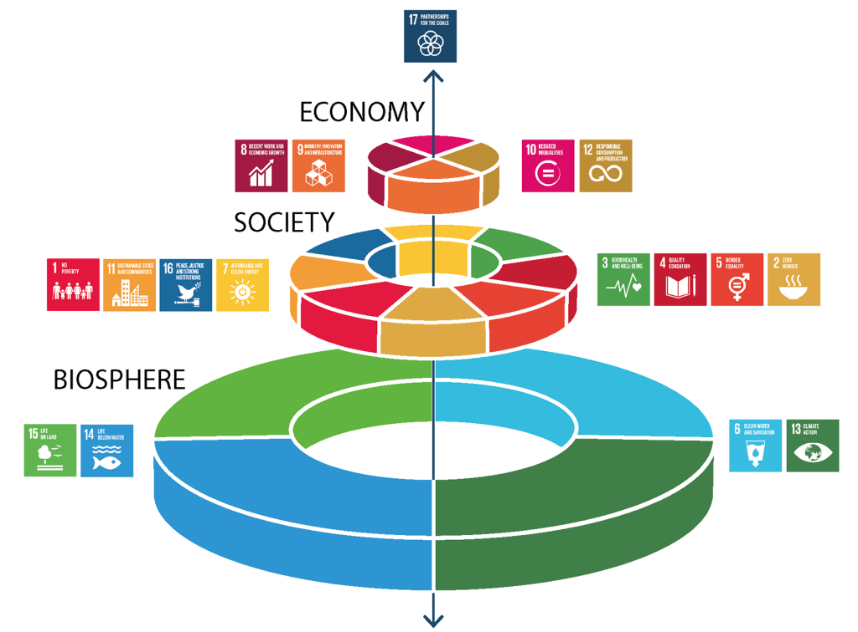
Sustainable Development Goals (SDGs) and 5P
Partnership
Peace
Prosperity
People
Planet
Source: Folke, Carl, Reinette Biggs, Albert V. Norström, Belinda Reyers, and Johan Rockström. "Social-ecological resilience and biosphere-based sustainability science.”Ecology and Society 21, no. 3 (2016).

Slide 78
Green Finance Generic term implying use or diversion of financial resources to deploy and support projects with long term positive impact on the environment
Source: Bhattacharyya, Rupsha. "Green finance for energy transition, climate action and sustainable development: overview of concepts, applications, implementation and challenges." Green Finance 4, no. 1 (2022): 1-35.

Slide 79
Sustainable Finance Finances deployed in support of projects that ensure just, sustainable and inclusive growth or attainment of one or more sustainable development goals
Source: Bhattacharyya, Rupsha. "Green finance for energy transition, climate action and sustainable development: overview of concepts, applications, implementation and challenges." Green Finance 4, no. 1 (2022): 1-35.

Slide 80
Carbon Finance
Financial instruments based on economic value of carbon emissions which an organization cannot avoid but which it offsets by funding other compensatory projects that contribute to carbon emissions reduction
Source: Bhattacharyya, Rupsha. "Green finance for energy transition, climate action and sustainable development: overview of concepts, applications, implementation and challenges." Green Finance 4, no. 1 (2022): 1-35.

Slide 81
Climate Finance
Finances deployed in support of low carbon and climate resilient projects that help in climate change mitigation and adaptation efforts, particularly in the energy and infrastructure sectors
Source: Bhattacharyya, Rupsha. "Green finance for energy transition, climate action and sustainable development: overview of concepts, applications, implementation and challenges." Green Finance 4, no. 1 (2022): 1-35.

Slide 82
ESG Investing
Investments considering the broad range of environmental (e.g. climate change, pollution biodiversity loss), social (e.g. working conditions, human rights, salary or compensation structures) and governance (e.g. board composition, diversity and inclusion, taxes) characteristics of the projects or companies being invested in; ethical and business sustainability considerations are integral part of financing
Source: Bhattacharyya, Rupsha. "Green finance for energy transition, climate action and sustainable development: overview of concepts, applications, implementation and challenges." Green Finance 4, no. 1 (2022): 1-35.

Slide 83
Impact Investing
Investing in projects that solve a social or environmental problem; the focus is on the positive impact rather than the means used to produce that impact
Source: Bhattacharyya, Rupsha. "Green finance for energy transition, climate action and sustainable development: overview of concepts, applications, implementation and challenges." Green Finance 4, no. 1 (2022): 1-35.

Slide 84
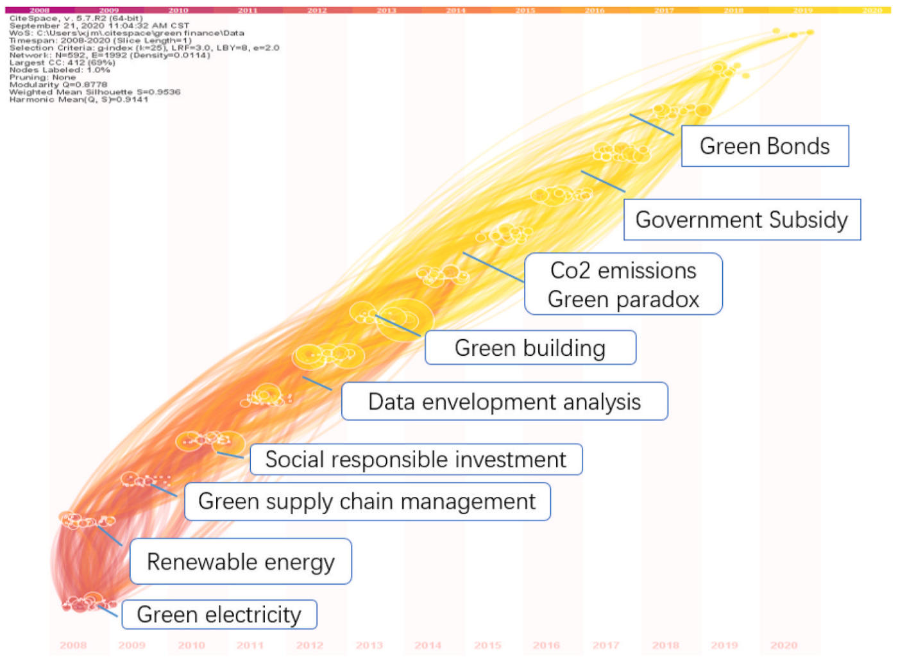
Dynamic Trends of Green Finance and Energy Policy
Source: Wang, Moran, Xuerong Li, and Shouyang Wang. (2021) "Discovering research trends and opportunities of green finance and energy policy: A data-driven scientometric analysis." Energy Policy 154 (2021): 112295.

Slide 85
ESG: Environmental Social Governance

Slide 86
CSR: Corporate Social Responsibility

Slide 87
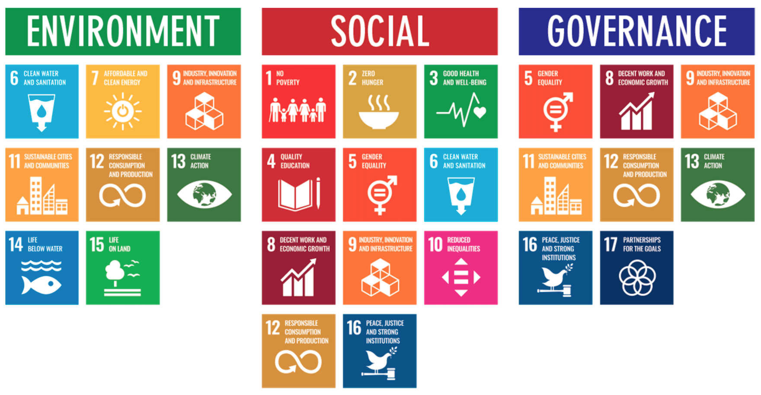
ESG to 17 SDGs
Source: Henrik Skaug Sætra (2021) "A Framework for Evaluating and Disclosing the ESG Related Impacts of AI with the SDGs." Sustainability 13, no. 15 (2021): 8503.

Slide 88
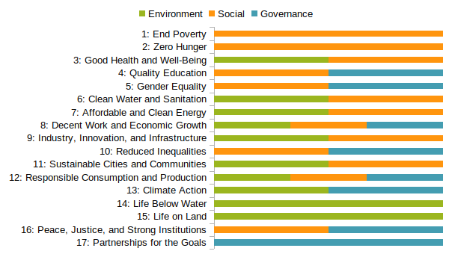
ESG to 17 SDGs
Source: https://sustainometric.com/esg-to-sdgs-connected-paths-to-a-sustainable-future/

Slide 89
Generative AI for ESG Applications

Slide 90
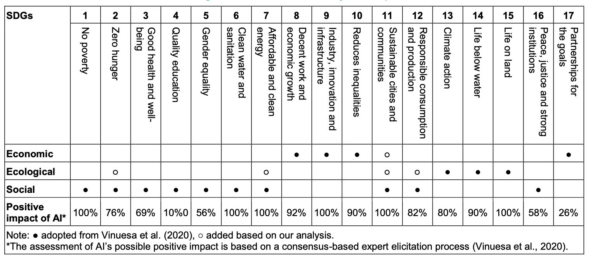
AI and Sustainability Development Goals (SDGs)
Source: Schoormann, T., Strobel, G., Möller, F., Petrik, D., & Zschech, P. (2023). Artificial Intelligence for Sustainability—A Systematic Review of Information Systems Literature. Communications of the Association for Information Systems, 52(1), 8.

Slide 91
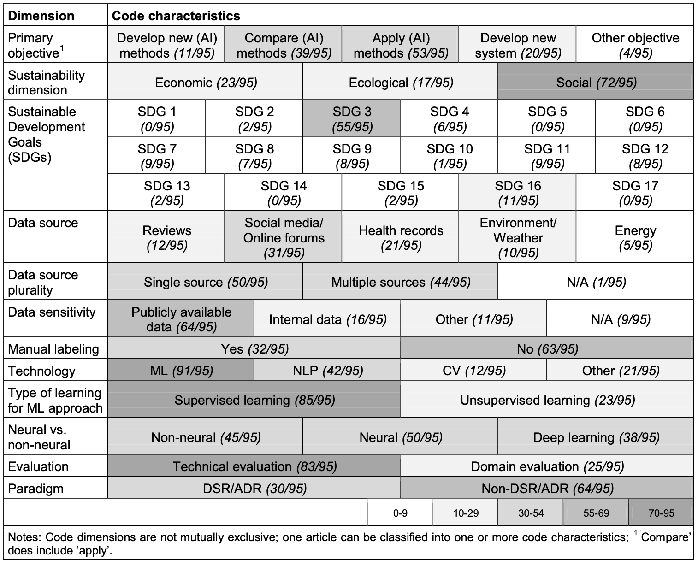
AI for Sustainability
Source: Schoormann, T., Strobel, G., Möller, F., Petrik, D., & Zschech, P. (2023). Artificial Intelligence for Sustainability—A Systematic Review of Information Systems Literature. Communications of the Association for Information Systems, 52(1), 8.

Slide 92
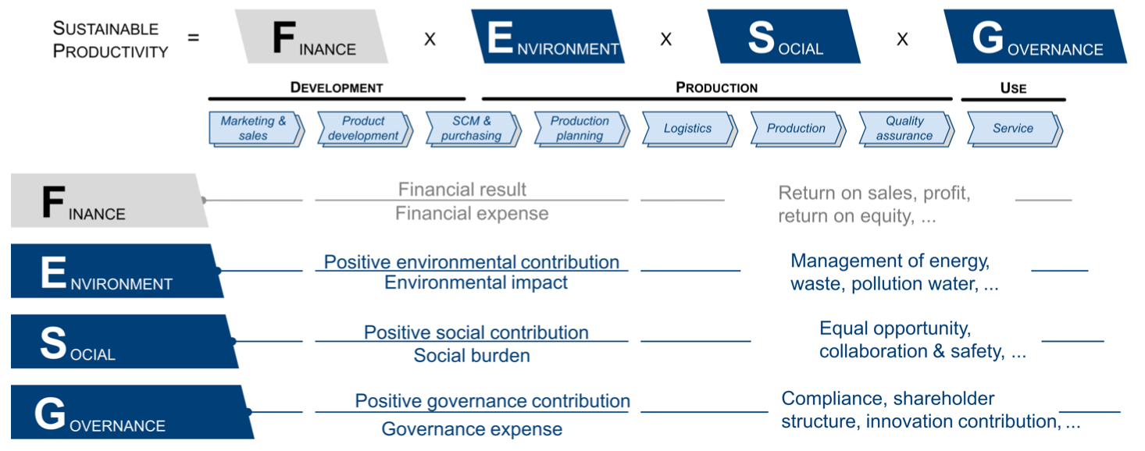
Sustainable Productivity: Finance ESG
Source: Huang, Ziqi, Yang Shen, Jiayi Li, Marcel Fey, and Christian Brecher (2021). "A survey on AI-driven digital twins in Industry 4.0: Smart manufacturing and advanced robotics." Sensors 21, no. 19: 6340.

Slide 93
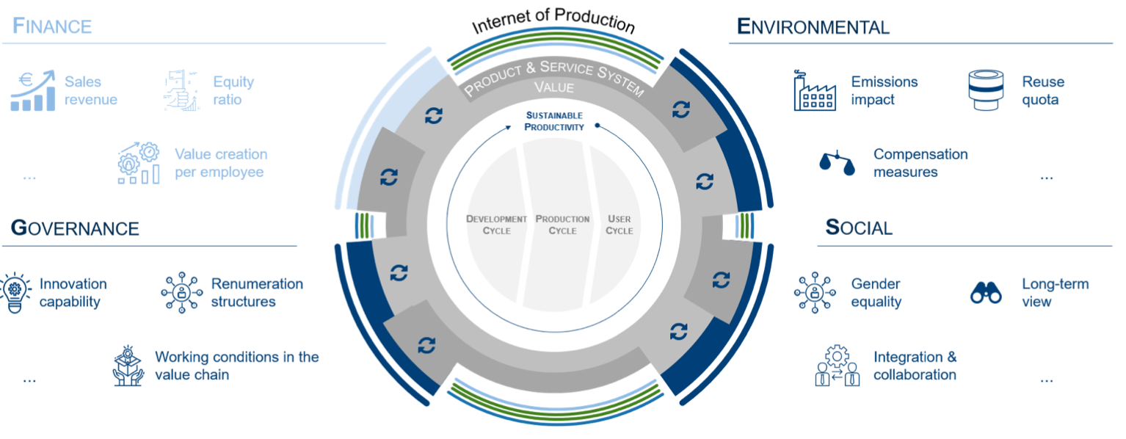
Sustainable Resilient Manufacturing ESG
Source: Huang, Ziqi, Yang Shen, Jiayi Li, Marcel Fey, and Christian Brecher (2021). "A survey on AI-driven digital twins in Industry 4.0: Smart manufacturing and advanced robotics." Sensors 21, no. 19: 6340.

Slide 94
ESG Indexes
MSCI ESG Index
Dow Jones Sustainability Indices (DJSI)
FTSE ESG Index

Slide 95
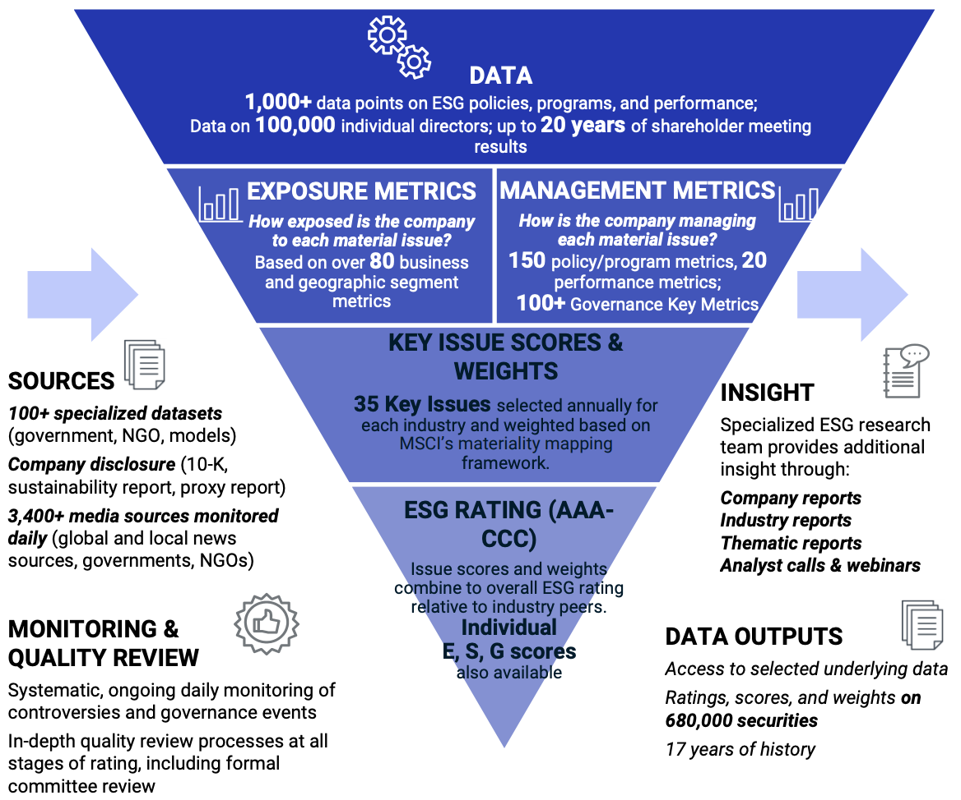
MSCI ESG Rating Framework
Source: https://www.msci.com/documents/1296102/21901542/ESG-Ratings-Methodology-Exec-Summary.pdf

Slide 96
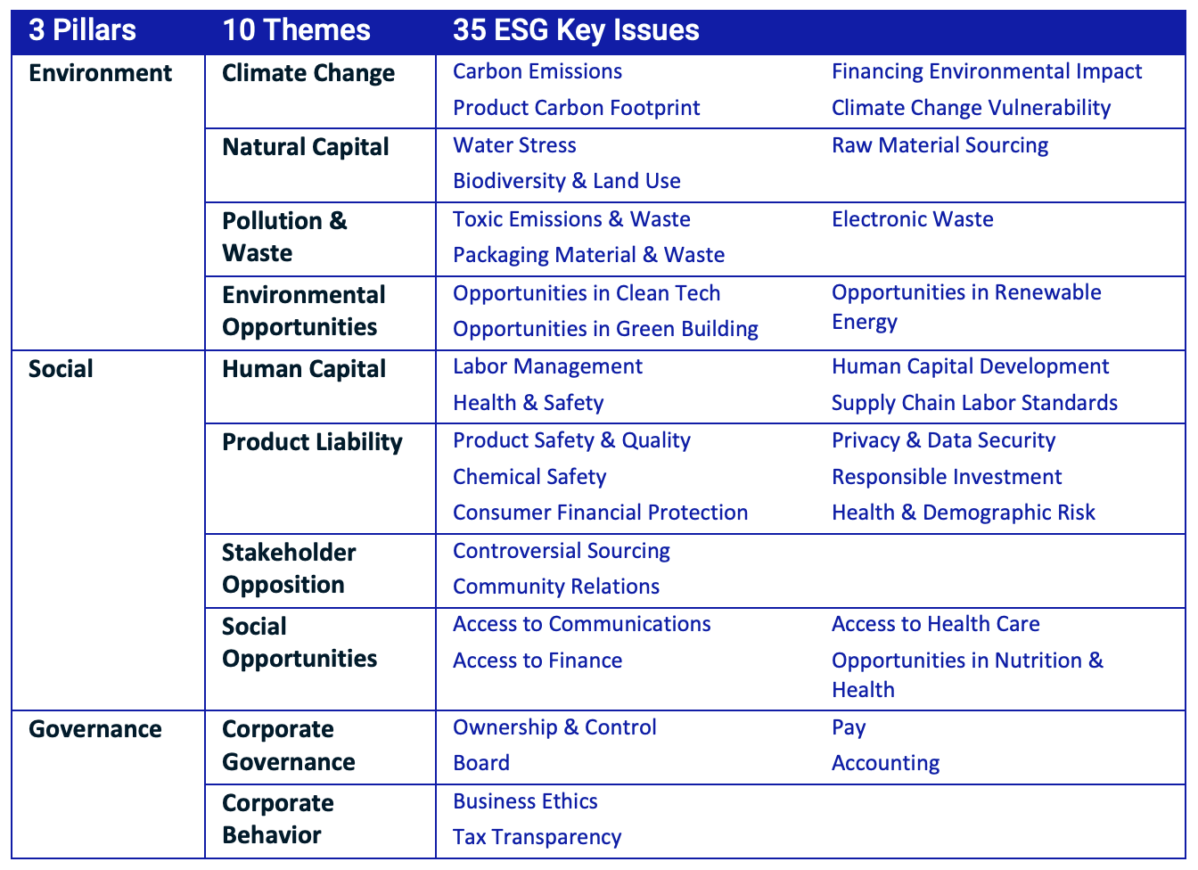
MSCI ESG Key Issue Hierarchy
Source: https://www.msci.com/documents/1296102/21901542/ESG-Ratings-Methodology-Exec-Summary.pdf

Slide 97
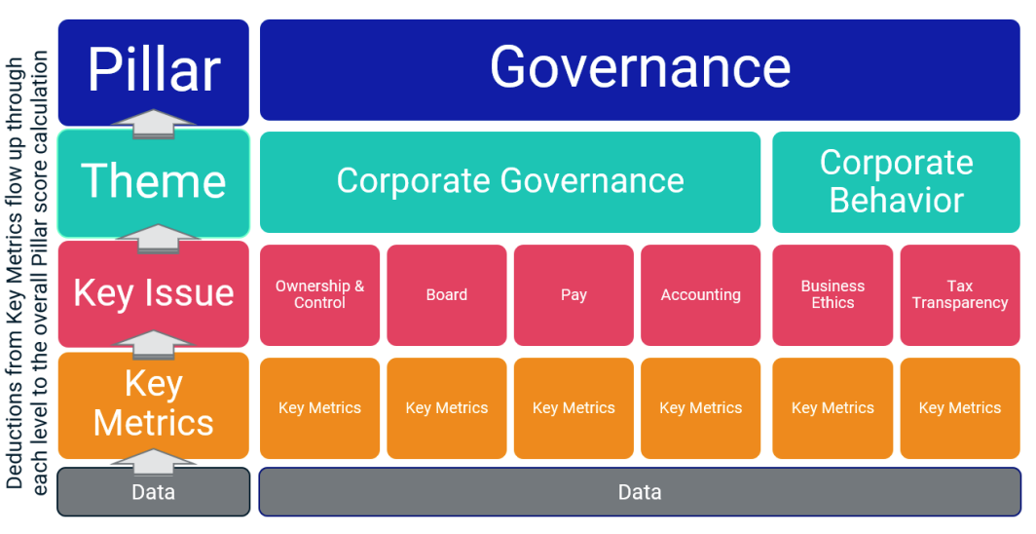
MSCI Governance Model Structure
Source: https://www.msci.com/documents/1296102/21901542/ESG-Ratings-Methodology-Exec-Summary.pdf

Slide 98
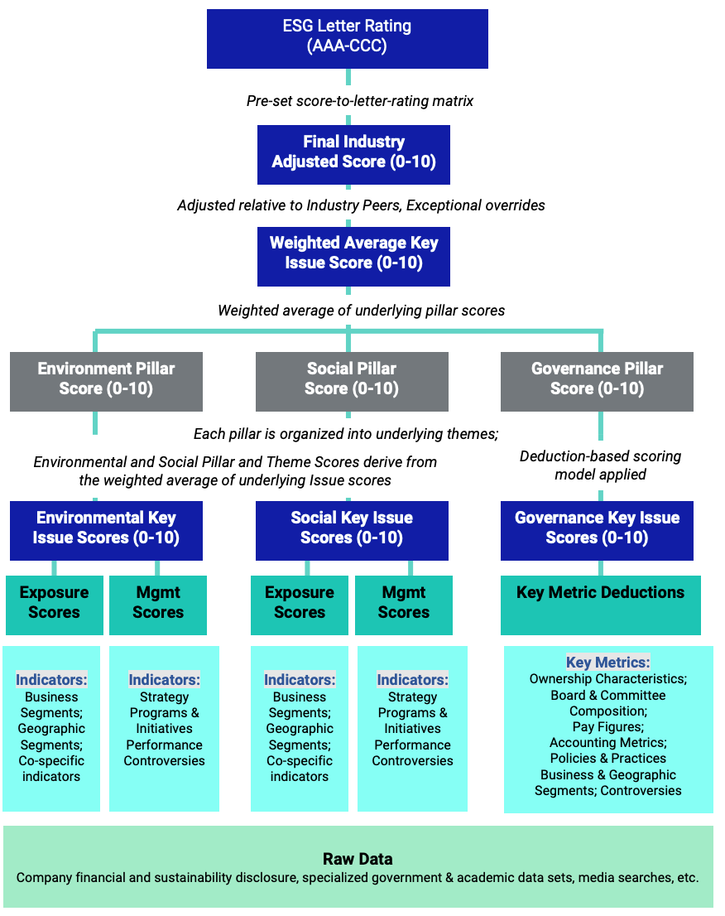
MSCI Hierarchy of ESG Scores
Source: https://www.msci.com/documents/1296102/21901542/ESG-Ratings-Methodology-Exec-Summary.pdf

Slide 99
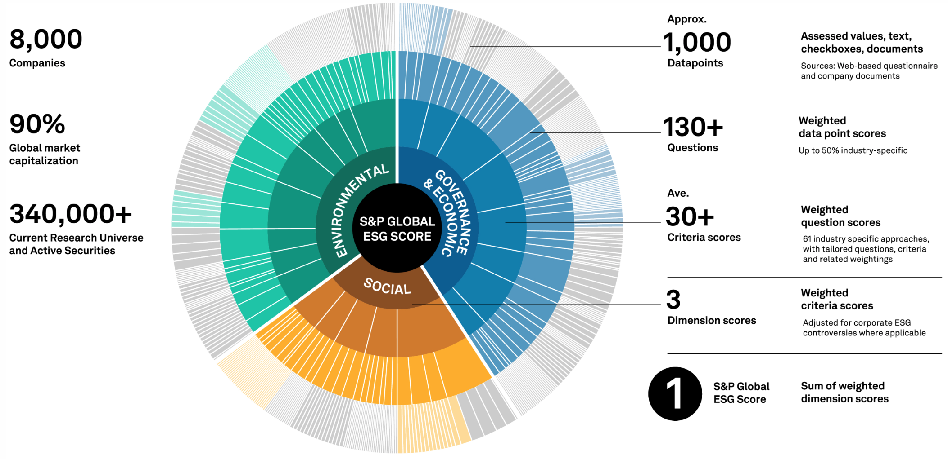
DJSI S&P Global ESG Score
Source: DJSI, S&P Global Corporate Sustainability Assessment (CSA), https://www.spglobal.com/esg/solutions/data-intelligence-esg-scores

Slide 100
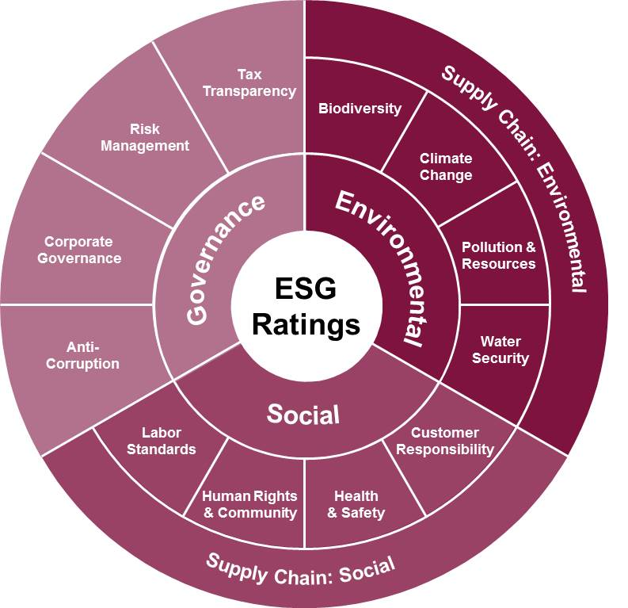
FTSE Russell ESG Ratings
Source: https://www.ftserussell.com/data/sustainability-and-esg-data/esg-ratings

Slide 101

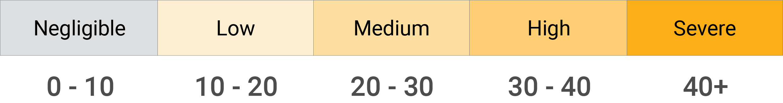
Sustainalytics ESG Risk Ratings
Analyst-based approach
Sustainalytics’ ESG Risk Ratings measure a company’s exposure to industry-specific material ESG risks and how well a company is managing those risks.
Source: https://www.sustainalytics.com/esg-data

Slide 102

Truvalue ESG Ranks
TruValue Labs
Machine-based approach
Truvalue Labs applies AI to analyze over 100,000 sources and uncover ESG risks and opportunities hidden in unstructured text.
The ESG Ranks data service produces an overall company rank based on industry percentile leveraging the 26 ESG categories defined by the Sustainability Accounting Standards Board (SASB).
The data feed covers 20,000+ companies with more than 13 years of history.
Source: :https://developer.truvaluelabs.com/data/esg-ranks

Slide 103
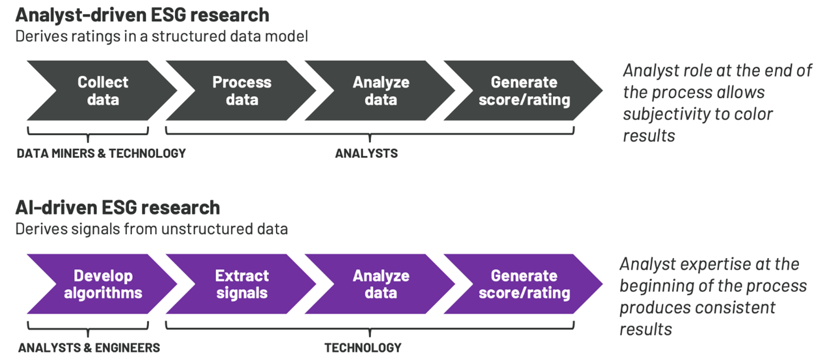
Analyst-driven vs. AI-driven ESG
Sustainalytics
Truvalue Labs
Source: Mark Tulay (2020), Man vs. machine: A tale of two sustainability ratings systems, GreenBiz, https://www.greenbiz.com/article/man-vs-machine-tale-two-sustainability-ratings-systems

Slide 104
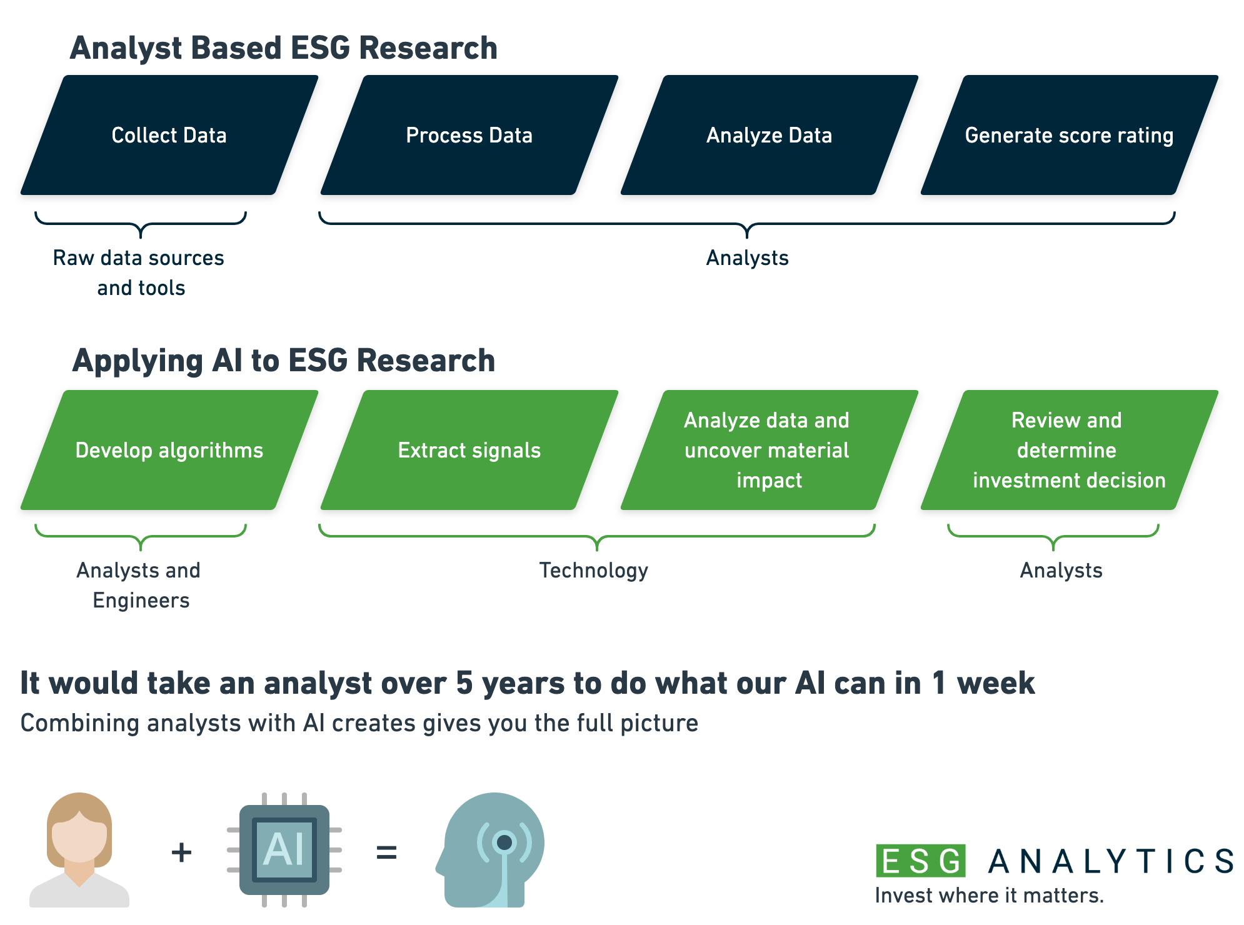
Analyst based ESG Research AI based ESG Research
Source: https://www.esganalytics.io/insights/how-data-is-accelerating-esg

Slide 105
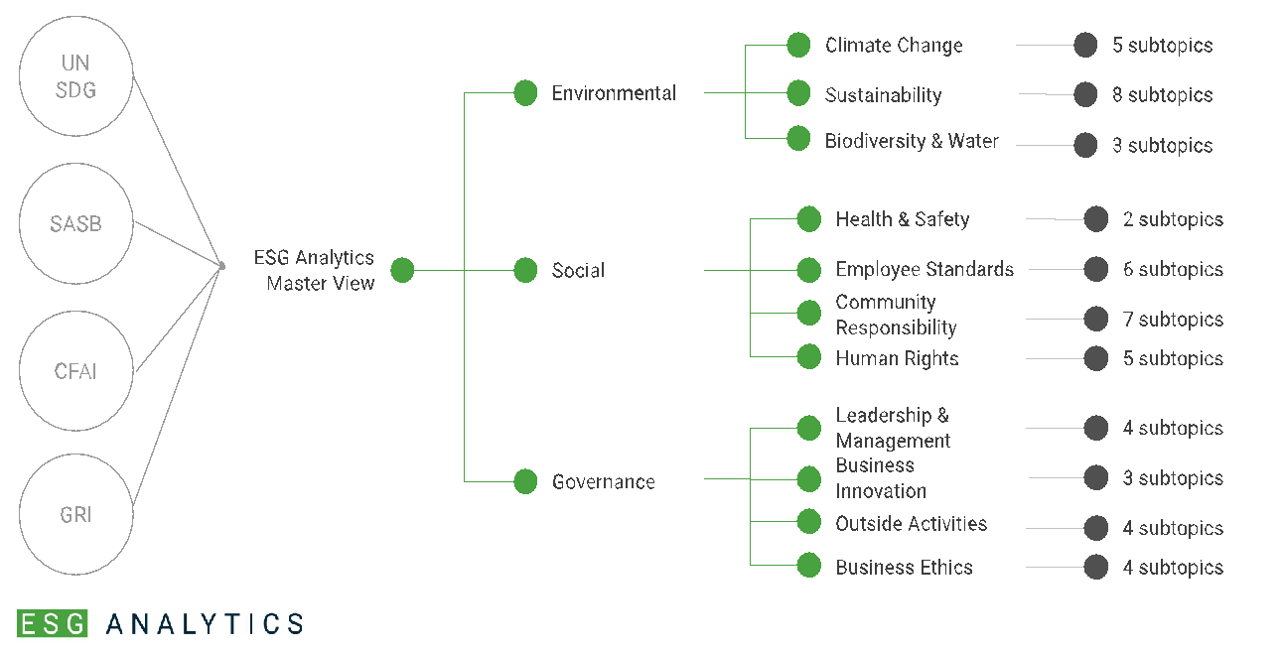
ESG Analytics: NLP Taxonomy
Source: https://www.esganalytics.io/insights/how-data-is-accelerating-esg

Slide 106
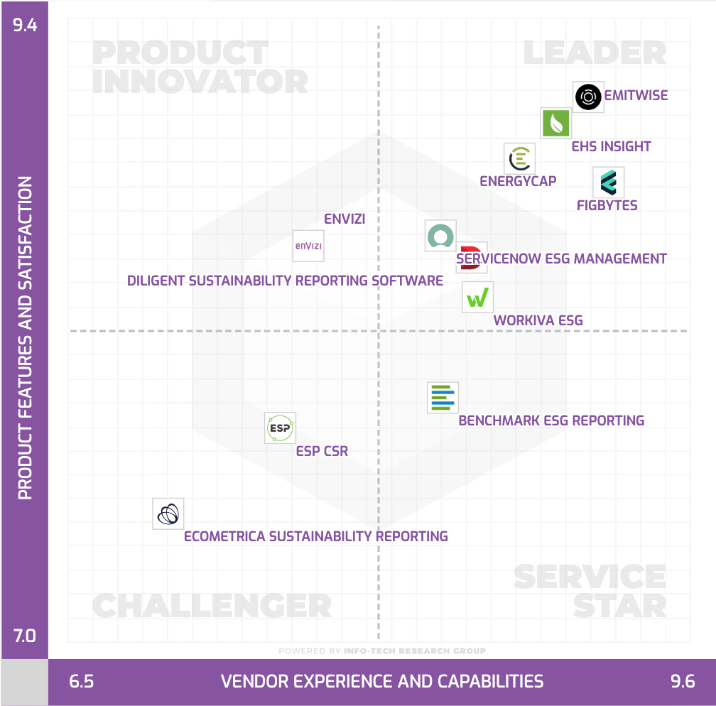
Top ESG Reporting Software
Environmental, Social and Governance (ESG) Reporting software or Sustainability software helps organizations manage their operational data, evaluate their impact on the environment and provide reporting to perform audits.
Source: https://www.softwarereviews.com/categories/environmental-social-and-governance-reporting

Slide 107
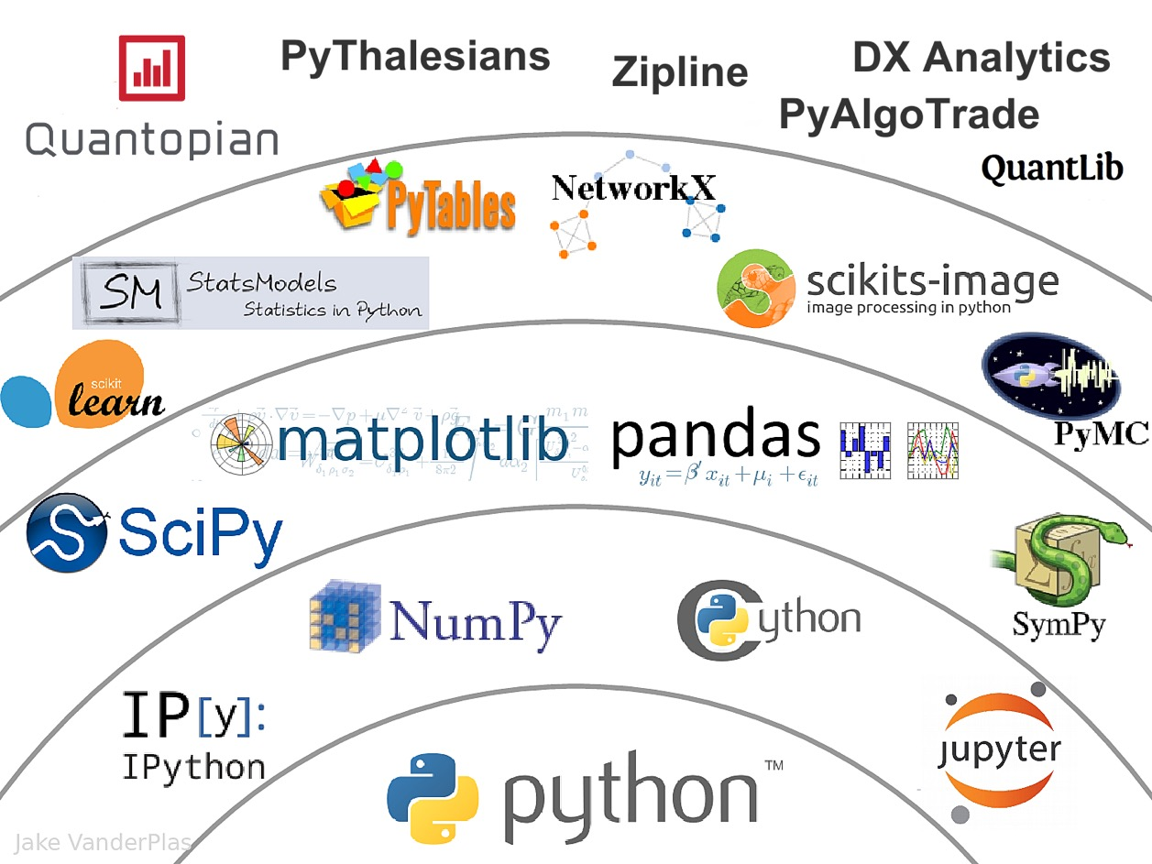
The Quant Finance PyData Stack
Source: http://nbviewer.jupyter.org/format/slides/github/quantopian/pyfolio/blob/master/pyfolio/examples/overview_slides.ipynb#/5

Slide 108

Teaching
Generative AI Innovative Applications
Spring 2025, Spring 2026
Artificial Intelligence in Finance and Quantitative
Fall 2021, Fall 2022, Fall 2023, Spring 2025, Spring 2026
Software Engineering
Fall 2020, Fall, 2021, Spring 2022, Spring 2023, Spring 2024, Spring 2025, Spring 2026
Artificial Intelligence
Spring 2021, Fall 2022, Fall 2024, Fall 2025
Sustainability and ESG Data Analytics
Spring 2024, Fall 2024, Fall 2025
Big Data Analytics
Fall 2020, Spring 2023, Spring 2024
Artificial Intelligence for Text Analytics
Spring 2022, Fall 2023
Python for Accounting Applications
Fall 2023, Fall 2024, ,Fall 2025
Foundation of Business Cloud Computing
Spring 2021, Spring 2022, Spring 2023, Spring 2024
https://web.ntpu.edu.tw/~myday/teaching.htm

Slide 109
Research Projects
PI, Generative AI Multi-Agent Systems with LLM-Based RAG for ESG Reporting Automation
NSTC (E4104), NSTC 114-2221-E-305-002-, 2025/08/01~2026/07/31
PI, ESG Sustainability Commitment Verification Competition and Annotation Data Collection Project (AI Cup 2026 VeriPromiseESG)
Ministry of Education (MoE), AI CUP 2026 MoE National Collegiate Artificial Intelligence Professional Domain Thematic Competition Project, 2025/10/01~2026/09/30
Co-PI, Physical AI and Physical AI Robotics Curriculum Development Project, Forward-Looking AI Talent Cultivation Program (NAPAI)
Ministry of Education (MoE), 2025/11/01~2027/03/31
Co-PI, Industry-Academia Alliance Program for Smart Healthcare: Smart Precision Next-Generation Preventive Medicine
NSTC 114-2622-8-371-001-IE, 2025/11/01~2026/10/31
Co-PI, Digital Support, Unimpeded Communication: The Development, Support and Promotion of AI-assisted Communication Assistive Devices for Speech Impairment(3/3), Sub-project 3: Multimodal Cross-lingual Task-Oriented Dialogue System for Inclusive Communication Support
NSTC (HZZ22), NSTC 114-2425-H-305-003-, 3 Years (2023/05/01-2026/04/30) Year 3: 2025/05/01~2026/04/30
https://web.ntpu.edu.tw/~myday/cindex.htm#projects

Slide 110
Course Outline
This course introduces the fundamental concepts, research issues, and hands-on practices of AI in Finance and Quantitative Analysis.
Topics include:
Introduction to Artificial Intelligence in Finance and Quantitative Analysis
AI in FinTech: Metaverse, Web3, DeFi, NFT, Generative AI and Agentic AI for Financial Innovation Applications
Investing Psychology and Behavioral Finance
Event Studies in Finance
Finance Theory and Data-Driven Finance
Financial Econometrics
AI-First Finance
Deep Learning in Finance; Reinforcement Learning in Finance; Generative AI and Agentic AI in Finance
Algorithmic Trading; Risk Management; Trading Bot and Event-Based Backtesting
Industry Practices of AI in Finance and Quantitative Analysis
Case Study on AI in Finance and Quantitative Analysis

Slide 111

AI in Finance and Quantitative Analysis
University Ambassador
Contact Information
Certified Instructor
Min-Yuh Day, Ph.D.
Professor and Director
Institute of Information Management, National Taipei University
Tel: 02-86741111 ext. 66873
Office: B8F12
Address: 151, University Rd., San Shia District, New Taipei City, 23741 Taiwan
Email: myday@gm.ntpu.edu.tw
Web: http://web.ntpu.edu.tw/~myday/

