Slide 1










Investing Psychology and
Behavioral Finance
Artificial Intelligence in Finance and Quantitative Analysis
1142AIFQA03
MBA, IM, NTPU (M5147) (Spring 2026)
Tue 5, 6, 7 (13:10-16:00) (B3F17)
University Ambassador
Certified Instructor
Min-Yuh Day, Ph.D,
Professor and Director
Institute of Information Management, National Taipei University
https://web.ntpu.edu.tw/~myday
https://meet.google.com/miy-fbif-max
2026-03-10

Slide 2
Syllabus
Week Date Subject/Topics
1 2026/02/24 Introduction to Artificial Intelligence in Finance and
Quantitative Analysis
2 2026/03/03 AI in FinTech: Metaverse, Web3, DeFi, NFT, Generative AI
and Agentic AI for Financial Innovation Applications
3 2026/03/10 Investing Psychology and Behavioral Finance
4 2026/03/17 Event Studies in Finance
5 2026/03/24 Case Study on AI in Finance and Quantitative Analysis I
6 2026/03/31 Finance Theory and Data-Driven Finance

Slide 3
Syllabus
Week Date Subject/Topics
7 2026/04/07 Make-up holiday for NTPU Sports Day (No Classes)
8 2026/04/14 Midterm Project Report
9 2026/04/21 Financial Econometrics
10 2026/04/28 AI-First Finance
11 2026/05/05 Industry Practices of AI in Finance and
Quantitative Analysis
12 2026/05/12 Case Study on AI in Finance and Quantitative Analysis II

Slide 4
Syllabus
Week Date Subject/Topics
13 2026/05/19 Deep Learning in Finance;
Reinforcement Learning in Finance;
Generative AI and Agentic AI in Finance
14 2026/05/26 Algorithmic Trading;
Risk Management;
Trading Bot and Event-Based Backtesting
15 2026/06/02 Final Project Report I
16 2026/06/09 Final Project Report II

Slide 5
Investing Psychology and
Behavioral
Finance

Slide 6
Outline
Investing Psychology
  Investor Sentiment
  Consumer Psychology and Behavior
Behavioral Finance
  Prospect Theory: An Analysis of Decision Under Risk
  Behavioral Heuristics and Biases in Decision Making
  Herding Behavior in Finance

Slide 7
Investor
Sentiment

Slide 8

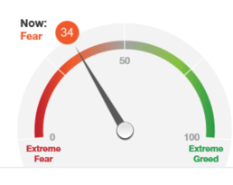
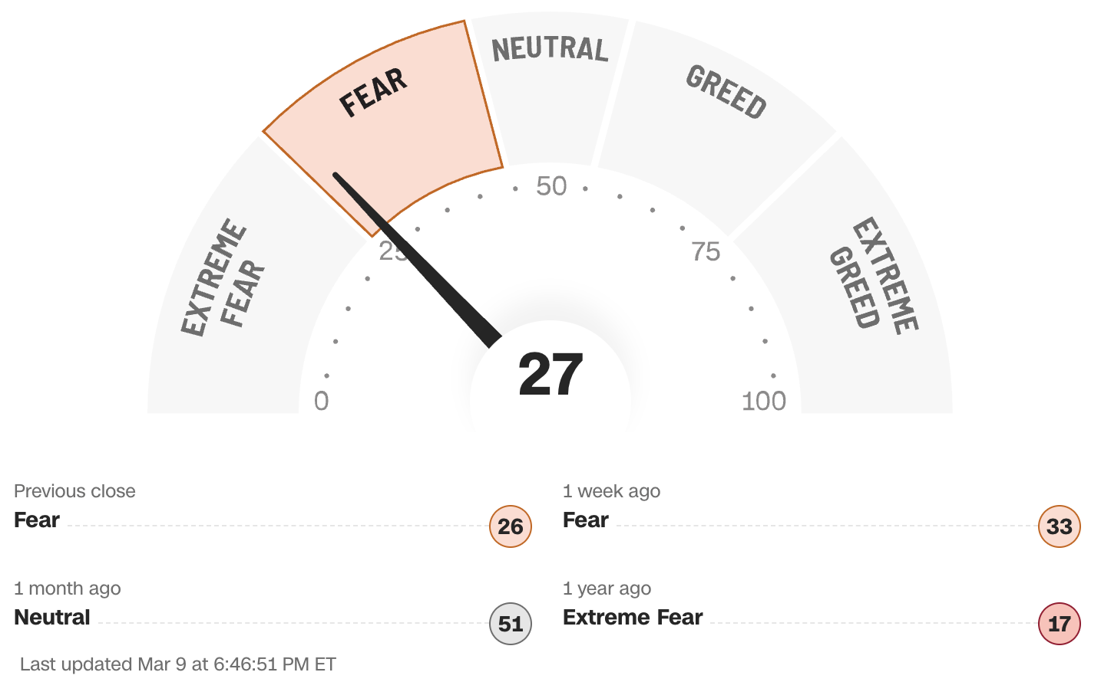
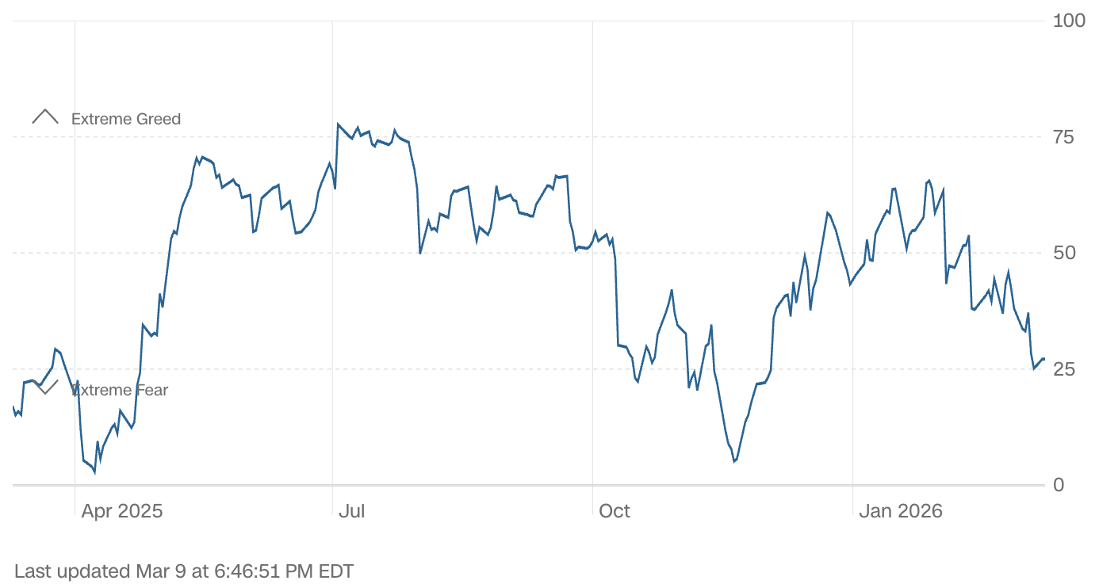
CNN Business (CNN Money)
Fear & Greed Index
What emotion is driving the market now?
Source: https://money.cnn.com/data/fear-and-greed/

Slide 9

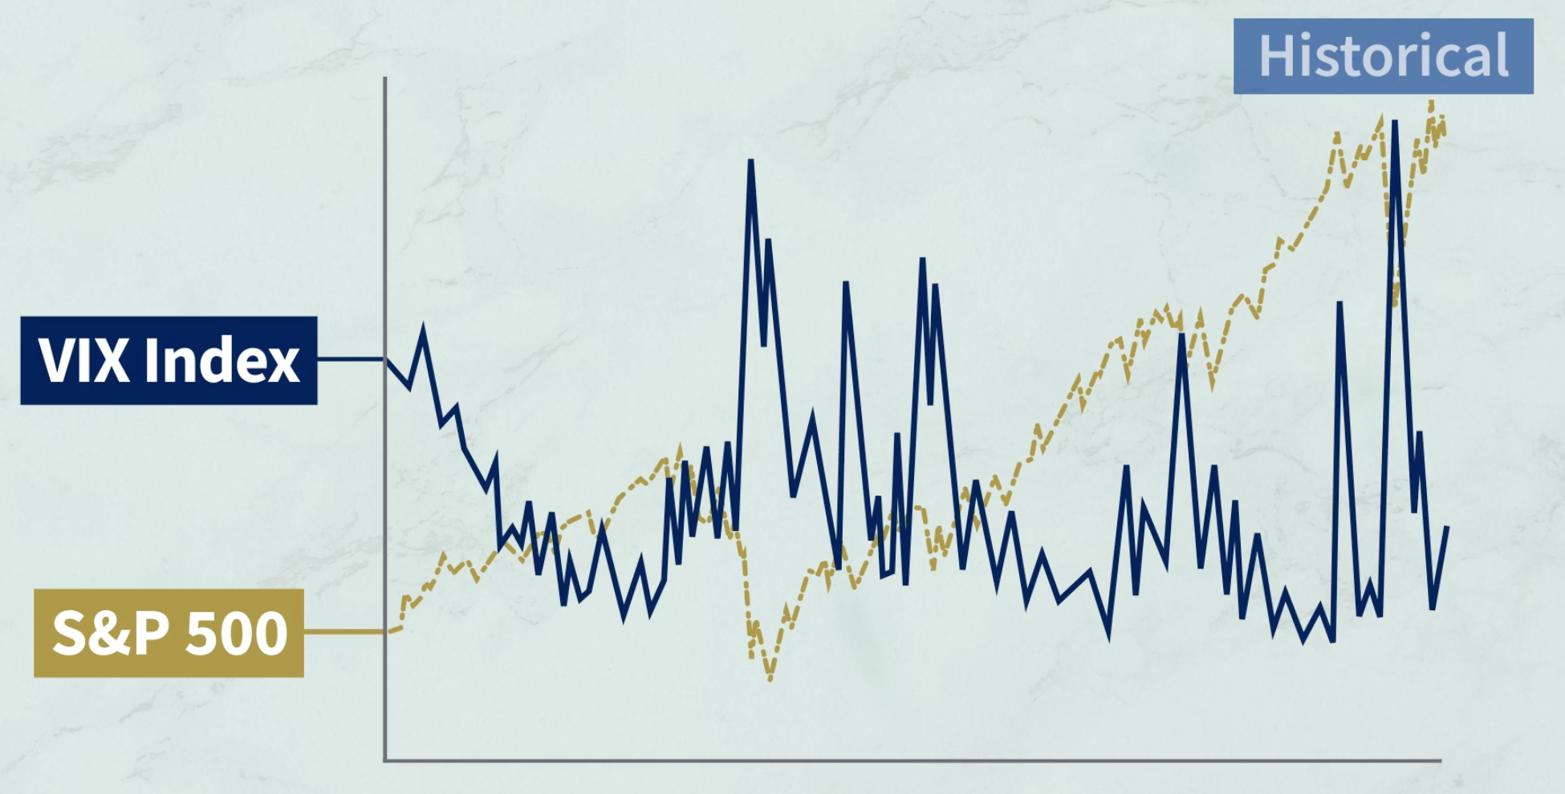
Cboe
VIX (Volatility Index)
An Indicator of Expected Market Volatility
82.69
9.14
Source:https://www.cboe.com/tradable_products/vix/

Slide 10
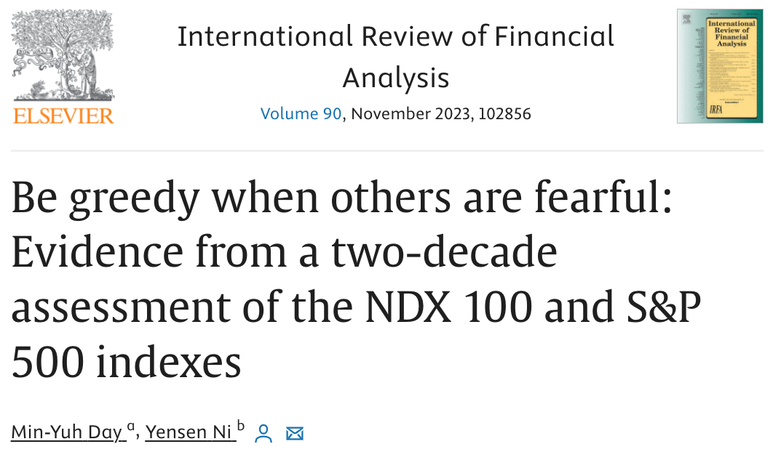
Min-Yuh Day and Yensen Ni (2023),
Be greedy when others are fearful: Evidence from a two-decade assessment of the NDX 100 and S&P 500 indexes,
International Review of Financial Analysis, 90, 102856.
Source: Min-Yuh Day and Yensen Ni (2023), "Be greedy when others are fearful: Evidence from a two-decade assessment of the NDX 100 and S&P 500 indexes",
International Review of Financial Analysis, Volume 90, November 2023, 102856.

Slide 11
Consumer
Psychology and
Behavior

Slide 12
How consumers think, feel, and act
Source: Philip Kotler & Kevin Lane Keller, Marketing Management, 14th ed., Pearson, 2012

Slide 13
Fintech Impact on
Consumer Behavior
Source: http://bitcoinist.com/fintech-impact-consumer-behavior-mobile-payments/

Slide 14
Behavioral Finance

Slide 15
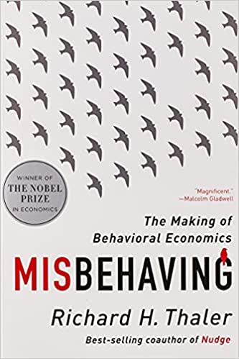

Richard H. Thaler (2016),
Misbehaving: The Making of Behavioral Economics,
‎ W. W. Norton & Company
Richard H. Thaler
Source: https://www.amazon.com/Misbehaving-Behavioral-Economics-Richard-Thaler/dp/039335279X

Slide 16
Edwin Burton and Sunit N. Shah (2013)
Behavioral Finance:
Understanding the Social, Cognitive, and Economic Debates,
Wiley
Source: https://www.amazon.com/Behavioral-Finance-Understanding-Cognitive-Economic/dp/111830019X

Slide 17
Lucy Ackert and Richard Deaves (2009),
Behavioral Finance: Psychology, Decision-Making, and Markets,
South-Western College Pub
Source: https://www.amazon.com/Behavioral-Finance-Psychology-Decision-Making-Markets/dp/0324661177

Slide 18
Hersh Shefrin (2007),
Beyond Greed and Fear:
Understanding Behavioral Finance and the Psychology of Investing,
Oxford University Press
Source: https://www.amazon.com/Beyond-Greed-Fear-Understanding-Association/dp/0195304217

Slide 19
Andrei Shleifer (2000),
Inefficient Markets: An Introduction to Behavioral Finance,
Oxford University Press
Source: https://www.amazon.com/Inefficient-Markets-Introduction-Behavioral-Clarendon/dp/0198292279

Slide 20
H. Kent Baker and Victor Ricciardi (2014)
Investor Behavior:
The Psychology of Financial Planning and Investing,
Wiley
Source: https://www.amazon.com/Investor-Behavior-Psychology-Financial-Investing/dp/1118492986

Slide 21
Marketing
“Meeting
needs profitably”
Source: Philip Kotler & Kevin Lane Keller, Marketing Management, 14th ed., Pearson, 2012

Slide 22
Value
the sum of the
tangible and intangible
benefits and costs
Source: Philip Kotler & Kevin Lane Keller, Marketing Management, 14th ed., Pearson, 2012

Slide 23
Value
Total
customer
benefit
Customer perceived
value
Total
customer
cost
Source: Philip Kotler & Kevin Lane Keller, Marketing Management, 14th ed., Pearson, 2012

Slide 24
Customer Perceived Value
Product benefit
Total
customer
benefit
Customer perceived
value
Services benefit
Personnel benefit
Image benefit
Monetary cost
Total
customer
cost
Time cost
Energy cost
Psychological cost
Source: Philip Kotler & Kevin Lane Keller, Marketing Management, 14th ed., Pearson, 2012

Slide 25
Model of Consumer Behavior
Psychology
Marketing
Stimuli
Other
Stimuli
Buying
Decision Process
Purchase
Decision
Motivation
Perception
Learning
Memory
Products & Services
Price
Distribution
Communications
Economic
Technological
Political
Cultural
Problem Recognition
Information Search
Evaluation of Alternatives
Purchase decision
Post-purchase behavior
Product choice
Brand choice
Dealer choice
Purchase amount
Purchase timing
Payment method
Consumer
Characteristics
Cultural
Social
Personal
Source: Philip Kotler & Kevin Lane Keller, Marketing Management, 14th ed., Pearson, 2012

Slide 26
Building
Customer Value,
Satisfaction, and
Loyalty
Source: Philip Kotler & Kevin Lane Keller, Marketing Management, 14th ed., Pearson, 2012

Slide 27
Customer Perceived Value, Customer Satisfaction, and Loyalty
Customer Perceived Performance
Customer
Perceived Value
Customer
Satisfaction
Customer
Loyalty
Customer
Expectations
Source: Philip Kotler & Kevin Lane Keller, Marketing Management, 14th ed., Pearson, 2012

Slide 28
Theory of
Reasoned
Action
(TRA)
Source: Fishbein, M., & Ajzen, I. (1975). Belief, Attitude, Intention, and Behavior: An Introduction to Theory and Research. Reading, MA: Addison-Wesley.

Slide 29
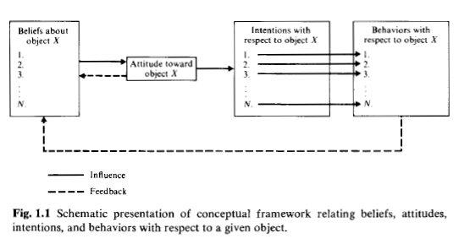
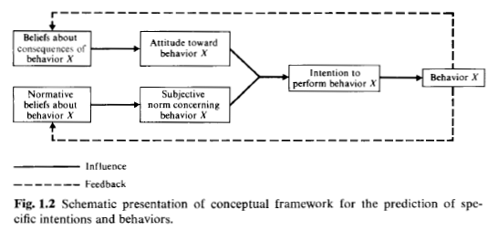
TRA
(1975)
Source: Fishbein, M., & Ajzen, I. (1975). Belief, Attitude, Intention, and Behavior: An Introduction to Theory and Research. Reading, MA: Addison-Wesley.

Slide 30
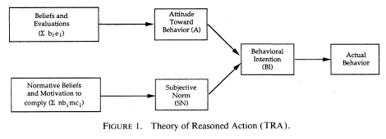
TRA
(1989)
Davis,F.D.,R.P.Bagozzi and P.R.Warshaw,“User acceptance of computer technology : A comparison of two theoretical models ”,Management Science,35(8),August 1989,pp.982-1003

Slide 31
Theory of
Planned
Behavior
(TPB)
Source: Ajzen, I., (1985) “From Intentions to Actions: A Theory of Planned Behavior,” in J. Kuhl and J. Beckmann (Eds.) Action Control: From Cognition to behavior, Springer Verlag, New york, 1985, pp.11-39.

Slide 32
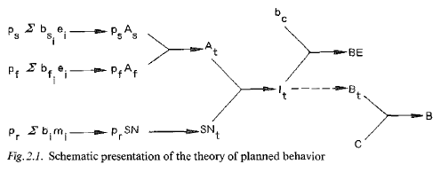
TPB
(1985)
Ajzen, I., (1985) “From Intentions to Actions: A Theory of Planned Behavior,” in J. Kuhl and J. Beckmann (Eds.) Action Control: From Cognition to behavior, Springer Verlag, New york, 1985, pp.11-39.

Slide 33
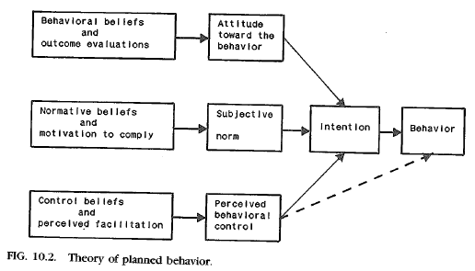
TPB
(1989)
Ajzen, I., (1989) “Attitude Structure and Behavior,” in A. R. Pratkanis, S. J. Breckler, and A. G. Greenwald(Eds.), Attitude Structure and Function, Lawrence Erlbaum Associates, Hillsdale, NJ, 1989, pp.241-274.

Slide 34
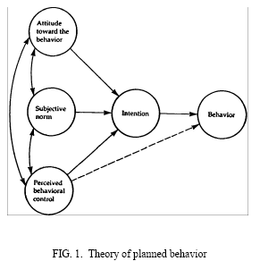
TPB
(1991)
Ajzen, I. (1991). The theory of planned behavior. Organizational Behavior and Human Decision Processes, 50, 179-211.

Slide 35
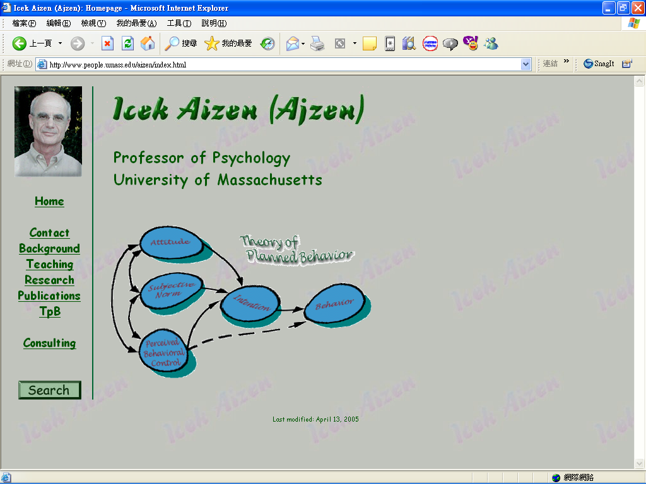
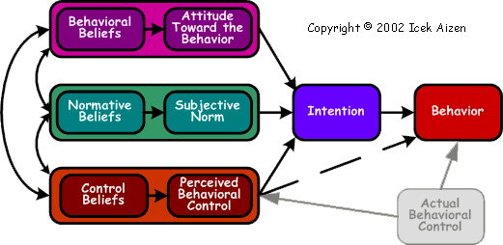
http://www.people.umass.edu/aizen/index.html

Slide 36
Technology Acceptance Model
(TAM)
Source: Davis,F.D.,R.P.Bagozzi and P.R.Warshaw,“User acceptance of computer technology : A comparison of two theoretical models ”,Management Science,35(8),August 1989,pp.982-1003

Slide 37
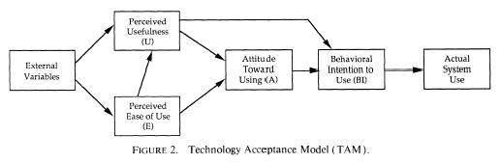
TAM
(1989)
Davis,F.D.,R.P.Bagozzi and P.R.Warshaw,“User acceptance of computer technology : A comparison of two theoretical models ”,Management Science,35(8),August 1989,pp.982-1003

Slide 38
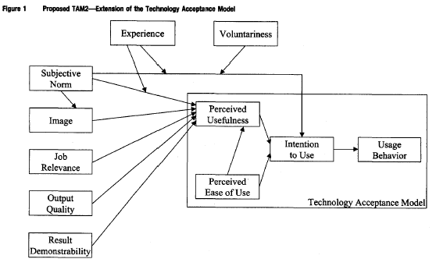
TAM2
(2000)
Venkatesh, V., & Davis, F. D. (2000) “A theoretical extension of the technology acceptance model: Four longitudinal field studies”, Management Science, 46(2), pp. 186-204.

Slide 39
Behavioral
Finance

Slide 40
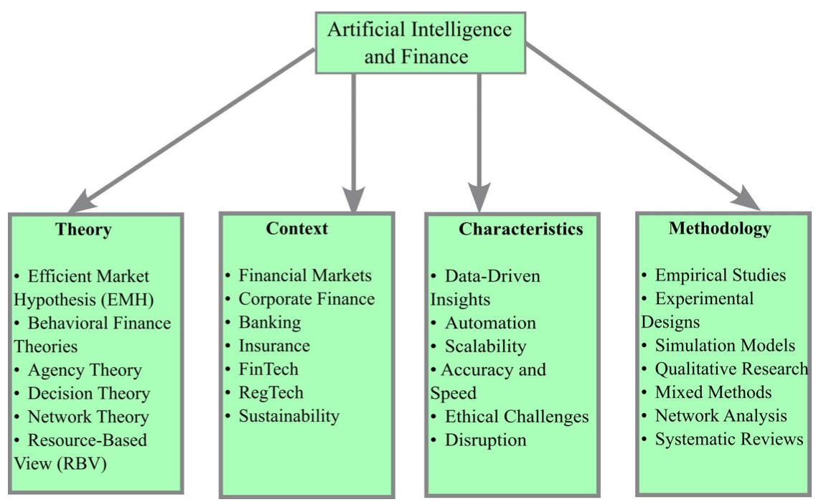
TCCM Framework for AI and Finance
Behavioral
Finance
Source: Roy, P., Ghose, B., Singh, P. K., Tyagi, P. K., & Vasudevan, A. (2025). Artificial Intelligence and Finance: A bibliometric review on the Trends, Influences, and Research Directions. F1000Research, 14, 122.

Slide 41
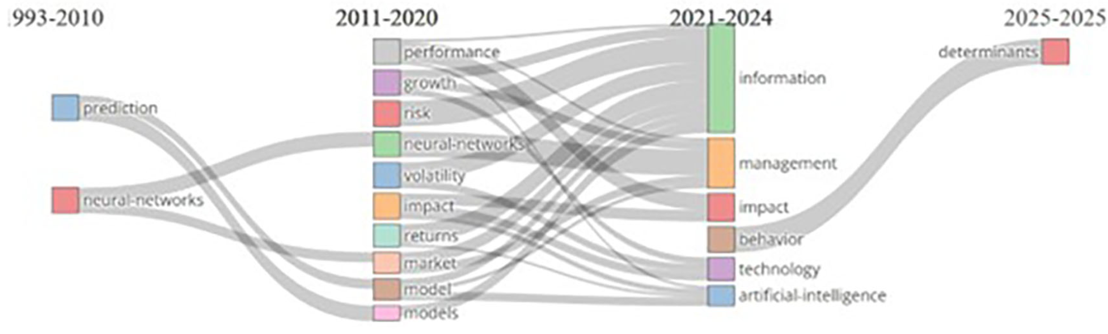
Evolution of AI and Finance Research
1993-2010
2011-2020
2021-2024
2025-2025
Behavior
Source: Roy, P., Ghose, B., Singh, P. K., Tyagi, P. K., & Vasudevan, A. (2025). Artificial Intelligence and Finance: A bibliometric review on the Trends, Influences, and Research Directions. F1000Research, 14, 122.

Slide 42
Rational Behavior
Irrational Behavior

Slide 43
Emotion
Sentiment

Slide 44
Modern Financial Research
Theoretical Finance
  study of logical relationships among assets.
Empirical Finance
  study of data in order to infer relationships.
Behavioral Finance
  integrates psychology into the investment process.
Source: Robert A. Strong (2004), Practical Investment Management, South-Western

Slide 45
Psychology in Behavior Finance
Beliefs
Preferences
  Prospect theory
  Ambiguity aversion
Source: Barberis, Nicholas, and Richard Thaler. "A survey of behavioral finance." Handbook of the Economics of Finance 1 (2003): 1053-1128.

Slide 46
Behavioral Finance Themes
Heuristic-Driven Bias
Framing Dependence
Inefficient Markets
Source: Hersh Shefrin (2007), “Beyond Greed and Fear: Understanding Behavioral Finance and the Psychology of Investing”, Oxford University Press.

Slide 47
Herding Behavior
Herding refers to the lemming-like behavior of investors and analysts looking around,
seeing what each other is doing,
and heading in that direction.
There may not have been safety in numbers,
but there probably was some comfort in them.
Source: Robert A. Strong (2004), Practical Investment Management, South-Western v

Slide 48
Herding Behavior in Finance
Gavrilakis, N., & Floros, C. (2023).
ESG performance, herding behavior and stock market returns: evidence from Europe.
Operational Research, 23(1), 3.
Youssef, M. (2022).
What drives herding behavior in the cryptocurrency market?
Journal of Behavioral Finance, 23(2), 230-239.
Manahov, V. (2021).
Cryptocurrency liquidity during extreme price movements: is there a problem with virtual money?
Quantitative Finance, 21(2), 341-360.
Hsieh, S. F., Chan, C. Y., & Wang, M. C. (2020).
Retail investor attention and herding behavior.
Journal of Empirical Finance, 59, 109-132.
Christoffersen, J., & Staehr, S. (2019).
Individual risk tolerance and herding behaviors in financial forecasts.
European Financial Management, 25(5), 1348-1377.

Slide 49
Efficient
Market
Hypothesis
(EMH)
Source: Hersh Shefrin (2007), “Beyond Greed and Fear: Understanding Behavioral Finance and the Psychology of Investing”, Oxford University Press.

Slide 50
Expected Utility Theory
(EUT)
Source: Kahneman, Daniel, and Amos Tversky. "Prospect theory: An analysis of decision under risk."
Econometrica: Journal of the econometric society (1979): 263-291.

Slide 51
Prospect theory:
An analysis of decision under risk
Source: Kahneman, Daniel, and Amos Tversky. "Prospect theory: An analysis of decision under risk."
Econometrica: Journal of the econometric society (1979): 263-291.

Slide 52
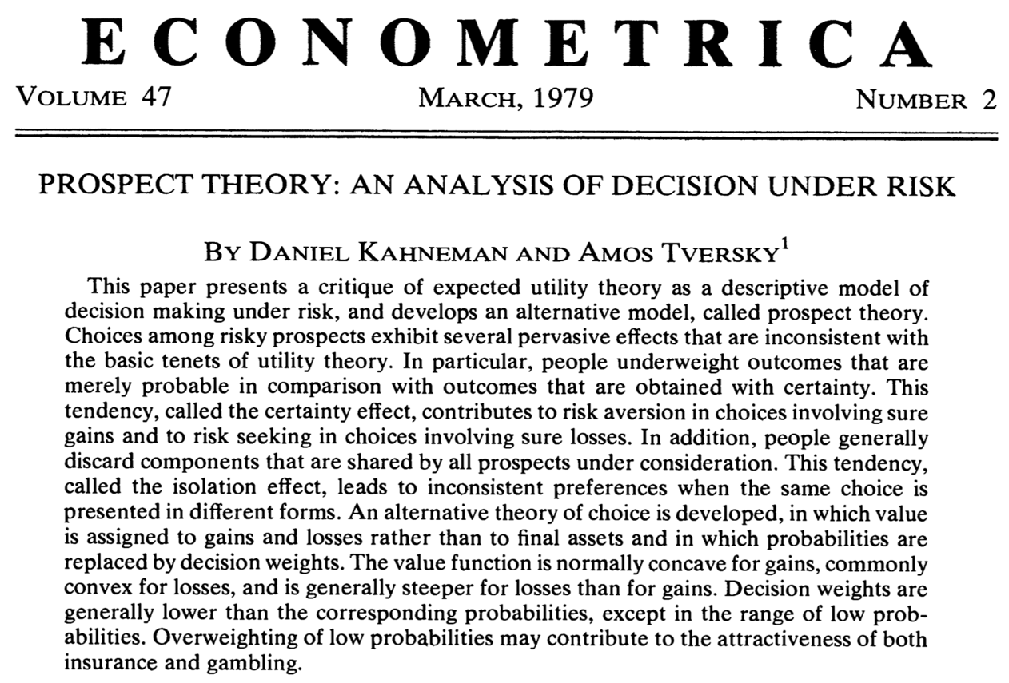
Prospect Theory
(Kahneman and Tversky, 1979)
Source: Kahneman, Daniel, and Amos Tversky. "Prospect theory: An analysis of decision under risk."
Econometrica: Journal of the econometric society (1979): 263-291.

Slide 53
Decision Making under
Risk
Source: Kahneman, Daniel, and Amos Tversky. "Prospect theory: An analysis of decision under risk."
Econometrica: Journal of the econometric society (1979): 263-291.

Slide 54
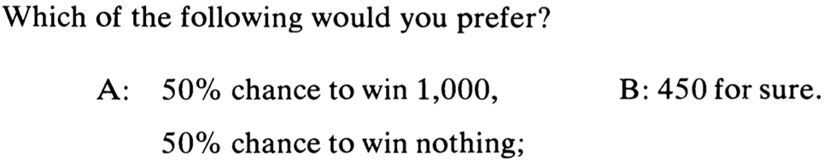
Which of the following would you prefer?
A:
  50% chance to win 1,000,
  50% chance to win nothing;
B:
  450 for sure.
Source: Kahneman, Daniel, and Amos Tversky. "Prospect theory: An analysis of decision under risk."
Econometrica: Journal of the econometric society (1979): 263-291.

Slide 55
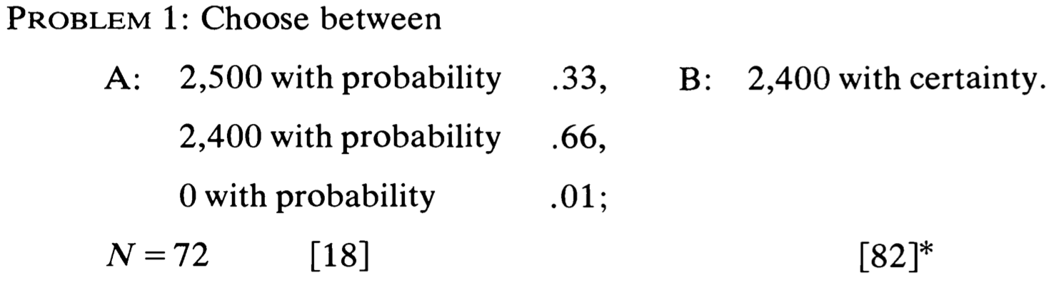
Decision
Source: Kahneman, Daniel, and Amos Tversky. "Prospect theory: An analysis of decision under risk."
Econometrica: Journal of the econometric society (1979): 263-291.

Slide 56
Decision
Source: Kahneman, Daniel, and Amos Tversky. "Prospect theory: An analysis of decision under risk."
Econometrica: Journal of the econometric society (1979): 263-291.

Slide 57
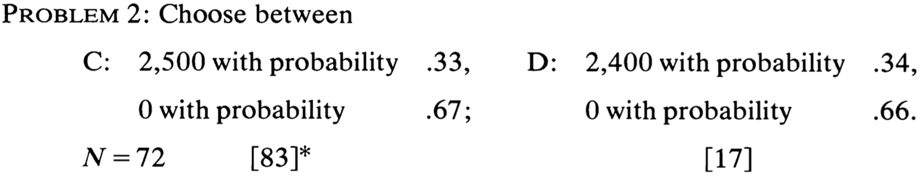
Decision
Source: Kahneman, Daniel, and Amos Tversky. "Prospect theory: An analysis of decision under risk."
Econometrica: Journal of the econometric society (1979): 263-291.

Slide 58
Decision
Source: Kahneman, Daniel, and Amos Tversky. "Prospect theory: An analysis of decision under risk."
Econometrica: Journal of the econometric society (1979): 263-291.

Slide 59
Expected Utility
Source: Kahneman, Daniel, and Amos Tversky. "Prospect theory: An analysis of decision under risk."
Econometrica: Journal of the econometric society (1979): 263-291.

Slide 60
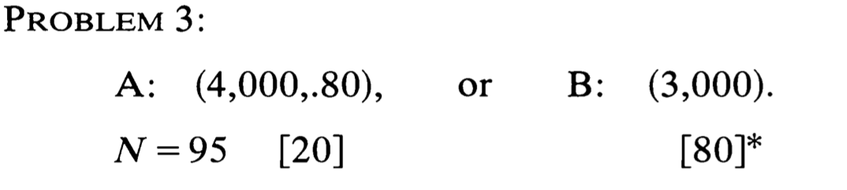
Decision
Source: Kahneman, Daniel, and Amos Tversky. "Prospect theory: An analysis of decision under risk."
Econometrica: Journal of the econometric society (1979): 263-291.

Slide 61
Decision
Source: Kahneman, Daniel, and Amos Tversky. "Prospect theory: An analysis of decision under risk."
Econometrica: Journal of the econometric society (1979): 263-291.

Slide 62
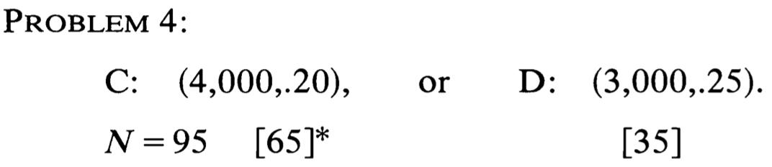
Decision
Source: Kahneman, Daniel, and Amos Tversky. "Prospect theory: An analysis of decision under risk."
Econometrica: Journal of the econometric society (1979): 263-291.

Slide 63
Decision
Source: Kahneman, Daniel, and Amos Tversky. "Prospect theory: An analysis of decision under risk."
Econometrica: Journal of the econometric society (1979): 263-291.

Slide 64
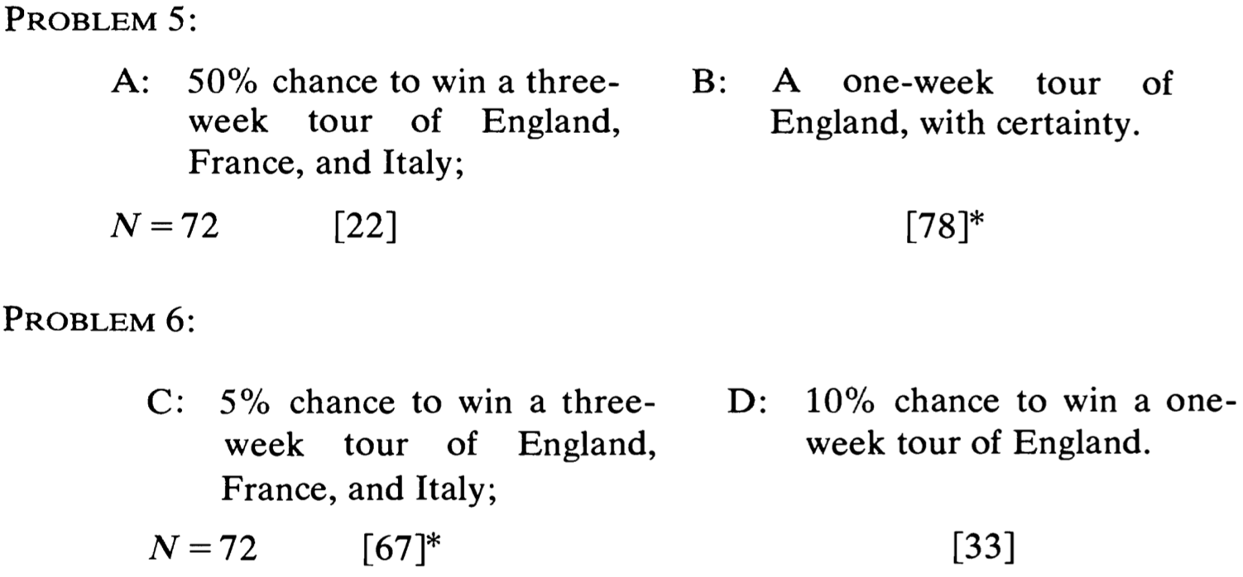
Decision
Source: Kahneman, Daniel, and Amos Tversky. "Prospect theory: An analysis of decision under risk."
Econometrica: Journal of the econometric society (1979): 263-291.

Slide 65
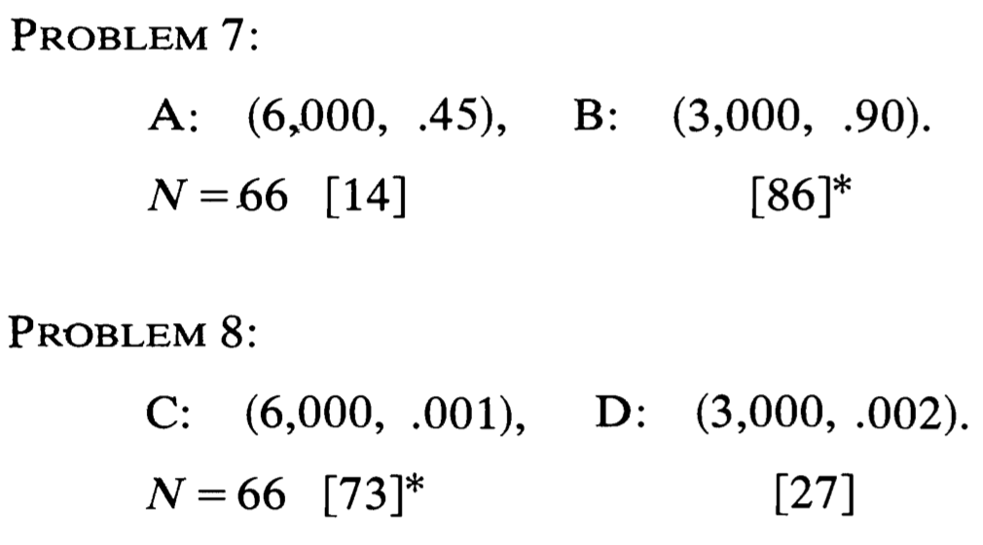
Decision
Source: Kahneman, Daniel, and Amos Tversky. "Prospect theory: An analysis of decision under risk."
Econometrica: Journal of the econometric society (1979): 263-291.

Slide 66
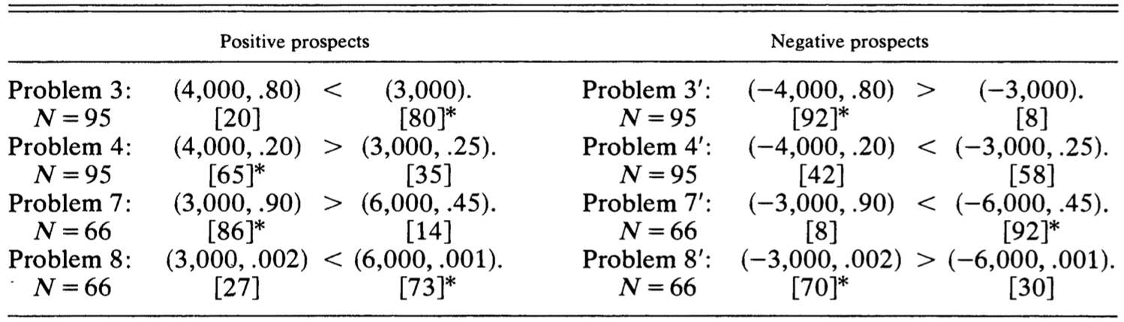
Preferences Between
Positive and Negative Prospects
Source: Kahneman, Daniel, and Amos Tversky. "Prospect theory: An analysis of decision under risk."
Econometrica: Journal of the econometric society (1979): 263-291.

Slide 67
Certainty,
Probability, and
Possibility
Source: Kahneman, Daniel, and Amos Tversky. "Prospect theory: An analysis of decision under risk."
Econometrica: Journal of the econometric society (1979): 263-291.

Slide 68
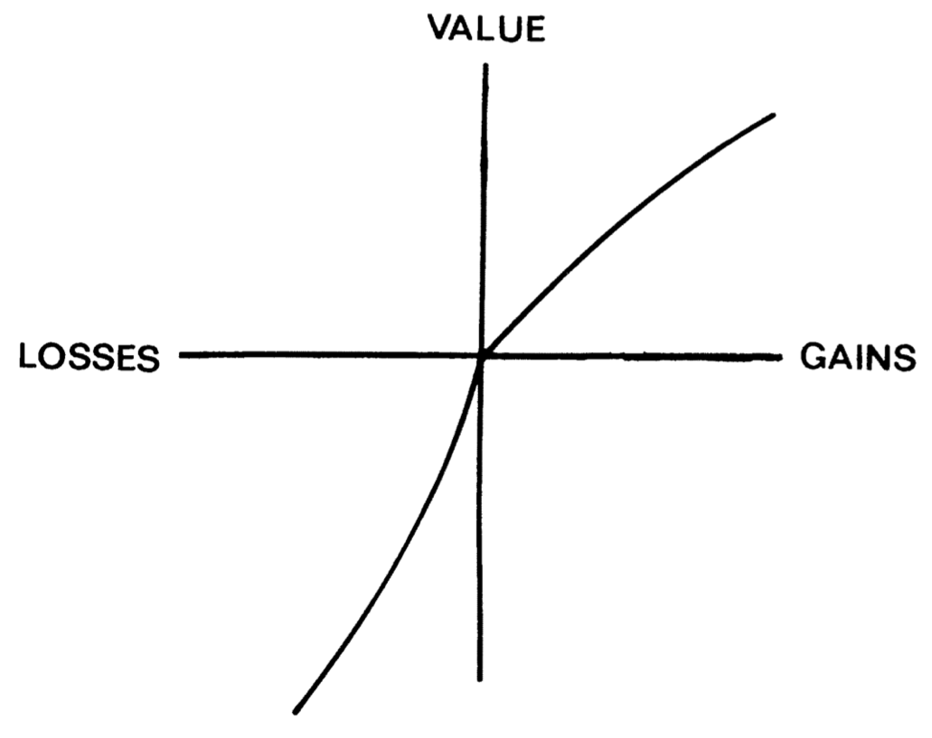
Prospect theory
Value Function
Source: Kahneman, Daniel, and Amos Tversky. "Prospect theory: An analysis of decision under risk."
Econometrica: Journal of the econometric society (1979): 263-291.

Slide 69
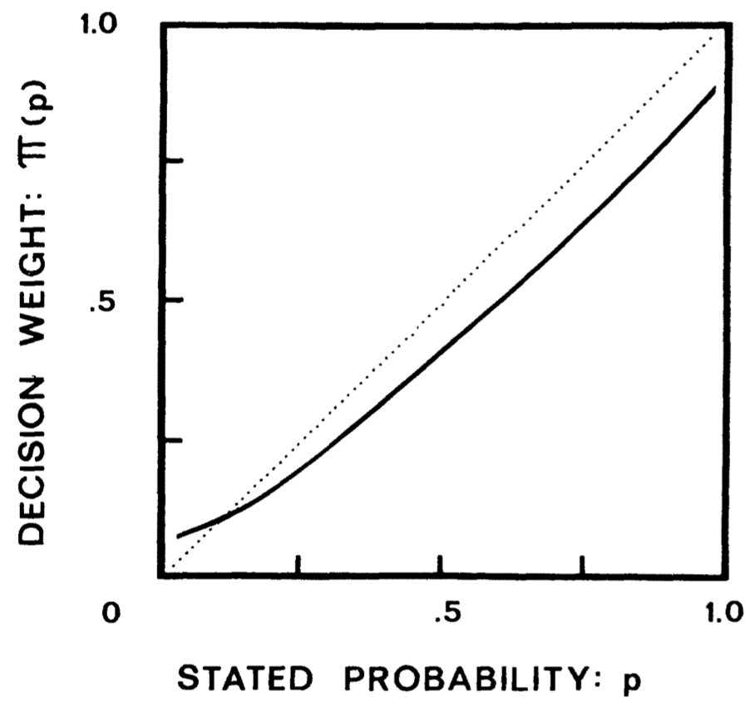
Prospect theory
Weighting Function
Source: Kahneman, Daniel, and Amos Tversky. "Prospect theory: An analysis of decision under risk."
Econometrica: Journal of the econometric society (1979): 263-291.

Slide 70
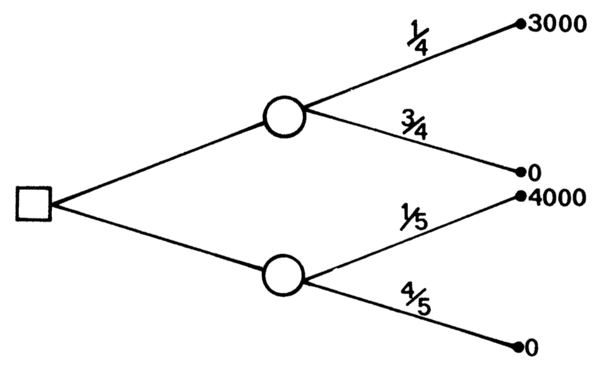
Problem 4 as a decision tree (standard formulation)
Source: Kahneman, Daniel, and Amos Tversky. "Prospect theory: An analysis of decision under risk."
Econometrica: Journal of the econometric society (1979): 263-291.

Slide 71
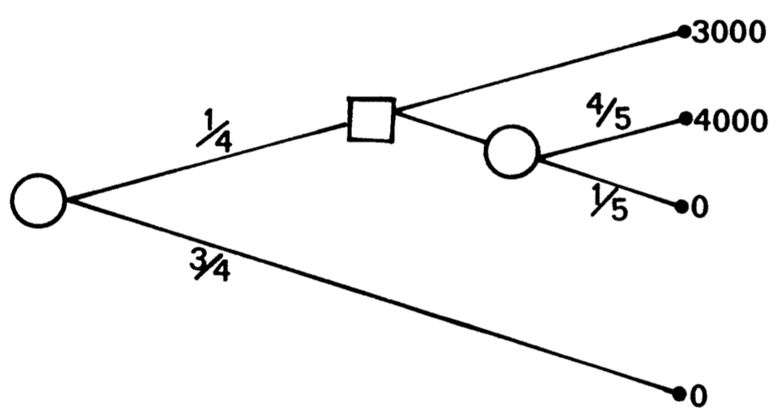
Problem 10 as a decision tree (sequential formulation)
Source: Kahneman, Daniel, and Amos Tversky. "Prospect theory: An analysis of decision under risk."
Econometrica: Journal of the econometric society (1979): 263-291.

Slide 72
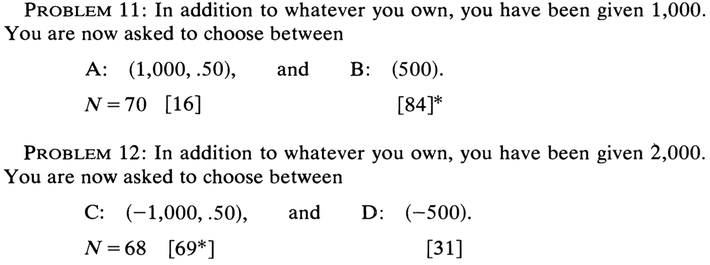
Decision
Source: Kahneman, Daniel, and Amos Tversky. "Prospect theory: An analysis of decision under risk."
Econometrica: Journal of the econometric society (1979): 263-291.

Slide 73
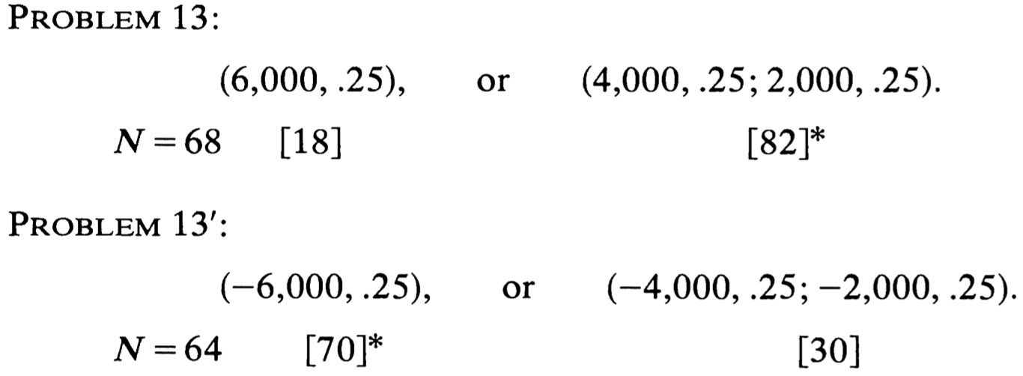
Decision
Source: Kahneman, Daniel, and Amos Tversky. "Prospect theory: An analysis of decision under risk."
Econometrica: Journal of the econometric society (1979): 263-291.

Slide 74
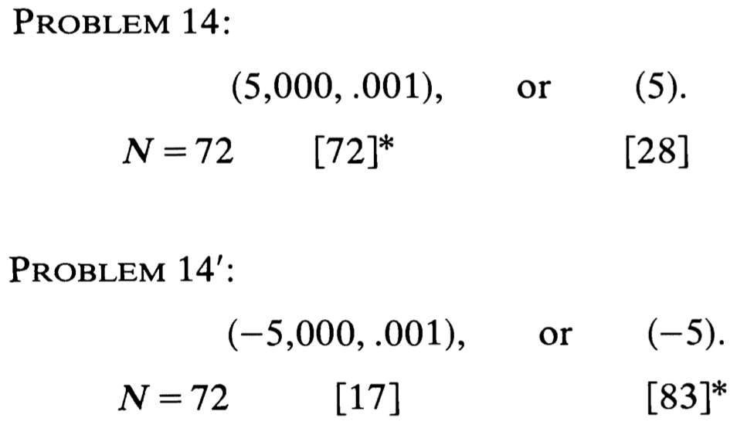
Decision
Source: Kahneman, Daniel, and Amos Tversky. "Prospect theory: An analysis of decision under risk."
Econometrica: Journal of the econometric society (1979): 263-291.

Slide 75
Prospect theory
People underweight outcomes that are merely probable in comparison with outcomes that are obtained with certainty.
  This tendency, called the certainty effect, contributes to risk aversion in choices involving sure gains and to risk seeking in choices involving sure losses.
Source: Kahneman, Daniel, and Amos Tversky. "Prospect theory: An analysis of decision under risk."
Econometrica: Journal of the econometric society (1979): 263-291.

Slide 76
Prospect theory
People generally discard components that are shared by all prospects under consideration.
  This tendency, called the isolation effect, leads to inconsistent preferences when the same choice is presented in different form .
Source: Kahneman, Daniel, and Amos Tversky. "Prospect theory: An analysis of decision under risk."
Econometrica: Journal of the econometric society (1979): 263-291.

Slide 77
Prospect theory
People generally discard components that are shared by all prospects under consideration.
  This tendency, called the isolation effect, leads to inconsistent preferences when the same choice is presented in different form .
Source: Kahneman, Daniel, and Amos Tversky. "Prospect theory: An analysis of decision under risk."
Econometrica: Journal of the econometric society (1979): 263-291.

Slide 78
Prospect theory
Value is assigned to gains and losses rather than to
final assets and in which probabilities are replaced by decision weights.
The value function is normally concave for gains, commonly convex for losses, and is generally steeper for losses than for gains.
Source: Kahneman, Daniel, and Amos Tversky. "Prospect theory: An analysis of decision under risk."
Econometrica: Journal of the econometric society (1979): 263-291.

Slide 79
Prospect theory
Decision weights are generally lower than the corresponding probabilities,
except in the range of low probabilities.
Overweighting of low probabilities may contribute to the attractiveness of both insurance and gambling.
Source: Kahneman, Daniel, and Amos Tversky. "Prospect theory: An analysis of decision under risk."
Econometrica: Journal of the econometric society (1979): 263-291.

Slide 80
Behavioral
Heuristics and Biases in
Decision Making

Slide 81
Behavioral Finance Anomalies
The Rational Man
  Consumer Choice with Certainty
  Consumer Choice with Uncertainty
  The Allais Paradox
Source: Edwin Burton and Sunit N. Shah (2013), “Behavioral Finance: Understanding the Social, Cognitive, and Economic Debates”, Wiley.

Slide 82
Prospect Theory
The Reference Point
The S-Curve
Loss Aversion
Source: Edwin Burton and Sunit N. Shah (2013), “Behavioral Finance: Understanding the Social, Cognitive, and Economic Debates”, Wiley.

Slide 83
Behavioral Finance Anomalies
Perception Biases
Inertial Effects
Causality and Statistics
Illusions
Source: Edwin Burton and Sunit N. Shah (2013), “Behavioral Finance: Understanding the Social, Cognitive, and Economic Debates”, Wiley.

Slide 84
Perception Biases
Saliency
Framing
Anchoring
Sunk Cost Bias
Source: Edwin Burton and Sunit N. Shah (2013), “Behavioral Finance: Understanding the Social, Cognitive, and Economic Debates”, Wiley.

Slide 85
Inertial Effects
Endowment Effect
Status Quo Effect
Disposition Effect
Source: Edwin Burton and Sunit N. Shah (2013), “Behavioral Finance: Understanding the Social, Cognitive, and Economic Debates”, Wiley.

Slide 86
Causality and Statistics
Representativeness
Conjunction Fallacy
Reading into Randomness
Small Sample Bias
Probability Neglect
Source: Edwin Burton and Sunit N. Shah (2013), “Behavioral Finance: Understanding the Social, Cognitive, and Economic Debates”, Wiley.

Slide 87
Illusions
Illusion of Talent
Illusion of Skill
Illusion of Superiority
Illusion of Validity
Source: Edwin Burton and Sunit N. Shah (2013), “Behavioral Finance: Understanding the Social, Cognitive, and Economic Debates”, Wiley.

Slide 88
Behavioral Finance:
Two Major Foundations
Investor Sentiment
  creates disturbances to efficient prices.
Limited arbitrage
  arbitrage is never riskfree, hence it does not counter irrational disturbances.
    Prices may not react to information by the “right” amount.
    Prices may react to non-information.
    Markets may remain efficient.

Slide 89
Arbitrage
Source: http://www.beliefnet.com/columnists/moviemom/2012/09/interview-nicholas-jarecki-of-arbitrage.html

Slide 90
Arbitrage
$120
Gain $20
$100
Sell High in Market B
Buy Low in Market A

Slide 91
Heuristics
Overconfidence
  people overestimate the reliability of their knowledge.
Excessive trading
Framing Effect

Slide 92
Heuristics
Regret Aversion
  anticipation of a future regret can influence current decision.
Disposition Effect
  sell winners, hold on to the losers.
Anchoring and adjustment: can create under-reaction.

Slide 93
Fashions and Fads
People are influenced by each other. There is a social pressure to conform.
Herding behavior: “safety-in-numbers”.
Informational Cascades
Positive Feedback
Example: excessive demand for internet IPOs. Extremely high opening day returns.

Slide 94
Social Influences
Social norms
  The informal opinions, rules, and procedures of a group.
  Your piers and social groups influence your investment participation
Herding Behavior
  The movement into or out of a stock or industry of companies by large groups of investors.

Slide 95
Psychology of Belief
Confirmation Bias
Source: https://www.interaction-design.org/literature/article/confirmation-bias-it-s-not-what-we-think-we-know-that-counts

Slide 96
Confirmation Bias
The
Facts
Your
Beliefs
Overvalued
Source: Robert A. Strong (2004), Practical Investment Management, South-Western

Slide 97
Representativeness Heuristic
A
B
A & B
P (A & B) < P (A) or P (B)
Source: Robert A. Strong (2004), Practical Investment Management, South-Western

Slide 98

Katona’s
Economic Psychology Model
Economic Conditions
(E)
Personal Characteristics
(P)
Economic
Behavior
(B)
Source: Van Raaij, W. Fred. "Economic psychology." Journal of Economic Psychology 1, no. 1 (1981): 1-24.

Slide 99
Summary
Investing Psychology
  Investor Sentiment
  Consumer Psychology and Behavior
Behavioral Finance
  Prospect Theory: An Analysis of Decision Under Risk
  Behavioral Heuristics and Biases in Decision Making
  Herding Behavior in Finance

Slide 100
References
Yves Hilpisch (2020), Artificial Intelligence in Finance: A Python-Based Guide, O’Reilly Media.
Aurélien Géron (2019), Hands-On Machine Learning with Scikit-Learn, Keras, and TensorFlow: Concepts, Tools, and Techniques to Build Intelligent Systems, 2nd Edition, O’Reilly Media.
Yves Hilpisch (2018), Python for Finance: Mastering Data-Driven Finance, 2nd Edition, O'Reilly Media.
Paolo Sironi (2016), “FinTech Innovation: From Robo-Advisors to Goal Based Investing and Gamification”, Wiley.
Chris Kelliher (2022), Quantitative Finance With Python: A Practical Guide to Investment Management, Trading, and Financial Engineering, Chapman and Hall/CRC.
Susanne Chishti and Janos Barberis (2016), “The FINTECH Book: The Financial Technology Handbook for Investors, Entrepreneurs and Visionaries”, Wiley.
Richard H. Thaler (2016), Misbehaving: The Making of Behavioral Economics, W. W. Norton & Company
Lucy Ackert and Richard Deaves (2009), “Behavioral Finance: Psychology, Decision-Making, and Markets”, South-Western College Pub.
Hersh Shefrin (2007), “Beyond Greed and Fear: Understanding Behavioral Finance and the Psychology of Investing”, Oxford University Press.
Edwin Burton and Sunit N. Shah (2013), “Behavioral Finance: Understanding the Social, Cognitive, and Economic Debates”, Wiley.
Daniel Kahneman and Amos Tversky (1979), "Prospect theory: An analysis of decision under risk." Econometrica: Journal of the econometric society (1979): 263-291.
Day, M. Y., & Ni, Y. (2023). Be greedy when others are fearful: Evidence from a two-decade assessment of the NDX 100 and S&P 500 indexes. International Review of Financial Analysis, 90, 102856.
Roy, P., Ghose, B., Singh, P. K., Tyagi, P. K., & Vasudevan, A. (2025). Artificial Intelligence and Finance: A bibliometric review on the Trends, Influences, and Research Directions. F1000Research, 14, 122.
Manahov, V. (2021). Cryptocurrency liquidity during extreme price movements: is there a problem with virtual money? Quantitative Finance, 21(2), 341-360.
Gavrilakis, N., & Floros, C. (2023). ESG performance, herding behavior and stock market returns: evidence from Europe. Operational Research, 23(1), 3.
Hsieh, S. F., Chan, C. Y., & Wang, M. C. (2020). Retail investor attention and herding behavior. Journal of Empirical Finance, 59, 109-132.
Christoffersen, J., & Staehr, S. (2019). Individual risk tolerance and herding behaviors in financial forecasts. European Financial Management, 25(5), 1348-1377.
Frijns, B., & Huynh, T. D. (2018). Herding in analysts' recommendations: The role of media. Journal of Banking & Finance, 91, 1-18.

