Slide 1










Event Studies in Finance
Artificial Intelligence in Finance and Quantitative Analysis
1142AIFQA04
MBA, IM, NTPU (M5147) (Spring 2026)
Tue 5, 6, 7 (13:10-16:00) (B3F17)
University Ambassador
Certified Instructor
Min-Yuh Day, Ph.D,
Professor and Director
Institute of Information Management, National Taipei University
https://web.ntpu.edu.tw/~myday
https://meet.google.com/miy-fbif-max
2026-03-17

Slide 2
Syllabus
Week Date Subject/Topics
1 2026/02/24 Introduction to Artificial Intelligence in Finance and
Quantitative Analysis
2 2026/03/03 AI in FinTech: Metaverse, Web3, DeFi, NFT, Generative AI
and Agentic AI for Financial Innovation Applications
3 2026/03/10 Investing Psychology and Behavioral Finance
4 2026/03/17 Event Studies in Finance
5 2026/03/24 Case Study on AI in Finance and Quantitative Analysis I
6 2026/03/31 Finance Theory and Data-Driven Finance

Slide 3
Syllabus
Week Date Subject/Topics
7 2026/04/07 Make-up holiday for NTPU Sports Day (No Classes)
8 2026/04/14 Midterm Project Report
9 2026/04/21 Financial Econometrics
10 2026/04/28 AI-First Finance
11 2026/05/05 Industry Practices of AI in Finance and
Quantitative Analysis
12 2026/05/12 Case Study on AI in Finance and Quantitative Analysis II

Slide 4
Syllabus
Week Date Subject/Topics
13 2026/05/19 Deep Learning in Finance;
Reinforcement Learning in Finance;
Generative AI and Agentic AI in Finance
14 2026/05/26 Algorithmic Trading;
Risk Management;
Trading Bot and Event-Based Backtesting
15 2026/06/02 Final Project Report I
16 2026/06/09 Final Project Report II

Slide 5
Event Studies in Finance

Slide 6
Outline
Event Studies in Finance
Event Studies for Financial Research
Event Study Methodology
Efficient Market Hypothesis (EMH)
  Efficient Markets
  Inefficient Markets

Slide 7
Doron Kliger and Gregory Gurevich (2014),
Event Studies for Financial Research:
A Comprehensive Guide,
Palgrave Macmillan
Source: https://www.amazon.com/Event-Studies-Financial-Research-Comprehensive/dp/1137435380/

Slide 8
Event Studies in Finance
Event studies are widely used in finance research
to investigate the implications of
  Announcements of corporate initiatives
    Mergers and acquisitions, equity and debt issuance, dividends and repurchases, corporate restructuring
  Regulatory changes
    Board reform, compensation, changes in taxation, workplace safety
  Macroeconomic shocks on stock prices
    The COVID-19 pandemic, Brexit, the Paris Agreement
Source: El Ghoul, Sadok, Omrane Guedhami, Sattar A. Mansi, and Oumar Sy (2022). "Event studies in international finance research." Journal of International Business Studies : 1-21.

Slide 9
Event Studies in ESG and Sustainable Finance
Atz, U., Van Holt, T., Liu, Z. Z., & Bruno, C. C. (2023). Does sustainability generate better financial performance? review, meta-analysis, and propositions. Journal of Sustainable Finance & Investment, 13(1), 802-825.
Kumar, S. (2023). Exploratory review of esg factor attribution to the portfolio return in Fama-French factor model framework. Academy of Marketing Studies Journal, 27, 1-20.
Leite, B. J., & Uysal, V. B. (2023). Does ESG matter to investors? ESG scores and the stock price response to new information. Global Finance Journal, 100851.
Li, Z., Feng, L., Pan, Z., & Sohail, H. M. (2022). ESG performance and stock prices: evidence from the COVID-19 outbreak in China. Humanities and Social Sciences Communications, 9(1), 1-10.
Wang, J., Hu, X., & Zhong, A. (2023). Stock market reaction to mandatory ESG disclosure. Finance Research Letters, 53, 103402.

Slide 10
Firm-level Event Studies
M&As
Restructuring
Equity issuance
Dividends
Analyst forecasts and recommendations
Earnings
Source: El Ghoul, Sadok, Omrane Guedhami, Sattar A. Mansi, and Oumar Sy (2022). "Event studies in international finance research." Journal of International Business Studies : 1-21.

Slide 11
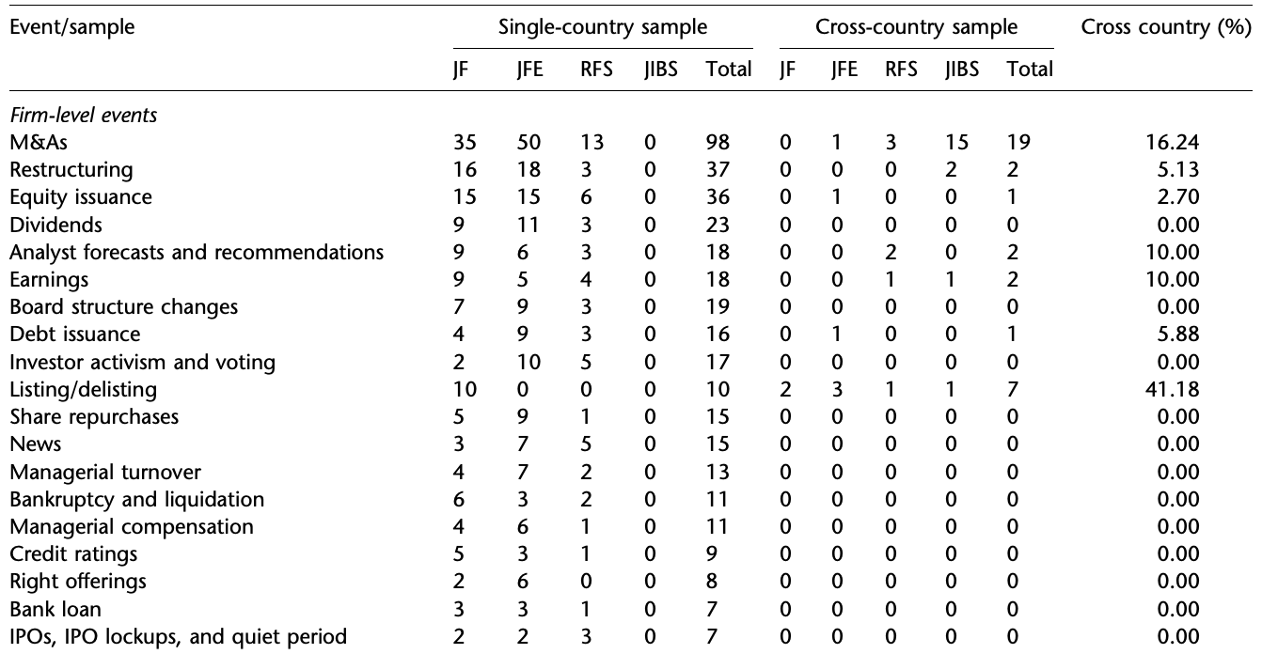
Single- and Cross-country Event Studies published in the four major finance and IB journals
Firm-level events
Source: El Ghoul, Sadok, Omrane Guedhami, Sattar A. Mansi, and Oumar Sy (2022). "Event studies in international finance research." Journal of International Business Studies : 1-21.

Slide 12
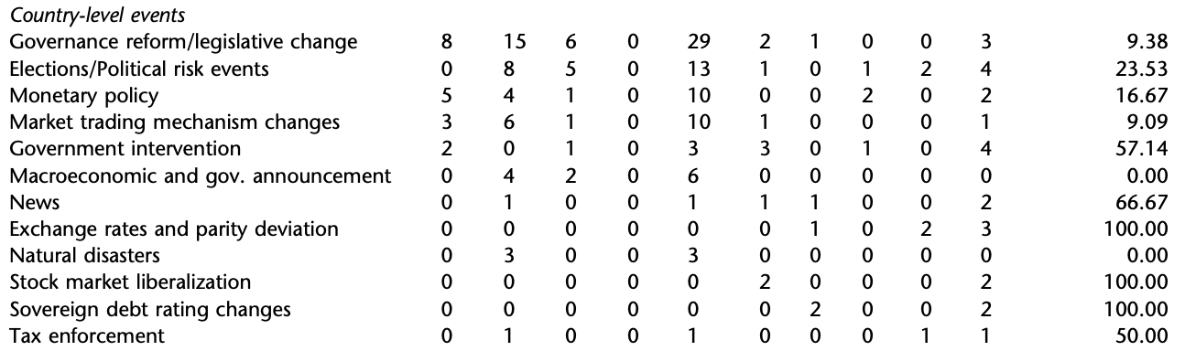
Single- and Cross-country Event Studies published in the four major finance and IB journals
Country-level events
Source: El Ghoul, Sadok, Omrane Guedhami, Sattar A. Mansi, and Oumar Sy (2022). "Event studies in international finance research." Journal of International Business Studies : 1-21.

Slide 13
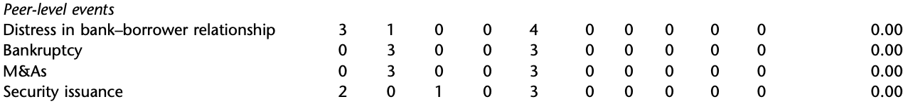
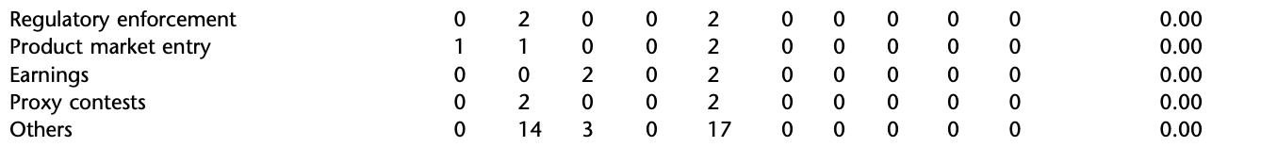
Single- and Cross-country Event Studies published in the four major finance and IB journals
Peer-level events
Source: El Ghoul, Sadok, Omrane Guedhami, Sattar A. Mansi, and Oumar Sy (2022). "Event studies in international finance research." Journal of International Business Studies : 1-21.

Slide 14
Event Studies for
Financial Research

Slide 15
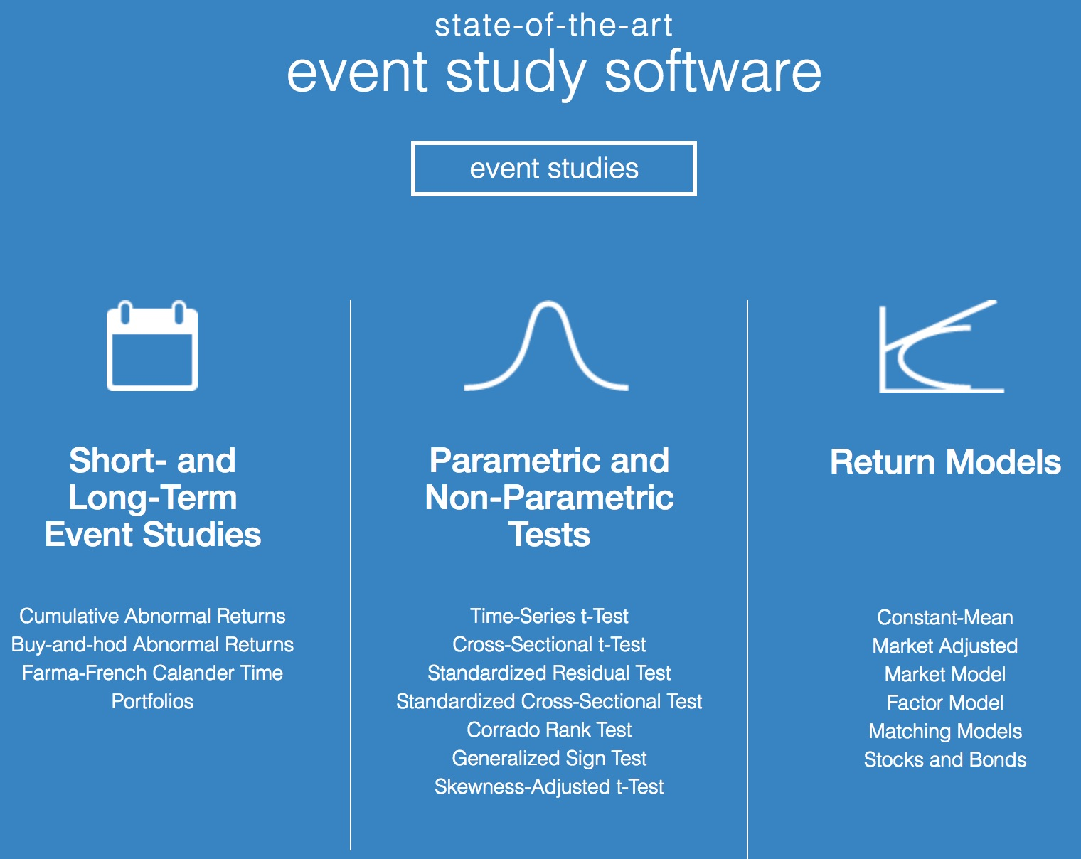
https://eventstudymetrics.com/

Slide 16
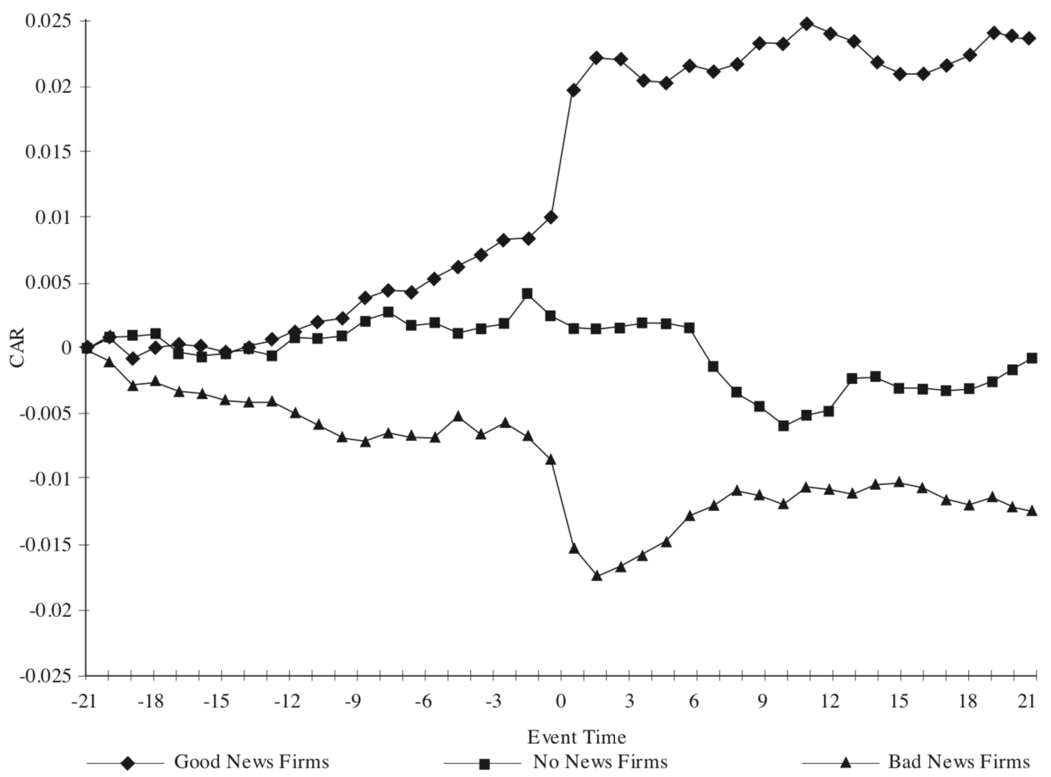
Event Studies in Economics and Finance
Good News
No News
Bad News
Source: MacKinlay, A. C. (1997). Event studies in economics and finance. Journal of economic literature, 35(1), 13-39.

Slide 17
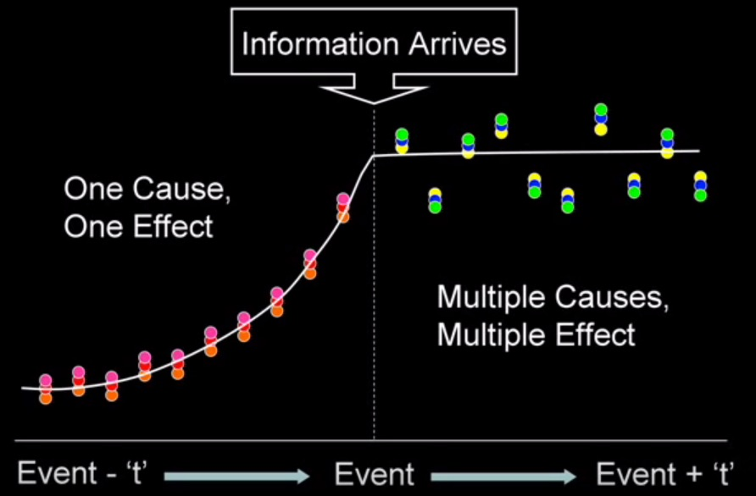
Event Study
Source: Rajesh Mudholkar (2014), "Event studies: Confirms Market Efficiency or Behavioral Anomalies?", https://www.youtube.com/watch?v=VErwDaQNB74

Slide 18
Event Study
Time line for an event study
Event
Source: https://eventstudymetrics.com/index.php/event-study-methodology/

Slide 19
Event Study Methodology
estimation
window
event
window
post event
window
T₀
T₁
0
T₂
T₃
L₁
L₂
Source: https://eventstudymetrics.com/index.php/event-study-methodology/

Slide 20
Event Study Methodology
estimation
window
event
window
post event
window
-30
-5 -4 -3 -2 -1 0 +1 +2 +3 +4 +5
+30
T₀
T₁
0
T₂
T₃
L₁
L₂
Source: https://eventstudymetrics.com/index.php/event-study-methodology/

Slide 21
Event Study Methodology
estimation
window
event
window
post event
window
-260
-10 0 +10
+30
T₀
T₁
0
T₂
T₃
L₁
L₂
Source: https://eventstudymetrics.com/index.php/event-study-methodology/

Slide 22
Efficient Markets

Slide 23
Behavioral Economics

Slide 24
Behavioral Finance

Slide 25
Rational Behavior
Irrational Behavior

Slide 26
Emotion
Sentiment

Slide 27
Modern Financial Research
Theoretical Finance
  study of logical relationships among assets.
Empirical Finance
  study of data in order to infer relationships.
Behavioral Finance
  integrates psychology into the investment process.
Source: Robert A. Strong (2004), Practical Investment Management, South-Western

Slide 28
Behavioral Finance Themes
Heuristic-Driven Bias
Framing Dependence
Inefficient Markets
Source: Hersh Shefrin (2007), “Beyond Greed and Fear: Understanding Behavioral Finance and the Psychology of Investing”, Oxford University Press.

Slide 29
Efficient Market Hypothesis
(EMH)
Source: Doron Kliger and Gregory Gurevich (2014), Event Studies for Financial Research: A Comprehensive Guide, Palgrave Macmillan

Slide 30
Efficient Market Hypothesis (EMH) (Fama, 1970)
Efficient capital markets: A review of theory and empirical work
EF Fama - The Journal of Finance, 1970
This paper reviews the theoretical and empirical iterature on the efficient markets model.
After a discussion of the theory, empirical work concerned with the adjustment of security
prices to three relevant information subsets is considered. First, weak form tests, in which the
information set is just historical prices, are discussed. Then semi-strong form tests, in which
the concern is whether prices efficiently adjust to other information that is obviously ...
Cited by 37957 Related articles All 25 versions
Malkiel, B. G., & Fama, E. F. (1970).
Efficient capital markets: A review of theory and empirical work. The Journal of Finance, 25(2), 383-417.

Slide 31
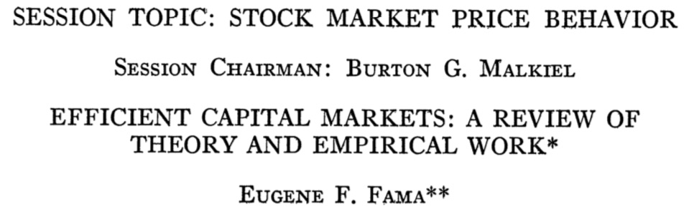
Efficient Market Hypothesis (EMH) (Fama, 1970)
Malkiel, B. G., & Fama, E. F. (1970).
Efficient capital markets: A review of theory and empirical work. The Journal of Finance, 25(2), 383-417.

Slide 32
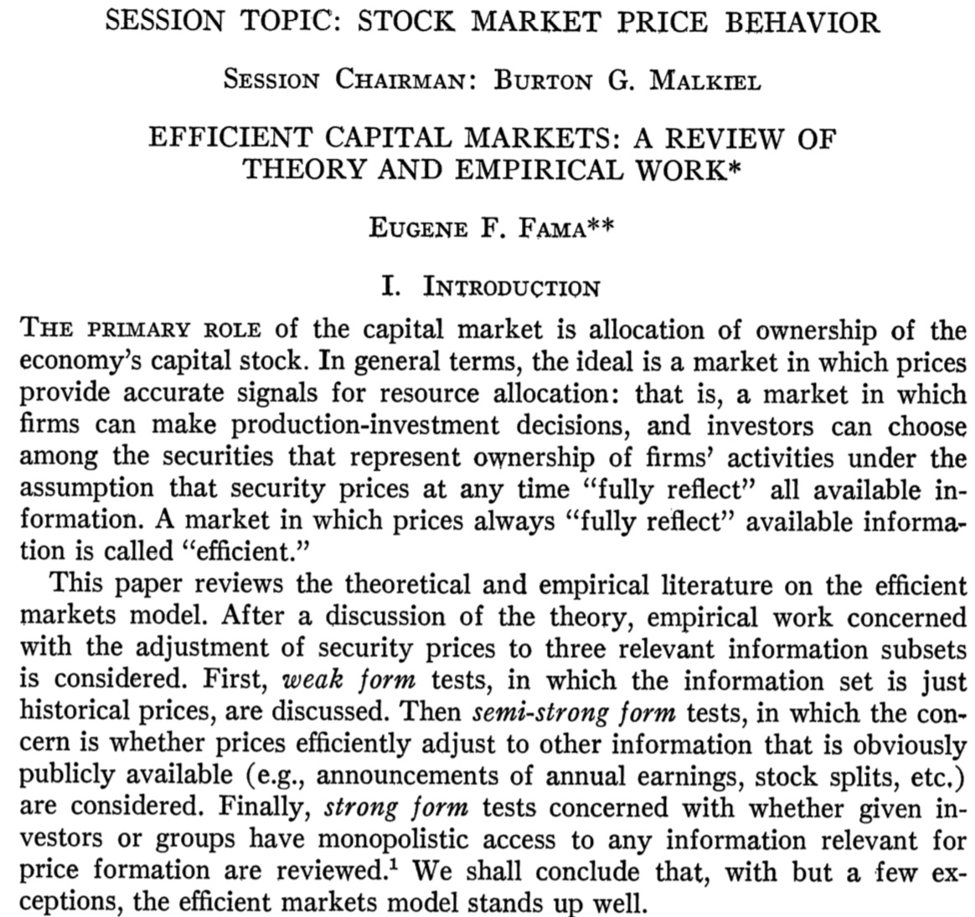
Efficient Market Hypothesis (EMH) (Fama, 1970)
Source: Malkiel, B. G., & Fama, E. F. (1970). Efficient capital markets: A review of theory and empirical work. The Journal of Finance, 25(2), 383-417.

Slide 33
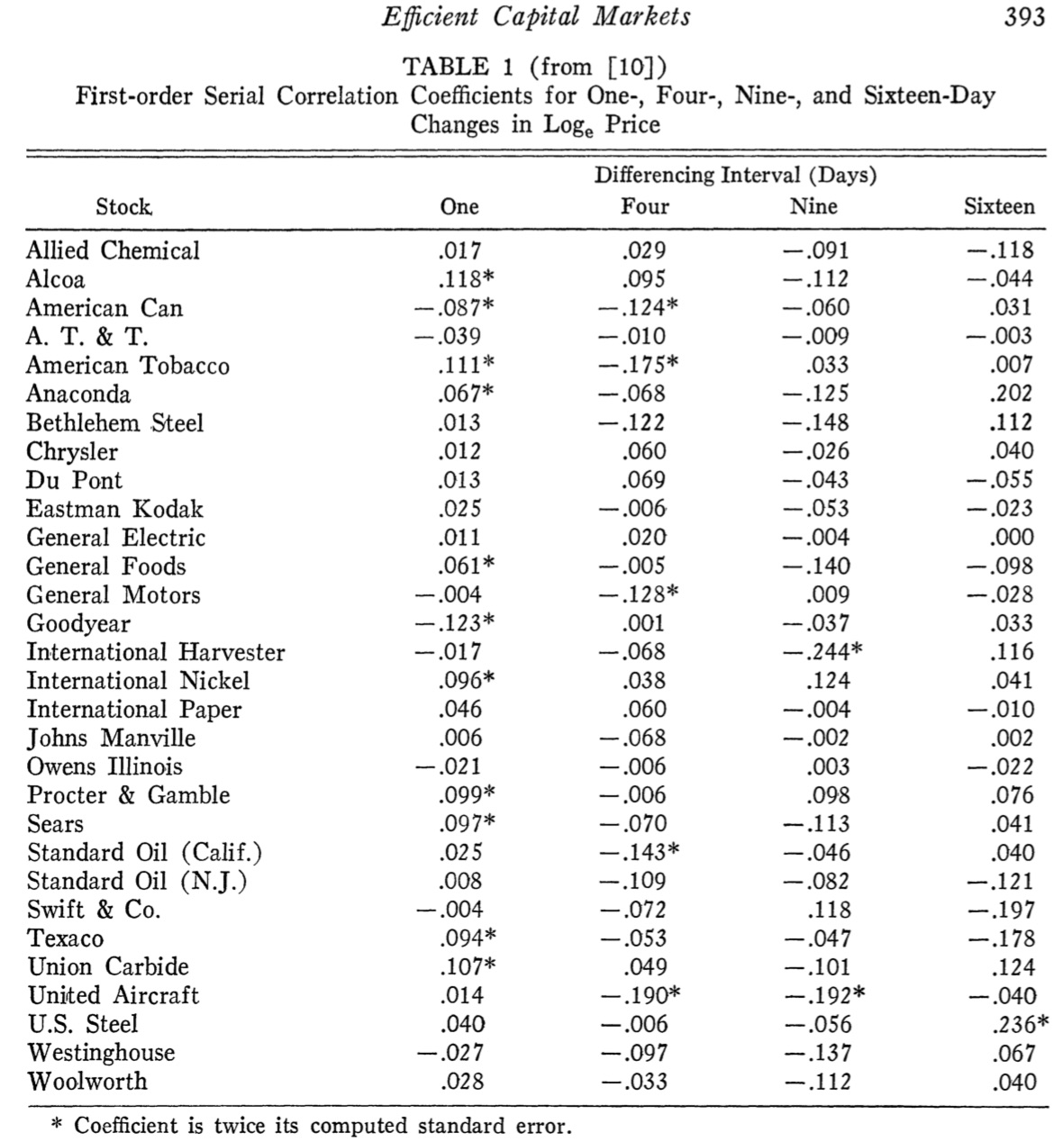
Source: Malkiel, B. G., & Fama, E. F. (1970). Efficient capital markets: A review of theory and empirical work. The Journal of Finance, 25(2), 383-417.

Slide 34
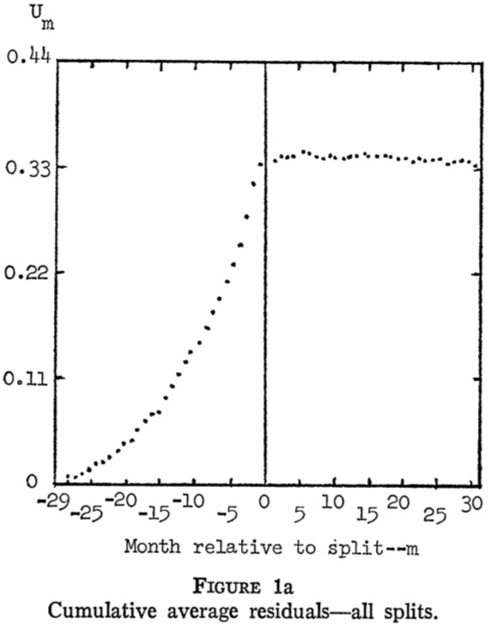
Cumulative Average Residuals
Source: Malkiel, B. G., & Fama, E. F. (1970). Efficient capital markets: A review of theory and empirical work. The Journal of Finance, 25(2), 383-417.

Slide 35
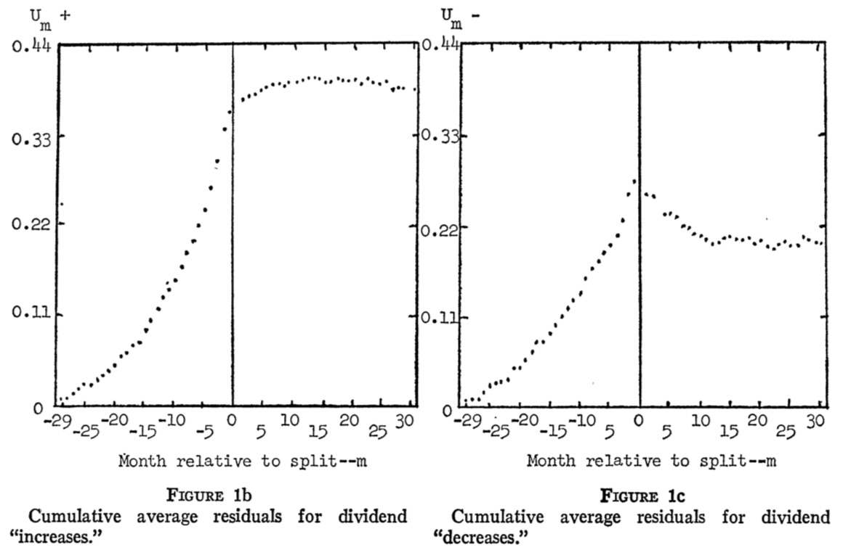
Cumulative Average Residuals
Source: Malkiel, B. G., & Fama, E. F. (1970). Efficient capital markets: A review of theory and empirical work. The Journal of Finance, 25(2), 383-417.

Slide 36
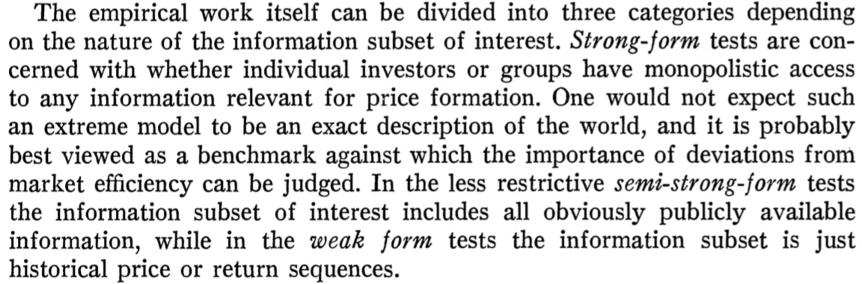
Market Efficiency
Source: Malkiel, B. G., & Fama, E. F. (1970). Efficient capital markets: A review of theory and empirical work. The Journal of Finance, 25(2), 383-417.

Slide 37
Types of Efficiency Market
Weak Form
  Security prices reflect all information found in
  past prices and volume.
Semi-Strong Form
  Security prices reflect all publicly available information.
Strong Form
  Security prices reflect all information—public and private.
Source: Ross et al. (2005), "Corporate Finance", 7th Edition, McGraw−Hill

Slide 38
Can Financing Decisions
Create Value?
Source: Ross et al. (2005), "Corporate Finance", 7th Edition, McGraw−Hill

Slide 39
What Sort of Financing Decisions?
Typical financing decisions include:
  How much debt and equity to sell
  When (or if) to pay dividends
  When to sell debt and equity
Just as we can use NPV criteria to evaluate investment decisions, we can use NPV to evaluate financing decisions.
Source: Ross et al. (2005), "Corporate Finance", 7th Edition, McGraw−Hill

Slide 40
How to Create Value through Financing
Fool Investors
  Empirical evidence suggests that it is hard to fool investors consistently.
Reduce Costs or Increase Subsidies
  Certain forms of financing have tax advantages or carry other subsidies.
Create a New Security
  Sometimes a firm can find a previously-unsatisfied clientele and issue new securities at favorable prices.
  In the long-run, this value creation is relatively small, however.
Source: Ross et al. (2005), "Corporate Finance", 7th Edition, McGraw−Hill

Slide 41
Efficient Capital Markets
An efficient capital market is one in which stock prices fully reflect available information.
The EMH has implications for investors and firms.
  Since information is reflected in security prices quickly, knowing information when it is released does an investor no good.
  Firms should expect to receive the fair value for securities that they sell. Firms cannot profit from fooling investors in an efficient market.
Source: Ross et al. (2005), "Corporate Finance", 7th Edition, McGraw−Hill

Slide 42
Reaction of Stock Price to New Information in Efficient and Inefficient Markets
Stock Price
Overreaction to “good news” with reversion
Delayed response to “good news”
Efficient market response to “good news”
-30 -20 -10 0 +10 +20 +30
Days before (-) and after (+) announcement
Source: Ross et al. (2005), "Corporate Finance", 7th Edition, McGraw−Hill

Slide 43
Reaction of Stock Price to New Information in Efficient and Inefficient Markets
Efficient market response to “bad news”
Stock Price
Delayed response to “bad news”
Overreaction to “bad news” with reversion
-30 -20 -10 0 +10 +20 +30
Days before (-) and after (+) announcement
Source: Ross et al. (2005), "Corporate Finance", 7th Edition, McGraw−Hill

Slide 44
Versions of EMH/Info-Efficiency
Weak-form efficiency:
  Prices reflect all information contained in past prices
Semi-strong-form efficiency:
  Prices reflect all publicly available information
Strong-form efficiency:
  Prices reflect all relevant information, include private (insider) information
all public & private info
all public info
past market info
Source: Markus K. Brunnermeier (2015), “Lecture 10: Market Efficiency”, Finance 501: Asset Pricing, Princeton University

Slide 45
Relationship among
Three Different Information Sets
All information
relevant to a stock
Information set
of publicly available
information
Information
set of
past prices
Source: Ross et al. (2005), "Corporate Finance", 7th Edition, McGraw−Hill

Slide 46
Efficient Market
An efficient market incorporates information in security prices.
There are three forms of the EMH:
  Weak-Form EMH
    Security prices reflect past price data.
  Semistrong-Form EMH
    Security prices reflect publicly available information.
  Strong-Form EMH
    Security prices reflect all information.
There is abundant evidence for the first two forms of the EMH.
Source: Ross et al. (2005), "Corporate Finance", 7th Edition, McGraw−Hill

Slide 47
Why Technical Analysis Fails
Investor behavior tends to eliminate any profit opportunity associated with stock price patterns.
Stock Price
If it were possible to make big money simply by finding “the pattern” in the stock price movements, everyone would do it and the profits would be competed away.
Sell
Sell
Buy
Buy
Time
Source: Ross et al. (2005), "Corporate Finance", 7th Edition, McGraw−Hill

Slide 48
Evidence on Market Efficiency
Return Predictability Studies
Event Studies
Performance Studies
Source: Markus K. Brunnermeier (2015), “Lecture 10: Market Efficiency”, Finance 501: Asset Pricing, Princeton University

Slide 49
Event Studies
Objective
  Examine if new (company specific) information is incorporated into the
  stock price in one single price jump upon public release?
Source: Markus K. Brunnermeier (2015), “Lecture 10: Market Efficiency”, Finance 501: Asset Pricing, Princeton University

Slide 50
Event Studies Methodology
Define as day “zero” the day the information is released
Calculate the daily returns R_{it} the 30 days around day “zero”:
t = -30, -29,…-1, 0, 1,…, 29, 30
Calculate the daily returns R_{mt} for the same days on the market (or a comparison group of firms of similar industry and risk)
Define Abnormal Returns (AR) as the difference
Calculate Average Abnormal Returns (AAR) over all N events in the sample for all 60 reference days
Cumulate the returns on the first T days to CAAR
AR_{it}= R_{it} –R_{mt}
Source: Markus K. Brunnermeier (2015), “Lecture 10: Market Efficiency”, Finance 501: Asset Pricing, Princeton University

Slide 51
Event Studies Methodology
Step 1.
Define as day “zero” the day the information is released
Source: Markus K. Brunnermeier (2015), “Lecture 10: Market Efficiency”, Finance 501: Asset Pricing, Princeton University

Slide 52
Event Studies Methodology
Step 2.
Calculate the daily returns R_{it}
the 30 days around day “zero”:
t = -30, -29,…-1, 0, 1,…, 29, 30
Source: Markus K. Brunnermeier (2015), “Lecture 10: Market Efficiency”, Finance 501: Asset Pricing, Princeton University

Slide 53
Event Studies Methodology
Step 3.
Calculate the daily returns
R_{mt} for the same days on the market (or a comparison group of firms of similar industry and risk)
Source: Markus K. Brunnermeier (2015), “Lecture 10: Market Efficiency”, Finance 501: Asset Pricing, Princeton University

Slide 54
Event Studies Methodology
Step 4.
Define
Abnormal Returns (AR)
as the difference
AR_{it}= R_{it} –R_{mt}
Source: Markus K. Brunnermeier (2015), “Lecture 10: Market Efficiency”, Finance 501: Asset Pricing, Princeton University

Slide 55
Event Studies Methodology
Step 5.
Calculate
Average Abnormal Returns (AAR)
over all N events in the sample for
all 60 reference days
Source: Markus K. Brunnermeier (2015), “Lecture 10: Market Efficiency”, Finance 501: Asset Pricing, Princeton University

Slide 56
Event Studies Methodology
Step 6.
Cumulate the returns on the
first T days to
Cumulative Average Abnormal Returns (CAAR)
Source: Markus K. Brunnermeier (2015), “Lecture 10: Market Efficiency”, Finance 501: Asset Pricing, Princeton University

Slide 57
Event Studies Methodology
Define as day “zero” the day the information is released
Calculate the daily returns R_{it} the 30 days around day “zero”:
t = -30, -29,…-1, 0, 1,…, 29, 30
Calculate the daily returns R_{mt} for the same days on the market (or a comparison group of firms of similar industry and risk)
Define Abnormal Returns (AR) as the difference
Calculate Average Abnormal Returns (AAR) over all N events in the sample for all 60 reference days
Cumulate the returns on the first T days to CAAR
AR_{it}= R_{it} –R_{mt}
Source: Markus K. Brunnermeier (2015), “Lecture 10: Market Efficiency”, Finance 501: Asset Pricing, Princeton University

Slide 58
Market Efficiency in Event Studies
Over-reaction
Efficient Reaction
Under-reaction
T
-30 | -25 | -20 | -15 | -10 | -5 | 0 | 5 | 10 | 15 | 20 | 25 | 30
Source: Markus K. Brunnermeier (2015), “Lecture 10: Market Efficiency”, Finance 501: Asset Pricing, Princeton University

Slide 59
Event Study:
Earning Announcement
Good News
Cumulative abnormal returns around earning announcements
(MacKinlay 1997)
No News
Bad News
Source: Markus K. Brunnermeier (2015), “Lecture 10: Market Efficiency”, Finance 501: Asset Pricing, Princeton University

Slide 60
Event Study: Stock Splits
Event Study on Stock Splits by
Fama-French-Fischer-Jensen-Roll
(1969)
Split is a signal of good profit
Pre-announcement drift can be due
to selection bias (only good firms
split) or insider trading.
→ inconclusive
No post-announcement drift
→ for weak form
Selection bias
or
Insider trading
Source: Markus K. Brunnermeier (2015), “Lecture 10: Market Efficiency”, Finance 501: Asset Pricing, Princeton University

Slide 61
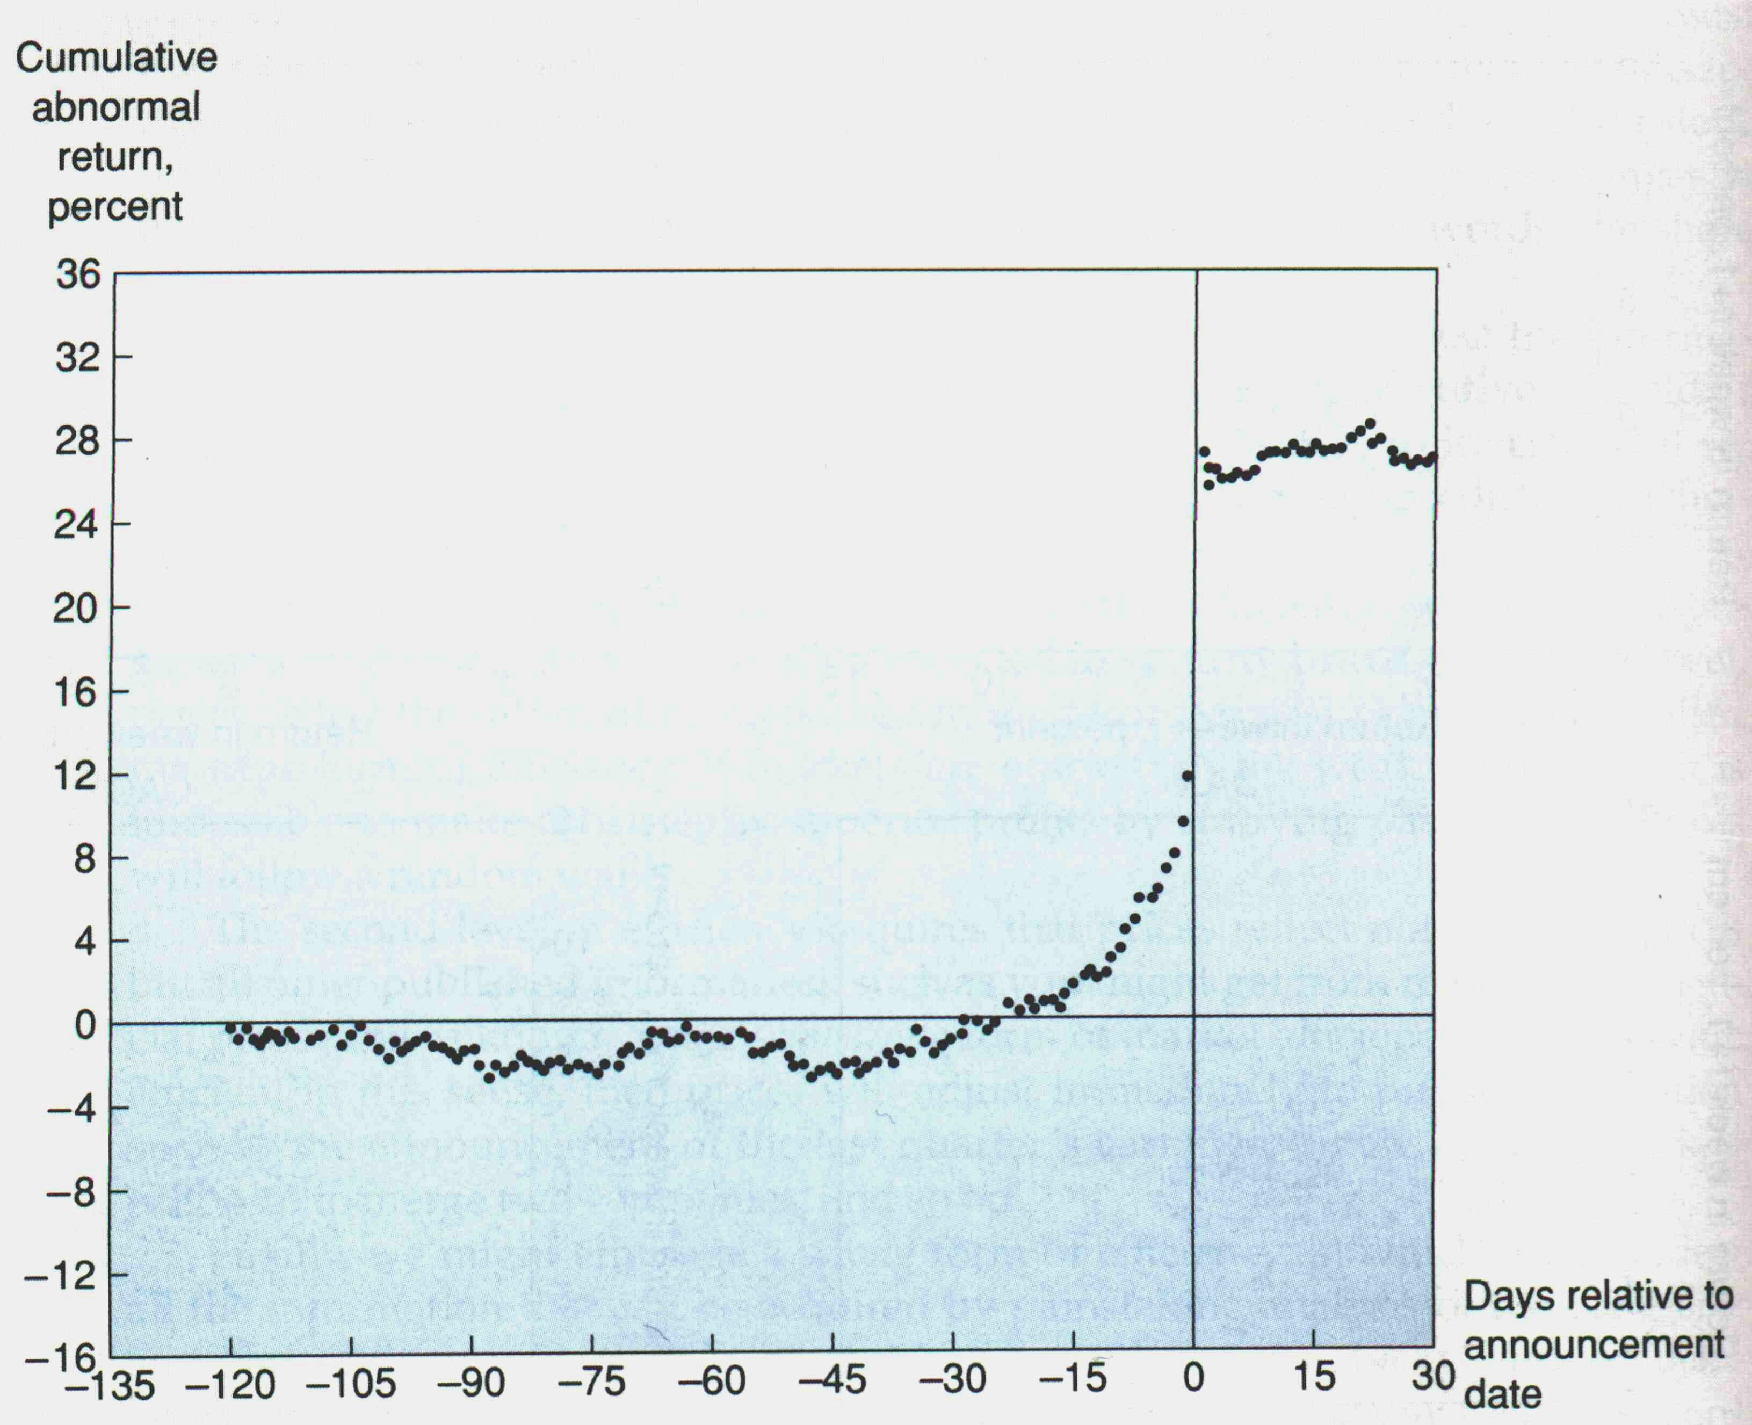
Event Study: Take-over
Source: Markus K. Brunnermeier (2015), “Lecture 10: Market Efficiency”, Finance 501: Asset Pricing, Princeton University

Slide 62
Event Study: Death of CEO
Source: Markus K. Brunnermeier (2015), “Lecture 10: Market Efficiency”, Finance 501: Asset Pricing, Princeton University

Slide 63
Evidence I: Predictabilities Studies
Statistical variables have only low forecasting power, but
  But some forecasting power for P/E or B/M
  Short-run momentum and long-run reversals
Calendar specific abnormal returns due to Monday effect, January effect etc.
CAVEAT: Data mining: Find variables with spurious forecasting power if we search enough
Source: Markus K. Brunnermeier (2015), “Lecture 10: Market Efficiency”, Finance 501: Asset Pricing, Princeton University

Slide 64
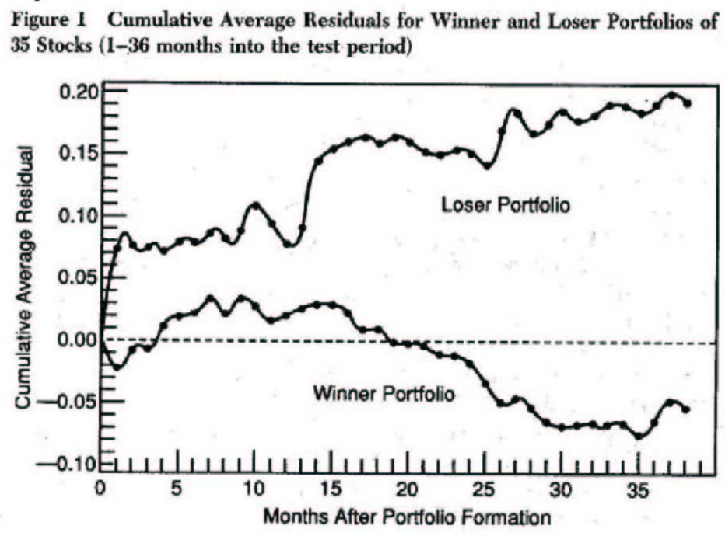
Long-Run Reversals
Long-run Reversals
Returns to previous 5 year’s
winner-loser stocks
(market adjusted returns)
Source: Markus K. Brunnermeier (2015), “Lecture 10: Market Efficiency”, Finance 501: Asset Pricing, Princeton University

Slide 65
Short-run Momentum
Momentum
Monthly Difference Between Winner and
Loser Portfolios at Announcement Dates
1.0%
0.5%
0.0%
Monthly Difference Between Winner and
25
31
33
35
Loser Portfolios
1
3
5
7
9
11
13
15
17
19
21
23
27
29
-0.5%
-1.0%
-1.5%
Months Following 6 Month Performance Period
Source: Markus K. Brunnermeier (2015), “Lecture 10: Market Efficiency”, Finance 501: Asset Pricing, Princeton University

Slide 66
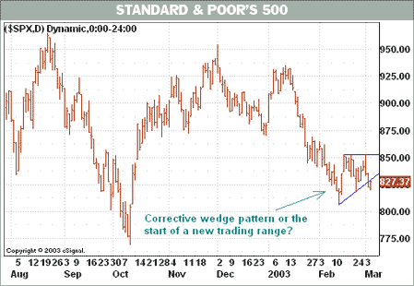
Getting Technical
Barron’s March 5, 2003
Source: Ross et al. (2005), "Corporate Finance", 7th Edition, McGraw−Hill

Slide 67
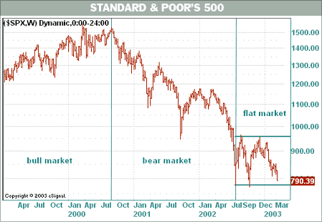
Getting Technical
Back to Buy Low, Sell High Barron’s March 12, 2003
Source: Ross et al. (2005), "Corporate Finance", 7th Edition, McGraw−Hill

Slide 68
What Pattern Do You See?
With different patterns, you may believe that you can predict the next value in the series—even though you know it is random.
Source: Ross et al. (2005), "Corporate Finance", 7th Edition, McGraw−Hill

Slide 69
Event Studies: Dividend Omissions
Efficient market response to “bad news”
S.H. Szewczyk, G.P. Tsetsekos, and Z. Santout “Do Dividend Omissions Signal Future Earnings or Past Earnings?” Journal of Investing (Spring 1997)
Source: Ross et al. (2005), "Corporate Finance", 7th Edition, McGraw−Hill

Slide 70
The Record of Mutual Funds
Taken from Lubos Pastor and Robert F. Stambaugh, “Evaluating and Investing in Equity Mutual Funds,” unpublished paper, Graduate School of Business, University of Chicago (March 2000).
Source: Ross et al. (2005), "Corporate Finance", 7th Edition, McGraw−Hill

Slide 71
Weak Form Market Efficiency
Security prices reflect all information found in past prices and volume.
If the weak form of market efficiency holds, then technical analysis is of no value.
Often weak-form efficiency is represented as
P_{t} = P_{t-1} + Expected return + random error t
Since stock prices only respond to new information, which by definition arrives randomly, stock prices are said to follow a random walk.
Source: Ross et al. (2005), "Corporate Finance", 7th Edition, McGraw−Hill
Notes:
Stock prices following a random walk is not the same thing as stock prices having random returns.

Slide 72
Market Efficiency
One group of studies of strong-form market efficiency investigates insider trading.
A number of studies support the view that insider trading is abnormally profitable.
Thus, strong-form efficiency does not seem to be substantiated by the evidence
Source: Ross et al. (2005), "Corporate Finance", 7th Edition, McGraw−Hill

Slide 73
Why Doesn’t Everybody Believe the EMH?
There are optical illusions, mirages, and apparent patterns in charts of stock market returns.
The truth is less interesting.
There is some evidence against market efficiency:
  Seasonality
  Small versus Large stocks
  Value versus growth stocks
The tests of market efficiency are weak.
Source: Ross et al. (2005), "Corporate Finance", 7th Edition, McGraw−Hill

Slide 74
Efficient Markets

Slide 75
Inefficient Markets

Slide 76
Behavioral Finance

Slide 77
Summary
Event Studies in Finance
Event Studies for Financial Research
Event Study Methodology
Efficient Market Hypothesis (EMH)
  Efficient Markets
  Inefficient Markets

Slide 78
References
Doron Kliger and Gregory Gurevich (2014), Event Studies for Financial Research: A Comprehensive Guide, Palgrave Macmillan
El Ghoul, Sadok, Omrane Guedhami, Sattar A. Mansi, and Oumar Sy (2022). "Event studies in international finance research." Journal of International Business Studies : 1-21.
Malkiel, B. G., & Fama, E. F. (1970), Efficient capital markets: A review of theory and empirical work. The Journal of Finance, 25(2), 383-417.
MacKinlay, A. C. (1997), Event studies in economics and finance. Journal of economic literature, 35(1), 13-39.
Ross et al. (2005), Corporate Finance, 7th Edition, McGraw−Hill
Richard H. Thaler (2016), Misbehaving: The Making of Behavioral Economics, W. W. Norton & Company
Lucy Ackert and Richard Deaves (2009), “Behavioral Finance: Psychology, Decision-Making, and Markets”, South-Western College Pub.
Hersh Shefrin (2007), “Beyond Greed and Fear: Understanding Behavioral Finance and the Psychology of Investing”, Oxford University Press.
Edwin Burton and Sunit N. Shah (2013), “Behavioral Finance: Understanding the Social, Cognitive, and Economic Debates”, Wiley.
Schertler, A. (2021). Listing of classical options and the pricing of discount certificates. Journal of Banking & Finance, 123.
Pandey, D. K., & Kumari, V. (2021). Event study on the reaction of the developed and emerging stock markets to the 2019-nCoV outbreak. International Review of Economics & Finance, 71, 467-483.
Naidu, D., & Ranjeeni, K. (2021). Effect of coronavirus fear on the performance of Australian stock returns: Evidence from an event study. Pacific-Basin Finance Journal, 66.
Cahill, D., Baur, D. G., Liu, Z. X., & Yang, J. W. (2020). I am a blockchain too: How does the market respond to companies' interest in blockchain? Journal of Banking & Finance, 113.
Loipersberger, F. (2018). The effect of supranational banking supervision on the financial sector: Event study evidence from Europe. Journal of Banking & Finance, 91, 34-48.
Lanfear, M. G., Lioui, A., & Siebert, M. G. (2019). Market anomalies and disaster risk: Evidence from extreme weather events. Journal of Financial Markets, 46.
Dutta, A., Knif, J., Kolari, J. W., & Pynnonen, S. (2018). A robust and powerful test of abnormal stock returns in long-horizon event studies. Journal of Empirical Finance, 47, 1-24.
Gu, X., Zhang, W. Q., & Cheng, S. (2021). How do investors in Chinese stock market react to external uncertainty? An event study to the Sino-US disputes. Pacific-Basin Finance Journal, 68.
Bohmann, M., Michayluk, D., Patel, V., & Walsh, K. (2019). Liquidity and earnings in event studies: Does data granularity matter? Pacific-Basin Finance Journal, 54, 118-131.
Fan, R., Talavera, O., & Tran, V. (2020). Social media bots and stock markets. European Financial Management, 26(3), 753-777.
Lee, J., & Ryu, D. (2019). The impacts of public news announcements on intraday implied volatility dynamics. Journal of Futures Markets, 39(6), 656-685.
Yves Hilpisch (2020), Artificial Intelligence in Finance: A Python-Based Guide, O’Reilly Media.
Aurélien Géron (2019), Hands-On Machine Learning with Scikit-Learn, Keras, and TensorFlow: Concepts, Tools, and Techniques to Build Intelligent Systems, 2nd Edition, O’Reilly Media.
Yves Hilpisch (2018), Python for Finance: Mastering Data-Driven Finance, 2nd Edition, O'Reilly Media.
Paolo Sironi (2016), “FinTech Innovation: From Robo-Advisors to Goal Based Investing and Gamification”, Wiley.
Chris Kelliher (2022), Quantitative Finance With Python: A Practical Guide to Investment Management, Trading, and Financial Engineering, Chapman and Hall/CRC.

Slide 79
References
Min-Yuh Day, Yensen Ni, Hung-Ching Hu (2025), "Data-driven profitability: Contrasting insights into TRB strategies in Taiwan and China stock markets", Applied Economics, 31 December, 2025, pp. 1-16.
Min-Yuh Day, Ching-Ying Yang, and Yensen Ni (2024), "Portfolio Dynamic Trading Strategies Using Deep Reinforcement Learning", Soft Computing, Volume 28, August 2024, pp. 8715–8730.
Yu-Sheng Kao, Min-Yuh Day, and Ke-Hsin Chou (2024), "A comparison of bitcoin futures return and return volatility based on news sentiment contemporaneously or lead-lag", The North American Journal of Economics and Finance, Volume 72, May 2024, 102159, pp. 1-22.
Min-Yuh Day and Yensen Ni (2023), "The Profitability of Seasonal Trading Timing: Insights from Energy-Related Markets", Energy Economics, Volume 128, December, 2023, 107132, pp. 1-12.
Min-Yuh Day and Yensen Ni (2023), "Be greedy when others are fearful: Evidence from a two-decade assessment of the NDX 100 and S&P 500 indexes", International Review of Financial Analysis, Volume 90, November 2023, 102856, pp. 1-13.
Ke-Hsin Chou, Min-Yuh Day*, and Chien-Liang Chiu (2023), "Do Bitcoin news information flow and return volatility fit the sequential information arrival hypothesis and the mixture of distribution hypothesis?", International Review of Economics and Finance, Volume 88, November 2023, pp. 365-385.
Min-Yuh Day, Paoyu Huang, Yi-Rung Cheng, and Yensen Ni (2023), "Can Investors Profit from Utilizing Technical Trading Rules during the COVID-19 Pandemic?", International Journal of Information Technology & Decision Making, Volume 22, Issue 6, November 2023, pp. 1893–1921.
Chien-Liang Chiu, Yensen Ni, Hung-Ching Hu, Min-Yuh Day, and Yuhsin Chen (2023), "Enhancing Crypto Success via Heatmap Visualization of Big Data Analytics for Numerous Variable Moving Average Strategies", Applied Sciences, Volume 13, Issue 23, November 2023, 12805, pp. 1-18.
Min-Yuh Day Paoyu Huang, Yirung Cheng and Yensen Ni (2023), "Investing Strategies for Trading Stocks as Overreaction Triggered by Technical Trading Rules with Big Data Concerns", Romanian Journal of Economic Forecasting, Volume 26, Issue 3, October 2023, pp. 148-161. [url]
Min-Yuh Day, Yensen Ni, Chinning Hsu, and Paoyu Huang (2023), "Visualizing profitability: A heatmap approach to evaluate Bitcoin futures trading using VMA trading rules", Heliyon, 21 October 2023, e21376.
Min-Yuh Day and Yensen Ni (2023), "Do clean energy indices outperform using contrarian strategies based on contrarian trading rules?", Energy, Volume 272, 1 June 2023, 127113, pp. 1-21.
Min-Yuh Day, Yirung Cheng, Paoyu Huang, and Yensen Ni (2023), "The Profitability of Bollinger Bands Trading Bitcoin Futures", Applied Economics Letters, Volume 30, Issue 11, June 2023, pp. 1437-1443.
Yuhsin Chen, Paoyu Huang, Min-Yuh Day, Yensen Ni, and Mei-Chu Liang (2023), "Using Heatmap Visualization to assess the performance of the DJ30 and NASDAQ100 Indices under diverse VMA trading rules", PLoS One, Volume 18, Issue 5, 11 May 2023, e0284918, pp. 1-16.
Min-Yuh Day, Yirung Cheng, Paoyu Huang, and Yensen Ni (2023), "The profitability of trading US stocks in Quarter 4 - evidence from trading signals emitted by SOI and RSI", Applied Economics Letters, Volume 30, Issue 9, May 2023, pp. 1173-1178.
Yensen Ni, Min-Yuh Day, Yi-Rung Cheng, and Paoyu Huang (2022), "Can Investors Profit by Utilizing Technical Trading Strategies? Evidence from Korean and Chinese Stock Markets", Financial Innovation, Volume 8, 54, June 2022, pp. 1-21.
Min-Yuh Day, Yensen Ni, Chinning Hsu, and Paoyu Huang (2022), "Do Investment Strategies Matter for Trading Global Clean Energy and Global Energy ETFs?", Energies, Volume 15, Number 9, 3 May 2022, 3328, pp. 1-15.
Min-Yuh Day, Pao-Yu Huang, Yirung Cheng, Yin-Tzu Lin, and Yensen Ni (2022), "Profitable day trading Bitcoin futures following continuous bullish (bearish) candlesticks", Applied Economics Letters, Volume 29, Issue 10, May 2022, pp. 947-954.
Chih-Chien Wang, Min-Yuh Day, and Chun-Lian Wu (2022), "Political Hate Speech Detection and Lexicon Building: A Study in Taiwan", IEEE Access, Volume 10, 21 March, 2022, pp. 44337-44346.
Kuei-Hui Cheng, Min-Yuh Day, and Hsiao-Lun Lin (2021), "The Impact of Revenue Key Audit Matters on the Difference between Self-declared and Audited Revenue", Taiwan Accounting Review, Volume 17, Number 2, December 2021, pp. 309-356.
Yulu Liao, Min-Yuh Day, Yirung Cheng, Paoyu Huang, and Yensen Ni (2021), "The profitability of Technical Trading for Hotel Stocks Under COVID-19 Pandemic", Journal of Computers, Volume 32, Number 5, October 2021, pp. 44-54.
Yulu Liao, Min-Yuh Day, Yirung Cheng, Paoyu Huang, and Yensen Ni (2021), "Does CBOE volatility index jumped or located at a higher level matter for evaluating DJ 30, NASDAQ, and S&P500 index subsequent performance", Journal of Computers, Volume 32, Number 4, August 2021, pp. 57-66.
Yensen Ni, Min-Yuh Day, and Paoyu Huang (2020), "Trading Stocks Following Sharp Movements in the USDX, GBP/USD, and USD/CNY", Financial Innovation, Volume 6, 35, September 2020, pp. 1-17.
Yensen Ni, Min-Yuh Day, Paoyu Huang, and Shang-Ru Yu (2020), "The profitability of Bollinger Bands: Evidence from the constituent stocks of Taiwan 50", Physica A: Statistical Mechanics and its Applications, Volume 551, 1 August 2020, 124144, pp. 1-14.
Yensen Ni, Paoyu Huang, Yaochia Ku, Yiching Liao, and Min-Yuh Day (2020), "Investing Strategies as Stochastic Oscillator Indicators Staying in Overreaction Zones for Consecutive Days with Big Data Concerns", Journal of Computers, Volume 31, Number 1, February 2020, pp. 1-17.
Yensen Ni, Manhwa Wu, Min-Yuh Day, and Paoyu Huang (2020), "Do sharp movements in oil prices matter for stock markets?", Physica A: Statistical Mechanics and its Applications, Volume 539, 1 February 2020, pp. 1-11.
Min-Yuh Day, Paoyu Huang, and Yensen Ni (2019), "Trading as sharp movements in oil prices and technical trading signals emitted with big data concerns", Physica A: Statistical Mechanics and its Applications, Volume 525, 1 July 2019, pp. 349-372.
Yensen Ni, Min-Yuh Day, and Paoyu Huang (2019), "Does Data Frequency Matter for Trading Signals Emitted by Various Technical Trading Rules? ", Pacific Business Review International, Volume 11, Issue 10, April 2019, pp. 7-17.
Min-Yuh Day, Manhwa Wu, Paoyu Huang, and Yensen Ni (2018), "Investing Strategies as a Sharp Movement in Exchange Rates Occurred– Evidence for the Constituent Stocks of SSE 50 and TW 50", The Journal of Investing, Volume 27, Issue 4, Winter 2018, pp. 58-68.
Min-Yuh Day, Paoyu Huang, Yensen Ni, and Yuhsin Chen (2018), "Do Implicit Phenomena Matter? Evidence from China Stock Index Futures", The Journal of Alternative Investments, Volume 21, Issue 1, Summer 2018, pp. 79-91.
Yensen Ni, Yirung Cheng, Paoyu Huang, and Min-Yuh Day (2018), "Trading strategies in terms of continuous rising (falling) prices or continuous bullish (bearish) candlesticks emitted", Physica A: Statistical Mechanics and its Applications, Volume 501, 1 July 2018, pp. 188-204.
Min-Yuh Day, Paoyu Huang, Yensen Ni, and Yuhsin Chen (2018), "Do Intraday Large Price Changes Matter for Trading Index Futures? Evidence from China Futures Markets", Journal of Financial Studies, Volume 26, Number 2, June 2018, pp. 139-174.

