Slide 1










Finance Theory and
Data-Driven Finance
Artificial Intelligence in Finance and Quantitative Analysis
1142AIFQA05
MBA, IM, NTPU (M5147) (Spring 2026)
Tue 5, 6, 7 (13:10-16:00) (B3F17)
University Ambassador
Certified Instructor
Min-Yuh Day, Ph.D,
Professor and Director
Institute of Information Management, National Taipei University
https://web.ntpu.edu.tw/~myday
https://meet.google.com/miy-fbif-max
2026-03-31

Slide 2
Syllabus
Week Date Subject/Topics
1 2026/02/24 Introduction to Artificial Intelligence in Finance and
Quantitative Analysis
2 2026/03/03 AI in FinTech: Metaverse, Web3, DeFi, NFT, Generative AI
and Agentic AI for Financial Innovation Applications
3 2026/03/10 Investing Psychology and Behavioral Finance
4 2026/03/17 Event Studies in Finance
5 2026/03/24 Case Study on AI in Finance and Quantitative Analysis I
6 2026/03/31 Finance Theory and Data-Driven Finance

Slide 3
Syllabus
Week Date Subject/Topics
7 2026/04/07 Make-up holiday for NTPU Sports Day (No Classes)
8 2026/04/14 Midterm Project Report
9 2026/04/21 Financial Econometrics
10 2026/04/28 AI-First Finance
11 2026/05/05 Industry Practices of AI in Finance and
Quantitative Analysis
12 2026/05/12 Case Study on AI in Finance and Quantitative Analysis II

Slide 4
Syllabus
Week Date Subject/Topics
13 2026/05/19 Deep Learning in Finance;
Reinforcement Learning in Finance;
Generative AI and Agentic AI in Finance
14 2026/05/26 Algorithmic Trading;
Risk Management;
Trading Bot and Event-Based Backtesting
15 2026/06/02 Final Project Report I
16 2026/06/09 Final Project Report II

Slide 5
Financial Theories and
Data-Driven Finance

Slide 6
Financial Theories and
Data-Driven Finance
Financial Theories
  Uncertainty and Risk
  Expected Utility Theory (EUT)
  Mean-Variance Portfolio Theory (MVPT)
  Capital Asset Pricing Model (CAPM)
  Arbitrage Pricing Theory (APT)
Data-Driven Finance
  Scientific Method
  Financial Econometrics and Regression
  Data Availability

Slide 7
AI Agents in
Financial Markets

Slide 8
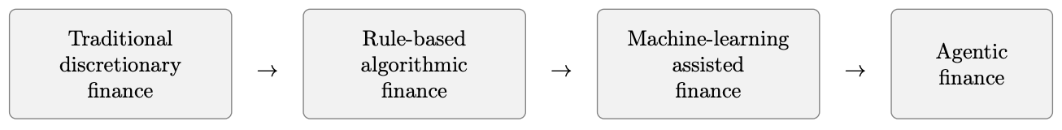
Financial AI: from Rule-based Execution to
Agentic Financial Systems
Source: Hui Gong (2026) "AI Agents in Financial Markets: Architecture, Applications, and Systemic Implications." arXiv preprint arXiv:2603.13942.

Slide 9
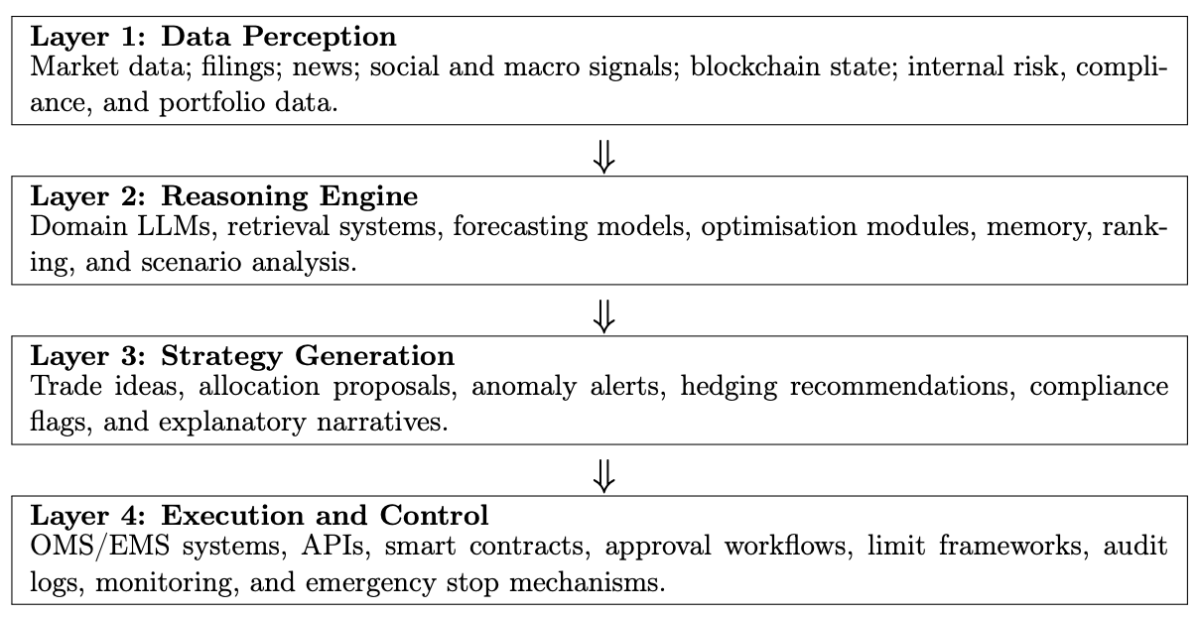
A Four-layer Architecture for
AI Agents in Financial Markets
Source: Hui Gong (2026) "AI Agents in Financial Markets: Architecture, Applications, and Systemic Implications." arXiv preprint arXiv:2603.13942.

Slide 10
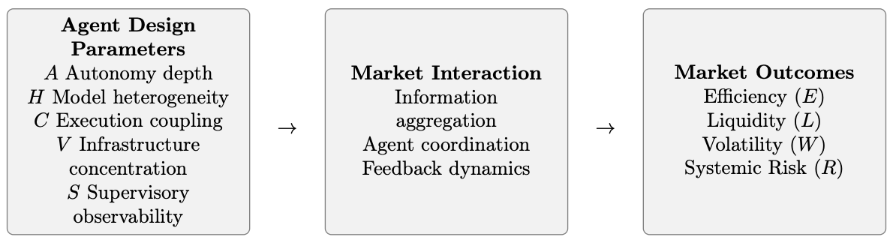
Conceptual Structure of the
Agentic Financial Market Model (AFMM)
Source: Hui Gong (2026) "AI Agents in Financial Markets: Architecture, Applications, and Systemic Implications." arXiv preprint arXiv:2603.13942.

Slide 11
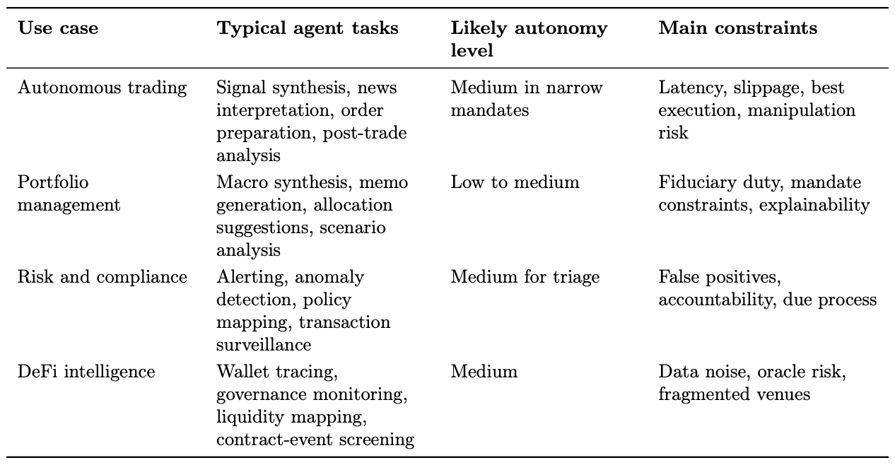
Application Map for AI Agents in Finance
Source: Hui Gong (2026) "AI Agents in Financial Markets: Architecture, Applications, and Systemic Implications." arXiv preprint arXiv:2603.13942.

Slide 12
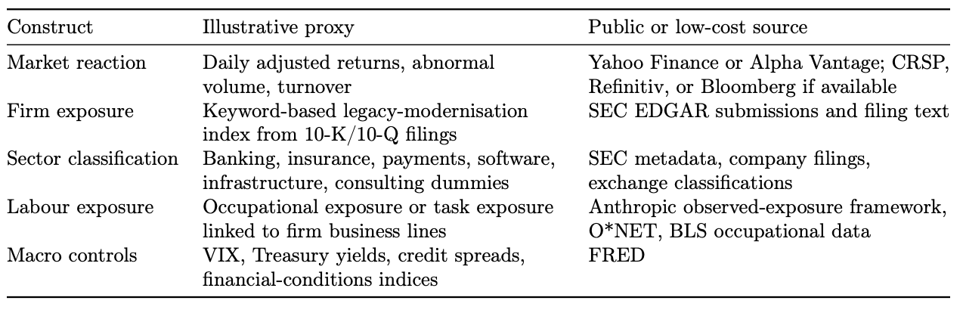
AI Agents in Financial Markets
Data Structure for the Empirical Application
Source: Hui Gong (2026) "AI Agents in Financial Markets: Architecture, Applications, and Systemic Implications." arXiv preprint arXiv:2603.13942.

Slide 13
Financial Theories

Slide 14
Financial Theories
Uncertainty and Risk
Expected Utility Theory (EUT)
Mean-Variance Portfolio Theory (MVPT)
Capital Asset Pricing Model (CAPM)
Arbitrage Pricing Theory (APT)
Source: Yves Hilpisch (2020), Artificial Intelligence in Finance: A Python-Based Guide, O’Reilly Media.

Slide 15
Major Normative Financial
Theories and Models
Normative Theory
  Based on assumptions (mathematically, axioms) and derives insights, results, and more from the set of relevant assumptions.
Positive theory
  Based on observation, experiments, data, relationships, and the like and describes phenomena given the insights gained from the available information and the derived results.
Source: Yves Hilpisch (2020), Artificial Intelligence in Finance: A Python-Based Guide, O’Reilly Media.

Slide 16
Normative Finance
The CAPM is based on many unrealistic assumptions.
  The assumption that investors care only about the mean and variance of one-period portfolio returns is extreme.
  (Eugene Fama and Kenneth French, 2004)
Source: Yves Hilpisch (2020), Artificial Intelligence in Finance: A Python-Based Guide, O’Reilly Media.

Slide 17
Uncertainty and Risk
Financial theory deals with investment, trading, and valuation in the presence of uncertainty and risk.
The focus is on fundamental concepts from probability theory that build the backbone of quantitative finance.
Source: Yves Hilpisch (2020), Artificial Intelligence in Finance: A Python-Based Guide, O’Reilly Media.

Slide 18
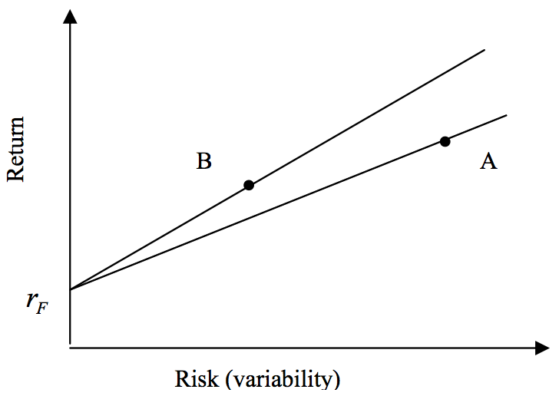
Risk and Return
Source: Bacon, Carl. "How sharp is the Sharpe-ratio?-Risk-adjusted Performance Measures." Statpro White Paper (2000).

Slide 19
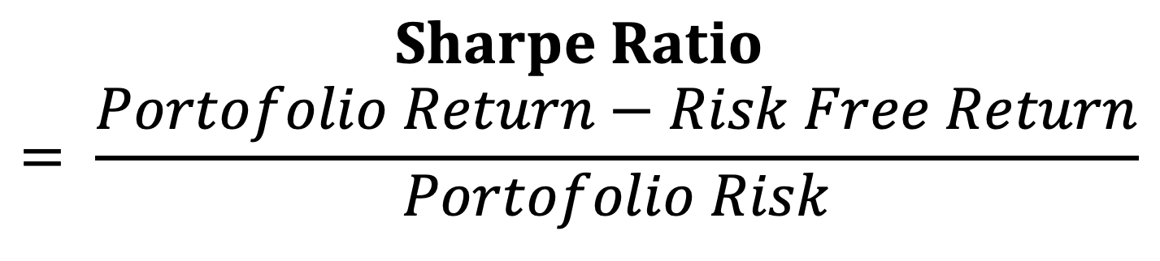
Sharpe Ratio
$$Sharpe Ratio= \frac{Portofolio Return−Risk Free Return}{Portofolio Risk}$$
Source: Bacon, Carl. "How sharp is the Sharpe-ratio?-Risk-adjusted Performance Measures." Statpro White Paper (2000).

Slide 20
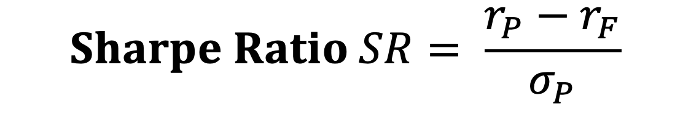
Sharpe Ratio
$$Sharpe Ratio SR= \frac{r_{P}−r_{F}}{σ_{P}}$$
Where
r_{P} = portfolio return
r_{F} = risk free rate
σ_{P} = portfolio risk
(variability, standard deviation of return)
Source: Bacon, Carl. "How sharp is the Sharpe-ratio?-Risk-adjusted Performance Measures." Statpro White Paper (2000).

Slide 21
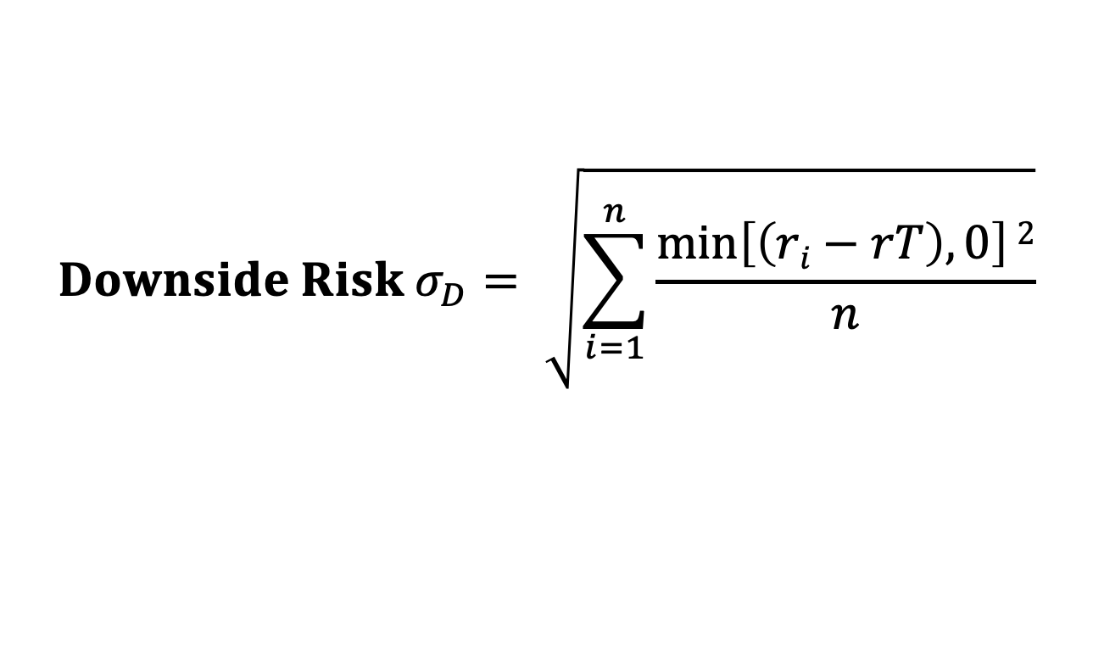
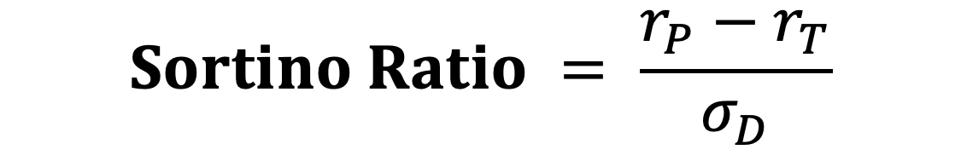
Sortino Ratio
$$Sortino Ratio = \frac{r_{P}−r_{T}}{σ_{D}}$$
Where
r_{P} = portfolio return
r_{T} = Minimum Target Return
σ_{D} = Downside Risk
$$Downside Risk{ σ}_{D}= \sqrt{\sum_{i=1}^{n}{\frac{\min\left[\left(ri−rT\right),0\right]2}{n}}}$$
Source: Bacon, Carl. "How sharp is the Sharpe-ratio?-Risk-adjusted Performance Measures." Statpro White Paper (2000).

Slide 22
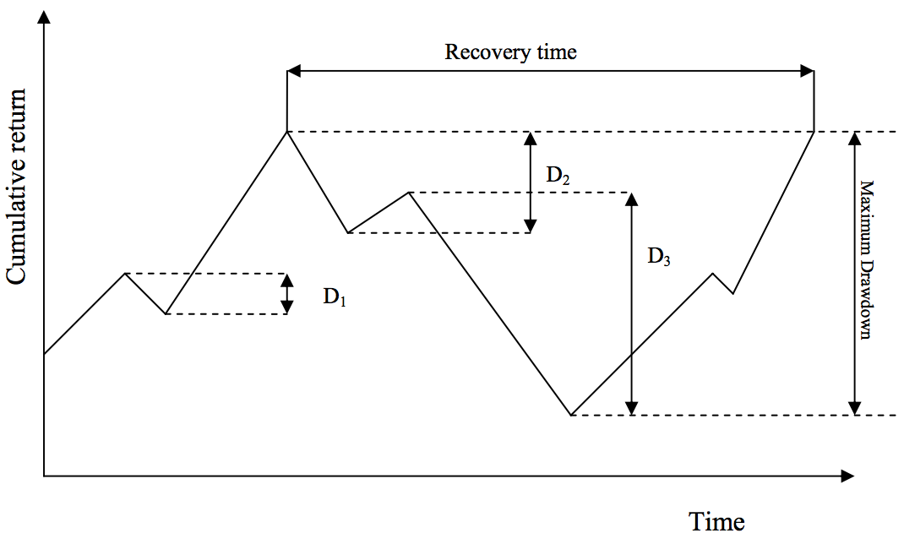
Max Drawdown
Source: Bacon, Carl. "How sharp is the Sharpe-ratio?-Risk-adjusted Performance Measures." Statpro White Paper (2000).

Slide 23
Traded Assets
In the economy, two assets are traded.
  The first is a risky asset, the stock, with a certain price today of S₀ = 10 and an uncertain payoff tomorrow.
  The second is a risk-less asset, the bond, with a certain price today of B₀ = 10 and a certain payoff tomorrow.
Source: Yves Hilpisch (2020), Artificial Intelligence in Finance: A Python-Based Guide, O’Reilly Media.

Slide 24
Arbitrage Pricing
Deriving the fair value of a European call option on the stock with a strike price of K = 14.5
Arbitrage pricing theory can be considered one of the strongest financial theories with some of the most robust mathematical results, such as the fundamental theorem of asset pricing (FTAP).
Source: Yves Hilpisch (2020), Artificial Intelligence in Finance: A Python-Based Guide, O’Reilly Media.

Slide 25
Expected Utility Theory
(EUT)
Expected utility theory (EUT)
  1940s
  cornerstone of financial theory
  One of the central paradigms for
  modeling decision making under uncertainty
Source: Yves Hilpisch (2020), Artificial Intelligence in Finance: A Python-Based Guide, O’Reilly Media.

Slide 26
Expected Utility Theory
Expected utility theory (EUT)
  EUT is an axiomatic theory
    von Neumann and Morgenstern (1944)
  Axiomatic
    Major results of the theory can be deduced from a small number of axioms only
Axioms and normative theory
  An axiom is a proposition regarded as
  self-evidently true without proof.
Source: Yves Hilpisch (2020), Artificial Intelligence in Finance: A Python-Based Guide, O’Reilly Media.

Slide 27
Preferences of an Agent
Assume an agent with preferences ⪰ is faced with the problem of investing in the two traded assets of the model economy M².
One possible set of axioms leading to EUT
  Completeness
  Transitivity
  Continuity
  Independence
  Dominance
Source: Yves Hilpisch (2020), Artificial Intelligence in Finance: A Python-Based Guide, O’Reilly Media.

Slide 28
Utility functions
A utility function is a way to represent the preferences ⪰ of an agent in a mathematical and numerical way in that such a function assigns a numerical value to a certain payoff.
Source: Yves Hilpisch (2020), Artificial Intelligence in Finance: A Python-Based Guide, O’Reilly Media.

Slide 29
Expected Utility Functions
Von Neumann and Morgenstern (1944) show that if the preferences of an agent ⪰ satisfy the preceding five axioms, then there exists an expected utility function.
Source: Yves Hilpisch (2020), Artificial Intelligence in Finance: A Python-Based Guide, O’Reilly Media.

Slide 30
Risk aversion
In finance, the concept of risk aversion is important.
The most commonly used measure of risk aversion is the Arrow-Pratt measure of
absolute risk aversion (ARA) (Pratt, 1964).
  ARA(x) > 0, risk‐averse
  ARA(x) = 0, risk‐neutral
  ARA(x) < 0, risk‐loving
Source: Yves Hilpisch (2020), Artificial Intelligence in Finance: A Python-Based Guide, O’Reilly Media.

Slide 31
Mean-Variance Portfolio Theory (MVPT)
Mean-variance portfolio (MVP) theory
  Markowitz (1952)
  cornerstone in financial theory
One of the first theories of investment under uncertainty that focused on statistical measures only for the construction of stock investment portfolios.
MVP completely abstracts from fundamentals of a company that might drive its stock performance or assumptions about the future competitiveness of a company that might be important for the growth prospects of a company.
Source: Yves Hilpisch (2020), Artificial Intelligence in Finance: A Python-Based Guide, O’Reilly Media.

Slide 32
Mean-Variance Portfolio Theory (MVPT)
The only input data that counts is the time series of share prices and statistics derived therefrom,
such as the (historical) annualized mean return and the (historical) annualized variance of the returns.
The central assumption of MVP, according to Markowitz (1952), is that investors only care about expected returns and the variance of these returns.
Source: Yves Hilpisch (2020), Artificial Intelligence in Finance: A Python-Based Guide, O’Reilly Media.

Slide 33
Mean-Variance Portfolio Theory (MVPT)
Portfolio statistics
  returns vector
  expected return
  vector of expected returns
  expected return of the portfolio
  covariance matrix
  expected variance of the portfolio
  expected volatility of the portfolio
Source: Yves Hilpisch (2020), Artificial Intelligence in Finance: A Python-Based Guide, O’Reilly Media.

Slide 34
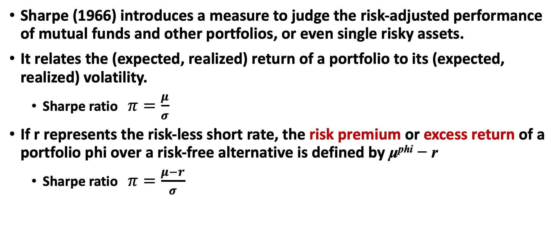
Sharpe ratio
Sharpe (1966) introduces a measure to judge the risk-adjusted performance of mutual funds and other portfolios, or even single risky assets.
It relates the (expected, realized) return of a portfolio to its (expected, realized) volatility.
  Sharpe ratio $π=\frac{μ}{σ}$
If r represents the risk-less short rate, the risk premium or excess return of a portfolio phi over a risk-free alternative is defined by μ^{phi} − r
  Sharpe ratio $π=\frac{μ−r}{σ}$
Source: Yves Hilpisch (2020), Artificial Intelligence in Finance: A Python-Based Guide, O’Reilly Media.

Slide 35
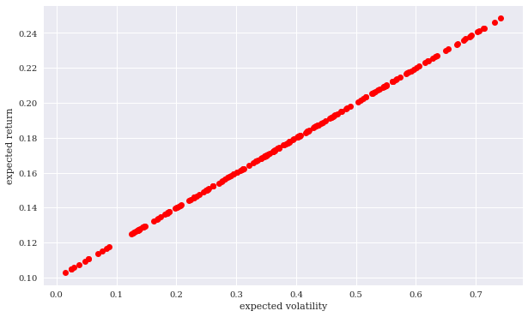
Investment Opportunity Set
Simulated expected portfolio volatility and return (one risky asset)
Source: Yves Hilpisch (2020), Artificial Intelligence in Finance: A Python-Based Guide, O’Reilly Media.

Slide 36
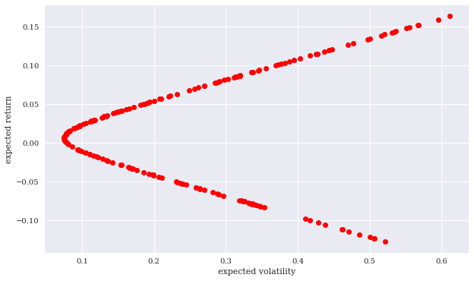
Investment Opportunity Set
Simulated expected portfolio volatility and return (two risky assets)
Source: Yves Hilpisch (2020), Artificial Intelligence in Finance: A Python-Based Guide, O’Reilly Media.

Slide 37
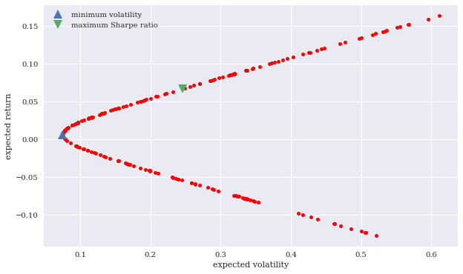
Minimum volatility and maximum Sharpe ratio portfolios
Source: Yves Hilpisch (2020), Artificial Intelligence in Finance: A Python-Based Guide, O’Reilly Media.

Slide 38
Efficient Frontier
An efficient portfolio
  has a maximum expected return (risk) given its expected risk (return)
All those portfolios that have a lower expected return than the minimum risk portfolio are inefficient.
Efficient frontier
  The set of all efficient portfolios
  Agents will only choose a portfolio that lies on the efficient frontier
Source: Yves Hilpisch (2020), Artificial Intelligence in Finance: A Python-Based Guide, O’Reilly Media.

Slide 39
Portfolio Optimization
Efficient Frontier
Efficient Frontier
Return
Risk
Source: Tucker Balch (2012), Investment Science: Portfolio Optimization, https://www.youtube.com/watch?v=5qbMhXXq0vI

Slide 40
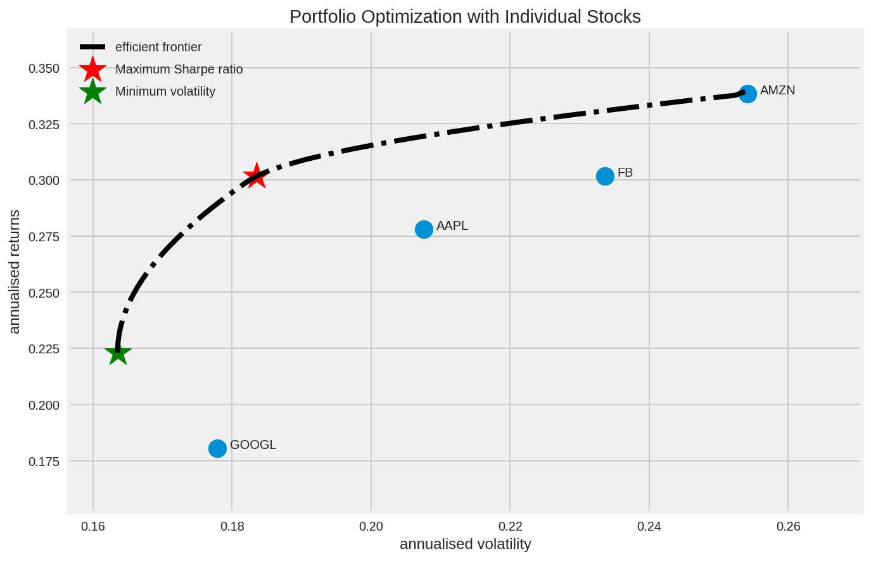
Portfolio Optimization
Efficient Frontier
https://tinyurl.com/aintpupython101

Slide 41
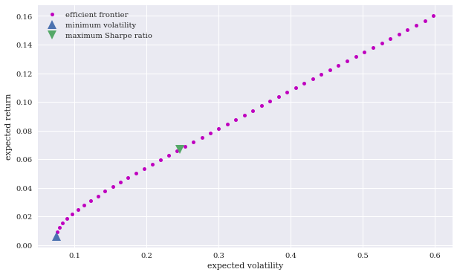
Efficient Frontier
Source: Yves Hilpisch (2020), Artificial Intelligence in Finance: A Python-Based Guide, O’Reilly Media.

Slide 42
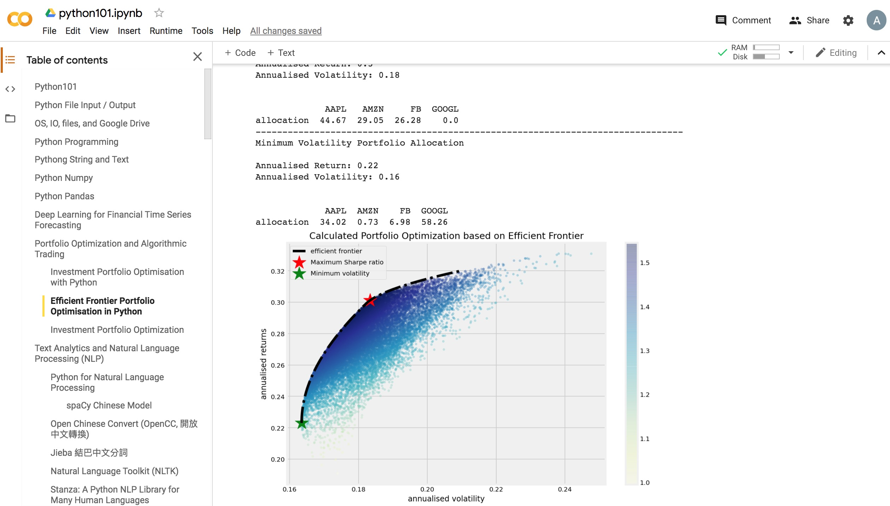
Portfolio Optimization and
Algorithmic Trading
https://colab.research.google.com/drive/1FEG6DnGvwfUbeo4zJ1zTunjMqf2RkCrT
https://tinyurl.com/aintpupython101

Slide 43
Capital Asset Pricing Model
(CAPM)
Capital Asset Pricing Model (CAPM)
  One of the most widely documented and applied models in finance
  It relates in linear fashion the expected return for a single stock to the expected return of the market portfolio, usually approximated by a broad stock index such as the S&P 500.
  Sharpe (1964) and Lintner (1965)
Source: Yves Hilpisch (2020), Artificial Intelligence in Finance: A Python-Based Guide, O’Reilly Media.

Slide 44
Capital Asset Pricing Model
(CAPM)
Capital asset prices: A theory of market equilibrium under conditions of risk
WF Sharpe - The journal of finance, 1964 - Wiley Online Library
ONE OF THE PROBLEMS which has plagued those attempting to predict the behavior of
capital markets is the absence of a body of positive microeconomic theory dealing with
conditions of risk. Although many useful insights can be obtained from the traditional models
of investment under conditions of certainty, the pervasive influence of risk in financial
transactions has forced those working in this area to adopt models of price behavior which
are little more than assertions. A typical classroom explanation of the determination of …
Cite Cited by 30490 Related articles All 26 versions
Source: Sharpe, William F. "Capital asset prices: A theory of market equilibrium under conditions of risk." The journal of finance 19, no. 3 (1964): 425-442.

Slide 45
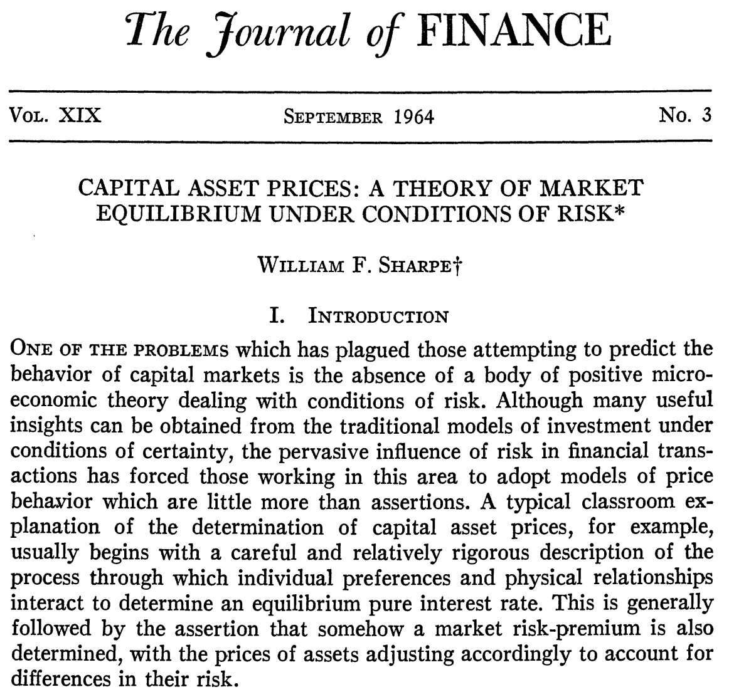
Capital Asset Pricing Model (CAPM)
Source: Sharpe, William F. "Capital asset prices: A theory of market equilibrium under conditions of risk." The journal of finance 19, no. 3 (1964): 425-442.

Slide 46
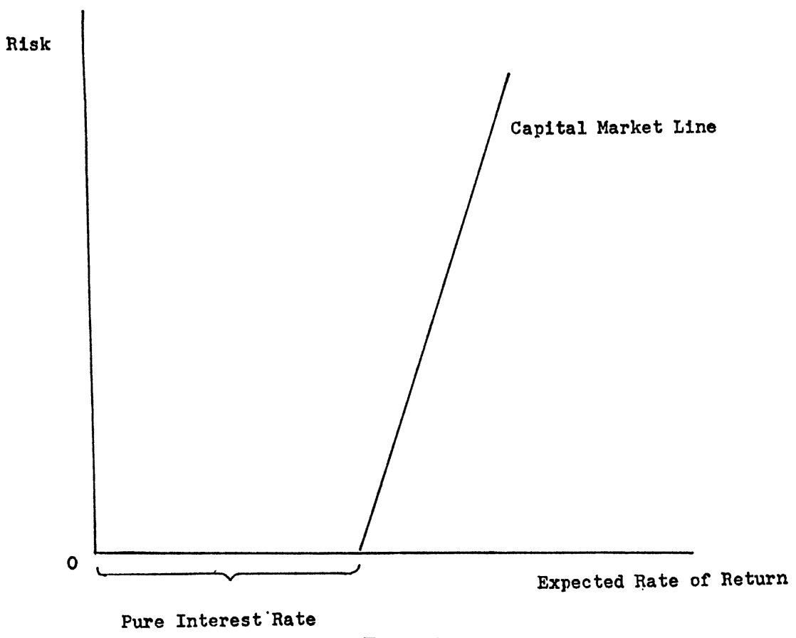
Capital Asset Pricing Model (CAPM)
Source: Sharpe, William F. "Capital asset prices: A theory of market equilibrium under conditions of risk." The journal of finance 19, no. 3 (1964): 425-442.

Slide 47
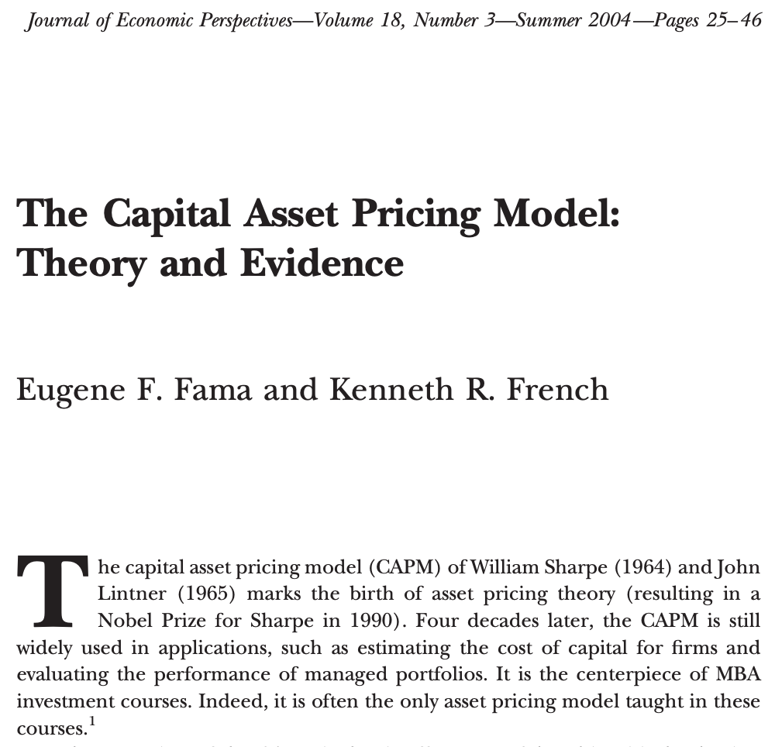
Capital Asset Pricing Model (CAPM)
Source: Fama, Eugene F., and Kenneth R. French. "The capital asset pricing model: Theory and evidence." Journal of economic perspectives 18, no. 3 (2004): 25-46.

Slide 48
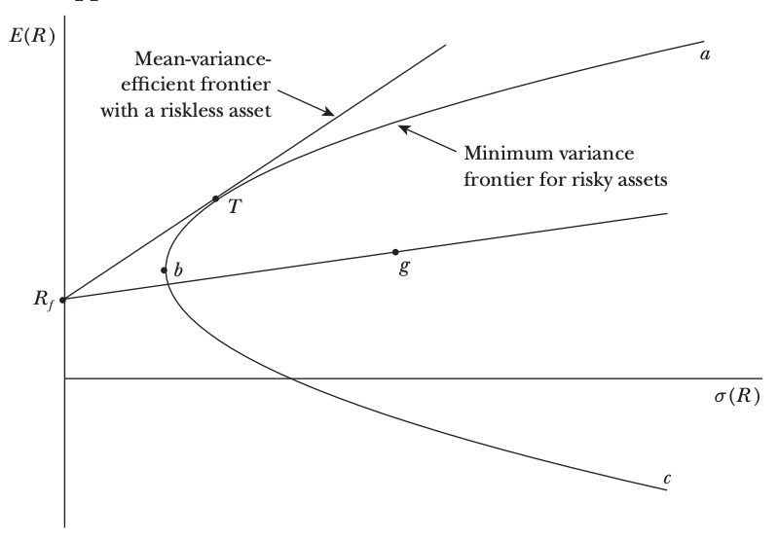
Investment Opportunities
Source: Fama, Eugene F., and Kenneth R. French. "The capital asset pricing model: Theory and evidence." Journal of economic perspectives 18, no. 3 (2004): 25-46.

Slide 49
Capital Asset Pricing Model
(CAPM)
E(R_{i}) = R_{f} + 𝛃_{iM} [E(R_{M}) - R_{f}]
The expected return on any asset i
is the risk-free interest rate, R_{f}, plus a risk premium,
which is the asset’s market beta, 𝛃_{iM} ,
times the premium per unit of beta risk, E(R_{M})-R_{f}
Source: Fama, Eugene F., and Kenneth R. French. "The capital asset pricing model: Theory and evidence." Journal of economic perspectives 18, no. 3 (2004): 25-46.

Slide 50
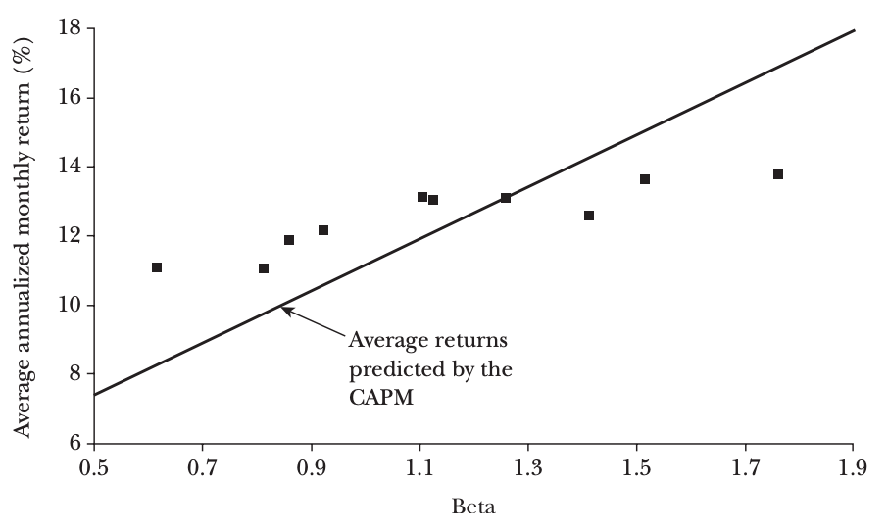
Capital Asset Pricing Model (CAPM)
Average Annualized Monthly Return versus Beta for Value Weight Portfolios Formed on Prior Beta, 1928–2003
Source: Fama, Eugene F., and Kenneth R. French. "The capital asset pricing model: Theory and evidence." Journal of economic perspectives 18, no. 3 (2004): 25-46.

Slide 51
Capital Asset Pricing Model
(CAPM)
Capital market theory is a positive theory in that it hypothesizes how investors do behave rather than how investors should behave, as in the case of modern portfolio theory (MVP)
  It is reasonable to view capital market theory as an extension of portfolio theory, but it is important to understand that MVP is not based on the validity, or lack thereof, of capital market theory.
Source: Yves Hilpisch (2020), Artificial Intelligence in Finance: A Python-Based Guide, O’Reilly Media.

Slide 52
Capital Asset Pricing Model
(CAPM)
The specific equilibrium model of interest to many investors is known as the capital asset pricing model, typically referred to as the CAPM.
  It allows us to assess the relevant risk of an individual security as well as to assess the relationship between risk and the returns expected from investing.
  The CAPM is attractive as an equilibrium model because of its simplicity and its implications.
Source: Yves Hilpisch (2020), Artificial Intelligence in Finance: A Python-Based Guide, O’Reilly Media.

Slide 53
Capital Asset Pricing Model
(CAPM)
In the CAPM, agents are assumed to invest according to MVP, caring only about the risk and return statistics of risky assets over one period.
In a capital market equilibrium, all available assets are held by all agents and the markets clear.
Market portfolio (set of tradable assets) must lie on the efficient frontier.
Two fund separation theorem
  Every agent will hold a combination of the market portfolio and the risk-free asset in equilibrium.
  The set of all such portfolios is called the Capital Market Line (CML).
Source: Yves Hilpisch (2020), Artificial Intelligence in Finance: A Python-Based Guide, O’Reilly Media.

Slide 54
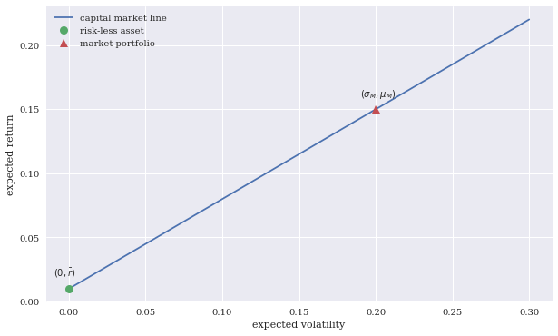
Capital Market Line (CML)
Source: Yves Hilpisch (2020), Artificial Intelligence in Finance: A Python-Based Guide, O’Reilly Media.

Slide 55
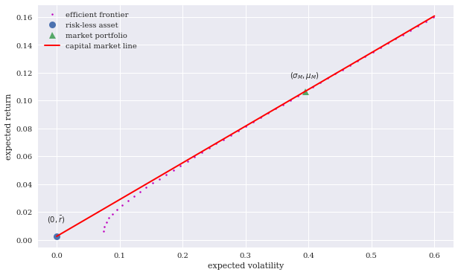
Capital Market Line with Two Risky Assets
Source: Yves Hilpisch (2020), Artificial Intelligence in Finance: A Python-Based Guide, O’Reilly Media.

Slide 56
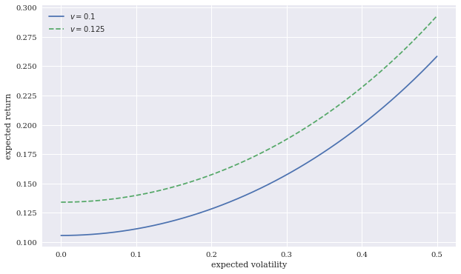
Indifference curves in risk-return space
Source: Yves Hilpisch (2020), Artificial Intelligence in Finance: A Python-Based Guide, O’Reilly Media.

Slide 57
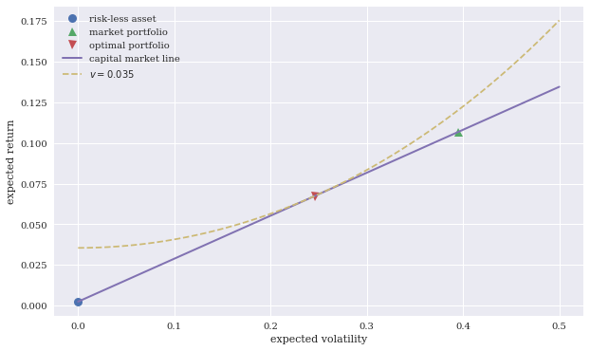
Optimal Portfolio on the
Capital Market Line (CML)
Source: Yves Hilpisch (2020), Artificial Intelligence in Finance: A Python-Based Guide, O’Reilly Media.

Slide 58
Arbitrage Pricing Theory
(APT)
Arbitrage Pricing Theory (APT)
  One of the major generalizations of the
  Capital Asset Pricing Model (CAPM)
  Ross (1971) and Ross (1976)
  The purpose of this paper is to examine rigorously the arbitrage model of capital asset pricing developed in Ross (1971).
    The arbitrage model was proposed as an alternative to the mean variance capital asset pricing model, introduced by Sharpe, Lintner, and Treynor, that has become the major analytic tool for explaining phenomena observed in capital markets for risky assets.
Source: Yves Hilpisch (2020), Artificial Intelligence in Finance: A Python-Based Guide, O’Reilly Media.

Slide 59
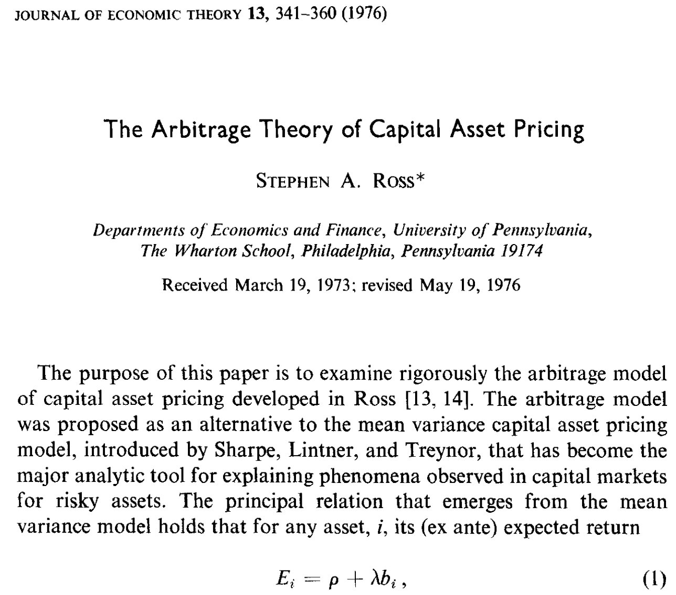
Arbitrage Pricing Theory (APT)
Source: Ross, Stephen A. "The arbitrage theory of capital asset pricing." Journal of Economic Theory 13, no. 3 (1976): 341-360.

Slide 60
Arbitrage Pricing Theory
(APT)
The APT is a generalization of the CAPM to multiple risk factors.
APT does not assume that the market portfolio is the only relevant risk factor
  There are rather multiple types of risk that together are assumed to drive the performance (expected returns) of a stock.
  Such risk factors might include size, volatility, value, and momentum.
Source: Yves Hilpisch (2020), Artificial Intelligence in Finance: A Python-Based Guide, O’Reilly Media.

Slide 61
Capital Asset Pricing Model (CAPM)
Arbitrage Pricing Theory (APT)
Capital Asset Pricing Model (CAPM)
  univariate ordinary least-squares (OLS) regression
Arbitrage Pricing Theory (APT)
  multivariate ordinary least-squares (OLS) regression
Source: Yves Hilpisch (2020), Artificial Intelligence in Finance: A Python-Based Guide, O’Reilly Media.

Slide 62
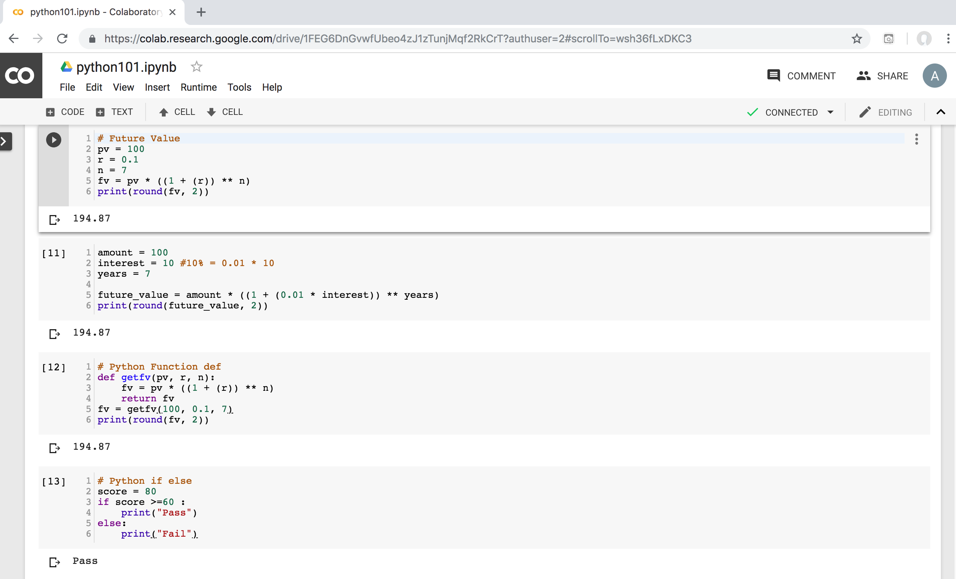
Python in Google Colab (Python101)
https://colab.research.google.com/drive/1FEG6DnGvwfUbeo4zJ1zTunjMqf2RkCrT
https://tinyurl.com/aintpupython101

Slide 63
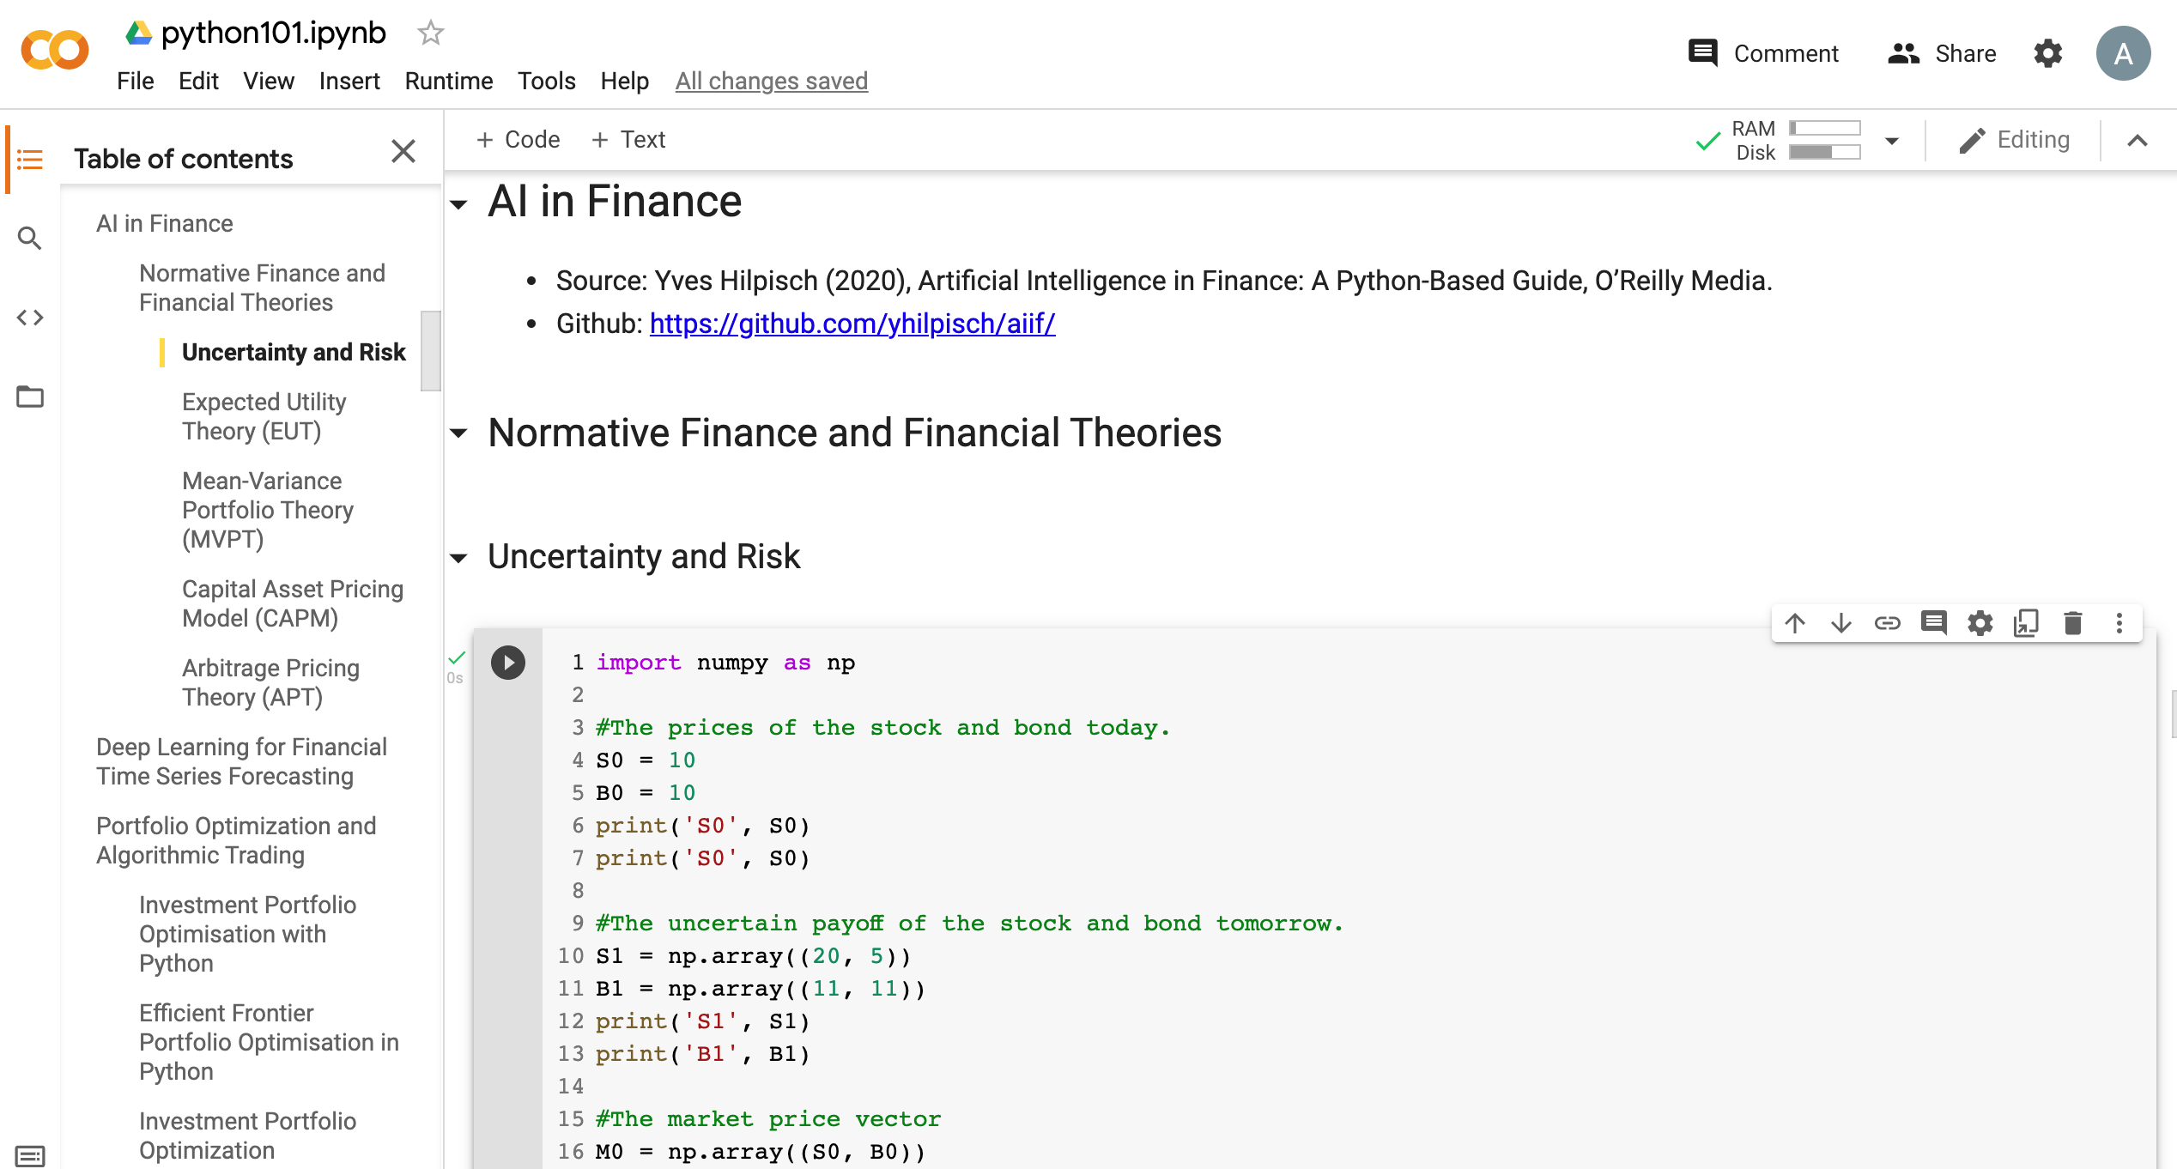
Python in Google Colab (Python101)
https://colab.research.google.com/drive/1FEG6DnGvwfUbeo4zJ1zTunjMqf2RkCrT
https://tinyurl.com/aintpupython101

Slide 64
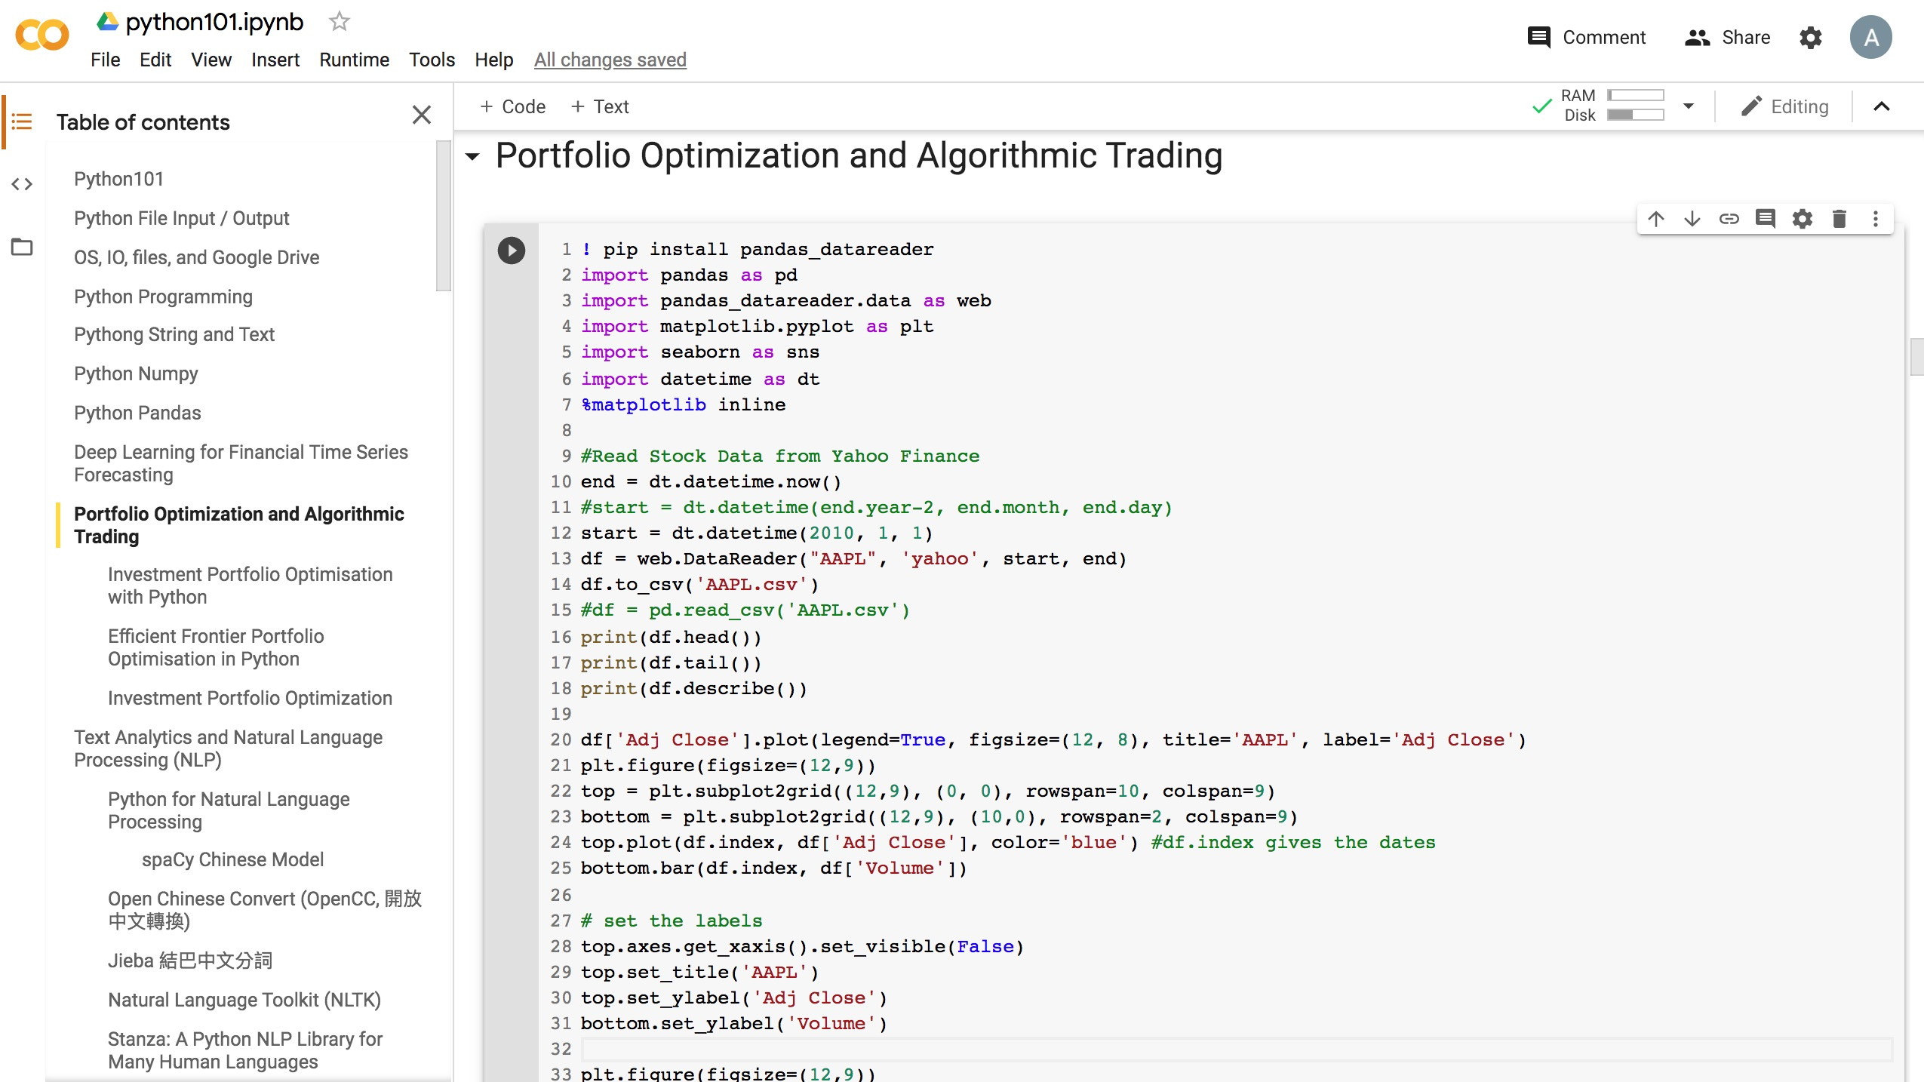
Python in Google Colab (Python101)
https://colab.research.google.com/drive/1FEG6DnGvwfUbeo4zJ1zTunjMqf2RkCrT
https://tinyurl.com/aintpupython101

Slide 65
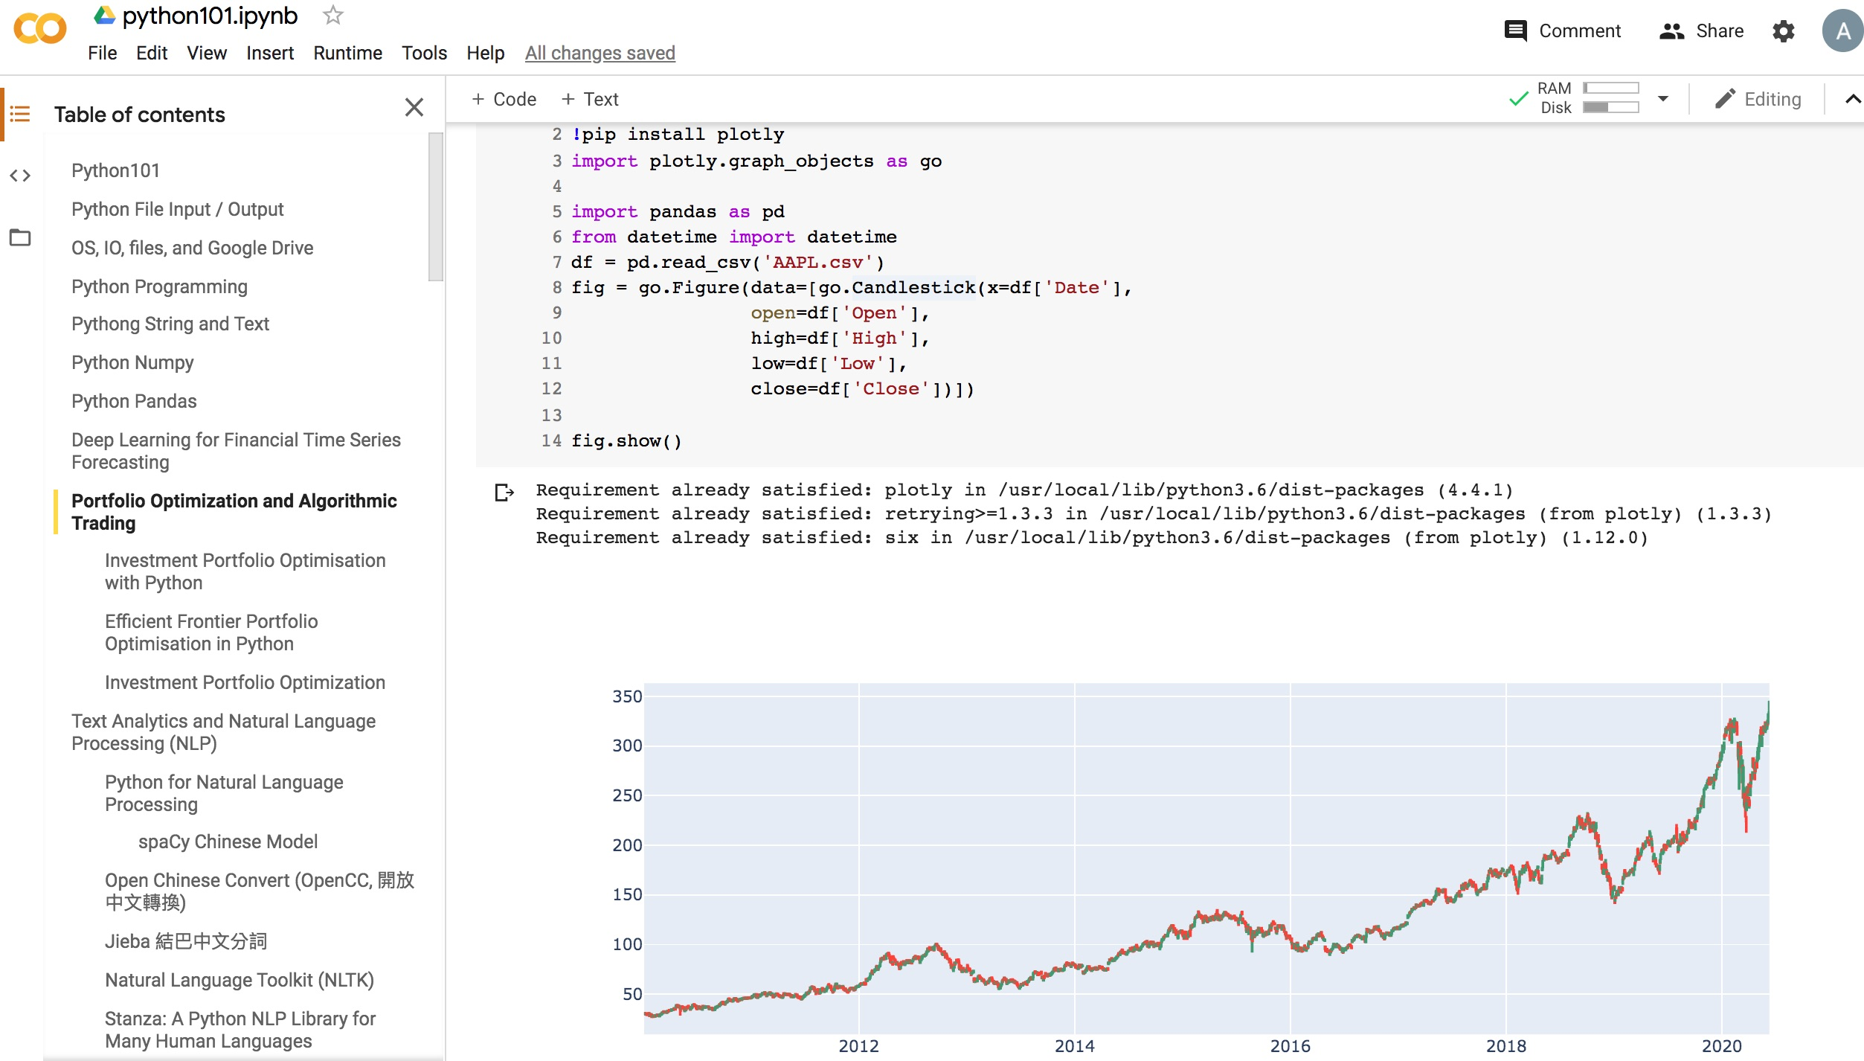
Python in Google Colab (Python101)
https://colab.research.google.com/drive/1FEG6DnGvwfUbeo4zJ1zTunjMqf2RkCrT
https://tinyurl.com/aintpupython101

Slide 66
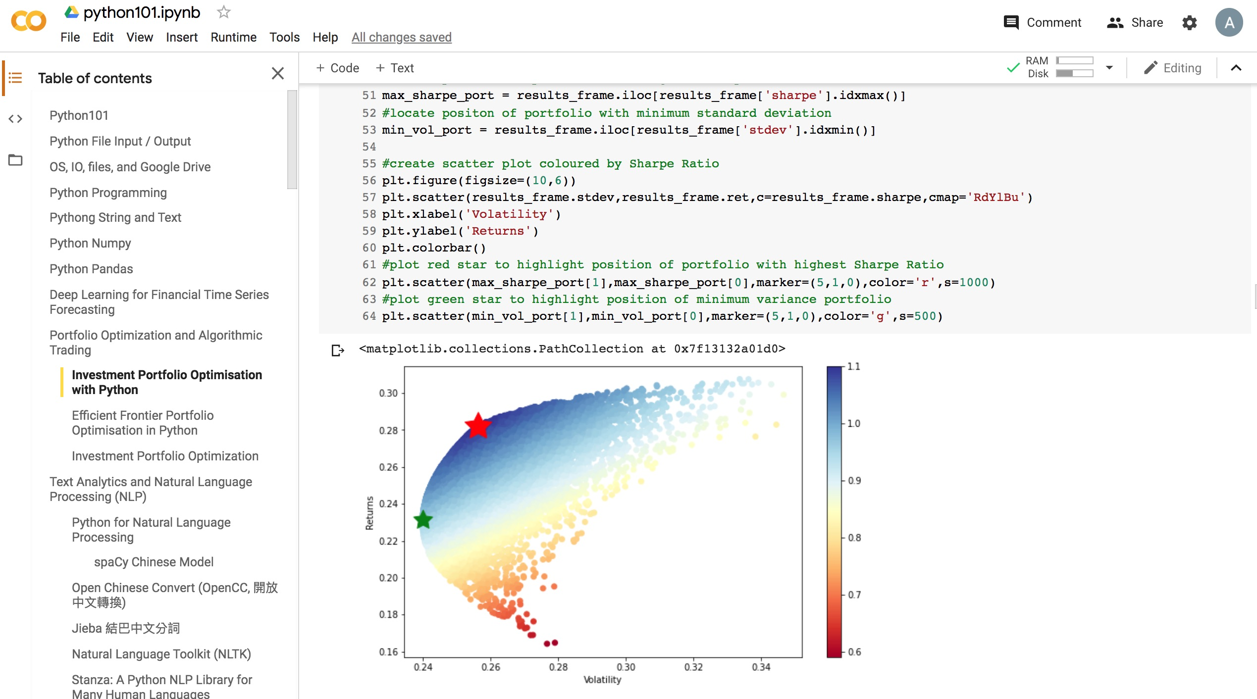
Python in Google Colab (Python101)
https://colab.research.google.com/drive/1FEG6DnGvwfUbeo4zJ1zTunjMqf2RkCrT
https://tinyurl.com/aintpupython101

Slide 67
Python in Google Colab (Python101)
https://colab.research.google.com/drive/1FEG6DnGvwfUbeo4zJ1zTunjMqf2RkCrT
https://tinyurl.com/aintpupython101

Slide 68
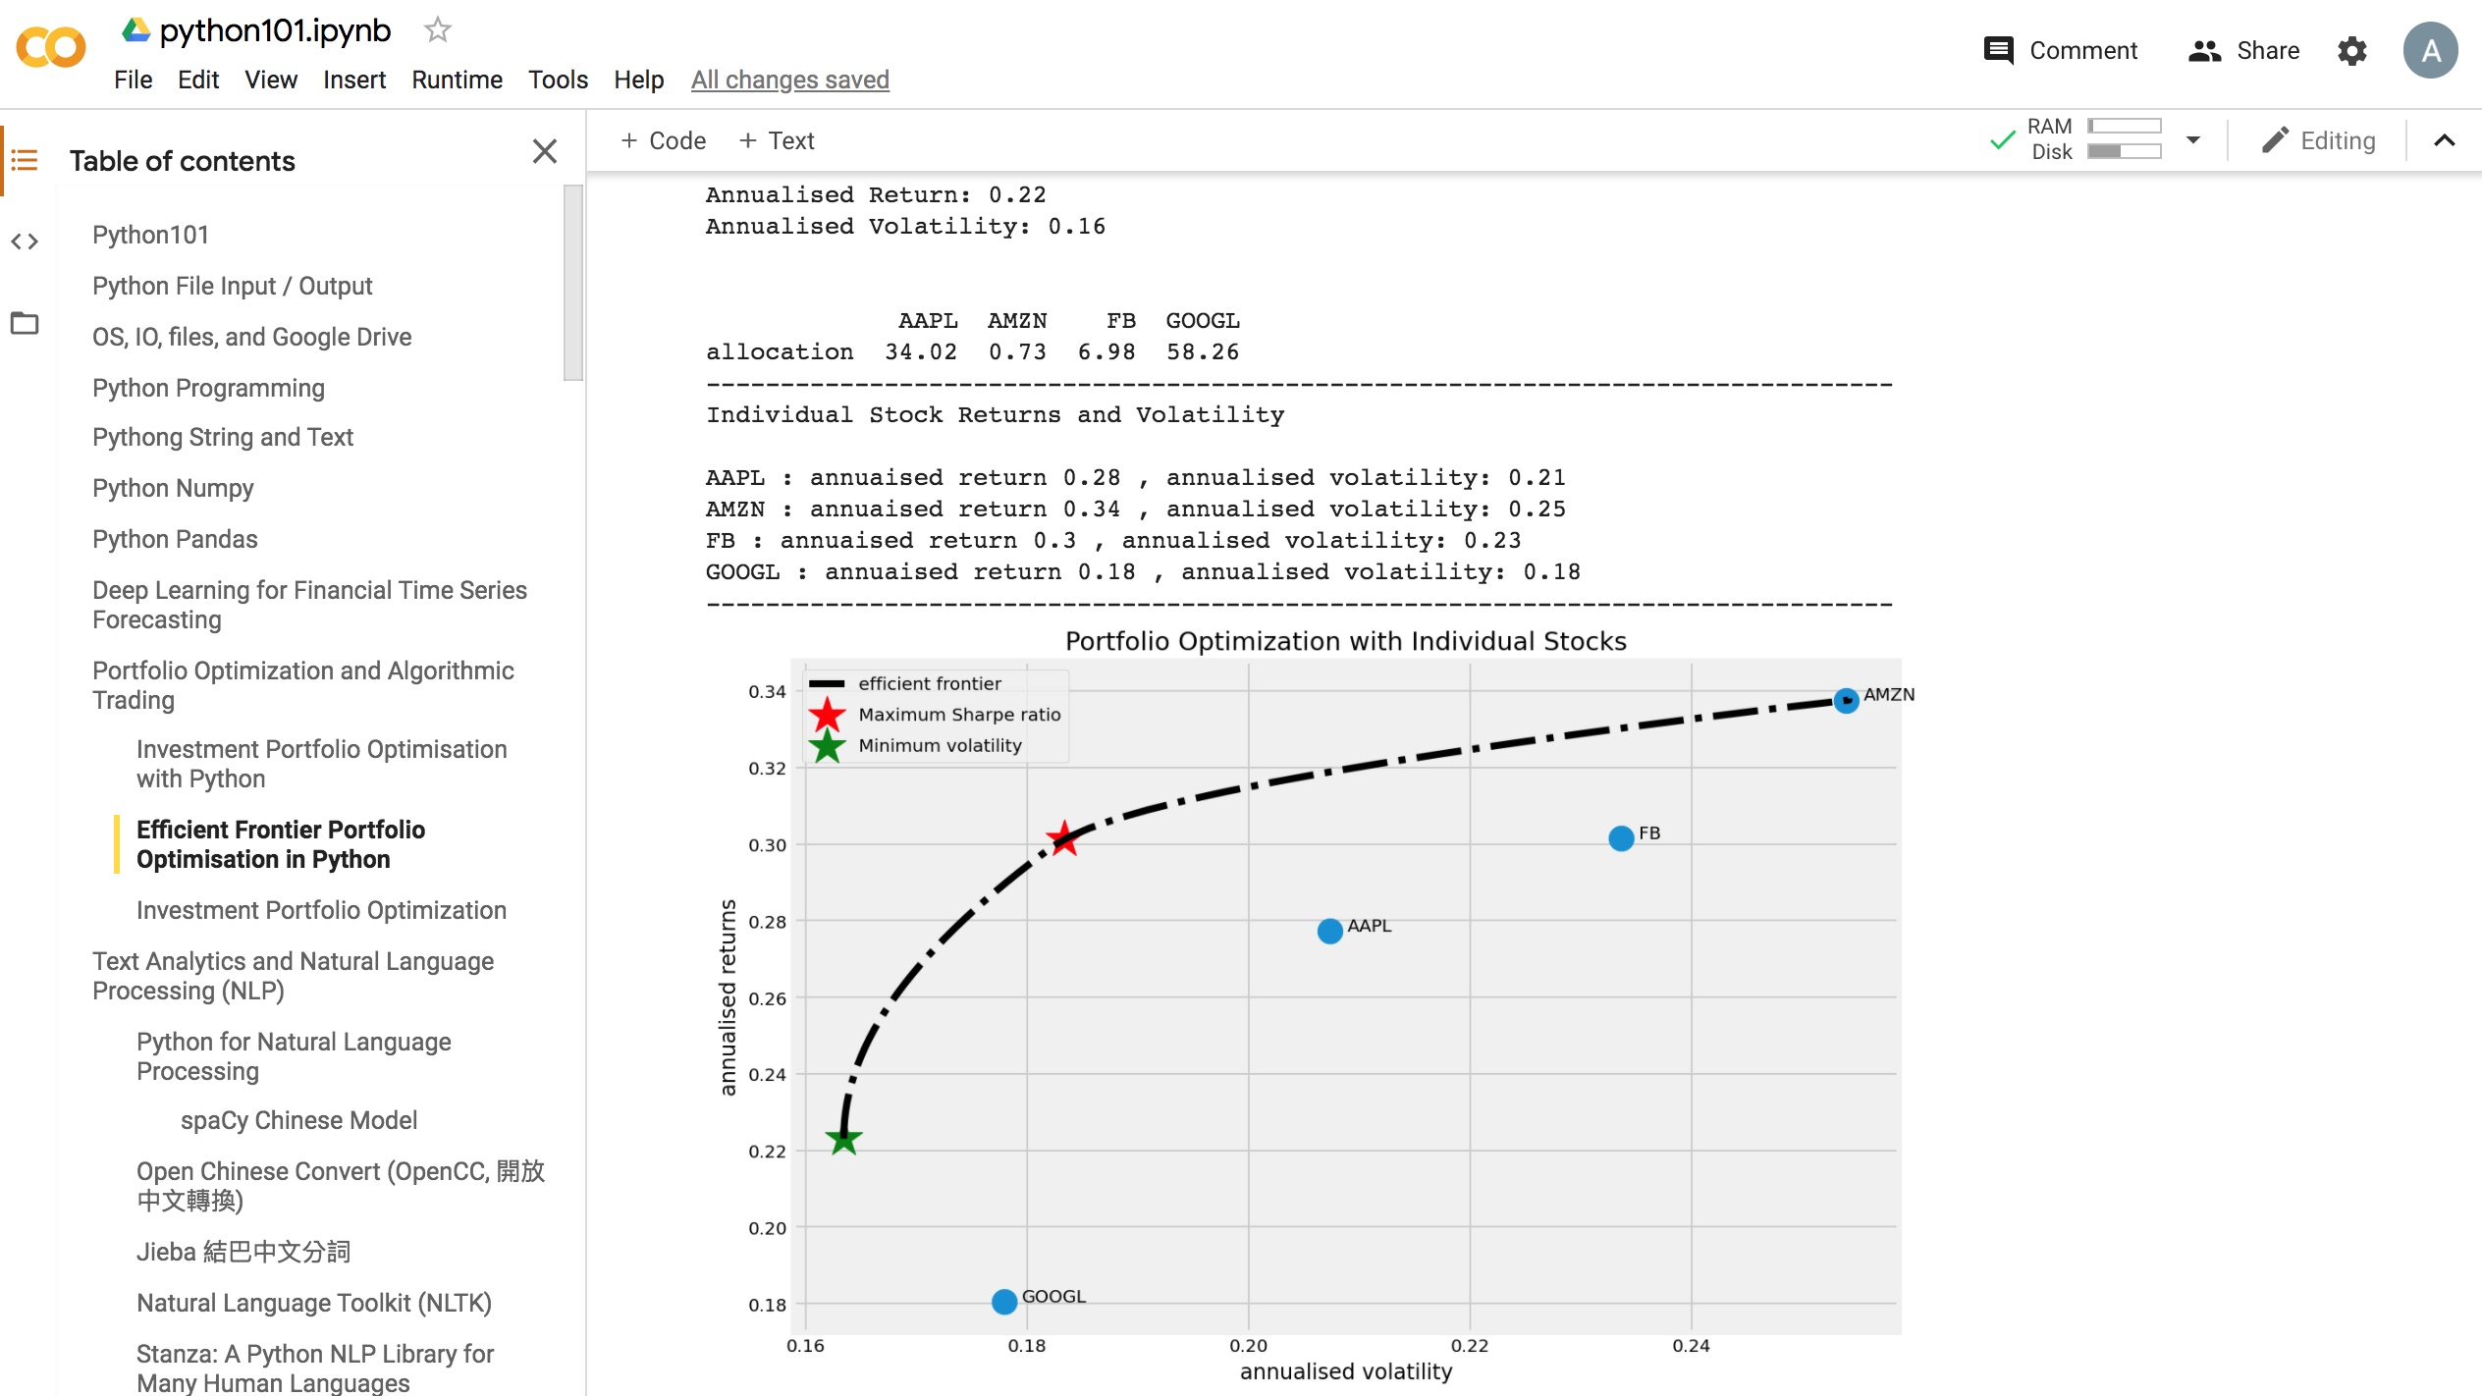
Python in Google Colab (Python101)
https://colab.research.google.com/drive/1FEG6DnGvwfUbeo4zJ1zTunjMqf2RkCrT
Portfolio Optimization
Efficient Frontier Portfolio Optimization
https://tinyurl.com/aintpupython101

Slide 69
Summary
Uncertainty and Risk
Expected Utility Theory (EUT)
Mean-Variance Portfolio Theory (MVPT)
Capital Asset Pricing Model (CAPM)
Arbitrage Pricing Theory (APT)
Source: Yves Hilpisch (2020), Artificial Intelligence in Finance: A Python-Based Guide, O’Reilly Media.

Slide 70
Data-Driven Finance

Slide 71
Data-Driven Finance
Scientific Method
Financial Econometrics and Regression
Data Availability
Normative Theories Revisited
Debunking Central Assumptions in Finance
Source: Yves Hilpisch (2020), Artificial Intelligence in Finance: A Python-Based Guide, O’Reilly Media.

Slide 72
Data-driven finance
Financial context (theory, model, application)
that is primarily driven by and based on
insights gained from data.
Source: Yves Hilpisch (2020), Artificial Intelligence in Finance: A Python-Based Guide, O’Reilly Media.

Slide 73
Data-driven finance
Robin Wigglesworth (2019)
Nowadays, analysts sift through
non-traditional information such as
satellite imagery and credit card data,
or use artificial intelligence techniques such as
machine learning and natural language processing to glean fresh insights from traditional sources such as economic data and earnings-call transcripts.
Source: Yves Hilpisch (2020), Artificial Intelligence in Finance: A Python-Based Guide, O’Reilly Media.

Slide 74
Scientific Method
Generally accepted principles that should guide scientific effort
The scientific method is an empirical method of acquiring knowledge that has characterized the development of science
It involves careful observation,
applying rigorous skepticism about what is observed,
given that cognitive assumptions can distort how one interprets the observation.
Source: Yves Hilpisch (2020), Artificial Intelligence in Finance: A Python-Based Guide, O’Reilly Media.

Slide 75
Scientific Method
It involves formulating hypotheses,
via induction, based on such observations;
experimental and measurement-based testing of deductions drawn from the hypotheses;
and refinement (or elimination) of the hypotheses based on the experimental findings
Source: Yves Hilpisch (2020), Artificial Intelligence in Finance: A Python-Based Guide, O’Reilly Media.

Slide 76
Normative Finance and Scientific Method
Normative financial theories mostly rely on assumptions and axioms in combination with deduction as the major analytical method to arrive at their central results.
  Expected utility theory (EUT) assumes that agents have the same utility function no matter what state of the world unfolds and that they maximize expected utility under conditions of uncertainty.
  Mean-variance portfolio (MVP) theory describes how investors should invest under conditions of uncertainty assuming that only the expected return and the expected volatility of a portfolio over one period count.
Source: Yves Hilpisch (2020), Artificial Intelligence in Finance: A Python-Based Guide, O’Reilly Media.

Slide 77
Normative Finance and Scientific Method
The capital asset pricing model (CAPM) assumes that only the nondiversifiable market risk explains the expected return and the expected volatility of a stock over one period.
Arbitrage pricing theory (APT) assumes that a number of identifiable risk factors explains the expected return and the expected volatility of a stock over time; admittedly, compared to the other theories, the formulation of APT is rather broad and allows for wide-ranging interpretations.
Source: Yves Hilpisch (2020), Artificial Intelligence in Finance: A Python-Based Guide, O’Reilly Media.

Slide 78
Financial Econometrics and Regression
[Financial] econometrics is the quantitative application of statistical and mathematical models using [financial] data to develop financial theories or test existing hypotheses in finance and to forecast future trends from historical data.
It subjects real-world [financial] data to statistical trials and then compares and contrasts the results against the [financial] theory or theories being tested.
Source: Yves Hilpisch (2020), Artificial Intelligence in Finance: A Python-Based Guide, O’Reilly Media.

Slide 79
Financial Econometrics and Regression
One of the major tools in financial econometrics is regression, in both its univariate and multivariate forms
Regression is also a central tool in statistical learning in general
Source: Yves Hilpisch (2020), Artificial Intelligence in Finance: A Python-Based Guide, O’Reilly Media.

Slide 80
Data Availability
Types of (financial) data
  Financial econometrics is driven by statistical methods, such as regression, and the availability of financial data
  Theoretical and empirical financial research was mainly driven by relatively small data sets and was mostly comprised of end-of-day (EOD) data
  Types of financial and other data available in ever increasing granularity, quantity, and velocity.
Quality and quantity via programmatic APIs
  Finance professionals have relied on data terminals from Refinitiv or Bloomberg
  Major breakthrough in data-driven finance via programmatic APIs
Source: Yves Hilpisch (2020), Artificial Intelligence in Finance: A Python-Based Guide, O’Reilly Media.

Slide 81
Relevant types of financial data
Time | Structured data | Unstructured data | Alternative data
Historical | Prices, fundamentals | News, texts | Web, social media, satellites
Streaming | Prices, volumes | News, filings | Web, social media, satellites, Internet of Things
Source: Yves Hilpisch (2020), Artificial Intelligence in Finance: A Python-Based Guide, O’Reilly Media.

Slide 82
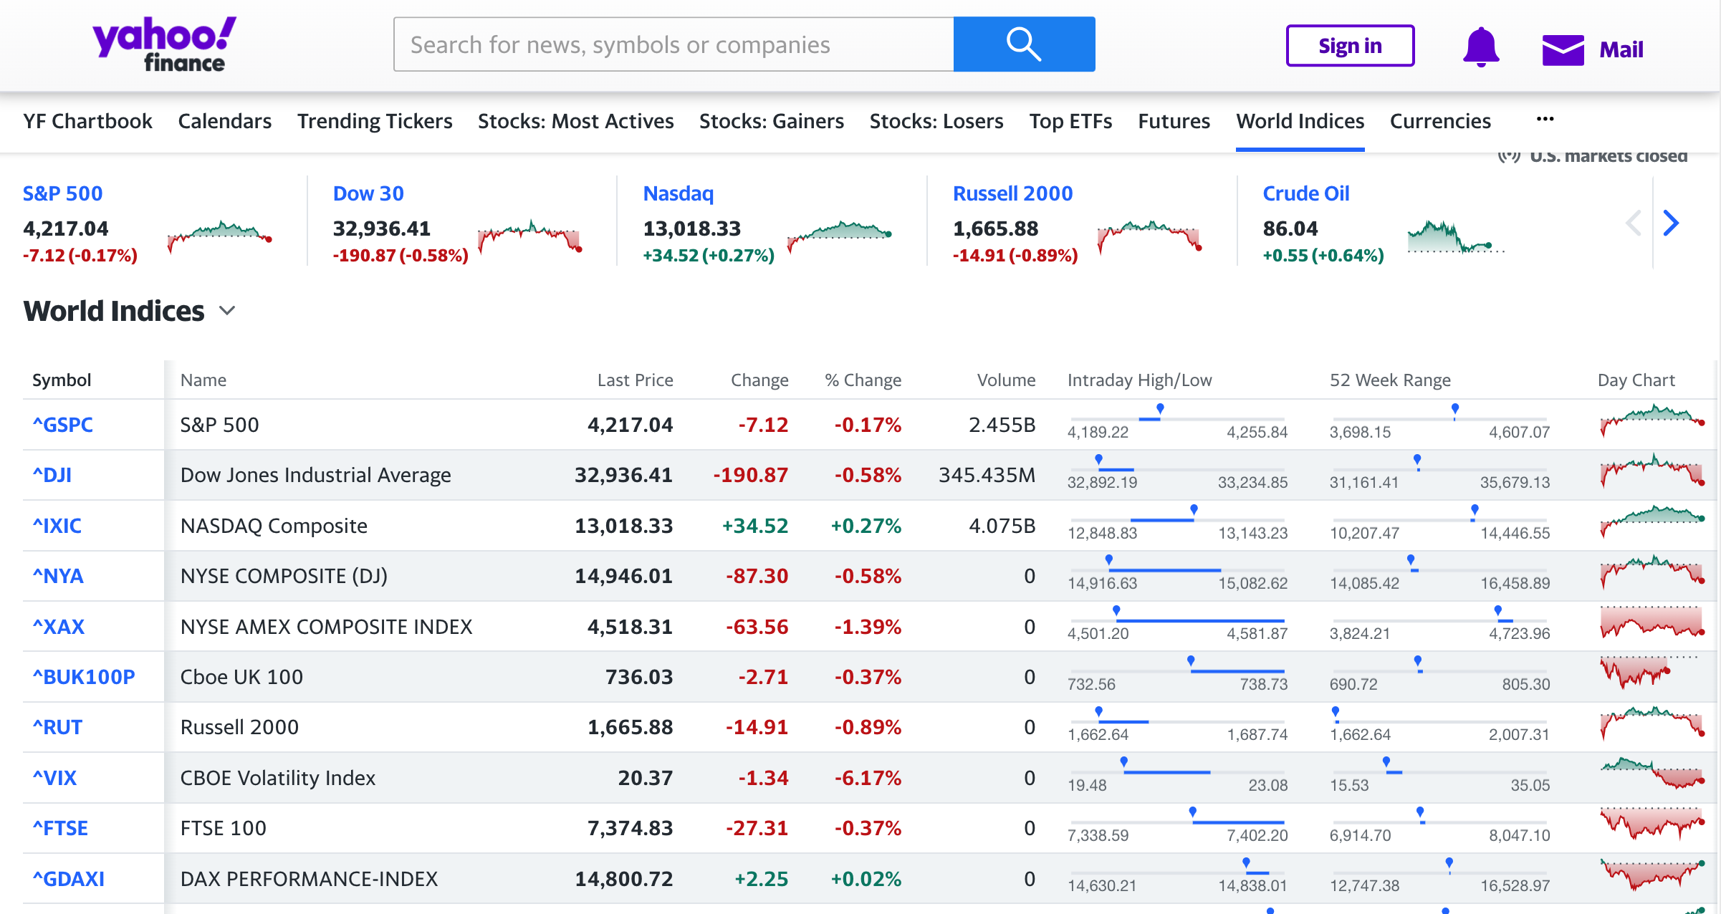
Yahoo Finance World Indices
https://finance.yahoo.com/world-indices/

Slide 83
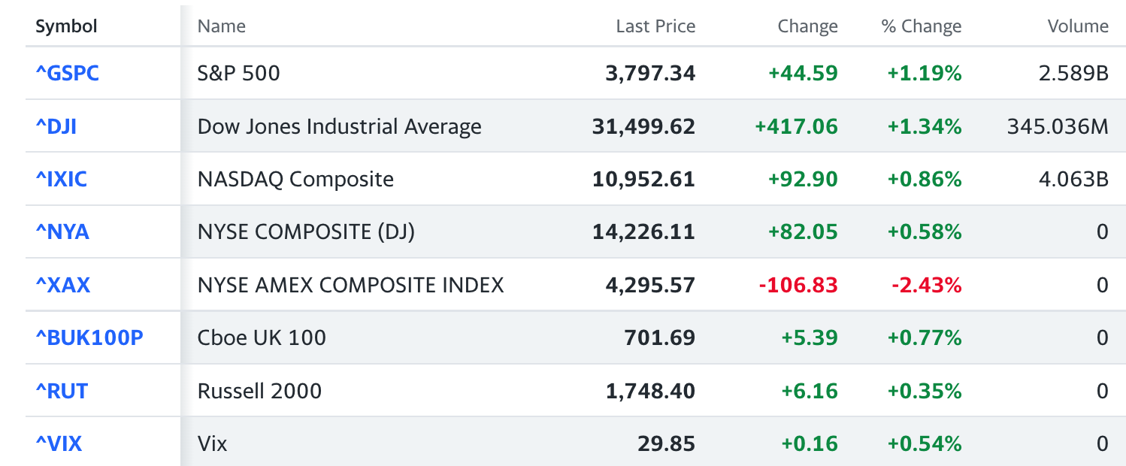
World Indices
import io
import requests
import pandas as pd
response = requests.get('https://finance.yahoo.com/world-indices/')
df = pd.read_html(io.StringIO(response.text))
worldidx = df[0]
worldidx.to_csv('world_indices.csv')
worldidx

Slide 84
ffn: Financial Functions for Python
#^GSPC S&P 500
#^DJI Dow 30
#^IXIC Nasdaq
!pip install ffn
import ffn
%pylab inline
df = ffn.get('^gspc, ^dji, ^ixic', start='2010-01-01', end='2022-01-01')
print(df.head())
print(df.tail())
print(df.describe())
ax = df.plot(figsize=(12,9))
gspc dji ixic
Date
2010-01-04 1132.989990 10583.959961 2308.419922
2010-01-05 1136.520020 10572.019531 2308.709961
2010-01-06 1137.140015 10573.679688 2301.090088
2010-01-07 1141.689941 10606.860352 2300.050049
2010-01-08 1144.979980 10618.190430 2317.169922
gspc dji ixic
Date
2021-12-27 4791.189941 36302.378906 15871.259766
2021-12-28 4786.350098 36398.210938 15781.719727
2021-12-29 4793.060059 36488.628906 15766.219727
2021-12-30 4778.729980 36398.078125 15741.559570
2021-12-31 4766.180176 36338.300781 15644.969727
gspc dji ixic
count 3021.000000 3021.000000 3021.000000
mean 2260.488112 19756.317518 6004.283709
std 890.501675 6927.100147 3438.840186
min 1022.580017 9686.480469 2091.790039
25% 1461.400024 13557.000000 3131.489990
50% 2088.479980 17851.509766 4984.620117
75% 2798.360107 25332.179688 7669.169922
max 4793.060059 36488.628906 16057.440430

Slide 85
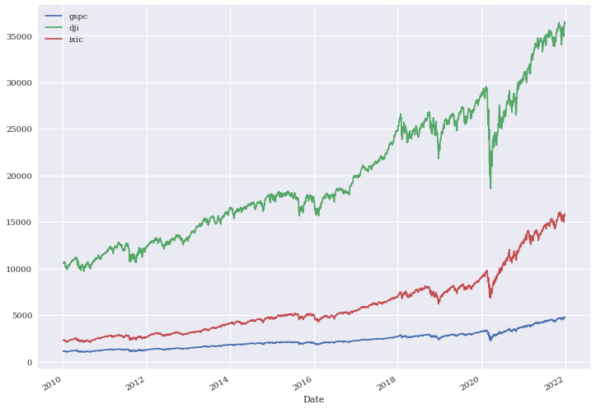
^GSPC: S&P 500, ^DJI: Dow 30, ^IXIC: Nasdaq
df = ffn.get('^gspc, ^dji, ^ixic', start='2010-01-01', end='2022-01-01')
ax = df.plot(figsize=(12,9))

Slide 86
ffn: Financial Functions for Python
!pip install ffn
import ffn
%pylab inline
df = ffn.get('^gspc, ^dji, ^ixic', start='2010-01-01', end='2022-01-01')
print(df.head())
print(df.tail())
print(df.describe())
ax = df.plot(figsize=(12,9))
returns = df.to_returns().dropna()
ax = returns.hist(figsize=(14, 10))
returns.corr().as_format('.2f')
returns.plot_corr_heatmap()
ax = df.plot(figsize=(14,10))
perf = df.calc_stats()
perf.plot(figsize=(14, 10))
print(perf.display())

Slide 87
CoinGeckoAPI(): Cryptocurrency Data API
from pycoingecko import CoinGeckoAPI
import pandas as pd
from datetime import datetime
start_date_obj = datetime.strptime('2020-01-01', '%Y-%m-%d')
end_date_obj = datetime.strptime('2022-12-31', '%Y-%m-%d’)
cg = CoinGeckoAPI()
data = cg.get_coin_market_chart_range_by_id(id='bitcoin', vs_currency='usd', from_timestamp=start_date_obj.timestamp(), to_timestamp=end_date_obj.timestamp())
processed_data = [ {'date': datetime.utcfromtimestamp(price[0] / 1000).date(), 'price': price[1]} for price in data.get('prices', [])]
df = pd.DataFrame(processed_data)
df.to_csv('btcusd.csv')
Source: https://www.coingecko.com/en/api

Slide 88
Normative Theories Revisited
Revisits the normative theories and analyzes them based on real financial time series data
Expected Utility and Reality
Mean-Variance Portfolio Theory (MVPT)
Capital Asset Pricing Model (CAPM)
Arbitrage Pricing Theory (APT)
Source: Yves Hilpisch (2020), Artificial Intelligence in Finance: A Python-Based Guide, O’Reilly Media.

Slide 89
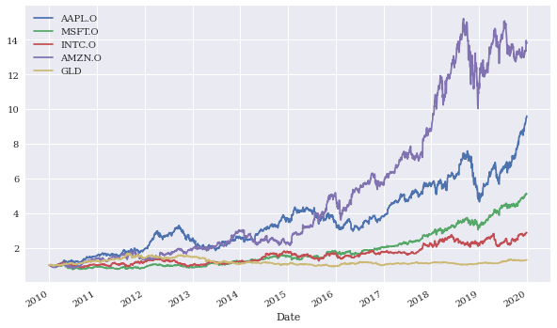
Normalized financial time series data
Source: Yves Hilpisch (2020), Artificial Intelligence in Finance: A Python-Based Guide, O’Reilly Media.

Slide 90
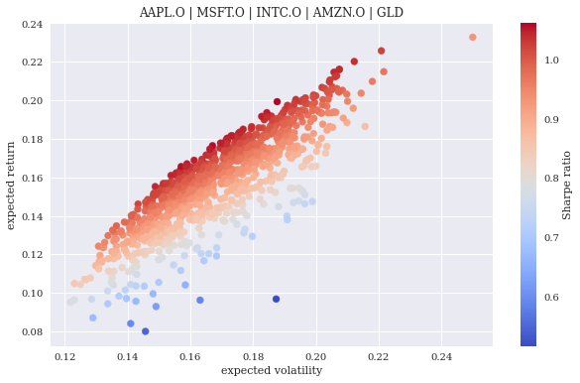
Simulated portfolio volatilities, returns, and Sharpe ratios
Source: Yves Hilpisch (2020), Artificial Intelligence in Finance: A Python-Based Guide, O’Reilly Media.

Slide 91
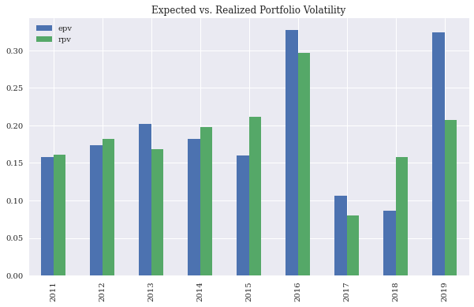
Expected versus realized portfolio volatilities
Source: Yves Hilpisch (2020), Artificial Intelligence in Finance: A Python-Based Guide, O’Reilly Media.

Slide 92
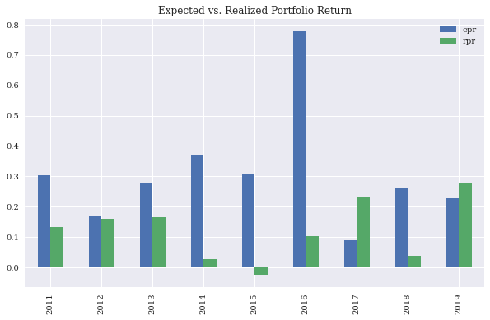
Expected versus realized portfolio returns
Source: Yves Hilpisch (2020), Artificial Intelligence in Finance: A Python-Based Guide, O’Reilly Media.

Slide 93
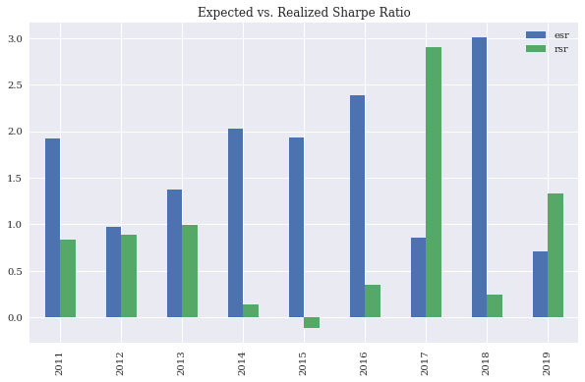
Expected versus realized portfolio Sharpe ratios
Source: Yves Hilpisch (2020), Artificial Intelligence in Finance: A Python-Based Guide, O’Reilly Media.

Slide 94
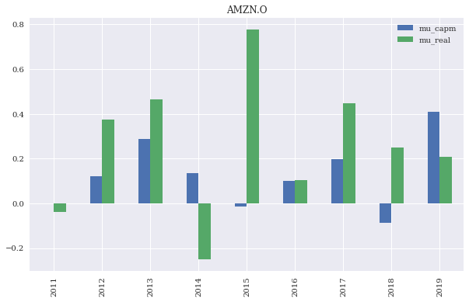
CAPM-predicted versus realized stock returns for a single stock
Source: Yves Hilpisch (2020), Artificial Intelligence in Finance: A Python-Based Guide, O’Reilly Media.

Slide 95
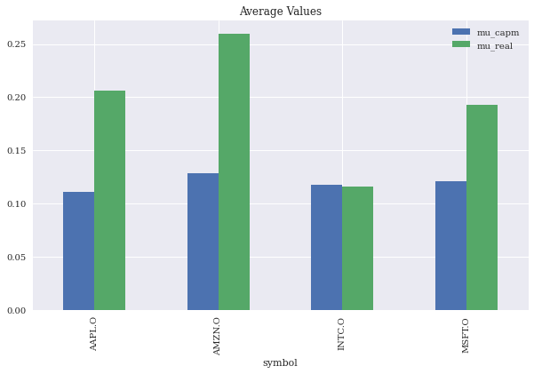
Average CAPM-predicted versus average realized stock returns for multiple stocks
Source: Yves Hilpisch (2020), Artificial Intelligence in Finance: A Python-Based Guide, O’Reilly Media.

Slide 96
Arbitrage Pricing Theory (APT)
Relevant types of financial data
Factor | Description
Market | MSCI World Gross Return Daily USD (PUS = Price Return)
Size | MSCI World Equal Weight Price Net Index EOD
Volatility | MSCI World Minimum Volatility Net Return
Value | MSCI World Value Weighted Gross (NUS for Net)
Risk | MSCI World Risk Weighted Gross USD EOD
Growth | MSCI World Quality Net Return USD
Momentum | MSCI World Momentum Gross Index USD EOD
factors = pd.read_csv('http://hilpisch.com/aiif_eikon_eod_factors.csv’,
index_col=0, parse_dates=True)
Source: Yves Hilpisch (2020), Artificial Intelligence in Finance: A Python-Based Guide, O’Reilly Media.

Slide 97
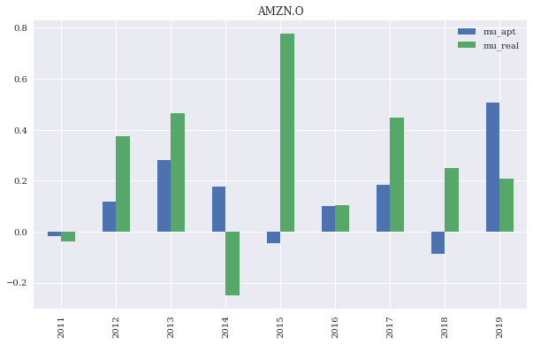
APT-predicted versus realized stock returns for a stock
Source: Yves Hilpisch (2020), Artificial Intelligence in Finance: A Python-Based Guide, O’Reilly Media.

Slide 98
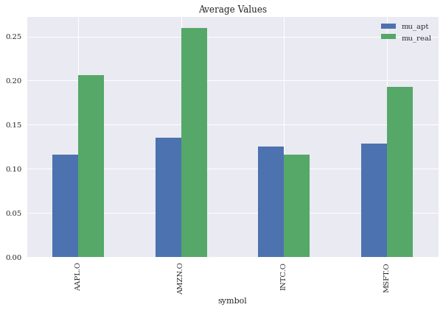
Average APT-predicted versus average realized stock returns for multiple stocks
Source: Yves Hilpisch (2020), Artificial Intelligence in Finance: A Python-Based Guide, O’Reilly Media.

Slide 99
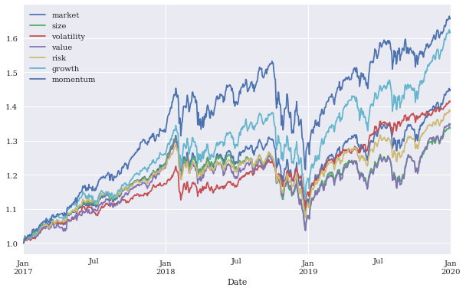
Normalized factors time series data
Source: Yves Hilpisch (2020), Artificial Intelligence in Finance: A Python-Based Guide, O’Reilly Media.

Slide 100
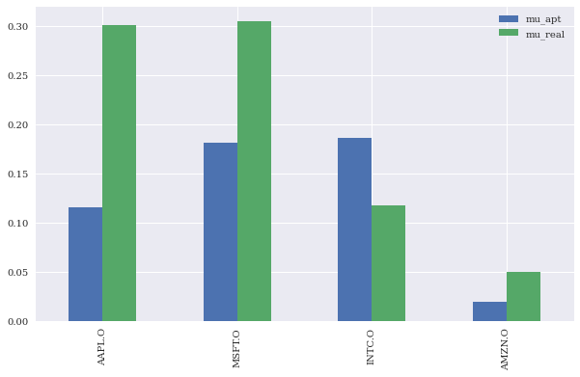
APT-predicted returns based on typical factors compared to realized returns
Source: Yves Hilpisch (2020), Artificial Intelligence in Finance: A Python-Based Guide, O’Reilly Media.

Slide 101
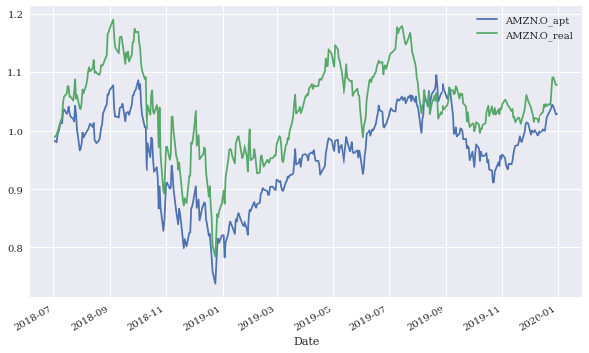
APT-predicted performance and real performance over time (gross)
Source: Yves Hilpisch (2020), Artificial Intelligence in Finance: A Python-Based Guide, O’Reilly Media.

Slide 102
Debunking Central Assumptions in Finance
Debunks two of the most commonly found assumptions in financial models and theories
  Normality of returns
  Linear relationships
Source: Yves Hilpisch (2020), Artificial Intelligence in Finance: A Python-Based Guide, O’Reilly Media.

Slide 103
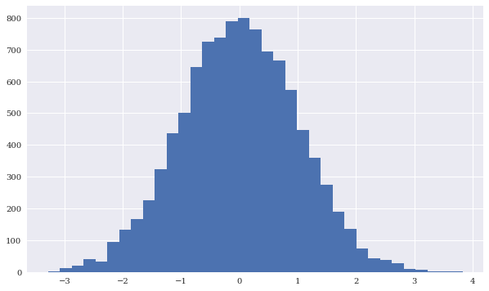
Standard normally distributed random numbers
Source: Yves Hilpisch (2020), Artificial Intelligence in Finance: A Python-Based Guide, O’Reilly Media.

Slide 104

Distribution with first and second moment of 0.0 and 1.0, respectively
Source: Yves Hilpisch (2020), Artificial Intelligence in Finance: A Python-Based Guide, O’Reilly Media.

Slide 105

Histogram and PDF for standard normally distributed numbers
Source: Yves Hilpisch (2020), Artificial Intelligence in Finance: A Python-Based Guide, O’Reilly Media.

Slide 106

Histogram and normal PDF for discrete numbers
Source: Yves Hilpisch (2020), Artificial Intelligence in Finance: A Python-Based Guide, O’Reilly Media.

Slide 107

Q-Q plot for standard normally distributed numbers
Source: Yves Hilpisch (2020), Artificial Intelligence in Finance: A Python-Based Guide, O’Reilly Media.

Slide 108

Q-Q plot for discrete numbers
Source: Yves Hilpisch (2020), Artificial Intelligence in Finance: A Python-Based Guide, O’Reilly Media.

Slide 109

Frequency distribution and normal PDF for S&P 500 log returns
Source: Yves Hilpisch (2020), Artificial Intelligence in Finance: A Python-Based Guide, O’Reilly Media.

Slide 110

Q-Q for S&P 500 log returns
Source: Yves Hilpisch (2020), Artificial Intelligence in Finance: A Python-Based Guide, O’Reilly Media.

Slide 111

Expected CAPM return versus beta
(including linear regression)
Source: Yves Hilpisch (2020), Artificial Intelligence in Finance: A Python-Based Guide, O’Reilly Media.

Slide 112

Expected CAPM return versus beta
(including linear regression)
Source: Yves Hilpisch (2020), Artificial Intelligence in Finance: A Python-Based Guide, O’Reilly Media.

Slide 113
Theory-First to Data-Driven Finance
Finance used to be characterized by normative theories based on simplified mathematical models of the financial markets, relying on assumptions such as normality of returns and linear relationships.
The almost universal and comprehensive availability of
(financial) data has led to a shift in focus
from a theory-first approach to data-driven finance.
Several examples based on real financial data illustrate that many popular financial models and theories cannot survive a confrontation with financial market realities.
Although elegant, they might be too simplistic to capture the complexities, changing nature, and nonlinearities of financial markets.
Source: Yves Hilpisch (2020), Artificial Intelligence in Finance: A Python-Based Guide, O’Reilly Media.

Slide 114

The Quant Finance PyData Stack
Source: http://nbviewer.jupyter.org/format/slides/github/quantopian/pyfolio/blob/master/pyfolio/examples/overview_slides.ipynb#/5

Slide 115

Yves Hilpisch (2020),
Artificial Intelligence in Finance:
A Python-Based Guide,
O’Reilly
Source: https://www.amazon.com/Artificial-Intelligence-Finance-Python-Based-Guide/dp/1492055433

Slide 116

Yves Hilpisch (2020), Artificial Intelligence in Finance: A Python-Based Guide, O’Reilly
https://github.com/yhilpisch/aiif
Source: https://github.com/yhilpisch/aiif

Slide 117

Yves Hilpisch (2020), Artificial Intelligence in Finance: A Python-Based Guide, O’Reilly
https://github.com/yhilpisch/aiif/tree/main/code
Source: https://github.com/yhilpisch/aiif/tree/main/code

Slide 118
Python in Google Colab (Python101)
https://colab.research.google.com/drive/1FEG6DnGvwfUbeo4zJ1zTunjMqf2RkCrT
https://tinyurl.com/aintpupython101

Slide 119

Python in Google Colab (Python101)
https://tinyurl.com/aintpupython101

Slide 120

Python in Google Colab (Python101)
https://tinyurl.com/aintpupython101

Slide 121

Python in Google Colab (Python101)
https://tinyurl.com/aintpupython101

Slide 122

Python in Google Colab (Python101)
https://tinyurl.com/aintpupython101

Slide 123

Python in Google Colab (Python101)
https://tinyurl.com/aintpupython101

Slide 124

Python in Google Colab (Python101)
https://tinyurl.com/aintpupython101

Slide 125

Python in Google Colab (Python101)
https://tinyurl.com/aintpupython101

Slide 126
Summary
Data-Driven Finance
Scientific Method
Financial Econometrics and Regression
Data Availability
Normative Theories Revisited
Debunking Central Assumptions in Finance
Source: Yves Hilpisch (2020), Artificial Intelligence in Finance: A Python-Based Guide, O’Reilly Media.

Slide 127
References
Yves Hilpisch (2020), Artificial Intelligence in Finance: A Python-Based Guide, O’Reilly Media, https://github.com/yhilpisch/aiif .
Fishburn, P. C. (1968). Utility theory. Management science, 14(5), 335-378.
Fama, E. F., & French, K. R. (2004). The capital asset pricing model: Theory and evidence. Journal of economic perspectives, 18(3), 25-46.
Markowitz, H. (1952). PORTFOLIO SELECTION. The Journal of Finance, 7(1), 77-91.
Pratt, J. W. (1964). Risk aversion in the small and in the large, econometrics 32, jan.
Ross, S. A. (1976). The arbitrage theory of capital asset pricing. Journal of Economic Theory, 13(3), 341-60.
Sharpe, W. F. (1964). Capital asset prices: A theory of market equilibrium under conditions of risk. The journal of finance, 19(3), 425-442.
Hui Gong (2026) "AI Agents in Financial Markets: Architecture, Applications, and Systemic Implications." arXiv preprint arXiv:2603.13942.
Min-Yuh Day (2026), Python 101, https://tinyurl.com/aintpupython101

