Slide 1










Financial Econometrics and Machine Learning
Artificial Intelligence in Finance and Quantitative Analysis
1142AIFQA06
MBA, IM, NTPU (M5147) (Spring 2026) Tue 5, 6, 7 (13:10-16:00) (B3F17)
University Ambassador
Certified Instructor
Min-Yuh Day, Ph.D, Professor and Director
Institute of Information Management, National Taipei University
https://web.ntpu.edu.tw/~myday
https://meet.google.com/miy-fbif-max
2026-04-21

Slide 2
Syllabus
Week Date Subject/Topics
1 2026/02/24 Introduction to Artificial Intelligence in Finance and Quantitative Analysis
2 2026/03/03 AI in FinTech: Metaverse, Web3, DeFi, NFT, Generative AI and Agentic AI for Financial Innovation Applications
3 2026/03/10 Investing Psychology and Behavioral Finance
4 2026/03/17 Event Studies in Finance
5 2026/03/24 Case Study on AI in Finance and Quantitative Analysis I
6 2026/03/31 Finance Theory and Data-Driven Finance

Slide 3
Syllabus
Week Date Subject/Topics
7 2026/04/07 Make-up holiday for NTPU Sports Day (No Classes)
8 2026/04/14 Midterm Project Report
9 2026/04/21 Financial Econometrics and Machine Learning
10 2026/04/28 AI-First Finance
11 2026/05/05 Industry Practices of AI in Finance and Quantitative Analysis
12 2026/05/12 Case Study on AI in Finance and Quantitative Analysis II

Slide 4
Syllabus
Week Date Subject/Topics
13 2026/05/19 Deep Learning in Finance; Reinforcement Learning in Finance; Generative AI and Agentic AI in Finance
14 2026/05/26 Algorithmic Trading; Risk Management; Trading Bot and Event-Based Backtesting
15 2026/06/02 Final Project Report I
16 2026/06/09 Final Project Report II

Slide 5
Financial Econometrics and Machine Learning

Slide 6
Outline
Financial Econometrics
Financial Theories, OLS Regression
Machine Learning
Learning, Evaluation, Bias and variance
Cross-validation
Source: Yves Hilpisch (2020), Artificial Intelligence in Finance: A Python-Based Guide, O’Reilly Media.

Slide 7
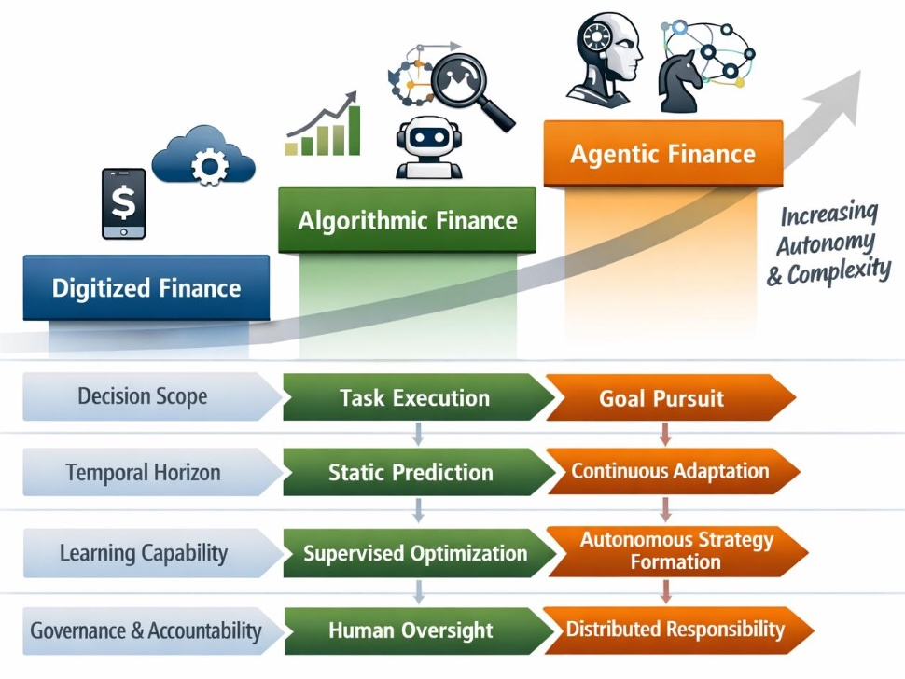
From Algorithms to Agents: Reframing FinTech Through Agentic AI
Source: Azmat Islam and Muhammad Ajmal. (2025) "From Algorithms to Agents: Reframing FinTech Through Agentic Artificial Intelligence." Advance Journal of Econometrics and Finance 3, no. 1 (2025): 180-190.

Slide 8
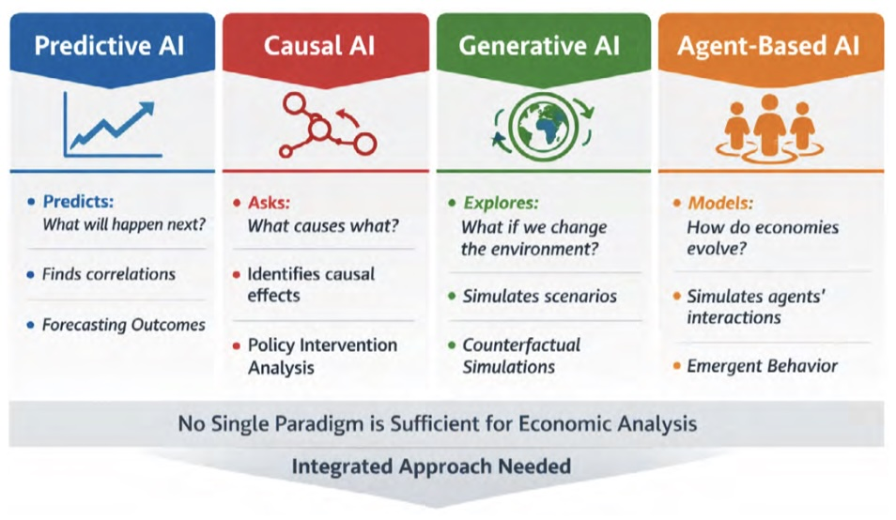
AI Paradigms for Economic Questions
Source: Solomon Tetteh Mensah, Adebayo Fatai Lamidi, Olukunle O. Akanbi, Ayo Samuel Avwerosuo, and Afolashade Joy Jubrilla. (2026) "From Prediction to Causation: Integrating Causal, Generative, and Agent-Based AI in Economics and Finance." Journal of Accounts and Finance 1, no. 1 (2026): 1-9.

Slide 9
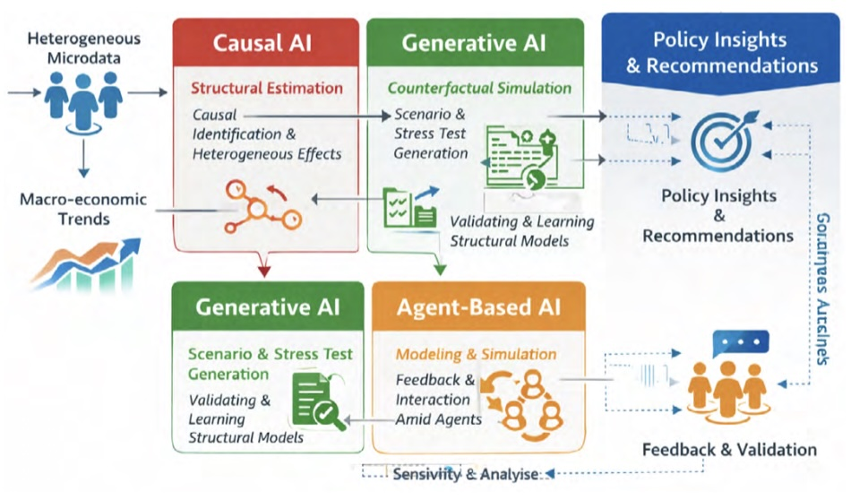
From Prediction to Causation: Integrating Causal, Generative, and Agent-Based AI in Economics and Finance
Source: Solomon Tetteh Mensah, Adebayo Fatai Lamidi, Olukunle O. Akanbi, Ayo Samuel Avwerosuo, and Afolashade Joy Jubrilla. (2026) "From Prediction to Causation: Integrating Causal, Generative, and Agent-Based AI in Economics and Finance." Journal of Accounts and Finance 1, no. 1 (2026): 1-9.

Slide 10
Financial Econometrics

Slide 11
Financial Econometrics
Financial Theories
OLS Regression
Source: Yves Hilpisch (2020), Artificial Intelligence in Finance: A Python-Based Guide, O’Reilly Media.

Slide 12
Financial Econometrics
The discipline at the intersection of mathematics, statistics, and finance that applies such methods to financial market data is typically called financial econometrics.
Finance
Mathematics
Statistics
Financial Econometrics
Source: Yves Hilpisch (2020), Artificial Intelligence in Finance: A Python-Based Guide, O’Reilly Media.

Slide 13
Financial Econometrics (Chris Brooks, 2019)
Financial econometrics
the application of statistical techniques to problems in finance
Financial econometrics can be useful for testing theories in finance, determining asset prices or returns, testing hypotheses concerning the relationships between variables, examining the effect on financial markets of changes in economic conditions, forecasting future values of financial variables and for financial decision-making.
Source: Chris Brooks (2019), Introductory Econometrics for Finance, 4th Edition, Cambridge University Press

Slide 14
Financial Econometrics
[Financial] econometrics is the quantitative application of statistical and mathematical models using [financial] data to develop financial theories or test existing hypotheses in finance and to forecast future trends from historical data.
It subjects real-world [financial] data to statistical trials and then compares and contrasts the results against the [financial] theory or theories being tested.
Source: Yves Hilpisch (2020), Artificial Intelligence in Finance: A Python-Based Guide, O’Reilly Media.

Slide 15
Topics of Financial Econometrics (Oliver Linton, 2019)
Econometric
Return Predictability and the Efficient Markets Hypothesis
Robust Tests and Tests of Nonlinear Predictability of Returns
Empirical Market Microstructure
Event Study Analysis
Portfolio Choice and Testing the Capital Asset Pricing Model
Multifactor Pricing Models
Source: Oliver Linton (2019), Financial Econometrics: Models and Methods, Cambridge University Press

Slide 16
Topics of Financial Econometrics (Oliver Linton, 2019)
Present Value Relations
Intertemporal Equilibrium Pricing
Volatility
Continuous Time Processes
Yield Curve
Risk Management and Tail Estimation
Source: Oliver Linton (2019), Financial Econometrics: Models and Methods, Cambridge University Press

Slide 17
Applications of Financial Econometrics (Chris Brooks, 2019)
Testing whether financial markets are weak-form informationally efficient
Testing whether the capital asset pricing model (CAPM) or arbitrage pricing theory (APT) represent superior models for the determination of returns on risky assets
Measuring and forecasting the volatility of bond returns
Explaining the determinants of bond credit ratings used by the ratings agencies
Modelling long-term relationships between prices and exchange rates
Source: Chris Brooks (2019), Introductory Econometrics for Finance, 4th Edition, Cambridge University Press

Slide 18
Applications of Financial Econometrics (Chris Brooks, 2019)
Determining the optimal hedge ratio for a spot position in oil
Testing technical trading rules to determine which makes the most money
Testing the hypothesis that earnings or dividend announcements have no effect on stock prices
Testing whether spot or futures markets react more rapidly to news
Forecasting the correlation between the stock indices of two countries
Source: Chris Brooks (2019), Introductory Econometrics for Finance, 4th Edition, Cambridge University Press

Slide 19
Machine Learning and Financial Econometrics
ML and DL methods are able to discover statistical inefficiencies and even economic inefficiencies that are not discoverable by traditional econometric methods, such as multivariate OLS regression.
Source: Yves Hilpisch (2020), Artificial Intelligence in Finance: A Python-Based Guide, O’Reilly Media.

Slide 20
Normative Financial Theories
Normative financial theories mostly rely on assumptions and axioms in combination with deduction as the major analytical method to arrive at their central results.
Expected utility theory (EUT) assumes that agents have the same utility function no matter what state of the world unfolds and that they maximize expected utility under conditions of uncertainty.
Mean-variance portfolio (MVP) theory describes how investors should invest under conditions of uncertainty assuming that only the expected return and the expected volatility of a portfolio over one period count.
Source: Yves Hilpisch (2020), Artificial Intelligence in Finance: A Python-Based Guide, O’Reilly Media.

Slide 21
Normative Financial Theories
The capital asset pricing model (CAPM) assumes that only the nondiversifiable market risk explains the expected return and the expected volatility of a stock over one period.
Arbitrage pricing theory (APT) assumes that a number of identifiable risk factors explains the expected return and the expected volatility of a stock over time; admittedly, compared to the other theories, the formulation of APT is rather broad and allows for wide-ranging interpretations.
Source: Yves Hilpisch (2020), Artificial Intelligence in Finance: A Python-Based Guide, O’Reilly Media.

Slide 22
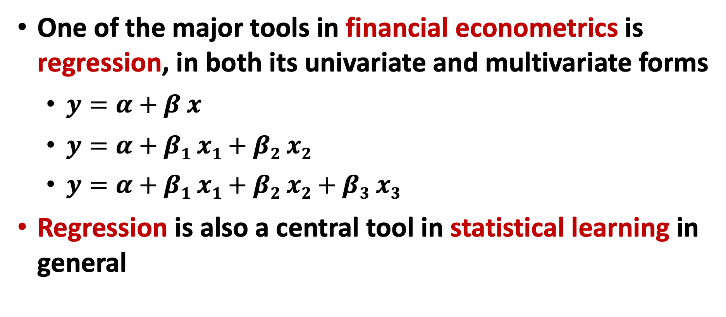
Financial Econometrics and Regression
One of the major tools in financial econometrics is regression, in both its univariate and multivariate forms
$y=α+β x$
$y=α+β1 x1+β2 x2$
$y=α+β1 x1+β2 x2+β3 x3$
Regression is also a central tool in statistical learning in general
Source: Yves Hilpisch (2020), Artificial Intelligence in Finance: A Python-Based Guide, O’Reilly Media.

Slide 23
CAPM and APT OLS regression
Both the CAPM and the APT relate the output variables with the relevant input factors in linear fashion.
From an econometric point of view, both models are implemented based on linear ordinary least-squares (OLS) regression.
CAPM: univariate linear OLS regression
APT: multivariate OLS regression
Source: Yves Hilpisch (2020), Artificial Intelligence in Finance: A Python-Based Guide, O’Reilly Media.

Slide 24
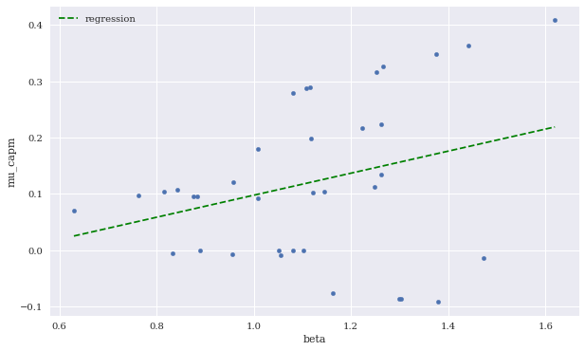
Expected CAPM return versus beta (including linear regression)
Source: Yves Hilpisch (2020), Artificial Intelligence in Finance: A Python-Based Guide, O’Reilly Media.

Slide 25
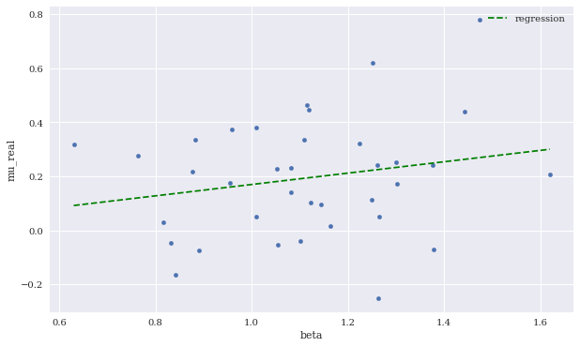
Expected CAPM return versus beta (including linear regression)
Source: Yves Hilpisch (2020), Artificial Intelligence in Finance: A Python-Based Guide, O’Reilly Media.

Slide 26
Machine Learning

Slide 27
Machine Learning
Learning
Evaluation
Bias and variance
Cross-validation
Source: Yves Hilpisch (2020), Artificial Intelligence in Finance: A Python-Based Guide, O’Reilly Media.

Slide 28
Artificial Intelligence Machine Learning & Deep Learning
Source: https://blogs.nvidia.com/blog/2016/07/29/whats-difference-artificial-intelligence-machine-learning-deep-learning-ai/

Slide 29
AI, ML, DL
Artificial Intelligence (AI)
Machine Learning (ML)
Supervised Learning
Unsupervised Learning
Deep Learning (DL)
CNN
RNN LSTM GRU
GAN
Semi-supervised Learning
Reinforcement Learning
Source: https://leonardoaraujosantos.gitbooks.io/artificial-inteligence/content/deep_learning.html

Slide 30
3 Machine Learning Algorithms
Source: Enrico Galimberti, http://blogs.teradata.com/data-points/tree-machine-learning-algorithms/

Slide 31
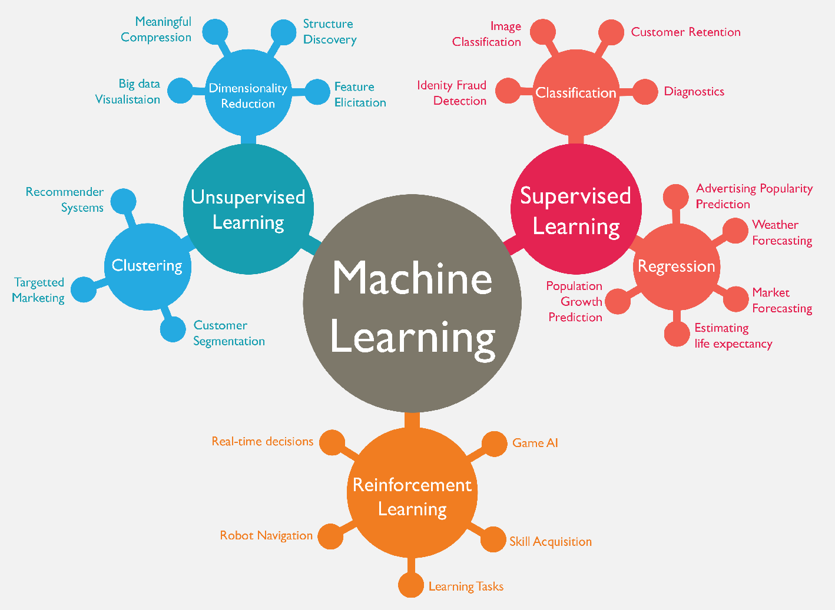
Machine Learning (ML)
Source: https://www.mactores.com/services/aws-big-data-machine-learning-cognitive-services/

Slide 32
Stock Market Movement Forecast: ML Phases of the stock market modeling
Source: O. Bustos and A. Pomares-Quimbaya (2020), "Stock Market Movement Forecast: A Systematic Review." Expert Systems with Applications (2020): 113464.

Slide 33
Machine Learning
Learning
Data: Features, Labels
Success (Loss Function): MSE
Capacity (Model Fit)
Evaluation
Bias and variance
Cross-validation
Source: Yves Hilpisch (2020), Artificial Intelligence in Finance: A Python-Based Guide, O’Reilly Media.

Slide 34
Learning (Mitchell, 1997)
A computer program is said to learn from experience E with respect to some class of tasks T and performance measure P, if its performance at tasks in T, as measured by P, improves with experience E.
Source: Yves Hilpisch (2020), Artificial Intelligence in Finance: A Python-Based Guide, O’Reilly Media.

Slide 35
Machine Learning Supervised Learning (Classification) Learning from Examples
y = f(x)
x
y

Slide 36
Machine Learning Supervised Learning (Classification) Learning from Examples
y = f(x)
x
y
input
Output
label

Slide 37
Machine Learning Supervised Learning (Classification) Learning from Examples
y = f(x)
5.1,3.5,1.4,0.2,Iris-setosa 4.9,3.0,1.4,0.2,Iris-setosa 4.7,3.2,1.3,0.2,Iris-setosa 7.0,3.2,4.7,1.4,Iris-versicolor 6.4,3.2,4.5,1.5,Iris-versicolor 6.9,3.1,4.9,1.5,Iris-versicolor 6.3,3.3,6.0,2.5,Iris-virginica 5.8,2.7,5.1,1.9,Iris-virginica 7.1,3.0,5.9,2.1,Iris-virginica

Slide 38
Machine Learning Supervised Learning (Classification) Learning from Examples
y = f(x)
Example
5.1,3.5,1.4,0.2,Iris-setosa 4.9,3.0,1.4,0.2,Iris-setosa 4.7,3.2,1.3,0.2,Iris-setosa 7.0,3.2,4.7,1.4,Iris-versicolor 6.4,3.2,4.5,1.5,Iris-versicolor 6.9,3.1,4.9,1.5,Iris-versicolor 6.3,3.3,6.0,2.5,Iris-virginica 5.8,2.7,5.1,1.9,Iris-virginica 7.1,3.0,5.9,2.1,Iris-virginica

Slide 39
Machine Learning Supervised Learning (Classification) Learning from Examples
y = f(x)
Example
5.1,3.5,1.4,0.2,Iris-setosa 4.9,3.0,1.4,0.2,Iris-setosa 4.7,3.2,1.3,0.2,Iris-setosa 7.0,3.2,4.7,1.4,Iris-versicolor 6.4,3.2,4.5,1.5,Iris-versicolor 6.9,3.1,4.9,1.5,Iris-versicolor 6.3,3.3,6.0,2.5,Iris-virginica 5.8,2.7,5.1,1.9,Iris-virginica 7.1,3.0,5.9,2.1,Iris-virginica
y
x

Slide 40
Time Series Data
[10, 20, 30, 40, 50, 60, 70, 80, 90]
X
Y
[10 20 30] 40
[20 30 40] 50
[30 40 50] 60
[40 50 60] 70
[50 60 70] 80
[60 70 80] 90

Slide 41
Time Series Data
[100, 110, 120, 130, 140, 150]
Y
X
Y
[100 110 120 130 140] 150
X_{t1}
X_{t2}
X_{t3}
X_{t4}
X_{t5}

Slide 42
The Theory of Learning
How can we be sure that our learned hypothesis will predict well for previously unseen inputs?
How do we know that the hypothesis h is close to the target function f if we don’t know what is?
How many examples do we need to get a good h?
What hypothesis space should we use?
If the hypothesis space is very complex, can we even find the best h or do we have to settle for a local maximum?
How complex should h be?
How do we avoid overfitting?

Slide 43
Linear function
y = f(x)
y = w₁x + w₀
h_{w}(x) = w₁x + w₀
Source: Stuart Russell and Peter Norvig (2020), Artificial Intelligence: A Modern Approach, 4th Edition, Pearson

Slide 44
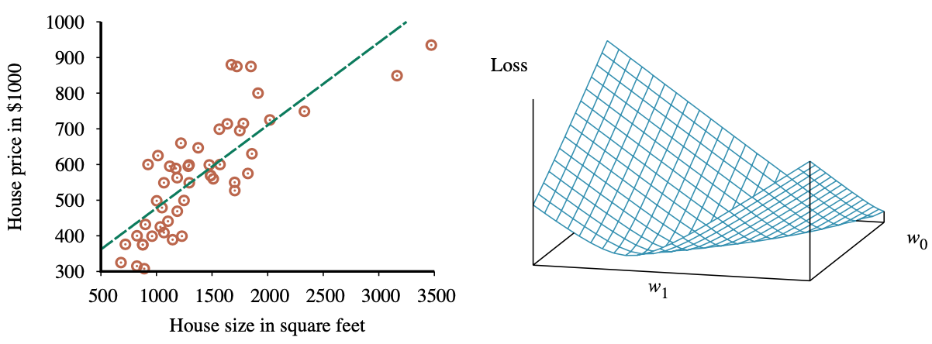
Linear Regression Weight Space
h_{w}(x) = w₁x + w₀
w* = argmin_{w} Loss(h_{w})
y = 0.232 x + 246
Loss function for Weights (w₁, w₀)
Source: Stuart Russell and Peter Norvig (2020), Artificial Intelligence: A Modern Approach, 4th Edition, Pearson

Slide 45
Performance Measure
The measure of success for estimation problems
mean-squared error (MSE)
Classification problems
accuracy ratio
Source: Yves Hilpisch (2020), Artificial Intelligence in Finance: A Python-Based Guide, O’Reilly Media.

Slide 46
Evaluation (Accuracy of Classification Model)

Slide 47
Assessing the Classification Model
Predictive accuracy
Hit rate
Speed
Model building; predicting
Robustness
Scalability
Interpretability
Transparency, explainability
Source: Ramesh Sharda, Dursun Delen, and Efraim Turban (2017), Business Intelligence, Analytics, and Data Science: A Managerial Perspective, 4th Edition, Pearson

Slide 48
Accuracy Precision
Validity
Reliability

Slide 50
Accuracy vs. Precision
A
B
High Accuracy
High Precision
Low Accuracy
High Precision
C
D
High Accuracy
Low Precision
Low Accuracy
Low Precision

Slide 51
Accuracy vs. Precision
A
B
High Accuracy
High Precision
Low Accuracy
High Precision
High Validity
High Reliability
Low Validity
High Reliability
C
D
High Accuracy
Low Precision
Low Accuracy
Low Precision
High Validity
Low Reliability
Low Validity
Low Reliability

Slide 52
Accuracy vs. Precision
A
B
High Accuracy
High Precision
Low Accuracy
High Precision
High Validity
High Reliability
Low Validity
High Reliability
C
D
High Accuracy
Low Precision
Low Accuracy
Low Precision
High Validity
Low Reliability
Low Validity
Low Reliability

Slide 53
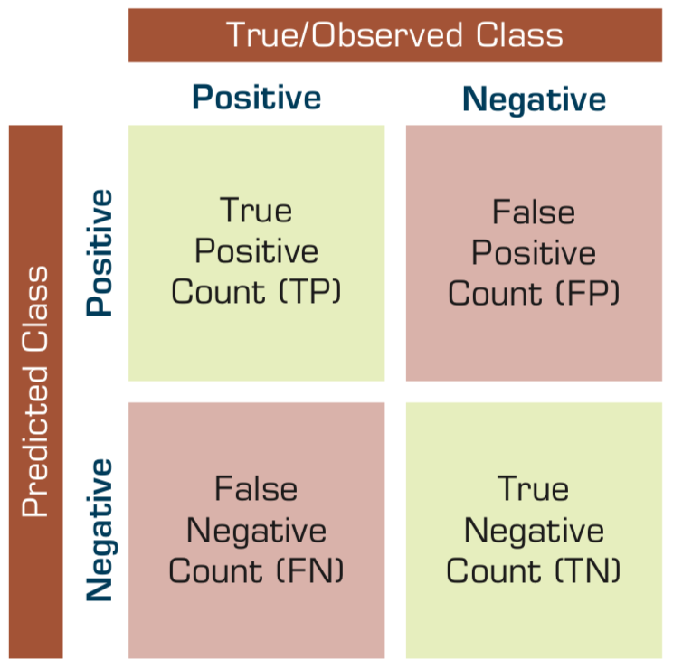
Confusion Matrix for Tabulation of Two-Class Classification Results
Source: Ramesh Sharda, Dursun Delen, and Efraim Turban (2017), Business Intelligence, Analytics, and Data Science: A Managerial Perspective, 4th Edition, Pearson

Slide 54
Sensitivity Specificity
=True Positive Rate
=True Negative Rate

Slide 55
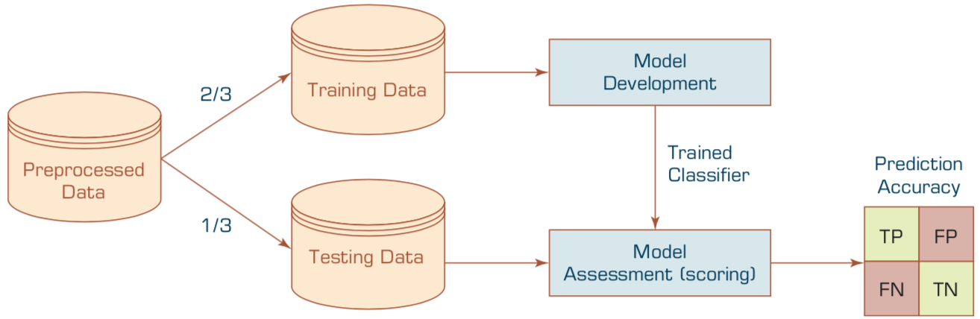
Estimation Methodologies for Classification
Simple split (or holdout or test sample estimation)
Split the data into 2 mutually exclusive sets training (~70%) and testing (30%)
For ANN, the data is split into three sub-sets (training [~60%], validation [~20%], testing [~20%])
Source: Ramesh Sharda, Dursun Delen, and Efraim Turban (2017), Business Intelligence, Analytics, and Data Science: A Managerial Perspective, 4th Edition, Pearson

Slide 56
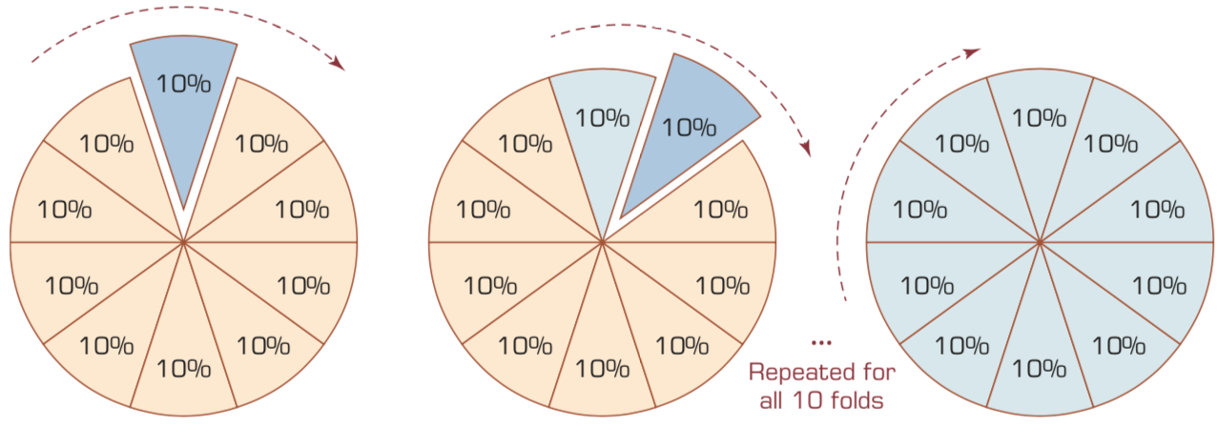
k-Fold Cross-Validation
Source: Ramesh Sharda, Dursun Delen, and Efraim Turban (2017), Business Intelligence, Analytics, and Data Science: A Managerial Perspective, 4th Edition, Pearson

Slide 57
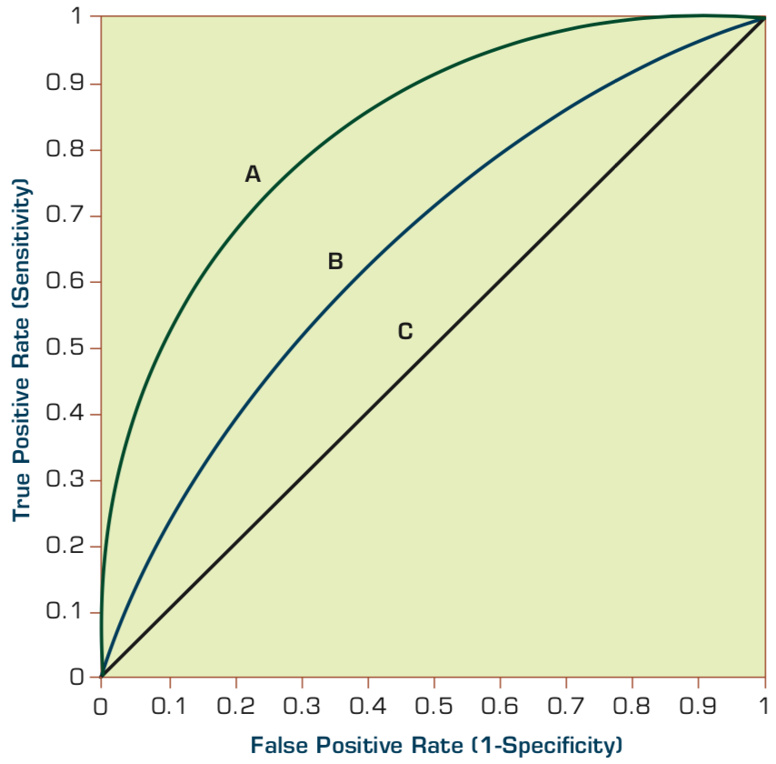
Estimation Methodologies for Classification Area under the ROC curve
Source: Ramesh Sharda, Dursun Delen, and Efraim Turban (2017), Business Intelligence, Analytics, and Data Science: A Managerial Perspective, 4th Edition, Pearson

Slide 58
True Class (actual value)
Positive
Negative
total
True Positive (TP)
False Positive (FP)
Positive
P’
Predictive Class (prediction outcome)
False Negative (FN)
True Negative (TN)
Negative
N’
total
P
N
Source: http://en.wikipedia.org/wiki/Receiver_operating_characteristic

Slide 59
True Class (actual value)
Positive
Negative
total
True Positive (TP)
False Positive (FP)
Positive
P’
Predictive Class (prediction outcome)
False Negative (FN)
True Negative (TN)
Negative
N’
total
P
N
Sensitivity = True Positive Rate = Recall = Hit rate
= TP / (TP + FN)
Source: http://en.wikipedia.org/wiki/Receiver_operating_characteristic

Slide 60
True Class (actual value)
Positive
Negative
total
True Positive (TP)
False Positive (FP)
Positive
P’
Predictive Class (prediction outcome)
False Negative (FN)
True Negative (TN)
Negative
N’
total
P
N
Specificity = True Negative Rate
= TN / N
= TN / (TN+ FP)
Source: http://en.wikipedia.org/wiki/Receiver_operating_characteristic

Slide 61
True Class (actual value)
Precision = Positive Predictive Value (PPV)
Positive
Negative
total
True Positive (TP)
False Positive (FP)
Positive
P’
Recall = True Positive Rate (TPR)
= Sensitivity
= Hit Rate
Predictive Class (prediction outcome)
False Negative (FN)
True Negative (TN)
Negative
N’
total
P
N
F1 score (F-score)(F-measure)
is the harmonic mean of precision and recall = 2TP / (P + P’) = 2TP / (2TP + FP + FN)
Source: http://en.wikipedia.org/wiki/Receiver_operating_characteristic

Slide 62
A
63 (TP)
28 (FP)
Recall = True Positive Rate (TPR)
= Sensitivity
= Hit Rate
= TP / (TP + FN)
Specificity = True Negative Rate
= TN / N
= TN / (TN + FP)
91
37 (FN)
72 (TN)
109
100
100
200
TPR = 0.63
FPR = 0.28
PPV = 0.69
=63/(63+28) =63/91
Precision = Positive Predictive Value (PPV)
F1 = 0.66 = 2*(0.63*0.69)/(0.63+0.69) = (2 * 63) /(100 + 91)
= (0.63 + 0.69) / 2 =1.32 / 2 =0.66
F1 score (F-score) (F-measure)
is the harmonic mean of precision and recall = 2TP / (P + P’) = 2TP / (2TP + FP + FN)
ACC = 0.68
= (63 + 72) / 200
= 135/200 = 67.5
Source: http://en.wikipedia.org/wiki/Receiver_operating_characteristic

Slide 63
A
B
63 (TP)
28 (FP)
77 (TP)
77 (FP)
91
154
37 (FN)
72 (TN)
109
23 (FN)
23 (TN)
46
100
100
200
100
100
200
TPR = 0.63
TPR = 0.77
FPR = 0.77
PPV = 0.50
F1 = 0.61
ACC = 0.50
FPR = 0.28
PPV = 0.69
=63/(63+28) =63/91
F1 = 0.66 = 2*(0.63*0.69)/(0.63+0.69) = (2 * 63) /(100 + 91)
= (0.63 + 0.69) / 2 =1.32 / 2 =0.66
Recall = True Positive Rate (TPR)
= Sensitivity
= Hit Rate
ACC = 0.68
= (63 + 72) / 200
= 135/200 = 67.5
Precision = Positive Predictive Value (PPV)
Source: http://en.wikipedia.org/wiki/Receiver_operating_characteristic

Slide 64
C
C’
24 (TP)
88 (FP)
76 (TP)
12 (FP)
112
88
76 (FN)
12 (TN)
88
24 (FN)
88 (TN)
112
100
100
200
100
100
200
TPR = 0.24
FPR = 0.88
PPV = 0.21
F1 = 0.22
ACC = 0.18
TPR = 0.76
FPR = 0.12
PPV = 0.86
F1 = 0.81
ACC = 0.82
Recall = True Positive Rate (TPR)
= Sensitivity
= Hit Rate
Precision = Positive Predictive Value (PPV)
Source: http://en.wikipedia.org/wiki/Receiver_operating_characteristic

Slide 65
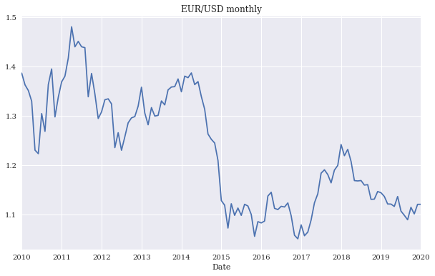
EUR/USD exchange rate as time series (monthly)
Source: Yves Hilpisch (2020), Artificial Intelligence in Finance: A Python-Based Guide, O’Reilly Media.

Slide 66
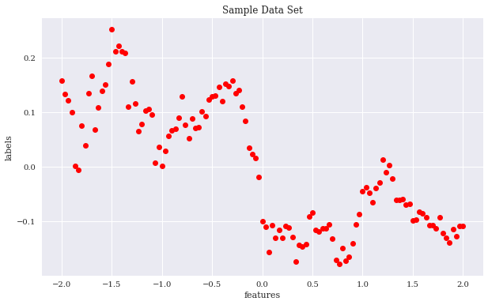
Sample data set
Source: Yves Hilpisch (2020), Artificial Intelligence in Finance: A Python-Based Guide, O’Reilly Media.

Slide 67
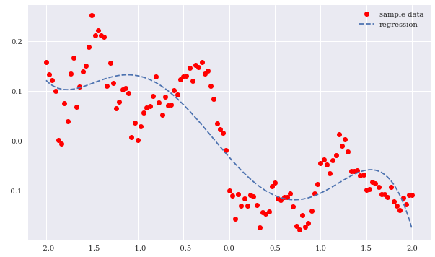
Sample data and cubic regression line
Source: Yves Hilpisch (2020), Artificial Intelligence in Finance: A Python-Based Guide, O’Reilly Media.

Slide 68
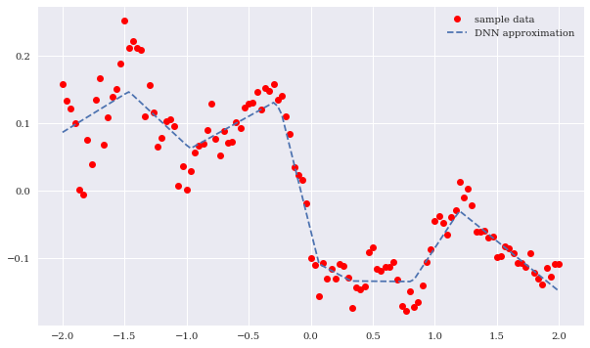
Sample data and neural network approximation
Source: Yves Hilpisch (2020), Artificial Intelligence in Finance: A Python-Based Guide, O’Reilly Media.

Slide 69
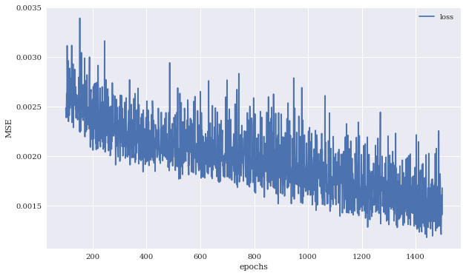
MSE values against number of training epochs
Source: Yves Hilpisch (2020), Artificial Intelligence in Finance: A Python-Based Guide, O’Reilly Media.

Slide 70
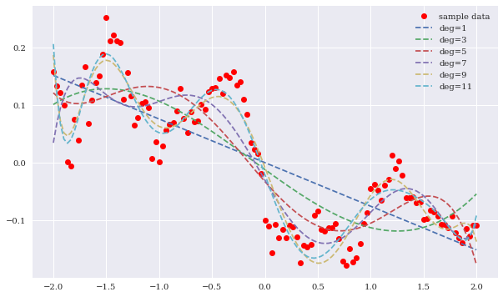
Regression lines for different highest degrees
Source: Yves Hilpisch (2020), Artificial Intelligence in Finance: A Python-Based Guide, O’Reilly Media.

Slide 71
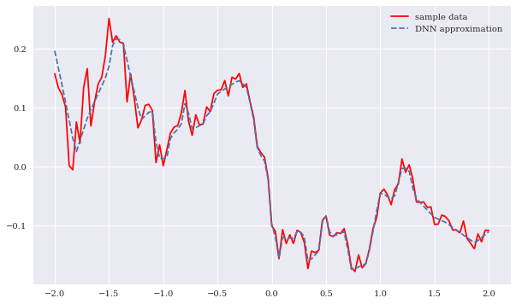
Sample data and DNN approximation (higher capacity)
Source: Yves Hilpisch (2020), Artificial Intelligence in Finance: A Python-Based Guide, O’Reilly Media.

Slide 72
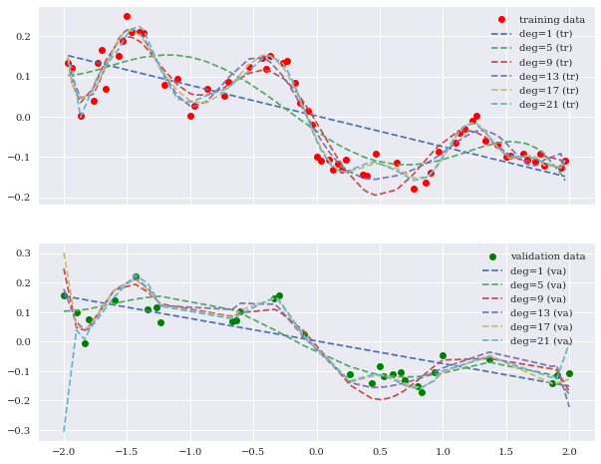
Training and validation data including regression fits
Source: Yves Hilpisch (2020), Artificial Intelligence in Finance: A Python-Based Guide, O’Reilly Media.

Slide 73
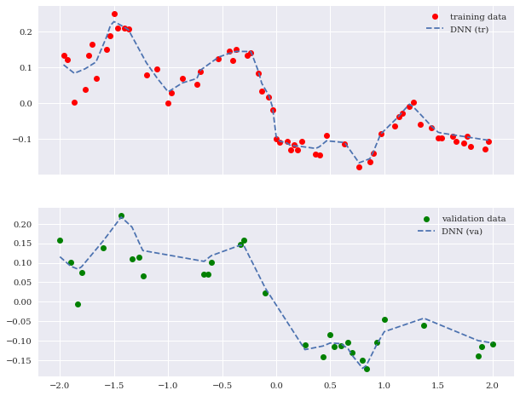
Training and validation data including DNN predictions
Source: Yves Hilpisch (2020), Artificial Intelligence in Finance: A Python-Based Guide, O’Reilly Media.

Slide 74
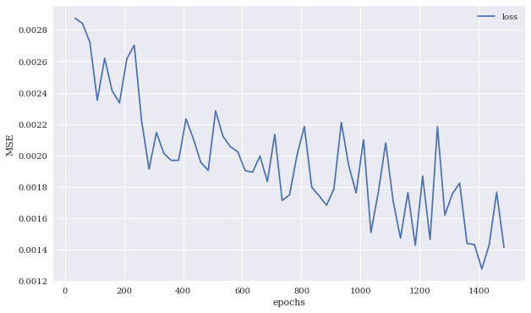
MSE values for DNN model on the training and validation data sets
Source: Yves Hilpisch (2020), Artificial Intelligence in Finance: A Python-Based Guide, O’Reilly Media.

Slide 75
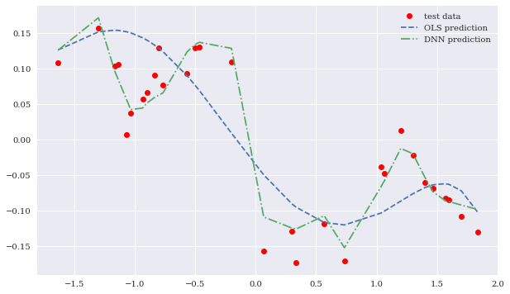
Test data and predictions from OLS regression and the DNN model
Source: Yves Hilpisch (2020), Artificial Intelligence in Finance: A Python-Based Guide, O’Reilly Media.

Slide 76
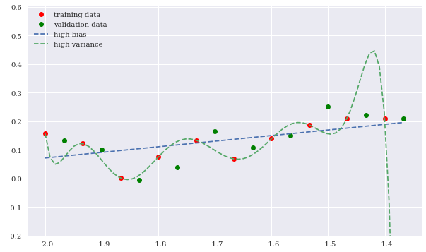
High bias and high variance OLS regression fits
Source: Yves Hilpisch (2020), Artificial Intelligence in Finance: A Python-Based Guide, O’Reilly Media.

Slide 77
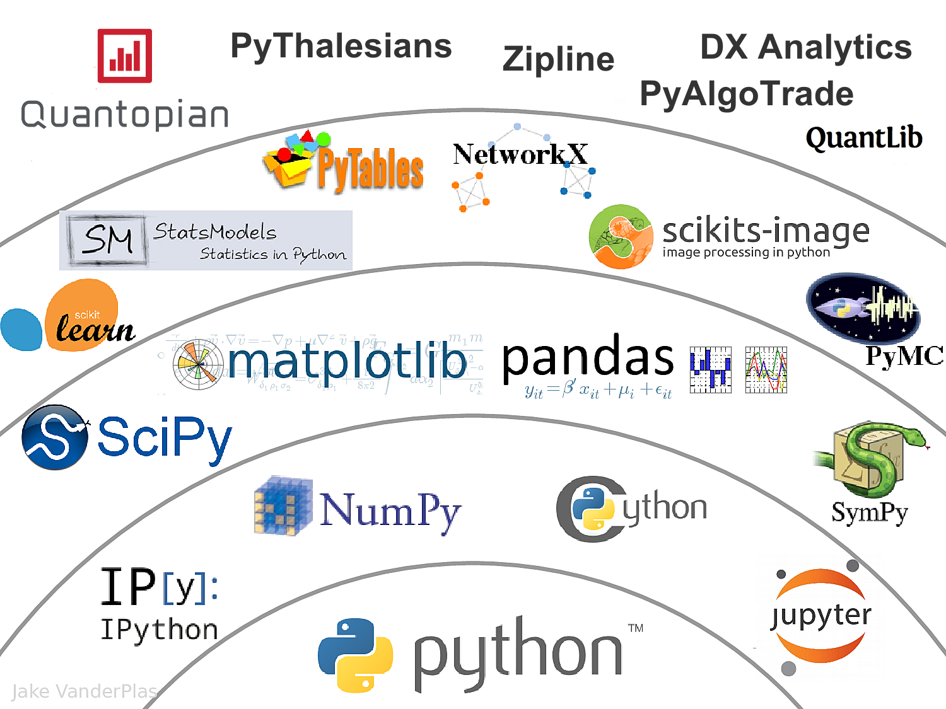
The Quant Finance PyData Stack
Source: http://nbviewer.jupyter.org/format/slides/github/quantopian/pyfolio/blob/master/pyfolio/examples/overview_slides.ipynb#/5

Slide 78
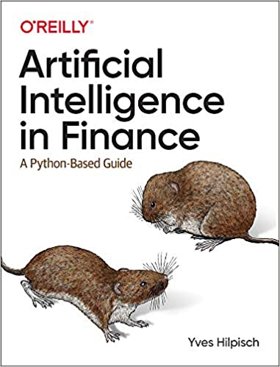
Yves Hilpisch (2020), Artificial Intelligence in Finance: A Python-Based Guide, O’Reilly
Source: https://www.amazon.com/Artificial-Intelligence-Finance-Python-Based-Guide/dp/1492055433

Slide 79
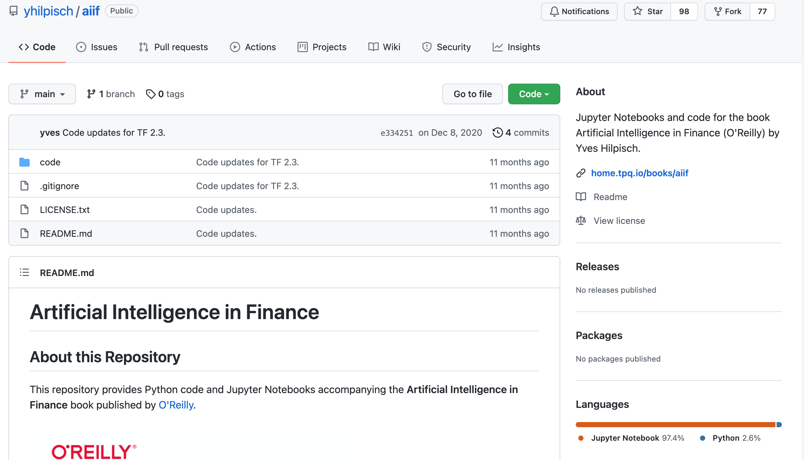
Yves Hilpisch (2020), Artificial Intelligence in Finance: A Python-Based Guide, O’Reilly
https://github.com/yhilpisch/aiif
Source: https://github.com/yhilpisch/aiif

Slide 80
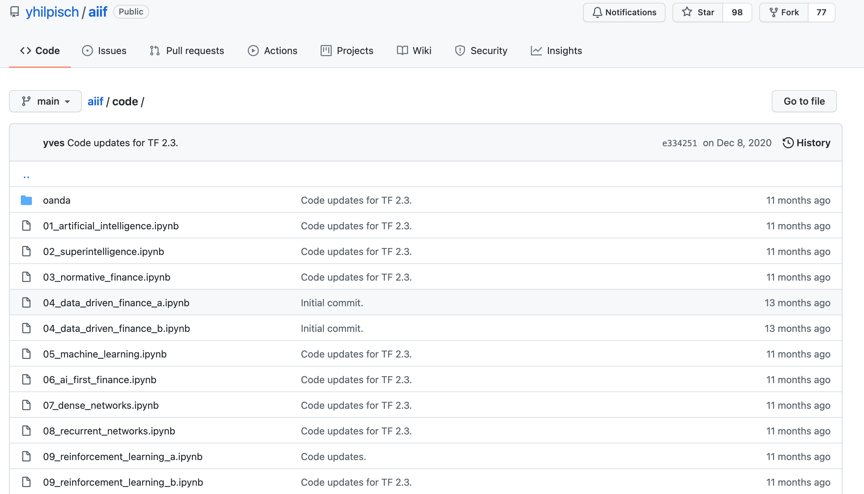
Yves Hilpisch (2020), Artificial Intelligence in Finance: A Python-Based Guide, O’Reilly
https://github.com/yhilpisch/aiif/tree/main/code
Source: https://github.com/yhilpisch/aiif/tree/main/code

Slide 81
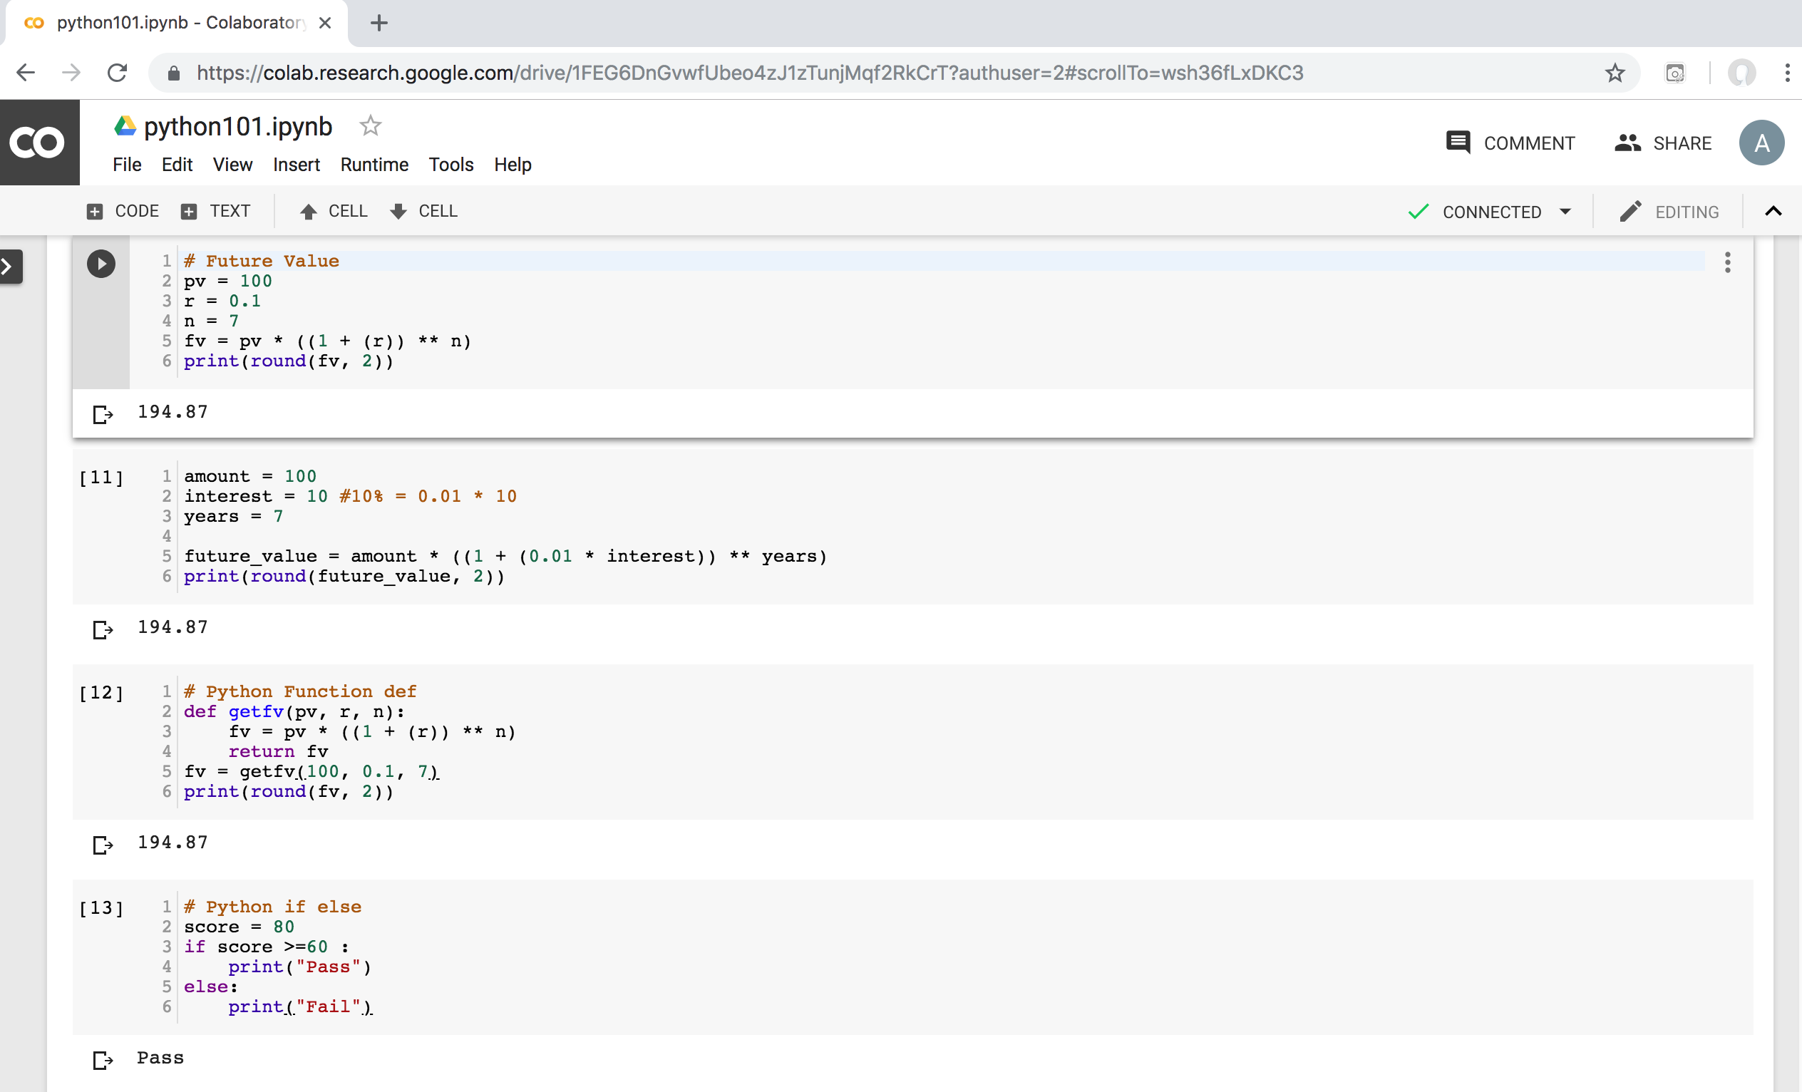
Python in Google Colab (Python101)
https://colab.research.google.com/drive/1FEG6DnGvwfUbeo4zJ1zTunjMqf2RkCrT
https://tinyurl.com/aintpupython101

Slide 82
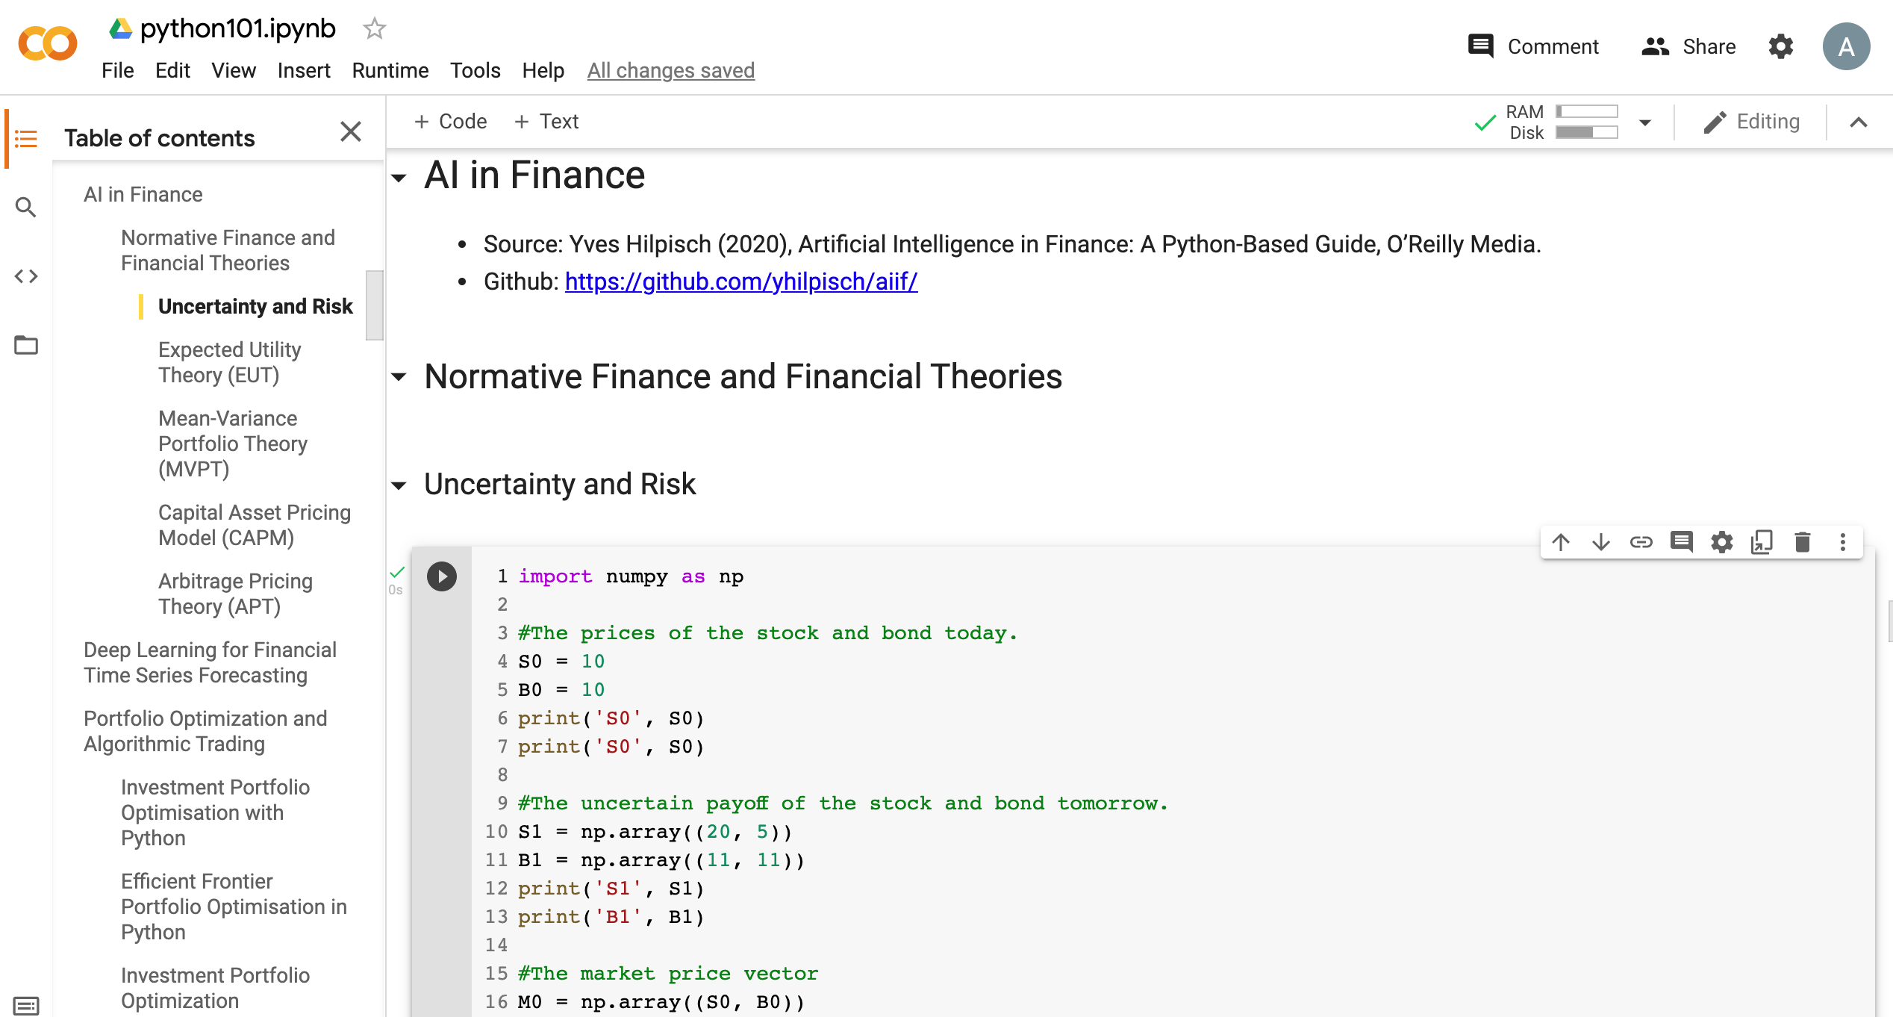
Python in Google Colab (Python101)
https://colab.research.google.com/drive/1FEG6DnGvwfUbeo4zJ1zTunjMqf2RkCrT
AI in Finance
https://tinyurl.com/aintpupython101

Slide 83
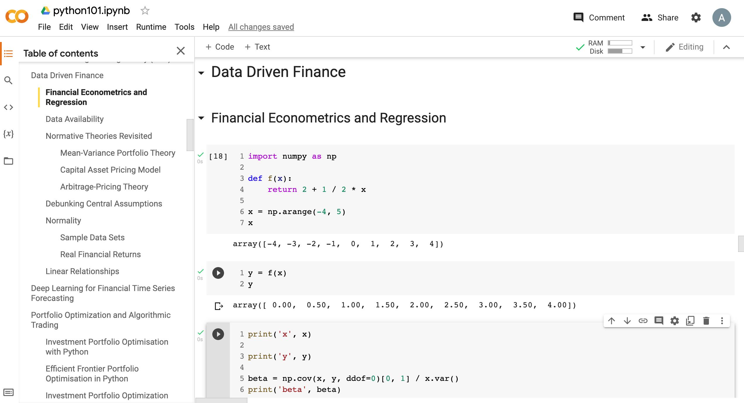
Python in Google Colab (Python101)
Data Driven Finance
https://tinyurl.com/aintpupython101

Slide 84
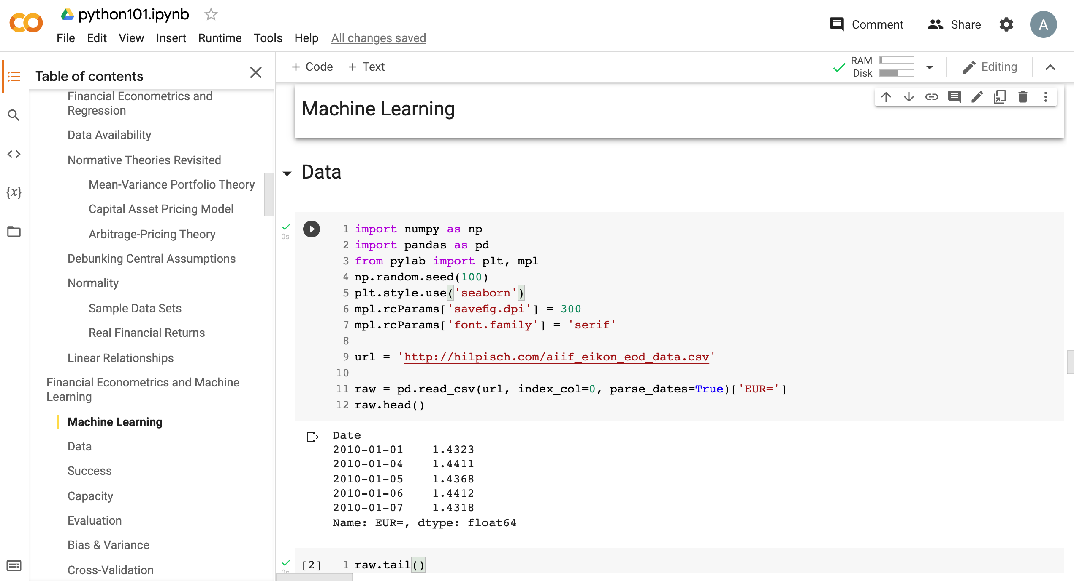
Python in Google Colab (Python101)
Machine Learning
https://tinyurl.com/aintpupython101

Slide 85
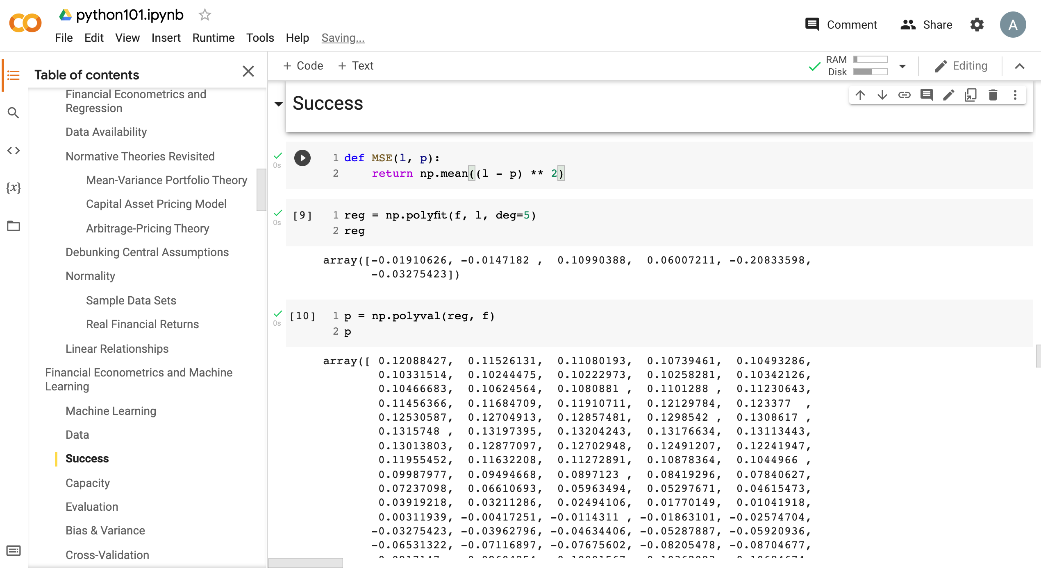
Python in Google Colab (Python101)
https://tinyurl.com/aintpupython101

Slide 86
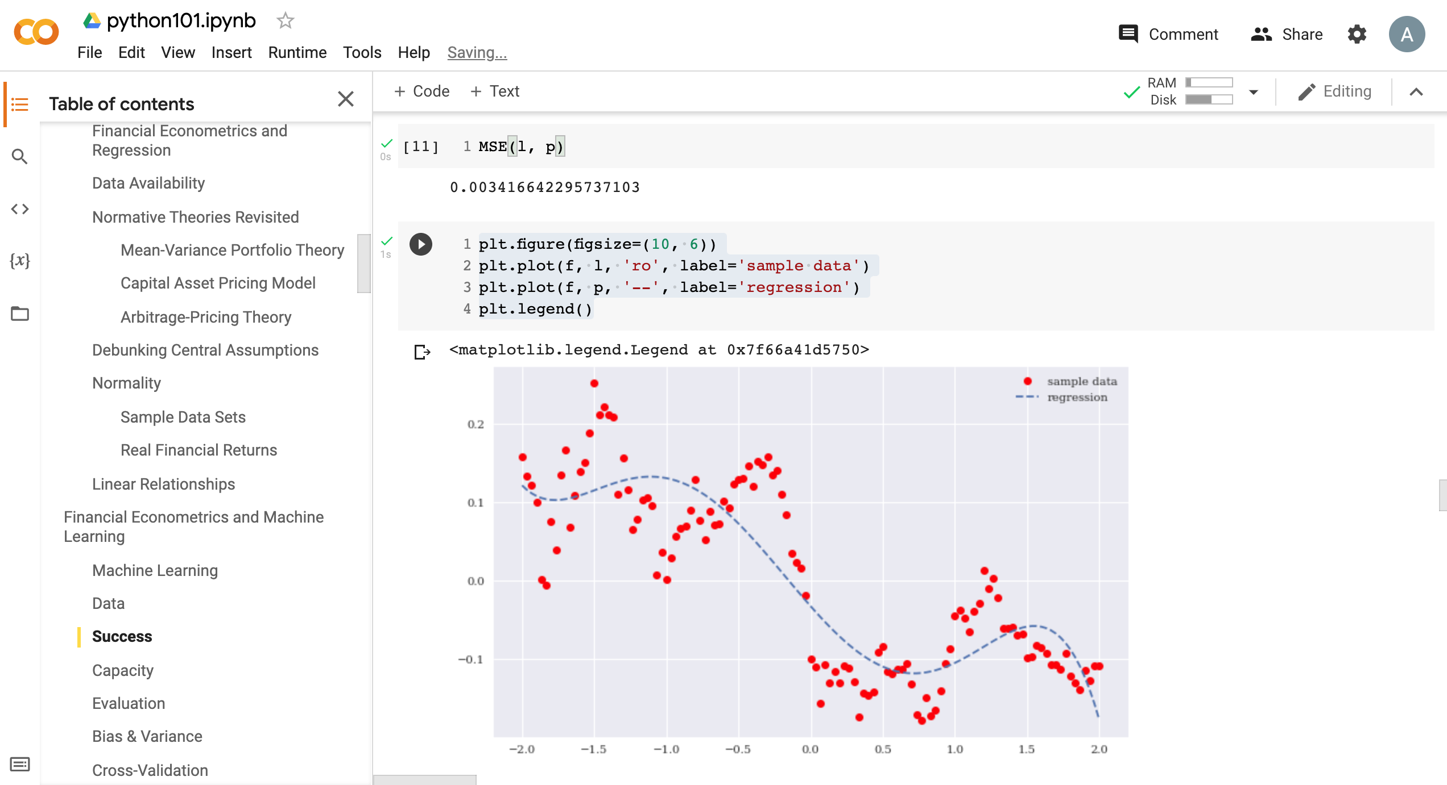
Python in Google Colab (Python101)
https://tinyurl.com/aintpupython101

Slide 87
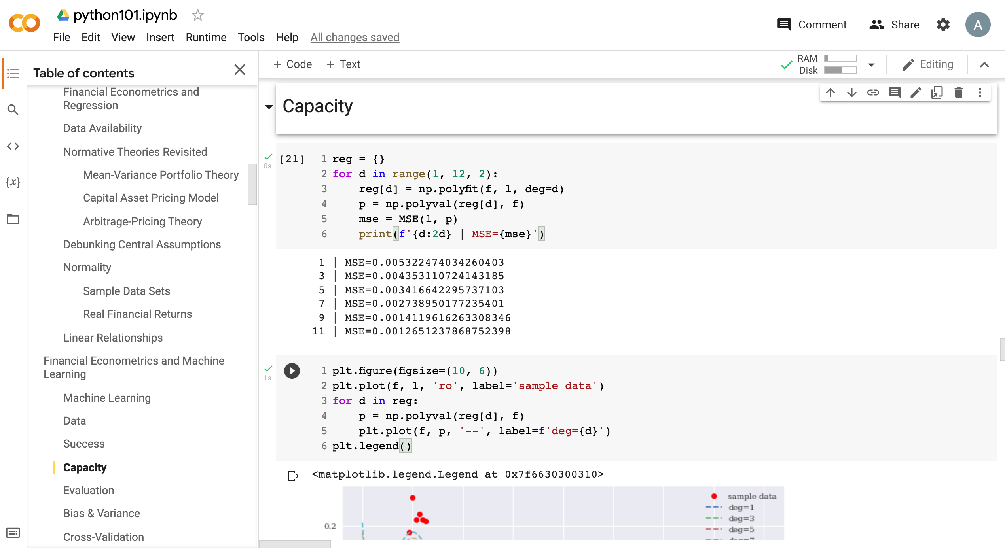
Python in Google Colab (Python101)
https://tinyurl.com/aintpupython101

Slide 88
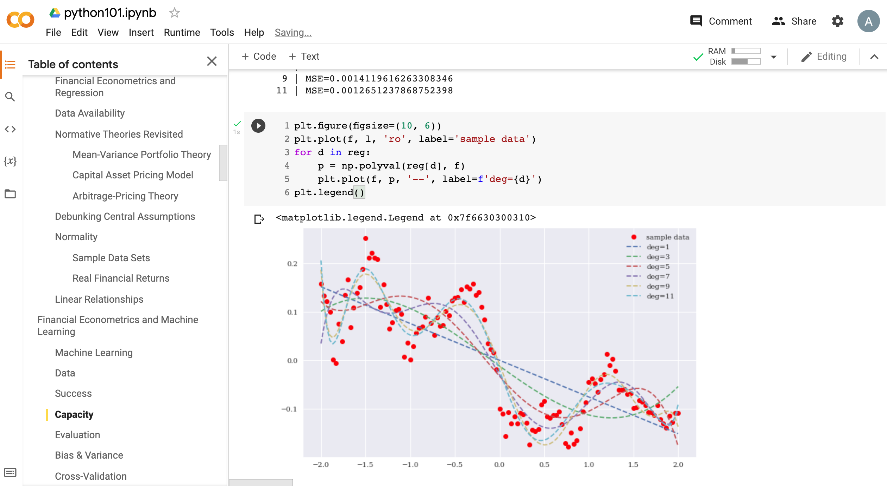
Python in Google Colab (Python101)
https://tinyurl.com/aintpupython101

Slide 89
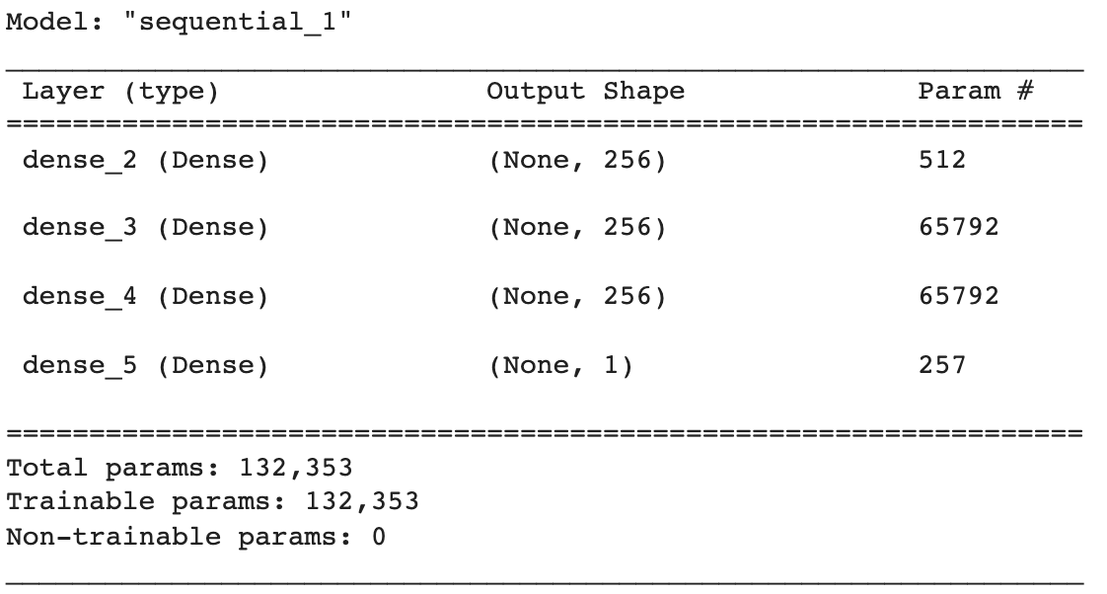
Python in Google Colab (Python101)
def create_dnn_model(hl=1, hu=256):
''' Function to create Keras DNN model.
Parameters
==========
hl: int
number of hidden layers
hu: int
number of hidden units (per layer)
'''
model = Sequential()
for _ in range(hl):
model.add(Dense(hu, activation='relu', input_dim=1))
model.add(Dense(1, activation='linear'))
model.compile(loss='mse', optimizer='rmsprop')
return model
model = create_dnn_model(3)
model.summary()
https://tinyurl.com/aintpupython101

Slide 90
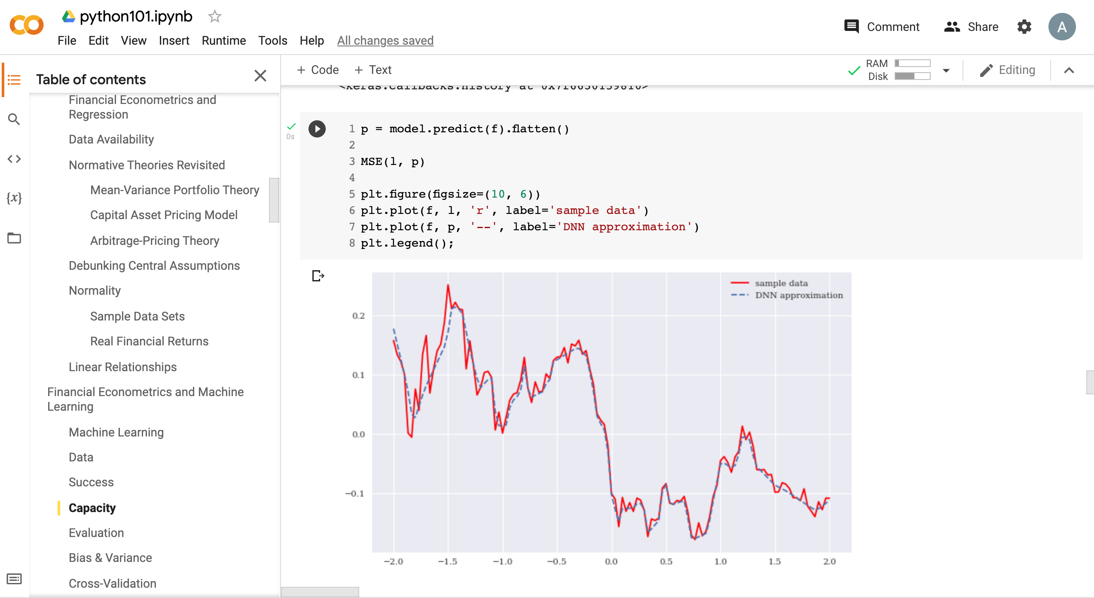
Python in Google Colab (Python101)
https://tinyurl.com/aintpupython101

Slide 91
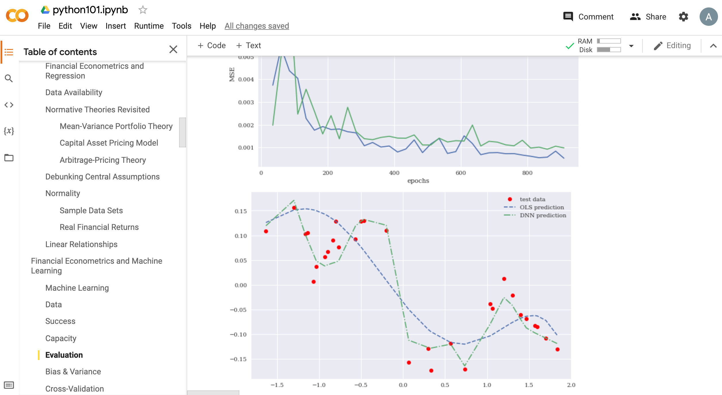
Python in Google Colab (Python101)
https://tinyurl.com/aintpupython101

Slide 92
Summary
Financial Econometrics
Financial Theories, OLS Regression
Machine Learning
Learning, Evaluation, Bias and variance
Cross-validation
Source: Yves Hilpisch (2020), Artificial Intelligence in Finance: A Python-Based Guide, O’Reilly Media.

Slide 93
References
Yves Hilpisch (2020), Artificial Intelligence in Finance: A Python-Based Guide, O’Reilly Media, https://github.com/yhilpisch/aiif .
Chris Brooks (2019), Introductory Econometrics for Finance, 4th Edition, Cambridge University Press
Oliver Linton (2019), Financial Econometrics: Models and Methods, Cambridge University Press
Azmat Islam and Muhammad Ajmal. (2025) "From Algorithms to Agents: Reframing FinTech Through Agentic Artificial Intelligence." Advance Journal of Econometrics and Finance 3, no. 1 (2025): 180-190.
Solomon Tetteh Mensah, Adebayo Fatai Lamidi, Olukunle O. Akanbi, Ayo Samuel Avwerosuo, and Afolashade Joy Jubrilla. (2026) "From Prediction to Causation: Integrating Causal, Generative, and Agent-Based AI in Economics and Finance." Journal of Accounts and Finance 1, no. 1 (2026): 1-9.
Tom Mitchell (1997), Machine Learning, McGraw-Hill.
Max Tegmark (2017), Life 3.0: Being human in the age of artificial intelligence. Vintage.
Ajay Agrawal, Joshua Gans, and Avi Goldfarb (2018). Prediction machines: the simple economics of artificial intelligence. Harvard Business Press.
Eugene F. Fama (1995), "Random walks in stock market prices." Financial Analysts Journal 51, no. 1, 75-80.
Ruey S. Tsay (2005), Analysis of financial time series, Wiley.
Min-Yuh Day (2026), Python 101, https://tinyurl.com/aintpupython101

