Slide 1



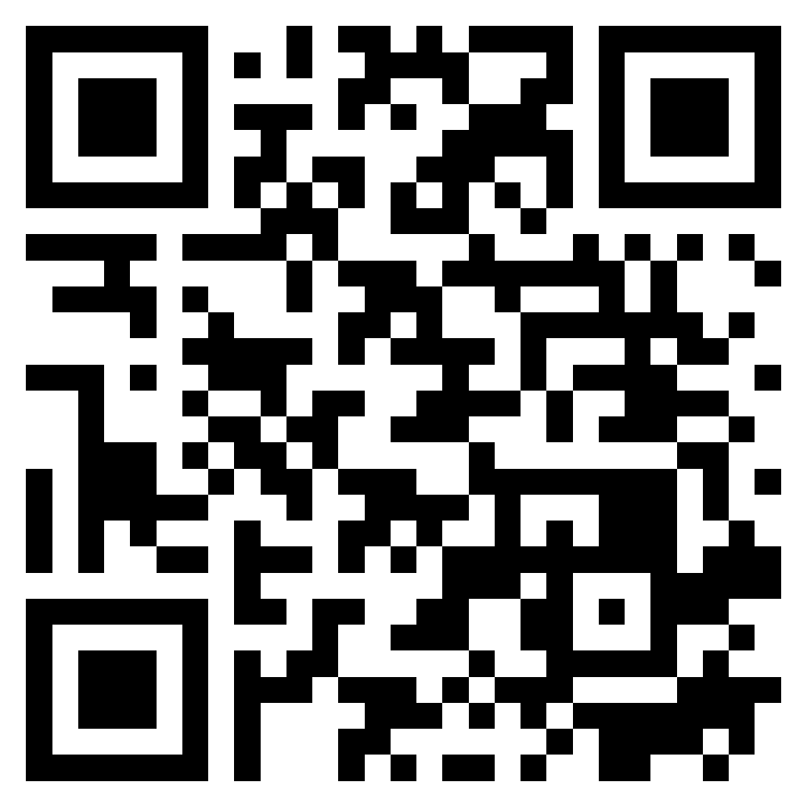


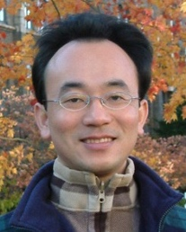



Introduction to Software Engineering
Software Engineering
1142SE01
MBA, IM, NTPU (M5010) (Spring 2026) Wed 2, 3, 4 (9:10-12:00) (B3F17)
University Ambassador
Certified Instructor
Min-Yuh Day, Ph.D, Professor and Director
Institute of Information Management, National Taipei University
https://web.ntpu.edu.tw/~myday
https://meet.google.com/ish-gzmy-pmo
2026-02-25

Slide 2









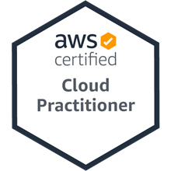
Prof. Min-Yuh Day
Director, Information Management, NTPU
Director, Intelligent Financial Innovation Technology, IFIT Lab, IM, NTPU
Director, Fintech and Green Finance Center (FGFC), NTPU
Visiting Scholar, IIS, Academia Sinica
Ph.D., Information Management, NTU
Artificial Intelligence, Agentic AI, ESG and Green Financial Technology, Big Data Analytics, Electronic Commerce
University Ambassador
Certified Instructor

Slide 3
Course Syllabus National Taipei University Academic Year 114, 2nd Semester (Spring 2026)
Course Title: Software Engineering
Instructor: Min-Yuh Day
Course Class: MBA, IM, NTPU (3 Credits, Elective) GMBA in Finance; SHM; IPUG
Details
In-Person and Distance Learning EMI Course (3 Credits, Elective, One Semester) (M5010)
Time & Place: Wed, 2, 3, 4, (9:10-12:00) (B3F17)
Google Meet: https://meet.google.com/ish-gzmy-pmo
https://meet.google.com/ish-gzmy-pmo

Slide 4
Course Objectives
Understand the fundamental concepts and research issues of software engineering.
Equip with Hands-on practices of software engineering.
Conduct information systems research in the context of software engineering.

Slide 5
Course Outline
This course introduces the fundamental concepts, research issues, and hands-on practices of software engineering.
Topics include:
Introduction to Software Engineering
Software Products and Project Management: Software product management and prototyping with Generative AI and Agentic AI
Agile Software Engineering: Agile methods, Scrum, and Extreme Programming
Features, Scenarios, and Stories
Software Architecture: Architectural design, System decomposition, and Distribution architecture
Cloud-Based Software: Virtualization and containers, Everything as a service, Software as a service
Cloud Computing and Cloud Software Architecture
Microservices Architecture, RESTful services, Service deployment
Security and Privacy; Reliable Programming
Testing: Functional testing, Test automation, Test-driven development, and Code reviews
DevOps and Code Management: Code management and DevOps automation
Case Study on Software Engineering

Slide 6
Core Competence
Exploring new knowledge in information technology, system development and application 80 %
Internet marketing planning ability 10 %
Thesis writing and independent research skills 10 %

Slide 7
Four Fundamental Qualities
Professionalism
Creative thinking and Problem-solving 30 %
Comprehensive Integration 30 %
Interpersonal Relationship
Communication and Coordination 10 %
Teamwork 10 %
Ethics
Honesty and Integrity 5 %
Self-Esteem and Self-reflection 5 %
International Vision
Caring for Diversity 5 %
Interdisciplinary Vision 5 %

Slide 8
College Learning Goals
Ethics/Corporate Social Responsibility
Global Knowledge/Awareness
Communication
Analytical and Critical Thinking

Slide 9
Department Learning Goals
Information Technologies and System Development Capabilities
Internet Marketing Management Capabilities
Research capabilities

Slide 10
Syllabus
Week Date Subject/Topics
1 2026/02/25 Introduction to Software Engineering
2 2026/03/04 Software Products and Project Management: Software product management and prototyping with Generative AI and Agentic AI
3 2026/03/11 Agile Software Engineering: Agile methods, Scrum, and Extreme Programming
4 2026/03/18 Case Study on Software Engineering I
5 2026/03/25 Features, Scenarios, and Stories
6 2026/04/01 Software Architecture: Architectural design, System decomposition, and Distribution architecture

Slide 11
Syllabus
Week Date Subject/Topics
7 2026/04/08 Cloud-Based Software: Virtualization and containers, Everything as a service, Software as a service
8 2026/04/15 Midterm Project Report
9 2026/04/22 Cloud Computing and Cloud Software Architecture
10 2026/04/29 Microservices Architecture, RESTful services, Service deployment
11 2026/05/06 Case Study on Software Engineering II
12 2026/05/13 Security and Privacy; Reliable Programming; Testing: Functional testing, Test automation, Test-driven development, and Code reviews

Slide 12
Syllabus
Week Date Subject/Topics
13 2026/05/20 Industry Practices of Software Engineering
14 2026/05/27 DevOps and Code Management: Code management and DevOps automation
15 2026/06/03 Final Project Report I
16 2026/06/10 Final Project Report II

Slide 13
Teaching Methods and Activities
Lecture
Discussion
Practicum

Slide 14
Evaluation Methods
Individual Presentation 60 %
Group Presentation 10 %
Case Report 10 %
Class Participation 10 %
Assignment 10 %

Slide 15
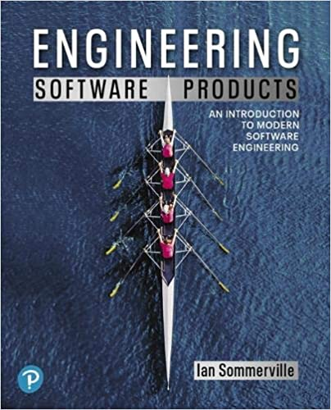
Required Texts
Ian Sommerville (2019), Engineering Software Products: An Introduction to Modern Software Engineering, Pearson.

Slide 16
References
Ian Sommerville (2015), Software Engineering, 10th Edition, Pearson.
Titus Winters, Tom Manshreck, and Hyrum Wright (2020), Software Engineering at Google: Lessons Learned from Programming Over Time, O'Reilly Media.
Project Management Institute (2017), Agile Practice Guide, PMI
Project Management Institute (2021), A Guide to the Project Management Body of Knowledge (PMBOK Guide) – Seventh Edition and The Standard for Project Management, PMI
Denis Rothman (2024), RAG-Driven Generative AI: Build custom retrieval augmented generation pipelines with LlamaIndex, Deep Lake, and Pinecone, Packt Publishing
NVIDIA DLI (2025), Building RAG Agents with LLMs, https://learn.nvidia.com/courses/course-detail?course_id=course-v1:DLI+S-FX-15+V1
NVIDIA DLI (2025), Generative AI with Diffusion Models, https://learn.nvidia.com/courses/course-detail?course_id=course-v1:DLI+S-FX-14+V1

Slide 17
Ian Sommerville (2019), Engineering Software Products: An Introduction to Modern Software Engineering, Pearson.

Slide 18

Ian Sommerville (2015), Software Engineering, 10th Edition, Pearson.

Slide 19
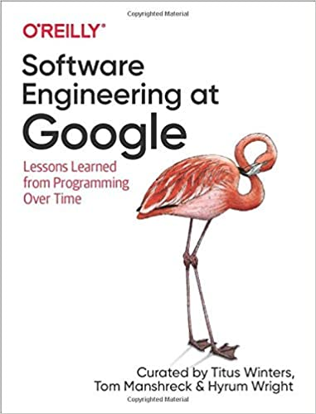
Titus Winters, Tom Manshreck, and Hyrum Wright (2020), Software Engineering at Google: Lessons Learned from Programming Over Time, O'Reilly Media.

Slide 20
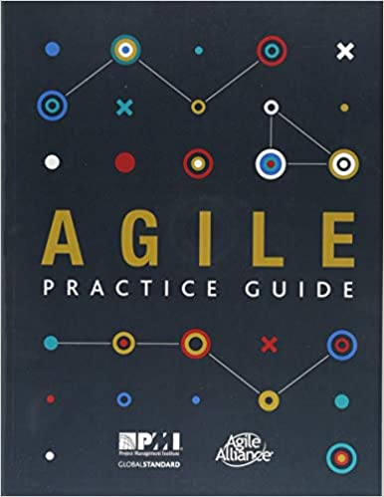
Project Management Institute (2017), Agile Practice Guide PMI

Slide 21
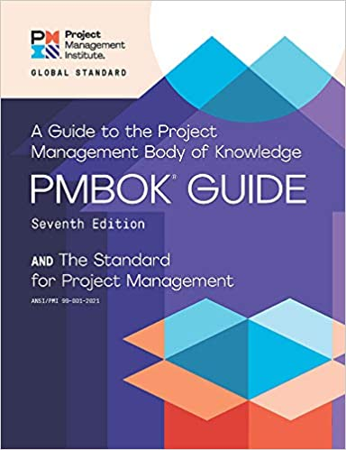
Project Management Institute (2021), A Guide to the Project Management Body of Knowledge (PMBOK Guide) – Seventh Edition and The Standard for Project Management

Slide 22
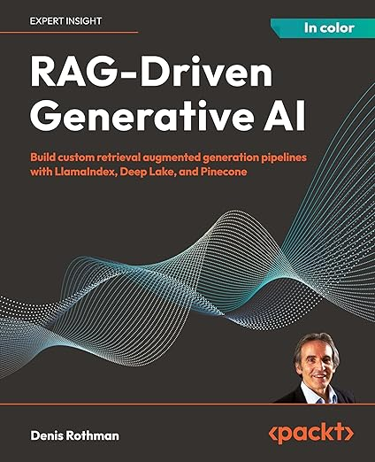
Denis Rothman (2024), RAG-Driven Generative AI: Build custom retrieval augmented generation pipelines with LlamaIndex, Deep Lake, and Pinecone, Packt Publishing
Source: https://www.amazon.com/RAG-Driven-Generative-retrieval-generation-LlamaIndex/dp/1836200919/

Slide 23
Software Engineering

Slide 24
Software Engineering and Project Management
Analyze
Requirements definition
Design
System and Software design
Build
Implementation and
unit testing
Test
Integration and system testing
Deliver
Operation and maintenance
Project Management

Slide 25
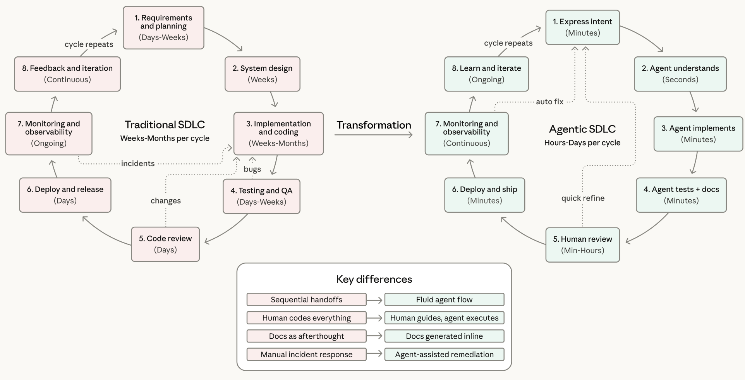
Agentic Coding Software Development Lifecycle

Slide 26
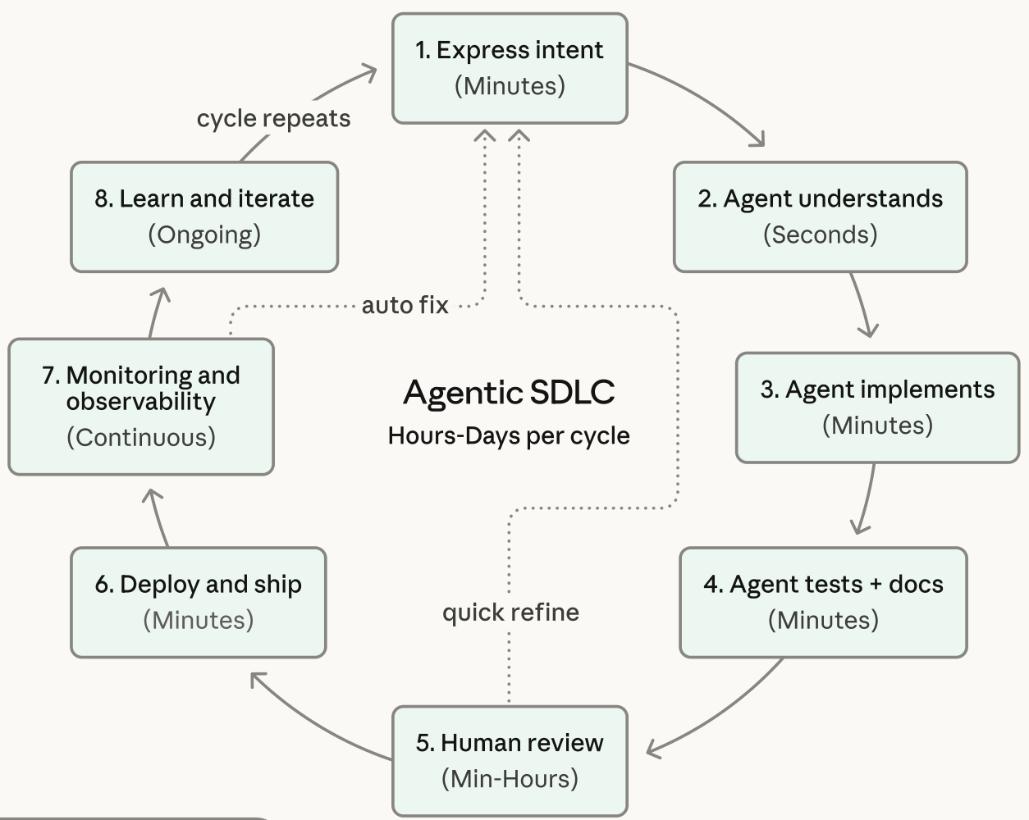
Agentic Coding Software Development Lifecycle

Slide 27
Information Management Management Information Systems (MIS) Information Systems

Slide 28
Information Management (MIS) Information Systems
Organizations
Technology
Information Systems
Management

Slide 29
Fundamental MIS Concepts
Business Challenges
Management
Organization
Information System
Business Solutions
Technology

Slide 30
Project-based software engineering
CUSTOMER
Problem
generates
helps-with
Requirements
implemented-by
Software
1
CUSTOMER and DEVELOPER
DEVELOPER

Slide 31
Product software engineering
DEVELOPER
Opportunity
1
inspires
realizes
Product features
implemented-by
Software
DEVELOPER
DEVELOPER

Slide 32
Software execution models
Stand-alone execution
Hybrid execution
Software as a service
User’s computer
User’s computer
User’s computer
User interface
Product functionality
User data
User interface
Partial functionality
User data
User interface
(browser or app)
Product updates
Additional functionality
User data backups
Product updates
Product functionality
User data
Vendor’s servers
Vendor’s servers
Vendor’s servers

Slide 33
Product management concerns
Business needs
Product manager
Technology constraints
Customer experience

Slide 34
Technical interactions of product managers
Product vision management
Product backlog management
User stories and scenarios
Product manager
Acceptance testing
Customer testing
User interface design

Slide 35
Software Development Life Cycle (SDLC) The waterfall model
Requirements definition
System and Software design
Implementation and unit testing
Integration and system testing
Operation and maintenance

Slide 36
Plan-based and Agile development
Plan-based development
Requirements engineering
Requirements specification
Design and implementation
Requirements change requests
Agile development
Requirements engineering
Design and implementation

Slide 37
The Continuum of Life Cycles
High
Incremental
Agile
Frequency of Delivery
Predictive
Iterative
Low
Low
High
Degree of Change

Slide 38
Predictive Life Cycle
Analyze
Design
Build
Test
Deliver

Slide 39
Iterative Life Cycle
Prototype
Refine
Analyze
Analyze
Design
Build
Test
Deliver

Slide 40
A Life Cycle of Varying-Sized Increments
Analyze
Design
Build
Test
Deliver
Analyze
Design
Build
Test
Deliver
Analyze
Design
Build
Test
Deliver

Slide 41
Iteration-Based and Flow-Based Agile Life Cycles
Iteration-Based Agile
Requirements
Analysis
Design
Build
Test
Requirements
Analysis
Design
Build
Test
Requirements
Analysis
Design
Build
Test
Requirements
Analysis
Design
Build
Test
Repeat as needed
…
Requirements
Analysis
Design
Build
Test
Requirements
Analysis
Design
Build
Test
Flow-Based Agile
Requirements
Analysis
Design
Build
Test
the number of features in the WIP limit
Requirements
Analysis
Design
Build
Test
the number of features in the WIP limit
Requirements
Analysis
Design
Build
Test
the number of features in the WIP limit
Repeat as needed
…
Requirements
Analysis
Design
Build
Test
the number of features in the WIP limit
Requirements
Analysis
Design
Build
Test
the number of features in the WIP limit

Slide 42
From personas to features
1
Personas
A way of representing users
inspire
Natural language descriptions of a user interacting with a software product
2
Scenarios
are-developed-into
3
inspire
Stories
Natural language descriptions of something that is needed or wanted by users
4
Features
define
Fragments of product functionality

Slide 43
Multi-tier client-server architecture
Client 1
Client 2
Web Server
Application Server
Database Server
Client 3
Client …

Slide 44
Service-oriented Architecture
Client 1
S1
S2
Client 2
S3
Web Server
Service gateway
S4
Client 3
S5
Client …
S6
Services

Slide 45
VM
Container
Virtual web server
Virtual mail server
User 1 Container 1
User 2 Container 2
Server software
Server software
Application software
Application software
Guest OS
Guest OS
Server software
Server software
Hypervisor
Container manager
Host OS
Host OS
Server Hardware
Server Hardware

Slide 46
Everything as a service
Photo editing
Software as a service (SaaS)
Logistics management
Cloud management Monitoring
Platform as a service (PaaS)
Database
Software development
Storage Network
Infrastructure as a service (IaaS)
Computing Virtualization
Cloud data center

Slide 47
Software as a service
Software customers
Software provider
Software services
Cloud Infrastructure
Cloud provider

Slide 48
Microservices architecture – key design questions
What are the microservices that make up the system?
How should data be distributed and shared?
How should microservices communicate with each other?
Microservices architecture
design
How should the microservices in the system be coordinated?
How should service failure be detected, reported and managed?

Slide 49
Types of security threat
An attacker attempts to deny access to the system for legitimate users
An attacker attempts to damage the system or its data
Availability
threats
Integrity
threats
SOFTWARE PRODUCT
PROGRAM
Distributed denial of service (DDoS) attack
Virus
DATA
Ransomware
Data theft
Confidentiality threats
An attacker tries to gain access to private information held by the system

Slide 50
Software product quality attributes
Reliability
Availability
1
2
Software product quality attributes
Security
Resilience
7
3
Usability
Maintainability
6
4
Responsiveness
5

Slide 51
A refactoring process
1
2
Start
Identify code ‘smell’
Identify refactoring strategy
4
3
Run automated code tests
Make small
improvement until strategy completed

Slide 52
Functional testing
Start
1
Unit Testing
4
2
Release Testing
Feature Testing
3
System Testing

Slide 53
Test-driven development (TDD)
Start
1
Identify new functionality
2
Identify partial implementation
of functionality
3
Write code stub that will fail test
Functionality complete
Functionality incomplete
4
Run all automated test
7
Refactor code if required
5
Implement code that should cause failing test to pass
Test failure
6
Run all automated test
All tests pass

Slide 54
DevOps
Development
Deployment
Support
Multi-skilled DevOps team

Slide 55
Code management and DevOps
DevOps automation
Continuous integration
Continuous deployment
Continuous delivery
Infrastructure as code
Code management system
Branching and merging
Recover version information
Code repository
Save and retrieve versions
Transfer code to/from developer’s filestore
DevOps measurement
Data collection
Data analysis
Report generation

Slide 56
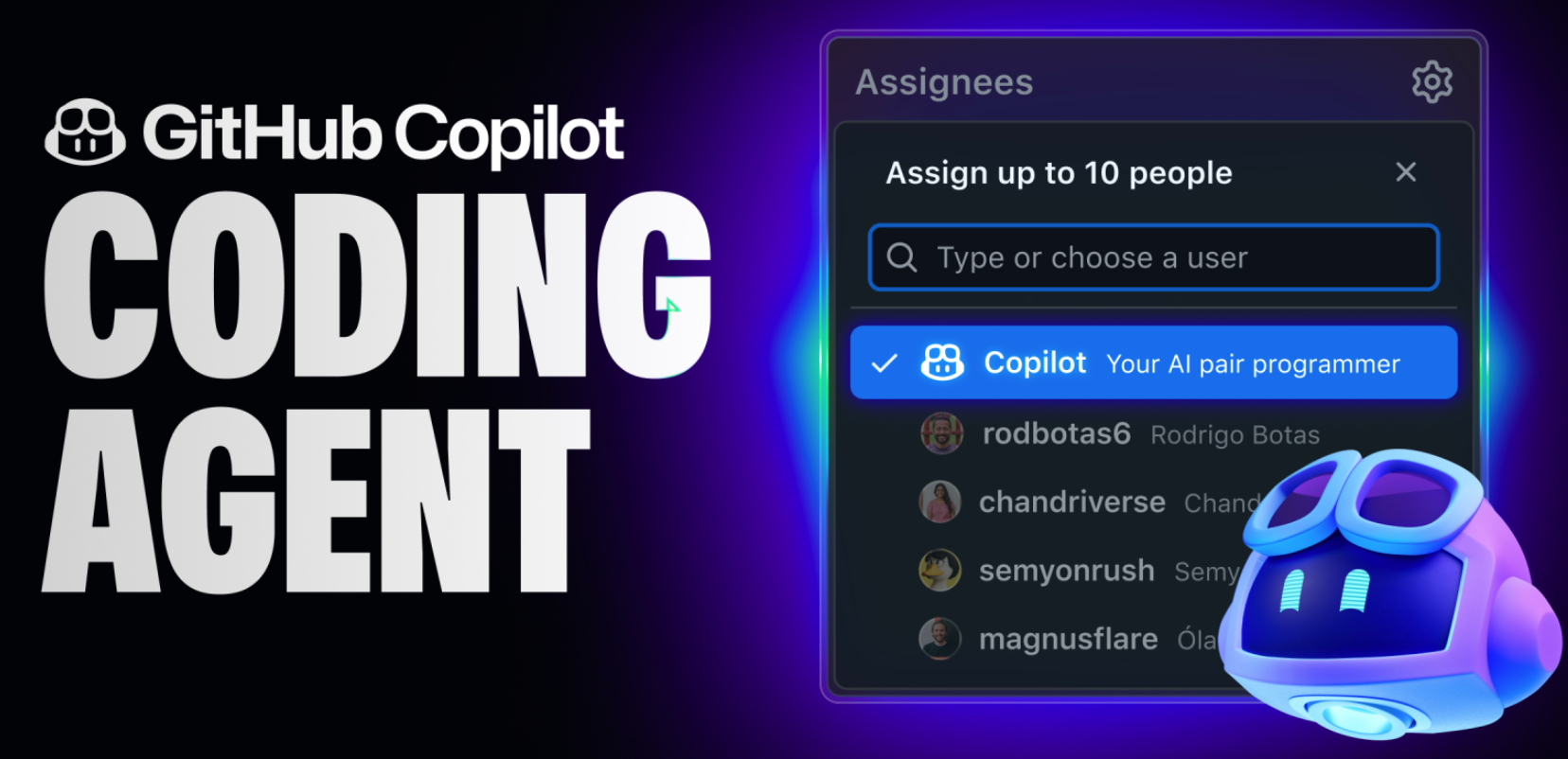
GitHub Copilot CODING AGENT

Slide 57
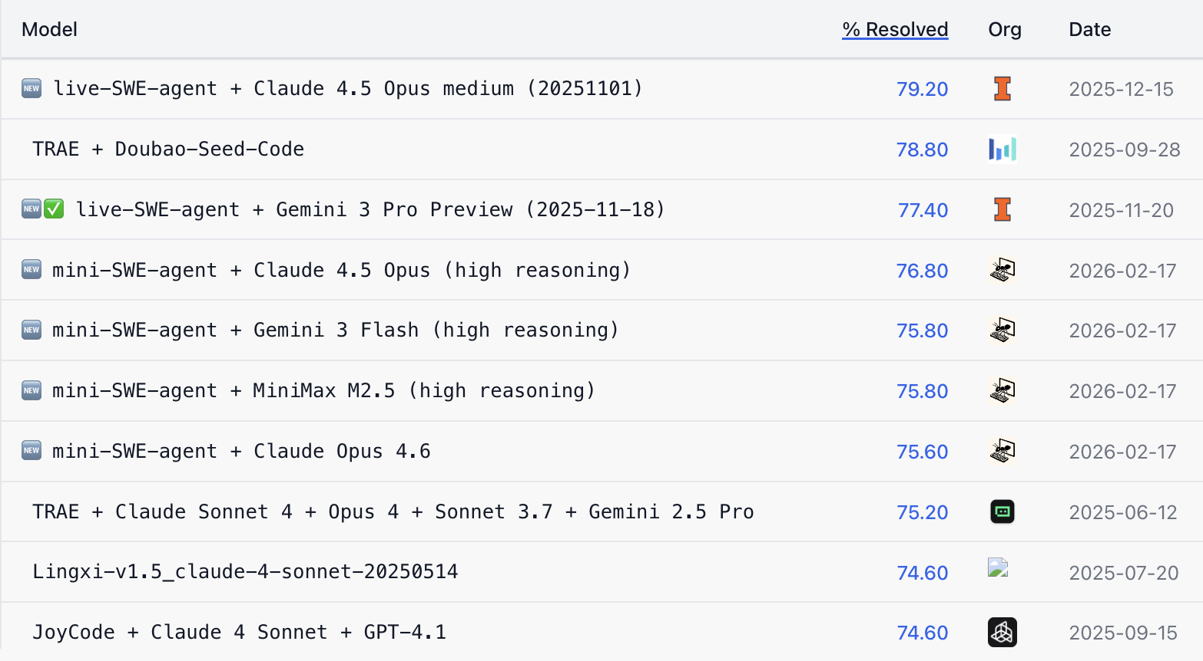
SWE-bench Verified Leaderboard AI coding agents ranking by software engineering problems resolved rate

Slide 58
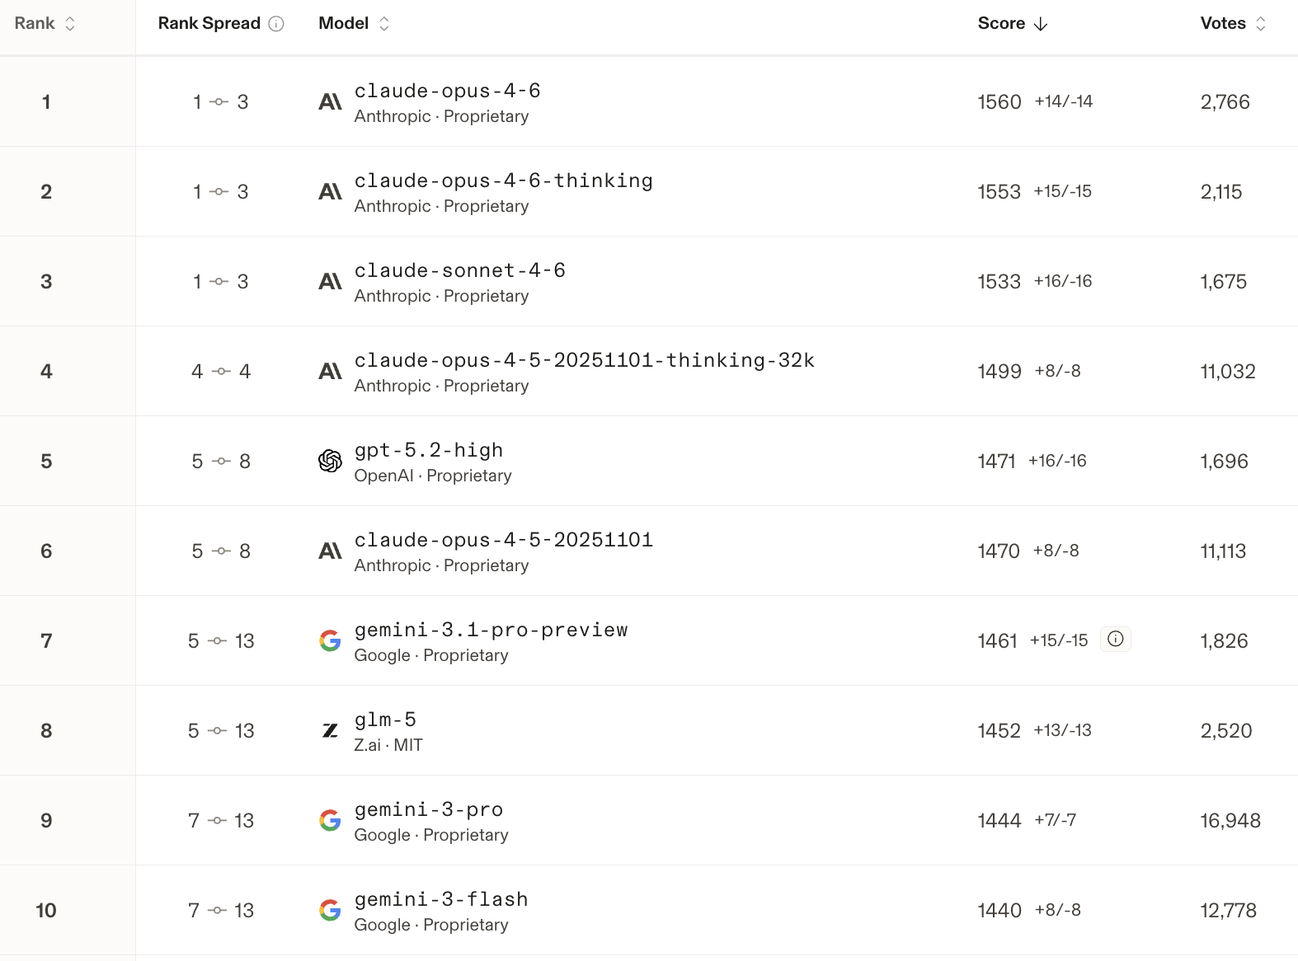
AI WebDev Code Arena AI models on agentic coding tasks (multi-step reasoning and tool use)

Slide 59
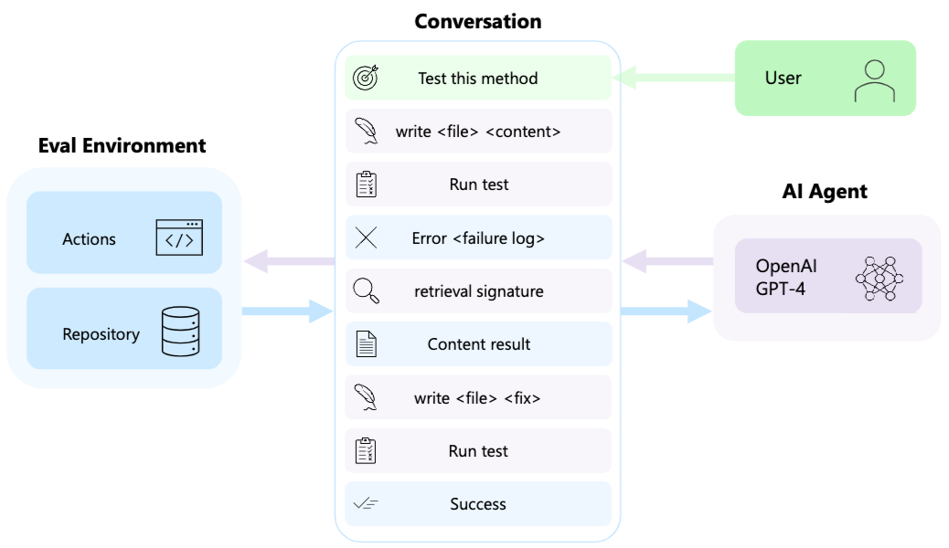
AutoDev: Automated AI-Driven Development

Slide 60
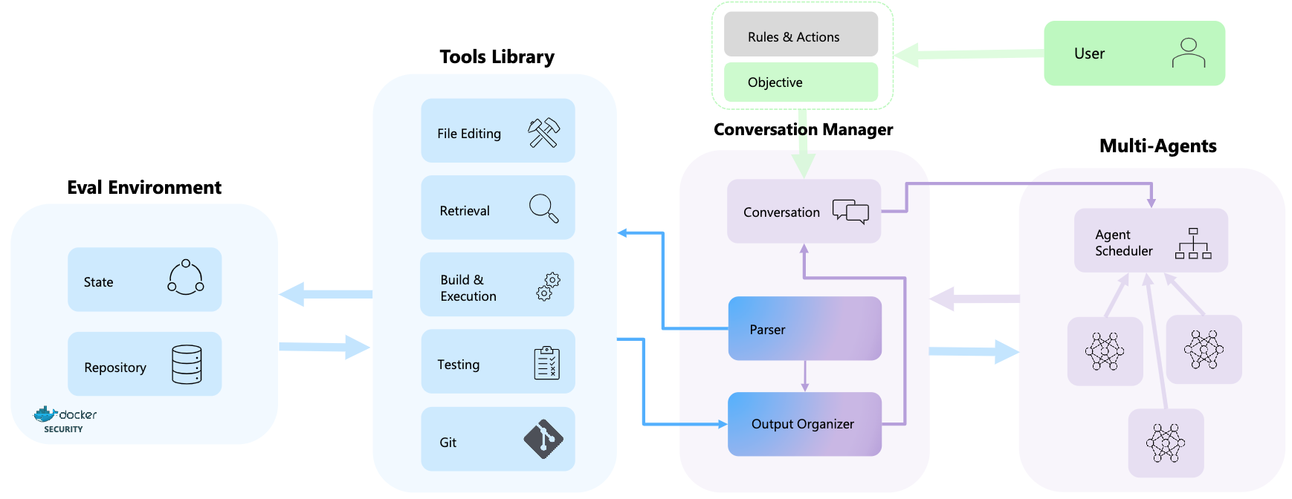
AutoDev: Automated AI-Driven Development

Slide 61
Marketing

Slide 62
Marketing
“Meeting needs profitably”

Slide 63
Marketing
“Marketing is an organizational function and a set of processes for creating, communicating, and delivering value to customers and for managing customer relationships in ways that benefit the organization and its stakeholders.”

Slide 64
Marketing Management

Slide 65
Marketing Management
“Marketing management is the art and science of choosing target markets and getting, keeping, and growing customers through creating, delivering, and communicating superior customer value.”

Slide 66
Marketing Management
1
Understanding Marketing Management
2
Capturing Marketing Insights
3
Connecting with Customers
4
Building Strong Brands
5
Creating Value
6
Delivering Value
7
Communicating Value
8
Conducting Marketing Responsibly for Long-term Success

Slide 67
Agentic AI for Agile AI Software Engineering

Slide 68
Generative AI Agentic AI Physical AI

Slide 69
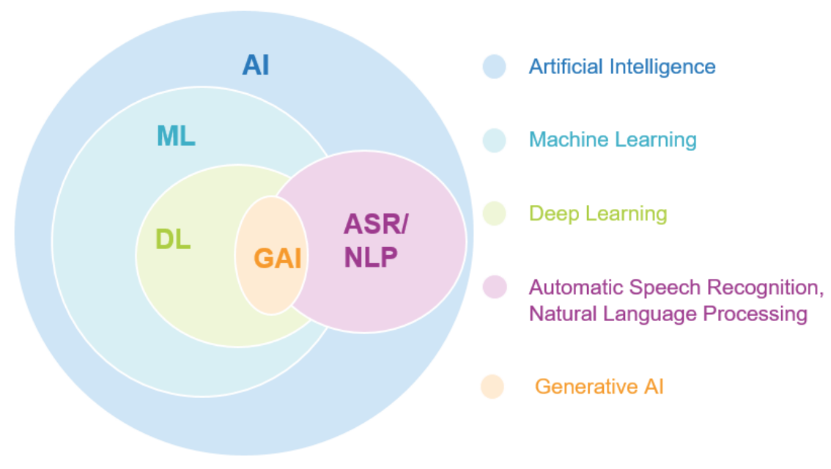
AI, ML, DL, Generative AI
Source: Jeong, Cheonsu. "A Study on the Implementation of Generative AI Services Using an Enterprise Data-Based LLM Application Architecture." arXiv preprint arXiv:2309.01105 (2023).

Slide 70
Generative AI, Agentic AI, Physical AI
Physical AI
Self-driving cars
General robotics
Agentic AI
Coding assistants
Customer service
Patient care
Generative AI
Digital marketing
Content creation
Perception AI
Speech recognition
Deep recommender systems
Medical imaging
2012 AlexNet
Deep learning breakthrough
Source: NVIDIA (2025), GTC March 2025 Keynote with NVIDIA CEO Jensen Huang, https://www.youtube.com/watch?v=_waPvOwL9Z8

Slide 71
Generative AI
Computing
Generative AI
Data
Algorithms

Slide 72
Generative AI, Agentic AI, Physical AI
New Economic Paradigm Shift:
From Creation to Execution
Physical AI
(Actuation)
Real-world Interaction & Execution
Autonomous Synergy
Generative AI
(Creation)
Content & Idea Synthesis
Agentic AI
(Orchestration)
Workflow & Decision Automation

Slide 73
The Future of AI From Tools to Agents: The Rise and Autonomy of Agentic AI
Narrow AI
(Tool)
Agentic AI
(Autonomous System)
AGI
(Artificial General Intelligence)
Goal-Oriented Behavior, Autonomous Decision-Making, Multi-Step Workflows, Self-Improvement within Parameters
Executes Specific Tasks, Content Generation
Connecting Multimodal GenAl to Future AGI

Slide 74
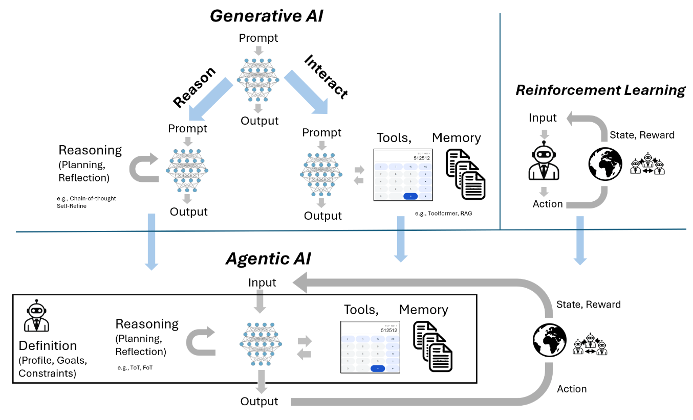
From Generative AI to Agentic AI
Source: Schneider, Johannes. "Generative to Agentic AI: Survey, Conceptualization, and Challenges." arXiv preprint arXiv:2504.18875 (2025).

Slide 75
Agentic AI Systems RAG Agents with LLM Dialogue Systems

Slide 76
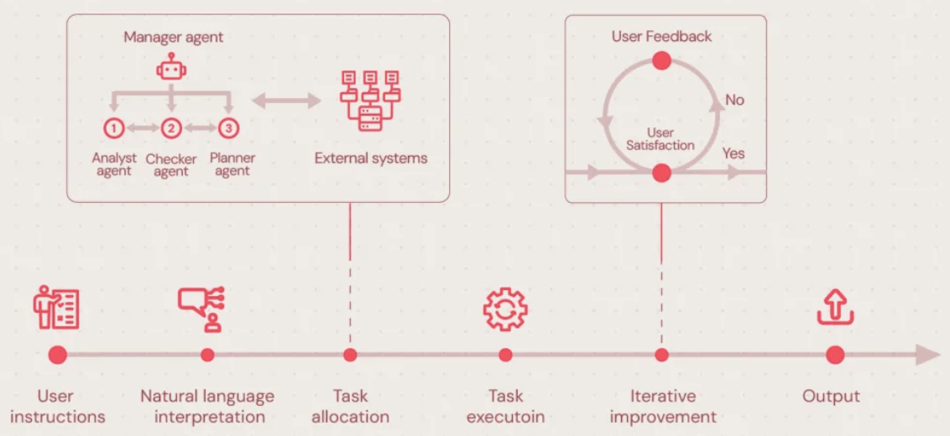
Agentic AI Systems
Source: https://neontri.com/blog/agentic-ai/

Slide 77
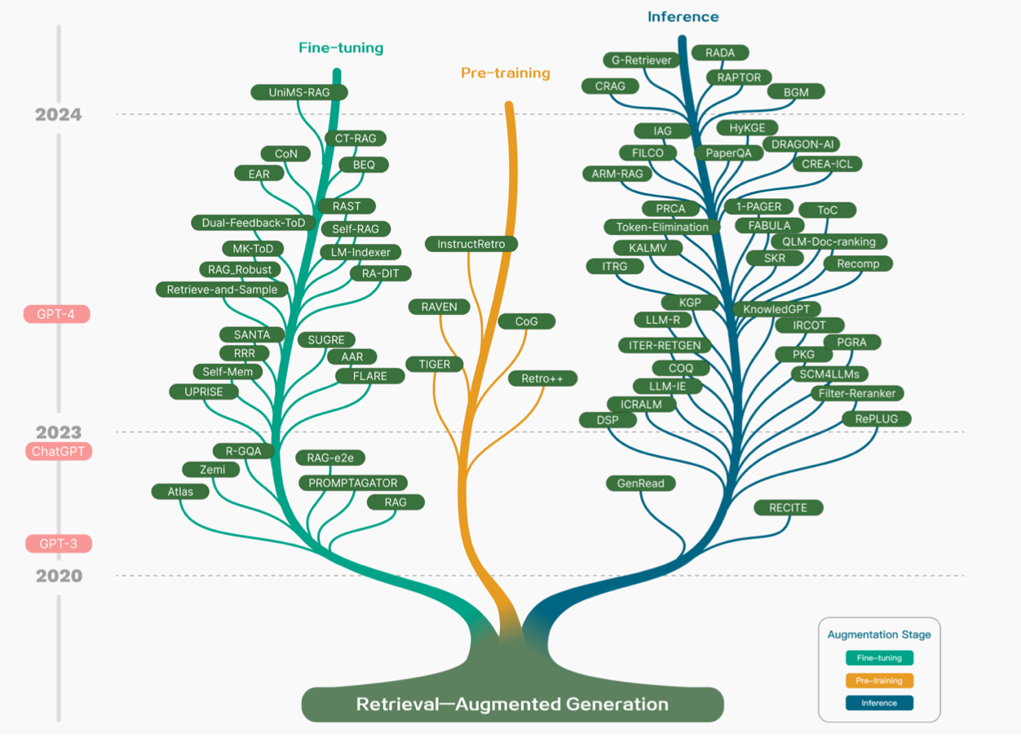
Technology Tree of RAG Research Retrieval-Augmented Generation (RAG) for Large Language Models (LLMs)
Source: Gao, Y., Xiong, Y., Gao, X., Jia, K., Pan, J., Bi, Y., ... & Wang, H. (2023). Retrieval-augmented generation for large language models: A survey. arXiv preprint arXiv:2312.10997.

Slide 78
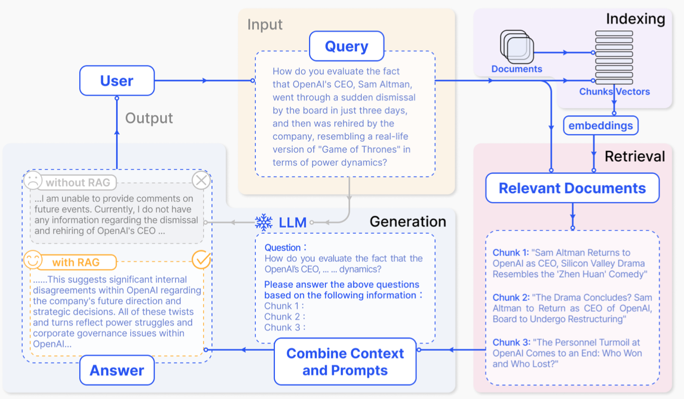
Retrieval-Augmented Generation (RAG) for Large Language Models (LLMs)
Source: Gao, Y., Xiong, Y., Gao, X., Jia, K., Pan, J., Bi, Y., ... & Wang, H. (2023). Retrieval-augmented generation for large language models: A survey. arXiv preprint arXiv:2312.10997.

Slide 79
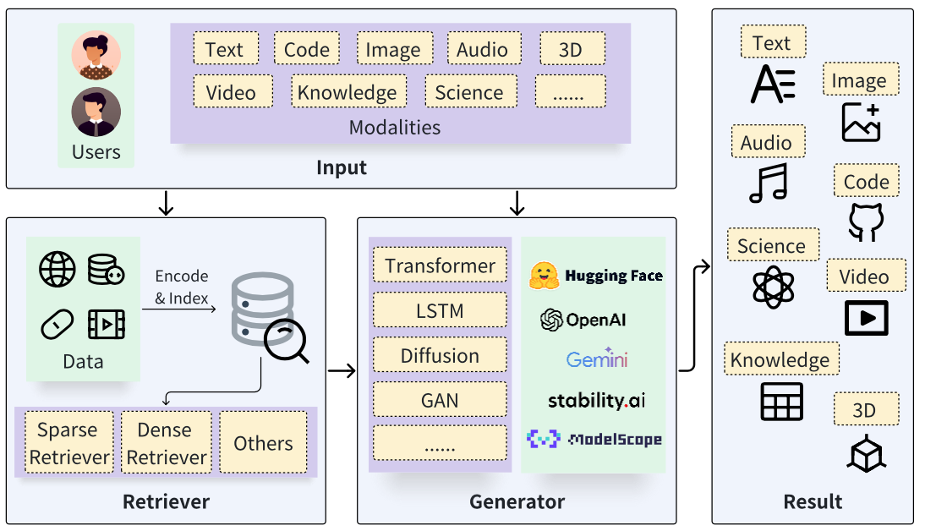
Retrieval-Augmented Generation (RAG) Architecture
Source: Zhao, P., Zhang, H., Yu, Q., Wang, Z., Geng, Y., Fu, F., ... & Cui, B. (2024). Retrieval-augmented generation for ai-generated content: A survey. arXiv preprint arXiv:2402.19473.

Slide 80
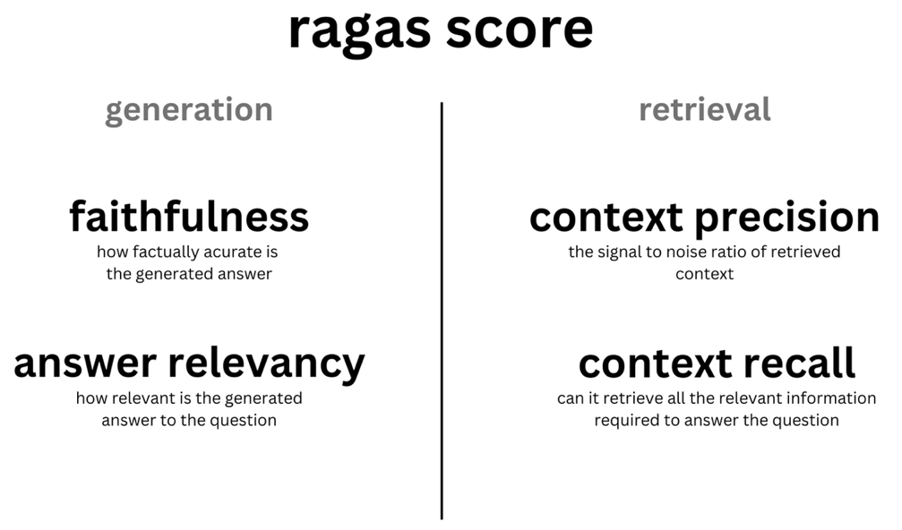
Evaluating RAG with Ragas Metrics
Source: https://blog.langchain.dev/evaluating-rag-pipelines-with-ragas-langsmith/

Slide 81


NVIDIA Developer Program NVIDIA Deep Learning Institute (DLI)
https://developer.nvidia.com/join-nvidia-developer-program
https://learn.nvidia.com/

Slide 82
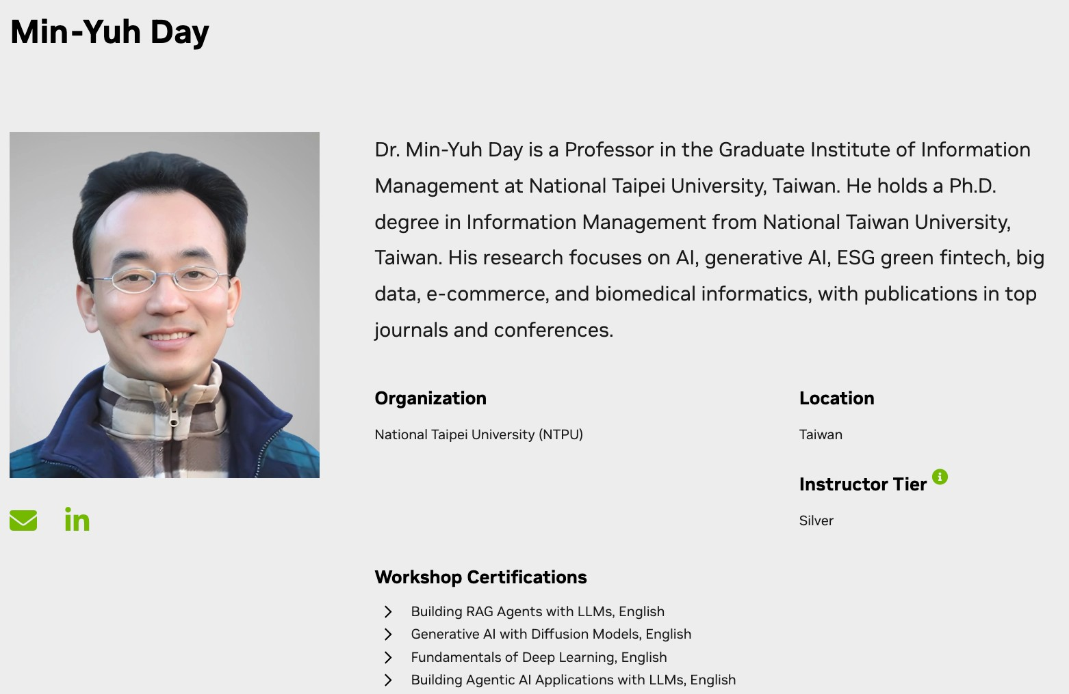
NVIDIA Certified Instructor
https://www.nvidia.com/en-us/training/instructor-directory/search/

Slide 83
Get NVIDIA DLI Certificate Before the NVIDIA Workshop
Step 1. Join NVIDIA Developer Program (Free) https://developer.nvidia.com/join-nvidia-developer-program
Step 2. Visit NVIDIA Deep Learning Institute (DLI) https://learn.nvidia.com/
Step 3. Enroll "Building RAG Agents with LLMs" Self-Paced Course (Free) https://learn.nvidia.com/courses/course-detail?course_id=course-v1:DLI+S-FX-15+V1

Slide 84
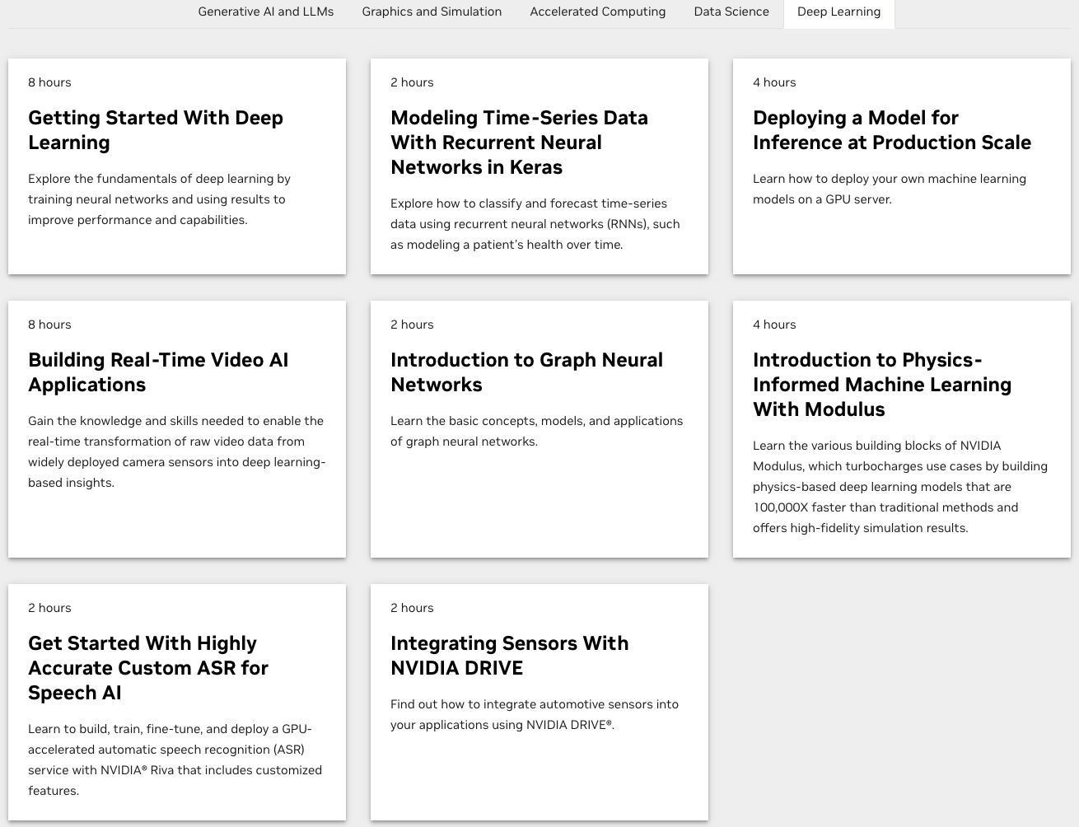
Join the NVIDIA Developer Program take one of the complimentary technical self-paced courses (worth up to $90)
https://developer.nvidia.com/join-nvidia-developer-program

Slide 85
NVIDIA Deep Learning Institute (DLI)
Self-Paced Course
Generative AI Explained
Free
2 hours
Self-Paced Course
Getting Started With Deep Learning
Certificate available
$90
8 hours
Instructor-Led Workshop
Fundamentals of Deep Learning
Certificate available
$500
8 hours
Self-Paced Course
Introduction to Transformer-Based Natural Language Processing
Certificate available
$30
6 hours
Self-Paced Course
Building RAG Agents With LLMs
Certificate available
Free
8 hours
Instructor-Led Workshop
Building RAG Agents With LLMs
Certificate available
$500
8 hours
Self-Paced Course
Generative AI with Diffusion Models
Certificate available
$90
8 hours
Instructor-Led Workshop
Generative AI with Diffusion Models
Certificate available
$500
8 hours
https://www.nvidia.com/en-us/learn/learning-path/generative-ai-llm/

Slide 86
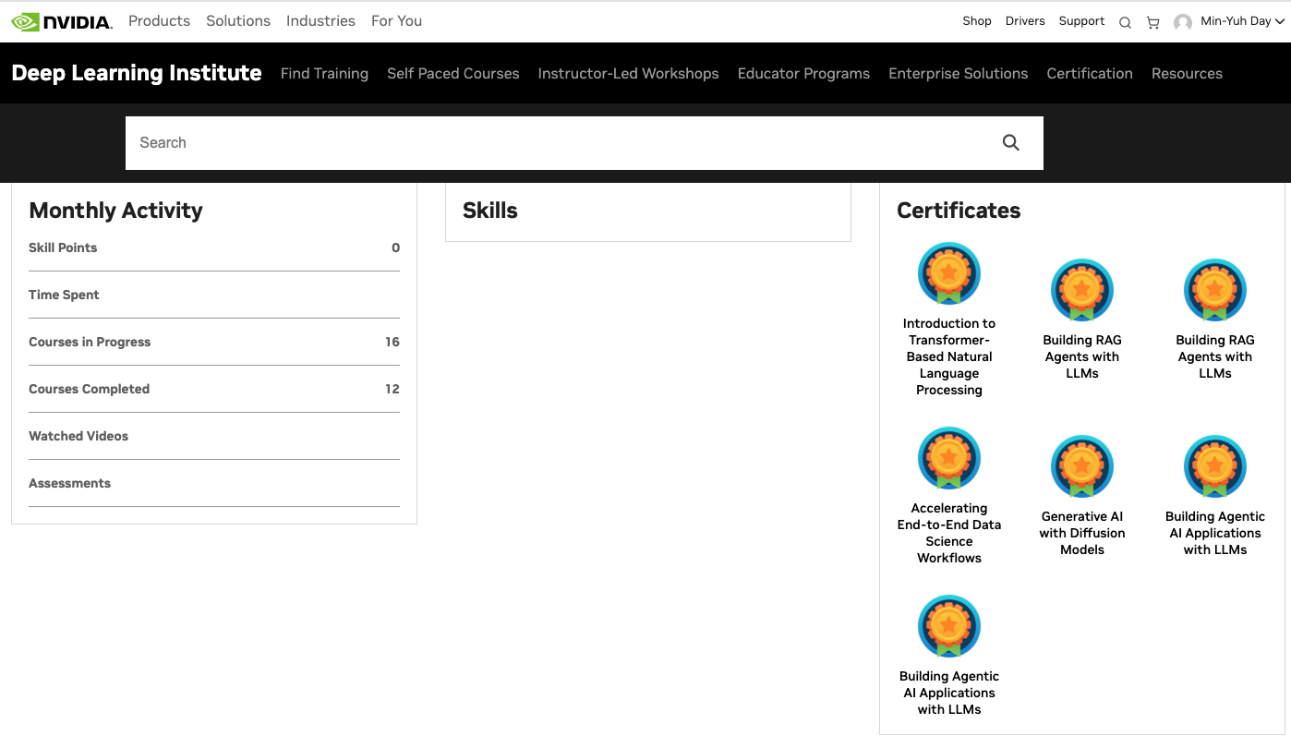
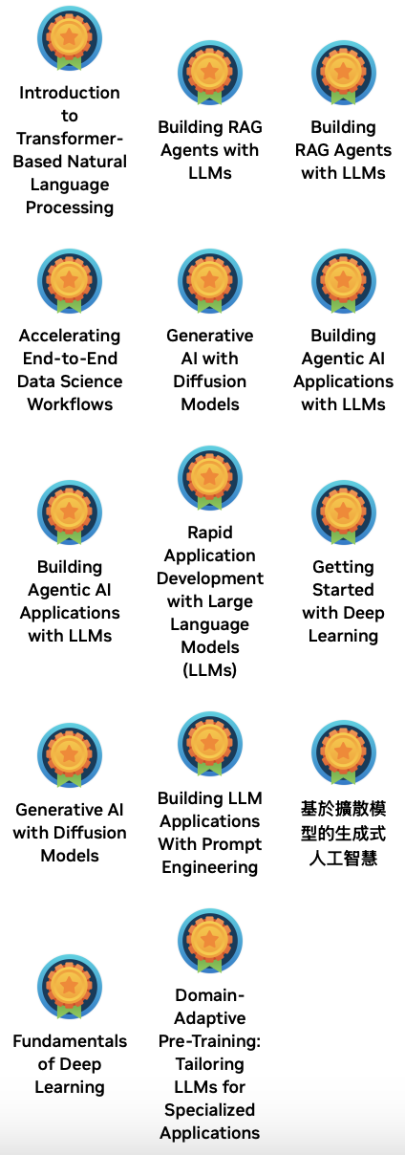
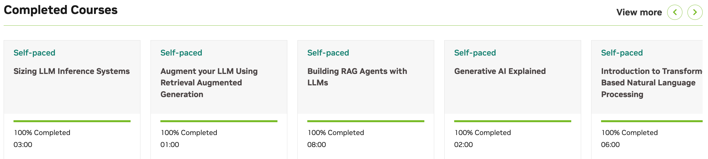
Deep Learning Institute (DLI)
https://learn.nvidia.com/my-learning

Slide 87

Teaching
Generative AI Innovative Applications
Spring 2025, Spring 2026
Artificial Intelligence in Finance and Quantitative
Fall 2021, Fall 2022, Fall 2023, Spring 2025, Spring 2026
Software Engineering
Fall 2020, Fall, 2021, Spring 2022, Spring 2023, Spring 2024, Spring 2025, Spring 2026
Artificial Intelligence
Spring 2021, Fall 2022, Fall 2024, Fall 2025
Sustainability and ESG Data Analytics
Spring 2024, Fall 2024, Fall 2025
Big Data Analytics
Fall 2020, Spring 2023, Spring 2024
Artificial Intelligence for Text Analytics
Spring 2022, Fall 2023
Python for Accounting Applications
Fall 2023, Fall 2024, ,Fall 2025
Foundation of Business Cloud Computing
Spring 2021, Spring 2022, Spring 2023, Spring 2024
https://web.ntpu.edu.tw/~myday/teaching.htm

Slide 88
Research Projects
PI, Generative AI Multi-Agent Systems with LLM-Based RAG for ESG Reporting Automation
NSTC (E4104), NSTC 114-2221-E-305-002-, 2025/08/01~2026/07/31
PI, ESG Sustainability Commitment Verification Competition and Annotation Data Collection Project (AI Cup 2026 VeriPromiseESG)
Ministry of Education (MoE), AI CUP 2026 MoE National Collegiate Artificial Intelligence Professional Domain Thematic Competition Project, 2025/10/01~2026/09/30
Co-PI, Physical AI and Physical AI Robotics Curriculum Development Project, Forward-Looking AI Talent Cultivation Program (NAPAI)
Ministry of Education (MoE), 2025/11/01~2027/03/31
Co-PI, Industry-Academia Alliance Program for Smart Healthcare: Smart Precision Next-Generation Preventive Medicine
NSTC 114-2622-8-371-001-IE, 2025/11/01~2026/10/31
Co-PI, Digital Support, Unimpeded Communication: The Development, Support and Promotion of AI-assisted Communication Assistive Devices for Speech Impairment(3/3), Sub-project 3: Multimodal Cross-lingual Task-Oriented Dialogue System for Inclusive Communication Support
NSTC (HZZ22), NSTC 114-2425-H-305-003-, 3 Years (2023/05/01-2026/04/30) Year 3: 2025/05/01~2026/04/30
https://web.ntpu.edu.tw/~myday/cindex.htm#projects

Slide 89
Software Engineering and Project Management
Analyze
Requirements definition
Design
System and Software design
Build
Implementation and
unit testing
Test
Integration and system testing
Deliver
Operation and maintenance
Project Management

Slide 90
Summary
This course introduces the fundamental concepts, research issues, and hands-on practices of software engineering.
Topics include:
Introduction to Software Engineering
Software Products and Project Management: Software product management and prototyping with Generative AI and Agentic AI
Agile Software Engineering: Agile methods, Scrum, and Extreme Programming
Features, Scenarios, and Stories
Software Architecture: Architectural design, System decomposition, and Distribution architecture
Cloud-Based Software: Virtualization and containers, Everything as a service, Software as a service
Cloud Computing and Cloud Software Architecture
Microservices Architecture, RESTful services, Service deployment
Security and Privacy; Reliable Programming
Testing: Functional testing, Test automation, Test-driven development, and Code reviews
DevOps and Code Management: Code management and DevOps automation
Case Study on Software Engineering

Slide 91

Software Engineering
University Ambassador
Contact Information
Certified Instructor
Min-Yuh Day, Ph.D.
Professor and Director
Institute of Information Management, National Taipei University
Tel: 02-86741111 ext. 66873
Office: B8F12
Address: 151, University Rd., San Shia District, New Taipei City, 23741 Taiwan
Email: myday@gm.ntpu.edu.tw
Web: http://web.ntpu.edu.tw/~myday/

