Slide 1



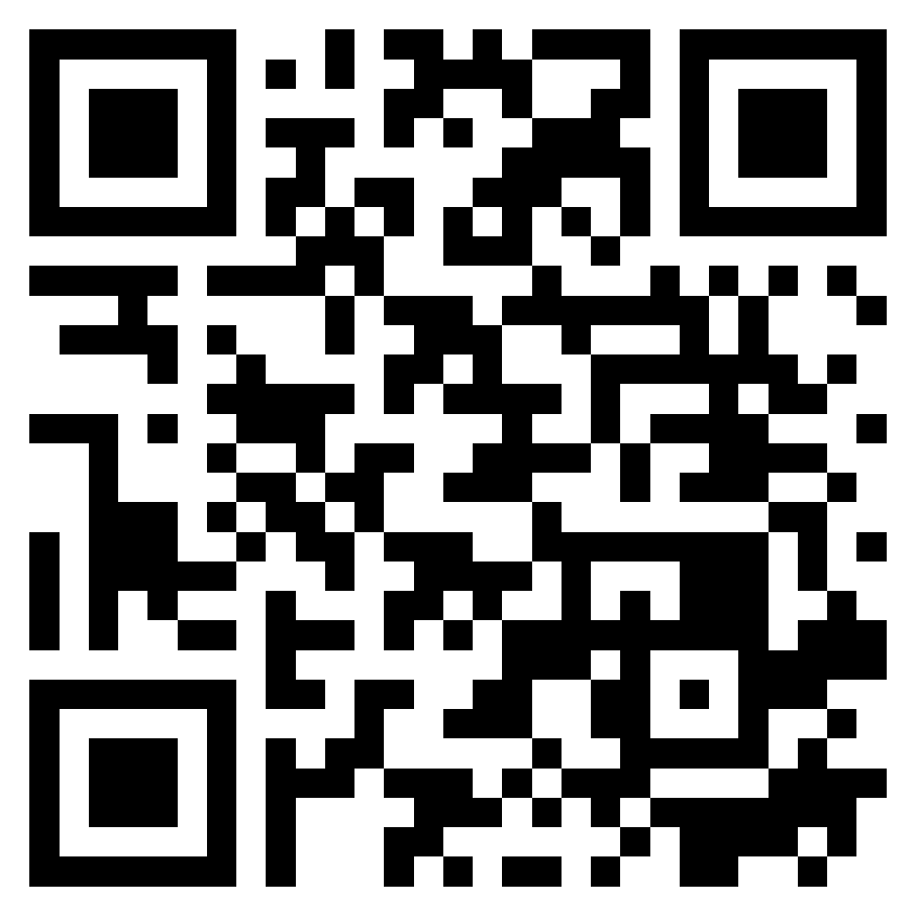






Software Products and Project Management:
Software product management and prototyping with Generative AI and Agentic AI
Software Engineering
1142SE02
MBA, IM, NTPU (M5010) (Spring 2026)
Wed 2, 3, 4 (9:10-12:00) (B3F17)
University Ambassador
Certified Instructor
Min-Yuh Day, Ph.D,
Professor and Director
Institute of Information Management, National Taipei University
https://web.ntpu.edu.tw/~myday
https://meet.google.com/ish-gzmy-pmo
2026-03-04

Slide 2
Syllabus
Week Date Subject/Topics
1 2026/02/25 Introduction to Software Engineering
2 2026/03/04 Software Products and Project Management:
Software product management and prototyping with
Generative AI and Agentic AI
3 2026/03/11 Agile Software Engineering:
Agile methods, Scrum, and Extreme Programming
4 2026/03/18 Case Study on Software Engineering I
5 2026/03/25 Features, Scenarios, and Stories
6 2026/04/01 Software Architecture: Architectural design,
System decomposition, and Distribution architecture

Slide 3
Syllabus
Week Date Subject/Topics
7 2026/04/08 Cloud-Based Software: Virtualization and containers,
Everything as a service, Software as a service
8 2026/04/15 Midterm Project Report
9 2026/04/22 Cloud Computing and Cloud Software Architecture
10 2026/04/29 Microservices Architecture, RESTful services,
Service deployment
11 2026/05/06 Case Study on Software Engineering II
12 2026/05/13 Security and Privacy; Reliable Programming;
Testing: Functional testing, Test automation,
Test-driven development, and Code reviews

Slide 4
Syllabus
Week Date Subject/Topics
13 2026/05/20 Industry Practices of Software Engineering
14 2026/05/27 DevOps and Code Management:
Code management and DevOps automation
15 2026/06/03 Final Project Report I
16 2026/06/10 Final Project Report II

Slide 5
Software Products and Project Management:
Software Product Management and Prototyping with
Generative AI and Agentic AI

Slide 6
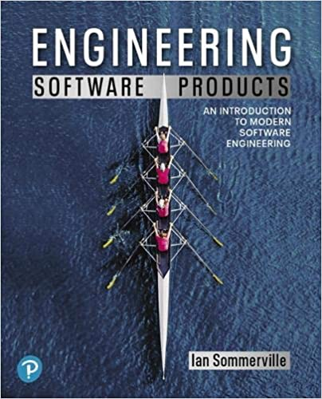
Ian Sommerville (2019),
Engineering Software Products:
An Introduction to Modern Software Engineering,
Pearson.

Slide 7

Ian Sommerville (2015),
Software Engineering,
10th Edition, Pearson.

Slide 8

Titus Winters, Tom Manshreck, and Hyrum Wright (2020),
Software Engineering at Google:
Lessons Learned from Programming Over Time,
O'Reilly Media.

Slide 9

Project Management Institute (2017),
Agile Practice Guide
PMI

Slide 10
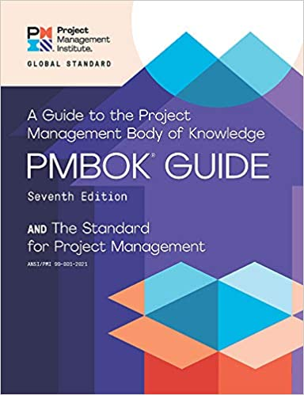
Project Management Institute (2021),
A Guide to the
Project Management Body of Knowledge (PMBOK Guide) –
Seventh Edition and The Standard for Project Management

Slide 11
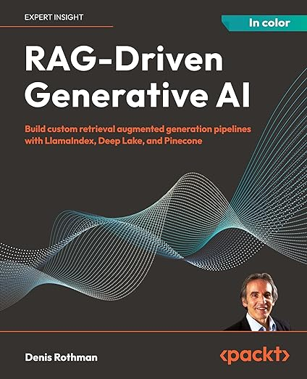
Denis Rothman (2024),
RAG-Driven Generative AI:
Build custom retrieval augmented generation pipelines with LlamaIndex, Deep Lake, and Pinecone, Packt Publishing
Source: https://www.amazon.com/RAG-Driven-Generative-retrieval-generation-LlamaIndex/dp/1836200919/

Slide 12
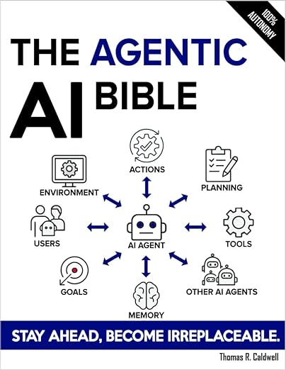
Thomas R. Caldwell (2025),
The Agentic AI Bible:
The Complete and Up-to-Date Guide to Design, Build, and Scale Goal-Driven,
LLM-Powered Agents that Think, Execute and Evolve,
Independently published
Source: https://www.amazon.com/Agentic-Bible-Up-Date-Goal-Driven/dp/B0FL21R86Q

Slide 13
Software
Engineering

Slide 14
Software Engineering and
Project Management
Analyze
Requirements
definition
Design
System and Software design
Build
Implementation and
unit testing
Test
Integration
and
system testing
Deliver
Operation
and maintenance
Project Management

Slide 15
2026 Agentic Coding Trends
Foundation
1. The software development lifecycle changes dramatically
Capability
2. Single agents evolve into coordinated teams
3. Long-running agents build complete systems
4. Human oversight scales through intelligent collaboration
5. Agentic coding expands to new surfaces and users
Impact
6. Productivity gains reshape software development economics
7. Non-technical use cases expand across organizations
8. Dual-use risk requires security-first architecture

Slide 16
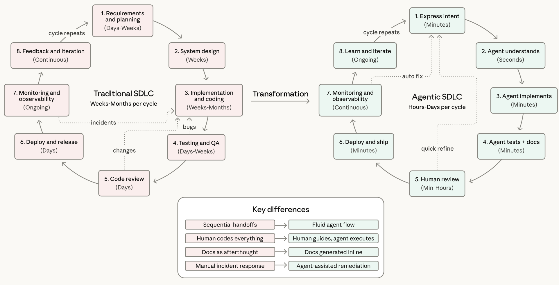
Agentic Coding Software Development Lifecycle

Slide 17
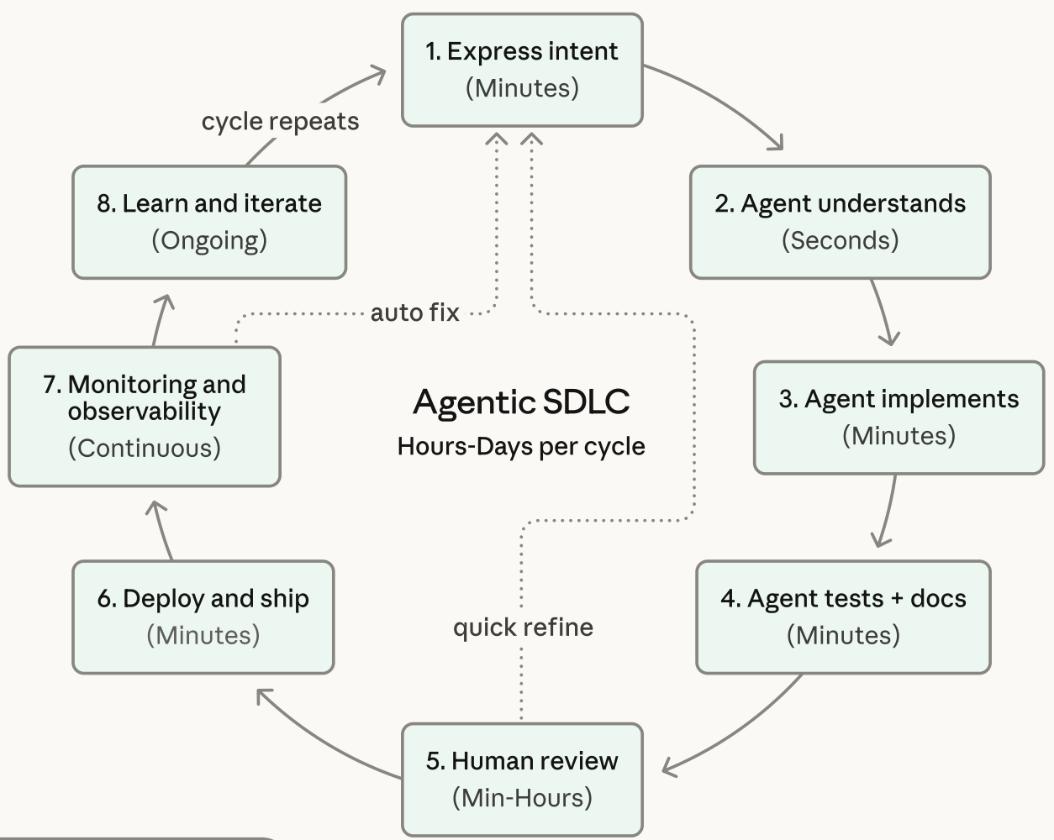
Agentic Coding Software Development Lifecycle

Slide 18
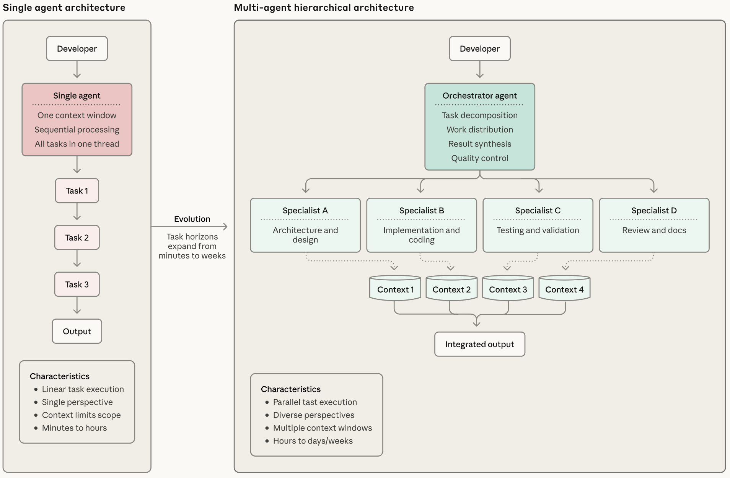
Coding Agent Architectures:
From Single Agents to Coordinated Teams

Slide 19
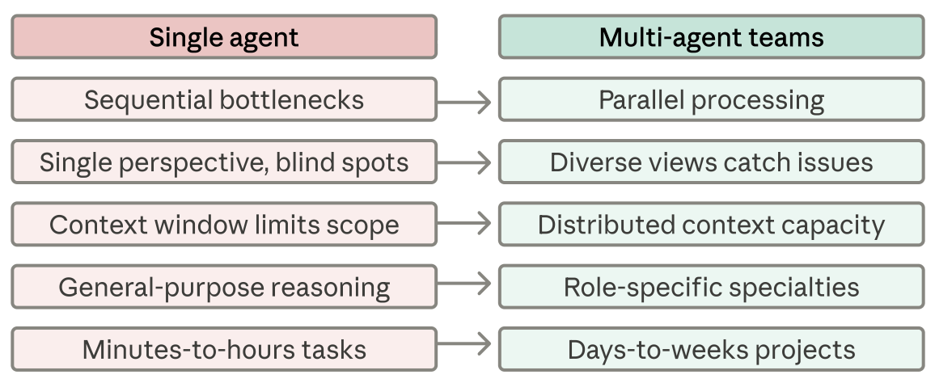
Coding Agent Architectures:
Single Agent to Multi-Agent Teams
Performance Impact

Slide 20
Generative AI Meets Product Development
Use Case 1:
Enhancing Creativity and Design Workflows
Use Case 2:
GenAI for Customer Insights and Concept Validation
Use Case 3:
LLMs as Natural Language Interfaces to
Complex Design Tools
Source: Tucker J. Marion, Mahdi Srour, and Frank Piller (2024), "When Generative AI meets product development." MIT Sloan Management Review 66, no. 1 : 14-15.

Slide 21
Information Management
Management
Information Systems (MIS)
Information Systems

Slide 22
Information Management (MIS)
Information Systems
Organizations
Technology
Information
Systems
Management

Slide 23
Fundamental MIS Concepts
Business
Challenges
Management
Organization
Information
System
Business
Solutions
Technology

Slide 24
Project-based software engineering
CUSTOMER
Problem
generates
helps-with
Requirements
implemented-by
Software
1
CUSTOMER and
DEVELOPER
DEVELOPER

Slide 25
Project-based software engineering
The starting point for the software development is a set of ‘software requirements’ that are owned by an external client and which set out what they want a software system to do to support their business processes.
The software is developed by a software company (the contractor) who design and implement a system that delivers functionality to meet the requirements.
The customer may change the requirements at any time in response to business changes (they usually do). The contractor must change the software to reflect these requirements changes.
Custom software usually has a long-lifetime (10 years or more) and it must be supported over that lifetime.

Slide 26
Product software engineering
DEVELOPER
Opportunity
1
inspires
realizes
Product features
implemented-by
Software
DEVELOPER
DEVELOPER

Slide 27
Product software engineering
The starting point for product development is a business opportunity that is identified by individuals or a company.
They develop a software product to take advantage of this opportunity and sell this to customers.
The company who identified the opportunity design and implement a set of software features that realize the opportunity and that will be useful to customers.
The software development company are responsible for deciding on the development timescale, what features to include and when the product should change.
Rapid delivery of software products is essential to capture the market for that type of product.

Slide 28
Software execution models
Stand-alone execution
Hybrid execution
Software as a service
User’s computer
User’s computer
User’s computer
User interface
Product functionality
User data
User interface
Partial functionality
User data
User interface
(browser or app)
Product updates
Additional functionality
User data backups
Product updates
Product functionality
User data
Vendor’s servers
Vendor’s servers
Vendor’s servers

Slide 29
Product management concerns
Business
needs
Product manager
Technology
constraints
Customer
experience

Slide 30
Technical interactions of product managers
Product
vision management
Product
backlog management
User stories
and
scenarios
Product manager
Acceptance
testing
Customer
testing
User
interface
design

Slide 31
Software Development Life Cycle (SDLC)
The waterfall model
Requirements
definition
System and Software design
Implementation and unit testing
Integration and system testing
Operation and maintenance

Slide 32
Plan-based and Agile development
Plan-based development
Requirements
engineering
Requirements
specification
Design and implementation
Requirements change requests
Agile development
Requirements
engineering
Design and implementation

Slide 33
The Continuum of Life Cycles
High
Incremental
Agile
Frequency of Delivery
Predictive
Iterative
Low
Low
High
Degree of Change

Slide 34
Predictive Life Cycle
Analyze
Design
Build
Test
Deliver

Slide 35
Iterative Life Cycle
Prototype
Refine
Analyze
Analyze
Design
Build
Test
Deliver

Slide 36
A Life Cycle of
Varying-Sized Increments
Analyze
Design
Build
Test
Deliver
Analyze
Design
Build
Test
Deliver
Analyze
Design
Build
Test
Deliver

Slide 37
Iteration-Based and Flow-Based Agile Life Cycles
Iteration-Based Agile
Requirements
Analysis
Design
Build
Test
Requirements
Analysis
Design
Build
Test
Requirements
Analysis
Design
Build
Test
Requirements
Analysis
Design
Build
Test
Repeat
as needed
…
Requirements
Analysis
Design
Build
Test
Requirements
Analysis
Design
Build
Test
Flow-Based Agile
Requirements
Analysis
Design
Build
Test
the number of features in the WIP limit
Requirements
Analysis
Design
Build
Test
the number of features in the WIP limit
Requirements
Analysis
Design
Build
Test
the number of features in the WIP limit
Repeat
as needed
…
Requirements
Analysis
Design
Build
Test
the number of features in the WIP limit
Requirements
Analysis
Design
Build
Test
the number of features in the WIP limit

Slide 38
From personas to features
1
Personas
A way of representing users
inspire
Natural language descriptions of a user interacting with a software product
2
Scenarios
are-developed-into
3
inspire
Stories
Natural language descriptions of something that is needed or wanted by users
4
Features
define
Fragments of product functionality

Slide 39
Multi-tier client-server architecture
Client 1
Client 2
Web
Server
Application
Server
Database
Server
Client 3
Client …

Slide 40
Service-oriented Architecture
Client 1
S1
S2
Client 2
S3
Web
Server
Service
gateway
S4
Client 3
S5
Client …
S6
Services

Slide 41
VM
Container
Virtual
web server
Virtual
mail server
User 1
Container 1
User 2
Container 2
Server
software
Server
software
Application
software
Application
software
Guest
OS
Guest
OS
Server
software
Server
software
Hypervisor
Container manager
Host OS
Host OS
Server Hardware
Server Hardware

Slide 42
Everything as a service
Photo
editing
Software as a service
(SaaS)
Logistics
management
Cloud management
Monitoring
Platform as a service
(PaaS)
Database
Software
development
Storage Network
Infrastructure as a service
(IaaS)
Computing Virtualization
Cloud data center

Slide 43
Software as a service
Software customers
Software
provider
Software services
Cloud Infrastructure
Cloud
provider

Slide 44
Microservices architecture – key design questions
What are the microservices that make up the system?
How should data be distributed and shared?
How should microservices communicate with each other?
Microservices architecture
design
How should the microservices in the system be coordinated?
How should service failure be detected, reported and managed?

Slide 45
Types of security threat
An attacker attempts to deny access to the system for legitimate users
An attacker attempts to damage the system or its data
Availability
threats
Integrity
threats
SOFTWARE PRODUCT
PROGRAM
Distributed denial of service (DDoS) attack
Virus
DATA
Ransomware
Data theft
Confidentiality
threats
An attacker tries to gain access to private information held by the system

Slide 46
Software product quality attributes
Reliability
Availability
1
2
Software product quality attributes
Security
Resilience
7
3
Usability
Maintainability
6
4
Responsiveness
5

Slide 47
A refactoring process
1
2
Start
Identify code
‘smell’
Identify refactoring strategy
4
3
Run automated code tests
Make small
improvement until strategy completed

Slide 48
Functional testing
Start
1
Unit
Testing
4
2
Release
Testing
Feature
Testing
3
System
Testing

Slide 49
Test-driven development (TDD)
Start
1
Identify new
functionality
2
Identify partial implementation
of functionality
3
Write code stub
that will fail test
Functionality
complete
Functionality
incomplete
4
Run all
automated test
7
Refactor code
if required
5
Implement code that should cause failing test to pass
Test failure
6
Run all
automated test
All tests pass

Slide 50
DevOps
Development
Deployment
Support
Multi-skilled DevOps team

Slide 51
Code management and DevOps
DevOps automation
Continuous
integration
Continuous
deployment
Continuous
delivery
Infrastructure
as code
Code management system
Branching and merging
Recover
version
information
Code
repository
Save and
retrieve
versions
Transfer code to/from developer’s filestore
DevOps measurement
Data
collection
Data
analysis
Report
generation

Slide 52
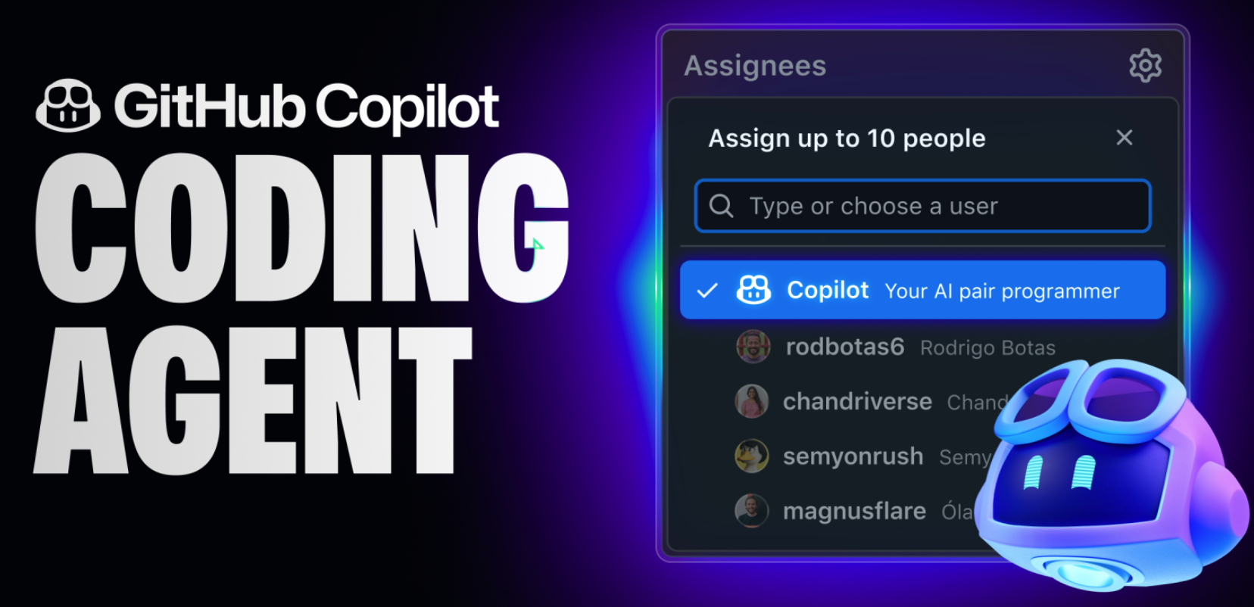
GitHub Copilot CODING AGENT

Slide 53
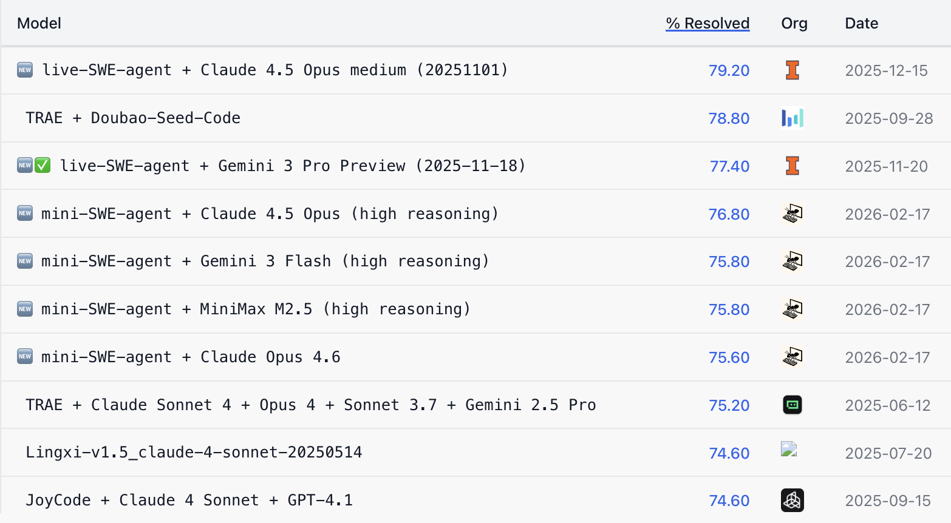
SWE-bench Verified Leaderboard
AI coding agents ranking by software engineering problems resolved rate

Slide 54
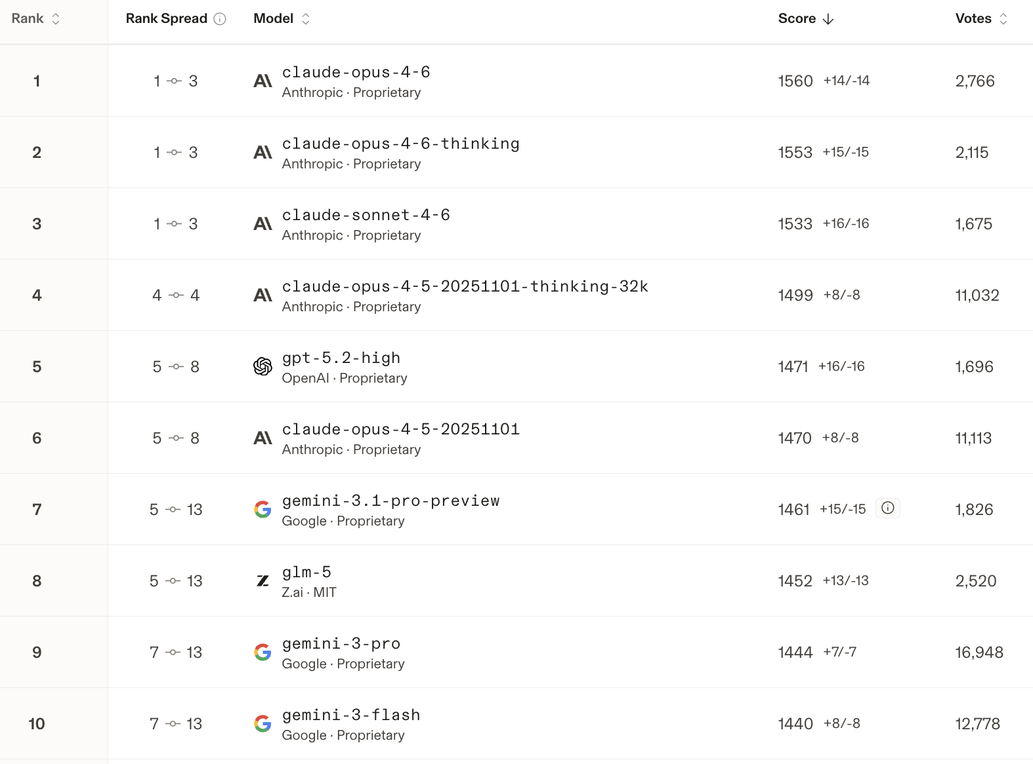
AI WebDev Code Arena
AI models on agentic coding tasks (multi-step reasoning and tool use)

Slide 55
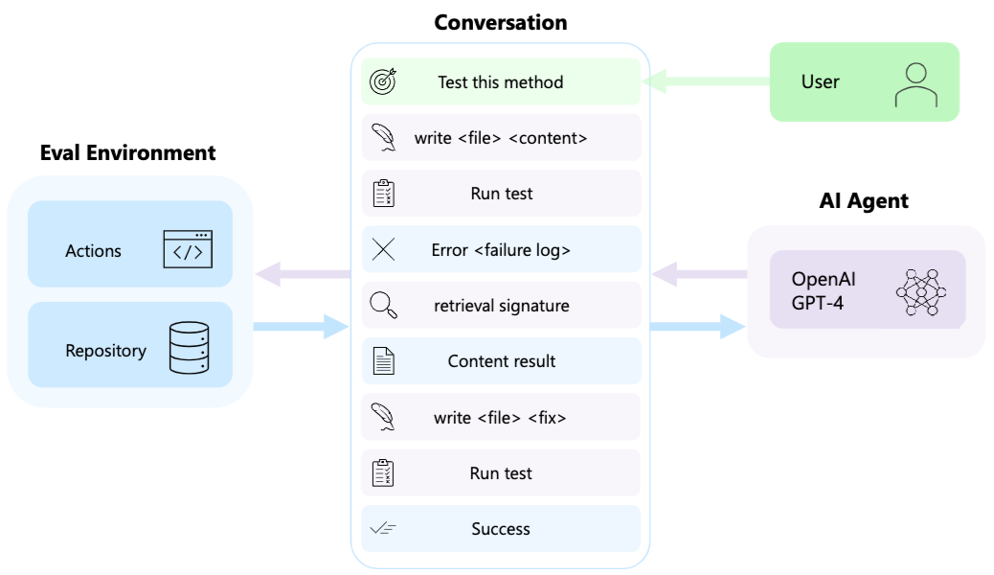
AutoDev: Automated AI-Driven Development

Slide 56
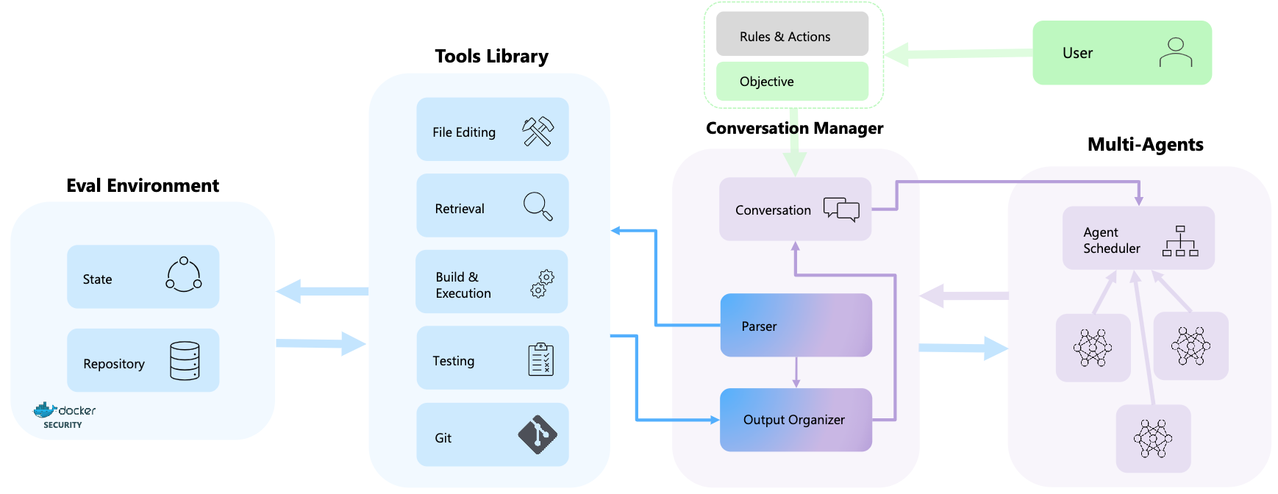
AutoDev: Automated AI-Driven Development

Slide 57
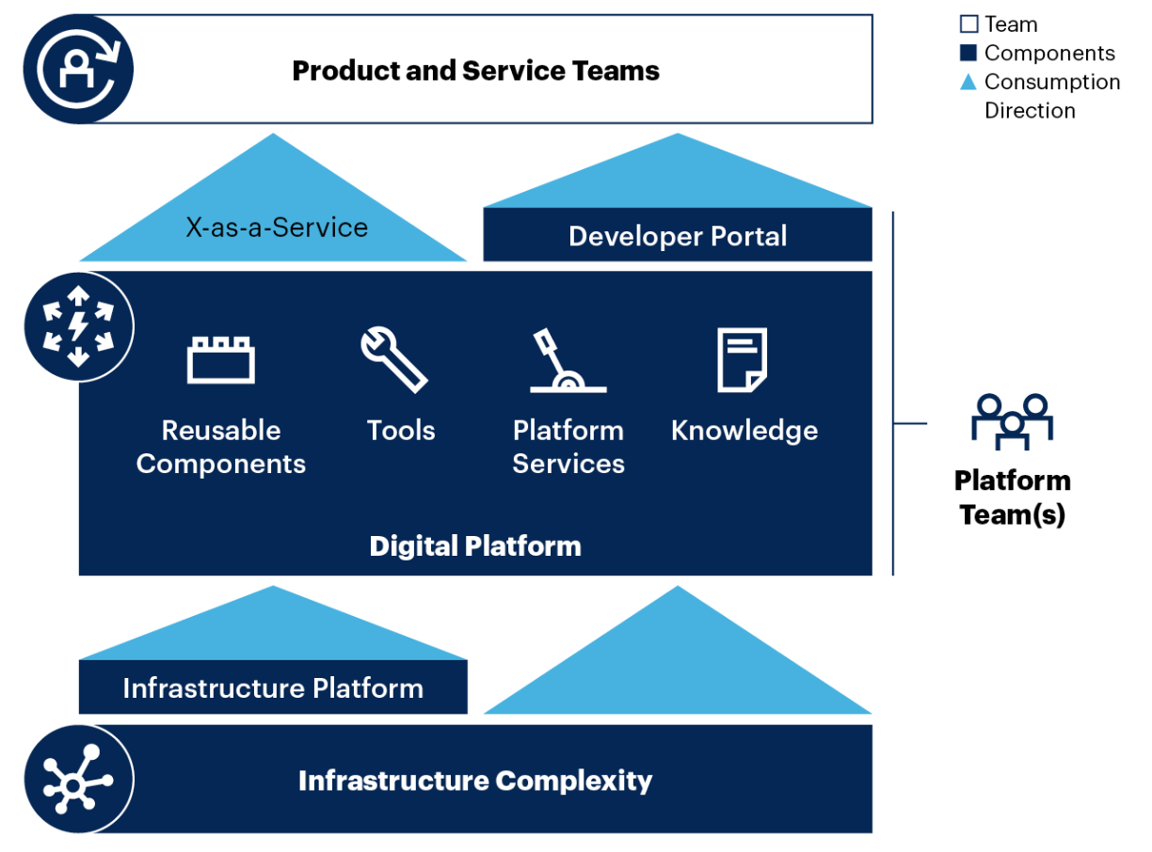
Platform Engineering

Slide 58
Marketing

Slide 59
Marketing
“Meeting
needs profitably”

Slide 60
Marketing
“Marketing is an organizational function
and a set of processes for
creating, communicating, and delivering
value to customers and
for managing customer relationships
in ways that benefit the organization and its stakeholders.”

Slide 61
Marketing
Management

Slide 62
Marketing Management
“Marketing management is the
art and science
of choosing target markets
and getting, keeping, and growing
customers through
creating, delivering, and communicating
superior customer value.”

Slide 63
Marketing Management
1
Understanding Marketing Management
2
Capturing Marketing Insights
3
Connecting with Customers
4
Building Strong Brands
5
Creating Value
6
Delivering Value
7
Communicating Value
8
Conducting Marketing Responsibly for Long-term Success

Slide 64
OKRs, CFRs, KPIs
Agile Performance Management
OKRs
  Objectives and Key Results
CFRs
  Conversations, Feedback, Recognition
KPIs
  Key Performance Indicators

Slide 65
Agentic AI for
Agile AI Software Engineering

Slide 66
Generative AI
Agentic AI
Physical AI

Slide 67
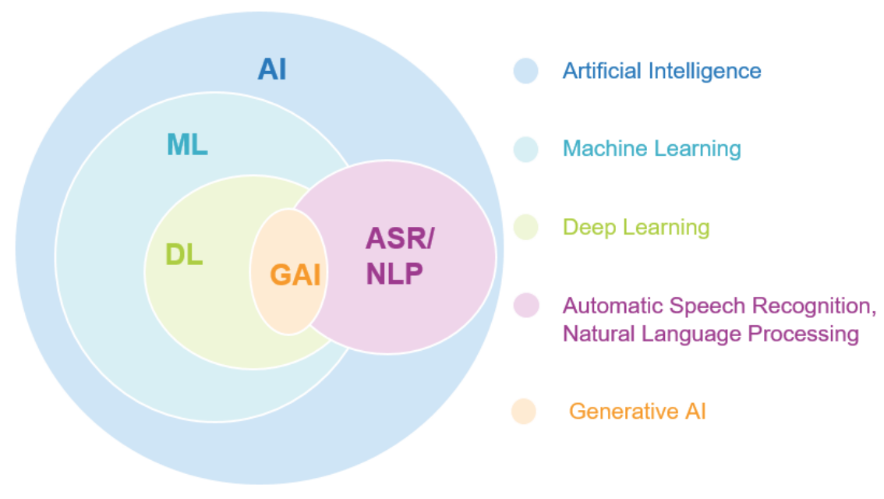
AI, ML, DL, Generative AI
Source: Jeong, Cheonsu. "A Study on the Implementation of Generative AI Services Using an Enterprise Data-Based LLM Application Architecture." arXiv preprint arXiv:2309.01105 (2023).

Slide 68
Generative AI, Agentic AI, Physical AI
Physical AI
Self-driving cars
General robotics
Agentic AI
Coding assistants
Customer service
Patient care
Generative AI
Digital marketing
Content creation
Perception AI
Speech recognition
Deep recommender systems
Medical imaging
2012 AlexNet
Deep learning breakthrough
Source: NVIDIA (2025), GTC March 2025 Keynote with NVIDIA CEO Jensen Huang, https://www.youtube.com/watch?v=_waPvOwL9Z8

Slide 69
Generative AI
Computing
Generative AI
Data
Algorithms

Slide 70
Generative AI, Agentic AI, Physical AI
New Economic
Paradigm Shift:
From Creation
to Execution
Physical AI
(Actuation)
Real-world
Interaction & Execution
Autonomous
Synergy
Generative AI
(Creation)
Content & Idea
Synthesis
Agentic AI
(Orchestration)
Workflow &
Decision
Automation

Slide 71
The Future of AI
From Tools to Agents:
The Rise and Autonomy of Agentic AI
Narrow AI
(Tool)
Agentic AI
(Autonomous System)
AGI
(Artificial General Intelligence)
Goal-Oriented Behavior,
Autonomous Decision-Making,
Multi-Step Workflows,
Self-Improvement within Parameters
Executes Specific Tasks, Content Generation
Connecting Multimodal GenAl
to Future AGI

Slide 72
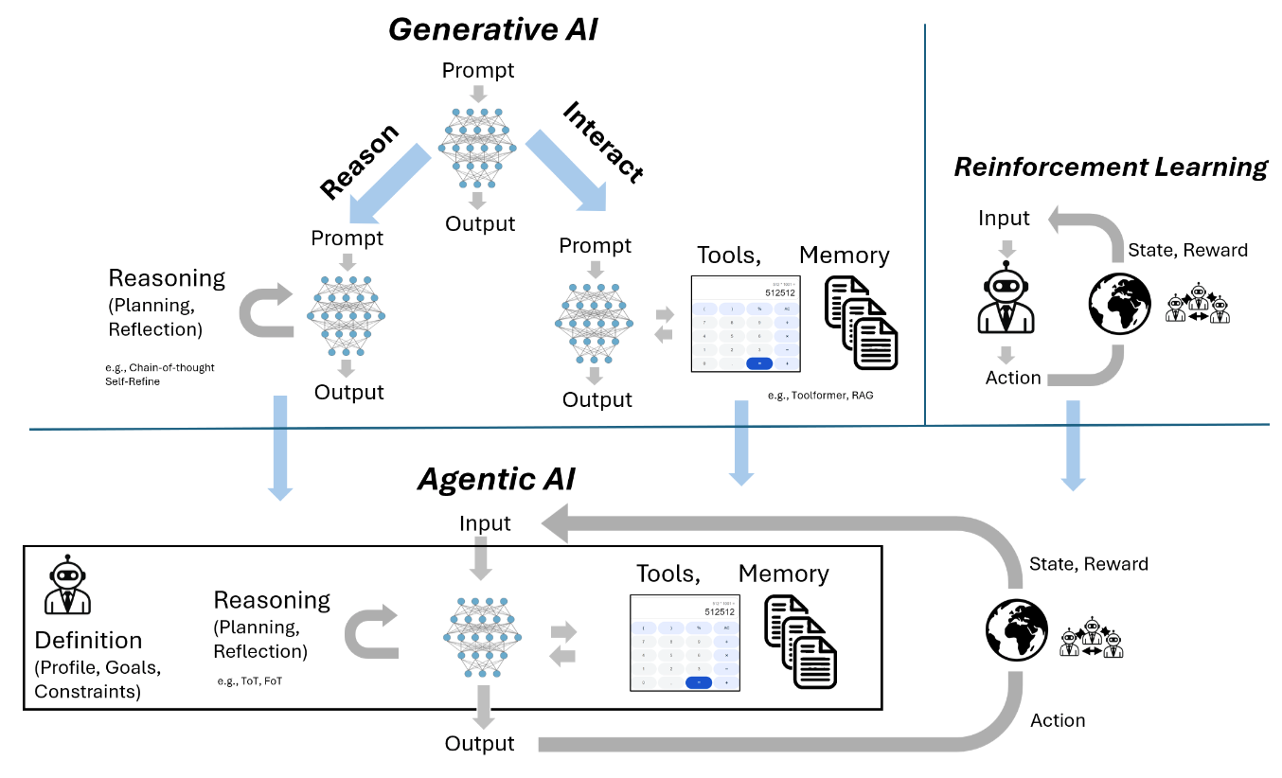
From Generative AI to Agentic AI
Source: Schneider, Johannes. "Generative to Agentic AI: Survey, Conceptualization, and Challenges." arXiv preprint arXiv:2504.18875 (2025).

Slide 73
Agentic AI Systems
RAG Agents with LLM
Dialogue Systems

Slide 74
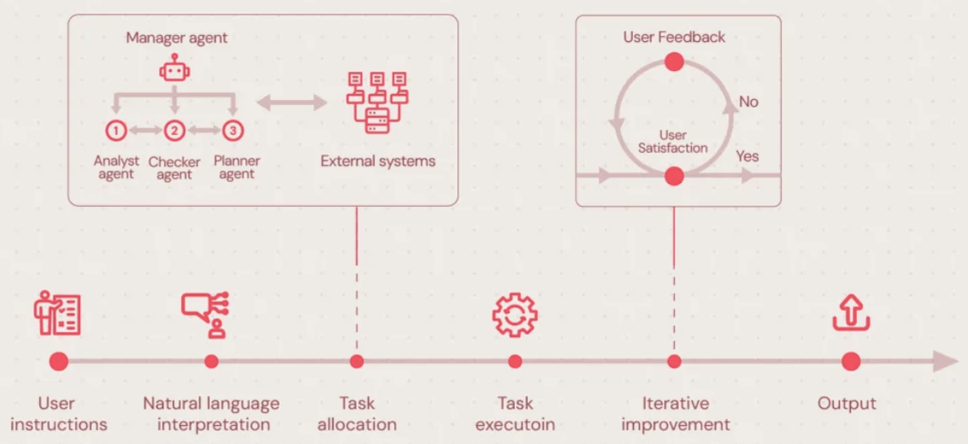
Agentic AI Systems
Source: https://neontri.com/blog/agentic-ai/

Slide 75
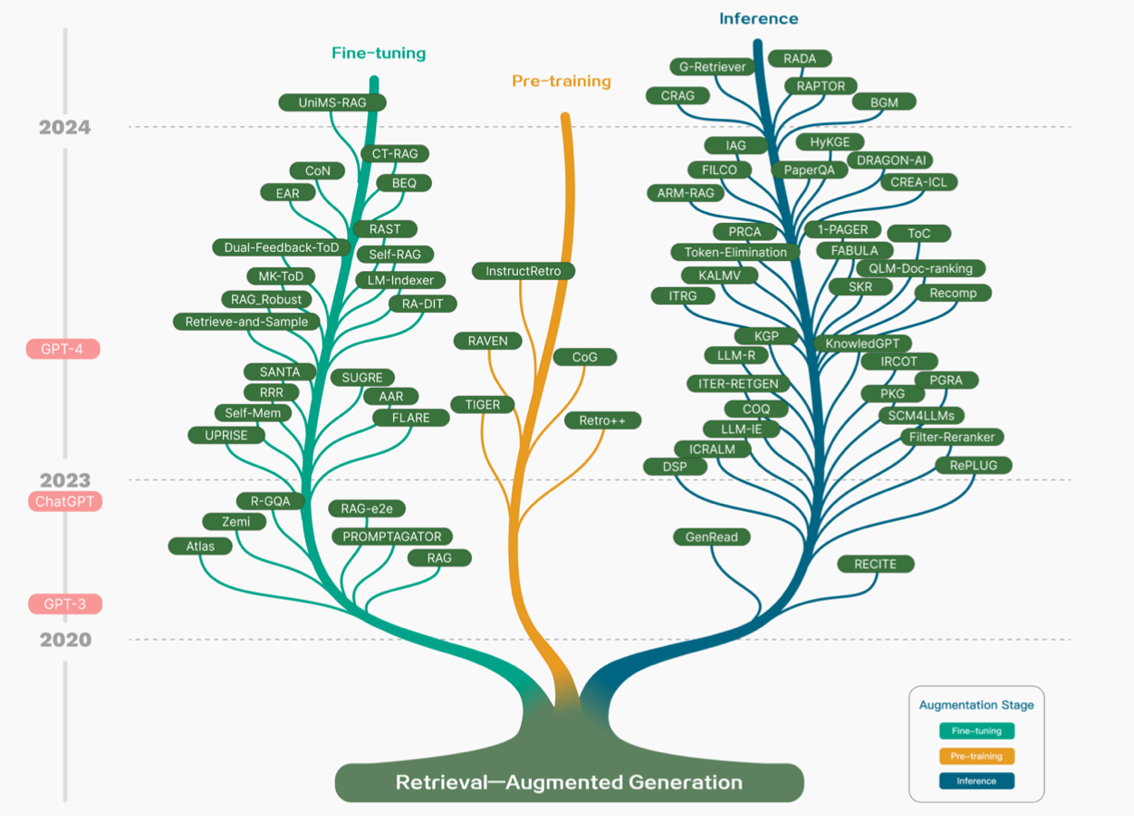
Technology Tree of RAG Research
Retrieval-Augmented Generation (RAG) for Large Language Models (LLMs)
Source: Gao, Y., Xiong, Y., Gao, X., Jia, K., Pan, J., Bi, Y., ... & Wang, H. (2023). Retrieval-augmented generation for large language models: A survey. arXiv preprint arXiv:2312.10997.

Slide 76
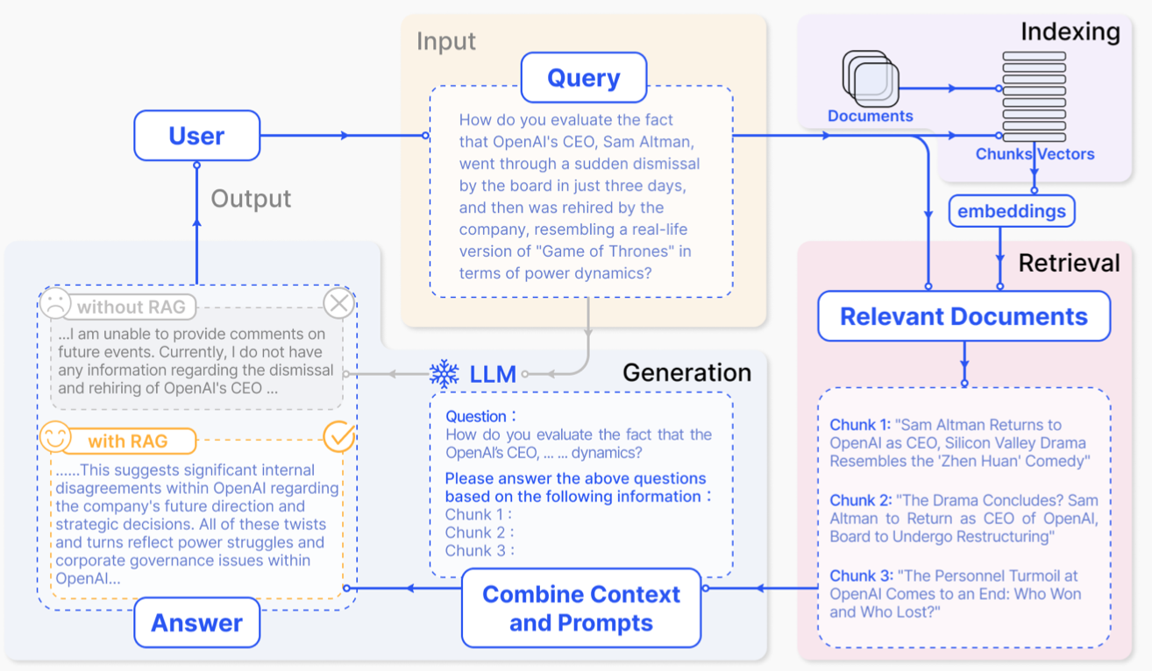
Retrieval-Augmented Generation (RAG) for Large Language Models (LLMs)
Source: Gao, Y., Xiong, Y., Gao, X., Jia, K., Pan, J., Bi, Y., ... & Wang, H. (2023). Retrieval-augmented generation for large language models: A survey. arXiv preprint arXiv:2312.10997.

Slide 77
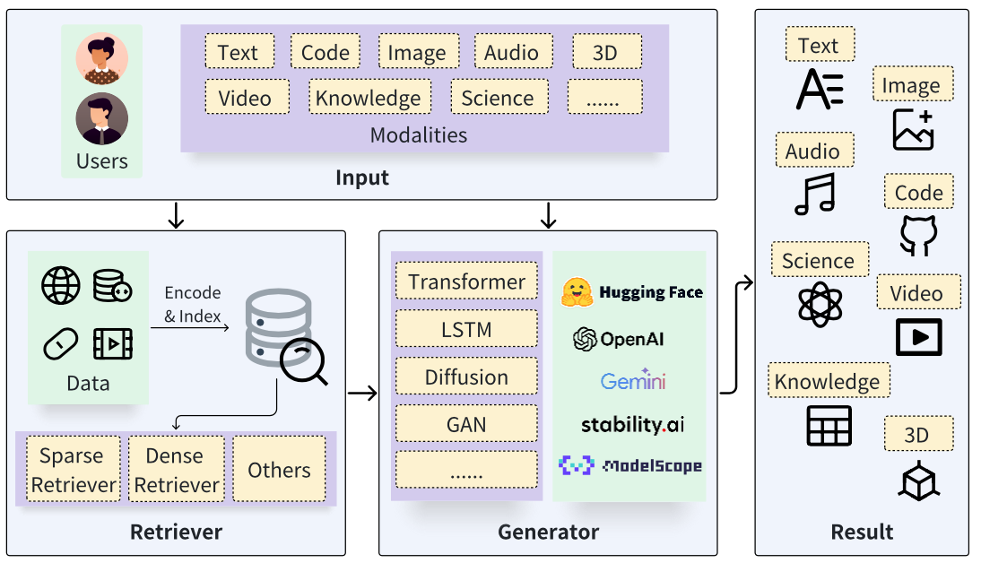
Retrieval-Augmented Generation (RAG) Architecture
Source: Zhao, P., Zhang, H., Yu, Q., Wang, Z., Geng, Y., Fu, F., ... & Cui, B. (2024). Retrieval-augmented generation for ai-generated content: A survey. arXiv preprint arXiv:2402.19473.

Slide 78
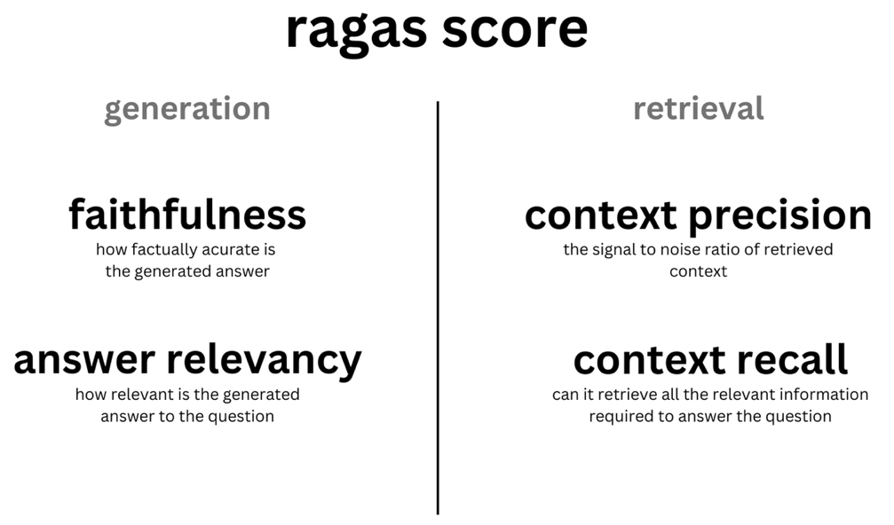
Evaluating RAG with Ragas Metrics
Source: https://blog.langchain.dev/evaluating-rag-pipelines-with-ragas-langsmith/

Slide 79


NVIDIA Developer Program
NVIDIA
Deep Learning Institute (DLI)
https://developer.nvidia.com/join-nvidia-developer-program
https://learn.nvidia.com/

Slide 80
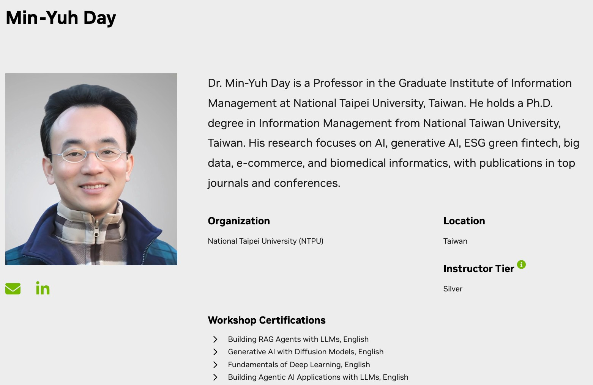
NVIDIA Certified Instructor
https://www.nvidia.com/en-us/training/instructor-directory/search/

Slide 81
Get NVIDIA DLI Certificate
Before the NVIDIA Workshop
Step 1. Join NVIDIA Developer Program (Free)
https://developer.nvidia.com/join-nvidia-developer-program
Step 2. Visit NVIDIA Deep Learning Institute (DLI)
https://learn.nvidia.com/
Step 3. Enroll "Building RAG Agents with LLMs" Self-Paced Course (Free)
https://learn.nvidia.com/courses/course-detail?course_id=course-v1:DLI+S-FX-15+V1

Slide 82
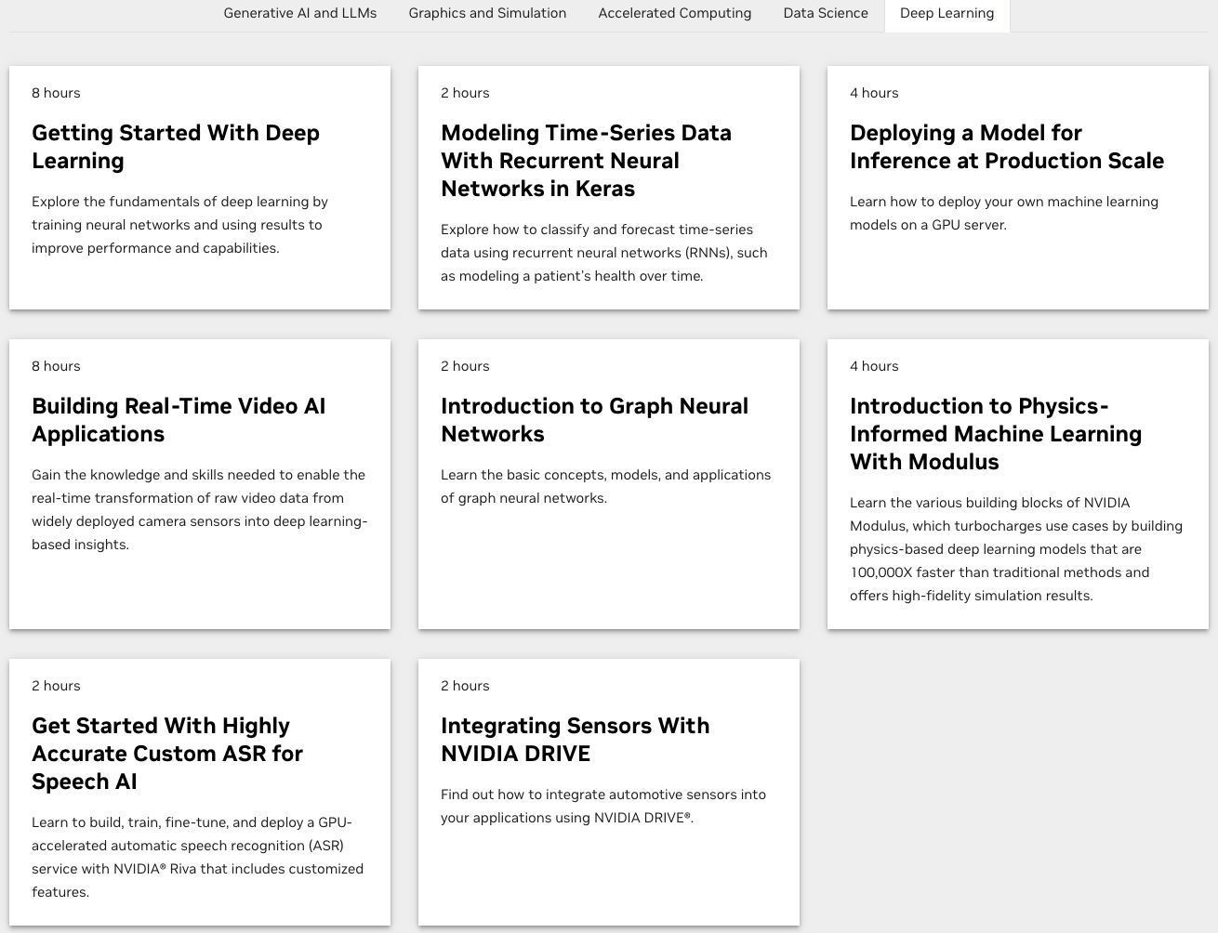
Join the NVIDIA Developer Program take one of the complimentary technical self-paced courses
(worth up to $90)
https://developer.nvidia.com/join-nvidia-developer-program

Slide 83
NVIDIA Deep Learning Institute (DLI)
Self-Paced Course
Generative AI Explained
Free
2 hours
Self-Paced Course
Getting Started With Deep Learning
Certificate available
$90
8 hours
Instructor-Led Workshop
Fundamentals of Deep Learning
Certificate available
$500
8 hours
Self-Paced Course
Introduction to Transformer-Based Natural Language Processing
Certificate available
$30
6 hours
Self-Paced Course
Building RAG Agents With LLMs
Certificate available
Free
8 hours
Instructor-Led Workshop
Building RAG Agents With LLMs
Certificate available
$500
8 hours
Self-Paced Course
Generative AI with Diffusion Models
Certificate available
$90
8 hours
Instructor-Led Workshop
Generative AI with Diffusion Models
Certificate available
$500
8 hours
https://www.nvidia.com/en-us/learn/learning-path/generative-ai-llm/

Slide 84
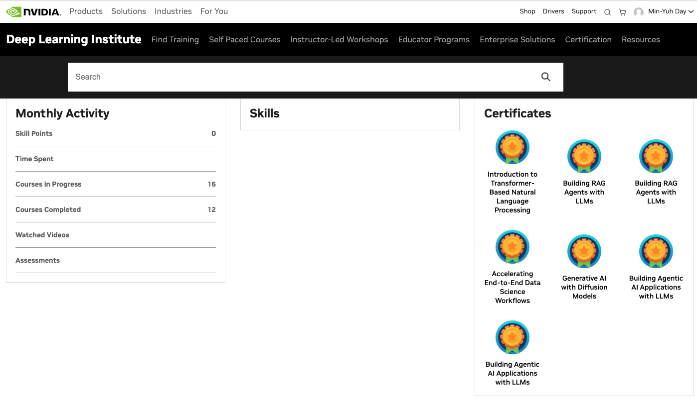
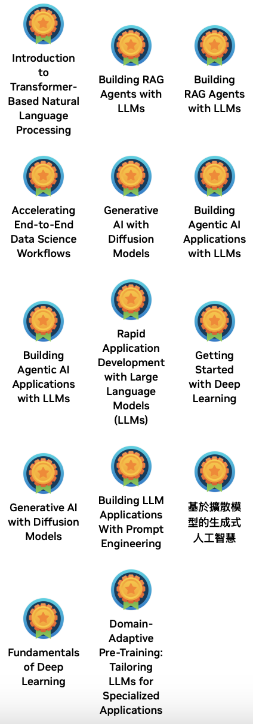
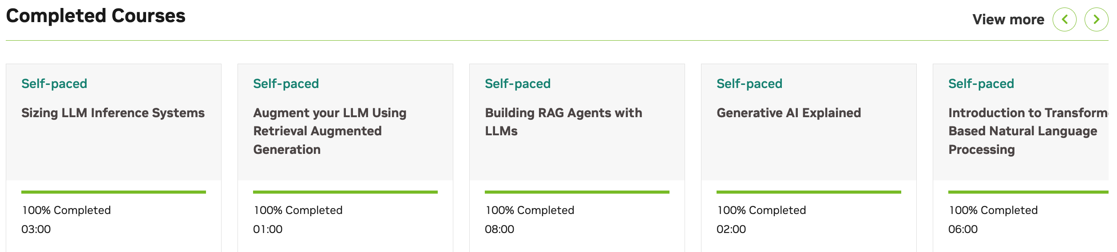
Deep Learning Institute (DLI)
https://learn.nvidia.com/my-learning

Slide 85
Software
Engineering

Slide 86
Software Engineering and
Project Management
Analyze
Requirements
definition
Design
System and Software design
Build
Implementation and
unit testing
Test
Integration
and
system testing
Deliver
Operation
and maintenance
Project Management

Slide 87
Software Engineering
Software engineering is an engineering discipline that is concerned with all aspects of software production from the early stages of system specification through to maintaining the system after it has gone into use.

Slide 88
What is software?
Computer programs and associated documentation. Software products may be developed for a particular customer or may be developed for a general market.

Slide 89
What are the attributes of good software?
Good software should deliver the required functionality and performance to the user and should be maintainable, dependable and usable.

Slide 90
What is software engineering?
Software engineering is an engineering discipline that is concerned with all aspects of software production from initial conception to operation and maintenance.

Slide 91
What are the fundamental software engineering activities?
Software specification, software development, software validation and software evolution.

Slide 92
What is the difference between software engineering and computer science?
Computer science focuses on theory and fundamentals; software engineering is concerned with the practicalities of developing and delivering useful software.

Slide 93
What are the best software engineering techniques and methods?
While all software projects have to be professionally managed and developed, different techniques are appropriate for different types of system.
For example, games should always be developed using a series of prototypes whereas safety critical control systems require a complete and analyzable specification to be developed.
There are no methods and techniques that are good for everything.

Slide 94
What are the costs of software engineering?
Roughly 60% of software costs are development costs, 40% are testing costs.
For custom software, evolution costs often exceed development costs.

Slide 95
Information Management
Management
Information Systems (MIS)
Information Systems

Slide 96
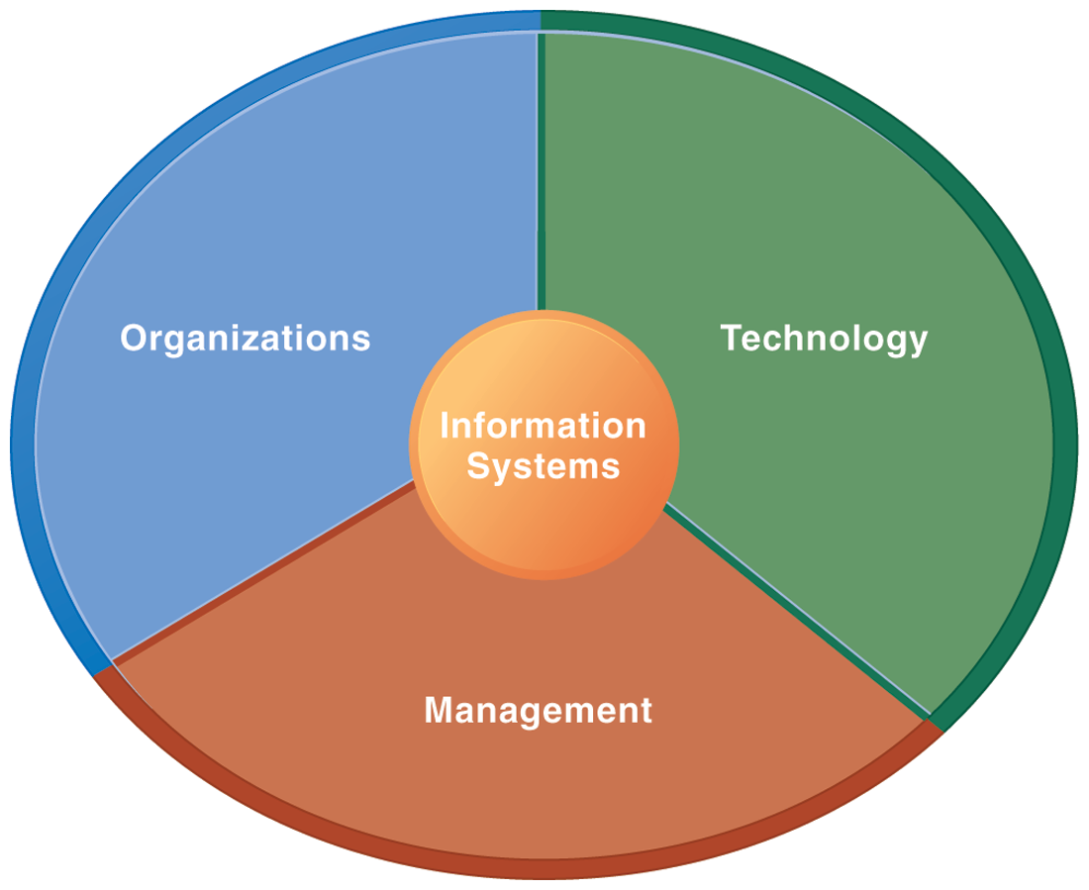
Information Management (MIS)
Information Systems

Slide 97
Fundamental MIS Concepts
Business
Challenges
Management
Organization
Information
System
Business
Solutions
Technology

Slide 98
Software products
Software products are generic software systems that provide functionality that is useful to a range of customers.
Software products:
  Large-scale business systems (e.g. MS Excel)
  Personal products (e.g. Evernote)
  Simple mobile phone apps and games (e.g. Suduko).

Slide 99
Software product engineering
Software product engineering methods and techniques have evolved from software engineering techniques that support the development of one-off, custom software systems.

Slide 100
Software projects
Custom software systems are still important for large businesses, government and public bodies.
They are developed in dedicated software projects.

Slide 101
Project
A project is a
temporary endeavor
undertaken to create a
unique product, service, or result.

Slide 102
Project Management Body of Knowledge (PMBOK Guide) PMBOK v6 vs. PMBOK v7
PMBOK Guide v6
PMBOK Guide v7
Project Management Body of Knowledge:
Introduction
Project Environment
Role of the Project Manager
10 Knowledge Areas
  Integration
  Scope
  Schedule
  Cost
  Quality
  Resources
  Communications
  Risk
  Procurement
  Stakeholders
The Standard for Project Management :
Introduction
System for Value Delivery
12 Project Management Principles:
  1. Stewardship, 2. Team
  3. Stakeholders, 4. Value
  5. Systems Thinking, 5. Leadership
  7. Tailoring, 8. Quality
  9. Complexity, 10, Risk
  11. Adaptability and Resiliency
  12. Change
The Standard for Project Management
(5 Process Groups):
Initiating
Planning
Executing
Monitoring and Controlling
Closing
Project Management Body of Knowledge:
8 Project Performance Domains:
  1. Stakeholders, 2. Team,
  3. Development approach and Life Cycle
  4. Planning, 5. Project Work, 6. Delivery,
  7. Measurement, 8. Uncertainty
Tailoring
Models, Methods, and Artifacts

Slide 103
Project Management Knowledge Areas
(PMBOK v6)
Project Integration Management
Project Scope Management
Project Schedule Management
Project Cost Management
Project Quality Management
Project Resource Management
Project Communications Management
Project Risk Management
Project Procurement Management
Project Stakeholder Management

Slide 104
Project Management Process Groups
(PMBOK v6)
Initiating Process Group
Planning Process Group
Executing Process Group
Monitoring and Controlling Process Group
Closing Process Group

Slide 105
Project Management 12 Principles
(PMBOK v7)
Stewardship
Team
Stakeholders
Value
Systems Thinking
Leadership
Tailoring
Quality
Complexity
Risk
Adaptability and Resiliency
Change

Slide 106
Project Management
8 Project Performance Domains
(PMBOK v7)
Stakeholders
Team
Development Approach and Life Cycle
Planning
Project Work
Delivery
Measurement
Uncertainty

Slide 107
Project-based software engineering
CUSTOMER
Problem
generates
helps-with
Requirements
implemented-by
Software
1
CUSTOMER and
DEVELOPER
DEVELOPER

Slide 108
Project-based software engineering
The starting point for the software development is a set of ‘software requirements’ that are owned by an external client and which set out what they want a software system to do to support their business processes.
The software is developed by a software company (the contractor) who design and implement a system that delivers functionality to meet the requirements.
The customer may change the requirements at any time in response to business changes (they usually do). The contractor must change the software to reflect these requirements changes.
Custom software usually has a long-lifetime (10 years or more) and it must be supported over that lifetime.

Slide 109
Product software engineering
DEVELOPER
Opportunity
1
inspires
realizes
Product features
implemented-by
Software
DEVELOPER
DEVELOPER

Slide 110
Product software engineering
The starting point for product development is a business opportunity that is identified by individuals or a company.
They develop a software product to take advantage of this opportunity and sell this to customers.
The company who identified the opportunity design and implement a set of software features that realize the opportunity and that will be useful to customers.
The software development company are responsible for deciding on the development timescale, what features to include and when the product should change.
Rapid delivery of software products is essential to capture the market for that type of product.

Slide 111
Software product line
A set of software products that share a common core.
Each member of the product line includes customer-specific adaptations and additions.
Software product lines may be used to implement a custom system for a customer with specific needs that can’t be met by a generic product.

Slide 112
Platform
A software (or software + hardware) product that includes functionality so that new applications can be built on it.
An example of a platform that you probably use is Facebook.
It provides an extensive set of product functionality but also provides support for creating ‘Facebook apps’.
These add new features that may be used by a business or a Facebook interest group.

Slide 113
Software execution models
Stand-alone execution
Hybrid execution
Software as a service
User’s computer
User’s computer
User’s computer
User interface
Product functionality
User data
User interface
Partial functionality
User data
User interface
(browser or app)
Product updates
Additional functionality
User data backups
Product updates
Product functionality
User data
Vendor’s servers
Vendor’s servers
Vendor’s servers

Slide 114
Software execution models
Stand-alone
  The software executes entirely on the customer’s computers.
Hybrid
  Part of the software’s functionality is implemented on the customer’s computer but some features are implemented on the product developer’s servers.
Software service
  All of the product’s features are implemented on the developer’s servers and the customer accesses these through a browser or a mobile app.

Slide 115
Comparable software development
The key feature of product development is that there is no external customer that generates requirements and pays for the software.
Student projects
  Individuals or student groups develop software as part of their course. Given an assignment, they decide what features to include in the software.
Research software
  Researchers develop software to help them answer questions that are relevant to their research.
Internal tool development

Slide 116
The product vision
The starting point for software product development is a ‘product vision’.
Product visions are simple statements that define the essence of the product to be developed.
The product vision should answer three fundamental questions:
  What is the product to be developed?
  Who are the target customers and users?
  Why should customers buy this product?

Slide 117
Moore’s vision template
FOR (target customer)
WHO (statement of the need or opportunity)
The (PRODUCT NAME) is a (product category)
THAT (key benefit, compelling reason to buy)
UNLIKE (primary competitive alternative)
OUR PRODUCT (statement of primary differentiation)

Slide 118
Vision template example
“FOR a mid-sized company's marketing and sales departments
WHO need basic CRM functionality,
THE CRM-Innovator is a Web-based service
THAT provides sales tracking, lead generation, and sales representative support features that improve customer relationships at critical touch points.
UNLIKE other services or package software products,
OUR product provides very capable services at a moderate cost.”

Slide 119
Information sources for developing a product vision
Domain experience
Product experience
Customer experience
Prototyping and playing around

Slide 120
Information sources for developing a product vision
Domain experience
  The product developers may work in a particular area (say marketing and sales) and understand the software support that they need.
  They may be frustrated by the deficiencies in the software they use and see opportunities for an improved system.

Slide 121
Information sources for developing a product vision
Product experience
  Users of existing software (such as word processing software) may see simpler and better ways of providing comparable functionality and propose a new system that implements this.
  New products can take advantage of recent technological developments such as speech interfaces.

Slide 122
Information sources for developing a product vision
Customer experience
  The software developers may have extensive discussions with prospective customers of the product to understand the problems that they face, constraints, such as interoperability, that limit their flexibility to buy new software, and the critical attributes of the software that they need.

Slide 123
Information sources for developing a product vision
Prototyping and playing around
  Developers may have an idea for software but need to develop a better understanding of that idea and what might be involved in developing it into a product.
  They may develop a prototype system as an experiment and ‘play around’ with ideas and variations using that prototype system as a platform.

Slide 124
A vision statement for the iLearn system
FOR teachers and educators WHO need a way to help students use web-based learning resources and applications, THE iLearn system is an open learning environment THAT allows the set of resources used by classes and students to be easily configured for these students and classes by teachers themselves. UNLIKE Virtual Learning Environments, such as Moodle, the focus of iLearn is the learning process rather than the administration and management of materials, assessments and coursework. OUR product enables teachers to create subject and age-specific environments for their students using any web-based resources, such as videos, simulations and written materials that are appropriate.
Schools and universities are the target customers for the iLearn system as it will significantly improve the learning experience of students at relatively low cost. It will collect and process learner analytics that will reduce the costs of progress tracking and reporting.

Slide 125
The Essence of
Strategic Marketing (STP)
Segmentation
Targeting
Positioning

Slide 126
Customer
Value

Slide 127
Value
the sum of the
tangible and intangible
benefits and costs

Slide 128
Value
Total
customer
benefit
Customer perceived
value
Total
customer
cost

Slide 129
Customer Perceived Value
Product benefit
Total
customer
benefit
Customer perceived
value
Services benefit
Personnel benefit
Image benefit
Monetary cost
Total
customer
cost
Time cost
Energy cost
Psychological cost

Slide 130
Business Model
8
7
2
4
1
Key
Partners
Key
Activities
Value Proposition
Customer
Relationships
Customer
Segments
6
3
Key
Resources
Channels
9
5
Cost
Structure
Revenue
Streams
Source: Alexander Osterwalder & Yves Pigneur, Business Model Generation: A Handbook for Visionaries, Game Changers, and Challengers, Wiley, 2010.

Slide 131
Software product management
Software product management is a business activity that focuses on the software products developed and sold by the business.
Product managers (PMs) take overall responsibility for the product and are involved in planning, development and product marketing.
Product managers are the interface between the organization, its customers and the software development team. They are involved at all stages of a product’s lifetime from initial conception through to withdrawal of the product from the market.
Product managers must look outward to customers and potential customers rather than focus on the software being developed

Slide 132
Product management concerns
Business
needs
Product manager
Technology
constraints
Customer
experience

Slide 133
Product management concerns
Business needs
  PMs have to ensure that the software being developed meets the business goals of the software development company.
Technology constraints
  PMs must make developers aware of technology issues that are important to customers.
Customer experience
  PMs should be in regular contact with customers and potential customers to understand what they are looking for in a product, the types of users and their backgrounds and the ways that the product may be used.

Slide 134
Technical interactions of product managers
Product
vision management
Product
backlog management
User stories
and
scenarios
Product manager
Acceptance
testing
Customer
testing
User
interface
design

Slide 135
Technical interactions of product managers
Product vision management
  The product manager may be responsible for helping with the development of the product vision.
  The should always be responsible for managing the vision, which involves assessing and evaluating proposed changes against the product vision.
  They should ensure that there is no ‘vision drift’

Slide 136
Technical interactions of product managers
Product roadmap development
  A product roadmap is a plan for the development, release and marketing of the software.
  The PM should lead roadmap development and should be the ultimate authority in deciding if changes to the roadmap should be made.

Slide 137
Technical interactions of product managers
User story and scenario development
  User stories and scenarios are used to refine a product vision and identify product features.
  Based on his or her knowledge of customers, the PM should lead the development of stories and scenarios.

Slide 138
Technical interactions of product managers
Product backlog creation and management
  The product backlog is a prioritized ‘to-do’ list of what has to be developed.
  PMs should be involved in creating and refining the backlog and deciding on the priority of product features to be developed.

Slide 139
Technical interactions of product managers
Acceptance testing
  Acceptance testing is the process of verifying that a software release meets the goals set out in the product roadmap and that the product is efficient and reliable.
  The PM should be involved in developing tests of the product features that reflect how customers use the product.

Slide 140
Technical interactions of product managers
Customer testing
  Customer testing involves taking a release of a product to customers and getting feedback on the product’s features, usability and business.
  PMs are involved in selecting customers to be involved in the customer testing process and working with them during that process.

Slide 141
Technical interactions of product managers
User interface design
  Product managers should understand user limitations and act as surrogate users in their interactions with the development team.
  They should evaluate user interface features as they are developed to check that these features are not unnecessarily complex or force users to work in an unnatural way.

Slide 142
Product prototyping
Product prototyping is the process of developing an early version of a product to test your ideas and to convince yourself and company funders that your product has real market potential.

Slide 143
Product prototyping
You may be able to write an inspiring product vision, but your potential users can only really relate to your product when they see a working version of your software.
They can point out what they like and don’t like about it and make suggestions for new features.
A prototype may be also used to help identify fundamental software components or services and to test technology.

Slide 144
Product prototyping
Building a prototype should be the first thing that you do when developing a software product.
Your aim should be to have a working version of your software that can be used to demonstrate its key features.
You should always plan to throw-away the prototype after development and to re-implement the software, taking account of issues such as security and reliability.

Slide 145
Two-stage prototyping
1. Feasibility demonstration
  You create an executable system that demonstrates the new ideas in your product.
  The aims at this stage are to see if your ideas actually work and to show funders and/or company management the original product features that are better than those in competing products.
2. Customer demonstration

Slide 146
Two-stage prototyping
1. Feasibility demonstration
2. Customer demonstration
  You take an existing prototype created to demonstrate feasibility and extend this with your ideas for specific customer features and how these can be realized.
  Before you develop this type of prototype, you need to do some user studies and have a clearer idea of your potential users and scenarios of use.

Slide 147
Software process models
The waterfall model
  This takes the fundamental process activities of specification, development, validation, and evolution and represents them as separate process phases such as requirements specification, software design, implementation, and testing.
Incremental development
  This approach interleaves the activities of specification, development, and validation. The system is developed as a series of versions (increments), with each version adding functionality to the previous version.
Integration and configuration
  This approach relies on the availability of reusable components or systems. The system development process focuses on configuring these components for use in a new setting and integrating them into a system.

Slide 148
Software Development Life Cycle (SDLC)
The waterfall model
Requirements
definition
System and Software design
Implementation and unit testing
Integration and system testing
Operation and maintenance

Slide 149
Incremental development
Concurrent
activities
Specification
Initial
version
Outline description
Development
Intermediate versions
Intermediate versions
Intermediate versions
Validation
Final
version

Slide 150
Reuse-oriented software engineering
Application
system
available
Configure
application
system
Software
discovery
Requirements
specification
Requirements
refinement
Adapt
components
Software
evaluation
Integrate
system
Components
available
Develop new
components

Slide 151
Prototype development
Establish
prototype
objectives
Define
prototype
functionality
Develop
prototype
Evaluate
prototype
Prototyping
plan
Outline
definition
Executable
Prototyping
Evaluation
report

Slide 152
Incremental delivery
Define
outline
requirements
Assign
requirements
to increments
Design
system
architecture
Develop
system
increment
System
incomplete ?
Validate
increment
Integrate
increment
Validate
system
Deploy
increment
System
complete ?
Final
system

Slide 153
The process improvement model
Process
Measure
Process
Change
Process
Analyze

Slide 154
Capability maturity levels
Level 5
Optimizing
Level 4
Quantitatively
Defined
Level 3
Defined
Level 2
Managed
Level 1
Initial

Slide 155
Plan-based and Agile development
Plan-based development
Requirements
engineering
Requirements
specification
Design and implementation
Requirements change requests
Agile development
Requirements
engineering
Design and implementation

Slide 156
Uncertainty and Complexity Model Inspired by the Stacey Complexity Model
Chaos
Fundamentally risky
High Uncertainty
Complex
Requirements Uncertainty
Adaptive approaches
work well here
Complicated
Simple
Linear approaches
work well here
Low Uncertainty
Low Uncertainty
High Uncertainty
Technical Degree of Uncertainty

Slide 157
Characteristics of
Four Categories of Life Cycles
Approach
Requirements
Activities
Delivery
Goal
Predictive
Fixed
Performed once for
the entire project
Single delivery
Manage cost
Iterative
Dynamic
Repeated until
correct
Single delivery
Correctness of
solution
Incremental
Dynamic
Performed once for
a given increment
Frequent smaller deliveries
Speed
Agile
Dynamic
Repeated until
correct
Frequent smaller deliveries
Customer value via frequent deliveries
and feedback

Slide 158
The Continuum of Life Cycles
High
Incremental
Agile
Frequency of Delivery
Predictive
Iterative
Low
Low
High
Degree of Change

Slide 159
Predictive Life Cycle
Analyze
Design
Build
Test
Deliver

Slide 160
Iterative Life Cycle
Prototype
Refine
Analyze
Analyze
Design
Build
Test
Deliver

Slide 161
A Life Cycle of
Varying-Sized Increments
Analyze
Design
Build
Test
Deliver
Analyze
Design
Build
Test
Deliver
Analyze
Design
Build
Test
Deliver

Slide 162
Iteration-Based and Flow-Based Agile Life Cycles
Iteration-Based Agile
Requirements
Analysis
Design
Build
Test
Requirements
Analysis
Design
Build
Test
Requirements
Analysis
Design
Build
Test
Requirements
Analysis
Design
Build
Test
Repeat
as needed
…
Requirements
Analysis
Design
Build
Test
Requirements
Analysis
Design
Build
Test
Flow-Based Agile
Requirements
Analysis
Design
Build
Test
the number of features in the WIP limit
Requirements
Analysis
Design
Build
Test
the number of features in the WIP limit
Requirements
Analysis
Design
Build
Test
the number of features in the WIP limit
Repeat
as needed
…
Requirements
Analysis
Design
Build
Test
the number of features in the WIP limit
Requirements
Analysis
Design
Build
Test
the number of features in the WIP limit

Slide 163
Summary
Software products are software systems that include general functionality that is likely to be useful to a wide range of customers.
In product software engineering, the same company is responsible for deciding on the features that should be part of the product and the implementation of these features.

Slide 164
Summary
Software products may be delivered as stand-alone systems running on the customer’s computers, hybrid systems or service-based systems.
In hybrid systems, some features are implemented locally and others are accessed over the Internet.
All product features are remotely accessed in service-based products.

Slide 165
Summary
A product vision should succinctly describe what is to be developed, who are the target customers for the product and why they should buy the product that you are developing.
Domain experience, product experience, customer experience and an experimental software prototype may all contribute to the development of the product vision.

Slide 166
Summary
Key responsibilities of product managers are product vision ownership, product roadmap development, creating user stories and the product backlog, customer and acceptance testing and user interface design.
Product managers work at the interface between the business, the software development team and the product customers.
They facilitate communications between these groups.

Slide 167
Summary
You should always develop a product prototype to refine your own ideas and to demonstrate the planned product features to potential customers

Slide 168
References
Ian Sommerville (2019), Engineering Software Products: An Introduction to Modern Software Engineering, Pearson.
Ian Sommerville (2015), Software Engineering, 10th Edition, Pearson.
Titus Winters, Tom Manshreck, and Hyrum Wright (2020), Software Engineering at Google: Lessons Learned from Programming Over Time, O'Reilly Media.
Project Management Institute (2021), A Guide to the Project Management Body of Knowledge (PMBOK Guide) – Seventh Edition and The Standard for Project Management, PMI.
Project Management Institute (2017), A Guide to the Project Management Body of Knowledge (PMBOK Guide), Sixth Edition, Project Management Institute.
Project Management Institute (2017), Agile Practice Guide, Project Management Institute.
Denis Rothman (2024), RAG-Driven Generative AI: Build custom retrieval augmented generation pipelines with LlamaIndex, Deep Lake, and Pinecone, Packt Publishing
Thomas R. Caldwell (2025), The Agentic AI Bible: The Complete and Up-to-Date Guide to Design, Build, and Scale Goal-Driven, LLM-Powered Agents that Think, Execute and Evolve, Independently published
Yilei Zhao, Wentao Zhang, Xiao Lei, Yandan Zheng, Mengpu Liu, and Wei Yang Bryan Lim. (2026) "Advancing ESG Intelligence: An Expert-level Agent and Comprehensive Benchmark for Sustainable Finance." arXiv preprint arXiv:2601.08676 (2026).
NVIDIA DLI (2026), Building RAG Agents with LLMs,
https://learn.nvidia.com/courses/course-detail?course_id=course-v1:DLI+S-FX-15+V1
NVIDIA DLI (2026), Generative AI with Diffusion Models,
https://learn.nvidia.com/courses/course-detail?course_id=course-v1:DLI+S-FX-14+V1
Tucker J. Marion, Mahdi Srour, and Frank Piller (2024), "When Generative AI meets product development." MIT Sloan Management Review 66, no. 1 : 14-15.

