Slide 1










Agile Software Engineering:
Agile methods, Scrum, and Extreme Programming
Software Engineering
1142SE03
MBA, IM, NTPU (M5010) (Spring 2026)
Wed 2, 3, 4 (9:10-12:00) (B3F17)
University Ambassador
Certified Instructor
Min-Yuh Day, Ph.D,
Professor and Director
Institute of Information Management, National Taipei University
https://web.ntpu.edu.tw/~myday
https://meet.google.com/ish-gzmy-pmo
2026-03-11

Slide 2
Syllabus
Week Date Subject/Topics
1 2026/02/25 Introduction to Software Engineering
2 2026/03/04 Software Products and Project Management:
Software product management and prototyping with
Generative AI and Agentic AI
3 2026/03/11 Agile Software Engineering:
Agile methods, Scrum, and Extreme Programming
4 2026/03/18 Case Study on Software Engineering I
5 2026/03/25 Features, Scenarios, and Stories
6 2026/04/01 Software Architecture: Architectural design,
System decomposition, and Distribution architecture

Slide 3
Syllabus
Week Date Subject/Topics
7 2026/04/08 Cloud-Based Software: Virtualization and containers,
Everything as a service, Software as a service
8 2026/04/15 Midterm Project Report
9 2026/04/22 Cloud Computing and Cloud Software Architecture
10 2026/04/29 Microservices Architecture, RESTful services,
Service deployment
11 2026/05/06 Case Study on Software Engineering II
12 2026/05/13 Security and Privacy; Reliable Programming;
Testing: Functional testing, Test automation,
Test-driven development, and Code reviews

Slide 4
Syllabus
Week Date Subject/Topics
13 2026/05/20 Industry Practices of Software Engineering
14 2026/05/27 DevOps and Code Management:
Code management and DevOps automation
15 2026/06/03 Final Project Report I
16 2026/06/10 Final Project Report II

Slide 5
Agile
Software
Engineering

Slide 6
Software Engineering and
Project Management
Analyze
Requirements
definition
Design
System and Software design
Build
Implementation and
unit testing
Test
Integration
and
system testing
Deliver
Operation
and maintenance
Project Management

Slide 7
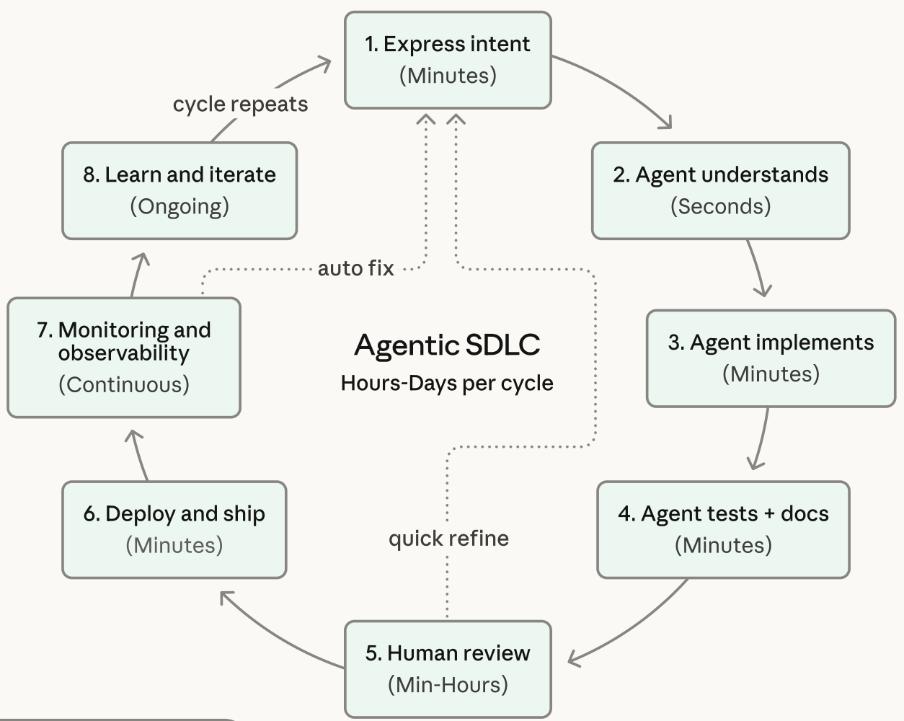
Agentic Coding Software Development Lifecycle

Slide 8
Information Management
Management
Information Systems (MIS)
Information Systems

Slide 9
Information Management (MIS)
Information Systems
Organizations
Technology
Information
Systems
Management

Slide 10
Fundamental MIS Concepts
Business
Challenges
Management
Organization
Information
System
Business
Solutions
Technology

Slide 11
Business Model
8
7
2
4
1
Key
Partners
Key
Activities
Value Proposition
Customer
Relationships
Customer
Segments
6
3
Key
Resources
Channels
9
5
Cost
Structure
Revenue
Streams
Source: Alexander Osterwalder & Yves Pigneur, Business Model Generation: A Handbook for Visionaries, Game Changers, and Challengers, Wiley, 2010.

Slide 12
Project-based software engineering
CUSTOMER
Problem
generates
helps-with
Requirements
implemented-by
Software
1
CUSTOMER and
DEVELOPER
DEVELOPER

Slide 13
Product software engineering
DEVELOPER
Opportunity
1
inspires
realizes
Product features
implemented-by
Software
DEVELOPER
DEVELOPER

Slide 14
Software execution models
Stand-alone execution
Hybrid execution
Software as a service
User’s computer
User’s computer
User’s computer
User interface
Product functionality
User data
User interface
Partial functionality
User data
User interface
(browser or app)
Product updates
Additional functionality
User data backups
Product updates
Product functionality
User data
Vendor’s servers
Vendor’s servers
Vendor’s servers

Slide 15
Product management concerns
Business
needs
Product manager
Technology
constraints
Customer
experience

Slide 16
Technical interactions of product managers
Product
vision management
Product
backlog management
User stories
and
scenarios
Product manager
Acceptance
testing
Customer
testing
User
interface
design

Slide 17
Software Development Life Cycle (SDLC)
The waterfall model
Requirements
definition
System and Software design
Implementation and unit testing
Integration and system testing
Operation and maintenance

Slide 18
Plan-based and Agile development
Plan-based development
Requirements
engineering
Requirements
specification
Design and implementation
Requirements change requests
Agile development
Requirements
engineering
Design and implementation

Slide 19
The Continuum of Life Cycles
High
Incremental
Agile
Frequency of Delivery
Predictive
Iterative
Low
Low
High
Degree of Change

Slide 20
Predictive Life Cycle
Analyze
Design
Build
Test
Deliver

Slide 21
Iterative Life Cycle
Prototype
Refine
Analyze
Analyze
Design
Build
Test
Deliver

Slide 22
A Life Cycle of
Varying-Sized Increments
Analyze
Design
Build
Test
Deliver
Analyze
Design
Build
Test
Deliver
Analyze
Design
Build
Test
Deliver

Slide 23
Iteration-Based and Flow-Based Agile Life Cycles
Iteration-Based Agile
Requirements
Analysis
Design
Build
Test
Requirements
Analysis
Design
Build
Test
Requirements
Analysis
Design
Build
Test
Requirements
Analysis
Design
Build
Test
Repeat
as needed
…
Requirements
Analysis
Design
Build
Test
Requirements
Analysis
Design
Build
Test
Flow-Based Agile
Requirements
Analysis
Design
Build
Test
the number of features in the WIP limit
Requirements
Analysis
Design
Build
Test
the number of features in the WIP limit
Requirements
Analysis
Design
Build
Test
the number of features in the WIP limit
Repeat
as needed
…
Requirements
Analysis
Design
Build
Test
the number of features in the WIP limit
Requirements
Analysis
Design
Build
Test
the number of features in the WIP limit

Slide 24
From personas to features
1
Personas
A way of representing users
inspire
Natural language descriptions of a user interacting with a software product
2
Scenarios
are-developed-into
3
inspire
Stories
Natural language descriptions of something that is needed or wanted by users
4
Features
define
Fragments of product functionality

Slide 25
Multi-tier client-server architecture
Client 1
Client 2
Web
Server
Application
Server
Database
Server
Client 3
Client …

Slide 26
Service-oriented Architecture
Client 1
S1
S2
Client 2
S3
Web
Server
Service
gateway
S4
Client 3
S5
Client …
S6
Services

Slide 27
VM
Container
Virtual
web server
Virtual
mail server
User 1
Container 1
User 2
Container 2
Server
software
Server
software
Application
software
Application
software
Guest
OS
Guest
OS
Server
software
Server
software
Hypervisor
Container manager
Host OS
Host OS
Server Hardware
Server Hardware

Slide 28
Everything as a service
Photo
editing
Software as a service
(SaaS)
Logistics
management
Cloud management
Monitoring
Platform as a service
(PaaS)
Database
Software
development
Storage Network
Infrastructure as a service
(IaaS)
Computing Virtualization
Cloud data center

Slide 29
Software as a service
Software customers
Software
provider
Software services
Cloud Infrastructure
Cloud
provider

Slide 30
Microservices architecture – key design questions
What are the microservices that make up the system?
How should data be distributed and shared?
How should microservices communicate with each other?
Microservices architecture
design
How should the microservices in the system be coordinated?
How should service failure be detected, reported and managed?

Slide 31
Types of security threat
An attacker attempts to deny access to the system for legitimate users
An attacker attempts to damage the system or its data
Availability
threats
Integrity
threats
SOFTWARE PRODUCT
PROGRAM
Distributed denial of service (DDoS) attack
Virus
DATA
Ransomware
Data theft
Confidentiality
threats
An attacker tries to gain access to private information held by the system

Slide 32
Software product quality attributes
Reliability
Availability
1
2
Software product quality attributes
Security
Resilience
7
3
Usability
Maintainability
6
4
Responsiveness
5

Slide 33
A refactoring process
1
2
Start
Identify code
‘smell’
Identify refactoring strategy
4
3
Run automated code tests
Make small
improvement until strategy completed

Slide 34
Functional testing
Start
1
Unit
Testing
4
2
Release
Testing
Feature
Testing
3
System
Testing

Slide 35
Test-driven development (TDD)
Start
1
Identify new
functionality
2
Identify partial implementation
of functionality
3
Write code stub
that will fail test
Functionality
complete
Functionality
incomplete
4
Run all
automated test
7
Refactor code
if required
5
Implement code that should cause failing test to pass
Test failure
6
Run all
automated test
All tests pass

Slide 36
DevOps
Development
Deployment
Support
Multi-skilled DevOps team

Slide 37
Code management and DevOps
DevOps automation
Continuous
integration
Continuous
deployment
Continuous
delivery
Infrastructure
as code
Code management system
Branching and merging
Recover
version
information
Code
repository
Save and
retrieve
versions
Transfer code to/from developer’s filestore
DevOps measurement
Data
collection
Data
analysis
Report
generation

Slide 38
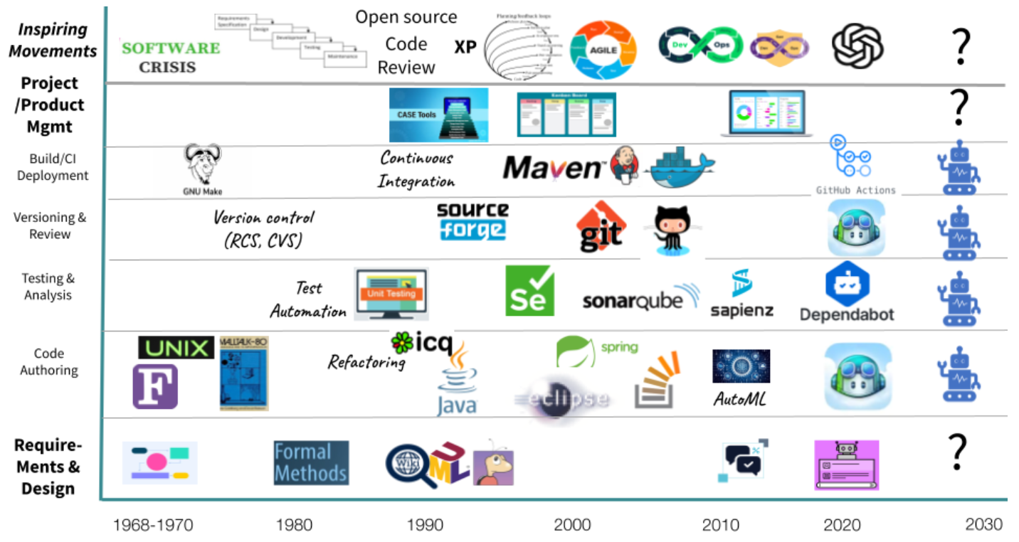
Tools for Software Engineering Lifecycle

Slide 39
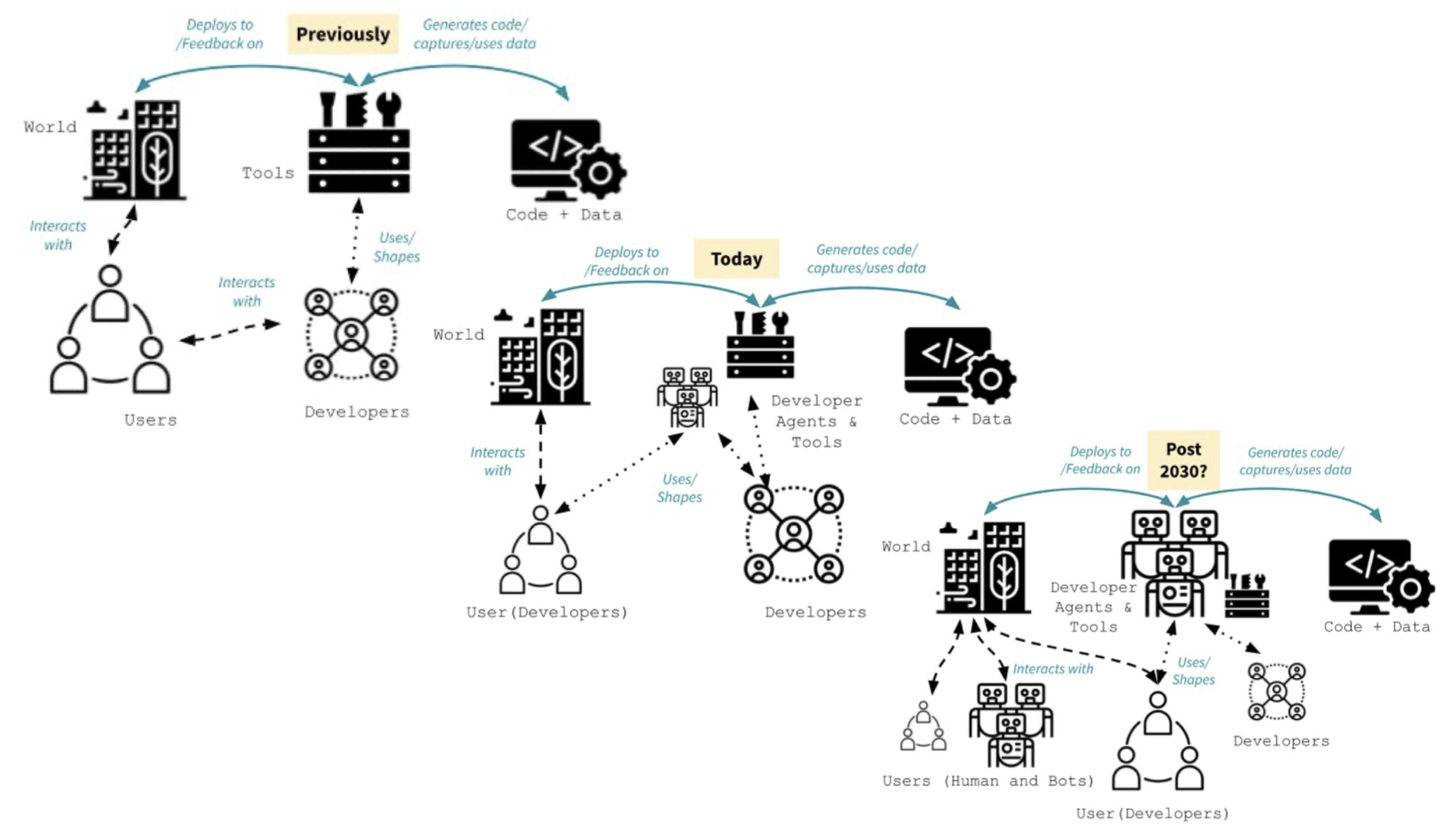
AI-powered Software Developer Agents

Slide 40
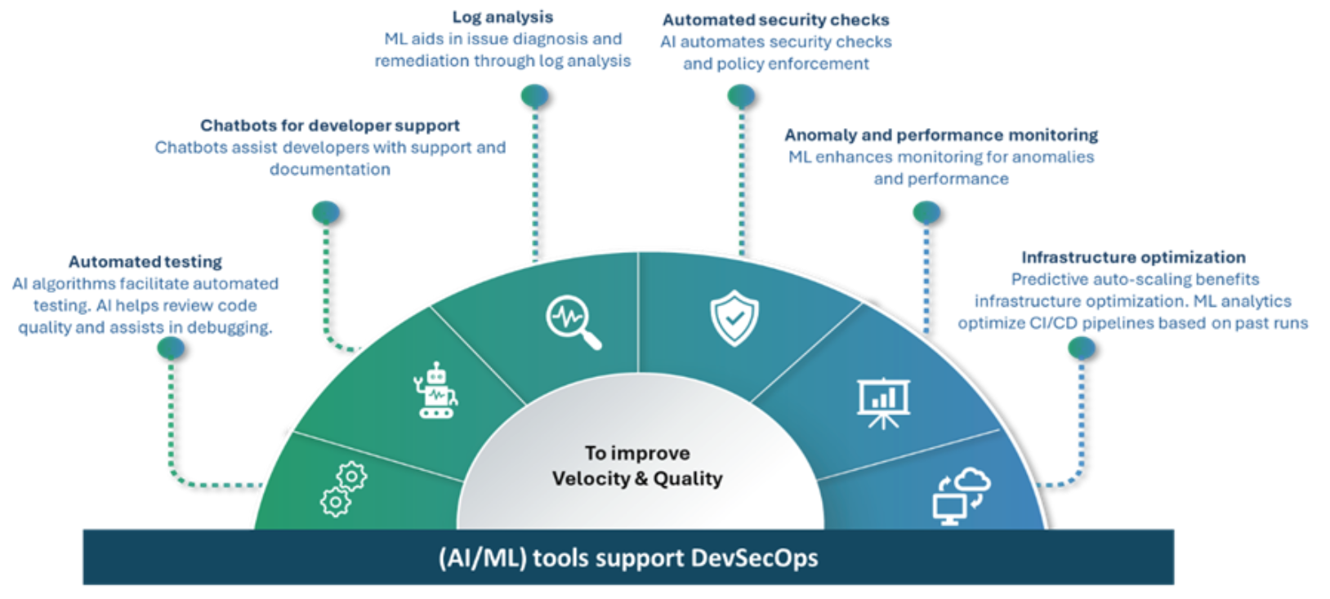
Generative AI in Agile Software Engineering

Slide 41
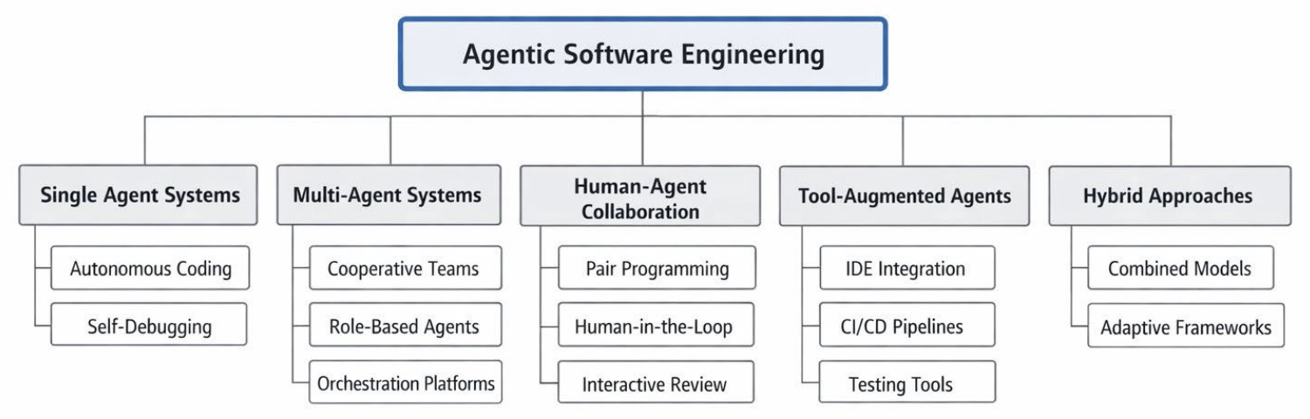
Agentic Software Engineering

Slide 42
Agile

Slide 43
Agile software engineering
Software products must be brought to market quickly so rapid software development and delivery is essential.
Virtually all software products are now developed using an agile approach.
Agile software engineering focuses on delivering functionality quickly,
responding to changing product specifications and minimizing development overheads.

Slide 44
Agile Manifesto Values, Principles, and Common Practices
Agile
Mindset
4
Values
12
Principles
Practices

Slide 45
Agile is a Blanket Term for
Many Approaches
Lean
Agile
Kanban
ScrumBan
Crystal
Scrum
AUP
XP
FDD
DSDM

Slide 46
Agile is a mindset defined by 4 values, guided by 12 principles, and manifested through many different practices.
Agile practitioners select practices based on their needs.
Agile Manifesto and Mindset

Slide 47
4
Agile Values

Slide 48
The Four Values of the Agile Manifesto
(Manifesto for Agile Software Development, 2001)
We are uncovering better ways of developing software by doing it and helping others do it. Through this work we have come to value:
individuals and interactions over processes and tools
working software over comprehensive documentation
customer collaboration over contract negotiation
responding to change over following a plan
That is, while there is value in the items on the right, we value the items on the left more.

Slide 49
12
Agile Principles

Slide 50
The Twelve Principles
Behind the Agile Manifesto
1. Our highest priority is to satisfy the customer through early and continuous delivery of valuable software.
2. Welcome changing requirements, even late in development. Agile processes harness change for the customer’s competitive advantage.
3. Deliver working software frequently, from a couple of weeks to a couple of months, with a preference to the shorter timescale.
4. Business people and developers must work together daily throughout the project.
5. Build projects around motivated individuals. Give them the environment and support they need, and trust them to get the job done.
6. The most efficient and effective method of conveying information to and within a development team is face-to-face conversation.

Slide 51
The Twelve Principles
Behind the Agile Manifesto
7. Working software is the primary measure of progress.
8. Agile processes promote sustainable development. The sponsors, developers, and users should be able to maintain a constant pace indefinitely.
9. Continuous attention to technical excellence and good design enhances agility.
10. Simplicity—the art of maximizing the amount of work not done—is essential.
11. The best architectures, requirements, and designs emerge from self-organizing teams.
12. At regular intervals, the team reflects on how to become more effective, then tunes and adjusts its behavior accordingly.

Slide 52
Agile Development Principles
Involve the customer
Involve customers closely with the software development team. Their role is to provide and prioritize new system requirements and to evaluate each increment of the system.
Embrace change
Expect the features of the product and the details of these features to change as the development team and the product manager learn more about it. Adapt the software to cope with changes as they are made.
Develop and deliver incrementally
Always develop software products in increments. Test and evaluate each increment as it is developed and feed back required changes to the development team.

Slide 53
Agile Development Principles
Maintain simplicity
Focus on simplicity in both the software being developed and in the development process. Wherever possible, do what you can to eliminate complexity from the system.
Focus on people, not things
Trust the development team and do not expect everyone to always do the development process in the same way. Team members should be left to develop their own ways of working without being limited by prescriptive software processes.

Slide 54
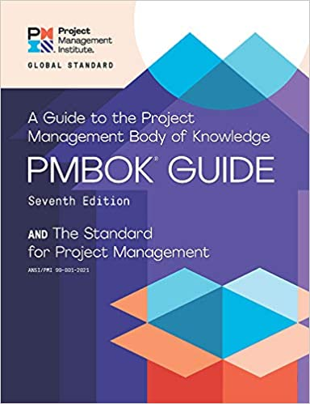
12
Project Management Principles

Slide 55
Project Management Body of Knowledge (PMBOK Guide) PMBOK v6 vs. PMBOK v7
PMBOK Guide v6
PMBOK Guide v7
Project Management Body of Knowledge:
Introduction
Project Environment
Role of the Project Manager
10 Knowledge Areas
  Integration
  Scope
  Schedule
  Cost
  Quality
  Resources
  Communications
  Risk
  Procurement
  Stakeholders
The Standard for Project Management :
Introduction
System for Value Delivery
12 Project Management Principles:
  1. Stewardship, 2. Team
  3. Stakeholders, 4. Value
  5. Systems Thinking, 5. Leadership
  7. Tailoring, 8. Quality
  9. Complexity, 10, Risk
  11. Adaptability and Resiliency
  12. Change
The Standard for Project Management
(5 Process Groups):
Initiating
Planning
Executing
Monitoring and Controlling
Closing
Project Management Body of Knowledge:
8 Project Performance Domains:
  1. Stakeholders, 2. Team,
  3. Development approach and Life Cycle
  4. Planning, 5. Project Work, 6. Delivery,
  7. Measurement, 8. Uncertainty
Tailoring
Models, Methods, and Artifacts

Slide 56
Project Management Knowledge Areas
(PMBOK v6)
Project Integration Management
Project Scope Management
Project Schedule Management
Project Cost Management
Project Quality Management
Project Resource Management
Project Communications Management
Project Risk Management
Project Procurement Management
Project Stakeholder Management

Slide 57
Project Management Process Groups
(PMBOK v6)
Initiating Process Group
Planning Process Group
Executing Process Group
Monitoring and Controlling Process Group
Closing Process Group

Slide 58
Project Management 12 Principles
(PMBOK v7)
Stewardship
Team
Stakeholders
Value
Systems Thinking
Leadership
Tailoring
Quality
Complexity
Risk
Adaptability and Resiliency
Change

Slide 59
Project Management
8 Project Performance Domains
(PMBOK v7)
Stakeholders
Team
Development Approach and Life Cycle
Planning
Project Work
Delivery
Measurement
Uncertainty

Slide 60
Agile software engineering
A large number of ‘agile methods’ have been developed.
  There is no ‘best’ agile method or technique.
  It depends on who is using the technique, the development team and the type of product being developed

Slide 61
Agile methods
Plan-driven development evolved to support the engineering of large, long-lifetime systems
  This approach is based on controlled and rigorous software development processes that include detailed project planning, requirements specification and analysis and system modelling.
  However, plan-driven development involves significant overheads and documentation and it does not support the rapid development and delivery of software.
Agile methods were developed in the 1990s to address this problem.
  These methods focus on the software rather than its documentation, develop software in a series of increments and aim to reduce process bureaucracy as much as possible.

Slide 62
Incremental development
All agile methods are based around
incremental development and delivery.
Product development focuses on the software features, where a feature does something for the software user.
With incremental development, you start by prioritizing the features so that the most important features are implemented first.
  You only define the details of the feature being implemented in an increment.
  That feature is then implemented and delivered.
Users or surrogate users can try it out and provide feedback to the development team. You then go on to define and implement the next feature of the system.

Slide 63
Incremental development
1
Product feature list
Choose features to
be included
in increment
If all features are
complete, deliver system release
5
2
Deliver system
increment
Refine features
descriptions
4
3
Integrate feature
into system
Implement and
test feature

Slide 64
Incremental development activities
Choose features to be included in an increment
Using the list of features in the planned product, select those features that can be implemented in the next product increment.
Refine feature descriptions
Add detail to the feature descriptions so that the team have a common understanding of each feature and there is sufficient detail to begin implementation.
Implement and test
Implement the feature and develop automated tests for that feature that show that its behaviour is consistent with its description.
Integrate feature and test
Integrate the developed feature with the existing system and test it to check that it works in conjunction with other features.
Deliver system increment
Deliver the system increment to the customer or product manager for checking and comments. If enough features have been implemented, release a version of the system for customer use.

Slide 65
Extreme programming
The most influential work that has changed software development culture was the development of Extreme Programming (XP).
The name was coined by Kent Beck in 1998 because the approach was developed by pushing recognized good practice, such as iterative development, to ‘extreme’ levels.
Extreme programming focused on 12 new development techniques that were geared to rapid, incremental software development, change and delivery.
Some of these techniques are now widely used; others have been less popular.

Slide 66
Extreme Programming Practices
Test-first
development
Continuous
integration
Refactoring
Incremental
planning
Small releases
Extreme
Programming
(XP)
Collective
ownership
Simple
design
Pair
programming
On-site
customer
Sustainable
pace

Slide 67
Widely adopted XP practices
Incremental planning/user stories
  There is no ‘grand plan’ for the system. Instead, what needs to be implemented (the requirements) in each increment are established in discussions with a customer representative.
  The requirements are written as user stories.
  The stories to be included in a release are determined by the time available and their relative priority.

Slide 68
Widely adopted XP practices
Small releases
  The minimal useful set of functionality that provides business value is developed first.
  Releases of the system are frequent and incrementally add functionality to the previous release.

Slide 69
Widely adopted XP practices
Test-driven development
  Instead of writing code then tests for that code, developers write the tests first.
  This helps clarify what the code should actually do and that there is always a ‘tested’ version of the code available.
  An automated unit test framework is used to run the tests after every change.
  New code should not ‘break’ code that has already been implemented.

Slide 70
Widely adopted XP practices
Continuous integration
  As soon as the work on a task is complete, it is integrated into the whole system and a new version of the system is created.
  All unit tests from all developers are run automatically and must be successful before the new version of the system is accepted.

Slide 71
Widely adopted XP practices
Refactoring
  Refactoring means improving the structure, readability, efficiency and security of a program.
  All developers are expected to refactor the code as soon as potential code improvements are found.
  This keeps the code simple and maintainable.

Slide 72
Widely adopted XP practices
Incremental planning/user stories
  There is no ‘grand plan’ for the system. Instead, what needs to be implemented (the requirements) in each increment are established in discussions with a customer representative.
  The requirements are written as user stories.
  The stories to be included in a release are determined by the time available and their relative priority.

Slide 73
Scrum
Software company managers need information that will help them understand how much it costs to develop a software product, how long it will take and when the product can be brought to market.
Plan-driven development provides this information through long-term development plans that identify deliverables - items the team will deliver and when these will be delivered.
Plans always change so anything apart from short-term plans are unreliable.
Scrum is an agile method that provides a framework for agile project organization and planning. It does not mandate any specific technical practices.

Slide 74
Scrum Terminology
Scrum
A daily team meeting where progress is reviewed and work to be done that day as discussed and agreed.
Sprint
A short period, typically two to four weeks, when a product increment is developed.
ScrumMaster
A team coach who guides the team in the effective use of Scrum.

Slide 75
Scrum Terminology
Product
The software product that is being developed by the Scrum team.
Product owner
A team member who is responsible for identifying product features and attributes. They review work done and help to test the product.
Product backlog
A to-do list of items such as bugs, features and product improvements that the Scrum team have not yet completed.

Slide 76
Scrum Terminology
Development team
A small self-organising team of five to eight people who are responsible for developing the product.
Potentially shippable product increment
The output of a sprint which should be of high enough quality to be deployed for customer use.
Velocity
An estimate of how much work a team can do in a single sprint.

Slide 77
Key roles in Scrum
The Product Owner is responsible for ensuring that the development team are always focused on the product they are building rather than diverted into technically interesting but less relevant work.
  In product development, the product manager should normally take on the Product Owner role.
The ScrumMaster is a Scrum expert whose job is to guide the team in the effective use of the Scrum method. The developers of Scrum emphasize that the ScrumMaster is not a conventional project manager but is a coach for the team. They have authority within the team on how Scrum is used.
  In many companies that use Scrum, the ScrumMaster also has some project management responsibilities.

Slide 78
Scrum and sprints
In Scrum, software is developed in sprints, which are fixed-length periods (2 - 4 weeks) in which software features are developed and delivered.
During a sprint, the team has daily meetings (Scrums) to review progress and to update the list of work items that are incomplete.
Sprints should produce a ‘shippable product increment’. This means that the developed software should be complete and ready to deploy.

Slide 79
Scrum cycles
Start
1
Review product
backlog
Select items
to implement
Review
sprint
Product
backlog
Plan
sprint
Shippable
product increment
sprint
Test
software
Sprint
backlog
Scrum
Develop
software

Slide 80
Key Scrum practices
Product backlog
This is a to-do list of items to be implemented that is reviewed and updated before each sprint.
Timeboxed sprints
Fixed-time (2-4 week) periods in which items from the product backlog are implemented,
Self-organizing teams
Self-organizing teams make their own decisions and work by discussing issues and making decisions by consensus.

Slide 81
Product backlogs
The product backlog is a list of what needs to be done to complete the development of the product.
The items on this list are called product backlog items (PBIs).
The product backlog may include a variety of different items such as product features to be implemented, user requests, essential development activities and desirable engineering improvements.
The product backlog should always be prioritized so that the items that be implemented first are at the top of the list.

Slide 82
Examples of
Product Backlog Items (PBIs)
1. As a teacher, I want to be able to configure the group of tools that are available to individual classes. (feature)
2. As a parent, I want to be able to view my children’s work and the assessments made by their teachers. (feature)
3. As a teacher of young children, I want a pictorial interface for children with limited reading ability. (user request)
4. Establish criteria for the assessment of open source software that might be used as a basis for parts of this system. (development activity)
5. Refactor user interface code to improve understandability and performance. (engineering improvement)
6. Implement encryption for all personal user data. (engineering improvement)

Slide 83
Product backlog item states
Ready for consideration
These are high-level ideas and feature descriptions that will be considered for inclusion in the product. They are tentative so may radically change or may not be included in the final product.
Ready for refinement
The team has agreed that this is an important item that should be implemented as part of the current development. There is a reasonably clear definition of what is required. However, work is needed to understand and refine the item.
Ready for implementation
The PBI has enough detail for the team to estimate the effort involved and to implement the item. Dependencies on other items have been identified.

Slide 84
Product backlog activities
REVISED
PRODUCT BACKLOG
PRODUCT BACKLOG
Refinement
PBI 1.1
PBI 1
PBI 1.2
PBI 2
Estimation
PBI 2E
PBI 3
PBI 3E
PBI 4
Prioritization
PBI 4
PBI 5
PBI 5
Creation
PBI 6

Slide 85
Sprint activities
Sprint
planning
Sprint backlog
Sprint
review
Sprint
execution
Sprint
backlog
Integration
Scrum
Develop
software

Slide 86
Managing External Interactions
External
interactions
Team-focused
external interactions
Product-focused
external interactions
ScrumMaster
Product owner

Slide 87
Project Management Responsibilities
Budget
Schedule
Risks
Problems
Progress
Reporting
Project
Management
Administration
People
Finance
Compliance
Procurement
Liaison
Vacations
Absence
Work quality
Reviewing
Hiring

Slide 88
Summary
The best way to develop software products is to use agile software engineering methods that are geared to rapid product development and delivery.
Agile methods are based around iterative development and the minimization of overheads during the development process.
Extreme programming (XP) is an influential agile method that introduced agile development practices such as user stories, test-first development and continuous integration. These are now mainstream software development activities.

Slide 89
Summary
Scrum is an agile method that focuses on agile planning and management. Unlike XP, it does not define the engineering practices to be used. The development team may use any technical practices that they believe are appropriate for the product being developed.
In Scrum, work to be done is maintained in a product backlog – a list of work items to be completed. Each increment of the software implements some of the work items from the product backlog.

Slide 90
Summary
Sprints are fixed-time activities (usually 2–4 weeks) where a product increment is developed. Increments should be ‘potentially shippable’ i.e. they should not need further work before they are delivered.
A self-organizing team is a development team that organizes the work to be done by discussion and agreement amongst team members.
Scrum practices such as the product backlog, sprints and self-organizing teams can be used in any agile development process, even if other aspects of Scrum are not used.

Slide 91
References
Ian Sommerville (2019), Engineering Software Products: An Introduction to Modern Software Engineering, Pearson.
Ian Sommerville (2015), Software Engineering, 10th Edition, Pearson.
Titus Winters, Tom Manshreck, and Hyrum Wright (2020), Software Engineering at Google: Lessons Learned from Programming Over Time, O'Reilly Media.
Project Management Institute (2021), A Guide to the Project Management Body of Knowledge (PMBOK Guide) – Seventh Edition and The Standard for Project Management, PMI.
Project Management Institute (2017), A Guide to the Project Management Body of Knowledge (PMBOK Guide), Sixth Edition, Project Management Institute.
Project Management Institute (2017), Agile Practice Guide, Project Management Institute.
Denis Rothman (2024), RAG-Driven Generative AI: Build custom retrieval augmented generation pipelines with LlamaIndex, Deep Lake, and Pinecone, Packt Publishing
Thomas R. Caldwell (2025), The Agentic AI Bible: The Complete and Up-to-Date Guide to Design, Build, and Scale Goal-Driven, LLM-Powered Agents that Think, Execute and Evolve, Independently published
Tucker J. Marion, Mahdi Srour, and Frank Piller (2024), "When Generative AI meets product development." MIT Sloan Management Review 66, no. 1 : 14-15.
Yilei Zhao, Wentao Zhang, Xiao Lei, Yandan Zheng, Mengpu Liu, and Wei Yang Bryan Lim. (2026) "Advancing ESG Intelligence: An Expert-level Agent and Comprehensive Benchmark for Sustainable Finance." arXiv preprint arXiv:2601.08676 (2026).
Nesreen Otoum and Nuha Elkhalili.(2026) "Methods and Techniques of Agentic Software Engineering: A Systematic Literature Review." IEEE Access 14 (2026): 7443-7465.
NVIDIA DLI (2026), Building RAG Agents with LLMs,
https://learn.nvidia.com/courses/course-detail?course_id=course-v1:DLI+S-FX-15+V1
NVIDIA DLI (2026), Generative AI with Diffusion Models,
https://learn.nvidia.com/courses/course-detail?course_id=course-v1:DLI+S-FX-14+V1

