Slide 1



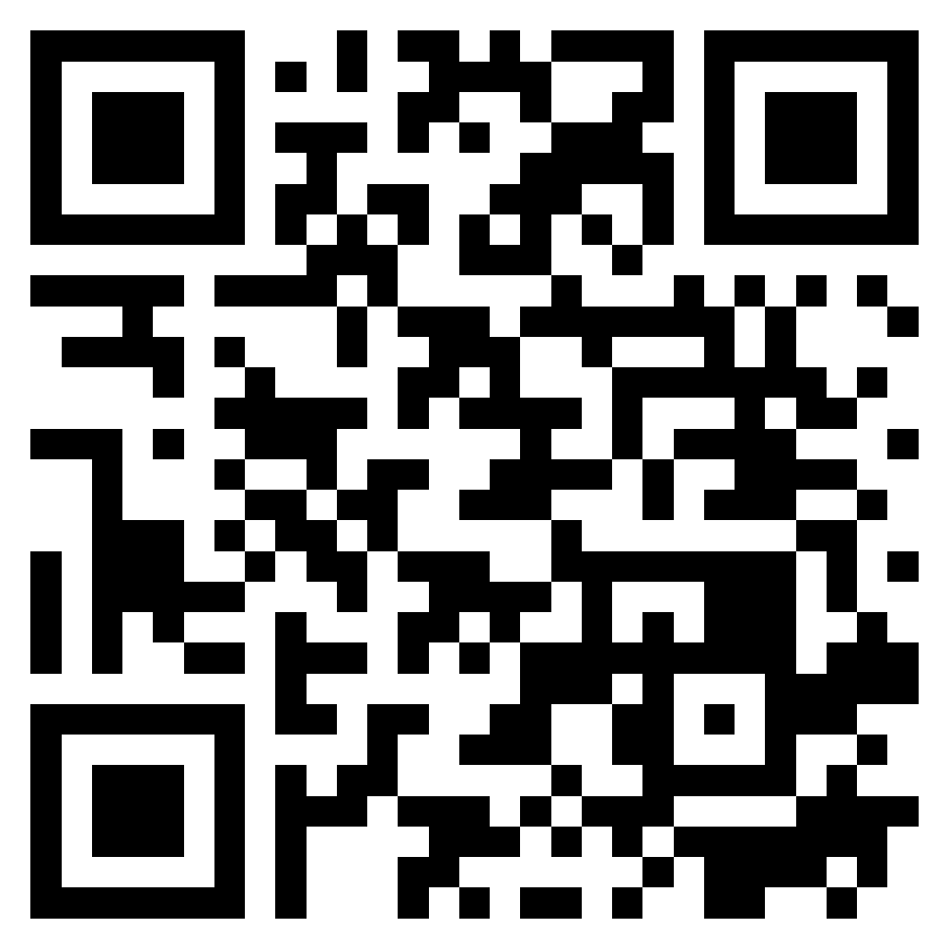






Features, Scenarios, and Stories
Software Engineering
1142SE04
MBA, IM, NTPU (M5010) (Spring 2026)
Wed 2, 3, 4 (9:10-12:00) (B3F17)
University Ambassador
Certified Instructor
Min-Yuh Day, Ph.D,
Professor and Director
Institute of Information Management, National Taipei University
https://web.ntpu.edu.tw/~myday
https://meet.google.com/ish-gzmy-pmo
2026-03-25

Slide 2
Syllabus
Week Date Subject/Topics
1 2026/02/25 Introduction to Software Engineering
2 2026/03/04 Software Products and Project Management:
Software product management and prototyping with
Generative AI and Agentic AI
3 2026/03/11 Agile Software Engineering:
Agile methods, Scrum, and Extreme Programming
4 2026/03/18 Case Study on Software Engineering I
5 2026/03/25 Features, Scenarios, and Stories
6 2026/04/01 Software Architecture: Architectural design,
System decomposition, and Distribution architecture

Slide 3
Syllabus
Week Date Subject/Topics
7 2026/04/08 Cloud-Based Software: Virtualization and containers,
Everything as a service, Software as a service
8 2026/04/15 Midterm Project Report
9 2026/04/22 Cloud Computing and Cloud Software Architecture
10 2026/04/29 Microservices Architecture, RESTful services,
Service deployment
11 2026/05/06 Case Study on Software Engineering II
12 2026/05/13 Security and Privacy; Reliable Programming;
Testing: Functional testing, Test automation,
Test-driven development, and Code reviews

Slide 4
Syllabus
Week Date Subject/Topics
13 2026/05/20 Industry Practices of Software Engineering
14 2026/05/27 DevOps and Code Management:
Code management and DevOps automation
15 2026/06/03 Final Project Report I
16 2026/06/10 Final Project Report II

Slide 5
Features, Scenarios, and Stories

Slide 6
Software Engineering and
Project Management
Analyze
Requirements
definition
Design
System and Software design
Build
Implementation and
unit testing
Test
Integration
and
system testing
Deliver
Operation
and maintenance
Project Management

Slide 7
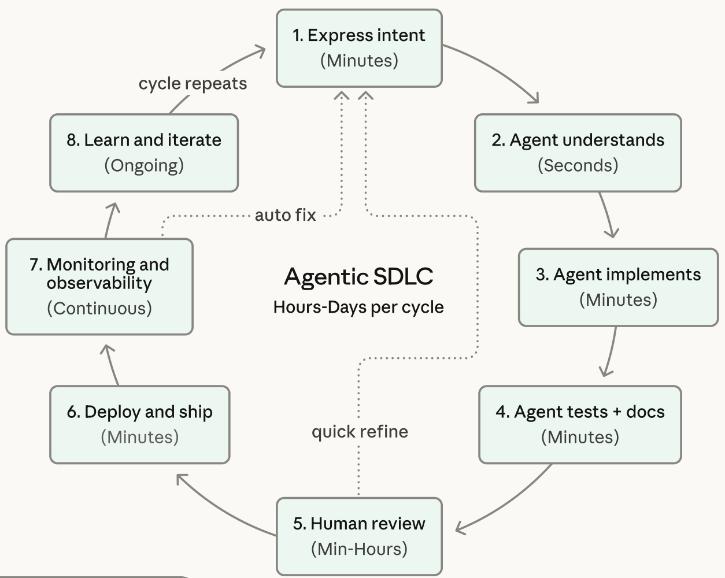
Agentic Coding Software Development Lifecycle

Slide 8
Information Management
Management
Information Systems (MIS)
Information Systems

Slide 9
Information Management (MIS)
Information Systems
Organizations
Technology
Information
Systems
Management

Slide 10
Fundamental MIS Concepts
Business
Challenges
Management
Organization
Information
System
Business
Solutions
Technology

Slide 11
Business Model
8
7
2
4
1
Key
Partners
Key
Activities
Value Proposition
Customer
Relationships
Customer
Segments
6
3
Key
Resources
Channels
9
5
Cost
Structure
Revenue
Streams
Source: Alexander Osterwalder & Yves Pigneur, Business Model Generation: A Handbook for Visionaries, Game Changers, and Challengers, Wiley, 2010.

Slide 12
Project-based software engineering
CUSTOMER
Problem
generates
helps-with
Requirements
implemented-by
Software
1
CUSTOMER and
DEVELOPER
DEVELOPER

Slide 13
Product software engineering
DEVELOPER
Opportunity
1
inspires
realizes
Product features
implemented-by
Software
DEVELOPER
DEVELOPER

Slide 14
Software execution models
Stand-alone execution
Hybrid execution
Software as a service
User’s computer
User’s computer
User’s computer
User interface
Product functionality
User data
User interface
Partial functionality
User data
User interface
(browser or app)
Product updates
Additional functionality
User data backups
Product updates
Product functionality
User data
Vendor’s servers
Vendor’s servers
Vendor’s servers

Slide 15
Product management concerns
Business
needs
Product manager
Technology
constraints
Customer
experience

Slide 16
Technical interactions of product managers
Product
vision management
Product
backlog management
User stories
and
scenarios
Product manager
Acceptance
testing
Customer
testing
User
interface
design

Slide 17
Software Development Life Cycle (SDLC)
The waterfall model
Requirements
definition
System and Software design
Implementation and unit testing
Integration and system testing
Operation and maintenance

Slide 18
Plan-based and Agile development
Plan-based development
Requirements
engineering
Requirements
specification
Design and implementation
Requirements change requests
Agile development
Requirements
engineering
Design and implementation

Slide 19
The Continuum of Life Cycles
High
Incremental
Agile
Frequency of Delivery
Predictive
Iterative
Low
Low
High
Degree of Change

Slide 20
Predictive Life Cycle
Analyze
Design
Build
Test
Deliver

Slide 21
Iterative Life Cycle
Prototype
Refine
Analyze
Analyze
Design
Build
Test
Deliver

Slide 22
A Life Cycle of
Varying-Sized Increments
Analyze
Design
Build
Test
Deliver
Analyze
Design
Build
Test
Deliver
Analyze
Design
Build
Test
Deliver

Slide 23
Iteration-Based and Flow-Based Agile Life Cycles
Iteration-Based Agile
Requirements
Analysis
Design
Build
Test
Requirements
Analysis
Design
Build
Test
Requirements
Analysis
Design
Build
Test
Requirements
Analysis
Design
Build
Test
Repeat
as needed
…
Requirements
Analysis
Design
Build
Test
Requirements
Analysis
Design
Build
Test
Flow-Based Agile
Requirements
Analysis
Design
Build
Test
the number of features in the WIP limit
Requirements
Analysis
Design
Build
Test
the number of features in the WIP limit
Requirements
Analysis
Design
Build
Test
the number of features in the WIP limit
Repeat
as needed
…
Requirements
Analysis
Design
Build
Test
the number of features in the WIP limit
Requirements
Analysis
Design
Build
Test
the number of features in the WIP limit

Slide 24
From personas to features
1
Personas
A way of representing users
inspire
Natural language descriptions of a user interacting with a software product
2
Scenarios
are-developed-into
3
inspire
Stories
Natural language descriptions of something that is needed or wanted by users
4
Features
define
Fragments of product functionality

Slide 25
Multi-tier client-server architecture
Client 1
Client 2
Web
Server
Application
Server
Database
Server
Client 3
Client …

Slide 26
Service-oriented Architecture
Client 1
S1
S2
Client 2
S3
Web
Server
Service
gateway
S4
Client 3
S5
Client …
S6
Services

Slide 27
VM
Container
Virtual
web server
Virtual
mail server
User 1
Container 1
User 2
Container 2
Server
software
Server
software
Application
software
Application
software
Guest
OS
Guest
OS
Server
software
Server
software
Hypervisor
Container manager
Host OS
Host OS
Server Hardware
Server Hardware

Slide 28
Everything as a service
Photo
editing
Software as a service
(SaaS)
Logistics
management
Cloud management
Monitoring
Platform as a service
(PaaS)
Database
Software
development
Storage Network
Infrastructure as a service
(IaaS)
Computing Virtualization
Cloud data center

Slide 29
Software as a service
Software customers
Software
provider
Software services
Cloud Infrastructure
Cloud
provider

Slide 30
Microservices architecture – key design questions
What are the microservices that make up the system?
How should data be distributed and shared?
How should microservices communicate with each other?
Microservices architecture
design
How should the microservices in the system be coordinated?
How should service failure be detected, reported and managed?

Slide 31
Types of security threat
An attacker attempts to deny access to the system for legitimate users
An attacker attempts to damage the system or its data
Availability
threats
Integrity
threats
SOFTWARE PRODUCT
PROGRAM
Distributed denial of service (DDoS) attack
Virus
DATA
Ransomware
Data theft
Confidentiality
threats
An attacker tries to gain access to private information held by the system

Slide 32
Software product quality attributes
Reliability
Availability
1
2
Software product quality attributes
Security
Resilience
7
3
Usability
Maintainability
6
4
Responsiveness
5

Slide 33
A refactoring process
1
2
Start
Identify code
‘smell’
Identify refactoring strategy
4
3
Run automated code tests
Make small
improvement until strategy completed

Slide 34
Functional testing
Start
1
Unit
Testing
4
2
Release
Testing
Feature
Testing
3
System
Testing

Slide 35
Test-driven development (TDD)
Start
1
Identify new
functionality
2
Identify partial implementation
of functionality
3
Write code stub
that will fail test
Functionality
complete
Functionality
incomplete
4
Run all
automated test
7
Refactor code
if required
5
Implement code that should cause failing test to pass
Test failure
6
Run all
automated test
All tests pass

Slide 36
DevOps
Development
Deployment
Support
Multi-skilled DevOps team

Slide 37
Code management and DevOps
DevOps automation
Continuous
integration
Continuous
deployment
Continuous
delivery
Infrastructure
as code
Code management system
Branching and merging
Recover
version
information
Code
repository
Save and
retrieve
versions
Transfer code to/from developer’s filestore
DevOps measurement
Data
collection
Data
analysis
Report
generation

Slide 38
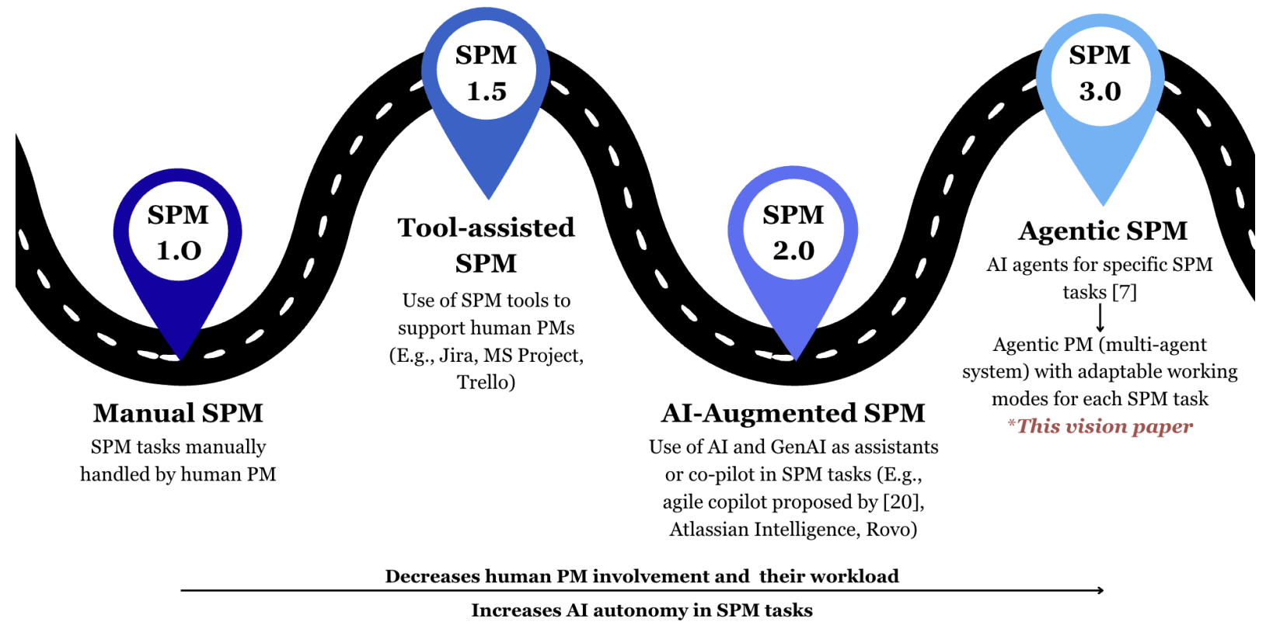
Agentic Software Project Management (SPM)

Slide 39
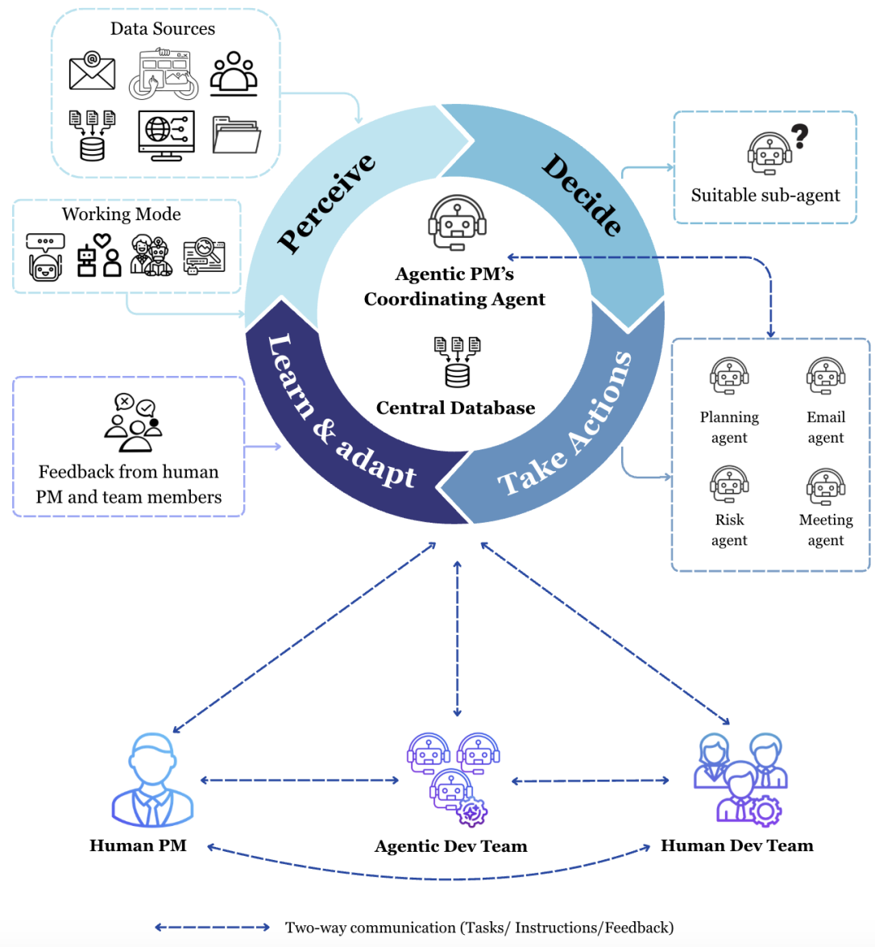
Agentic PM as an Assistant to Human PM

Slide 40
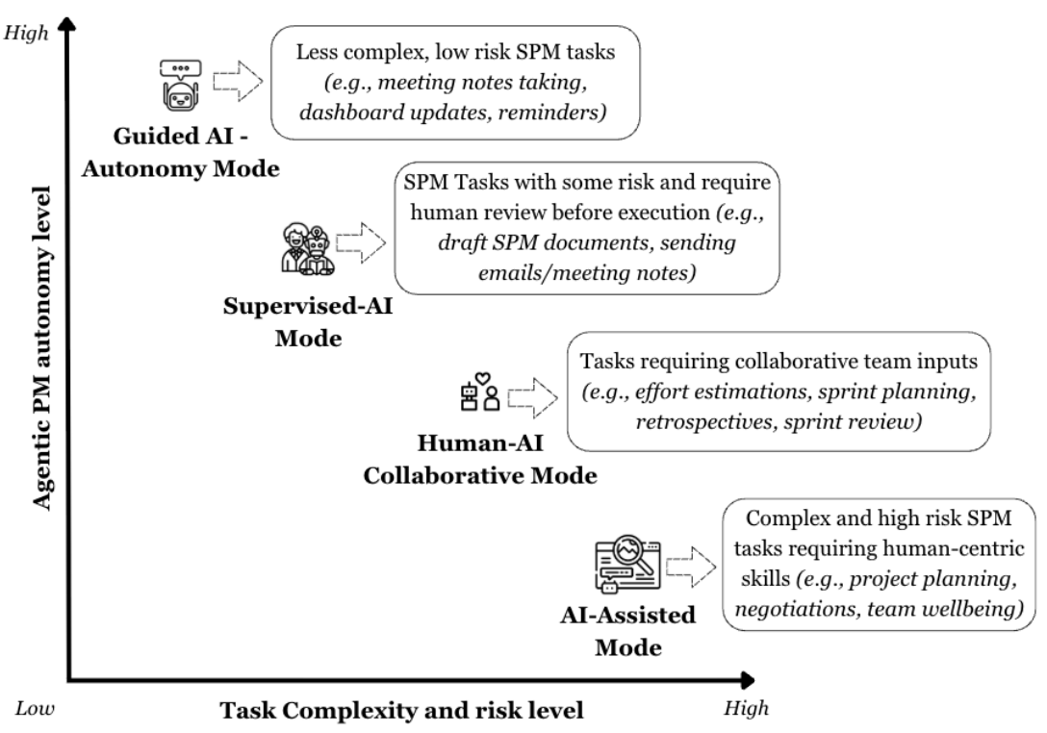
Agentic PM on Task Complexity and Risk

Slide 41
Features, Scenarios, and
Stories

Slide 42
From personas to features
1
Personas
A way of representing users
inspire
Natural language descriptions of a user interacting with a software product
2
Scenarios
are-developed-into
3
inspire
Stories
Natural language descriptions of something that is needed or wanted by users
4
Features
define
Fragments of product functionality

Slide 43
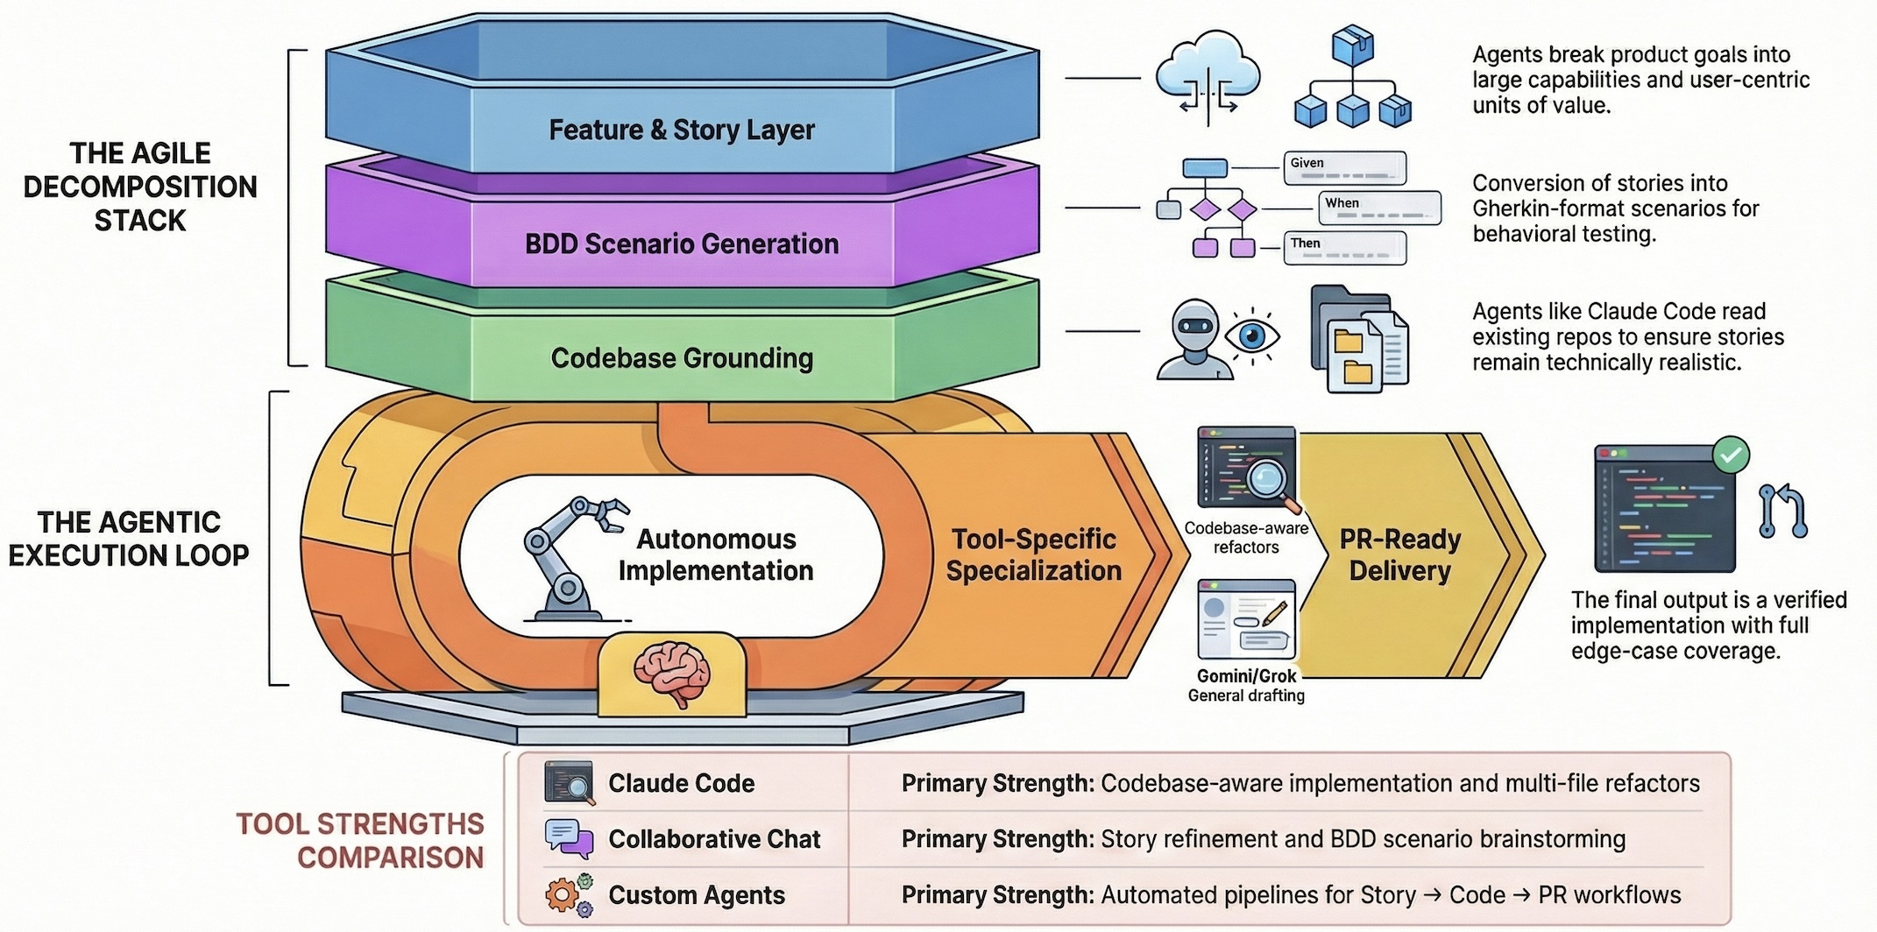
Agentic AI for Features, Scenarios, and Stories

Slide 44
Marketing for Software Products
Background Introduction
SWOT
  Strengths, Weaknesses, Opportunities, Threats
  PESTLE, Five Forces, Value Chain Analysis
  TOWS
STP
  Segmentation, Targeting, Positioning
4P
  Product, Price, Place, Promotion
Business Model

Slide 45
The Essence of
Strategic Marketing (STP)
Segmentation
Targeting
Positioning

Slide 46
Business Model
8
7
2
4
1
Key
Partners
Key
Activities
Value Proposition
Customer
Relationships
Customer
Segments
6
3
Key
Resources
Channels
9
5
Cost
Structure
Revenue
Streams
Source: Alexander Osterwalder & Yves Pigneur, Business Model Generation: A Handbook for Visionaries, Game Changers, and Challengers, Wiley, 2010.

Slide 47
Marketing

Slide 48
Marketing
“Meeting
needs profitably”

Slide 49
Marketing
“Marketing is an organizational function
and a set of processes for
creating, communicating, and delivering
value to customers and
for managing customer relationships
in ways that benefit the organization and its stakeholders.”

Slide 50
Marketing
Management

Slide 51
Marketing Management
“Marketing management is the
art and science
of choosing target markets
and getting, keeping, and growing
customers through
creating, delivering, and communicating
superior customer value.”

Slide 52
Marketing Management
1
Understanding Marketing Management
2
Capturing Marketing Insights
3
Connecting with Customers
4
Building Strong Brands
5
Creating Value
6
Delivering Value
7
Communicating Value
8
Conducting Marketing Responsibly for Long-term Success

Slide 53
Customer
Value

Slide 54
Value
the sum of the
tangible and intangible
benefits and costs

Slide 55
Value
Total
customer
benefit
Customer perceived
value
Total
customer
cost

Slide 56
Customer Perceived Value
Product benefit
Total
customer
benefit
Customer perceived
value
Services benefit
Personnel benefit
Image benefit
Monetary cost
Total
customer
cost
Time cost
Energy cost
Psychological cost

Slide 57
Customer Value Triad
Quality, Service, and Price
(qsp)
Quality
Service
Price

Slide 58
Value and Satisfaction
Marketing
  identification, creation, communication, delivery, and monitoring of customer value.
Satisfaction
  a person’s judgment of a product’s
  perceived performance
  in relationship to
  expectations

Slide 59
Building
Customer Value,
Satisfaction, and
Loyalty

Slide 60
Satisfaction
“a person’s feelings of pleasure or disappointment that result from comparing a product’s
perceived performance (or outcome)
to expectations”

Slide 61
Loyalty
“a deeply held commitment to
rebuy or repatronize
a preferred product or service
in the future
despite situational influences and marketing efforts having the potential to cause switching behavior.”

Slide 62
Customer Perceived Value, Customer Satisfaction, and Loyalty
Customer Perceived Performance
Customer
Perceived Value
Customer
Satisfaction
Customer
Loyalty
Customer
Expectations

Slide 63
Software products
Three factors that drive the design of software products
  Business and consumer needs that are not met by current products
  Dissatisfaction with existing business or consumer software products
  Changes in technology that make completely new types of product possible
In the early stage of product development, you are trying to understand, what product features would be useful to users, and what they like and dislike about the products that they use.

Slide 64
Software features
A feature is a fragment of functionality such as a ‘print’ feature, a ‘change background feature’, a ‘new document’ feature and so on.
Before you start programming a product, you should aim to create a list of features to be included in your product.
The feature list should be your starting point for product design and development.

Slide 65
User understanding
It makes sense in any product development to spend time trying to understand the potential users and customers of your product.
A range of techniques have been developed for understanding the ways that people work and use software.
  These include user interviews, surveys, ethnography and task analysis.
  Some of these techniques are expensive and unrealistic for small companies.
Informal user analysis and discussions, which simply involve asking users about their work, the software that they use, and its strengths and weaknesses are inexpensive and very valuable.

Slide 66
Feature description
Input
Activation
Feature name
The input from the user and other
How the feature is activated by the user
Action
A description of how the input data is process
Output
The output to the user and the system

Slide 67
The ‘New Group’ feature description
Input
Activation
New Group
The name of the group chosen by the user
Using the ‘New Group’ menu option or keyboard shortcut
Action
A new container is created with the specified name
Output
An empty document container and an updated list of documents that includes the newly created group

Slide 68
Personas
You need to have an understanding of your potential users to design features that they are likely to find useful and to design a user interface that is suited to them.
Personas are ‘imagined users’ where you create a character portrait of a type of user that you think might use your product.
  For example, if your product is aimed at managing appointments for dentists, you might create a dentist persona, a receptionist persona and a patient persona.
Personas of different types of user help you imagine what these users may want to do with your software and how it might be used. They help you envisage difficulties that they might have in understanding and using product features.

Slide 69
Persona descriptions
A persona should ‘paint a picture’ of a type of product user. They should be relatively short and easy-to-read.
Describe their background and why they might want to use your product.
Say something about their educational background and technical skills.
These help you assess whether or not a software feature is likely to be useful, understandable and usable by typical product users.

Slide 70
Persona descriptions
Personalization
Job-related
Include personal information about
the individual
Include details of
the individual’s job
Persona
Include details of
their interest in the product
Include details of
their education and experience
Relevance
Education

Slide 71
Persona benefits
Personas help you and other development team members
empathize with potential users of the software.
Personas help because they are a tool that allows developers to
‘step into the user’s shoes’.
  Instead of thinking about what you would do in a particular situation, you can imagine how a persona would behave and react.
Personas can help you check your ideas to make sure that you are not including product features that aren’t really needed.
They help you to avoid making unwarranted assumptions, based on your own knowledge, and designing an over-complicated or irrelevant product.

Slide 72
Deriving personas
Personas should be based on an understanding of the potential product users, their jobs, their background and their aspirations.
You should study and survey potential users to understand what they want and how they might use the product.
From this data, you can then abstract the essential information about the different types of product user and use this as a basis for creating personas.
Personas that are developed on the basis of limited user information are called proto-personas.
Proto-personas may be created as a collective team exercise using whatever information is available about potential product users. They can never be as accurate as personas developed from detailed user studies, but they are better than nothing.

Slide 73
Scenarios
A scenario is a narrative that describes how a user, or a group of users, might use your system.
There is no need to include everything in a scenario –
the scenario isn’t a system specification.
It is simply a description of a situation where a user is using your product’s features to do something that they want to do.
Scenario descriptions may vary in length from
two to three paragraphs up to a page of text.

Slide 74
Elements of a scenario description
Scenario
name
Personas of actors involved in the scenarios
Overall objective
Scenario
description
Problem that can’t be addressed by existing system
What’s involved in reaching the objective
Possible way that the problem could be tackled

Slide 75
Writing scenarios
Scenarios should always be written from the user’s perspective and based on identified personas or real users.
Your starting point for scenario writing should be the personas that you have created. You should normally try to imagine several scenarios from each persona.
Ideally, scenarios should be general and should not include implementation information.
However, describing an implementation is often the easiest way to explain how a task is done.
It is important to ensure that you have coverage of all of the potential user roles when describing a system.

Slide 76
User involvement
It is easy for anyone to read and understand scenarios, so it is possible to get users involved in their development.
The best approach is to develop an imaginary scenario based on our understanding of how the system might be used then ask users to explain what you have got wrong.
They might ask about things they did not understand and suggest how the scenario could be extended and made more realistic.
Our experience was that users are not good at writing scenarios.
The scenarios that they created were based on how they worked at the moment. They were far too detailed and the users couldn’t easily generalize their experience.

Slide 77
User stories
1
WHO
As a <role>
2
WHAT
I <want | need> to <do something>
3
WHY
so that <reason>

Slide 78
User stories
As a <role>,
I <want | need> to <do something>
  As a teacher,
  I want to tell all members of my group when new information is available
As a <role>
I <want | need> to <do something>
so that <reason>
  As a teacher,
  I need to be able to report who is attending a class trip
  so that the school maintains the required health and safety records.

Slide 79
User stories
Scenarios are high-level stories of system use.
They should describe a sequence of interactions with the system but should not include details of these interactions.
User stories are finer-grain narratives that set out in a more detailed and structured way a single thing
that a user wants from a software system.
  As an author,
  I need a way to organize the book
  that I’m writing into chapters and sections.

Slide 80
User stories
This story reflects what has become the standard format of a user story:
As a <role>, I <want | need> to <do something>
  As a teacher, I want to tell all members of my group when new information is available
A variant of this standard format adds a justification for the action:
  As a <role> I <want | need> to <do something> so that <reason>
    As a teacher,
    I need to be able to report who is attending a class trip
    so that the school maintains the required health and safety records.

Slide 81
User stories in planning
An important use of user stories is in planning.
  Many users of the Scrum method represent
  the product backlog as a set of user stories.
User stories should focus on
a clearly defined system feature or
aspect of a feature
that can be implemented
within a single sprint.

Slide 82
User stories in planning
If the story is about a more complex feature that might take several sprints to implement, then it is called an epic.
  As a system manager, I need a way to backup the system and restore either individual applications, files, directories or the whole system.
  There is a lot of functionality associated with this user story. For implementation, it should be broken down into simpler stories with each story focusing on a single aspect of the backup system.

Slide 83
User stories from Emma’s scenario
As a teacher,
I want to be able to log in to my iLearn account from home using my Google credentials
so that I don’t have to remember another login id and password.
As a teacher,
I want to access the apps that I use for class management and administration.
User stories
As a teacher and parent,
I want to be able to select the appropriate iLearn account
so that I don’t have to have separate credentials for each account.

Slide 84
Feature description using user stories
Stories can be used to describe features in your product that should be implemented.
Each feature can have a set of associated stories that describe how that feature is used.

Slide 85
User stories describing the
Groups feature
As a teacher,
I want to be able to send email to all group members using a single email address.
As a teacher,
I want to be able to share uploaded information with other group members
As a teacher,
I want to the iLearn system to automatically set up sharing mechanisms such as wikis, blogs and web sites.
User stories
As a teacher,
I want to be able to create a group of students and teachers
so that I can share information with that group.
As a teacher,
I want the system to make it easy for me to select the students and teachers to be added to a group.

Slide 86
Stories and scenarios
As you can express all of the functionality described in a scenario as user stories, do you really need scenarios?’
Scenarios are more natural and are helpful for the following reasons:
  Scenarios read more naturally because they describe what a user of a system is actually doing with that system. People often find it easier to relate to this specific information rather than the statement of wants or needs set out in a set of user stories.
  If you are interviewing real users or are checking a scenario with real users, they don’t talk in the stylized way that is used in user stories. People relate better to the more natural narrative in scenarios.
  Scenarios often provide more context - information about what the user is trying to do and their normal ways of working. You can do this in user stories, but it means that they are no longer simple statements about the use of a system feature.

Slide 87
Feature identification
Your aim in the initial stage of product design should be to create a list of features that define your product.
A feature is a way of allowing users to access and use your product’s functionality so the feature list defines the overall functionality of the system.
Features should be independent, coherent and relevant.

Slide 88
Feature identification
Features should be independent, coherent and relevant:
  Independence
  Features should not depend on how other system features are implemented and should not be affected by the order of activation of other features.
  Coherence
  Features should be linked to a single item of functionality.
  They should not do more than one thing and they should never have side-effects.
  Relevance
  Features should reflect the way that users normally carry out some task. They should not provide obscure functionality that is hardly ever required.

Slide 89
Feature design
User knowledge
Technology knowledge
Feature design
Product knowledge
Domain knowledge

Slide 90
Factors in feature set design
Simplicity
Functionality
Feature set design factors
Familiarity
Novelty
Automation
Control

Slide 91
Feature trade-offs
Simplicity and functionality
  You need to find a balance between providing a simple, easy-to-use system and including enough functionality to attract users with a variety of needs.
Familiarity and novelty
  Users prefer that new software should support the familiar everyday tasks that are part of their work or life.
  To encourage them to adopt your system, you need to find a balance between familiar features and new features that convince users that your product can do more than its competitors.
Automation and control
  Some users like automation, where the software does things for them. Others prefer to have control.
  You have to think carefully about what can be automated, how it is automated and how users can configure the automation so that the system can be tailored to their preferences.

Slide 92
Feature creep
Feature creep occurs when new features are added in response to user requests without considering whether or not these features are generally useful or whether they can be implemented in some other way.
Too many features make products hard to use and understand
There are three reasons why feature creep occurs:
  Product managers are reluctant to say ‘no’ when users ask for specific features.
  Developers try to match features in competing products.
  The product includes features to support both inexperienced and experienced users.

Slide 93
Avoiding feature creep
Does this feature really add anything new or is it simply an alternative way of doing something that is already supported?
Is this feature likely to be important to and used by most software users?
Feature questions
Can this feature be implemented by extending an existing feature rather than adding another feature to the system?
Does this feature provide general functionality or is it a very specific feature?

Slide 94
Feature derivation
Features can be identified directly from the product vision or from scenarios.
You can highlight phrases in narrative description to identify features to be included in the software.
  You should think about the features needed to support user actions, identified by active verbs, such as use and choose.

Slide 95
The iLearn system vision
FOR teachers and educators WHO need a way to help students use web-based learning resources and applications, THE iLearn system is an open learning environment THAT allows the set of resources used by classes and students to be easily configured for these students and classes by teachers themselves.
UNLIKE Virtual Learning Environments, such as Moodle, the focus of iLearn is the learning process itself, rather than the administration and management of materials, assessments and coursework.
OUR product enables teachers to create subject and age-specific environments for their students using any web-based resources, such as videos, simulations and written materials that are appropriate

Slide 96
Features from the product vision
A feature that allows users to access and use existing web-based resources;
A feature that allows the system to exist in multiple different instantiations;
A feature that allows user configuration of the system to create a specific instantiation.

Slide 97
Feature description using user stories
Description
  As a system manager, I want to create and configure an iLearn environment by adding and removing services to/from that environment so that I can create environments for specific purposes.
  As a system manager, I want to set up sub-environments that include a subset of services that are included in another environment.
  As a system manager, I want to assign administrators to created environments.
  As a system manager, I want to limit the rights of environment administrators so that they cannot accidentally or deliberately disrupt the operation of key services.
  As a teacher, I want to be able to add services that are not integrated with the iLearn authentication system.
Constraints
  The use of some tools may be limited for license reasons so there may be a need to access license management tools during configuration.
Comments
  Based on Elena’s and Jack’s scenarios.

Slide 98
Innovation and feature identification
Scenarios and user stories should always be your starting point for identifying product features.
Scenarios tell you how users work at the moment. They don’t show how they might change their way of working if they had the right software to support them.
Stories and scenarios are ‘tools for thinking’ and they help you gain an understanding of how your software might be used. You can identify a feature set from stories and scenarios.
User research, on its own, rarely helps you innovate and invent new ways of working.
You should also think creatively about alternative or additional features that help users to work more efficiently or to do things differently.

Slide 99
Summary
A software product feature is a fragment of functionality that implements something that a user may need or want when using the product.
The first stage of product development is to identify the list of product features in which you identify each feature and give a brief description of its functionality.
Personas are ‘imagined users’ where you create a character portrait of a type of user that you think might use your product.

Slide 100
Summary
A persona description should ‘paint a picture’ of a typical product user. It should describe their educational background, technology experience and why they might want to use your product.
A scenario is a narrative that describes a situation where a user is accessing product features to do something that they want to do.

Slide 101
Summary
Scenarios should always be written from the user’s perspective and should be based on identified personas or real users.
User stories are finer-grain narratives that set out, in a structured way, something that a user wants from a software system.

Slide 102
Summary
User stories may be used as a way of extending and adding detail to a scenario or as part of the description of system features.
The key influences in feature identification and design are user research, domain knowledge, product knowledge, and technology knowledge.
You can identify features from scenarios and stories by highlighting user actions in these narratives and thinking about the features that you need to support these actions.

Slide 103
References
Ian Sommerville (2019), Engineering Software Products: An Introduction to Modern Software Engineering, Pearson.
Ian Sommerville (2015), Software Engineering, 10th Edition, Pearson.
Titus Winters, Tom Manshreck, and Hyrum Wright (2020), Software Engineering at Google: Lessons Learned from Programming Over Time, O'Reilly Media.
Project Management Institute (2021), A Guide to the Project Management Body of Knowledge (PMBOK Guide) – Seventh Edition and The Standard for Project Management, PMI.
Project Management Institute (2017), A Guide to the Project Management Body of Knowledge (PMBOK Guide), Sixth Edition, Project Management Institute.
Project Management Institute (2017), Agile Practice Guide, Project Management Institute.
Denis Rothman (2024), RAG-Driven Generative AI: Build custom retrieval augmented generation pipelines with LlamaIndex, Deep Lake, and Pinecone, Packt Publishing
Thomas R. Caldwell (2025), The Agentic AI Bible: The Complete and Up-to-Date Guide to Design, Build, and Scale Goal-Driven, LLM-Powered Agents that Think, Execute and Evolve, Independently published
Tucker J. Marion, Mahdi Srour, and Frank Piller (2024), "When Generative AI meets product development." MIT Sloan Management Review 66, no. 1 : 14-15.
Yilei Zhao, Wentao Zhang, Xiao Lei, Yandan Zheng, Mengpu Liu, and Wei Yang Bryan Lim. (2026) "Advancing ESG Intelligence: An Expert-level Agent and Comprehensive Benchmark for Sustainable Finance." arXiv preprint arXiv:2601.08676 (2026).
Nesreen Otoum and Nuha Elkhalili.(2026) "Methods and Techniques of Agentic Software Engineering: A Systematic Literature Review." IEEE Access 14 (2026): 7443-7465.
Lakshana Iruni Assalaarachchi, Zainab Masood, Rashina Hoda, and John Grundy. (2026) "Toward Agentic Software Project Management: A Vision and Roadmap." arXiv preprint arXiv:2601.16392 (2026).
NVIDIA DLI (2026), Building RAG Agents with LLMs,
https://learn.nvidia.com/courses/course-detail?course_id=course-v1:DLI+S-FX-15+V1
NVIDIA DLI (2026), Generative AI with Diffusion Models,
https://learn.nvidia.com/courses/course-detail?course_id=course-v1:DLI+S-FX-14+V1

