Slide 1










Software Architecture:
Architectural design, System decomposition, and Distribution architecture
Software Engineering
1142SE05
MBA, IM, NTPU (M5010) (Spring 2026)
Wed 2, 3, 4 (9:10-12:00) (B3F17)
University Ambassador
Certified Instructor
Min-Yuh Day, Ph.D,
Professor and Director
Institute of Information Management, National Taipei University
https://web.ntpu.edu.tw/~myday
https://meet.google.com/ish-gzmy-pmo
2026-04-01

Slide 2
Syllabus
Week Date Subject/Topics
1 2026/02/25 Introduction to Software Engineering
2 2026/03/04 Software Products and Project Management:
Software product management and prototyping with
Generative AI and Agentic AI
3 2026/03/11 Agile Software Engineering:
Agile methods, Scrum, and Extreme Programming
4 2026/03/18 Case Study on Software Engineering I
5 2026/03/25 Features, Scenarios, and Stories
6 2026/04/01 Software Architecture: Architectural design,
System decomposition, and Distribution architecture

Slide 3
Syllabus
Week Date Subject/Topics
7 2026/04/08 Cloud-Based Software: Virtualization and containers,
Everything as a service, Software as a service
8 2026/04/15 Midterm Project Report
9 2026/04/22 Cloud Computing and Cloud Software Architecture
10 2026/04/29 Microservices Architecture, RESTful services,
Service deployment
11 2026/05/06 Case Study on Software Engineering II
12 2026/05/13 Security and Privacy; Reliable Programming;
Testing: Functional testing, Test automation,
Test-driven development, and Code reviews

Slide 4
Syllabus
Week Date Subject/Topics
13 2026/05/20 Industry Practices of Software Engineering
14 2026/05/27 DevOps and Code Management:
Code management and DevOps automation
15 2026/06/03 Final Project Report I
16 2026/06/10 Final Project Report II

Slide 5
Software Architecture:
Architectural design,
System decomposition, and Distribution architecture

Slide 6
Software Engineering and
Project Management
Analyze
Requirements
definition
Design
System and Software design
Build
Implementation and
unit testing
Test
Integration
and
system testing
Deliver
Operation
and maintenance
Project Management

Slide 7
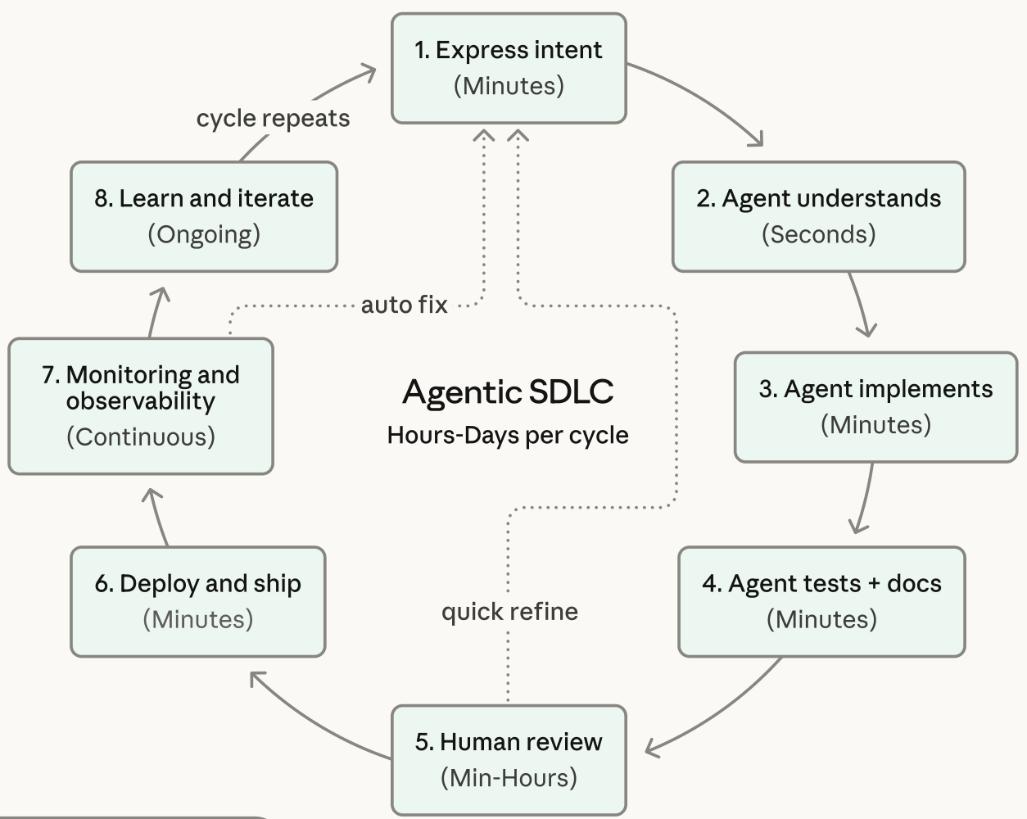
Agentic Coding Software Development Lifecycle

Slide 8
Information Management
Management
Information Systems (MIS)
Information Systems

Slide 9
Information Management (MIS)
Information Systems
Organizations
Technology
Information
Systems
Management

Slide 10
Fundamental MIS Concepts
Business
Challenges
Management
Organization
Information
System
Business
Solutions
Technology

Slide 11
Business Model
8
7
2
4
1
Key
Partners
Key
Activities
Value Proposition
Customer
Relationships
Customer
Segments
6
3
Key
Resources
Channels
9
5
Cost
Structure
Revenue
Streams
Source: Alexander Osterwalder & Yves Pigneur, Business Model Generation: A Handbook for Visionaries, Game Changers, and Challengers, Wiley, 2010.

Slide 12
Project-based software engineering
CUSTOMER
Problem
generates
helps-with
Requirements
implemented-by
Software
1
CUSTOMER and
DEVELOPER
DEVELOPER

Slide 13
Product software engineering
DEVELOPER
Opportunity
1
inspires
realizes
Product features
implemented-by
Software
DEVELOPER
DEVELOPER

Slide 14
Software execution models
Stand-alone execution
Hybrid execution
Software as a service
User’s computer
User’s computer
User’s computer
User interface
Product functionality
User data
User interface
Partial functionality
User data
User interface
(browser or app)
Product updates
Additional functionality
User data backups
Product updates
Product functionality
User data
Vendor’s servers
Vendor’s servers
Vendor’s servers

Slide 15
Product management concerns
Business
needs
Product manager
Technology
constraints
Customer
experience

Slide 16
Technical interactions of product managers
Product
vision management
Product
backlog management
User stories
and
scenarios
Product manager
Acceptance
testing
Customer
testing
User
interface
design

Slide 17
Software Development Life Cycle (SDLC)
The waterfall model
Requirements
definition
System and Software design
Implementation and unit testing
Integration and system testing
Operation and maintenance

Slide 18
Plan-based and Agile development
Plan-based development
Requirements
engineering
Requirements
specification
Design and implementation
Requirements change requests
Agile development
Requirements
engineering
Design and implementation

Slide 19
The Continuum of Life Cycles
High
Incremental
Agile
Frequency of Delivery
Predictive
Iterative
Low
Low
High
Degree of Change

Slide 20
Predictive Life Cycle
Analyze
Design
Build
Test
Deliver

Slide 21
Iterative Life Cycle
Prototype
Refine
Analyze
Analyze
Design
Build
Test
Deliver

Slide 22
A Life Cycle of
Varying-Sized Increments
Analyze
Design
Build
Test
Deliver
Analyze
Design
Build
Test
Deliver
Analyze
Design
Build
Test
Deliver

Slide 23
Iteration-Based and Flow-Based Agile Life Cycles
Iteration-Based Agile
Requirements
Analysis
Design
Build
Test
Requirements
Analysis
Design
Build
Test
Requirements
Analysis
Design
Build
Test
Requirements
Analysis
Design
Build
Test
Repeat
as needed
…
Requirements
Analysis
Design
Build
Test
Requirements
Analysis
Design
Build
Test
Flow-Based Agile
Requirements
Analysis
Design
Build
Test
the number of features in the WIP limit
Requirements
Analysis
Design
Build
Test
the number of features in the WIP limit
Requirements
Analysis
Design
Build
Test
the number of features in the WIP limit
Repeat
as needed
…
Requirements
Analysis
Design
Build
Test
the number of features in the WIP limit
Requirements
Analysis
Design
Build
Test
the number of features in the WIP limit

Slide 24
From personas to features
1
Personas
A way of representing users
inspire
Natural language descriptions of a user interacting with a software product
2
Scenarios
are-developed-into
3
inspire
Stories
Natural language descriptions of something that is needed or wanted by users
4
Features
define
Fragments of product functionality

Slide 25
Multi-tier client-server architecture
Client 1
Client 2
Web
Server
Application
Server
Database
Server
Client 3
Client …

Slide 26
Service-oriented Architecture
Client 1
S1
S2
Client 2
S3
Web
Server
Service
gateway
S4
Client 3
S5
Client …
S6
Services

Slide 27
VM
Container
Virtual
web server
Virtual
mail server
User 1
Container 1
User 2
Container 2
Server
software
Server
software
Application
software
Application
software
Guest
OS
Guest
OS
Server
software
Server
software
Hypervisor
Container manager
Host OS
Host OS
Server Hardware
Server Hardware

Slide 28
Everything as a service
Photo
editing
Software as a service
(SaaS)
Logistics
management
Cloud management
Monitoring
Platform as a service
(PaaS)
Database
Software
development
Storage Network
Infrastructure as a service
(IaaS)
Computing Virtualization
Cloud data center

Slide 29
Software as a service
Software customers
Software
provider
Software services
Cloud Infrastructure
Cloud
provider

Slide 30
Microservices architecture – key design questions
What are the microservices that make up the system?
How should data be distributed and shared?
How should microservices communicate with each other?
Microservices architecture
design
How should the microservices in the system be coordinated?
How should service failure be detected, reported and managed?

Slide 31
Types of security threat
An attacker attempts to deny access to the system for legitimate users
An attacker attempts to damage the system or its data
Availability
threats
Integrity
threats
SOFTWARE PRODUCT
PROGRAM
Distributed denial of service (DDoS) attack
Virus
DATA
Ransomware
Data theft
Confidentiality
threats
An attacker tries to gain access to private information held by the system

Slide 32
Software product quality attributes
Reliability
Availability
1
2
Software product quality attributes
Security
Resilience
7
3
Usability
Maintainability
6
4
Responsiveness
5

Slide 33
A refactoring process
1
2
Start
Identify code
‘smell’
Identify refactoring strategy
4
3
Run automated code tests
Make small
improvement until strategy completed

Slide 34
Functional testing
Start
1
Unit
Testing
4
2
Release
Testing
Feature
Testing
3
System
Testing

Slide 35
Test-driven development (TDD)
Start
1
Identify new
functionality
2
Identify partial implementation
of functionality
3
Write code stub
that will fail test
Functionality
complete
Functionality
incomplete
4
Run all
automated test
7
Refactor code
if required
5
Implement code that should cause failing test to pass
Test failure
6
Run all
automated test
All tests pass

Slide 36
DevOps
Development
Deployment
Support
Multi-skilled DevOps team

Slide 37
Code management and DevOps
DevOps automation
Continuous
integration
Continuous
deployment
Continuous
delivery
Infrastructure
as code
Code management system
Branching and merging
Recover
version
information
Code
repository
Save and
retrieve
versions
Transfer code to/from developer’s filestore
DevOps measurement
Data
collection
Data
analysis
Report
generation

Slide 38
Agentic AI for Software Engineering Architecture
Architectural Design
Design Pattern
Suggestions
Technology Stack
Recommendation
Diagram Generation
Trade-Off Analysis
System Decomposition
Modulization Based on
Function
Automated
Component Design
Bottleneck Optimization
Distribution Architecture
Designing
Scalable Systems
Supporting
Dynamic Scaling
Optimizing Performance
Key Benefits: Enhanced Efficiency, Data-Driven Decisions, Scalability

Slide 39
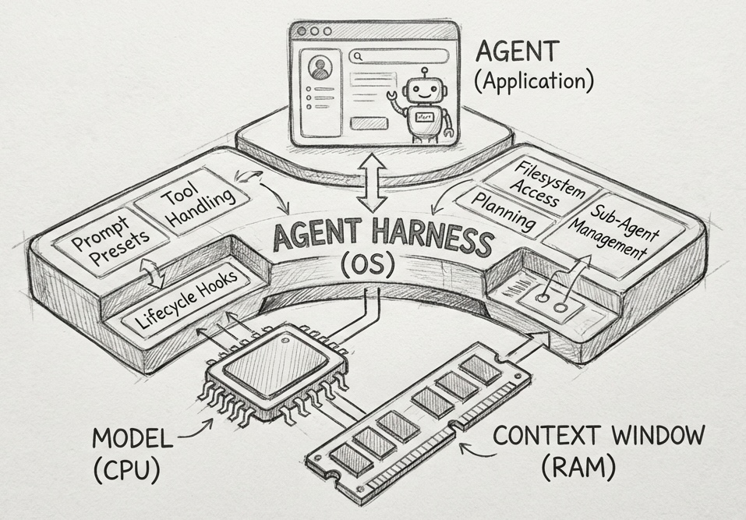
Harness Engineering
Source: https://www.philschmid.de/agent-harness-2026

Slide 40
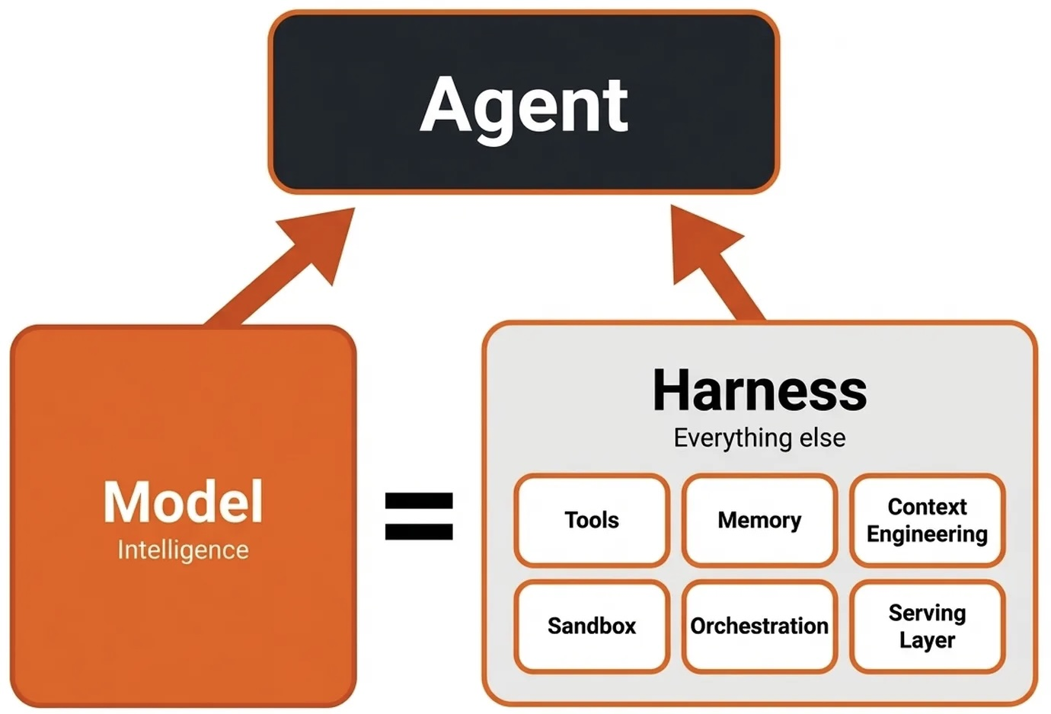
Agentic AI Harness Engineering
Building systems that transform the LLM into the new operating system
Source: https://www.decodingai.com/p/agentic-harness-engineering

Slide 41
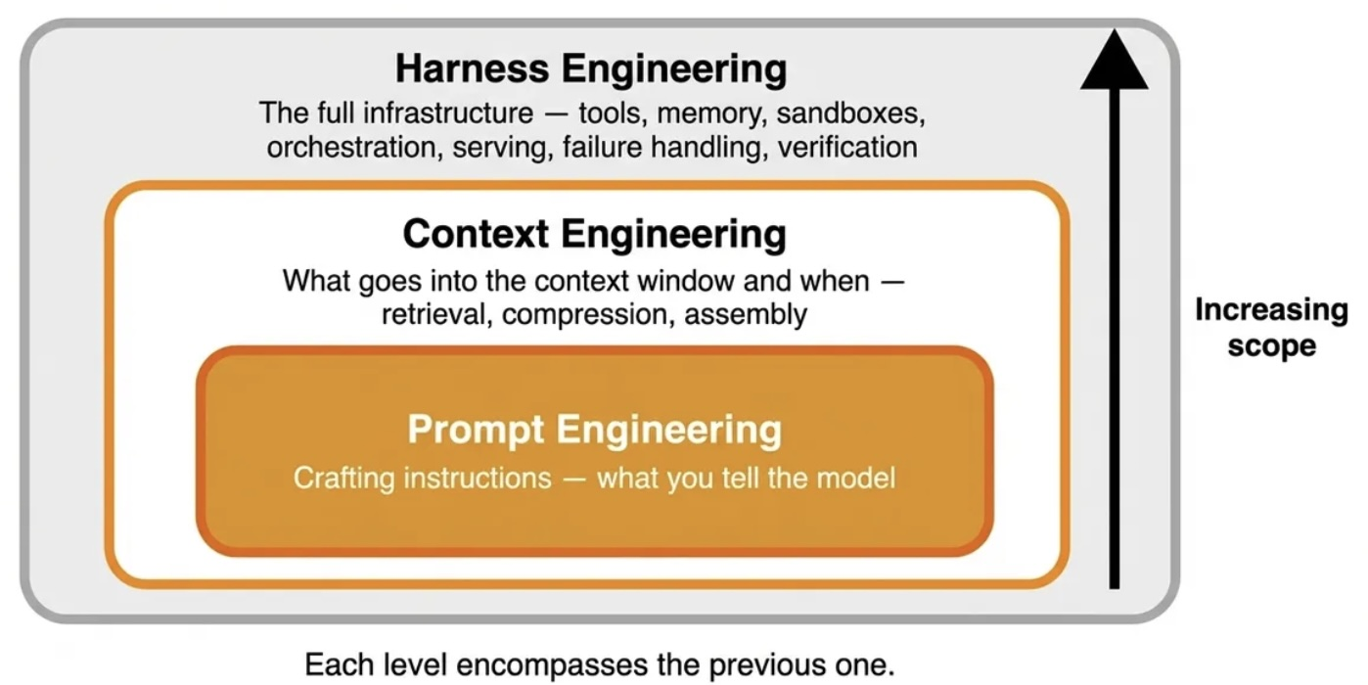
Harness Engineering
Context Engineering, Prompt Engineering
Source: https://www.decodingai.com/p/agentic-harness-engineering

Slide 42
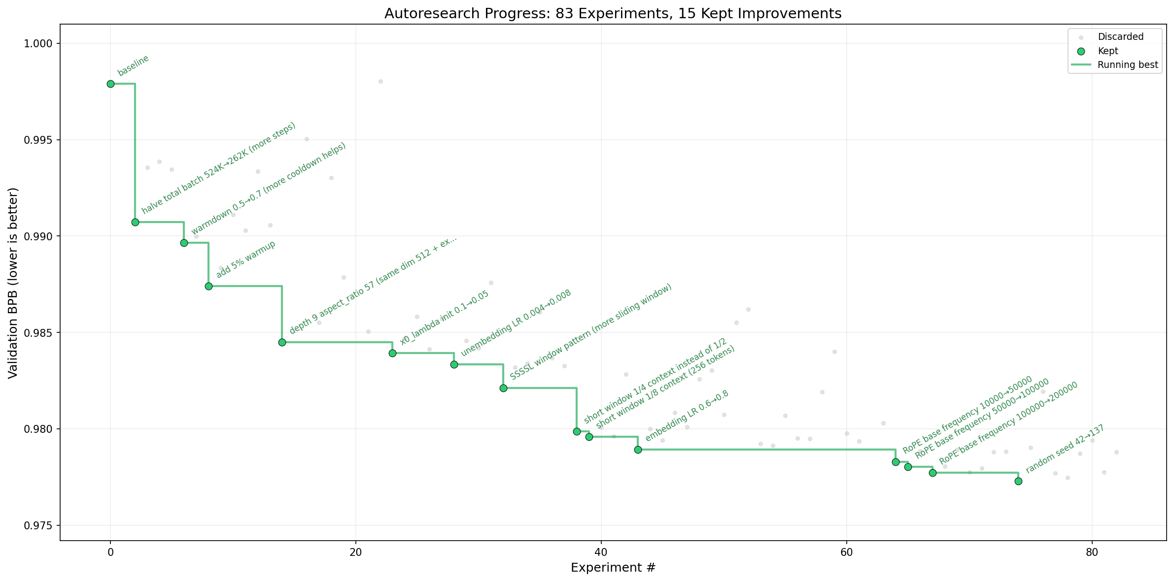
Karpathy Autoresearch
Source: https://github.com/karpathy/autoresearch

Slide 43
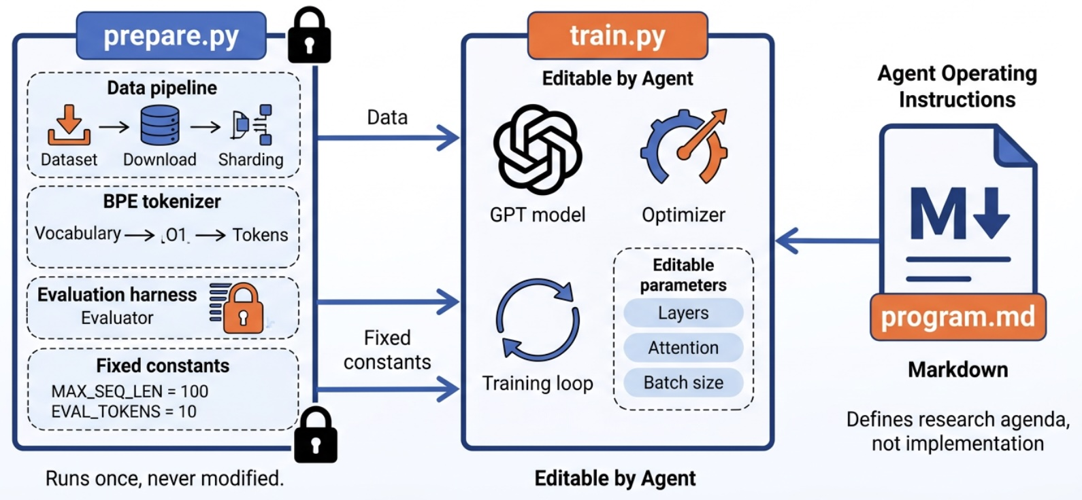
Karpathy Autoresearch Architecture
Source: https://datasciencedojo.com/blog/karpathy-autoresearch-explained/

Slide 44
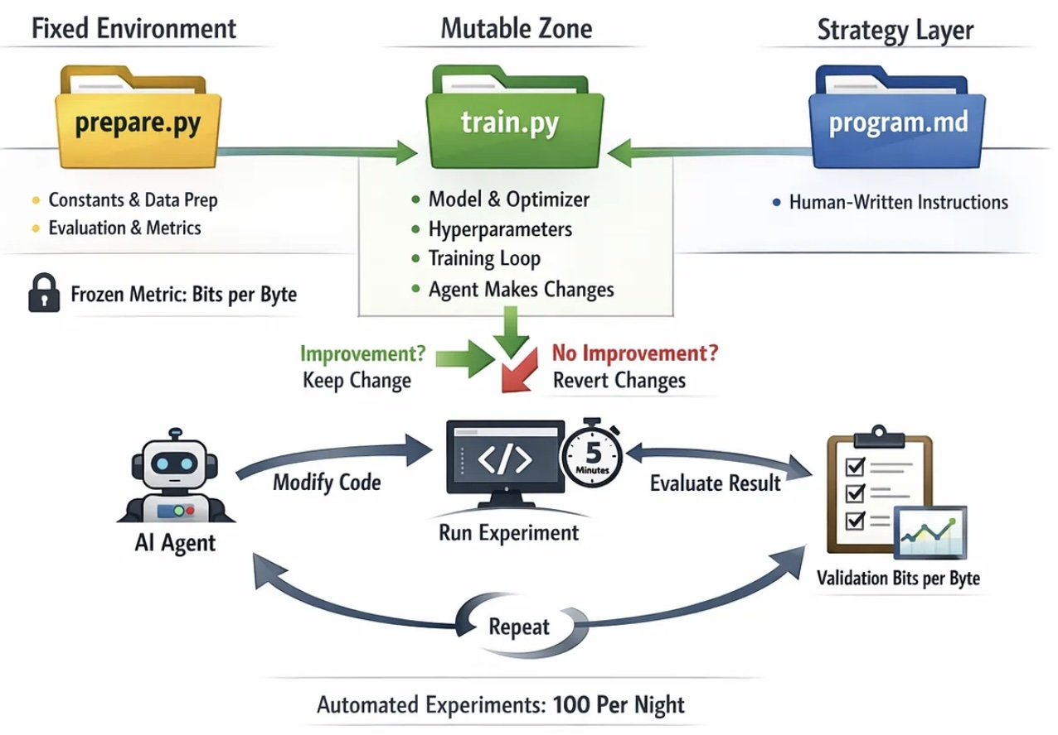
Karpathy Autoresearch: The Loop That Improves Your Work
Source: https://thecreatorsai.com/p/autoresearch-the-loop-that-improves

Slide 45
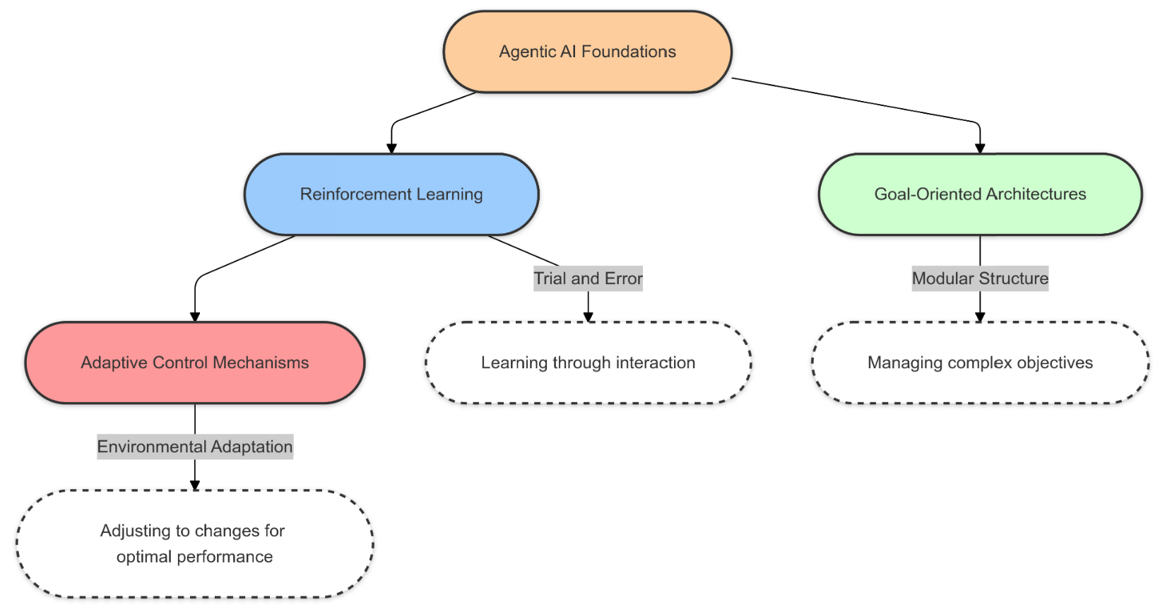
Agentic AI Foundations
Source: Acharya, Deepak Bhaskar, Karthigeyan Kuppan, and B. Divya. "Agentic AI: Autonomous Intelligence for Complex Goals–A Comprehensive Survey." IEEE Access (2025).

Slide 46
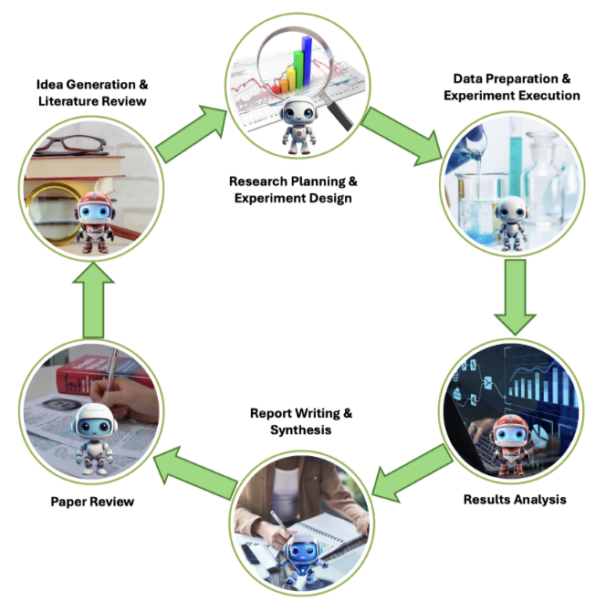
Agentic AI Workflow for Scientific Discovery
Source: Gridach, Mourad, Jay Nanavati, Khaldoun Zine El Abidine, Lenon Mendes, and Christina Mack. "Agentic AI for Scientific Discovery: A Survey of Progress, Challenges, and Future Directions." arXiv preprint arXiv:2503.08979 (2025).

Slide 47
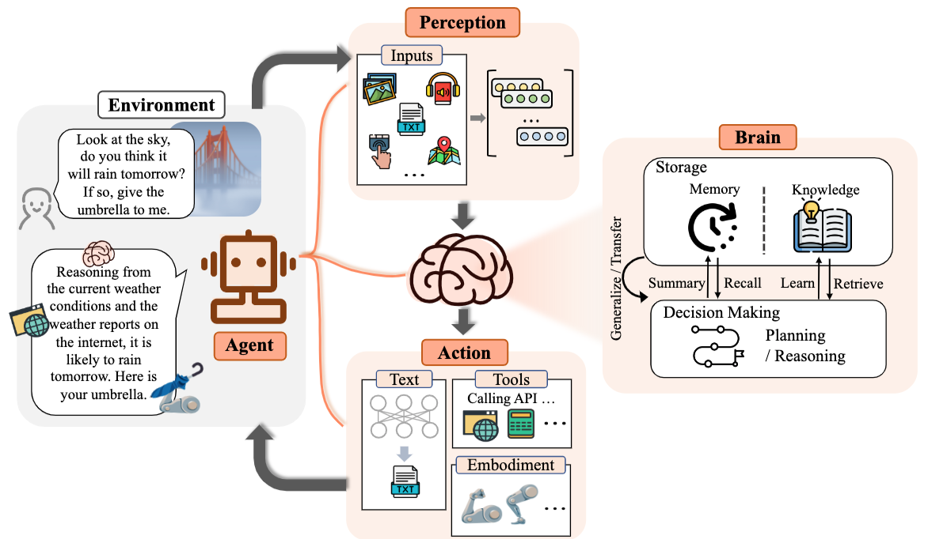
Large Language Model (LLM) Based Agents
Source: Guo, Taicheng, Xiuying Chen, Yaqi Wang, Ruidi Chang, Shichao Pei, Nitesh V. Chawla, Olaf Wiest, and Xiangliang Zhang. "Large language model based multi-agents: A survey of progress and challenges." arXiv preprint arXiv:2402.01680 (2024).

Slide 48
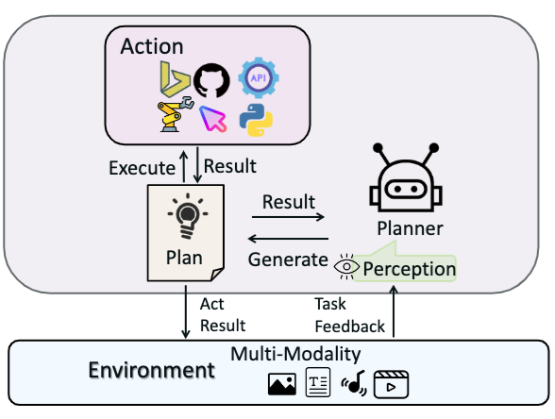
Large Multimodal Agents (LMAs)
(a) Type I: Closed-source LLMs as Planners w/o Longterm Memory.
Use prompt techniques to guide closed-source LLMs in decision-making
and planning to complete tasks without long memory.
Source: Xie, Junlin, Zhihong Chen, Ruifei Zhang, Xiang Wan, and Guanbin Li. "Large Multimodal Agents: A Survey." arXiv preprint arXiv:2402.15116 (2024).

Slide 49
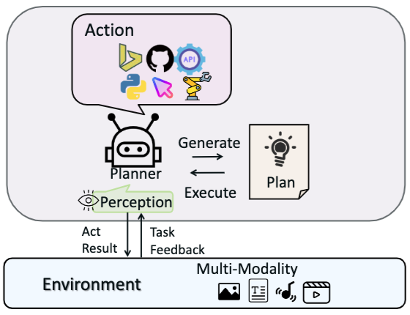
Large Multimodal Agents (LMAs)
(b) Type II: Finetuned LLMs as Planners w/o long-term Memory.
Use action-related data to finetune existing open-source large models,
enabling them to achieve decision-making, planning, and tool invocation capabilities comparable
to closed-source LLMs
Source: Xie, Junlin, Zhihong Chen, Ruifei Zhang, Xiang Wan, and Guanbin Li. "Large Multimodal Agents: A Survey." arXiv preprint arXiv:2402.15116 (2024).

Slide 50
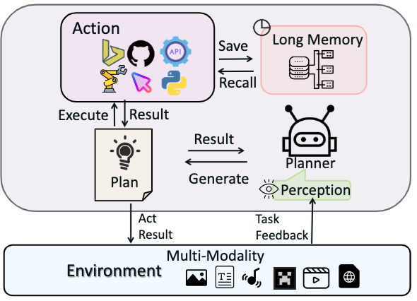
Large Multimodal Agents (LMAs)
(c) Type III: Planners with Indirect Long-term Memory
Introduce indirect
long-term memory functions,
further enhancing their generalization and adaptation abilities in environments closer to the real world.
Source: Xie, Junlin, Zhihong Chen, Ruifei Zhang, Xiang Wan, and Guanbin Li. "Large Multimodal Agents: A Survey." arXiv preprint arXiv:2402.15116 (2024).

Slide 51
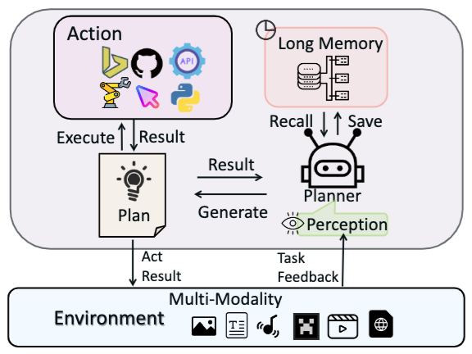
Large Multimodal Agents (LMAs)
(d) Type IV: Planners with Native Long-term Memory
Introduce native
long-term memory functions,
further enhancing their generalization and adaptation abilities in environments closer to the real world.
Source: Xie, Junlin, Zhihong Chen, Ruifei Zhang, Xiang Wan, and Guanbin Li. "Large Multimodal Agents: A Survey." arXiv preprint arXiv:2402.15116 (2024).

Slide 52
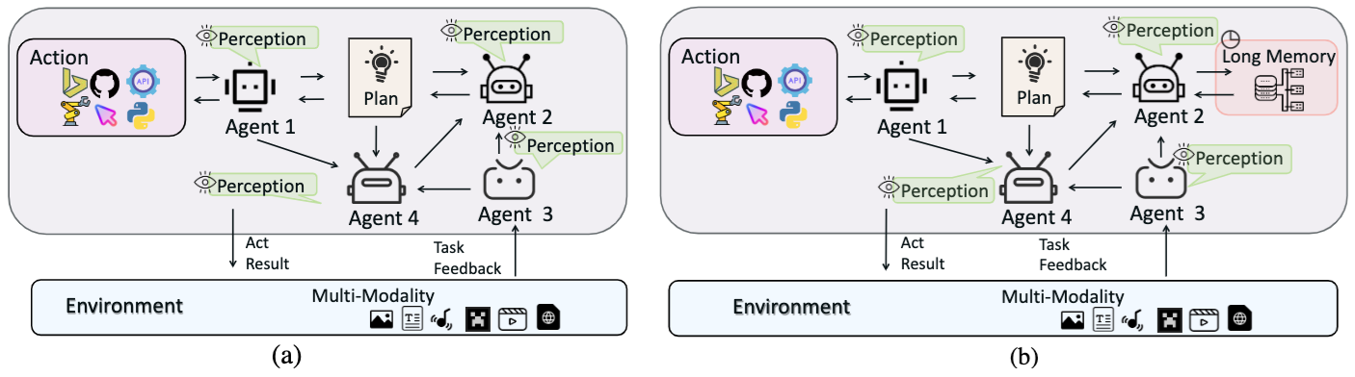
Multi-Agent Frameworks
Source: Xie, Junlin, Zhihong Chen, Ruifei Zhang, Xiang Wan, and Guanbin Li. "Large Multimodal Agents: A Survey." arXiv preprint arXiv:2402.15116 (2024).

Slide 53
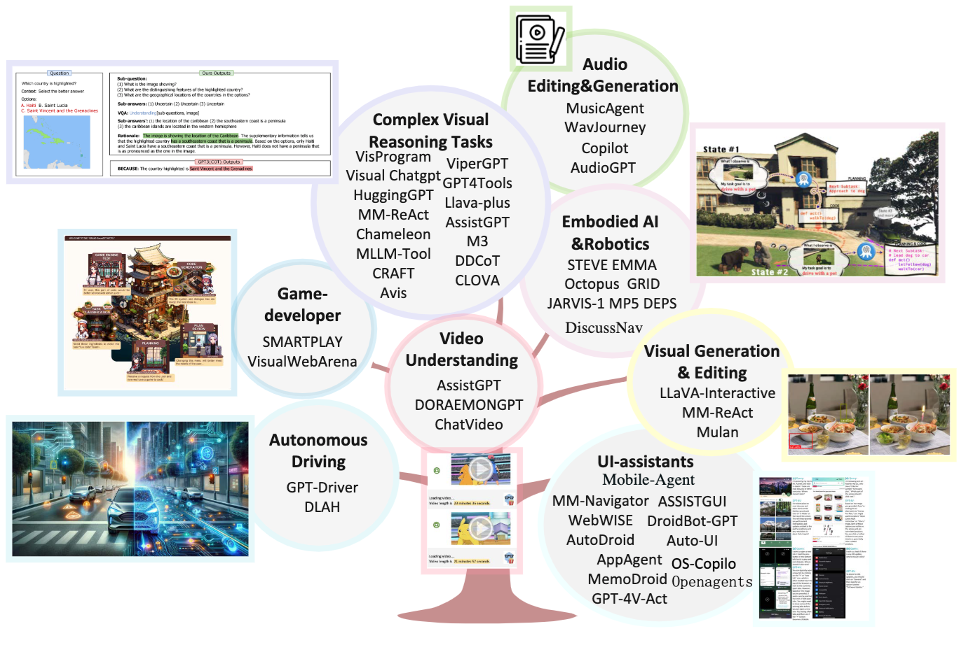
Applications of Large Multimodal Agents (LMAs)
Source: Xie, Junlin, Zhihong Chen, Ruifei Zhang, Xiang Wan, and Guanbin Li. "Large Multimodal Agents: A Survey." arXiv preprint arXiv:2402.15116 (2024).

Slide 54
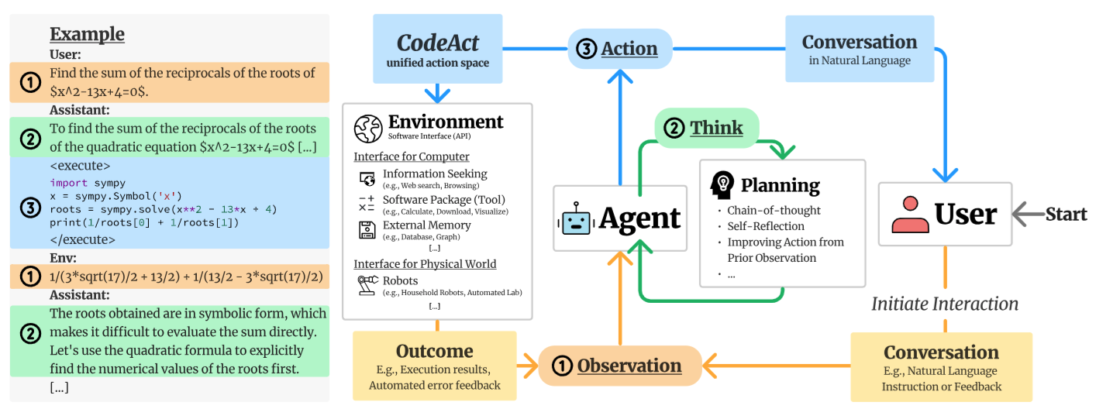
CodeActAgent:
General Agent Multi-turn Interaction Framework
Source: Wang, Xingyao, Yangyi Chen, Lifan Yuan, Yizhe Zhang, Yunzhu Li, Hao Peng, and Heng Ji. "Executable code actions elicit better llm agents." arXiv preprint arXiv:2402.01030 (2024).

Slide 55
Software architecture
To create a reliable, secure and efficient product, you need to pay attention to architectural design which includes:
  its overall organization,
  how the software is decomposed into components,
  the server organization
  the technologies that you use to build the software. The architecture of a software product affects its performance, usability, security, reliability and maintainability.

Slide 56
Software architecture
There are many different interpretations of the term ‘software architecture’.
  Some focus on ‘architecture’ as a noun
  - the structure of a system
  and others consider ‘architecture’ to be a verb
  - the process of defining these structures.

Slide 57
The IEEE definition of software architecture
Architecture is the
fundamental organization of a software system
embodied in its components, their relationships to each other and
to the environment, and
the principles guiding its design and evolution.

Slide 58
Software architecture and components
A component is an element that implements a coherent set of functionality or features.
Software component can be considered as a collection of one or more services that may be used by other components.
When designing software architecture, you don’t have to decide how an architectural element or component is to be implemented.
Rather, you design the component interface and leave the implementation of that interface to a later stage of the development process.

Slide 59
Access to services provided by software components
Services accessed through
the component API
Services accessed directly
by other components
API
S1
S2
S3
S4
S5
S6
Component 1
Component 2

Slide 60
Why is architecture important?
Architecture is important because the architecture of a system has a fundamental influence on the non-functional system properties.
Architectural design involves understanding the issues that affect the architecture of your product and creating an architectural description that shows the critical components and their relationships.
Minimizing complexity should be an important goal for architectural designers.

Slide 61
Non-functional system quality attributes
Responsiveness
Does the system return results to users in a reasonable time?
Reliability
Do the system features behave as expected by both developers and users?
Availability
Can the system deliver its services when requested by users?
Security
Does the system protect itself and users’ data from unauthorized attacks and intrusions?

Slide 62
Non-functional system quality attributes
Usability
Can system users access the features that they need and use them quickly and without errors?
Maintainability
Can the system be readily updated and new features added without undue costs?
Resilience
Can the system continue to deliver user services in the event of partial failure or external attack?

Slide 63
Centralized security architectures
The benefits of a centralized security architecture are that it is easier to design and build protection and that the protected information can be accessed more efficiently.
However, if your security is breached, you lose everything.
If you distribute information, it takes longer to access all of the information and costs more to protect it.
If security is breached in one location, you only lose the information that you have stored there.

Slide 64
Shared database architecture
User interface
C1
C2
Shared database

Slide 65
Multiple database architecture
User interface
C1
C2
C1 database
C2 database
C3
Database reconciliation

Slide 66
Maintainability and performance
Shared database architecture:
  system with two components (C1 and C2) that share a common database.
Multiple database architecture:
  each component has its own copy of the parts of the database that it needs.
  If one component needs to change the database organization, this does not affect the other component.
A multi-database architecture may run more slowly and may cost more to implement and change.
  A multi-database architecture needs a mechanism
  (component C3) to ensure that the data shared by C1 and C2 is kept consistent when it is changed.

Slide 67
Issues that influence architectural decisions
1
Nonfunctional
product characteristics
5
2
Software compatibility
Product
lifetime
Architectural influences
4
3
Number of
users
Software
reuse

Slide 68
The importance of architectural design issues
1
Nonfunctional product characteristics
Nonfunctional product characteristics such as security and performance affect all users.
If you get these wrong,
your product will is unlikely to be a commercial success. Unfortunately, some characteristics are opposing,
so you can only optimize the most important.

Slide 69
The importance of architectural design issues
2
Product lifetime
If you anticipate a long product lifetime, you will need to create regular product revisions. You therefore need an architecture that is evolvable, so that it can be adapted to accommodate new features and technology.

Slide 70
The importance of architectural design issues
3
Software reuse
You can save a lot of time and effort, if you can reuse large components from other products or open-source software. However, this constrains your architectural choices because you must fit your design around the software that is being reused.

Slide 71
The importance of architectural design issues
4
Number of users
If you are developing consumer software delivered over the Internet, the number of users can change very quickly. This can lead to serious performance degradation unless you design your architecture so that your system can be quickly scaled up and down.

Slide 72
The importance of architectural design issues
5
Software compatibility
For some products, it is important to maintain compatibility with other software so that users can adopt your product and use data prepared using a different system. This may limit architectural choices, such as the database software that you can use.

Slide 73
Trade off:
Maintainability vs performance
System maintainability is an attribute that reflects how difficult and expensive it is to make changes to a system after it has been released to customers.
  You improve maintainability by building a system from small self-contained parts, each of which can be replaced or enhanced if changes are required.
In architectural terms, this means that the system should be decomposed into fine-grain components, each of which does one thing and one thing only.
  However, it takes time for components to communicate with each other. Consequently, if many components are involved in implementing a product feature, the software will be slower.

Slide 74
Trade off:
Security vs usability
You can achieve security by designing the system protection as a series of layers.
An attacker has to penetrate all of those layers before the system is compromised.
Layers might include system authentication layers, a separate critical feature authentication layer, an encryption layer and so on.
Architecturally, you can implement each of these layers as separate components so that if one of these components is compromised by an attacker, then the other layers remain intact.

Slide 75
Authentication layers
IP authentication
Application authentication
Feature authentication
Encryption
Protect asset such as a
database of user’s credit card

Slide 76
Usability issues
A layered approach to security affects the usability of the software.
  Users have to remember information, like passwords, that is needed to penetrate a security layer.
  Their interaction with the system is inevitably slowed down by its security features.
  Many users find this irritating and often look for work-arounds so that they do not have to re-authenticate to access system features or data.
To avoid this, you need an architecture:
  that doesn’t have too many security layers
  that doesn’t enforce unnecessary security
  that provides helper components that reduce the load on users

Slide 77
An architectural model of a document retrieval system
Web browser
Local input validation
User interaction
Local printing
User interface
management
Authentication and authorization
Form and query manager
Web page generation
Information retrieval
Document
retrieval
Rights
management
Search
Payments
Accounting
Document index
Index management
Index
querying
Index
creation
Basic services
Database
Query
Query
validation
Logging
User account
management
Databases
DB1
DB2
DB3
DB4
DB5

Slide 78
Examples of component relationships
C1 is part of C2
C1 uses C2
C1
C2
calls
C1
C2
C1 is-located-with C2
C1 shared-data-with C2
Data
C1
C2
C1
C2

Slide 79
Architectural design guidelines
Separation of concerns
Organize your architecture
into components that
focus on a single concern
Design
guidelines
Stable interfaces
Design component interfaces
that are coherent and
that changes slowly
Implement once
Avoid duplicating
functionality at different
places in your architecture

Slide 80
Cross-cutting concerns
Security
Performance
Reliability
User interface
Application
Infrastructure
Operating System
Hardware

Slide 81
A generic layered architecture for a web-based application
Browser-based or mobile user interface
Authentication and user interaction management
Application-specific functionality
Basic shared services
Transaction and database management

Slide 82
A layered architectural model of the iLearn system
User interface
Web browser
iLearn app
User interface
management
Interface
creation
Forms management
Interface
delivery
Login
Configuration
services
Group
configuration
Application
configuration
Security
configuration
User interface configuration
Setup
service
Application
services
Archive access Word processor Video conf.
Email and
messaging
User installed application
Blog Wiki Spreadsheet Presentation Drawing
Integrated
services
Resource
discovery
User
analytics
Virtual Learning environment
Authentication and authorization
Shared infrastructure services
Authentication Logging and monitoring Application interfacing
User storage Application storage Search

Slide 83
Distribution architecture
The distribution architecture of a software system defines the servers in the system and the allocation of components to these servers.
Client-server architectures are a type of distribution architecture that is suited to applications where clients access a shared database and business logic operations on that data.
In this architecture, the user interface is implemented on the user’s own computer or mobile device.
  Functionality is distributed between the client and one or more server computers.

Slide 84
Client-server architecture
Client 1
request
response
Client 2
request
response
request
Client 3
response
request
Servers
Client …
Load
balancer
response

Slide 85
The Model-View-Controller (MVC) pattern
Browser
CLIENT
User inputs
Page to display
User changes
Controller
View
View update request
Change notification
View refresh request
Model
SERVER

Slide 86




Mobile Web App
HTML
Phone Data
Templates
CSS
JavaScript
External Data
Mobile frameworks
and
Libraries
Source: Scott Preston, Learn HTML5 and JavaScript for iOS: Web Standards-based Apps for iPhone, iPad, and iPod touch, Apress, 2012

Slide 87
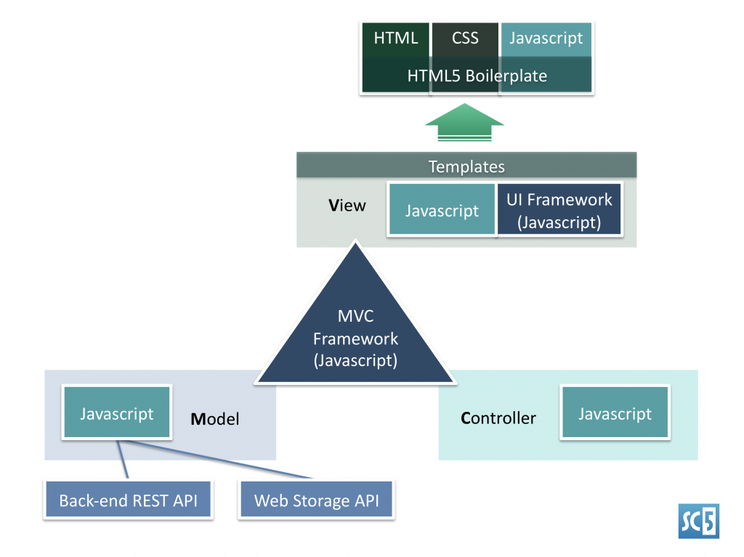
MVC Framework of Mobile Apps
(HTML5, CSS3, JavaScript)
Source: http://sc5.io/blog/2012/02/anatomy-of-a-html5-app/

Slide 88
Multi-tier client-server architecture
Client 1
Client 2
Web
Server
Application
Server
Database
Server
Client 3
Client …

Slide 89
Service-oriented Architecture
Services in a service-oriented architecture are stateless components, which means that they can be replicated and can migrate from one computer to another.
Many servers may be involved in providing services
A service-oriented architecture is usually easier to scale as demand increases and is resilient to failure.

Slide 90
Service-oriented Architecture
Client 1
S1
S2
Client 2
S3
Web
Server
Service
gateway
S4
Client 3
S5
Client …
S6
Services

Slide 91
Issues in architectural choice
Data type and data updates
Change frequency
The system execution platform

Slide 92
Issues in architectural choice
Data type and data updates
  If you are mostly using structured data that may be updated by different system features, it is usually best to have a single shared database that provides locking and transaction management. If data is distributed across services, you need a way to keep it consistent and this adds overhead to your system.

Slide 93
Issues in architectural choice
Change frequency
  If you anticipate that system components will be regularly changed or replaced, then isolating these components as separate services simplifies those changes.

Slide 94
Issues in architectural choice
The system execution platform
  If you plan to run your system on the cloud with users accessing it over the Internet, it is usually best to implement it as a service-oriented architecture because scaling the system is simpler.
  If your product is a business system that runs on local servers, a multi-tier architecture may be more appropriate.

Slide 95
Technology choices
Database
Should you use a relational SQL database or an unstructured NOSQL database?
Platform
Should you deliver your product on a mobile app and/or a web platform?
Server
Should you use dedicated in-house servers or design your system to run on a public cloud? If a public cloud, should you use Amazon, Google, Microsoft, or some other option?
Open source
Are there suitable open-source components that you could incorporate into your products?
Development tools
Do your development tools embed architectural assumptions about the software being developed that limit your architectural choices

Slide 96
Summary
Software architecture is the fundamental organization of a system embodied in its components, their relationships to each other, and to the environment, and the principles guiding its design and evolution.
The architecture of a software system has a significant influence on non-functional system properties such as reliability, efficiency and security.
Architectural design involves understanding the issues that are critical for your product and creating system descriptions that shows components and their relationships.

Slide 97
Summary
The principal role of architectural descriptions is to provide a basis for the development team to discuss the system organization. Informal architectural diagrams are effective in architectural description because they are fast and easy to draw and share.
System decomposition involves analyzing architectural components and representing them as a set of finer-grain components.

Slide 98
Summary
To minimize complexity, you should separate concerns, avoid functional duplication and focus on component interfaces.
Web-based systems often have a common layered structure including user interface layers, application-specific layers and a database layer.
The distribution architecture in a system defines the organization of the servers in that system and the allocation of components to these servers.

Slide 99
Summary
Multi-tier client-server and
service-oriented architectures are the most commonly used architectures for web-based systems.
Making decisions on technologies such as database and cloud technologies are an important part of the architectural design process.

Slide 100
References
Ian Sommerville (2019), Engineering Software Products: An Introduction to Modern Software Engineering, Pearson.
Ian Sommerville (2015), Software Engineering, 10th Edition, Pearson.
Titus Winters, Tom Manshreck, and Hyrum Wright (2020), Software Engineering at Google: Lessons Learned from Programming Over Time, O'Reilly Media.
Project Management Institute (2021), A Guide to the Project Management Body of Knowledge (PMBOK Guide) – Seventh Edition and The Standard for Project Management, PMI.
Project Management Institute (2017), A Guide to the Project Management Body of Knowledge (PMBOK Guide), Sixth Edition, Project Management Institute.
Project Management Institute (2017), Agile Practice Guide, Project Management Institute.
Thomas R. Caldwell (2025), The Agentic AI Bible: The Complete and Up-to-Date Guide to Design, Build, and Scale Goal-Driven, LLM-Powered Agents that Think, Execute and Evolve, Independently published
Tucker J. Marion, Mahdi Srour, and Frank Piller (2024), "When Generative AI meets product development." MIT Sloan Management Review 66, no. 1 : 14-15.
Yilei Zhao, Wentao Zhang, Xiao Lei, Yandan Zheng, Mengpu Liu, and Wei Yang Bryan Lim. (2026) "Advancing ESG Intelligence: An Expert-level Agent and Comprehensive Benchmark for Sustainable Finance." arXiv preprint arXiv:2601.08676 (2026).
Nesreen Otoum and Nuha Elkhalili.(2026) "Methods and Techniques of Agentic Software Engineering: A Systematic Literature Review." IEEE Access 14 (2026): 7443-7465.
Lakshana Iruni Assalaarachchi, Zainab Masood, Rashina Hoda, and John Grundy. (2026) "Toward Agentic Software Project Management: A Vision and Roadmap." arXiv preprint arXiv:2601.16392 (2026).
NVIDIA DLI (2026), Building RAG Agents with LLMs,
https://learn.nvidia.com/courses/course-detail?course_id=course-v1:DLI+S-FX-15+V1
NVIDIA DLI (2026), Generative AI with Diffusion Models,
https://learn.nvidia.com/courses/course-detail?course_id=course-v1:DLI+S-FX-14+V1
NVIDIA DLI (2026), Building Agentic AI Applications with LLMs,
https://learn.nvidia.com/courses/course-detail?course_id=course-v1:DLI+S-FX-41+V1

