Slide 1
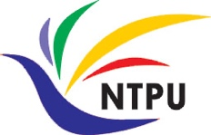


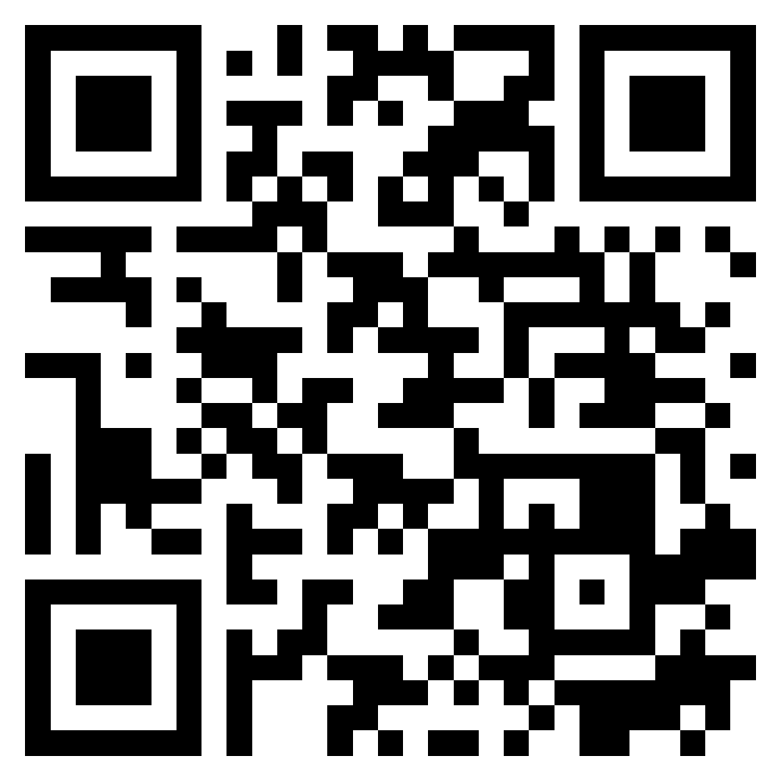






Cloud-Based Software:
Virtualization and containers,
Everything as a service, Software as a service
Software Engineering
1142SE06
MBA, IM, NTPU (M5010) (Spring 2026)
Wed 2, 3, 4 (9:10-12:00) (B3F17)
University Ambassador
Certified Instructor
Min-Yuh Day, Ph.D,
Professor and Director
Institute of Information Management, National Taipei University
https://web.ntpu.edu.tw/~myday
https://meet.google.com/ish-gzmy-pmo
2026-04-10

Slide 2
Syllabus
Week Date Subject/Topics
1 2026/02/25 Introduction to Software Engineering
2 2026/03/04 Software Products and Project Management:
Software product management and prototyping with
Generative AI and Agentic AI
3 2026/03/11 Agile Software Engineering:
Agile methods, Scrum, and Extreme Programming
4 2026/03/18 Case Study on Software Engineering I
5 2026/03/25 Features, Scenarios, and Stories
6 2026/04/01 Software Architecture: Architectural design,
System decomposition, and Distribution architecture

Slide 3
Syllabus
Week Date Subject/Topics
7 2026/04/08 Cloud-Based Software: Virtualization and containers,
Everything as a service, Software as a service
8 2026/04/15 Midterm Project Report
9 2026/04/22 Cloud Computing and Cloud Software Architecture
10 2026/04/29 Microservices Architecture, RESTful services,
Service deployment
11 2026/05/06 Case Study on Software Engineering II
12 2026/05/13 Security and Privacy; Reliable Programming;
Testing: Functional testing, Test automation,
Test-driven development, and Code reviews

Slide 4
Syllabus
Week Date Subject/Topics
13 2026/05/20 Industry Practices of Software Engineering
14 2026/05/27 DevOps and Code Management:
Code management and DevOps automation
15 2026/06/03 Final Project Report I
16 2026/06/10 Final Project Report II

Slide 5
Cloud-Based Software:
Virtualization and containers,
Everything as a service,
Software as a service

Slide 6
Software Engineering and
Project Management
Analyze
Requirements
definition
Design
System and Software design
Build
Implementation and
unit testing
Test
Integration
and
system testing
Deliver
Operation
and maintenance
Project Management

Slide 7
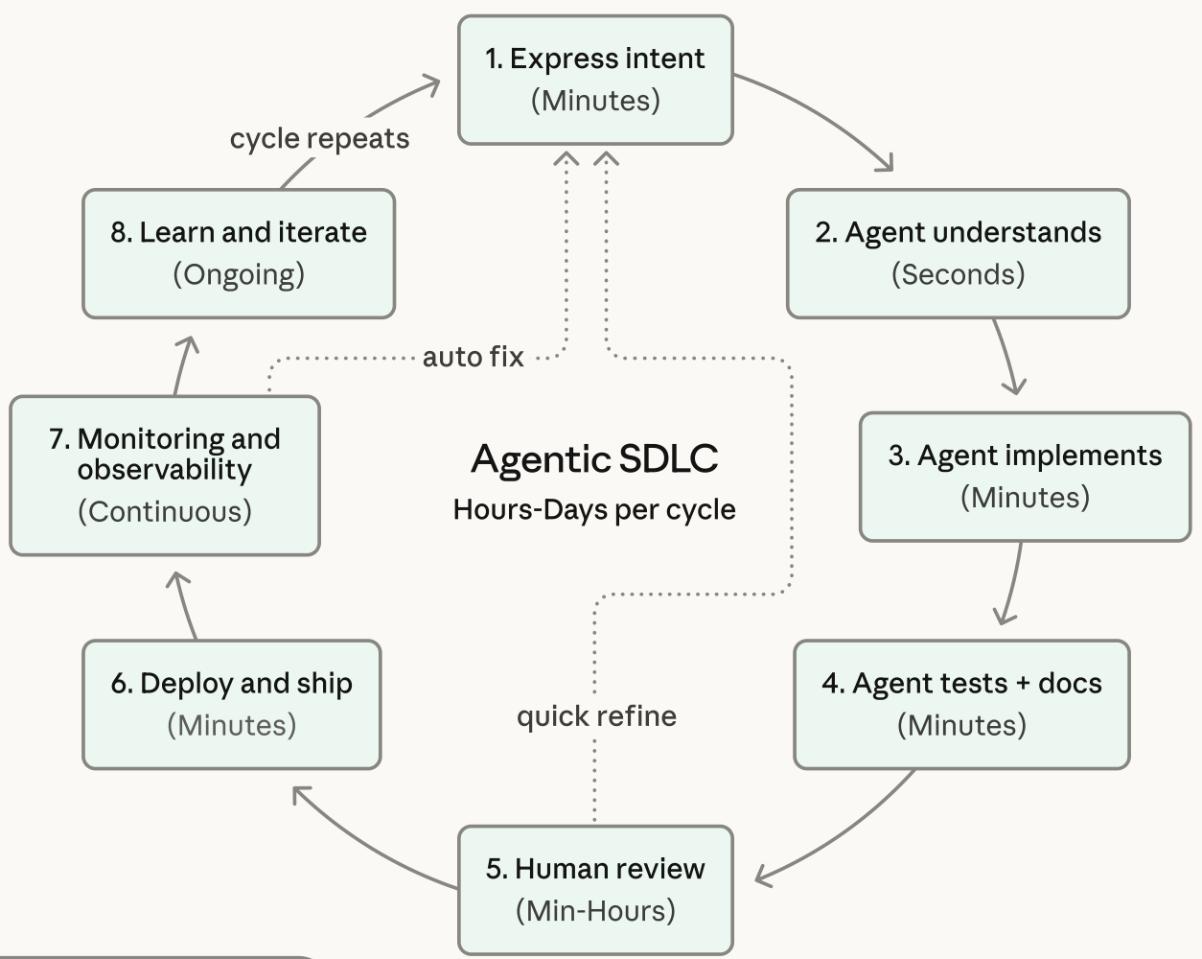
Agentic Coding Software Development Lifecycle

Slide 8
Information Management
Management
Information Systems (MIS)
Information Systems

Slide 9
Information Management (MIS)
Information Systems
Organizations
Technology
Information
Systems
Management

Slide 10
Fundamental MIS Concepts
Business
Challenges
Management
Organization
Information
System
Business
Solutions
Technology

Slide 11
Business Model
8
7
2
4
1
Key
Partners
Key
Activities
Value Proposition
Customer
Relationships
Customer
Segments
6
3
Key
Resources
Channels
9
5
Cost
Structure
Revenue
Streams
Source: Alexander Osterwalder & Yves Pigneur, Business Model Generation: A Handbook for Visionaries, Game Changers, and Challengers, Wiley, 2010.

Slide 12
Project-based software engineering
CUSTOMER
Problem
generates
helps-with
Requirements
implemented-by
Software
1
CUSTOMER and
DEVELOPER
DEVELOPER

Slide 13
Product software engineering
DEVELOPER
Opportunity
1
inspires
realizes
Product features
implemented-by
Software
DEVELOPER
DEVELOPER

Slide 14
Software execution models
Stand-alone execution
Hybrid execution
Software as a service
User’s computer
User’s computer
User’s computer
User interface
Product functionality
User data
User interface
Partial functionality
User data
User interface
(browser or app)
Product updates
Additional functionality
User data backups
Product updates
Product functionality
User data
Vendor’s servers
Vendor’s servers
Vendor’s servers

Slide 15
Product management concerns
Business
needs
Product manager
Technology
constraints
Customer
experience

Slide 16
Technical interactions of product managers
Product
vision management
Product
backlog management
User stories
and
scenarios
Product manager
Acceptance
testing
Customer
testing
User
interface
design

Slide 17
Software Development Life Cycle (SDLC)
The waterfall model
Requirements
definition
System and Software design
Implementation and unit testing
Integration and system testing
Operation and maintenance

Slide 18
Plan-based and Agile development
Plan-based development
Requirements
engineering
Requirements
specification
Design and implementation
Requirements change requests
Agile development
Requirements
engineering
Design and implementation

Slide 19
The Continuum of Life Cycles
High
Incremental
Agile
Frequency of Delivery
Predictive
Iterative
Low
Low
High
Degree of Change

Slide 20
Predictive Life Cycle
Analyze
Design
Build
Test
Deliver

Slide 21
Iterative Life Cycle
Prototype
Refine
Analyze
Analyze
Design
Build
Test
Deliver

Slide 22
A Life Cycle of
Varying-Sized Increments
Analyze
Design
Build
Test
Deliver
Analyze
Design
Build
Test
Deliver
Analyze
Design
Build
Test
Deliver

Slide 23
Iteration-Based and Flow-Based Agile Life Cycles
Iteration-Based Agile
Requirements
Analysis
Design
Build
Test
Requirements
Analysis
Design
Build
Test
Requirements
Analysis
Design
Build
Test
Requirements
Analysis
Design
Build
Test
Repeat
as needed
…
Requirements
Analysis
Design
Build
Test
Requirements
Analysis
Design
Build
Test
Flow-Based Agile
Requirements
Analysis
Design
Build
Test
the number of features in the WIP limit
Requirements
Analysis
Design
Build
Test
the number of features in the WIP limit
Requirements
Analysis
Design
Build
Test
the number of features in the WIP limit
Repeat
as needed
…
Requirements
Analysis
Design
Build
Test
the number of features in the WIP limit
Requirements
Analysis
Design
Build
Test
the number of features in the WIP limit

Slide 24
From personas to features
1
Personas
A way of representing users
inspire
Natural language descriptions of a user interacting with a software product
2
Scenarios
are-developed-into
3
inspire
Stories
Natural language descriptions of something that is needed or wanted by users
4
Features
define
Fragments of product functionality

Slide 25
Multi-tier client-server architecture
Client 1
Client 2
Web
Server
Application
Server
Database
Server
Client 3
Client …

Slide 26
Service-oriented Architecture
Client 1
S1
S2
Client 2
S3
Web
Server
Service
gateway
S4
Client 3
S5
Client …
S6
Services

Slide 27
VM
Container
Virtual
web server
Virtual
mail server
User 1
Container 1
User 2
Container 2
Server
software
Server
software
Application
software
Application
software
Guest
OS
Guest
OS
Server
software
Server
software
Hypervisor
Container manager
Host OS
Host OS
Server Hardware
Server Hardware

Slide 28
Everything as a service
Photo
editing
Software as a service
(SaaS)
Logistics
management
Cloud management
Monitoring
Platform as a service
(PaaS)
Database
Software
development
Storage Network
Infrastructure as a service
(IaaS)
Computing Virtualization
Cloud data center

Slide 29
Software as a service
Software customers
Software
provider
Software services
Cloud Infrastructure
Cloud
provider

Slide 30
Microservices architecture – key design questions
What are the microservices that make up the system?
How should data be distributed and shared?
How should microservices communicate with each other?
Microservices architecture
design
How should the microservices in the system be coordinated?
How should service failure be detected, reported and managed?

Slide 31
Types of security threat
An attacker attempts to deny access to the system for legitimate users
An attacker attempts to damage the system or its data
Availability
threats
Integrity
threats
SOFTWARE PRODUCT
PROGRAM
Distributed denial of service (DDoS) attack
Virus
DATA
Ransomware
Data theft
Confidentiality
threats
An attacker tries to gain access to private information held by the system

Slide 32
Software product quality attributes
Reliability
Availability
1
2
Software product quality attributes
Security
Resilience
7
3
Usability
Maintainability
6
4
Responsiveness
5

Slide 33
A refactoring process
1
2
Start
Identify code
‘smell’
Identify refactoring strategy
4
3
Run automated code tests
Make small
improvement until strategy completed

Slide 34
Functional testing
Start
1
Unit
Testing
4
2
Release
Testing
Feature
Testing
3
System
Testing

Slide 35
Test-driven development (TDD)
Start
1
Identify new
functionality
2
Identify partial implementation
of functionality
3
Write code stub
that will fail test
Functionality
complete
Functionality
incomplete
4
Run all
automated test
7
Refactor code
if required
5
Implement code that should cause failing test to pass
Test failure
6
Run all
automated test
All tests pass

Slide 36
DevOps
Development
Deployment
Support
Multi-skilled DevOps team

Slide 37
Code management and DevOps
DevOps automation
Continuous
integration
Continuous
deployment
Continuous
delivery
Infrastructure
as code
Code management system
Branching and merging
Recover
version
information
Code
repository
Save and
retrieve
versions
Transfer code to/from developer’s filestore
DevOps measurement
Data
collection
Data
analysis
Report
generation

Slide 38
Cloud-Based Software:
Virtualization and containers,
Everything as a service,
Software as a service

Slide 39
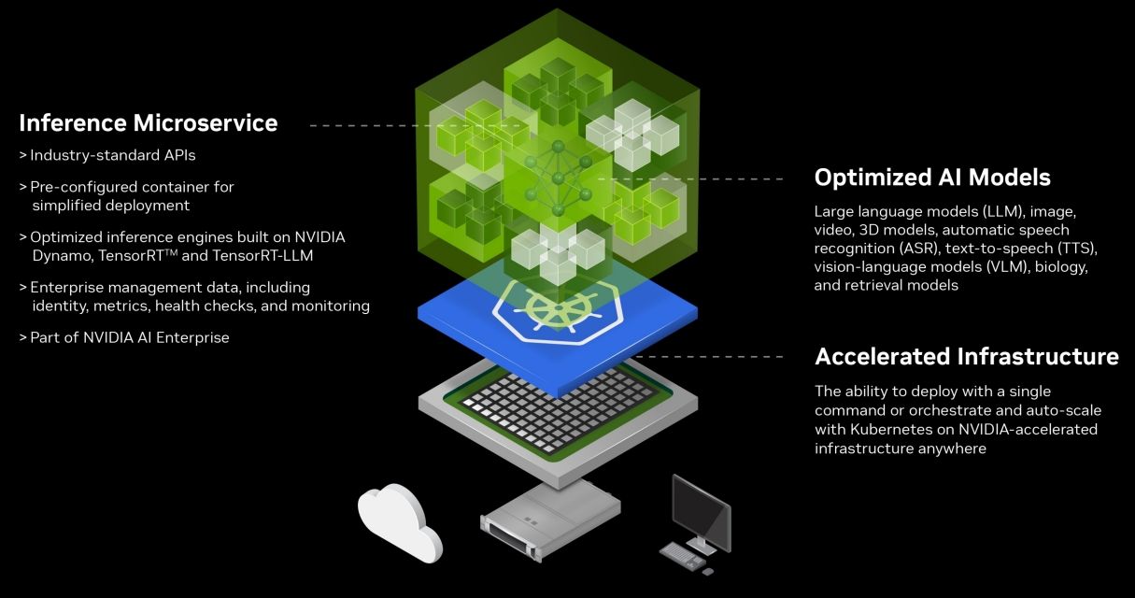
Nvidia Inference Microservices (NIM)
Designed for rapid, reliable deployment of accelerated generative AI inference anywhere
NVIDIA NIM™ provides prebuilt, optimized inference microservices for rapidly deploying the latest AI models on any NVIDIA-accelerated infrastructure—cloud, data center, workstation, and edge.
https://www.nvidia.com/en-us/ai-data-science/products/nim-microservices/

Slide 40
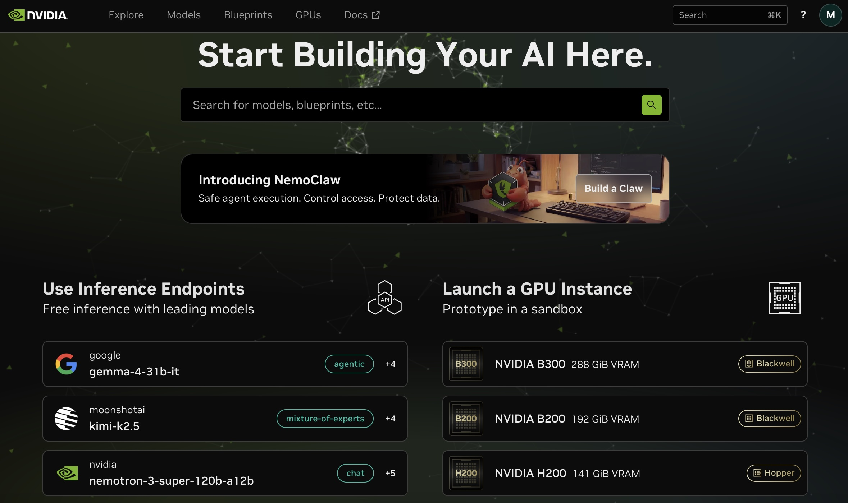
Nvidia Inference Microservices (NIM)
Designed for rapid, reliable deployment of accelerated generative AI inference anywhere
https://build.nvidia.com/

Slide 41
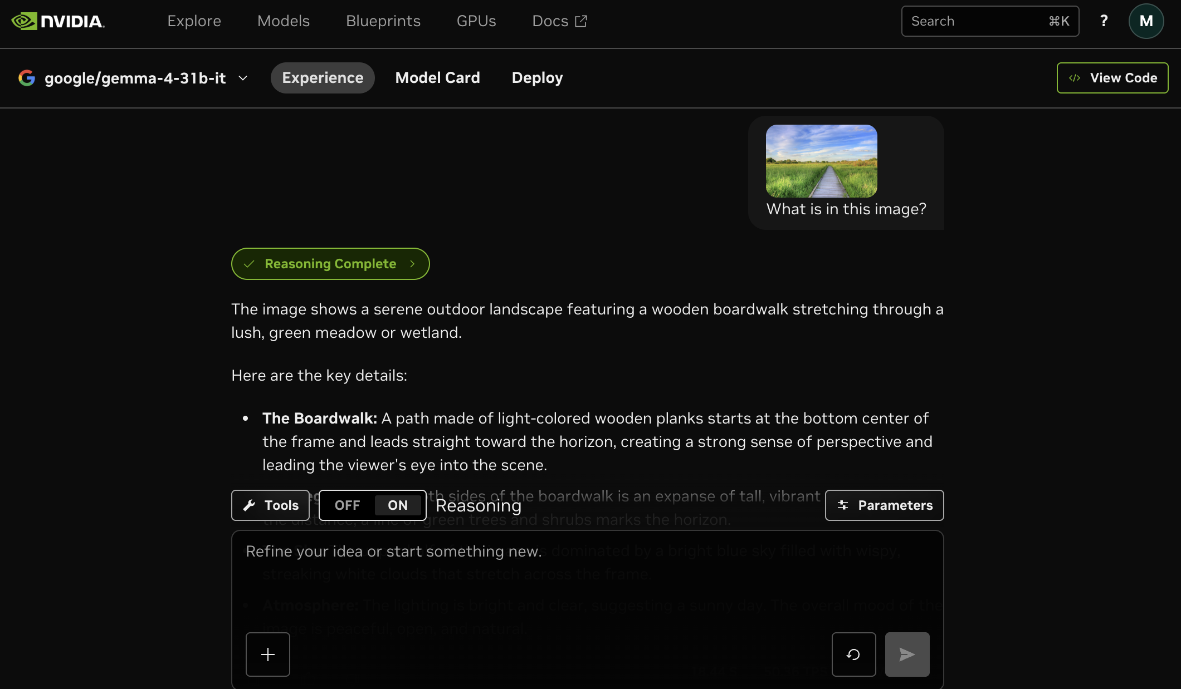
Agentic AI with Google Gemma 4 31B in
NVIDIA Cloud-Native NIM Architecture
https://build.nvidia.com/google/gemma-4-31b-it

Slide 42
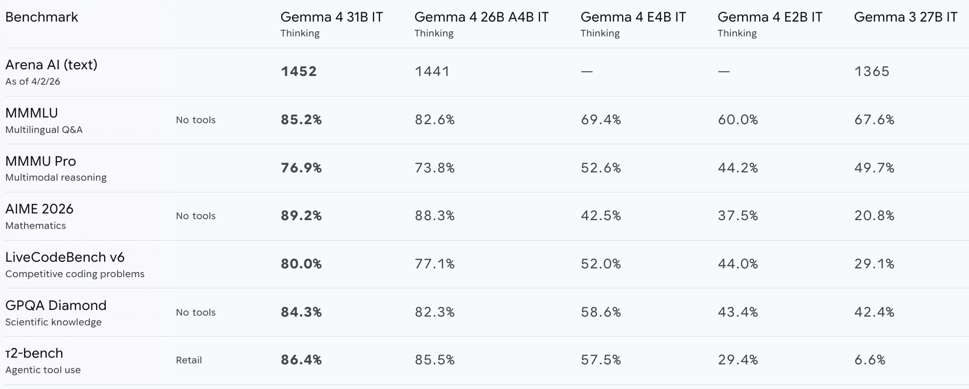
Google Gemma 4
Google most intelligent open models, built from Gemini 3 research and technology to maximize intelligence-per-parameter
https://deepmind.google/models/gemma/gemma-4/

Slide 43
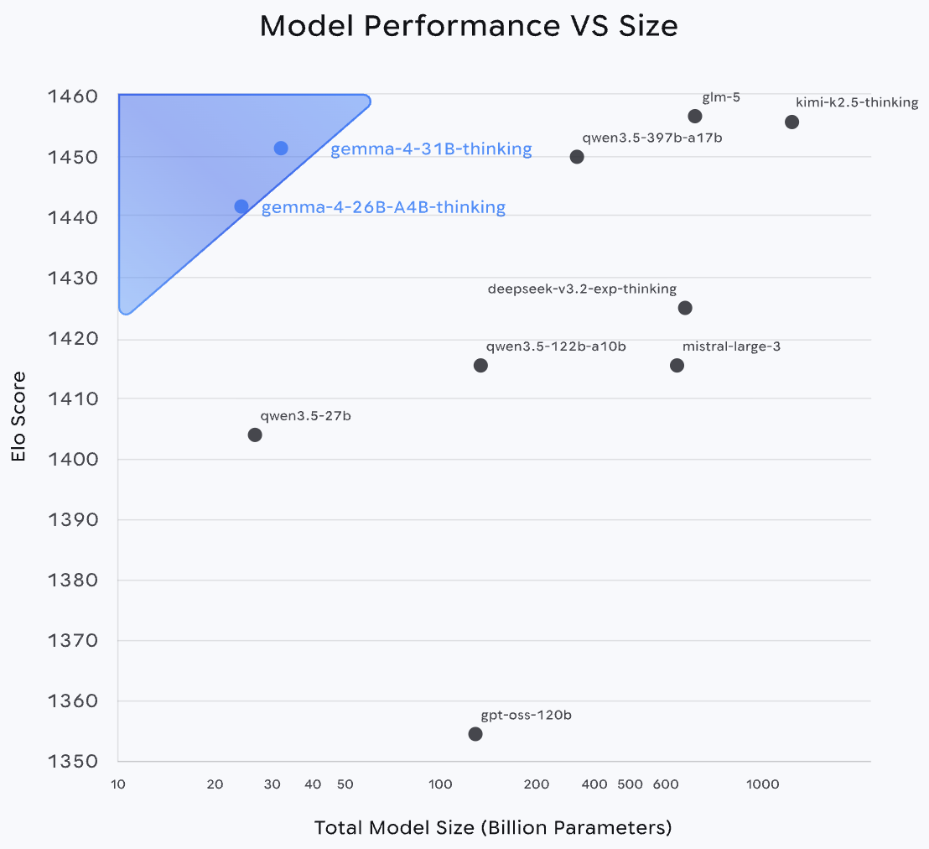
Google Gemma 4 31B
Gemma 4 26B A4B
https://deepmind.google/models/gemma/gemma-4/

Slide 44
Everything as a Service (XaaS)
Software as a Service (SaaS)
Agent as a Service (AaaS)
Service-as-Software (SaS)
Powered by AI Agents

Slide 45
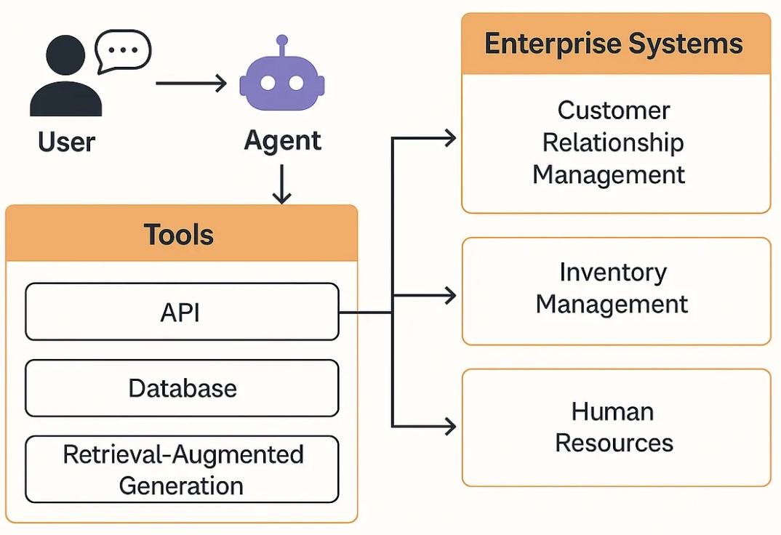
Agent as a Service (AaaS)
Source: https://medium.com/@divya.parashar03/agent-as-a-service-aaas-the-next-evolution-in-enterprise-architecture-27a84e05ab06

Slide 46
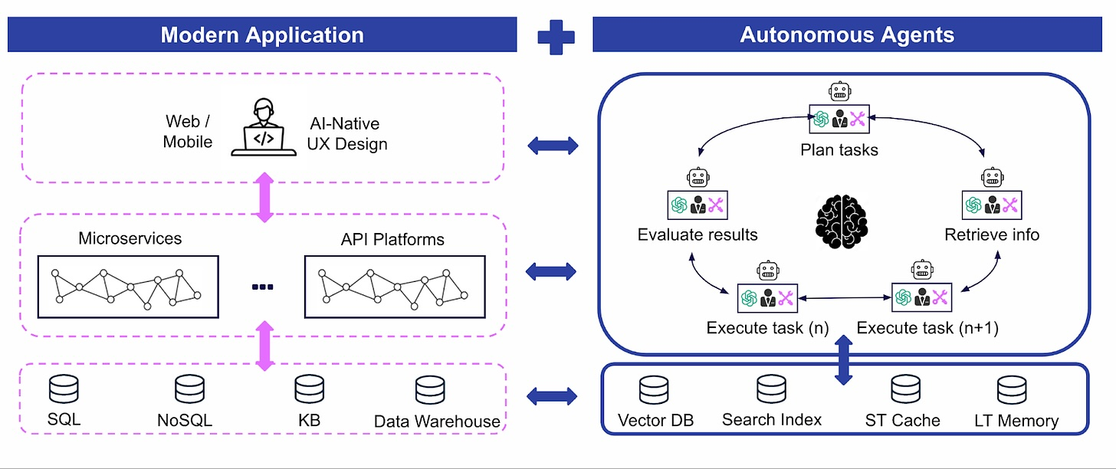
Service-as-Software
Powered by AI Agents
Source: https://www.decibel.vc/articles/service-as-software-powered-by-ai-agents

Slide 47
The cloud
The cloud is made up of
very large number of remote servers
that are offered for rent
by companies that own these servers.
  Cloud-based servers are ‘virtual servers’,
  which means that they are implemented in software rather than hardware.

Slide 48
The cloud
You can rent as many servers as you need, run your software on these servers and make them available to your customers.
  Cloud servers can be started up and shut down as demand changes.
You may rent a server and install your own software, or you may pay for access to software products that are available on the cloud.

Slide 49
Cloud Software:
Scaleability, elasticity and resilience
Scaleability
Maintain performance
as load increases
Elasticity
Adapt the server configuration
to changing demands
Cloud software
characteristics
Resilience
Maintain service in the
event of server failure

Slide 50
Scaleability
Scaleability reflects the ability of your software to cope with increasing numbers of users.
  As the load on your software increases, your software automatically adapts so that the system performance and response time is maintained.

Slide 51
Elasticity
Elasticity is related to scaleability but also allows for scaling-down as well as scaling-up.
  You can monitor the demand on your application and add or remove servers dynamically as the number of users change.

Slide 52
Resilience
Resilience means that you can design your software architecture to tolerate server failures.
  You can make several copies of your software concurrently available. If one of these fails, the others continue to provide a service.

Slide 53
Benefits of using the cloud for software development
Cost
You avoid the initial capital costs of hardware procurement
Startup time
Using the cloud, you can have servers up and running in a few minutes.
Server choice
If you find that the servers you are renting are not powerful enough, you can upgrade to more powerful systems. You can add servers for short-term requirements, such as load testing.
Distributed development
If you have a distributed development team, working from different locations, all team members have the same development environment and can seamlessly share all information.

Slide 54
Virtual cloud servers
A virtual server runs on an underlying physical computer and is made up of an operating system plus a set of software packages that provide the server functionality required.
A virtual server is a stand-alone system that can run on any hardware in the cloud.
  This ‘run anywhere’ characteristic is possible because the virtual server has no external dependencies.

Slide 55
Virtual cloud servers
Virtual machines (VMs), running on physical server hardware, can be used to implement virtual servers.
  A hypervisor provides hardware emulation that simulates the operation of the underlying hardware.
If you use a virtual machine to implement virtual servers, you have exactly the same hardware platform as a physical server.

Slide 56
Implementing a virtual server as a Virtual Machine (VM)
Virtual
web server
Virtual
mail server
Apache
Web Server
Server
software
Server
software
Outlook
Guest
OS
Guest
OS
Linux
Windows Server
Hypervisor
Host OS
Server Hardware

Slide 57
Container-based virtualization
If you are running a cloud-based system with many instances of applications or services, these all use the same operating system, you can use a simpler virtualization technology called ‘containers’.
Using containers accelerates the process of deploying virtual servers on the cloud.
  Containers are usually megabytes in size whereas VMs are gigabytes.
  Containers can be started and shut down in a few seconds rather than the few minutes required for a VM.

Slide 58
Container-based virtualization
Containers are an operating system virtualization technology that allows independent servers to share a single operating system.
  They are particularly useful for providing isolated application services where each user sees their own version of an application.

Slide 59
Using containers to provide isolated services
User 1
Container 1
User 2
Container 2
Graphic design
Software
Application
software
Application
software
Graphic design
Software
Graphics
libraries
Photo Manager
Graphics
libraries
Photo Manager
Server
software
Server
software
Container manager
Host OS
Server Hardware

Slide 60
VM
Container
Virtual
web server
Virtual
mail server
User 1
Container 1
User 2
Container 2
Server
software
Server
software
Application
software
Application
software
Guest
OS
Guest
OS
Server
software
Server
software
Hypervisor
Container manager
Host OS
Host OS
Server Hardware
Server Hardware

Slide 61
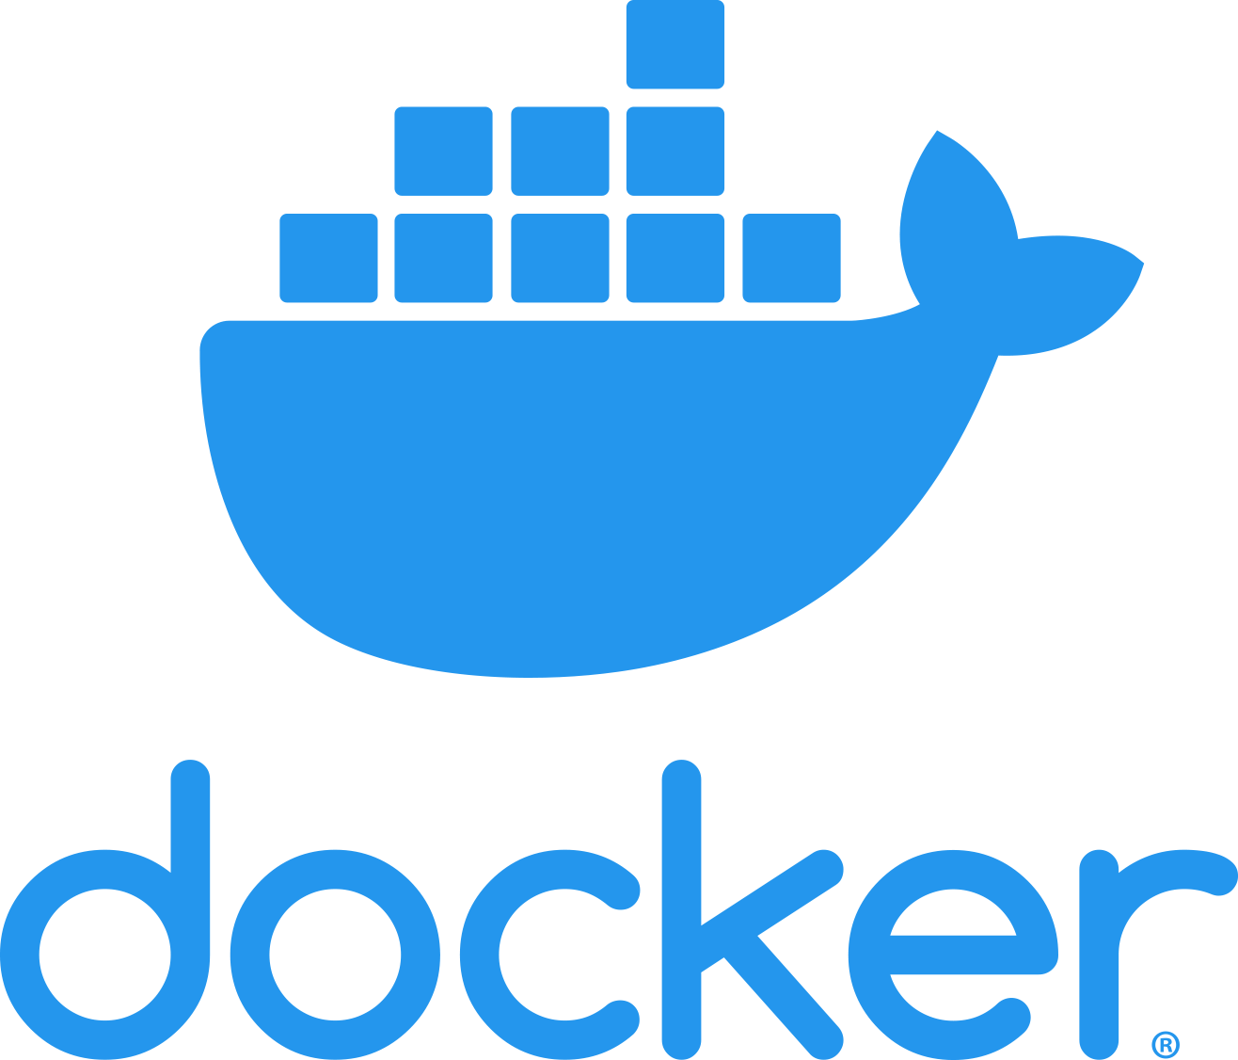
Docker
Containers were developed by Google around 2007 but containers became a mainstream technology around 2015.
An open-source project called Docker provided a standard means of container management that is fast and easy to use.
Docker is a container management system that allows users to define the software to be included in a container as a Docker image.
It also includes a run-time system that can create and manage containers using these Docker images.

Slide 62
The Docker container system
Registries
Docker hub
Images
Images
Images
Docker client
Docker
Daemon
Containers
Dockerfiles
Docker host

Slide 63
The elements of the
Docker container system
Docker daemon
This is a process that runs on a host server and is used to setup, start, stop, and monitor containers, as well as building and managing local images.
Docker client
This software is used by developers and system managers to define and control containers

Slide 64
The elements of the
Docker container system
Dockerfiles
Dockerfiles define runnable applications (images) as a series of setup commands that specify the software to be included in a container. Each container must be defined by an associated Dockerfile.
Image
A Dockerfile is interpreted to create a Docker image, which is a set of directories with the specified software and data installed in the right places. Images are set up to be runnable Docker applications.

Slide 65
The elements of the
Docker container system
Docker hub
This is a registry of images that has been created. These may be reused to setup containers or as a starting point for defining new images.
Containers
Containers are executing images. An image is loaded into a container and the application defined bby the image starts execution. Containers may be moved from server to server without modification and replicated across many servers. You can make changes to a Docker container (e.g. by modifying files) but you then must commit these changes to create a new image and restart the container.

Slide 66
Docker images
Docker images are directories that can be archived, shared and run on different Docker hosts. Everything that’s needed to run a software system - binaries, libraries, system tools, etc. is included in the directory.
A Docker image is a base layer, usually taken from the Docker registry, with your own software and data added as a layer on top of this.
  The layered model means that updating Docker applications is fast and efficient. Each update to the filesystem is a layer on top of the existing system.
  To change an application, all you have to do is to ship the changes that you have made to its image, often just a small number of files.

Slide 67
Benefits of containers
They solve the problem of software dependencies.
  You don’t have to worry about the libraries and other software on the application server being different from those on your development server.
  Instead of shipping your product as stand-alone software, you can ship a container that includes all of the support software that your product needs.

Slide 68
Benefits of containers
They provide a mechanism for software portability across different clouds.
  Docker containers can run on any system or cloud provider where the Docker daemon is available
They provide an efficient mechanism for implementing software services and so support the development of service-oriented architectures.
They simplify the adoption of DevOps.
  This is an approach to software support where the same team are responsible for both developing and supporting operational software.

Slide 69
Everything as a service
Photo
editing
Software as a service
(SaaS)
Logistics
management
Cloud management
Monitoring
Platform as a service
(PaaS)
Database
Software
development
Storage Network
Infrastructure as a service
(IaaS)
Computing Virtualization
Cloud data center

Slide 70
Everything as a service
The idea of a service that is rented rather than owned is fundamental to cloud computing.
Infrastructure as a service (IaaS)
Platform as a service (PaaS)
Software as a service (SaaS)

Slide 71
Infrastructure as a service (IaaS)
Infrastructure as a service (IaaS)
  Cloud providers offer different kinds of infrastructure service such as a compute service, a network service and a storage service that you can use to implement virtual servers.

Slide 72
Platform as a service (PaaS)
Platform as a service (PaaS)
  This is an intermediate level where you use libraries and frameworks provided by the cloud provider to implement your software.
  These provide access to a range of functions, including SQL and NoSQL databases.

Slide 73
Software as a service (SaaS)
Software as a service (SaaS)
  Your software product runs on the cloud and is accessed by users through a web browser or mobile app.

Slide 74
Management responsibilities for IaaS and PaaS
Managed by
software provider
Software as a Service
(SaaS)
Managed by
software provider
Managed by
software provider
Application Services
(database etc.)
Application Services
(database etc.)
Managed by
Cloud vendor
Managed by
software provider
Cloud management
Services
Cloud management
Services
Managed by
Cloud vendor
Managed by
Cloud vendor
Basic Computational
Services
Basic Computational
Services
Managed by
Cloud vendor
Infrastructure as a Service
(IaaS)
Platform as a Service
(PaaS)

Slide 75
Software as a service
Increasingly, software products are being delivered as a service, rather than installed on the buyer’s computers.
If you deliver your software product as a service, you run the software on your servers, which you may rent from a cloud provider.
Customers don’t have to install software and they access the remote system through a web browser or dedicated mobile app.
The payment model for software as a service is usually a subscription model.
  Users pay a monthly fee to use the software rather than buy it outright.

Slide 76
Software as a service
Software customers
Software
provider
Software services
Cloud Infrastructure
Cloud
provider

Slide 77
Benefits of SaaS for software product providers
Cash flow
Customers either pay a regular subscription or pay as they use the software. This means you have a regular cash flow, with payments throughout the year. You don’t have a situation where you have a large cash injection when products are purchased but very little income between product releases.
Update management
You are in control of updates to your product and all customers receive the update at the same time. You avoid the issue of several versions being simultaneously used and maintained. This reduces your costs and makes it easier to maintain a consistent software code base.
Continuous deployment
You can deploy new versions of your software as soon as changes have been made and tested. This means you can fix bugs quickly so that your software reliability can continuously improve.

Slide 78
Benefits of SaaS for software product providers
Payment flexibility
You can have several different payment options so that you can attract a wider range of customers. Small companies or individuals need not be discouraged by having to pay large upfront software costs.
Try before you buy
You can make early free or low-cost versions of the software available quickly with the aim of getting customer feedback on bugs and how the product could be approved.
Data collection
You can easily collect data on how the product is used and so identify areas for improvement. You may also be able to collect customer data that allows you to market other products to these customers.

Slide 79
Advantages and disadvantages of SaaS for customers
Advantages
No upfront costs
for software or
servers
Reduced software
management costs
Mobile, laptop and
desktop access
Immediate
software updates
Software
customer
Disadvantages
Privacy
regulation
conformance
Network constraints
Lost of control
over updates
Service lock-in
Security concerns
Data exchange

Slide 80
Data storage and management issues for SaaS
Regulation
Some countries, such as EU countries, have strict laws on the storage of personal information. These may be incompatible with the laws and regulations of the country where the SaaS provider is based. If a SaaS provider cannot guarantee that their storage locations conform to the laws of the customer’s country, businesses may be reluctant to use their product.
Data transfer
If software use involves a lot of data transfer, the software response time may be limited by the network speed. This is a problem for individuals and smaller companies who can’t afford to pay for very high speed network connections.

Slide 81
Data storage and management issues for SaaS
Data security
Companies dealing with sensitive information may be unwilling to hand over the control of their data to an external software provider. As we have seen from a number of high profile cases, even large cloud providers have had security breaches. You can’t assume that they always provide better security than the customer’s own servers.
Data exchange
If you need to exchange data between a cloud service and other services or local software applications, this can be difficult unless the cloud service provides an API that is accessible for external use.

Slide 82
Design issues for software delivered as a service
Local/remote
processing
Authentication
SaaS
design issue
Information
leakage
Multitenant or
multi-instance
database
management

Slide 83
Multi-tenant systems
A multi-tenant database is partitioned so that customer companies have their own space and can store and access their own data.
  There is a single database schema, defined by the SaaS provider, that is shared by all of the system’s users.
  Items in the database are tagged with a tenant identifier, representing a company that has stored data in the system. The database access software uses this tenant identifier to provide ‘logical isolation’, which means that users seem to be working with their own database.

Slide 84
Possible customisations for SaaS
Authentication
Businesses may want users to authenticate using their business credentials rather than the account credentials set up by the software provider.
Branding
Businesses may want a user interface that is branded to reflect their own organisation.

Slide 85
Possible customisations for SaaS
Business rules
Businesses may want to be able to define their own business rules and workflows that apply to their own data.
Data schemas
Businesses may want to be able to extend the standard data model used in the system database to meet their own business needs.
Access control
Businesses may want to be able to define their own access control model that sets out the data that specific users or user groups can access and the allowed operations on that data.

Slide 86
Advantages of multi-tenant databases
Resource utilization
The SaaS provider has control of all the resources used by the software and can optimize the software to make effective use of these resources.
Security
Multitenant databases have to be designed for security because the data for all customers is held in the same database. They are, therefore, likely to have fewer security vulnerabilities than standard database products. Security management is simplified as there is only a single copy of the database software to be patched if a security vulnerability is discovered.
Update management
It is easier to update a single instance of software rather than multiple instances. Updates are delivered to all customers at the same time so all use the latest version of the software.

Slide 87
Disadvantages of multi-tenant databases
Inflexibility
Customers must all use the same database schema with limited scope for adapting this schema to individual needs. I explain possible database adaptations later in this section.
Security
As data for all customers is maintained in the same database, then there is a theoretical possibility that data will leak from one customer to another. In fact, there are very few instances of this happening. More seriously, perhaps, if there is a database security breach then it affects all customers.
Complexity
Multitenant systems are usually more complex than multi-instance systems because of the need to manage many users. There is, therefore, an increased likelihood of bugs in the database software.

Slide 88
User profiles for SaaS access
co1 user
co1 user
co1 user
Profile
co1
co6 user
Profile
co2
Profile
co6
co6 user
SaaS
application
co3 user
Profile
co3
Profile
co5
co3 user
Profile
co4
co3 user
co4 user
co4 user
co4 user
co4 user

Slide 89
Architectural decisions for cloud software engineering
Database
organization
Scalability and
resilience
Software
structure
Should the software
use a multitenant or
multi-instance
database?
What are the
software scalability
and resilience
requirements?
Should the software
structure be
monolithic or
service-oriented?
What cloud platform
should be used for
development and
delivery?
Cloud platform

Slide 90
Questions to ask when choosing a database organization
Target customers
Transaction requirements
Database size and connectivity
Database interoperability
System structure

Slide 91
Questions to ask when choosing a database organization
Target customers
Do customers require different database schemas and database personalization? Do customers have security concerns about database sharing? If so, use a multi-instance database.
Transaction requirements
Is it critical that your products support ACID transactions where the data is guaranteed to be consistent at all times? If so, use a multi-tenant database or a VM-based multi-instance database.

Slide 92
Questions to ask when choosing a database organization
Database size and connectivity
How large is the typical database used by customers? How many relationships are there between database items? A multi-tenant model is usually best for very large databases as you can focus effort on optimizing performance.
Database interoperability
Will customers wish to transfer information from existing databases? What are the differences in schemas between these and a possible multitenant database? What software support will they expect to do the data transfer? If customers have many different schemas, a multi-instance database should be used.

Slide 93
Questions to ask when choosing a database organization
System structure
Are you using a service-oriented architecture for your system? Can customer databases be split into a set of individual service databases? If so, use containerized, multi-instance databases.

Slide 94
Scalability and resilience
The scalability of a system reflects its ability to adapt automatically to changes in the load on that system.
The resilience of a system reflects its ability to continue to deliver critical services in the event of system failure or malicious system use.

Slide 95
Scalability and resilience
You achieve scalability in a system by making it possible to add new virtual servers (scaling-out) or increase the power of a system server (scaling-up) in response to increasing load.
  In cloud-based systems, scaling-out rather than scaling-up is the normal approach used. Your software has to be organized so that individual software components can be replicated and run in parallel.
To achieve resilience, you need to be able to restart your software quickly after a hardware or software failure.

Slide 96
Using a standby system to provide resilience
System monitor
Location A
Location B
Active system
Standby system
Database
mirror
Database 1
Database 2

Slide 97
Resilience
Resilience relies on redundancy:
  Replicas of the software and data are maintained in different locations.
  Database updates are mirrored so that the standby database is a working copy of the operational database.
  A system monitor continually checks the system status. It can switch to the standby system automatically if the operational system fails.

Slide 98
Resilience
You should use redundant virtual servers that are not hosted on the same physical computer and locate servers in different locations.
  Ideally, these servers should be located in different data centers.
  If a physical server fails or if there is a wider data center failure, then operation can be switched automatically to the software copies elsewhere.

Slide 99
System structure
An object-oriented approach to software engineering has been that been extensively used for the development of client-server systems built around a shared database.
The system itself is, logically, a monolithic system with distribution across multiple servers running large software components. The traditional multi-tier client server architecture is based on this distributed system model.

Slide 100
System structure
The alternative to a monolithic approach to software organization is a service-oriented approach where the system is decomposed into fine-grain, stateless services.
  Because it is stateless, each service is independent and can be replicated, distributed and migrated from one server to another.
  The service-oriented approach is particularly suitable for cloud-based software, with services deployed in containers.

Slide 101
Cloud platform
Cloud platforms include general-purpose clouds such as Amazon Web Services or lesser known platforms oriented around a specific application, such as the SAP Cloud Platform. There are also smaller national providers that provide more limited services but who may be more willing to adapt their services to the needs of different customers.
There is no ‘best’ platform and you should choose a cloud provider based on your background and experience, the type of product that you are developing and the expectations of your customers.
You need to consider both technical issues and business issues when choosing a cloud platform for your product.

Slide 102
Technical issues in cloud platform choice
Expected load
and
load predictability
Resilience
Cloud
platform
choice
Supported
cloud services
Privacy and
data protection

Slide 103
Business issues in cloud platform choice
Cost
Business
issues
Developer
experience
Target
customers
Service-level
agreements
Portability and
cloud migration

Slide 104
Summary
The cloud is made up of a large number of virtual servers that you can rent for your own use. You and your customers access these servers remotely over the internet and pay for the amount of server time used.
Virtualization is a technology that allows multiple server instances to be run on the same physical computer. This means that you can create isolated instances of your software for deployment on the cloud.

Slide 105
Summary
Virtual machines are physical server replicas on which you run your own operating system, technology stack and applications.
Containers are a lightweight virtualization technology that allow rapid replication and deployment of virtual servers. All containers run the same operating system.
Docker is currently the most widely used container technology.

Slide 106
Summary
A fundamental feature of the cloud is that ‘everything’ can be delivered as a service and accessed over the internet.
A service is rented rather than owned and is shared with other users.

Slide 107
Summary
Infrastructure as a service (IaaS) means computing, storage and other services are available over the cloud. There is no need to run your own physical servers.
Platform as a service (PaaS) means using services provided by a cloud platform vendor to make it possible to auto-scale your software in response to demand.
Software as a service (SaaS) means that application software is delivered as a service to users. This has important benefits for users, such as lower capital costs, and software vendors, such as simpler deployment of new software releases.

Slide 108
Summary
Multitenant systems are SaaS systems where all users share the same database, which may be adapted at run-time to their individual needs. Multi-instance systems are SaaS applications where each user has their own separate database.
The key architectural issues for cloud-based software are the cloud platform to be used, whether to use a multitenant or multi-instance database, the scaleability and resilience requirements, and whether to use objects or services as the basic components in the system.

Slide 109
References
Ian Sommerville (2019), Engineering Software Products: An Introduction to Modern Software Engineering, Pearson.
Ian Sommerville (2015), Software Engineering, 10th Edition, Pearson.
Titus Winters, Tom Manshreck, and Hyrum Wright (2020), Software Engineering at Google: Lessons Learned from Programming Over Time, O'Reilly Media.
Project Management Institute (2021), A Guide to the Project Management Body of Knowledge (PMBOK Guide) – Seventh Edition and The Standard for Project Management, PMI.
Project Management Institute (2017), A Guide to the Project Management Body of Knowledge (PMBOK Guide), Sixth Edition, Project Management Institute.
Project Management Institute (2017), Agile Practice Guide, Project Management Institute.
Thomas R. Caldwell (2025), The Agentic AI Bible: The Complete and Up-to-Date Guide to Design, Build, and Scale Goal-Driven, LLM-Powered Agents that Think, Execute and Evolve, Independently published
Tucker J. Marion, Mahdi Srour, and Frank Piller (2024), "When Generative AI meets product development." MIT Sloan Management Review 66, no. 1 : 14-15.
Yilei Zhao, Wentao Zhang, Xiao Lei, Yandan Zheng, Mengpu Liu, and Wei Yang Bryan Lim. (2026) "Advancing ESG Intelligence: An Expert-level Agent and Comprehensive Benchmark for Sustainable Finance." arXiv preprint arXiv:2601.08676 (2026).
Nesreen Otoum and Nuha Elkhalili.(2026) "Methods and Techniques of Agentic Software Engineering: A Systematic Literature Review." IEEE Access 14 (2026): 7443-7465.
Lakshana Iruni Assalaarachchi, Zainab Masood, Rashina Hoda, and John Grundy. (2026) "Toward Agentic Software Project Management: A Vision and Roadmap." arXiv preprint arXiv:2601.16392 (2026).
NVIDIA DLI (2026), Building RAG Agents with LLMs,
https://learn.nvidia.com/courses/course-detail?course_id=course-v1:DLI+S-FX-15+V1
NVIDIA DLI (2026), Generative AI with Diffusion Models,
https://learn.nvidia.com/courses/course-detail?course_id=course-v1:DLI+S-FX-14+V1
NVIDIA DLI (2026), Building Agentic AI Applications with LLMs,
https://learn.nvidia.com/courses/course-detail?course_id=course-v1:DLI+S-FX-41+V1

