Slide 1



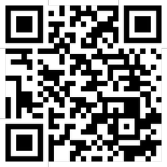






Cloud Computing and Cloud Software Architecture
Software Engineering
1142SE07
MBA, IM, NTPU (M5010) (Spring 2026) Wed 2, 3, 4 (9:10-12:00) (B3F17)
University Ambassador
Certified Instructor
Min-Yuh Day, Ph.D, Professor and Director
Institute of Information Management, National Taipei University
https://web.ntpu.edu.tw/~myday
https://meet.google.com/ish-gzmy-pmo
2026-04-22

Slide 2
Syllabus
Week Date Subject/Topics
1 2026/02/25 Introduction to Software Engineering
2 2026/03/04 Software Products and Project Management: Software product management and prototyping with Generative AI and Agentic AI
3 2026/03/11 Agile Software Engineering: Agile methods, Scrum, and Extreme Programming
4 2026/03/18 Case Study on Software Engineering I
5 2026/03/25 Features, Scenarios, and Stories
6 2026/04/01 Software Architecture: Architectural design, System decomposition, and Distribution architecture

Slide 3
Syllabus
Week Date Subject/Topics
7 2026/04/08 Cloud-Based Software: Virtualization and containers, Everything as a service, Software as a service
8 2026/04/15 Midterm Project Report
9 2026/04/22 Cloud Computing and Cloud Software Architecture
10 2026/04/29 Microservices Architecture, RESTful services, Service deployment
11 2026/05/06 Case Study on Software Engineering II
12 2026/05/13 Security and Privacy; Reliable Programming; Testing: Functional testing, Test automation, Test-driven development, and Code reviews

Slide 4
Syllabus
Week Date Subject/Topics
13 2026/05/20 Industry Practices of Software Engineering
14 2026/05/27 DevOps and Code Management: Code management and DevOps automation
15 2026/06/03 Final Project Report I
16 2026/06/10 Final Project Report II

Slide 5
Cloud Computing and Cloud Software Architecture

Slide 6
Software Engineering and Project Management
Analyze
Requirements definition
Design
System and Software design
Build
Implementation and
unit testing
Test
Integration and system testing
Deliver
Operation and maintenance
Project Management

Slide 7
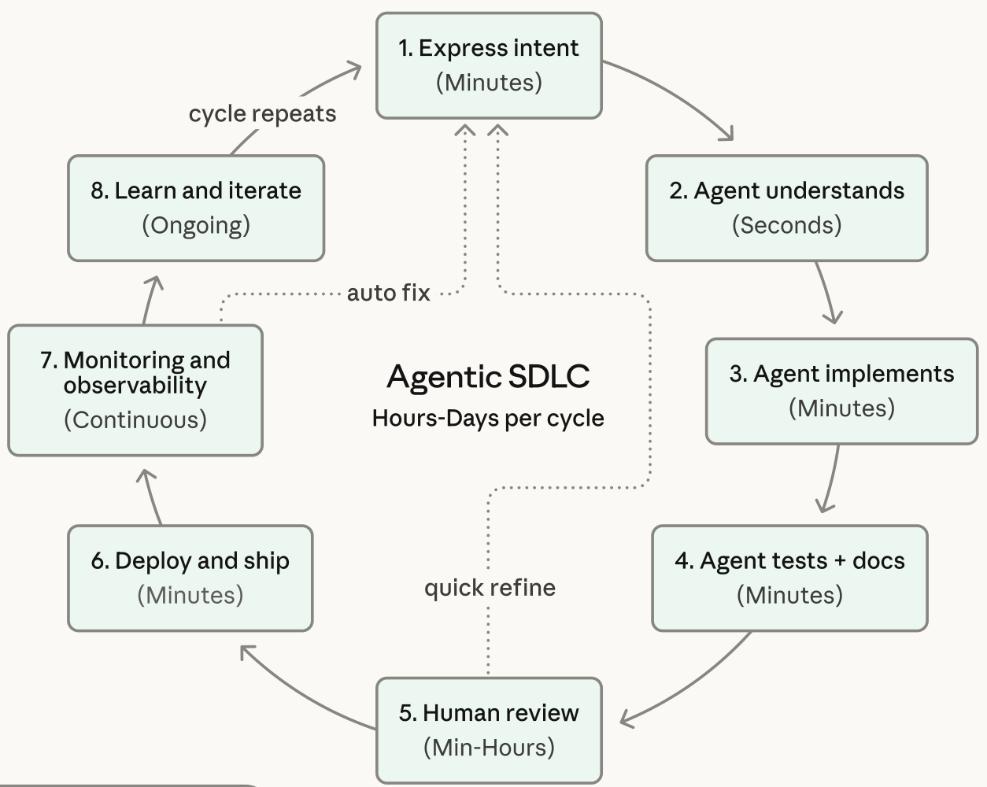
Agentic Coding Software Development Lifecycle

Slide 8
Information Management Management Information Systems (MIS) Information Systems

Slide 9
Information Management (MIS) Information Systems
Organizations
Technology
Information Systems
Management

Slide 10
Fundamental MIS Concepts
Business Challenges
Management
Organization
Information System
Business Solutions
Technology

Slide 11
Business Model
8
7
2
4
1
Key Partners
Key Activities
Value Proposition
Customer Relationships
Customer Segments
6
3
Key Resources
Channels
9
5
Cost Structure
Revenue Streams
Source: Alexander Osterwalder & Yves Pigneur, Business Model Generation: A Handbook for Visionaries, Game Changers, and Challengers, Wiley, 2010.

Slide 12
Project-based software engineering
CUSTOMER
Problem
generates
helps-with
Requirements
implemented-by
Software
1
CUSTOMER and DEVELOPER
DEVELOPER

Slide 13
Product software engineering
DEVELOPER
Opportunity
1
inspires
realizes
Product features
implemented-by
Software
DEVELOPER
DEVELOPER

Slide 14
Software execution models
Stand-alone execution
Hybrid execution
Software as a service
User’s computer
User’s computer
User’s computer
User interface
Product functionality
User data
User interface
Partial functionality
User data
User interface
(browser or app)
Product updates
Additional functionality
User data backups
Product updates
Product functionality
User data
Vendor’s servers
Vendor’s servers
Vendor’s servers

Slide 15
Product management concerns
Business needs
Product manager
Technology constraints
Customer experience

Slide 16
Technical interactions of product managers
Product vision management
Product backlog management
User stories and scenarios
Product manager
Acceptance testing
Customer testing
User interface design

Slide 17
Software Development Life Cycle (SDLC) The waterfall model
Requirements definition
System and Software design
Implementation and unit testing
Integration and system testing
Operation and maintenance

Slide 18
Plan-based and Agile development
Plan-based development
Requirements engineering
Requirements specification
Design and implementation
Requirements change requests
Agile development
Requirements engineering
Design and implementation

Slide 19
The Continuum of Life Cycles
High
Incremental
Agile
Frequency of Delivery
Predictive
Iterative
Low
Low
High
Degree of Change

Slide 20
Predictive Life Cycle
Analyze
Design
Build
Test
Deliver

Slide 21
Iterative Life Cycle
Prototype
Refine
Analyze
Analyze
Design
Build
Test
Deliver

Slide 22
A Life Cycle of Varying-Sized Increments
Analyze
Design
Build
Test
Deliver
Analyze
Design
Build
Test
Deliver
Analyze
Design
Build
Test
Deliver

Slide 23
Iteration-Based and Flow-Based Agile Life Cycles
Iteration-Based Agile
Requirements
Analysis
Design
Build
Test
Requirements
Analysis
Design
Build
Test
Requirements
Analysis
Design
Build
Test
Requirements
Analysis
Design
Build
Test
Repeat as needed
…
Requirements
Analysis
Design
Build
Test
Requirements
Analysis
Design
Build
Test
Flow-Based Agile
Requirements
Analysis
Design
Build
Test
the number of features in the WIP limit
Requirements
Analysis
Design
Build
Test
the number of features in the WIP limit
Requirements
Analysis
Design
Build
Test
the number of features in the WIP limit
Repeat as needed
…
Requirements
Analysis
Design
Build
Test
the number of features in the WIP limit
Requirements
Analysis
Design
Build
Test
the number of features in the WIP limit

Slide 24
From personas to features
1
Personas
A way of representing users
inspire
Natural language descriptions of a user interacting with a software product
2
Scenarios
are-developed-into
3
inspire
Stories
Natural language descriptions of something that is needed or wanted by users
4
Features
define
Fragments of product functionality

Slide 25
Multi-tier client-server architecture
Client 1
Client 2
Web Server
Application Server
Database Server
Client 3
Client …

Slide 26
Service-oriented Architecture
Client 1
S1
S2
Client 2
S3
Web Server
Service gateway
S4
Client 3
S5
Client …
S6
Services

Slide 27
VM
Container
Virtual web server
Virtual mail server
User 1 Container 1
User 2 Container 2
Server software
Server software
Application software
Application software
Guest OS
Guest OS
Server software
Server software
Hypervisor
Container manager
Host OS
Host OS
Server Hardware
Server Hardware

Slide 28
Everything as a service
Photo editing
Software as a service (SaaS)
Logistics management
Cloud management Monitoring
Platform as a service (PaaS)
Database
Software development
Storage Network
Infrastructure as a service (IaaS)
Computing Virtualization
Cloud data center

Slide 29
Software as a service
Software customers
Software provider
Software services
Cloud Infrastructure
Cloud provider

Slide 30
Microservices architecture – key design questions
What are the microservices that make up the system?
How should data be distributed and shared?
How should microservices communicate with each other?
Microservices architecture
design
How should the microservices in the system be coordinated?
How should service failure be detected, reported and managed?

Slide 31
Types of security threat
An attacker attempts to deny access to the system for legitimate users
An attacker attempts to damage the system or its data
Availability
threats
Integrity
threats
SOFTWARE PRODUCT
PROGRAM
Distributed denial of service (DDoS) attack
Virus
DATA
Ransomware
Data theft
Confidentiality threats
An attacker tries to gain access to private information held by the system

Slide 32
Software product quality attributes
Reliability
Availability
1
2
Software product quality attributes
Security
Resilience
7
3
Usability
Maintainability
6
4
Responsiveness
5

Slide 33
A refactoring process
1
2
Start
Identify code ‘smell’
Identify refactoring strategy
4
3
Run automated code tests
Make small
improvement until strategy completed

Slide 34
Functional testing
Start
1
Unit Testing
4
2
Release Testing
Feature Testing
3
System Testing

Slide 35
Test-driven development (TDD)
Start
1
Identify new functionality
2
Identify partial implementation
of functionality
3
Write code stub that will fail test
Functionality complete
Functionality incomplete
4
Run all automated test
7
Refactor code if required
5
Implement code that should cause failing test to pass
Test failure
6
Run all automated test
All tests pass

Slide 36
DevOps
Development
Deployment
Support
Multi-skilled DevOps team

Slide 37
Code management and DevOps
DevOps automation
Continuous integration
Continuous deployment
Continuous delivery
Infrastructure as code
Code management system
Branching and merging
Recover version information
Code repository
Save and retrieve versions
Transfer code to/from developer’s filestore
DevOps measurement
Data collection
Data analysis
Report generation

Slide 38
Cloud Computing and Cloud Software Architecture

Slide 39
Cloud Software Architecture for Agentic AI

Slide 40
Cloud Software Architecture for Agentic AI
Microservices and Serverless Architecture
Containers (Docker, Kubernetes) Serverless platforms (AWS Lambda, Google Cloud Functions)
APIs and Tooling Integration via MCP
Agents access tools (e.g., databases, APIs, CRMs, payment gateways) using Model Context Protocol (MCP)
Enhances tool-using behavior of LLM agents
Tools and Frameworks
LangChain, AutoGen, CrewAI: for orchestrating LLM agents
Anthropic’s MCP, Google’s A2A: communication protocols
Vector DBs (Pinecone, Weaviate): for agent memory

Slide 41
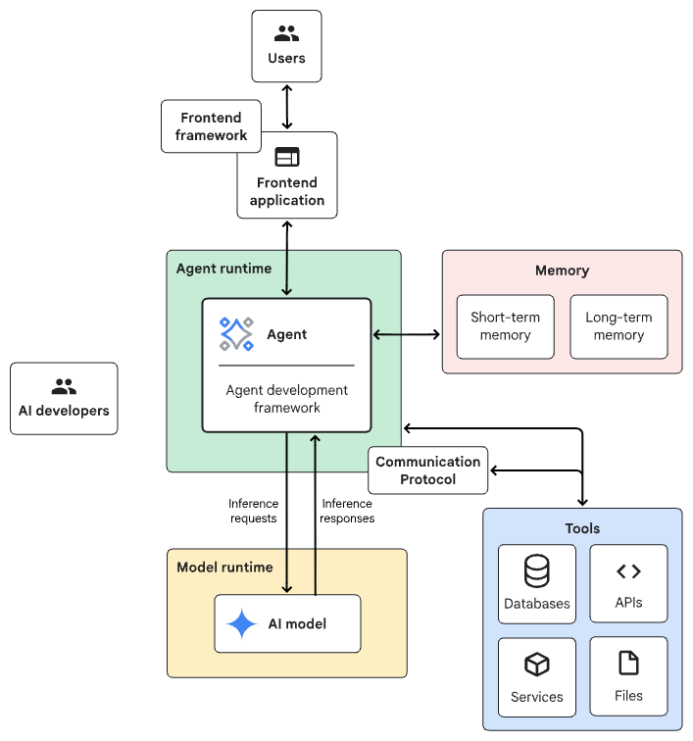
Agentic AI System Architecture
Source: https://docs.cloud.google.com/architecture/choose-agentic-ai-architecture-components

Slide 42
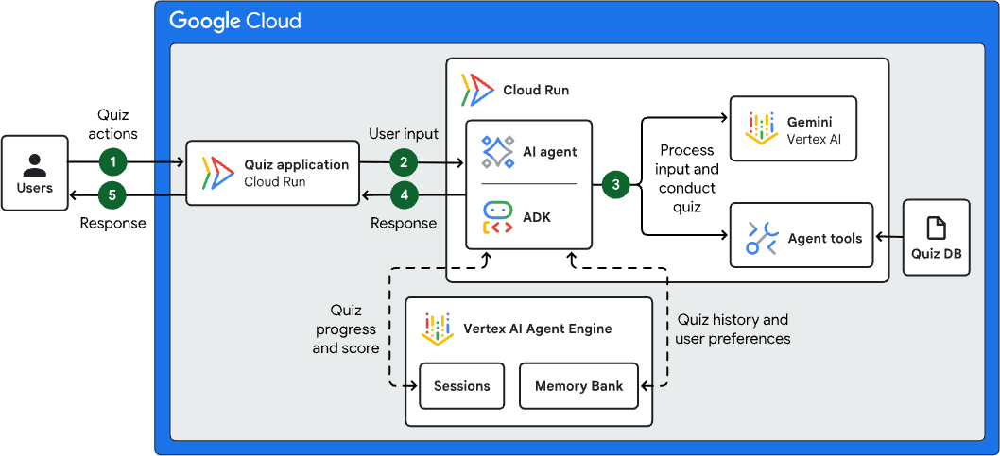
Agentic AI Cloud Architecture: Interactive Learning Agent
Source: https://docs.cloud.google.com/architecture/agentic-ai-interactive-learning

Slide 43
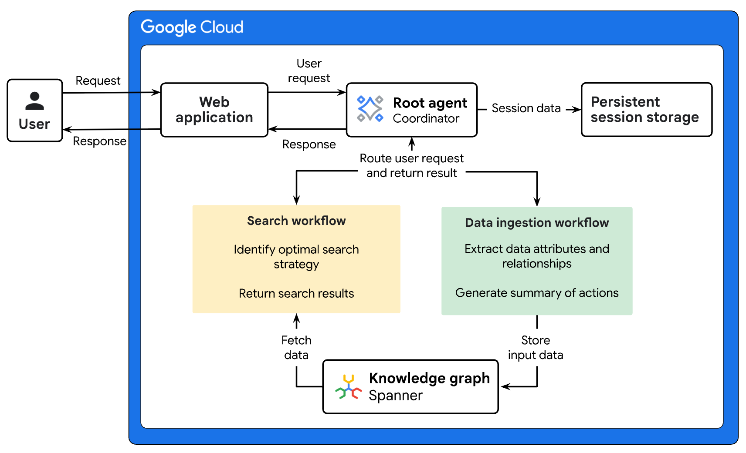
Agentic AI Cloud Architecture: Multi-agent AI System for Multimodal GraphRAG Resource Orchestration
Source: https://docs.cloud.google.com/architecture/agentic-ai-multimodal-graph-rag-resource-orchestration

Slide 44
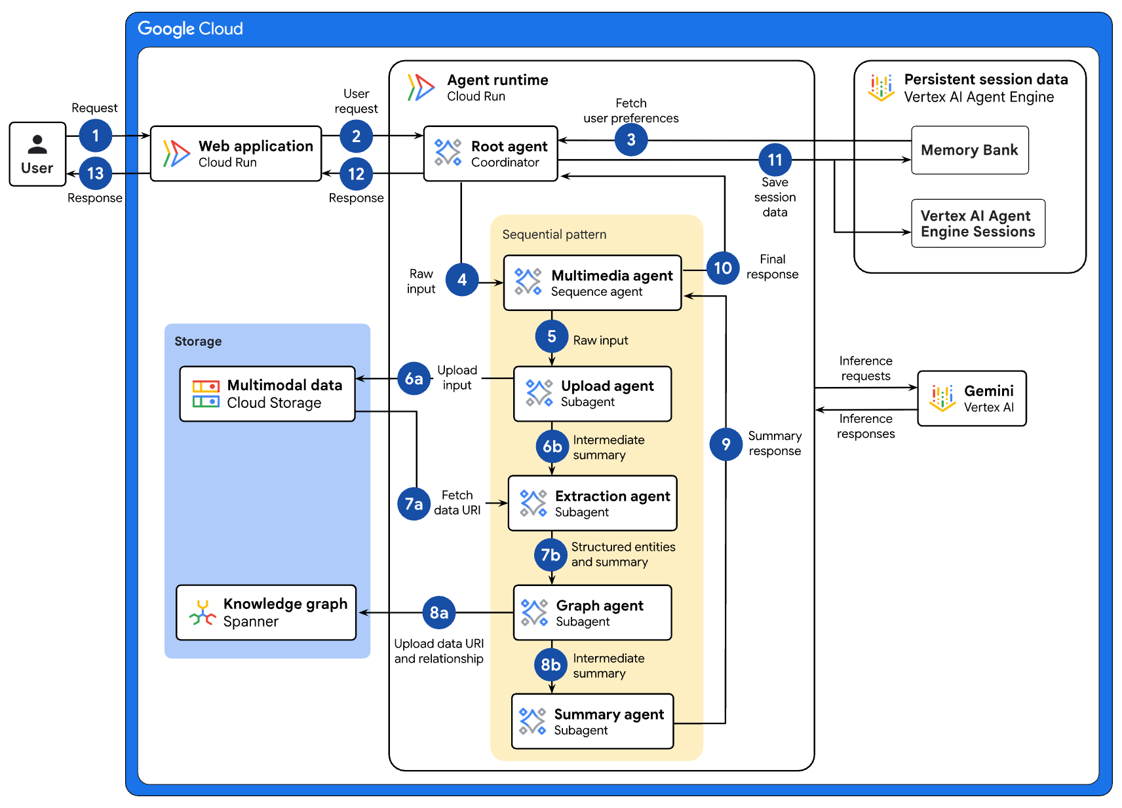
Agentic AI Cloud Architecture: Data Ingestion Workflow for Multimodal GraphRAG Resource Orchestration
Source: https://docs.cloud.google.com/architecture/agentic-ai-multimodal-graph-rag-resource-orchestration

Slide 45
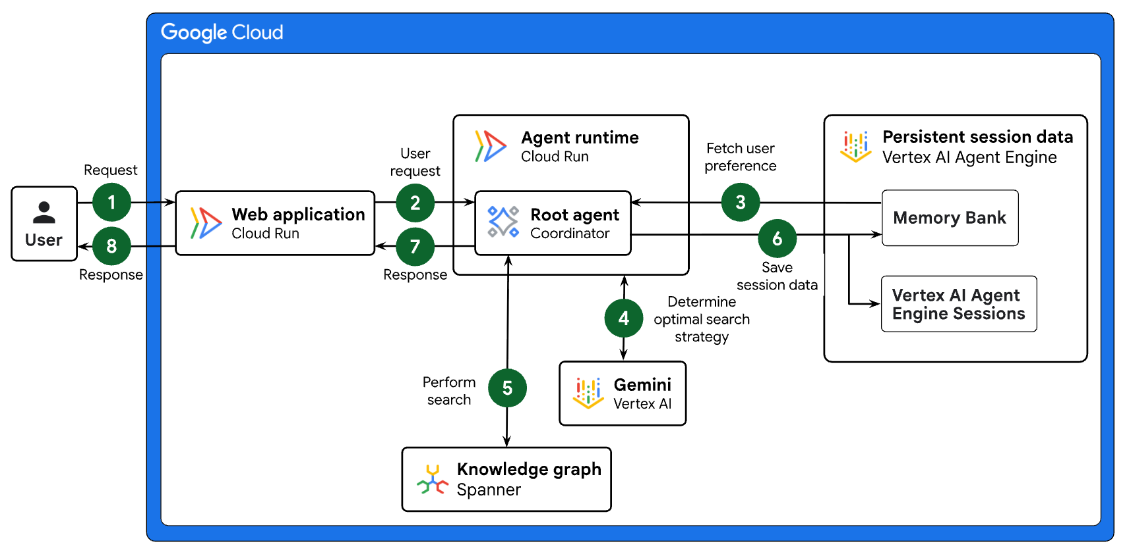
Agentic AI Cloud Architecture: Search Workflow for Multimodal GraphRAG Resource Orchestration
Source: https://docs.cloud.google.com/architecture/agentic-ai-multimodal-graph-rag-resource-orchestration

Slide 46
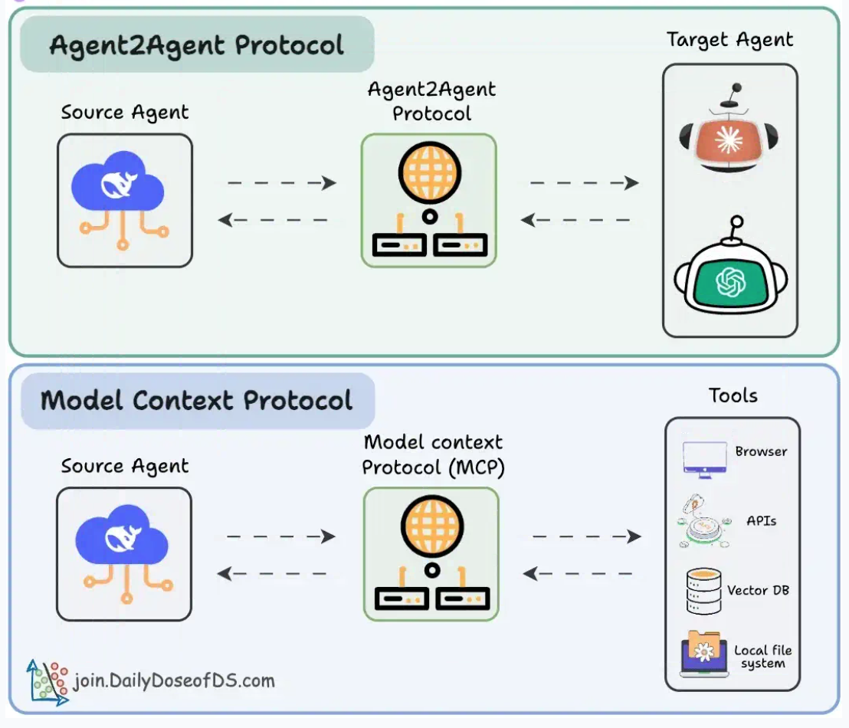
Agentic applications require both A2A and MCP A2A allows agents to connect with other agents and collaborate in teams. MCP provides agents with access to tools
Source: https://blog.dailydoseofds.com/p/a-visual-guide-to-agent2agent-a2a

Slide 47
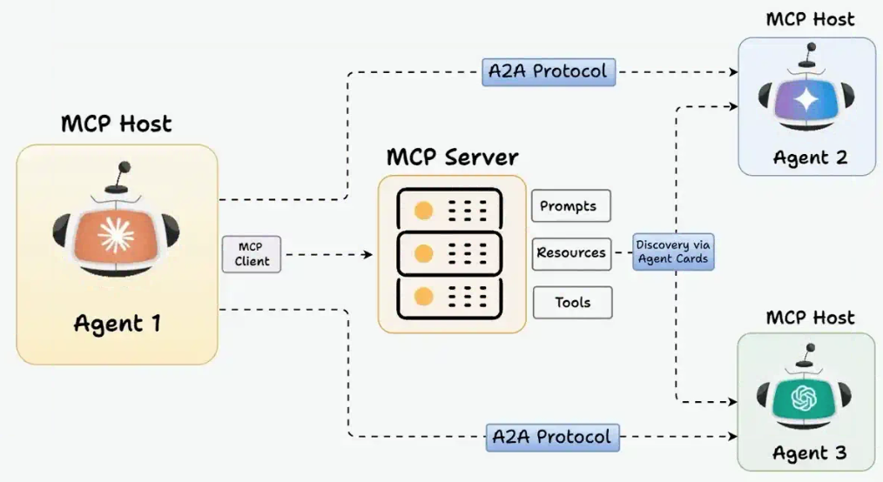
MCP and A2A Protocol for AI Agents
Source: https://blog.dailydoseofds.com/p/a-visual-guide-to-agent2agent-a2a

Slide 48
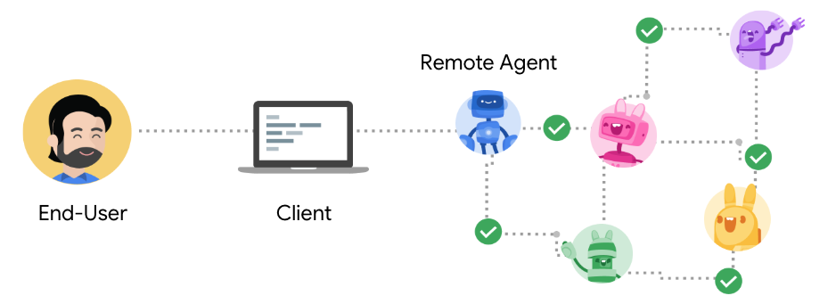
Agent2Agent Protocol (A2A) An open protocol enabling Agent-to-Agent interoperability, bridging the gap between opaque agentic systems
Source: https://google.github.io/A2A/

Slide 49
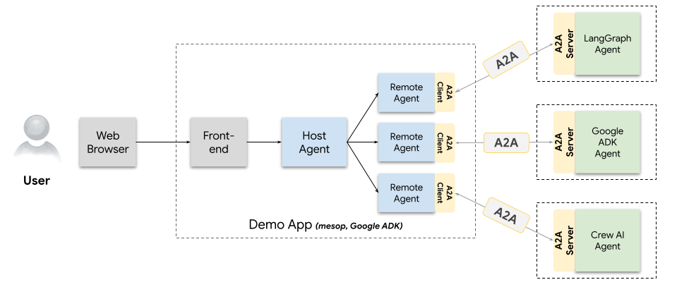
A2A Demo Web App Agents talking to other agents over A2A
Source: https://github.com/google/A2A/blob/main/demo/README.md

Slide 50
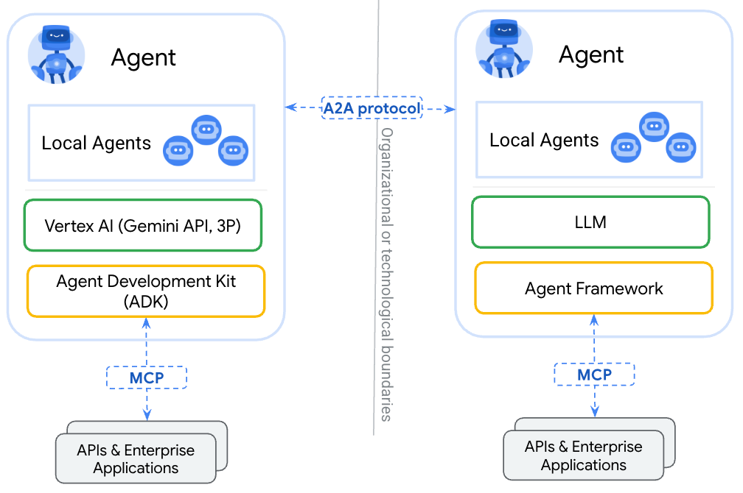
A2A (Agent2Agent Protocol) for agent-agent collaboration MCP (Model Context Protocol) for tools and resources
Source: https://google.github.io/A2A/

Slide 51
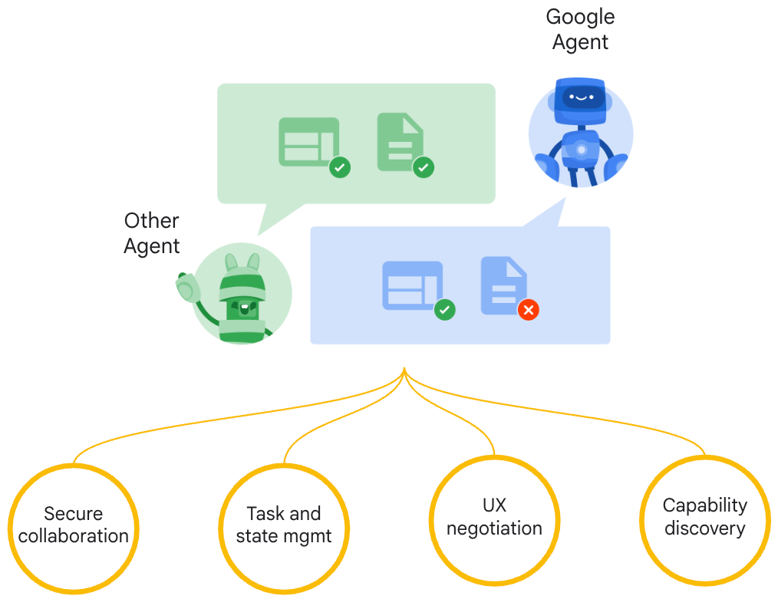
Google A2A (Agent2Agent Protocol)
Seamless Agent Collaboration
Simplifies Enterprise Agent Integration
Supports Key Enterprise Requirements
Source: https://google.github.io/A2A/

Slide 52
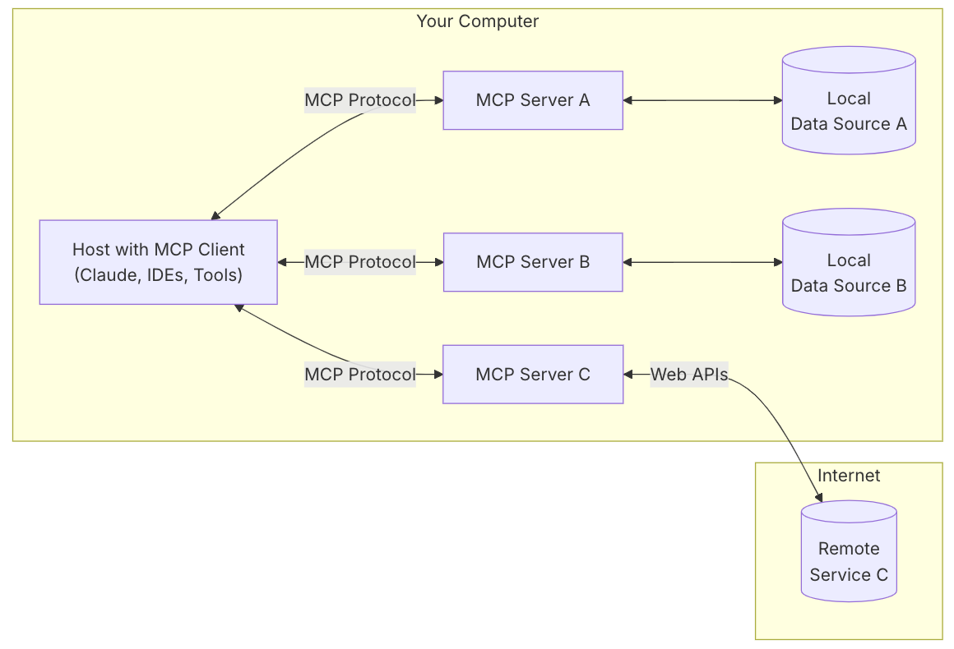
MCP (Model Context Protocol)
MCP is a open protocol that standardizes how applications provide context to LLMs.
MCP: USB-C port for AI applications.
Source: https://modelcontextprotocol.io/introduction

Slide 53
MCP and A2A
MCP (Model Context Protocol) for tools and resources
Connect agents to tools, APIs, and resources with structured inputs/outputs.
Google ADK supports MCP tools. Enabling wide range of MCP servers to be used with agents.
A2A (Agent2Agent Protocol) for agent-agent collaboration
Dynamic, multimodal communication between different agents without sharing memory, resources, and tools
Open standard driven by community.
Samples available using Google ADK, LangGraph, Crew.AI
Source: https://google.github.io/A2A/

Slide 54

Web Application with AWS Core Services

Slide 55
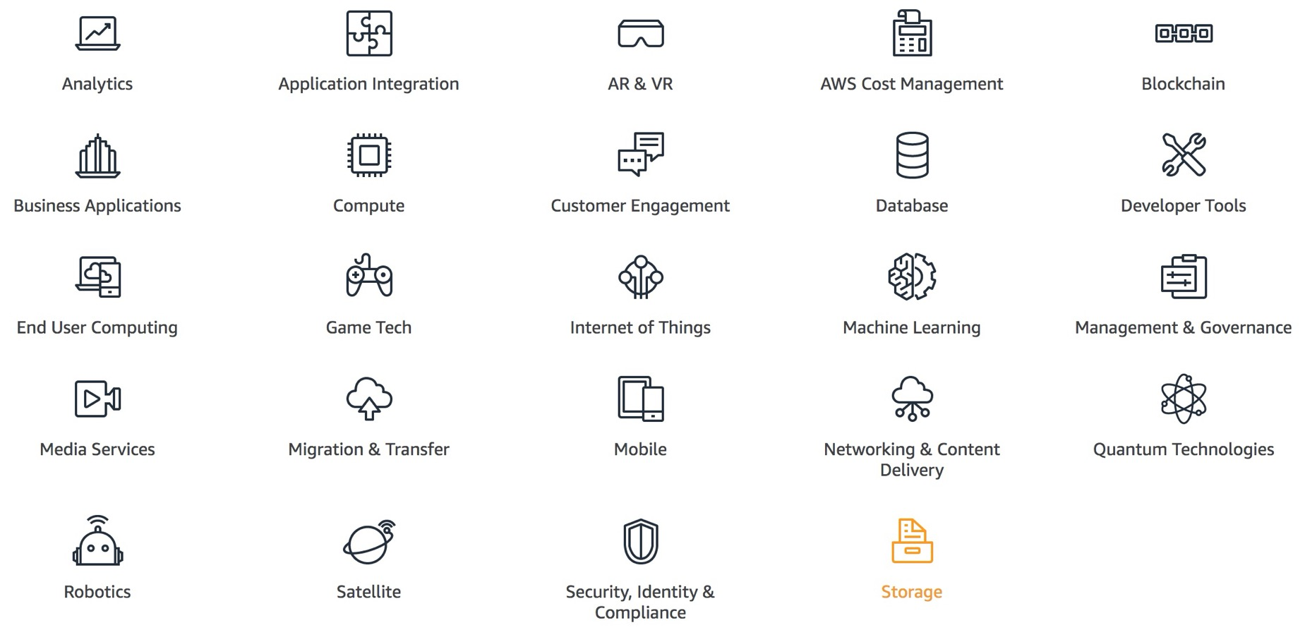
AWS Products and Services
Source: https://aws.amazon.com/

Slide 56
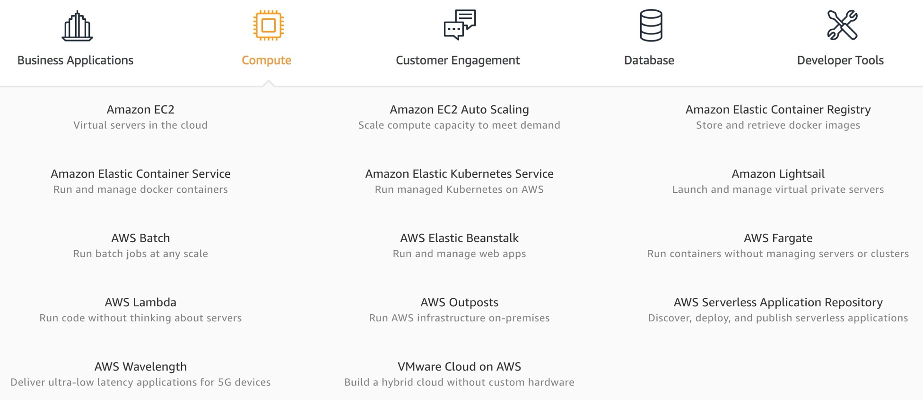
AWS Compute
Source: https://aws.amazon.com/

Slide 57
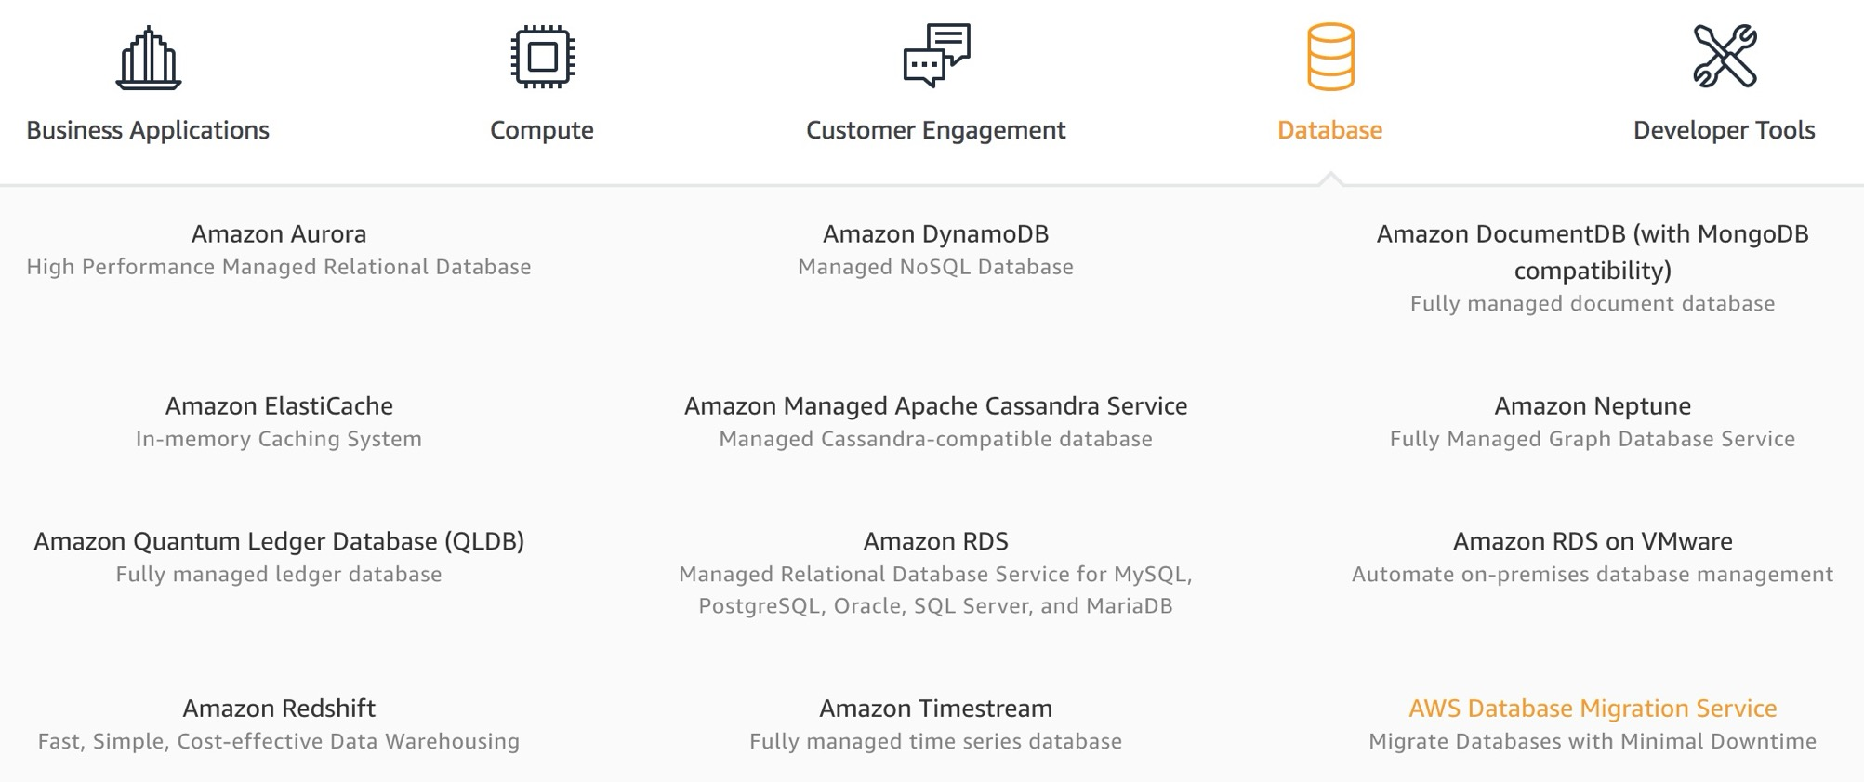
AWS Database
Source: https://aws.amazon.com/

Slide 58
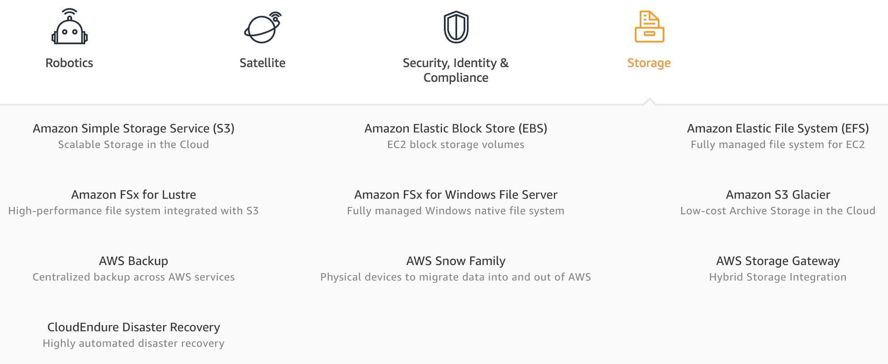
AWS Storage
Source: https://aws.amazon.com/

Slide 59
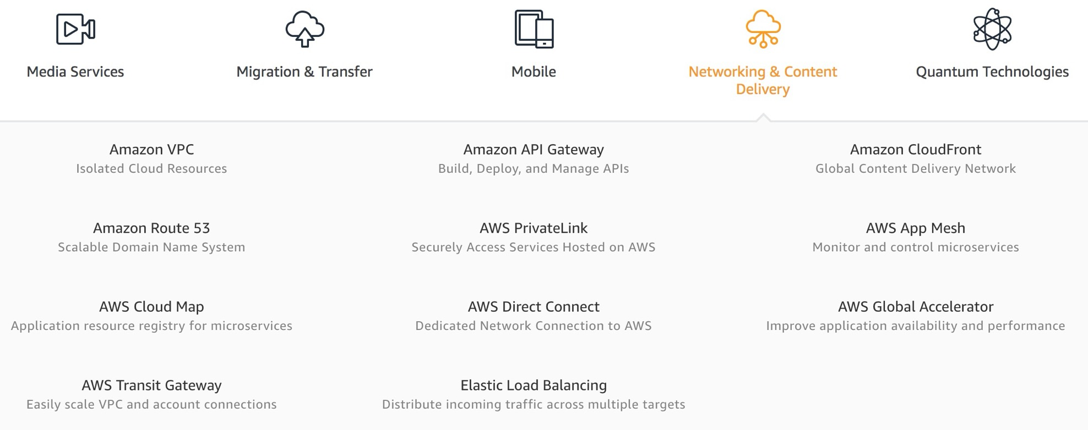
AWS Networking & Content Dilivery
Source: https://aws.amazon.com/

Slide 60
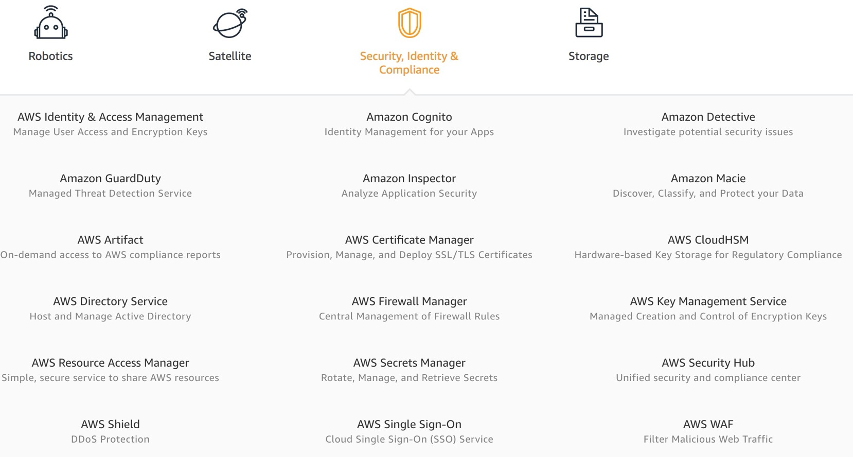
AWS Security, Identity & Compliance
Source: https://aws.amazon.com/

Slide 61
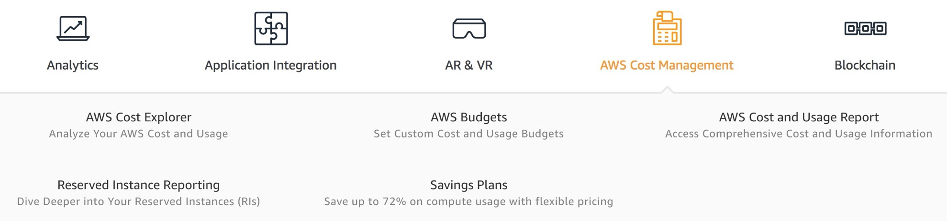
AWS Cost Management
Source: https://aws.amazon.com/

Slide 62
AWS Services
Amazon EC2
Virtual servers in the cloud
Amazon Simple Storage Service (S3)
Scalable storage in the cloud
Amazon Aurora
High performance managed relational database
Amazon DynamoDB
Managed NoSQL database
Amazon RDS
Managed relational database service for MySQL, PostgreSQL, Oracle, SQL Server, and MariaDB
Source: https://aws.amazon.com/

Slide 63
AWS Services
AWS Lambda
Run code without thinking about servers
AWS Elastic Beanstalk
Run and manage web apps
Amazon VPC
Isolated cloud resources
Amazon Lightsail
Launch and manage virtual private servers
Amazon SageMaker
Build, train, and deploy machine learning models at scale
Source: https://aws.amazon.com/

Slide 64
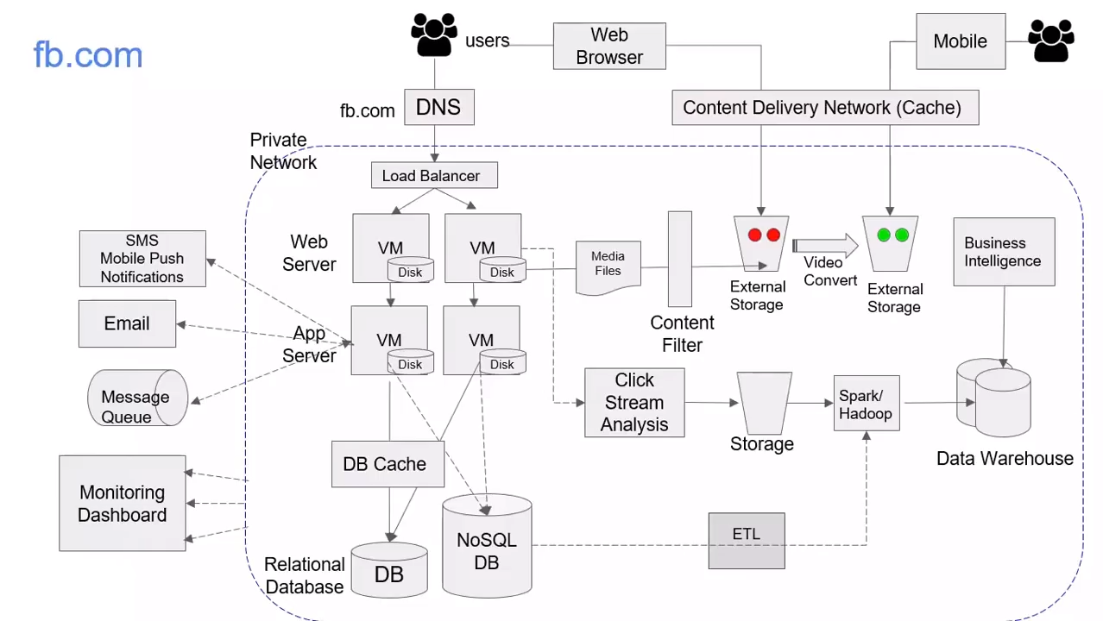
Source: AWS Training Center (2019), Introduction to AWS Services, https://youtu.be/Z3SYDTMP3ME

Slide 65
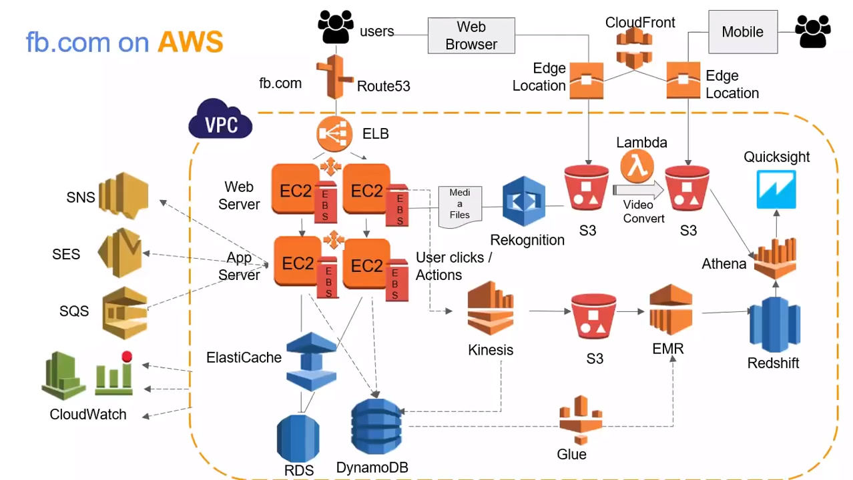
Source: AWS Training Center (2019), Introduction to AWS Services, https://youtu.be/Z3SYDTMP3ME

Slide 66
Source: AWS Training Center (2019), Introduction to AWS Services, https://youtu.be/Z3SYDTMP3ME

Slide 67
Source: AWS Training Center (2019), Introduction to AWS Services, https://youtu.be/Z3SYDTMP3ME

Slide 68
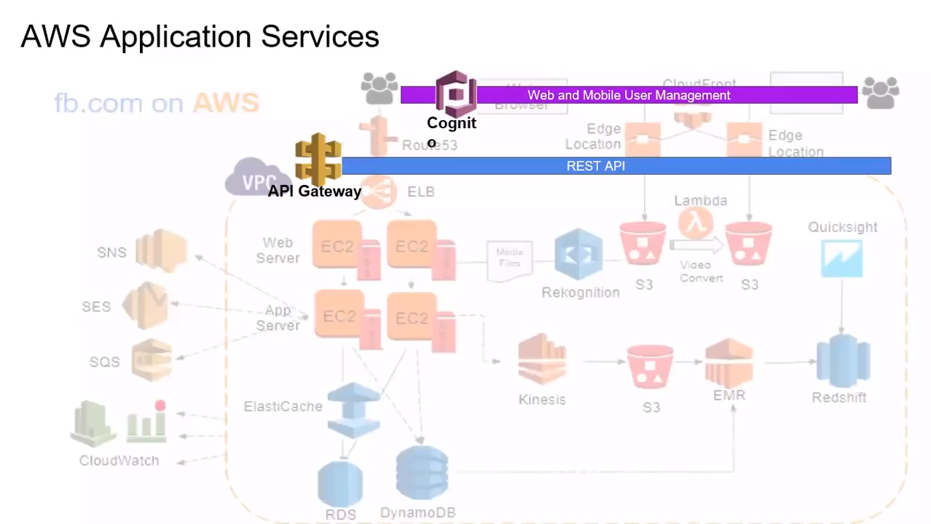
Source: AWS Training Center (2019), Introduction to AWS Services, https://youtu.be/Z3SYDTMP3ME

Slide 69
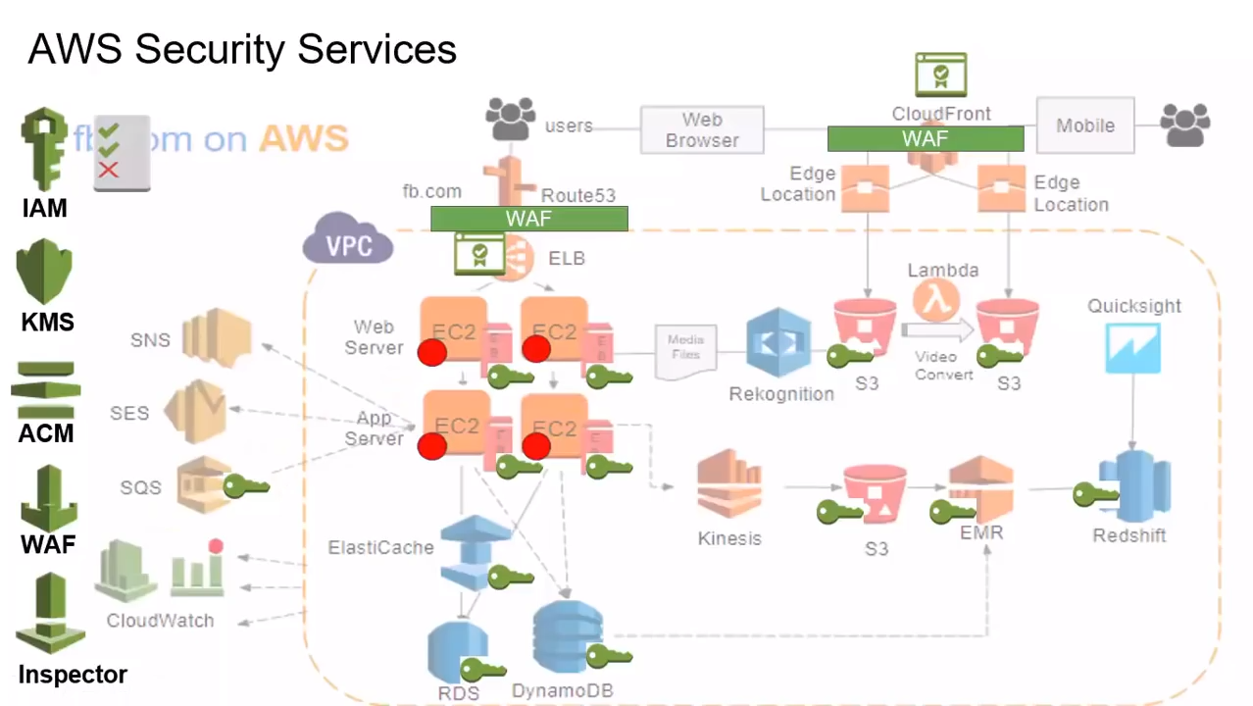
Source: AWS Training Center (2019), Introduction to AWS Services, https://youtu.be/Z3SYDTMP3ME

Slide 70
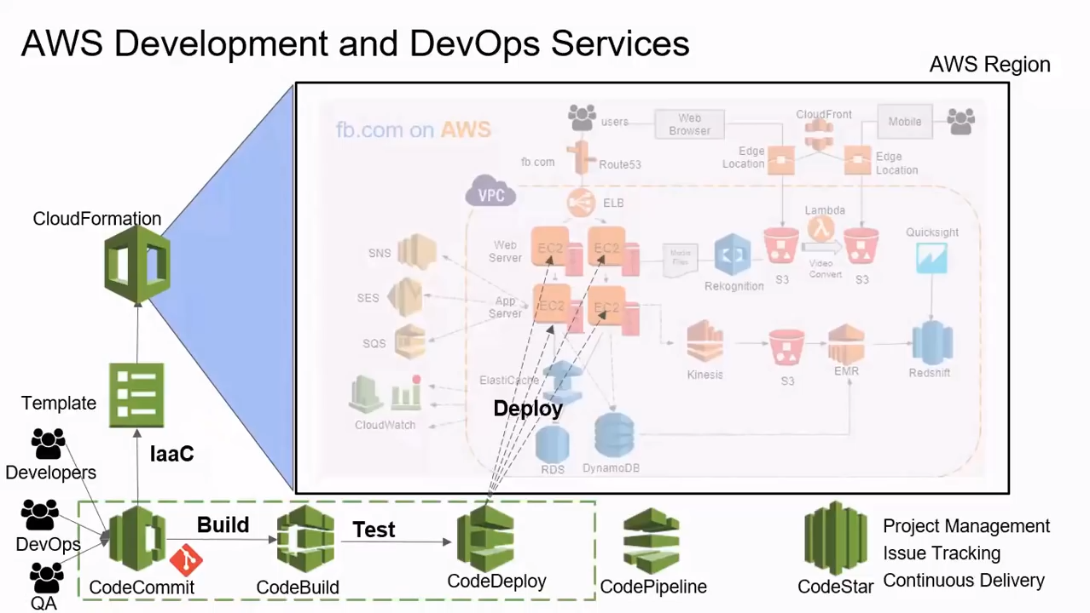
Source: AWS Training Center (2019), Introduction to AWS Services, https://youtu.be/Z3SYDTMP3ME

Slide 71
AWS Serverless Architecture

Slide 72
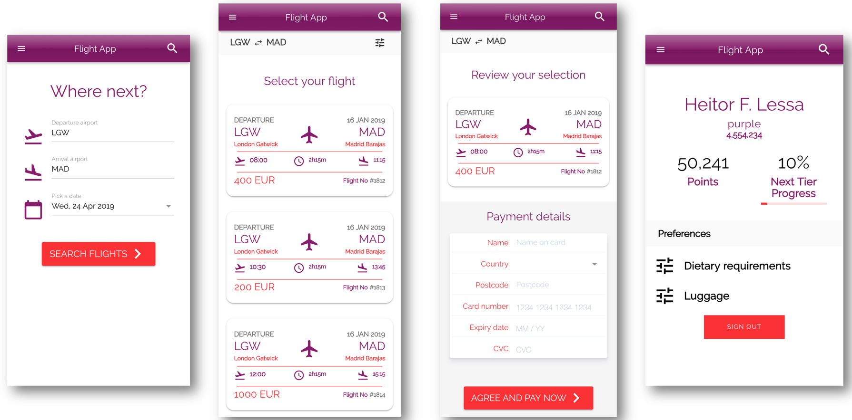
AWS Serverless Airline Booking
Source: https://github.com/aws-samples/aws-serverless-airline-booking

Slide 73
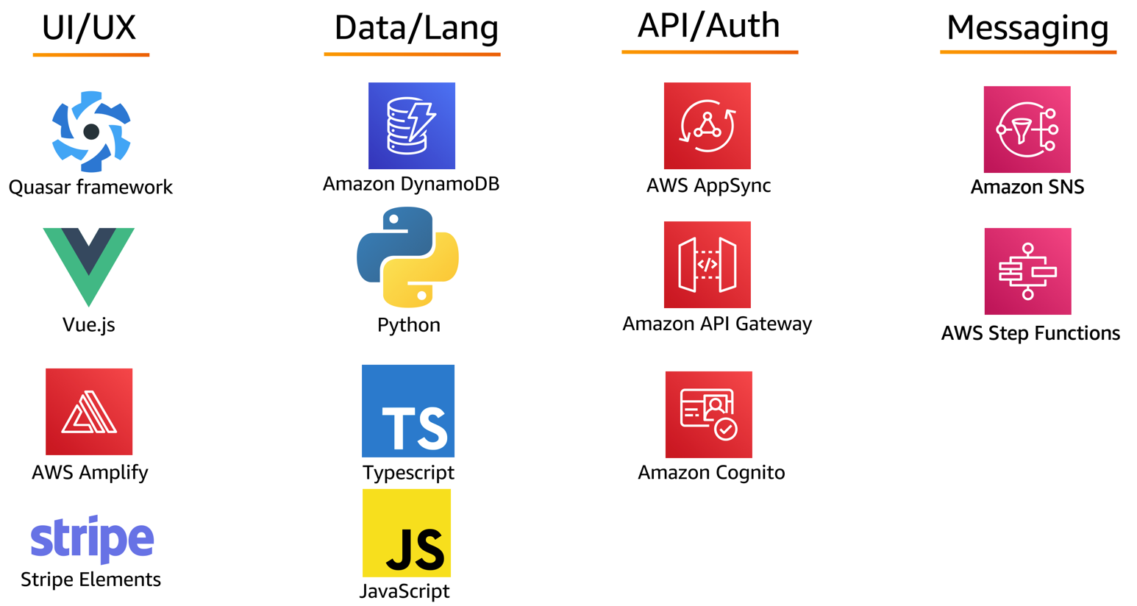
AWS Serverless Airline Booking Stack
Source: https://github.com/aws-samples/aws-serverless-airline-booking

Slide 74
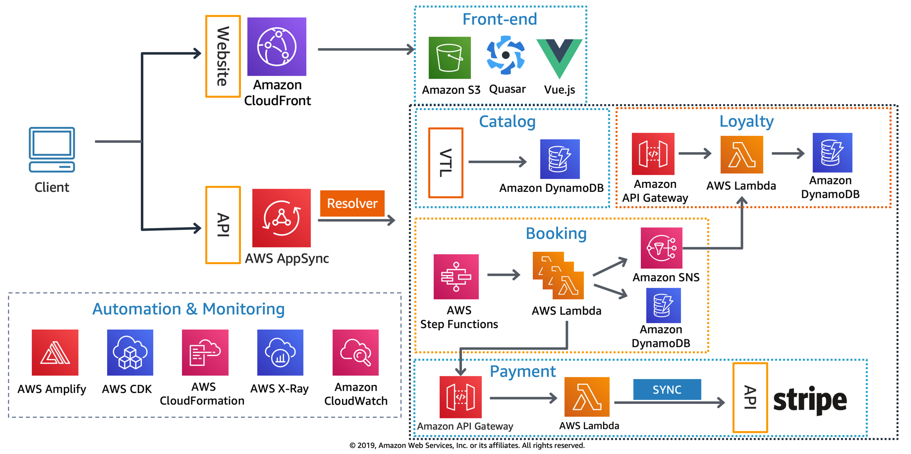
AWS Serverless Airline Booking High level infrastructure architecture
Source: https://github.com/aws-samples/aws-serverless-airline-booking

Slide 75
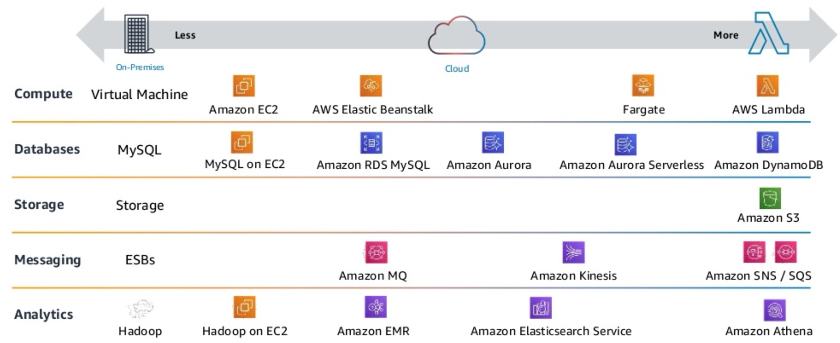
AWS Serverless Architecture AWS Operational Responsibility Models
Source: Heitor Lessa (2019), How to build a full stack serverless airline ticketing web app, https://www.youtube.com/watch?v=MyoOeHTp2pg

Slide 76
Build a Serverless Web Application

Slide 77
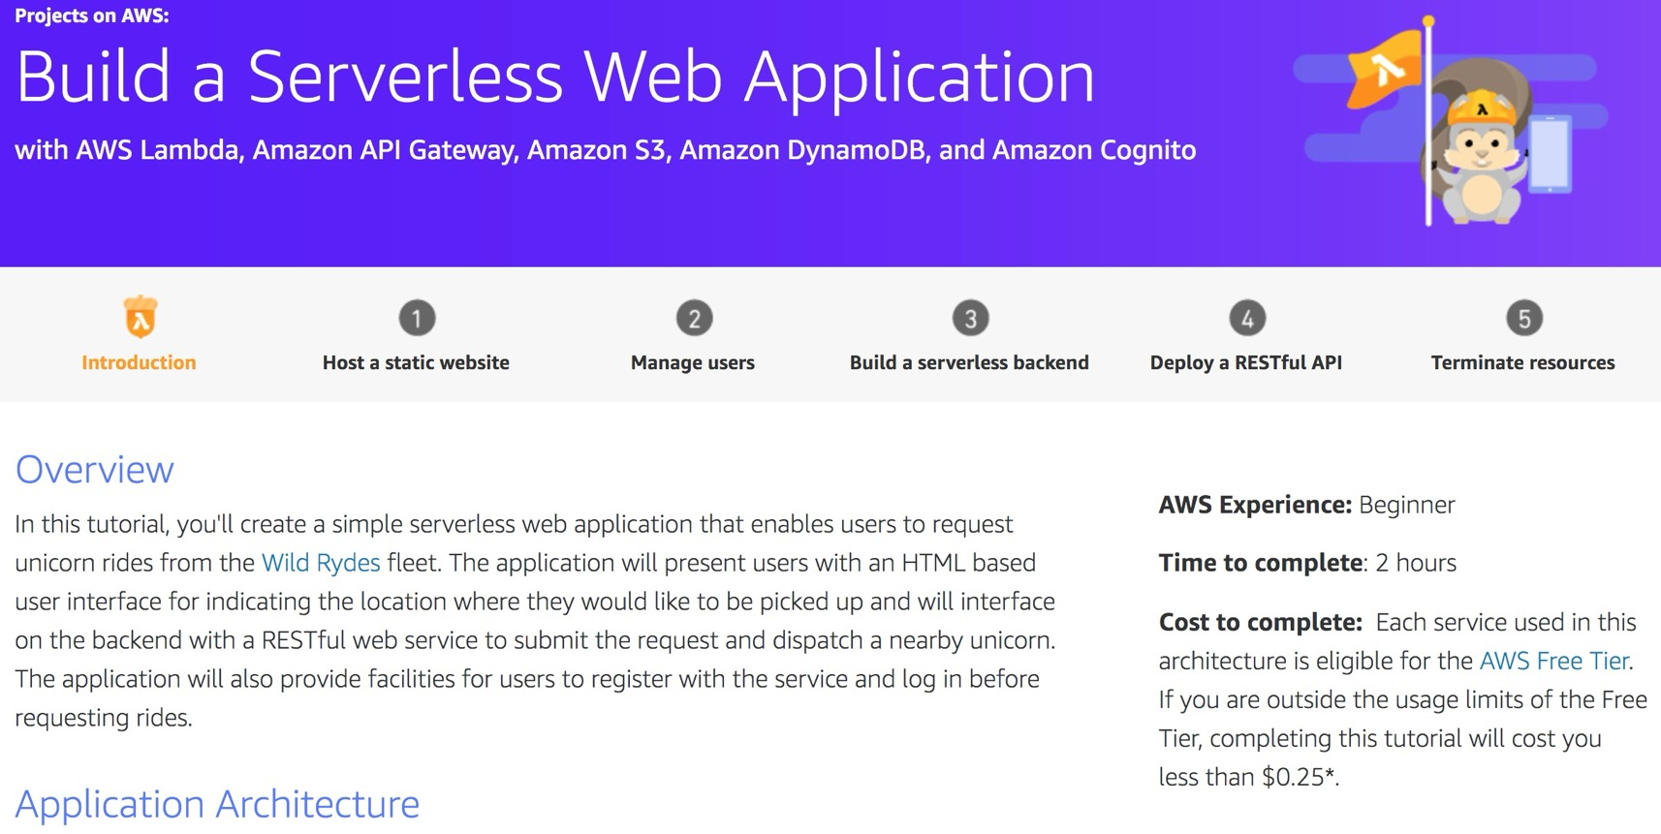
Build a Serverless Web Application
Source: https://aws.amazon.com/getting-started/projects/build-serverless-web-app-lambda-apigateway-s3-dynamodb-cognito/

Slide 78
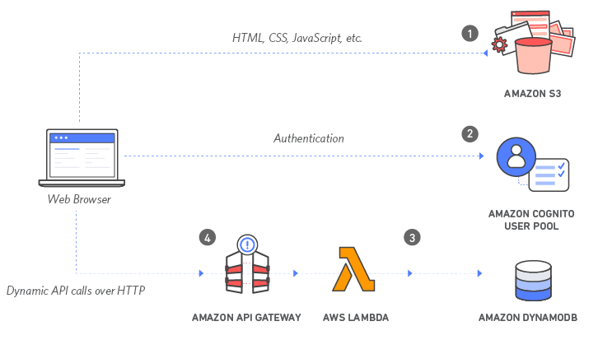
Build a Serverless Web Application with Amazon S3, AWS Lambda, Amazon API Gateway, Amazon DynamoDB, and Amazon Cognito
Source: https://aws.amazon.com/getting-started/projects/build-serverless-web-app-lambda-apigateway-s3-dynamodb-cognito/

Slide 79
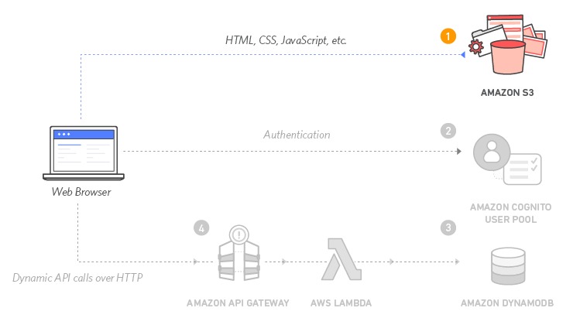
Build a Serverless Web Application with Amazon S3, AWS Lambda, Amazon API Gateway, Amazon DynamoDB, and Amazon Cognito
1
Source: https://aws.amazon.com/getting-started/projects/build-serverless-web-app-lambda-apigateway-s3-dynamodb-cognito/

Slide 80
Build a Serverless Web Application with Amazon S3, AWS Lambda, Amazon API Gateway, Amazon DynamoDB, and Amazon Cognito
1
Static Web Hosting
Amazon S3 hosts static web resources including HTML, CSS, JavaScript, and image files which are loaded in the user's browser.
Source: https://aws.amazon.com/getting-started/projects/build-serverless-web-app-lambda-apigateway-s3-dynamodb-cognito/

Slide 81
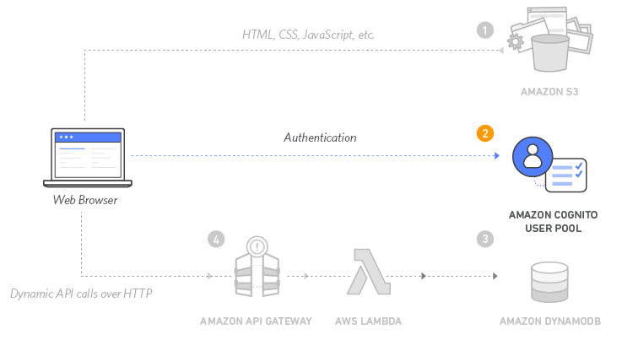
Build a Serverless Web Application with Amazon S3, AWS Lambda, Amazon API Gateway, Amazon DynamoDB, and Amazon Cognito
2
Source: https://aws.amazon.com/getting-started/projects/build-serverless-web-app-lambda-apigateway-s3-dynamodb-cognito/

Slide 82
Build a Serverless Web Application with Amazon S3, AWS Lambda, Amazon API Gateway, Amazon DynamoDB, and Amazon Cognito
2
User Management
Amazon Cognito provides user management and authentication functions to secure the backend API.
Source: https://aws.amazon.com/getting-started/projects/build-serverless-web-app-lambda-apigateway-s3-dynamodb-cognito/

Slide 83
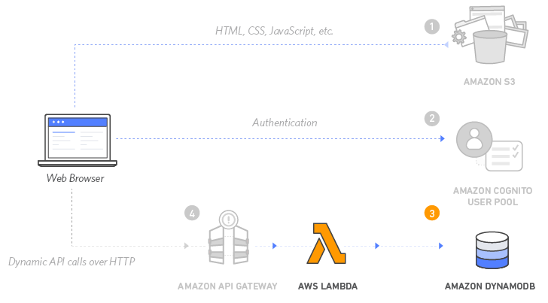
Build a Serverless Web Application with Amazon S3, AWS Lambda, Amazon API Gateway, Amazon DynamoDB, and Amazon Cognito
3
Source: https://aws.amazon.com/getting-started/projects/build-serverless-web-app-lambda-apigateway-s3-dynamodb-cognito/

Slide 84
Build a Serverless Web Application with Amazon S3, AWS Lambda, Amazon API Gateway, Amazon DynamoDB, and Amazon Cognito
3
Serverless Backend
Amazon DynamoDB provides a persistence layer where data can be stored by the API's Lambda function.
Source: https://aws.amazon.com/getting-started/projects/build-serverless-web-app-lambda-apigateway-s3-dynamodb-cognito/

Slide 85
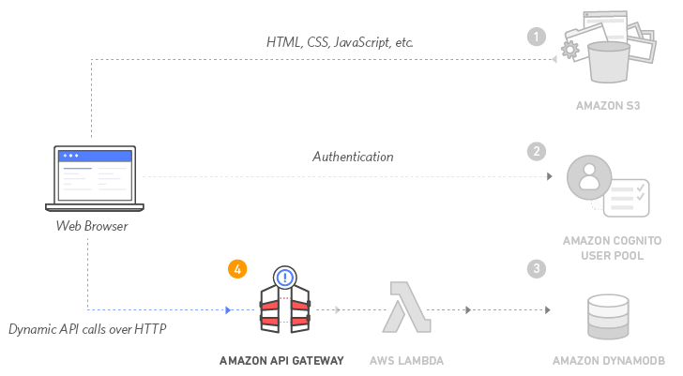
Build a Serverless Web Application with Amazon S3, AWS Lambda, Amazon API Gateway, Amazon DynamoDB, and Amazon Cognito
4
Source: https://aws.amazon.com/getting-started/projects/build-serverless-web-app-lambda-apigateway-s3-dynamodb-cognito/

Slide 86
Build a Serverless Web Application with Amazon S3, AWS Lambda, Amazon API Gateway, Amazon DynamoDB, and Amazon Cognito
4
RESTful API
JavaScript executed in the browser sends and receives data from a public backend API built using Lambda and API Gateway.
Source: https://aws.amazon.com/getting-started/projects/build-serverless-web-app-lambda-apigateway-s3-dynamodb-cognito/

Slide 87
Build a Serverless Web Application with Amazon S3, AWS Lambda, Amazon API Gateway, Amazon DynamoDB, and Amazon Cognito
5
Terminate resources
Resource Cleanup
You will terminate an Amazon S3 bucket, an Amazon Cognito User Pool, an AWS Lambda function, an IAM role, a DynamoDB table, a REST API, and a CloudWatch Log. It is a best practice to delete resources you are no longer using to avoid unwanted charges.
Source: https://aws.amazon.com/getting-started/projects/build-serverless-web-app-lambda-apigateway-s3-dynamodb-cognito/

Slide 88
References
Ian Sommerville (2019), Engineering Software Products: An Introduction to Modern Software Engineering, Pearson.
Ian Sommerville (2015), Software Engineering, 10th Edition, Pearson.
Titus Winters, Tom Manshreck, and Hyrum Wright (2020), Software Engineering at Google: Lessons Learned from Programming Over Time, O'Reilly Media.
Project Management Institute (2021), A Guide to the Project Management Body of Knowledge (PMBOK Guide) – Seventh Edition and The Standard for Project Management, PMI.
Project Management Institute (2017), A Guide to the Project Management Body of Knowledge (PMBOK Guide), Sixth Edition, Project Management Institute.
Project Management Institute (2017), Agile Practice Guide, Project Management Institute.
Nesreen Otoum and Nuha Elkhalili.(2026) "Methods and Techniques of Agentic Software Engineering: A Systematic Literature Review." IEEE Access 14 (2026): 7443-7465.
Lakshana Iruni Assalaarachchi, Zainab Masood, Rashina Hoda, and John Grundy. (2026) "Toward Agentic Software Project Management: A Vision and Roadmap." arXiv preprint arXiv:2601.16392 (2026).
NVIDIA DLI (2026), Building RAG Agents with LLMs, https://learn.nvidia.com/courses/course-detail?course_id=course-v1:DLI+S-FX-15+V1
NVIDIA DLI (2026), Generative AI with Diffusion Models, https://learn.nvidia.com/courses/course-detail?course_id=course-v1:DLI+S-FX-14+V1
NVIDIA DLI (2026), Building Agentic AI Applications with LLMs, https://learn.nvidia.com/courses/course-detail?course_id=course-v1:DLI+S-FX-41+V1

