Slide 1










Microservices Architecture:
RESTful services, Service deployment
Software Engineering
1142SE08
MBA, IM, NTPU (M5010) (Spring 2026)
Wed 2, 3, 4 (9:10-12:00) (B3F17)
University Ambassador
Certified Instructor
Min-Yuh Day, Ph.D,
Professor and Director
Institute of Information Management, National Taipei University
https://web.ntpu.edu.tw/~myday
https://meet.google.com/ish-gzmy-pmo
2026-04-29

Slide 2
Syllabus
Week Date Subject/Topics
1 2026/02/25 Introduction to Software Engineering
2 2026/03/04 Software Products and Project Management:
Software product management and prototyping with
Generative AI and Agentic AI
3 2026/03/11 Agile Software Engineering:
Agile methods, Scrum, and Extreme Programming
4 2026/03/18 Case Study on Software Engineering I
5 2026/03/25 Features, Scenarios, and Stories
6 2026/04/01 Software Architecture: Architectural design,
System decomposition, and Distribution architecture

Slide 3
Syllabus
Week Date Subject/Topics
7 2026/04/08 Cloud-Based Software: Virtualization and containers,
Everything as a service, Software as a service
8 2026/04/15 Midterm Project Report
9 2026/04/22 Cloud Computing and Cloud Software Architecture
10 2026/04/29 Microservices Architecture, RESTful services,
Service deployment
11 2026/05/06 Case Study on Software Engineering II
12 2026/05/13 Security and Privacy; Reliable Programming;
Testing: Functional testing, Test automation,
Test-driven development, and Code reviews

Slide 4
Syllabus
Week Date Subject/Topics
13 2026/05/20 Industry Practices of Software Engineering
14 2026/05/27 DevOps and Code Management:
Code management and DevOps automation
15 2026/06/03 Final Project Report I
16 2026/06/10 Final Project Report II

Slide 5
Microservices Architecture:
RESTful services,
Service deployment

Slide 6
Software Engineering and
Project Management
Analyze
Requirements
definition
Design
System and Software design
Build
Implementation and
unit testing
Test
Integration
and
system testing
Deliver
Operation
and maintenance
Project Management

Slide 7
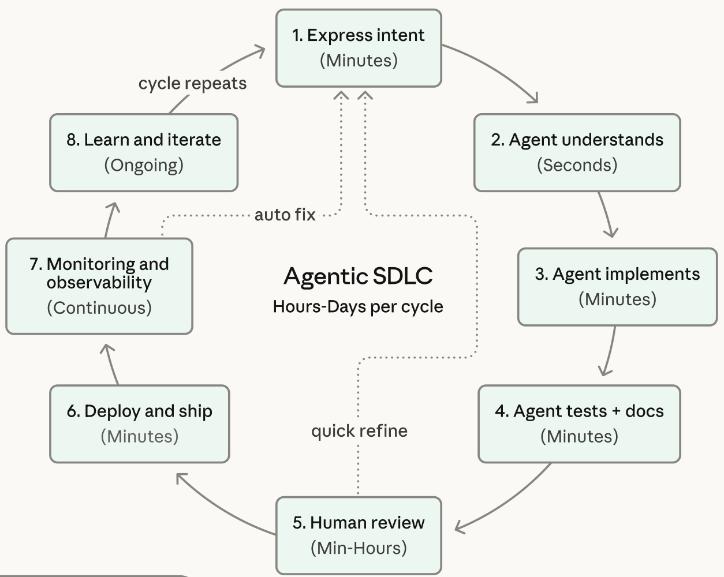
Agentic Coding Software Development Lifecycle

Slide 8
Information Management
Management
Information Systems (MIS)
Information Systems

Slide 9
Information Management (MIS)
Information Systems
Organizations
Technology
Information
Systems
Management

Slide 10
Fundamental MIS Concepts
Business
Challenges
Management
Organization
Information
System
Business
Solutions
Technology

Slide 11
Business Model
8
7
2
4
1
Key
Partners
Key
Activities
Value Proposition
Customer
Relationships
Customer
Segments
6
3
Key
Resources
Channels
9
5
Cost
Structure
Revenue
Streams
Source: Alexander Osterwalder & Yves Pigneur, Business Model Generation: A Handbook for Visionaries, Game Changers, and Challengers, Wiley, 2010.

Slide 12
Project-based software engineering
CUSTOMER
Problem
generates
helps-with
Requirements
implemented-by
Software
1
CUSTOMER and
DEVELOPER
DEVELOPER

Slide 13
Product software engineering
DEVELOPER
Opportunity
1
inspires
realizes
Product features
implemented-by
Software
DEVELOPER
DEVELOPER

Slide 14
Software execution models
Stand-alone execution
Hybrid execution
Software as a service
User’s computer
User’s computer
User’s computer
User interface
Product functionality
User data
User interface
Partial functionality
User data
User interface
(browser or app)
Product updates
Additional functionality
User data backups
Product updates
Product functionality
User data
Vendor’s servers
Vendor’s servers
Vendor’s servers

Slide 15
Product management concerns
Business
needs
Product manager
Technology
constraints
Customer
experience

Slide 16
Technical interactions of product managers
Product
vision management
Product
backlog management
User stories
and
scenarios
Product manager
Acceptance
testing
Customer
testing
User
interface
design

Slide 17
Software Development Life Cycle (SDLC)
The waterfall model
Requirements
definition
System and Software design
Implementation and unit testing
Integration and system testing
Operation and maintenance

Slide 18
Plan-based and Agile development
Plan-based development
Requirements
engineering
Requirements
specification
Design and implementation
Requirements change requests
Agile development
Requirements
engineering
Design and implementation

Slide 19
The Continuum of Life Cycles
High
Incremental
Agile
Frequency of Delivery
Predictive
Iterative
Low
Low
High
Degree of Change

Slide 20
Predictive Life Cycle
Analyze
Design
Build
Test
Deliver

Slide 21
Iterative Life Cycle
Prototype
Refine
Analyze
Analyze
Design
Build
Test
Deliver

Slide 22
A Life Cycle of
Varying-Sized Increments
Analyze
Design
Build
Test
Deliver
Analyze
Design
Build
Test
Deliver
Analyze
Design
Build
Test
Deliver

Slide 23
Iteration-Based and Flow-Based Agile Life Cycles
Iteration-Based Agile
Requirements
Analysis
Design
Build
Test
Requirements
Analysis
Design
Build
Test
Requirements
Analysis
Design
Build
Test
Requirements
Analysis
Design
Build
Test
Repeat
as needed
…
Requirements
Analysis
Design
Build
Test
Requirements
Analysis
Design
Build
Test
Flow-Based Agile
Requirements
Analysis
Design
Build
Test
the number of features in the WIP limit
Requirements
Analysis
Design
Build
Test
the number of features in the WIP limit
Requirements
Analysis
Design
Build
Test
the number of features in the WIP limit
Repeat
as needed
…
Requirements
Analysis
Design
Build
Test
the number of features in the WIP limit
Requirements
Analysis
Design
Build
Test
the number of features in the WIP limit

Slide 24
From personas to features
1
Personas
A way of representing users
inspire
Natural language descriptions of a user interacting with a software product
2
Scenarios
are-developed-into
3
inspire
Stories
Natural language descriptions of something that is needed or wanted by users
4
Features
define
Fragments of product functionality

Slide 25
Multi-tier client-server architecture
Client 1
Client 2
Web
Server
Application
Server
Database
Server
Client 3
Client …

Slide 26
Service-oriented Architecture
Client 1
S1
S2
Client 2
S3
Web
Server
Service
gateway
S4
Client 3
S5
Client …
S6
Services

Slide 27
VM
Container
Virtual
web server
Virtual
mail server
User 1
Container 1
User 2
Container 2
Server
software
Server
software
Application
software
Application
software
Guest
OS
Guest
OS
Server
software
Server
software
Hypervisor
Container manager
Host OS
Host OS
Server Hardware
Server Hardware

Slide 28
Everything as a service
Photo
editing
Software as a service
(SaaS)
Logistics
management
Cloud management
Monitoring
Platform as a service
(PaaS)
Database
Software
development
Storage Network
Infrastructure as a service
(IaaS)
Computing Virtualization
Cloud data center

Slide 29
Software as a service
Software customers
Software
provider
Software services
Cloud Infrastructure
Cloud
provider

Slide 30
Microservices architecture – key design questions
What are the microservices that make up the system?
How should data be distributed and shared?
How should microservices communicate with each other?
Microservices architecture
design
How should the microservices in the system be coordinated?
How should service failure be detected, reported and managed?

Slide 31
Types of security threat
An attacker attempts to deny access to the system for legitimate users
An attacker attempts to damage the system or its data
Availability
threats
Integrity
threats
SOFTWARE PRODUCT
PROGRAM
Distributed denial of service (DDoS) attack
Virus
DATA
Ransomware
Data theft
Confidentiality
threats
An attacker tries to gain access to private information held by the system

Slide 32
Software product quality attributes
Reliability
Availability
1
2
Software product quality attributes
Security
Resilience
7
3
Usability
Maintainability
6
4
Responsiveness
5

Slide 33
A refactoring process
1
2
Start
Identify code
‘smell’
Identify refactoring strategy
4
3
Run automated code tests
Make small
improvement until strategy completed

Slide 34
Functional testing
Start
1
Unit
Testing
4
2
Release
Testing
Feature
Testing
3
System
Testing

Slide 35
Test-driven development (TDD)
Start
1
Identify new
functionality
2
Identify partial implementation
of functionality
3
Write code stub
that will fail test
Functionality
complete
Functionality
incomplete
4
Run all
automated test
7
Refactor code
if required
5
Implement code that should cause failing test to pass
Test failure
6
Run all
automated test
All tests pass

Slide 36
DevOps
Development
Deployment
Support
Multi-skilled DevOps team

Slide 37
Code management and DevOps
DevOps automation
Continuous
integration
Continuous
deployment
Continuous
delivery
Infrastructure
as code
Code management system
Branching and merging
Recover
version
information
Code
repository
Save and
retrieve
versions
Transfer code to/from developer’s filestore
DevOps measurement
Data
collection
Data
analysis
Report
generation

Slide 38
Microservices
Architecture

Slide 39
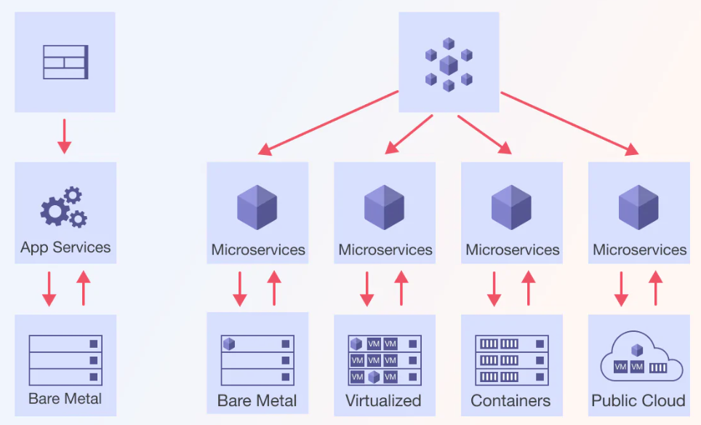
Microservices Architecture
Monolithic Architecture
Microservices Architecture

Slide 40
Agentic AI Microservice Architecture
1
Web client
Browser app
Mobile app
iOS / Android
API gateway
Auth, routing, rate limit
2
REST / JSON
Orchestrator
Agent loop control
Planner
Goal decomposition
Memory service
Short and long term
3
LLM service
Model inference
Tool service
Function execution
RAG service
Retrieve and rerank
4
Redis cache
Sessions, prompts
Postgres
Tasks and audit
Vector DB
Embeddings store
5
Deployment platform
Docker · Kubernetes · Service mesh · CI/CD · Observability

Slide 41
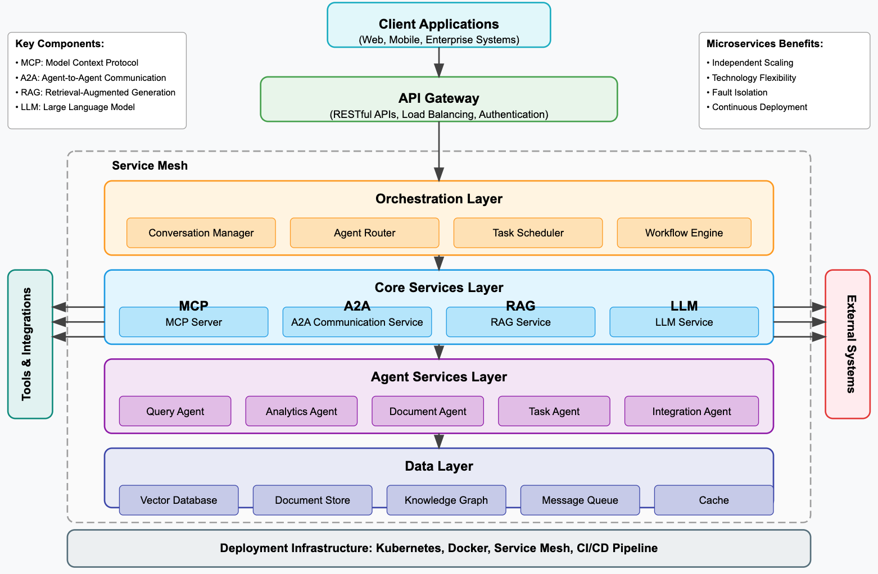
Agentic AI System with Microservices Architecture

Slide 42
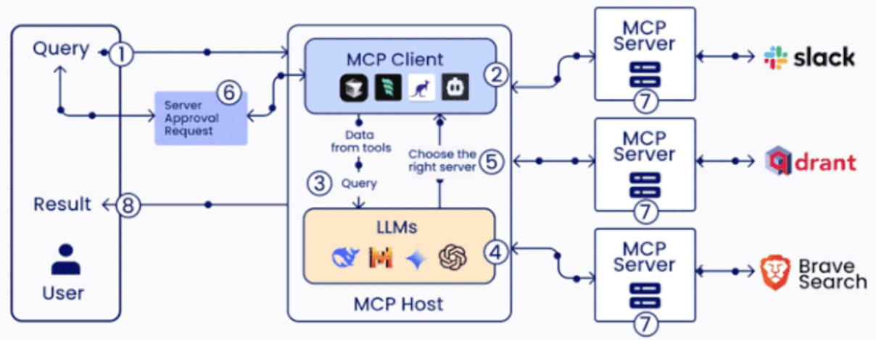
MCP (Model Context Protocol)

Slide 43
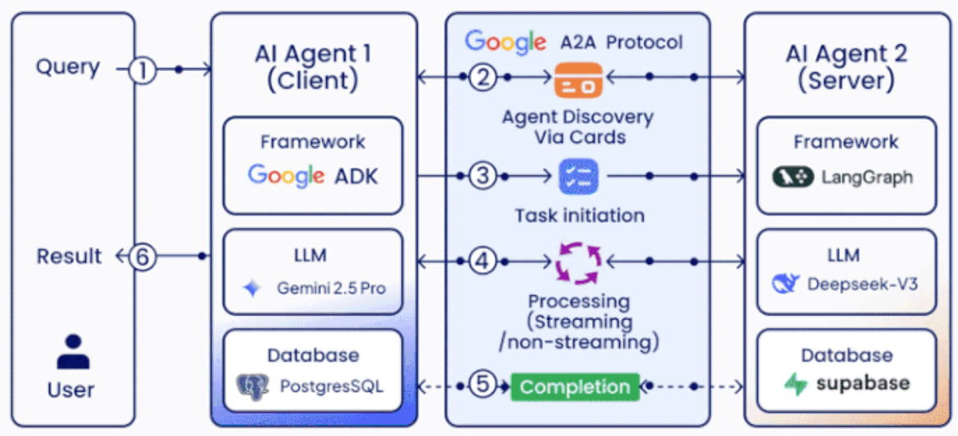
A2A (Agent2Agent Protocol)

Slide 44
Microservices Architecture:
RESTful services,
Service deployment

Slide 45
Outline
Microservices Architecture
RESTful services
Service deployment

Slide 46
Microservices
Architecture

Slide 47
Software services
A software service is a software component that can be accessed from remote computers over the Internet. Given an input, a service produces a corresponding output, without side effects.
  The service is accessed through its published interface and all details of the service implementation are hidden.
  Services do not maintain any internal state.
  State information is either stored in a database or is maintained by the service requestor.

Slide 48
Software services
When a service request is made, the state information may be included as part of the request and the updated state information is returned as part of the service result.
As there is no local state, services can be dynamically reallocated from one virtual server to another and replicated across several servers.

Slide 49
Modern web services
After various experiments in the 1990s with service-oriented computing, the idea of ‘big’ Web Services emerged in the early 2000s.
  These were based on XML-based protocols and standards such as Simple Object Access Protocol (SOAP) for service interaction and Web Service Definition Language (WSDL) for interface description.
  Most software services don’t need the generality that’s inherent in the design of web service protocols.
Consequently, modern service-oriented systems, use simpler, ‘lighter weight’ service-interaction protocols that have lower overheads and, consequently, faster execution.

Slide 50
Microservices
Microservices are small-scale, stateless, services that have a single responsibility. They are combined to create applications.
They are completely independent with their own database and UI management code.
Software products that use microservices have a microservices architecture.
  Create cloud-based software products that are adaptable, scaleable and resilient.

Slide 51
A microservice example
System authentication
  User registration, where users provide information about their identity, security information, mobile (cell) phone number and email address.
  Authentication using UID/password.
  Two-factor authentication using code sent to mobile phone.
  User information management e.g. change password or mobile phone number.
  Reset forgotten password.

Slide 52
A microservice example
System authentication
Each of these features could be implemented as a separate service that uses a central shared database to hold authentication information.
However, these features are too large to be microservices. To identify the microservices that might be used in the authentication system, you need to break down the coarse-grain features into more detailed functions.

Slide 53
Functional breakdown of authentication features
User registration
Authentication using UID/Password
Setup new login ID
Get login ID
Setup new Password
Get Password
Setup Password
recovery information
Check Credentials
Setup Two-factor
authentication
Confirm authentication
Confirm registration

Slide 54
Authentication microservices
UID
management
UID
data
Authentication
Password
management
Password data
User Info
management
User
data

Slide 55
Characteristics of microservices
Self-contained
  Microservices do not have external dependencies. They manage their own data and implement their own user interface.
Lightweight
  Microservices communicate using lightweight protocols.
Implementation-independent
  Microservices may be implemented using different programming languages and may use different technologies in their implementation.
Independently deployable
  Each microservice runs in its own process and is independently deployable, using automated systems.
Business-oriented
  Microservices should implement business capabilities and needs, rather than simply provide a technical service.

Slide 56
Microservice communication
Microservices communicate by exchanging messages.
A message that is sent between services includes some administrative information, a service request and the data required to deliver the requested service.
Services return a response to service request messages.
  An authentication service may send a message to a login service that includes the name input by the user.
  The response may be a token associated with a valid user name or might be an error saying that there is no registered user.

Slide 57
Microservice characteristics
A well-designed microservice should have high cohesion and low coupling.
  Cohesion is a measure of the number of relationships that parts of a component have with each other.
    High cohesion means that all of the parts that are needed to deliver the component’s functionality are included in the component.
  Coupling is a measure of the number of relationships that one component has with other components in the system.
    Low coupling means that components do not have many relationships with other components.

Slide 58
Microservice characteristics
Each microservice should have a single responsibility i.e. it should do one thing only and it should do it well.
  However, ‘one thing only’ is difficult to define in a way that’s applicable to all services.
  Responsibility does not always mean a single, functional activity.

Slide 59
Password management functionality
User functions
Supporting functions
Create password
Check password validity
Change password
Delete password
Check password
Backup password database
Recover password
Recover password database
Check database integrity
Repair database DB

Slide 60
Microservice support code
Microservice X
Service functionality
Message
management
Failure
management
UI
implementation
Data consistency
management

Slide 61
Microservices architecture
A microservices architecture is an architectural style – a tried and tested way of implementing a logical software architecture.
This architectural style addresses two problems with monolithic applications
  The whole system has to be rebuilt, re-tested and re-deployed when any change is made. This can be a slow process as changes to one part of the system can adversely affect other components.
  As the demand on the system increases, the whole system has to be scaled, even if the demand is localized to a small number of system components that implement the most popular system functions.

Slide 62
Benefits of microservices architecture
Microservices are self-contained and run in separate processes.
In cloud-based systems, each microservice may be deployed in its own container. This means a microservice can be stopped and restarted without affecting other parts of the system.
If the demand on a service increases, service replicas can be quickly created and deployed. These do not require a more powerful server so ‘scaling-out’ is, typically, much cheaper than ’scaling up’.

Slide 63
A microservices architecture for a photo printing system
SERVICES
Registration
Authentication
API
gateway
Mobile
App
Upload
Payment
Printing
Despatch

Slide 64
Microservices architecture – key design questions
What are the microservices that make up the system?
How should data be distributed and shared?
How should microservices communicate with each other?
Microservices architecture
design
How should the microservices in the system be coordinated?
How should service failure be detected, reported and managed?

Slide 65
Synchronous and asynchronous microservice interaction
Synchronous –
A waits for B
Asynchronous –
A and B execute concurrently
Service A
Service A
Processing
Waiting
Processing
Processing
Processing
Calls
Requests (B)
Queue B
Queue A
Returns
Requests (A)
Processing
Processing
Processing
Processing
Service B
Service B

Slide 66
Direct and indirect service communication
Direct communication –
A and B send message to each other
Service A
Service B
Indirect communication –
A and B communicate through a message broker
Message broker
Service A
Service B

Slide 67
Microservice data design
You should isolate data within each system service with as little data sharing as possible.
If data sharing is unavoidable, you should design microservices so that most sharing is ‘read-only’, with a minimal number of services responsible for data updates.
If services are replicated in your system, you must include a mechanism that can keep the database copies used by replica services consistent.

Slide 68
Inconsistency management
An ACID (atomicity, consistency, isolation, durability) transaction bundles a set of data updates into a single unit so that either all updates are completed or none of them are.
ACID transactions are impractical in a microservices architecture.
The databases used by different microservices or microservice replicas need not be completely consistent all of the time.

Slide 69
Inconsistency management
Dependent data inconsistency
  The actions or failures of one service can cause the data managed by another service to become inconsistent.
Replica inconsistency
  There are several replicas of the same service that are executing concurrently. These all have their own database copy and each updates its own copy of the service data. You need a way of making these databases ‘eventually consistent’ so that all replicas are working on the same data.

Slide 70
Eventual consistency
Eventual consistency is a situation where the system guarantees that the databases will eventually become consistent.
You can implement eventual consistency by maintaining a transaction log.
When a database change is made, this is recorded on a ‘pending updates’ log.
Other service instances look at this log, update their own database and indicate that they have made the change

Slide 71
Using a pending transaction log
Service A1
Database A
Service A2
Database A
A1/DB update 1
A1/DB update 2
A2/DB update 1
Pending transactions log

Slide 72
Service coordination
Most user sessions involve a series of interactions in which operations have to be carried out in a specific order.
This is called a workflow.
  An authentication workflow for UID/password authentication shows the steps involved in authenticating a user.
  In this example, the user is allowed 3 login attempts before the system indicates that the login has failed.

Slide 73
Authentication workflow
End
attempts > 3
Start
Retry
login
attempts <= 3
Indicate
failure
authfail = F
Increment
attempts
attempts = 1
authfail = F
Get login
Check
login
login invalid
authfail = T
login OK
Get
password
authfail = T
password
invalid
authfail = F
Check
password
password OK
End

Slide 74
Orchestration and Choreography
Service
Orchestration
Service Choreography
Authentication
controller
Login
service
Password
service
Login
service
Password
service
Authentication
events

Slide 75
Failure types in a microservices system
Internal service failure
  These are conditions that are detected by the service and can be reported to the service client in an error message. An example of this type of failure is a service that takes a URL as an input and discovers that this is an invalid link.
External service failure
  These failures have an external cause, which affects the availability of a service. Failure may cause the service to become unresponsive and actions have to be taken to restart the service.
Service performance failure
  The performance of the service degrades to an unacceptable level. This may be due to a heavy load or an internal problem with the service. External service monitoring can be used to detect performance failures and unresponsive services.

Slide 76
Timeouts and circuit breakers
Timeout
  A timeout is a counter that this associated with the service requests and starts running when the request is made.
  Once the counter reaches some predefined value, such as 10 seconds, the calling service assumes that the service request has failed and acts accordingly.
  The problem with the timeout approach is that every service call to a ‘failed service’ is delayed by the timeout value so the whole system slows down.
Circuit breaker
  Instead of using timeouts explicitly when a service call is made
  Like an electrical circuit breaker, this immediately denies access to a failed service without the delays associated with timeouts.

Slide 77
Using a circuit breaker to cope with service failure
Service S1
Service S2
Circuit breaker
Check S2
availability
S2 available
Set
timeout
Route service
request
S2 unavailable
retries <=3
Check
timeout
Response S2
availability
Set S2
unavailable
retries >3
timeout
fail
Increment
retries
Route service
response
timeout OK

Slide 78
RESTful services
The REST (REpresentational State Transfer) architectural style is based on the idea of transferring representations of digital resources from a server to a client.
  You can think of a resource as any chunk of data such as credit card details, an individual’s medical record, a magazine or newspaper, a library catalogue, and so on.
  Resources are accessed via their unique URI and RESTful services operate on these resources.

Slide 79
RESTful services
This is the fundamental approach used in the web where the resource is a page to be displayed in the user’s browser.
  An HTML representation is generated by the server in response to an HTTP GET request and is transferred to the client for display by a browser or a special-purpose app.

Slide 80
RESTful service principles
Use HTTP verbs
  The basic methods defined in the HTTP protocol (GET, PUT, POST, DELETE) must be used to access the operations made available by the service.
Stateless services
  Services must never maintain internal state. As I have already explained, microservices are stateless so fit with this principle.
URI addressable
  All resources must have a URI, with a hierarchical structure, that is used to access sub-resources.
Use XML or JSON
  Resources should normally be represented in JSON or XML or both. Other representations, such as audio and video representations, may be used if appropriate.

Slide 81
RESTful service operations
Create
  Implemented using HTTP POST, which creates the resource with the given URI. If the resource has already been created, an error is returned.
Read
  Implemented using HTTP GET, which reads the resource and returns its value. GET operations should never update a resource so that successive GET operations with no intervening PUT operations always return the same value.
Update
  Implemented using HTTP PUT, which modifies an existing resource. PUT should not be used for resource creation.
Delete
  Implemented using HTTP DELETE, which makes the resource inaccessible using the specified URI. The resource may or may not be physically deleted.

Slide 82
Service operations
Retrieve
  Returns information about a reported incident or incidents. Accessed using the GET verb.
Add
  Adds information about a new incident. Accessed using the POST verb.
Update
  Updates the information about a reported incident. Accessed using the PUT verb.
Delete
  Deletes an incident. The DELETE verb is used when an incident has been cleared.

Slide 83
Road information system
Imagine a system that maintains information about incidents, such as traffic delays, roadworks and accidents on a national road network. This system can be accessed via a browser using the URL:
  https://trafficinfo.net/incidents/
Users can query the system to discover incidents on the roads on which they are planning to travel.

Slide 84
Road information system
When implemented as a RESTful web service, you need to design the resource structure so that incidents are organized hierarchically.
For example, incidents may be recorded according to the road identifier (e.g. A90), the location (e.g. stonehaven), the carriageway direction (e.g. north) and an incident number (e.g. 1). Therefore, each incident can be accessed using its URI:
  https://trafficinfo.net/incidents/A90/stonehaven/north/1

Slide 85
HTTP request and response processing
Microservice
HTTP
request
Request
processing
Service
actions
Response
generation
HTTP
response

Slide 86
HTTP request and response processing
REQUEST
RESPONSE
[HTTP verb]
[URI]
[HTTP version]
[HTTP version]
[Response code]
[Request header]
[Response header]
[Request body]
[Response body]

Slide 87
XML and JSON descriptions
XML
<id>
A90N17061714391
</id>
<date>
20170617
</date>
<time>
1437
</time>
…
<description>Broken-down bus on north carriageway. One lane closed. Expect delays of up to 30 minutes.
</description>
JSON
{
id: “A90N17061714391”,
“date”: “20170617”,
“time”: “1437”,
“road_id”: “A90”,
“place”: “Stonehaven”,
“direction”: “north”,
“severity”: “significant”,
“description”: “Broken-down bus on north carriageway. One lane closed. Expect delays of up to 30 minutes.”
}

Slide 88
Service deployment
After a system has been developed and delivered, it has to be deployed on servers, monitored for problems and updated as new versions become available.
When a system is composed of tens or even hundreds of microservices, deployment of the system is more complex than for monolithic systems.
The service development teams decide which programming language, database, libraries and other support software should be used to implement their service. Consequently, there is no ‘standard’ deployment configuration for all services.

Slide 89
Service deployment
It is now normal practice for microservice development teams to be responsible for deployment and service management as well as software development and to use continuous deployment.
Continuous deployment means that as soon as a change to a service has been made and validated, the modified service is redeployed.

Slide 90
Deployment automation
Continuous deployment depends on automation so that as soon as a change is committed, a series of automated activities is triggered to test the software.
If the software ‘passes’ these tests, it then enters another automation pipeline that packages and deploys the software.
The deployment of a new service version starts with the programmer committing the code changes to a code management system such as Git.

Slide 91
Deployment automation
This triggers a set of automated tests that run using the modified service.
  If all service tests run successfully, a new version of the system that incorporates the changed service is created.
Another set of automated system tests are then executed.
  If these run successfully, the service is ready for deployment.

Slide 92
A continuous deployment pipeline
Commit change to version management
Reject change
Reject change
Reject change
Triggers
fail
fail
fail
Run unit
tests
pass
Built test
system
pass
Run integration
tests
pass
pass
Containerize
service
Deploy service
container
Run acceptance
tests
Replace current
service
fail
Reject change

Slide 93
Versioned services
Service
monitor
Monitor
response
Service request from cameras service
service
response
API
gateway
Current
version link
cameras
cameras 002
cameras service
response
cameras 001

Slide 94
Summary
A microservice is an independent and self-contained software component that runs in its own process and communicates with other microservices using lightweight protocols.
Microservices in a system can be implemented using different programming languages and database technologies.
Microservices have a single responsibility and should be designed so that they can be easily changed without having to change other microservices in the system.

Slide 95
Summary
Microservices architecture is an architectural style in which the system is constructed from communicating microservices. It is well-suited to cloud based systems where each microservice can run in its own container.
The two most important responsibilities of architects of a microservices system are to decide how to structure the system into microservices and to decide how microservices should communicate and be coordinated.

Slide 96
Summary
Communication and coordination decisions include deciding on microservice communication protocols, data sharing, whether services should be centrally coordinated, and failure management.
The RESTful architectural style is widely used in microservice-based systems. Services are designed so that the HTTP verbs, GET, POST, PUT and DELETE, map onto the service operations.
The RESTful style is based on digital resources that, in a microservices architecture, may be represented using XML or, more commonly, JSON.

Slide 97
Summary
Continuous deployment is a process where new versions of a service are put into production as soon as a service change has been made. It is a completely automated process that relies on automated testing to check that the new version is of ‘production quality’.
If continuous deployment is used, you may need to maintain multiple versions of deployed services so that you can switch to an older version if problems are discovered in a newly-deployed service.

Slide 98
References
Ian Sommerville (2019), Engineering Software Products: An Introduction to Modern Software Engineering, Pearson.
Ian Sommerville (2015), Software Engineering, 10th Edition, Pearson.
Titus Winters, Tom Manshreck, and Hyrum Wright (2020), Software Engineering at Google: Lessons Learned from Programming Over Time, O'Reilly Media.
Project Management Institute (2021), A Guide to the Project Management Body of Knowledge (PMBOK Guide) – Seventh Edition and The Standard for Project Management, PMI.
Project Management Institute (2017), A Guide to the Project Management Body of Knowledge (PMBOK Guide), Sixth Edition, Project Management Institute.
Project Management Institute (2017), Agile Practice Guide, Project Management Institute.
Nesreen Otoum and Nuha Elkhalili.(2026) "Methods and Techniques of Agentic Software Engineering: A Systematic Literature Review." IEEE Access 14 (2026): 7443-7465.
Lakshana Iruni Assalaarachchi, Zainab Masood, Rashina Hoda, and John Grundy. (2026) "Toward Agentic Software Project Management: A Vision and Roadmap." arXiv preprint arXiv:2601.16392 (2026).
NVIDIA DLI (2026), Building RAG Agents with LLMs,
https://learn.nvidia.com/courses/course-detail?course_id=course-v1:DLI+S-FX-15+V1
NVIDIA DLI (2026), Generative AI with Diffusion Models,
https://learn.nvidia.com/courses/course-detail?course_id=course-v1:DLI+S-FX-14+V1
NVIDIA DLI (2026), Building Agentic AI Applications with LLMs,
https://learn.nvidia.com/courses/course-detail?course_id=course-v1:DLI+S-FX-41+V1

