Slide 1



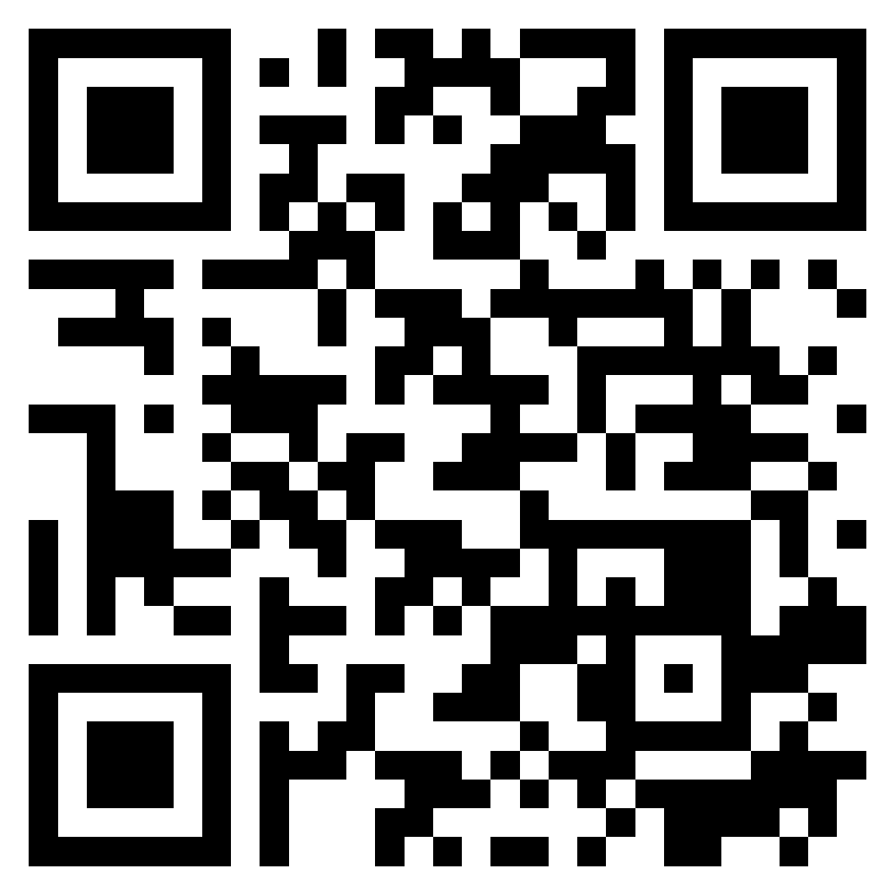






Security and Privacy; Reliable Programming;
Testing: Test-driven development, and Code reviews
Software Engineering
1142SE09
MBA, IM, NTPU (M5010) (Spring 2026)
Wed 2, 3, 4 (9:10-12:00) (B3F17)
University Ambassador
Certified Instructor
Min-Yuh Day, Ph.D,
Professor and Director
Institute of Information Management, National Taipei University
https://web.ntpu.edu.tw/~myday
https://meet.google.com/ish-gzmy-pmo
2026-05-13

Slide 2
Syllabus
Week Date Subject/Topics
1 2026/02/25 Introduction to Software Engineering
2 2026/03/04 Software Products and Project Management:
Software product management and prototyping with
Generative AI and Agentic AI
3 2026/03/11 Agile Software Engineering:
Agile methods, Scrum, and Extreme Programming
4 2026/03/18 Case Study on Software Engineering I
5 2026/03/25 Features, Scenarios, and Stories
6 2026/04/01 Software Architecture: Architectural design,
System decomposition, and Distribution architecture

Slide 3
Syllabus
Week Date Subject/Topics
7 2026/04/08 Cloud-Based Software: Virtualization and containers,
Everything as a service, Software as a service
8 2026/04/15 Midterm Project Report
9 2026/04/22 Cloud Computing and Cloud Software Architecture
10 2026/04/29 Microservices Architecture, RESTful services,
Service deployment
11 2026/05/06 Case Study on Software Engineering II
12 2026/05/13 Security and Privacy; Reliable Programming;
Testing: Functional testing, Test automation,
Test-driven development, and Code reviews

Slide 4
Syllabus
Week Date Subject/Topics
13 2026/05/20 Industry Practices of Software Engineering
[Invited Talk: Agentic AI and Development Trends in Human–AI Collaborative Applications,
Invited Speaker: Shihyu (Alex) Chu, Industry Consultant / Section Manager,
Software Industry Research Center, Market Intelligence & Consulting Institute (MIC)]
14 2026/05/27 DevOps and Code Management:
Code management and DevOps automation
15 2026/06/03 Final Project Report I
16 2026/06/10 Final Project Report II

Slide 5
Security and Privacy;
Reliable Programming;
Testing:
Test-driven development, and Code reviews;

Slide 6
Software Engineering and
Project Management
Analyze
Requirements
definition
Design
System and Software design
Build
Implementation and
unit testing
Test
Integration
and
system testing
Deliver
Operation
and maintenance
Project Management

Slide 7
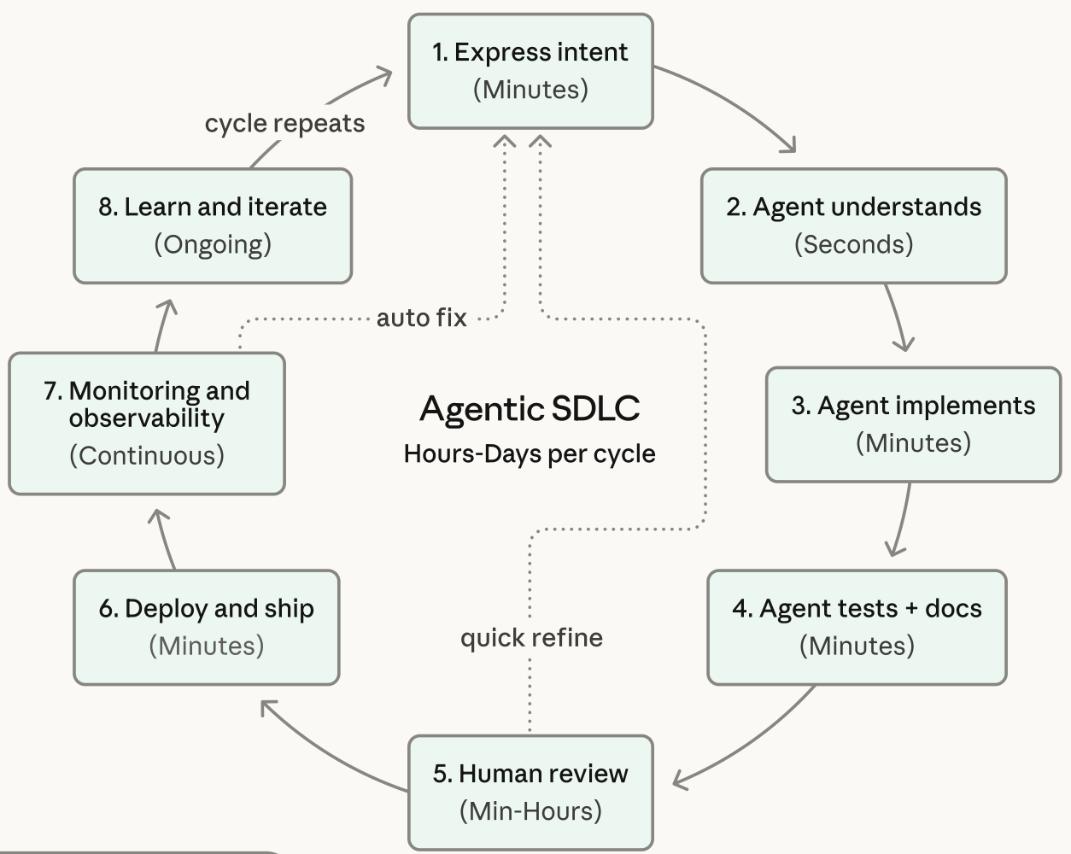
Agentic Coding Software Development Lifecycle

Slide 8
Information Management
Management
Information Systems (MIS)
Information Systems

Slide 9
Information Management (MIS)
Information Systems
Organizations
Technology
Information
Systems
Management

Slide 10
Fundamental MIS Concepts
Business
Challenges
Management
Organization
Information
System
Business
Solutions
Technology

Slide 11
Business Model
8
7
2
4
1
Key
Partners
Key
Activities
Value Proposition
Customer
Relationships
Customer
Segments
6
3
Key
Resources
Channels
9
5
Cost
Structure
Revenue
Streams
Source: Alexander Osterwalder & Yves Pigneur, Business Model Generation: A Handbook for Visionaries, Game Changers, and Challengers, Wiley, 2010.

Slide 12
Project-based software engineering
CUSTOMER
Problem
generates
helps-with
Requirements
implemented-by
Software
1
CUSTOMER and
DEVELOPER
DEVELOPER

Slide 13
Product software engineering
DEVELOPER
Opportunity
1
inspires
realizes
Product features
implemented-by
Software
DEVELOPER
DEVELOPER

Slide 14
Software execution models
Stand-alone execution
Hybrid execution
Software as a service
User’s computer
User’s computer
User’s computer
User interface
Product functionality
User data
User interface
Partial functionality
User data
User interface
(browser or app)
Product updates
Additional functionality
User data backups
Product updates
Product functionality
User data
Vendor’s servers
Vendor’s servers
Vendor’s servers

Slide 15
Product management concerns
Business
needs
Product manager
Technology
constraints
Customer
experience

Slide 16
Technical interactions of product managers
Product
vision management
Product
backlog management
User stories
and
scenarios
Product manager
Acceptance
testing
Customer
testing
User
interface
design

Slide 17
Software Development Life Cycle (SDLC)
The waterfall model
Requirements
definition
System and Software design
Implementation and unit testing
Integration and system testing
Operation and maintenance

Slide 18
Plan-based and Agile development
Plan-based development
Requirements
engineering
Requirements
specification
Design and implementation
Requirements change requests
Agile development
Requirements
engineering
Design and implementation

Slide 19
The Continuum of Life Cycles
High
Incremental
Agile
Frequency of Delivery
Predictive
Iterative
Low
Low
High
Degree of Change

Slide 20
Predictive Life Cycle
Analyze
Design
Build
Test
Deliver

Slide 21
Iterative Life Cycle
Prototype
Refine
Analyze
Analyze
Design
Build
Test
Deliver

Slide 22
A Life Cycle of
Varying-Sized Increments
Analyze
Design
Build
Test
Deliver
Analyze
Design
Build
Test
Deliver
Analyze
Design
Build
Test
Deliver

Slide 23
Iteration-Based and Flow-Based Agile Life Cycles
Iteration-Based Agile
Requirements
Analysis
Design
Build
Test
Requirements
Analysis
Design
Build
Test
Requirements
Analysis
Design
Build
Test
Requirements
Analysis
Design
Build
Test
Repeat
as needed
…
Requirements
Analysis
Design
Build
Test
Requirements
Analysis
Design
Build
Test
Flow-Based Agile
Requirements
Analysis
Design
Build
Test
the number of features in the WIP limit
Requirements
Analysis
Design
Build
Test
the number of features in the WIP limit
Requirements
Analysis
Design
Build
Test
the number of features in the WIP limit
Repeat
as needed
…
Requirements
Analysis
Design
Build
Test
the number of features in the WIP limit
Requirements
Analysis
Design
Build
Test
the number of features in the WIP limit

Slide 24
From personas to features
1
Personas
A way of representing users
inspire
Natural language descriptions of a user interacting with a software product
2
Scenarios
are-developed-into
3
inspire
Stories
Natural language descriptions of something that is needed or wanted by users
4
Features
define
Fragments of product functionality

Slide 25
Multi-tier client-server architecture
Client 1
Client 2
Web
Server
Application
Server
Database
Server
Client 3
Client …

Slide 26
Service-oriented Architecture
Client 1
S1
S2
Client 2
S3
Web
Server
Service
gateway
S4
Client 3
S5
Client …
S6
Services

Slide 27
VM
Container
Virtual
web server
Virtual
mail server
User 1
Container 1
User 2
Container 2
Server
software
Server
software
Application
software
Application
software
Guest
OS
Guest
OS
Server
software
Server
software
Hypervisor
Container manager
Host OS
Host OS
Server Hardware
Server Hardware

Slide 28
Everything as a service
Photo
editing
Software as a service
(SaaS)
Logistics
management
Cloud management
Monitoring
Platform as a service
(PaaS)
Database
Software
development
Storage Network
Infrastructure as a service
(IaaS)
Computing Virtualization
Cloud data center

Slide 29
Software as a service
Software customers
Software
provider
Software services
Cloud Infrastructure
Cloud
provider

Slide 30
Microservices architecture – key design questions
What are the microservices that make up the system?
How should data be distributed and shared?
How should microservices communicate with each other?
Microservices architecture
design
How should the microservices in the system be coordinated?
How should service failure be detected, reported and managed?

Slide 31
Types of security threat
An attacker attempts to deny access to the system for legitimate users
An attacker attempts to damage the system or its data
Availability
threats
Integrity
threats
SOFTWARE PRODUCT
PROGRAM
Distributed denial of service (DDoS) attack
Virus
DATA
Ransomware
Data theft
Confidentiality
threats
An attacker tries to gain access to private information held by the system

Slide 32
Software product quality attributes
Reliability
Availability
1
2
Software product quality attributes
Security
Resilience
7
3
Usability
Maintainability
6
4
Responsiveness
5

Slide 33
A refactoring process
1
2
Start
Identify code
‘smell’
Identify refactoring strategy
4
3
Run automated code tests
Make small
improvement until strategy completed

Slide 34
Functional testing
Start
1
Unit
Testing
4
2
Release
Testing
Feature
Testing
3
System
Testing

Slide 35
Test-driven development (TDD)
Start
1
Identify new
functionality
2
Identify partial implementation
of functionality
3
Write code stub
that will fail test
Functionality
complete
Functionality
incomplete
4
Run all
automated test
7
Refactor code
if required
5
Implement code that should cause failing test to pass
Test failure
6
Run all
automated test
All tests pass

Slide 36
DevOps
Development
Deployment
Support
Multi-skilled DevOps team

Slide 37
Code management and DevOps
DevOps automation
Continuous
integration
Continuous
deployment
Continuous
delivery
Infrastructure
as code
Code management system
Branching and merging
Recover
version
information
Code
repository
Save and
retrieve
versions
Transfer code to/from developer’s filestore
DevOps measurement
Data
collection
Data
analysis
Report
generation

Slide 38
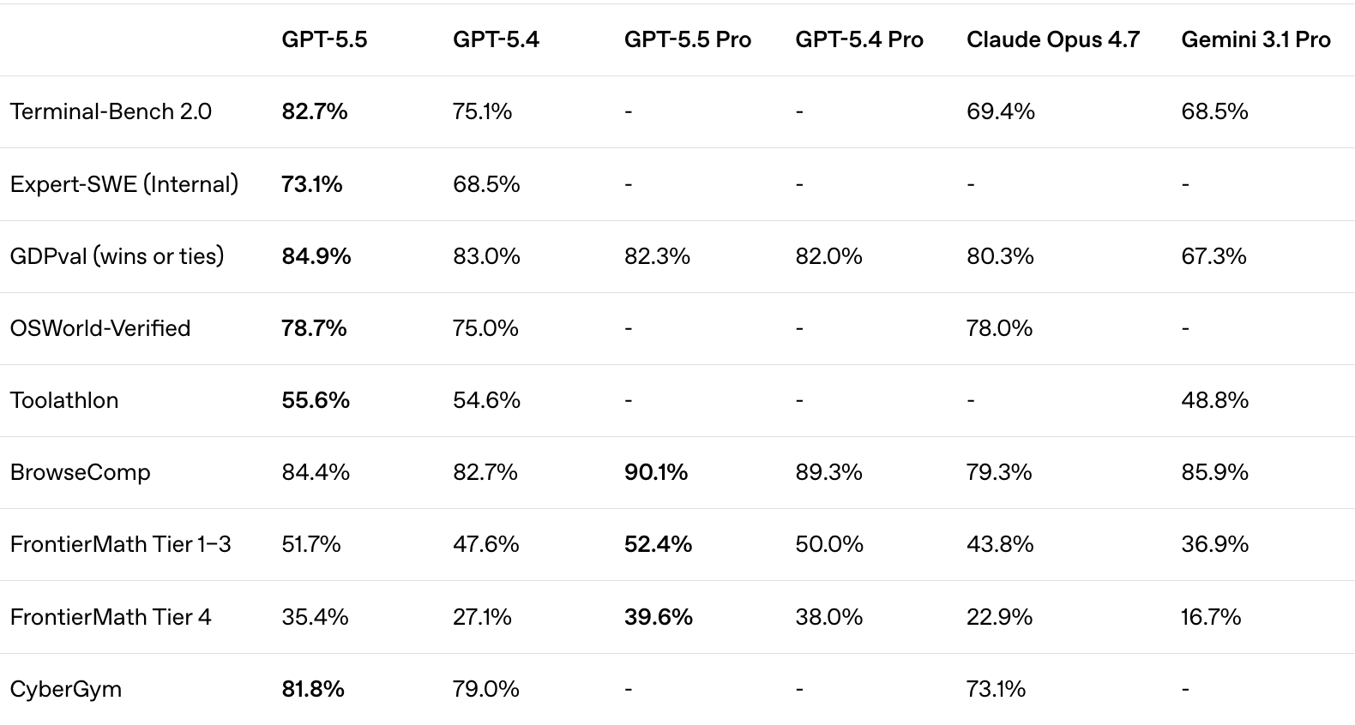
Agentic Coding:
OpenAI Codex GPT-5.5 vs Claude Code Opus 4.7

Slide 39
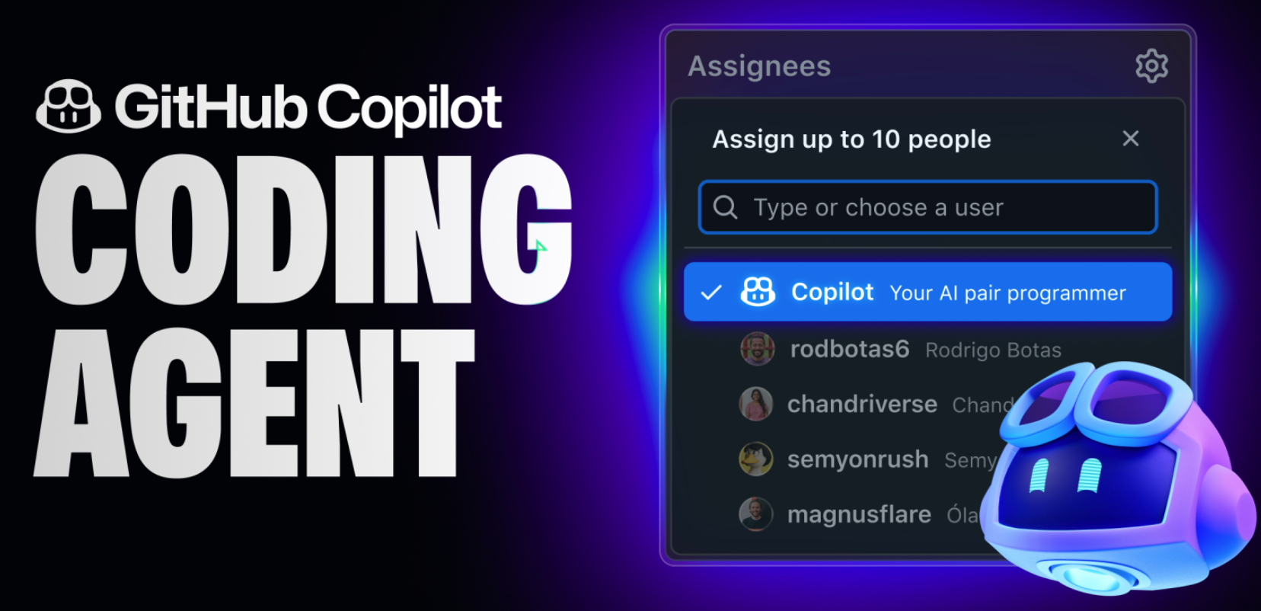
GitHub Copilot CODING AGENT

Slide 40
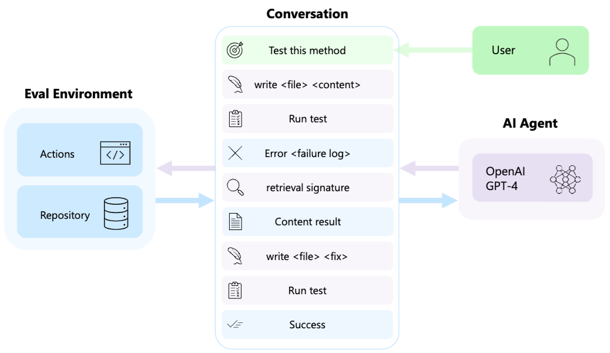
AutoDev: Automated AI-Driven Development

Slide 41
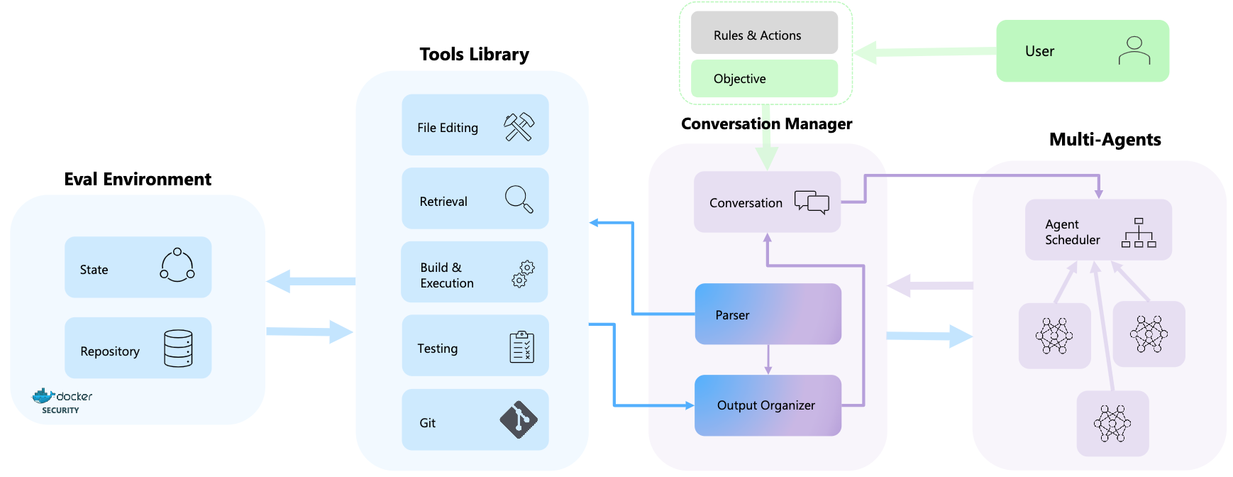
AutoDev: Automated AI-Driven Development

Slide 42
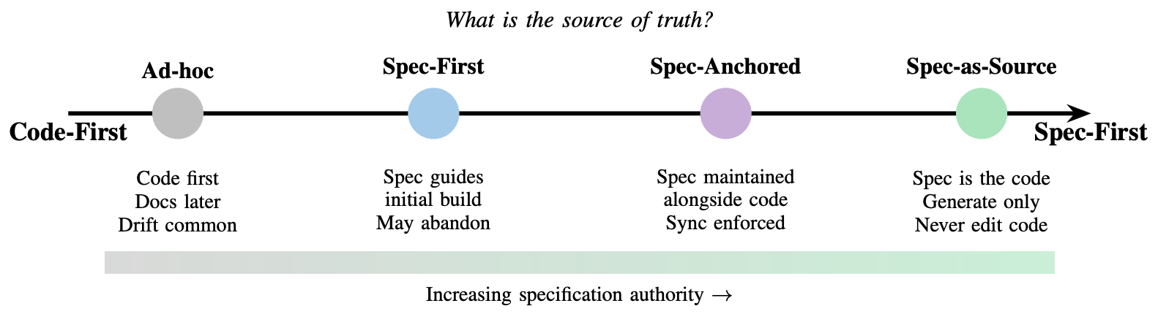
Specification-Driven Development (SDD)

Slide 43
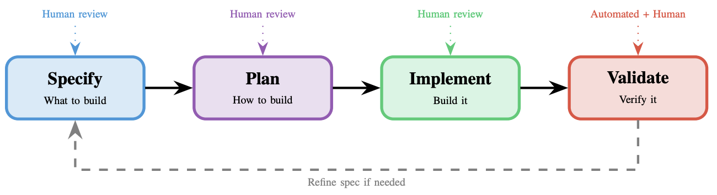
Spec-Driven Development (SDD) workflow
Human review at each checkpoint ensures alignment with intent

Slide 44
Spec-Driven Development (SDD)
Supporting Tools and Frameworks
Category | Examples | Role in SDD
Behavior-Driven Development (BDD) Frameworks | Cucumber, SpecFlow, Behave | Write executable specs in plain language (Gherkin)
Test-Driven Development (TDD) Frameworks | RSpec, JUnit, pytest | Encode specifications as unit tests
API Specification | OpenAPI/Swagger, GraphQL SDL, Protocol Buffers | Define contracts; generate code and tests
Contract Testing | Pact, Specmatic | Verify implementations match specs
AI-Assisted SDD | GitHub Spec Kit, Amazon Kiro, Tessl | Structured AI workflows from spec to code
Model-Based Design | Simulink, SCADE | Visual specs that generate embedded code

Slide 45
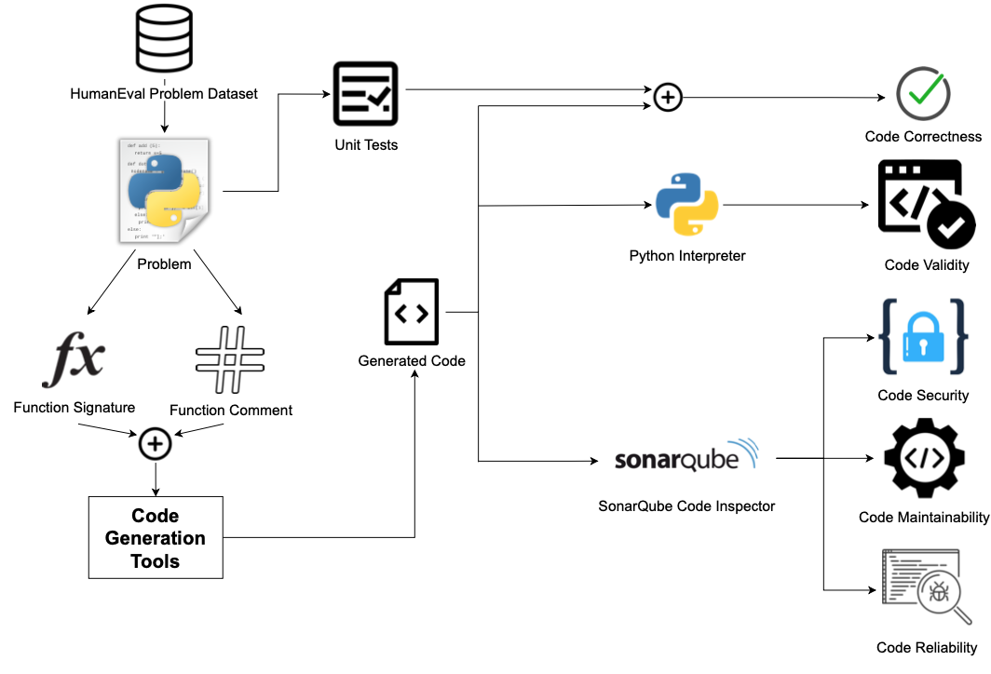
AI-Assisted Code Generation Tools: Experiment Setup

Slide 46
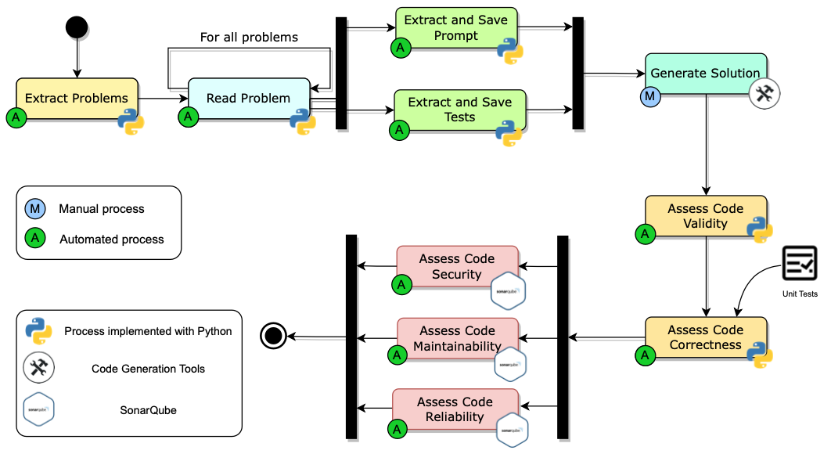
AI-Assisted Code Generation Tools: Experiment Workflow

Slide 47
Security and
Privacy

Slide 48
Security and Privacy
Outline
Security
Privacy

Slide 49
Software security
Software security should always be a high priority for product developers and their users.
If you don’t prioritize security, you and your customers will inevitably suffer losses from malicious attacks.
In the worst case, these attacks could can put product providers out of business.
  If their product is unavailable or if customer data is compromised, customers are liable to cancel their subscriptions.
Even if they can recover from the attacks, this will take time and effort that would have been better spent working on their software.

Slide 50
Types of security threat
An attacker attempts to deny access to the system for legitimate users
An attacker attempts to damage the system or its data
Availability
threats
Integrity
threats
SOFTWARE PRODUCT
PROGRAM
Distributed denial of service (DDoS) attack
Virus
DATA
Ransomware
Data theft
Confidentiality
threats
An attacker tries to gain access to private information held by the system

Slide 51
System infrastructure stack
Operational Environment
Application
Frameworks and application libraries
Browsers and messaging
System libraries
Database
Operating system
Software Infrastructure
Network

Slide 52
Security management
Authentication and authorization
You should have authentication and authorization standards and procedures that ensure that all users have strong authentication and that they have properly access permissions properly.
System infrastructure management
Infrastructure software should be properly configured and security updates that patch vulnerabilities should be applied as soon as they become available.
Attack monitoring
The system should be regularly checked for possible unauthorized access. If attacks are detected, it may be possible to put resistance strategies in place that minimize the effects of the attack.
Backup
Backup policies should be implemented to ensure that you keep undamaged copies of program and data files. These can then be restored after an attack.

Slide 53
Operational security
Operational security focuses on helping users to maintain security. User attacks try to trick users into disclosing their credentials or accessing a website that includes malware such as a key-logging system.
Operational security procedures and practices
  Auto-logout, which addresses the common problem of users forgetting to logout from a computer used in a shared space.
  User command logging, which makes it possible to discover actions taken by users that have deliberately or accidentally damaged some system resources.
  Multi-factor authentication, which reduces the chances of an intruder gaining access to the system using stolen credentials.

Slide 54
Injection attacks
Injection attacks are a type of attack where a malicious user uses a valid input field to input malicious code or database commands.
These malicious instructions are then executed, causing some damage to the system. Code can be injected that leaks system data to the attackers.
Common types of injection attack include buffer overflow attacks and SQL poisoning attacks.

Slide 55
SQL poisoning attacks
SQL poisoning attacks are attacks on software products that use an SQL database.
They take advantage of a situation where a user input is used as part of an SQL command.
A malicious user uses a form input field to input a fragment of SQL that allows access to the database.
The form field is added to the SQL query, which is executed and returns the information to the attacker.

Slide 56
Cross-site scripting attacks
Cross-site scripting attacks are another form of injection attack.
An attacker adds malicious Javascript code to the web page that is returned from a server to a client and this script is executed when the page is displayed in the user’s browser.
The malicious script may steal customer information or direct them to another website.
This may try to capture personal data or display advertisements.
Cookies may be stolen, which makes a session hijacking attack possible.
As with other types of injection attack, cross-site scripting attacks may be avoided by input validation.

Slide 57
Cross-site scripting attack
1.
Introduce malicious code
Product website
Attacker
Malicious code added to valid data
Browser
Website
3.
Malware script sends session cookie to attacker
Valid request for data from website
Browser
2.
Data delivered and malware script installed in victim’s browser
Victim

Slide 58
Session hijacking attacks
When a user authenticates themselves with a web application, a session is created.
  A session is a time period during which the user’s authentication is valid. They don’t have to re-authenticate for each interaction with the system.
  The authentication process involves placing a session cookie on the user’s device
Session hijacking is a type of attack where an attacker gets hold of a session cookie and uses this to impersonate a legitimate user.

Slide 59
Session hijacking attacks
There are several ways that an attacker can find out the session cookie value including cross-site scripting attacks and traffic monitoring.
  In a cross-site scripting attack, the installed malware sends session cookies to the attackers.
  Traffic monitoring involves attackers capturing the traffic between the client and server. The session cookie can then be identified by analyzing the data exchanged.

Slide 60
Actions to reduce the likelihood of hacking
Traffic encryption
Always encrypt the network traffic between clients and your server. This means setting up sessions using https rather than http. If traffic is encrypted it is harder to monitor to find session cookies.
Multi-factor authentication
Always use multi-factor authentication and require confirmation of new actions that may be damaging. For example, before a new payee request is accepted, you could ask the user to confirm their identity by inputting a code sent to their phone.
Short timeouts
Use relatively short timeouts on sessions. If there has been no activity in a session for a few minutes, the session should be ended and future requests directed to an authentication page.

Slide 61
Authentication
Authentication is the process of ensuring that a user of your system is who they claim to be.
You need authentication in all software products that maintain user information, so that only the providers of that information can access and change it.
You also use authentication to learn about your users so that you can personalize their experience of using your product.

Slide 62
Authentication approaches
Authentication approach
Example
Knowledge
Password
Possession
Mobile
device
Authenticating user
Attribute
Fingerprint

Slide 63
Weaknesses of password-based authentication
Insecure passwords
Users choose passwords that are easy to remember.
Phishing attacks
Users click on an email link that points to a fake site that tries to collect their login and password details.
Password reuse
Users use the same password for several sites.
Forgotten passwords
Users regularly forget their passwords so that you need to set up a password recovery mechanism to allow these to be reset.

Slide 64
Federated identity
Federated identity is an approach to authentication where you use an external authentication service.
‘Login with Google’ and ‘Login with Facebook’ are widely used examples of authentication using federated identity.
The advantage of federated identity for a user is that they have a single set of credentials that are stored by a trusted identity service.
Instead of logging into a service directly, a user provides their credentials to a known service who confirms their identity to the authenticating service.
They don’t have to keep track of different user ids and passwords.

Slide 65
Federated identity
User
Service
Trusted
authenticator
Request
authentication
Deliver Request
Request credentials
Provide credentials
Return authentication token
Authentication response

Slide 66
Authorization
Authentication involves a user proving their identity to a software system.
Authorization is a complementary process in which that identity is used to control access to software system resources.
  For example, if you use a shared folder on Dropbox, the folder’s owner may authorize you to read the contents of that folder, but not to add new files or overwrite files in the folder.
When a business wants to define the type of access that users get to resources, this is based on an access control policy.
  This policy is a set of rules that define what information (data and programs) is controlled, who has access to that information and the type of access that is allowed

Slide 67
Access control policies
Explicit access control policies are important for both legal and technical reasons.
Data protection rules limit the access the personal data and this must be reflected in the defined access control policy.
  If this policy is incomplete or does not conform to the data protection rules, then there may be subsequent legal action in the event of a data breach.
Technically, an access control policy can be a starting point for setting up the access control scheme for a system.
For example, if the access control policy defines the access rights of students, then when new students are registered, they all get these rights by default.

Slide 68
Access Control Lists (ACL)
Access control lists (ACLs) are used in most file and database systems to implement access control policies.
Access control lists are tables that link users with resources and specify what those users are permitted to do.
If access control lists are based on individual permissions, then these can become very large. However, you can dramatically cut their size by allocating users to groups and then assigning permissions to the group

Slide 69
Encryption
Encryption is the process of making a document unreadable by applying an algorithmic transformation to it.
A secret key is used by the encryption algorithm as the basis of this transformation. You can decode the encrypted text by applying the reverse transformation.
Modern encryption techniques are such that you can encrypt data so that it is practically uncrackable using currently available technology.
History has demonstrated that apparently strong encryption may be crackable when new technology becomes available.
If commercial quantum systems become available, we will have to use a completely different approach to encryption on the Internet.

Slide 70
Encryption and decryption
Secret
key
Secret
key
Plain
text
Encrypt
Encrypted
text
Decrypt
Plain
text

Slide 71
Symmetric encryption
Alice
Bob
Encryption key
Encryption key
a7Dr6yYf9F…
a7Dr6yYf9F…
Encrypt
Decrypt
Secret
message
Encrypted
text
Secret
message

Slide 72
Asymmetric encryption
Alice
Bob
Bob’s public key
Bob’s private key
dr5ts3TR9dt
x4ztmRsYY…
hTr34BbfsDy
9r3g5HHt76…
Encrypt
Decrypt
Secret
message
Encrypted
text
Secret
message

Slide 73
Encryption for authentication
Bob
Alice
Bob’s private key
Bob’s public key
hTr34BbfsDy
9r3g5HHt76…
dr5ts3TR9dt
x4ztmRsYY…
Encrypt
Decrypt
I am really
Bob
Encrypted
text
I am really
Bob

Slide 74
TLS and digital certificates
The https protocol is a standard protocol for securely exchanging texts on the web.
It is the standard http protocol plus an encryption layer called TLS (Transport Layer Security).
This encryption layer is used for 2 things:
  to verify the identity of the web server;
  to encrypt communications so that they cannot be read by an attacker who intercepts the messages between the client and the server

Slide 75
TLS and digital certificates
TLS encryption depends on a digital certificate that is sent from the web server to the client.
  Digital certificates are issued by a
  certificate authority (CA), which is a trusted identity verification service.
  The CA encrypts the information in the certificate using their private key to create a unique signature. This signature is included in the certificate along with the public key of the CA. To check that the certificate is valid, you can decrypt the signature using the CA’s public key.

Slide 76
Key management
Key management is the process of ensuring that encryption keys are securely generated, stored and accessed by authorized users.
Businesses may have to manage tens of thousands of encryption keys so it is impractical to do key management manually and you need to use some kind of automated key management system (KMS).

Slide 77
Digital certificates
Subject information
Information about the company or individual whose web site is being visited. Applicants apply for a digital certificate from a certificate authority who checks that the applicant is a valid organization.
Certificate authority information
Information about the certificate authority (CA) who has issued the certificate.
Certificate information
Information about the certificate itself, including a unique serial number and a validity period, defined by start and end dates.

Slide 78
Digital certificates
Digital signature
The combination of all of the above data uniquely identifies the digital certificate. The signature data is encrypted with the CA’s private key to confirm that the data is correct. The algorithm used to generate the digital signature is also specified.
Public key information
The public key of the CA is included along with the key size and the encryption algorithm used. The public key may be used to decrypt the digital signature.

Slide 79
Data encryption
As a product provider you inevitably store information about your users and, for cloud-based products, user data.
Encryption can be used to reduce the damage that may occur from data theft. If information is encrypted, it is impossible, or very expensive, for thieves to access and use the unencrypted data.
  Data in transit
  Data at rest
  Data in use

Slide 80
Encryption levels
Application
Database
Files
Media

Slide 81
Key management
Key management is important because, if you get it wrong, unauthorized users may be able to access your keys and so decrypt supposedly private data. Even worse, if you lose encryption keys, then your encrypted data may be permanently inaccessible.
A key management system (KMS) is a specialized database that is designed to securely store and manage encryption keys, digital certificates and other confidential information.

Slide 82
Using a KMS for encryption management
Application
Calls
Unencrypted
data
API
Key
management
system (KMS)
Encryption
engine
Keys
Key store
Stored
encrypted data

Slide 83
Long-term key storage
Business may be required by accounting and other regulations to keep copies of all of their data for several years.
  For example, in the UK, tax and company data has to be maintained for at least six years, with a longer retention period for some types of data. Data protection regulations may require that this data be stored securely, so the data should be encrypted.
To reduce the risks of a security breach, encryption keys should be changed regularly. This means that archival data may be encrypted with a different key from the current data in your system.
Therefore, key management systems must maintain multiple, timestamped versions of keys so that system backups and archives can be decrypted if required.

Slide 84
Privacy
Privacy is a social concept that relates to the collection, dissemination and appropriate use of personal information held by a third-party such as a company or a hospital.
The importance of privacy has changed over time and individuals have their own views on what degree of privacy is important.
Culture and age also affect peoples’ views on what privacy means.
  Younger people were early adopters of the first social networks and many of them seem to be less inhibited about sharing personal information on these platforms than older people.
  In some countries, the level of income earned by an individual is seen as a private matter; in others, all tax returns are openly published.

Slide 85
Business reasons for privacy
If you are offering a product directly to consumers and you fail to conform to privacy regulations, then you may be subject to legal action by product buyers or by a data regulator. If your conformance is weaker than the protection offered by data protection regulations in some countries, you won’t be able to sell your product in these countries.
If your product is a business product, business customers require privacy safeguards so that they are not put at risk of privacy violations and legal action by users.
If personal information is leaked or misused, even if this is not seen as a violation of privacy regulations, this can lead to serious reputational damage. Customers may stop using your product because of this.

Slide 86
Data protection laws
In many countries, the right to individual privacy is protected by data protection laws.
These laws limit the collection, dissemination and use of personal data to the purposes for which it was collected.
  For example, a travel insurance company may collect health information so that they can assess their level of risk. This is legal and permissible.
  However, it would not be legal for those companies to use this information to target online advertising of health products, unless their users had given specific permission for this.

Slide 87
Data protection laws
Data protection law
Responsibilities of
the data controller
Rights of
the data subject
Data storage
Data use
Security
Subject access
Data access
Error correction
Data deletion
Consent

Slide 88
Data protection principles
Awareness and control
Users of your product must be made aware of what data is collected when they are using your product, and must have control over the personal information that you collect from them.
Purpose
You must tell users why data is being collected and you must not use that data for other purposes.
Consent
You must always have the consent of a user before you disclose their data to other people.
Data lifetime
You must not keep data for longer than you need to. If a user deletes their account, you must delete the personal data associated with that account.

Slide 89
Data protection principles
Secure storage
You must maintain data securely so that it cannot be tampered with or disclosed to unauthorized people.
Discovery and error correction
You must allow users to find out what personal data that you store. You must provide a way for users to correct errors in their personal data.
Location
You must not store data in countries where weaker data protection laws apply unless there is an explicit agreement that the stronger data protection rules will be upheld.

Slide 90
Privacy policy
You should to establish a privacy policy that defines how personal and sensitive information about users is collected, stored and managed.
Software products use data in different ways, so your privacy policy has to define the personal data that you will collect and how you will use that data.
Product users should be able to review your privacy policy and change their preferences regarding the information that you store.

Slide 91
Privacy policy
Your privacy policy is a legal document and it should be auditable to check that it is consistent with the data protection laws in countries where your software is sold.
Privacy policies should not be expressed to users in a long ‘terms and conditions’ document that, in practice, nobody reads.
The General Data Protection Regulation (GDPR) now require software companies to include a summary of their privacy policy, written in plain language rather than legal jargon, on their website.

Slide 92
Summary
Security is a technical concept that relates to a software system’s ability to protect itself from malicious attacks that may threaten its availability, the integrity of the system and/or its data, and the theft of confidential information.
Common types of attack on software products include
  injection attacks,
  cross-site scripting attacks,
  session hijacking attacks,
  denial of service attacks and
  brute force attacks.

Slide 93
Summary
Authentication may be based on something a user knows, something a user has, or some physical attribute of the user.
Federated authentication involves devolving responsibility for authentication to a third-party such as Facebook or Google, or to a business’s authentication service.
Authorization involves controlling access to system resources based on the user’s authenticated identity. Access control lists are the most commonly-used mechanism to implement authorization.

Slide 94
Summary
Symmetric encryption involves encrypting and decrypting information with the same secret key.
Asymmetric encryption uses a key pair – a private key and a public key. Information encrypted using the public key can only be decrypted using the private key.
A major issue in symmetric encryption is key exchange.
The Transport Layer Security (TLS) protocol, which is used to secure web traffic, gets around this problem by using asymmetric encryption for transferring information used to generate a shared key.

Slide 95
Summary
If your product stores sensitive user data, you should encrypt that data when it is not in use.
A key management system (KMS) stores encryption keys. Using a KMS is essential because a business may have to manage thousands or even millions of keys and may have to decrypt historic data that was encrypted using an obsolete encryption key.

Slide 96
Summary
Privacy is a social concept that relates to how people feel about the release of their personal information to others. Different countries and cultures have different ideas on what information should and should not be private.
Data protection laws have been made in many countries to protect individual privacy. They require companies who manage user data to store it securely, to ensure that it is not used or sold without the permission of users, and to allow users to view and correct personal data held by the system.

Slide 97
Reliable Programming

Slide 98
Reliable Programming
Outline
Software quality
Programming for reliability
Design pattern
Refactoring

Slide 99
Software quality
Creating a successful software product does not simply mean providing useful features for users.
You need to create a high-quality product that people want to use.
Customers have to be confident that your product will not crash or lose information, and users have to be able to learn to use the software quickly and without mistakes.

Slide 100
Software product quality attributes
Reliability
Availability
1
2
Software product quality attributes
Security
Resilience
7
3
Usability
Maintainability
6
4
Responsiveness
5

Slide 101
Programming for reliability
There are three simple techniques for
reliability improvement that can be applied in any software company.
  Fault avoidance: You should program in such a way that you avoid introducing faults into your program.
  Input validation: You should define the expected format for user inputs and validate that all inputs conform to that format.
  Failure management: You should implement your software so that program failures have minimal impact on product users.

Slide 102
Underlying causes of program errors
Programmers make mistakes because they don’t properly understand the problem or
the application domain
Programmers make mistakes because they use unsuitable technology or they don’t properly understand the technologies used
Problem
Technology
Programming language, libraries, database, IDE, etc.
Program
Programmers make mistakes because they
make simple slips or they do not completely understand how multiple program components work together the program’s state.

Slide 103
Software complexity
The shaded node interacts, in some ways, with the linked nodes shown by the dotted line

Slide 104
Program complexity
Complexity is related to the
number of relationships between elements
in a program and the type and nature of these relationships
The number of relationships between entities is called the coupling. The higher the coupling, the more complex the system.
  The shaded node has a relatively high coupling because it has relationships with six other nodes.

Slide 105
Software complexity
A static relationship is one that is stable and does not depend on program execution.
  Whether or not one component is
  part of another component is a static relationship.
Dynamic relationships, which change over time, are more complex than static relationships.
  An example of a dynamic relationship is
  the ‘calls’ relationship between functions.

Slide 106
Types of complexity
Reading
complexity
This reflects how hard it is to
read and understand the program.
Structural
complexity
This reflects the number and types of
relationship between the structures
(classes, objects, methods or functions) in your program.
Data
complexity
This reflects the representations of
data used and relationships between
the data elements in your program.
Decision
complexity
This reflects the complexity of
the decisions in your program

Slide 107
Complexity reduction guidelines
Structural complexity
Functions should do one thing and one thing only
Functions should never have side-effects
Every class should have a single responsibility
Minimize the depth of inheritance hierarchies
Avoid multiple inheritance
Avoid threads (parallelism) unless absolutely necessary

Slide 108
Complexity reduction guidelines
Data complexity
Define interfaces for all abstractions
Define abstract data types
Avoid using floating-point numbers
Never use data aliases

Slide 109
Complexity reduction guidelines
Conditional complexity
Avoid deeply nested conditional statements
Avoid complex conditional expressions

Slide 110
Ensure that every class has a single responsibility
You should design classes so that there is only
a single reason to change a class.
  If you adopt this approach, your classes will be smaller and more cohesive.
  They will therefore be less complex and easier to understand and change.
The single responsibility principle
  Gather together the things that change for the same reasons.
  Separate those things that change for different reasons

Slide 111
The DeviceInventory class
DeviceInventory
DeviceInventory
laptops
tablets
phones
device_assignment
laptops
tablets
phones
device_assignment
addDevice
removeDevice
assignDevice
unassignDevice
getDeviceAssignment
addDevice
removeDevice
assignDevice
unassignDevice
getDeviceAssignment
printInventory
(a)
(b)

Slide 112
Adding a printInventory method
One way of making this change is to
add a printInventory method
  This change breaks the single responsibility principle as it then adds an additional ‘reason to change’ the class.
Instead of adding a printInventory method
to DeviceInventory,
it is better to
add a new class to represent the printed report.

Slide 113
The DeviceInventory and InventoryReport classes
DeviceInventory
InventoryReport
laptops
tablets
phones
device_assignment
report_data
report_format
addDevice
removeDevice
assignDevice
unassignDevice
getDeviceAssignment
updateData
updateFormat
print

Slide 114
Avoid deeply nested conditional statements
Deeply nested conditional (if) statements are used when you need to identify which of a possible set of choices is to be made.
For example, the function ‘agecheck’ is a short Python function that is used to calculate an age multiplier for insurance premiums.
  The insurance company’s data suggests that the age and experience of drivers affects the chances of them having an accident, so premiums are adjusted to take this into account.
  It is good practice to name constants rather than using absolute numbers, so Program names all constants that are used.

Slide 115
Deeply nested if-then-else statements
YOUNG_DRIVER_AGE_LIMIT = 25
OLDER_DRIVER_AGE = 70
ELDERLY_DRIVER_AGE = 80
YOUNG_DRIVER_PREMIUM_MULTIPLIER = 2
OLDER_DRIVER_PREMIUM_MULTIPLIER = 1.5
ELDERLY_DRIVER_PREMIUM_MULTIPLIER = 2
YOUNG_DRIVER_EXPERIENCE_MULTIPLIER = 2
NO_MULTIPLIER = 1
YOUNG_DRIVER_EXPERIENCE = 2
OLDER_DRIVER_EXPERIENCE = 5
def agecheck(age, experience):
# Assigns a premium multiplier depending on the age and experience of the driver multiplier = NO_MULTIPLIER
if age <= YOUNG_DRIVER_AGE_LIMIT:
if experience <= YOUNG_DRIVER_EXPERIENCE:
multiplier = YOUNG_DRIVER_PREMIUM_MULTIPLIER * YOUNG_DRIVER_EXPERIENCE_MULTIPLIER
else:
multiplier = YOUNG_DRIVER_PREMIUM_MULTIPLIER
else:
if age > OLDER_DRIVER_AGE and age <= ELDERLY_DRIVER_AGE:
if experience <= OLDER_DRIVER_EXPERIENCE:
multiplier = OLDER_DRIVER_PREMIUM_MULTIPLIER
else:
multiplier = NO_MULTIPLIER
else:
if age > ELDERLY_DRIVER_AGE:
multiplier = ELDERLY_DRIVER_PREMIUM_MULTIPLIER
return multiplier

Slide 116
Using guards to
make a selection
def agecheck_with_guards(age, experience):
if age <= YOUNG_DRIVER_AGE_LIMIT and experience <= YOUNG_DRIVER_EXPERIENCE:
return YOUNG_DRIVER_PREMIUM_MULTIPLIER * YOUNG_DRIVER_EXPERIENCE_MULTIPLIER
if age <= YOUNG_DRIVER_AGE_LIMIT:
return YOUNG_DRIVER_PREMIUM_MULTIPLIER
if (age > OLDER_DRIVER_AGE and age <= ELDERLY_DRIVER_AGE) and experience <= OLDER_DRIVER_EXPERIENCE:
return OLDER_DRIVER_PREMIUM_MULTIPLIER
if age > ELDERLY_DRIVER_AGE:
return ELDERLY_DRIVER_PREMIUM_MULTIPLIER
return NO_MULTIPLIER

Slide 117
Avoid deep inheritance hierarchies
Inheritance allows the attributes and methods of a class,
such as RoadVehicle, can be inherited by sub-classes,
such as Truck, Car and MotorBike.
Inheritance appears to be an effective and efficient way of
reusing code and of making changes that affect all subclasses.
However, inheritance increases the structural complexity of code as it increases the coupling of subclasses.
The problem with deep inheritance is that if you want to make changes to a class, you have to look at all of its superclasses to see where it is best to make the change.
You also have to look at all of the related subclasses to check that the change does not have unwanted consequences. It’s easy to make mistakes when you are doing this analysis and introduce faults into your program.

Slide 118
Part of the inheritance hierarchy for hospital staff
Hospital staff
Technicians
Paramedics
Clinical staff
Scientist
Ancillary staff
Admin staff
Doctor
Nurse
Physiotherapist
Midwife
Ward nurse
Nurse
Manager

Slide 119
Design pattern definition
Definition
  A general reusable solution to a
  commonly-occurring problem
  within a given context in software design.

Slide 120
Design pattern
Design patterns are object-oriented and describe solutions in terms of objects and classes.
They are not off-the-shelf solutions that can be directly expressed as code in an object-oriented language.
They describe the structure of a problem solution but have to be adapted to suit your application and the programming language that you are using.

Slide 121
Programming principles
Separation of concerns
  This means that each abstraction in the program (class, method, etc.) should address a separate concern and that all aspects of that concern should be covered there.
Separate the ‘what’ from the ‘how
  If a program component provides a particular service, you should make available only the information that is required to use that service (the ‘what’). The implementation of the service (‘the how’) should be of no interest to service users.

Slide 122
Common types of design patterns
Creational patterns
  These are concerned with class and object creation. They define ways of instantiating and initializing objects and classes that are more abstract than the basic class and object creation mechanisms defined in a programming language.
Structural patterns
  These are concerned with class and object composition. Structural design patterns are a description of how classes and objects may be combined to create larger structures.
Behavioural patterns
  These are concerned with class and object communication. They show how objects interact by exchanging messages, the activities in a process and how these are distributed amongst the participating objects.

Slide 123
Pattern description
Design patterns are usually documented in the stylized way. This includes:
  a meaningful name for the pattern and a brief description of what it does;
  a description of the problem it solves;
  a description of the solution and its implementation;
  the consequences and trade-offs of using the pattern and other issues that you should consider.

Slide 124
Refactoring
Refactoring means changing a program to reduce its complexity without changing the external behaviour of that program.
Refactoring makes a program more readable (so reducing the ‘reading complexity’) and more understandable.
It also makes it easier to change, which means that you reduce the chances of making mistakes when you introduce new features.

Slide 125
Refactoring
The reality of programming is that as you make changes and additions to existing code, you inevitably increase its complexity.
  The code becomes harder to understand and change.
  The abstractions and operations that you started with become more and more complex because you modify them in ways that you did not originally anticipate.

Slide 126
A refactoring process
1
2
Start
Identify code
‘smell’
Identify refactoring strategy
4
3
Run automated code tests
Make small
improvement until strategy completed

Slide 127
Code smells
The starting point for refactoring should be to identify code ‘smells’.
Code smells are indicators in the code that there might be a deeper problem.
  For example, very large classes may indicate that the class is trying to do too much. This probably means that its structural complexity is high.

Slide 128
Examples of code smells
Large classes
Large classes may mean that the single responsibility principle is being violated. Break down large classes into easier-to-understand, smaller classes.
Long methods/functions
Long methods or functions may indicate that the function is doing more than one thing. Split into smaller, more specific functions or methods.

Slide 129
Examples of code smells
Duplicated code
Duplicated code may mean that when changes are needed, these have to be made everywhere the code is duplicated. Rewrite to create a single instance of the duplicated code that is used as required
Meaningless names
Meaningless names are a sign of programmer haste. They make the code harder to understand. Replace with meaningful names and check for other shortcuts that the programmer may have taken.

Slide 130
Examples of code smells
Unused code
This simply increases the reading complexity of the code. Delete it even if it has been commented out. If you find you need it later, you should be able to retrieve it from the code management system.

Slide 131
Examples of refactoring for complexity reduction
Reading complexity
You can rename variable, function and class names throughout your program to make their purpose more obvious.
Structural complexity
You can break long classes or functions into shorter units that are likely to be more cohesive than the original large class.

Slide 132
Examples of refactoring for complexity reduction
Data complexity
You can simplify data by changing your database schema or reducing its complexity. For example, you can merge related tables in your database to remove duplicated data held in these tables.
Decision complexity
You can replace a series of deeply nested if-then-else statements with guard clauses.

Slide 133
Exception handling
Exceptions are events that disrupt the normal flow of processing in a program.
When an exception occurs, control is automatically transferred to exception management code.
Most modern programming languages include a mechanism for exception handling.
In Python, you use **try-except** keywords to indicate exception handling code;
in Java, the equivalent keywords are **try-catch.**

Slide 134
Exception handling
Executing code
Normal processing
Exception raised
Normal processing
Exit
Exception-handling
block
Exception-handling code
Exception re-raised or
abnormal exit

Slide 135
Python try: except: finally:
try:
f = open(”file1.txt")
f.write(”Hello World")
except:
print(”writing file error!")
finally:
f.close()

Slide 136
Auto-save and activity logging
Auto-save
Command
logger
Last
saved state
Command
executed
Crash
recovery
Restored
state

Slide 137
Summary
The most important quality attributes for most software products are reliability, security, availability, usability, responsiveness and maintainability.
To avoid introducing faults into your program, you should use programming practices that reduce the probability that you will make mistakes.
You should always aim to minimize complexity in your programs. Complexity makes programs harder to understand. It increases the chances of programmer errors and makes the program more difficult to change.

Slide 138
Summary
Design patterns are tried and tested solutions to commonly occurring problems. Using patterns is an effective way of reducing program complexity.
Refactoring is the process of reducing the complexity of an existing program without changing its functionality. It is good practice to refactor your program regularly to make it easier to read and understand.
Input validation involves checking all user inputs to ensure that they are in the format that is expected by your program. Input validation helps avoid the introduction of malicious code into your system and traps user errors that can pollute your database.

Slide 139
Summary
Regular expressions are a way of defining patterns that can match a range of possible input strings. Regular expression matching is a compact and fast way of checking that an input string conforms to the rules you have defined.
You should check that numbers have sensible values depending on the type of input expected. You should also check number sequences for feasibility.
You should assume that your program may fail and to manage these failures so that they have minimal impact on the user.

Slide 140
Summary
Exception management is supported in most modern programming languages. Control is transferred to your own exception handler to deal with the failure when a program exception is detected.
You should log user updates and maintain user data snapshots as your program executes. In the event of a failure, you can use these to recover the work that the user has done. You should also include ways of recognizing and recovering from external service failures.

Slide 141
Testing:
Functional testing,
Test automation,
Test-driven development, and Code reviews

Slide 142
Outline
Software testing
Functional testing
Test automation
Test-driven development
Code reviews

Slide 143
Software testing
Software testing is a process in which you execute your program using data that simulates user inputs.
You observe its behaviour to see whether or not your program is doing what it is supposed to do.
  Tests pass if the behaviour is what you expect.
  Tests fail if the behaviour differs from that expected.
  If your program does what you expect, this shows that for the inputs used, the program behaves correctly.
If these inputs are representative of a larger set of inputs, you can infer that the program will behave correctly for all members of this larger input set.

Slide 144
Program bugs
If the behaviour of the program does not match the behaviour that you expect, then this means that there are bugs in your program that need to be fixed.
There are two causes of program bugs:
  Programming errors
    You have accidentally included faults in your program code.
    For example: ‘off-by-1’ error
  Understanding errors
    You have misunderstood or have been unaware of some of the details of what the program is supposed to do.

Slide 145
Types of testing
Functional
testing
Test the functionality of the overall system.
User testing
Test that the software product is useful to
and usable by end-users.
Performance
and
load testing
Test that the software works quickly and
can handle the expected load placed
on the system by its users.
Security
testing
Test that the software maintains its integrity
and can protect user information
from theft and damage.

Slide 146
Functional testing
Functional testing involves developing a large set of program tests so that, ideally, all of a program’s code is executed at least once.
The number of tests needed obviously depends on the size and the functionality of the application.
For a business-focused web application, you may have to develop thousands of tests to convince yourself that your product is ready for release to customers.

Slide 147
Functional testing
Functional testing is a staged activity in which you initially test individual units of code.
You integrate code units with other units to create larger units then do more testing.
The process continues until you have created a complete system ready for release.

Slide 148
Functional testing
Start
1
Unit
Testing
4
2
Release
Testing
Feature
Testing
3
System
Testing

Slide 149
A name checking function
def namecheck(s):
# Checks that a name only includes alphabetic characters, - or
# a single quote. Names must be between 2 and 40 characters long
# quoted strings and -- are disallowed
namex = r"^[a-zA-Z][a-zA-Z-']{1,39}$"
if re.match(namex, s):
if re.search("'.*'", s) or re.search("--", s):
return False
else:
return True
else:
return False

Slide 150
Equivalence partitions for the name checking function
Correct names 1
The inputs only includes alphabetic characters and are between 2 and 40 characters long.
Correct names 2
The inputs only includes alphabetic characters, hyphens or apostrophes and are between 2 and 40 characters long.
Incorrect names 1
The inputs are between 2 and 40 characters long but include disallowed characters.
Incorrect names 2
The inputs include allowed characters but are either a single character or are more than 40 characters long.

Slide 151
Unit testing guidelines (1)
Test edge cases
If your partition has upper and lower bounds (e.g. length of strings, numbers, etc.) choose inputs at the edges of the range.
Force errors
Choose test inputs that force the system to generate all error messages. Choose test inputs that should generate invalid outputs.
Fill buffers
Choose test inputs that cause all input buffers to overflow.
Repeat yourself
Repeat the same test input or series of inputs several times.

Slide 152
Unit testing guidelines (2)
Overflow and underflow
If your program does numeric calculations, choose test inputs that cause it to calculate very large or very small numbers.
Don’t forget null and zero
If your program uses pointers or strings, always test with null pointers and strings.
Keep count
When dealing with lists and list transformation, keep count of the number of elements in each list and check that these are consistent after each transformation.
One is different
If your program deals with sequences, always test with sequences that have a single value.

Slide 153
Feature testing
Features have to be tested to show that the functionality is implemented as expected and that the functionality meets the real needs of users.
  For example, if your product has a feature that allows users to login using their Google account, then you have to check that this registers the user correctly and informs them of what information will be shared with Google.
  You may want to check that it gives users the option to sign up for email information about your product.

Slide 154
Feature testing
Normally, a feature that does several things is implemented by multiple, interacting, program units.
These units may be implemented by different developers and all of these developers should be involved in the feature testing process.

Slide 155
Types of feature test
Interaction tests
  These test the interactions between the units that implement the feature. The developers of the units that are combined to make up the feature may have different understandings of what is required of that feature.
  These misunderstandings will not show up in unit tests but may only come to light when the units are integrated.
  The integration may also reveal bugs in program units, which were not exposed by unit testing.
Usefulness tests
  These test that the feature implements what users are likely to want.

Slide 156
User stories for the sign-in with Google feature
User registration
As a user, I want to be able to login without creating a new account so that I don’t have to remember another login id and password.
Information sharing
As a user, I want to know what information you will share with other companies. I want to be able to cancel my registration if I don’t want to share this information.
Email choice
As a user, I want to be able to choose the types of email that I’ll get from you when I register for an account.

Slide 157
Feature tests for sign-in with Google
Initial login screen
Test that the screen displaying a request for Google account credentials is correctly displayed when a user clicks on the ‘Sign-in with Google’ link. Test that the login is completed if the user is already logged in to Google.
Incorrect credentials
Test that the error message and retry screen is displayed if the user inputs incorrect Google credentials.

Slide 158
Feature tests for sign-in with Google
Shared information
Test that the information shared with Google is displayed, along with a cancel or confirm option. Test that the registration is cancelled if the cancel option is chosen.
Email opt-in
Test that the user is offered a menu of options for email information and can choose multiple items to opt-in to emails. Test that the user is not registered for any emails if no options are selected.

Slide 159
System and release testing
System testing involves testing the
system as a whole, rather than the individual system features.

Slide 160
System testing
System testing should focus on four things:
  Testing to discover if there are unexpected and unwanted interactions between the features in a system.
  Testing to discover if the system features work together effectively to support what users really want to do with the system.
  Testing the system to make sure it operates in the expected way in the different environments where it will be used.
  Testing the responsiveness, throughput, security and other quality attributes of the system.

Slide 161
Scenario-based testing
The best way to systematically test a system is to start with a set of scenarios that describe possible uses of the system and then work through these scenarios each time a new version of the system is created.
Using the scenario, you identify a set of
end-to-end pathways that users might follow when using the system.
An end-to-end pathway is a sequence of actions from starting to use the system for the task, through to completion of the task.

Slide 162
Choosing a holiday destination
End-to-end pathways
User inputs departure airport and chooses to see only direct flights. User quits.
User inputs departure airport and chooses to see all flights. User quits.
User chooses destination country and chooses to see all flights. User quits.
User inputs departure airport and chooses to see direct flights. User sets filter specifying departure times and prices. User quits.
User inputs departure airport and chooses to see direct flights. User sets filter specifying departure times and prices. User selects a displayed flight and clicks through to airline website. User returns to holiday planner after booking flight.

Slide 163
Release testing
Release testing is a type of system testing where a system that’s intended for release to customers is tested.
Preparing a system for release involves packaging that system for deployment (e.g. in a container if it is a cloud service) and installing software and libraries that are used by your product.
You must define configuration parameters such as the name of a root directory, the database size limit per user and so on.

Slide 164
Release testing and System testing
The fundamental differences between
release testing and system testing are:
  Release testing tests the system in its real operational environment rather than in a test environment. Problems commonly arise with real user data, which is sometimes more complex and less reliable than test data.
  The aim of release testing is to decide if the system is good enough to release, not to detect bugs in the system. Therefore, some tests that ‘fail’ may be ignored if these have minimal consequences for most users.

Slide 165
Test automation
Automated testing is based on the idea that
tests should be executable.
An executable test includes the input data to the unit that is being tested, the expected result and a check that the unit returns the expected result.
You run the test and the test passes if the
unit returns the expected result.
Normally, you should develop hundreds or thousands of executable tests for a software product.

Slide 166
Automated testing
Files of executable tests
Code
being tested
Test
runner
Testing
framework
Test
Report

Slide 167
Test methods for an interest calculator
# TestInterestCalculator inherits attributes and methods from the class
# TestCase in the testing framework unittest
class TestInterestCalculator(unittest.TestCase):
# Define a set of unit tests where each test tests one thing only
# Tests should start with test_ and the name should explain what is being tested
def test_zeroprincipal(self):
#Arrange - set up the test parameters
p = 0; r = 3; n = 31
result_should_be = 0
#Action - Call the method to be tested
interest = interest_calculator (p, r, n)
#Assert - test what should be true
self.assertEqual(result_should_be, interest)
def test_yearly_interest(self):
#Arrange - set up the test parameters
p = 17000; r = 3; n = 365
#Action - Call the method to be tested
result_should_be = 270.36
interest = interest_calculator(p, r, n)
#Assert - test what should be true
self.assertEqual(result_should_be, interest)

Slide 168
Automated tests
It is good practice to
structure automated tests into three parts:
  Arrange
    You set up the system to run the test. This involves defining the test parameters and, if necessary, mock objects that emulate the functionality of code that has not yet been developed.
  Action
    You call the unit that is being tested with the test parameters.
  Assert
    You make an assertion about what should hold if the unit being tested has executed successfully.
    AssertEquals: checks if its parameters are equal.

Slide 169
Executable tests for the namecheck function (1)
import unittest
from RE_checker import namecheck
class TestNameCheck (unittest.TestCase):
def test_alphaname (self):
self.assertTrue (namecheck ('Sommerville'))
def test_doublequote (self):
self.assertFalse (namecheck ("Thisis'maliciouscode'"))
def test_namestartswithhyphen (self):
self.assertFalse (namecheck ('-Sommerville'))
def test_namestartswithquote (self):
self.assertFalse (namecheck ("'Reilly"))
def test_nametoolong (self):
self.assertFalse (namecheck ('Thisisalongstringwithmorethen40charactersfrombeginningtoend'))
def test_nametooshort (self):
self.assertFalse (namecheck ('S'))

Slide 170
Executable tests for the namecheck function (2)
def test_namewithdigit (self):
self.assertFalse (namecheck('C-3PO'))
def test_namewithdoublehyphen (self):
self.assertFalse (namecheck ('--badcode’))
def test_namewithhyphen (self):
self.assertTrue (namecheck ('Washington-Wilson'))
def test_namewithinvalidchar (self):
self.assertFalse (namecheck('Sommer_ville'))
def test_namewithquote (self):
self.assertTrue (namecheck ("O'Reilly"))
def test_namewithspaces (self):
self.assertFalse (namecheck ('Washington Wilson'))
def test_shortname (self):
self.assertTrue ('Sx')
def test_thiswillfail (self)
self.assertTrue (namecheck ("O Reilly"))

Slide 171
Code to run unit tests from files
import unittest
loader = unittest.TestLoader()
#Find the test files in the current directory
tests = loader.discover('.')
#Specify the level of information provided by the test runner
testRunner = unittest.runner.TextTestRunner(verbosity=2)
testRunner.run(tests)

Slide 172
The test pyramid
Increased automation
Reduced costs
System
tests
Feature tests
Unit tests

Slide 173
Feature editing through an API
Browser or
mobile app interface
Feature
tests
API
Feature 1
Feature 2
Feature 3
Feature 4

Slide 174
Interaction recording and playback
Browser or
mobile app interface
User action
recording
Interaction
session records
User action
playback
System API
System being tested

Slide 175
Test-driven development (TDD)
Test-driven development (TDD) is an approach to program development that is based around the general idea that you should write an executable test or tests for code that you are writing before you write the code.
It was introduced by early users of the Extreme Programming agile method, but it can be used with any incremental development approach.
Test-driven development works best for the development of individual program units and it is more difficult to apply to system testing.
Even the strongest advocates of TDD accept that it is challenging to use this approach when you are developing and testing systems with graphical user interfaces.

Slide 176
Test-driven development (TDD)
Start
1
Identify new
functionality
2
Identify partial implementation
of functionality
3
Write code stub
that will fail test
Functionality
complete
Functionality
incomplete
4
Run all
automated test
7
Refactor code
if required
5
Implement code that should cause failing test to pass
Test failure
6
Run all
automated test
All tests pass

Slide 177
Stages of test-driven development
Identify partial implementation
Break down the implementation of the functionality required into smaller mini-units. Choose one of these mini-units for implementation.
Write mini-unit tests
Write one or more automated tests for the mini-unit that you have chosen for implementation. The mini-unit should pass these tests if it is properly implemented.
Write a code stub that will fail test
Write incomplete code that will be called to implement the mini-unit. You know this will fail.
Run all existing automated tests
All previous tests should pass. The test for the incomplete code should fail.

Slide 178
Stages of test-driven development
Implement code that should cause the failing test to pass
Write code to implement the mini-unit, which should cause it to operate correctly
Rerun all automated tests
If any tests fail, your code is probably incorrect. Keep working on it until all tests pass.
Refactor code if necessary
If all tests pass, you can move on to implementing the next mini-unit. If you see ways of improving your code, you should do this before the next stage of implementation.

Slide 179
Benefits of test-driven development
It is a systematic approach to testing in which tests are clearly linked to sections of the program code.
  This means you can be confident that your tests cover all of the code that has been developed and that there are no untested code sections in the delivered code.
The tests act as a written specification for the program code. In principle at least, it should be possible to understand what the program does by reading the tests.
Debugging is simplified because, when a program failure is observed, you can immediately link this to the last increment of code that you added to the system.
TDD leads to simpler code as programmers only write code that’s necessary to pass tests. They don’t over-engineer their code with complex features that aren’t needed.

Slide 180
Reasons for not using TDD
TDD discourages radical program change
I focused on the tests rather than the problem I was trying to solve
I spent too much time thinking about implementation details rather than the programming problem
It is hard to write ‘bad data’ tests

Slide 181
Security testing
Security testing aims to find vulnerabilities that may be exploited by an attacker and to provide convincing evidence that the system is sufficiently secure.
The tests should demonstrate that the system can resist attacks on its availability, attacks that try to inject malware and attacks that try to corrupt or steal users’ data and identity.
Comprehensive security testing requires specialist knowledge of software vulnerabilities and approaches to testing that can find these vulnerabilities.

Slide 182
Risk-based security testing
A risk-based approach to security testing involves identifying common risks and developing tests to demonstrate that the system protects itself from these risks.
You may also use automated tools that scan your system to check for known vulnerabilities, such as unused HTTP ports being left open.
Based on the risks that have been identified, you then design tests and checks to see if the system is vulnerable.
It may be possible to construct automated tests for some of these checks, but others inevitably involve manual checking of the system’s behaviour and its files.

Slide 183
Risk analysis
Once you have identified security risks, you then analyze them to assess how they might arise.
  The user has set weak passwords that can be guessed by an attacker.
  The system’s password file has been stolen and passwords discovered by attacker.
Develop tests to check some of these possibilities.
  For example, you might run a test to check that the code that allows users to set their passwords always checks the strength of passwords.

Slide 184
Code reviews
Code reviews involve one or more people examining the code to check for errors and anomalies and discussing issues with the developer.
If problems are identified, it is the developer’s responsibility to change the code to fix the problems.
Code reviews complement testing. They are effective in finding bugs that arise through misunderstandings and bugs that may only arise when unusual sequences of code are executed.
Many software companies insist that all code has to go through a process of code review before it is integrated into the product codebase.

Slide 185
Code reviews
Programmer
Reviewer
Programmer
Setup
review
Check
code
Reviewer
Prepare
to-do list
Discussion
Prepare
code
Write review
report
Make code
Changes
Distribute
code/tests
Review
preparation
Code
checking
Review
Follow-up

Slide 186
Summary
The aim of program testing is to find bugs and to show that a program does what its developers expect it to do.
Four types of testing that are relevant to
software products are
functional testing, user testing,
load and performance testing and security testing.
Unit testing involves testing program units such as functions or class methods that have a single responsibility.
Feature testing focuses on testing individual system features.

Slide 187
Summary
System testing tests the system as a whole to check for unwanted interactions between features and between the system and its environment.
Identifying equivalence partitions, in which all inputs have the same characteristics, and choosing test inputs at the boundaries of these partitions, is an effective way of finding bugs in a program.
User stories may be used as a basis for deriving feature tests.

Slide 188
Summary
Test automation is based on the idea that tests should be executable. You develop a set of executable tests and run these each time you make a change to a system.
The structure of an automated unit test should be arrange-action-assert. You set up the test parameters, call the function or method being tested, and make an assertion of what should be true after the action has been completed.

Slide 189
Summary
Test-driven development is an approach to development where executable tests are written before the code. Code is then developed to pass the tests.
A disadvantage of test-driven development is that programmers focus on the detail of passing tests rather than considering the broader structure of their code and algorithms used.

Slide 190
Summary
Security testing may be risk driven where a list of security risks is used to identify tests that may identify system vulnerabilities.
Code reviews are an effective supplement to testing. They involve people checking the code to comment on the code quality and to look for bugs.

Slide 191
References
Ian Sommerville (2019), Engineering Software Products: An Introduction to Modern Software Engineering, Pearson.
Ian Sommerville (2015), Software Engineering, 10th Edition, Pearson.
Titus Winters, Tom Manshreck, and Hyrum Wright (2020), Software Engineering at Google: Lessons Learned from Programming Over Time, O'Reilly Media.
Project Management Institute (2021), A Guide to the Project Management Body of Knowledge (PMBOK Guide) – Seventh Edition and The Standard for Project Management, PMI.
Project Management Institute (2017), A Guide to the Project Management Body of Knowledge (PMBOK Guide), Sixth Edition, Project Management Institute.
Project Management Institute (2017), Agile Practice Guide, Project Management Institute.
Nesreen Otoum and Nuha Elkhalili.(2026) "Methods and Techniques of Agentic Software Engineering: A Systematic Literature Review." IEEE Access 14 (2026): 7443-7465.
Lakshana Iruni Assalaarachchi, Zainab Masood, Rashina Hoda, and John Grundy. (2026) "Toward Agentic Software Project Management: A Vision and Roadmap." arXiv preprint arXiv:2601.16392 (2026).
Deepak Babu Piskala. (2026) "Spec-Driven Development: From Code to Contract in the Age of AI Coding Assistants." arXiv preprint arXiv:2602.00180 (2026).
NVIDIA DLI (2026), Building RAG Agents with LLMs,
https://learn.nvidia.com/courses/course-detail?course_id=course-v1:DLI+S-FX-15+V1
NVIDIA DLI (2026), Generative AI with Diffusion Models,
https://learn.nvidia.com/courses/course-detail?course_id=course-v1:DLI+S-FX-14+V1
NVIDIA DLI (2026), Building Agentic AI Applications with LLMs,
https://learn.nvidia.com/courses/course-detail?course_id=course-v1:DLI+S-FX-41+V1

