Slide 1










DevOps and Code Management:
Code management and DevOps automation
Software Engineering
1142SE10
MBA, IM, NTPU (M5010) (Spring 2026)
Wed 2, 3, 4 (9:10-12:00) (B3F17)
University Ambassador
Certified Instructor
Min-Yuh Day, Ph.D,
Professor and Director
Institute of Information Management, National Taipei University
https://web.ntpu.edu.tw/~myday
https://meet.google.com/ish-gzmy-pmo
2026-05-27

Slide 2
Syllabus
Week Date Subject/Topics
1 2026/02/25 Introduction to Software Engineering
2 2026/03/04 Software Products and Project Management:
Software product management and prototyping with
Generative AI and Agentic AI
3 2026/03/11 Agile Software Engineering:
Agile methods, Scrum, and Extreme Programming
4 2026/03/18 Case Study on Software Engineering I
5 2026/03/25 Features, Scenarios, and Stories
6 2026/04/01 Software Architecture: Architectural design,
System decomposition, and Distribution architecture

Slide 3
Syllabus
Week Date Subject/Topics
7 2026/04/08 Cloud-Based Software: Virtualization and containers,
Everything as a service, Software as a service
8 2026/04/15 Midterm Project Report
9 2026/04/22 Cloud Computing and Cloud Software Architecture
10 2026/04/29 Microservices Architecture, RESTful services,
Service deployment
11 2026/05/06 Case Study on Software Engineering II
12 2026/05/13 Security and Privacy; Reliable Programming;
Testing: Functional testing, Test automation,
Test-driven development, and Code reviews

Slide 4
Syllabus
Week Date Subject/Topics
13 2026/05/20 Industry Practices of Software Engineering
[Invited Talk: Agentic AI and Development Trends in Human–AI Collaborative Applications,
Invited Speaker: Shihyu (Alex) Chu, Industry Consultant / Section Manager,
Software Industry Research Center, Market Intelligence & Consulting Institute (MIC)]
14 2026/05/27 DevOps and Code Management:
Code management and DevOps automation
15 2026/06/03 Final Project Report I
16 2026/06/10 Final Project Report II

Slide 5
DevOps and
Code Management:
Code management and
DevOps automation

Slide 6
Software Engineering and
Project Management
Analyze
Requirements
definition
Design
System and Software design
Build
Implementation and
unit testing
Test
Integration
and
system testing
Deliver
Operation
and maintenance
Project Management

Slide 7
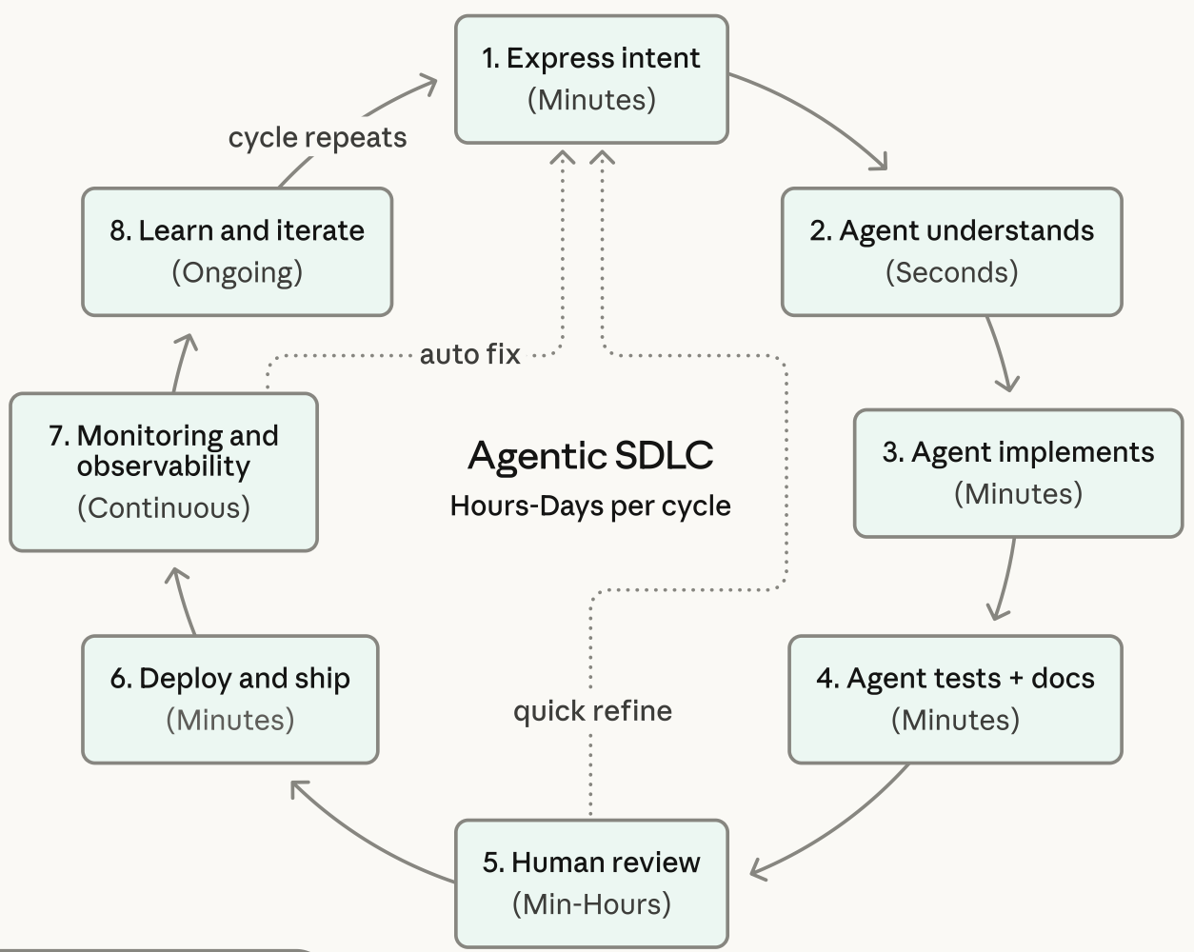
Agentic Coding Software Development Lifecycle

Slide 8
Information Management
Management
Information Systems (MIS)
Information Systems

Slide 9
Information Management (MIS)
Information Systems
Organizations
Technology
Information
Systems
Management

Slide 10
Fundamental MIS Concepts
Business
Challenges
Management
Organization
Information
System
Business
Solutions
Technology

Slide 11
Business Model
8
7
2
4
1
Key
Partners
Key
Activities
Value Proposition
Customer
Relationships
Customer
Segments
6
3
Key
Resources
Channels
9
5
Cost
Structure
Revenue
Streams
Source: Alexander Osterwalder & Yves Pigneur, Business Model Generation: A Handbook for Visionaries, Game Changers, and Challengers, Wiley, 2010.

Slide 12
Project-based software engineering
CUSTOMER
Problem
generates
helps-with
Requirements
implemented-by
Software
1
CUSTOMER and
DEVELOPER
DEVELOPER

Slide 13
Product software engineering
DEVELOPER
Opportunity
1
inspires
realizes
Product features
implemented-by
Software
DEVELOPER
DEVELOPER

Slide 14
Software execution models
Stand-alone execution
Hybrid execution
Software as a service
User’s computer
User’s computer
User’s computer
User interface
Product functionality
User data
User interface
Partial functionality
User data
User interface
(browser or app)
Product updates
Additional functionality
User data backups
Product updates
Product functionality
User data
Vendor’s servers
Vendor’s servers
Vendor’s servers

Slide 15
Product management concerns
Business
needs
Product manager
Technology
constraints
Customer
experience

Slide 16
Technical interactions of product managers
Product
vision management
Product
backlog management
User stories
and
scenarios
Product manager
Acceptance
testing
Customer
testing
User
interface
design

Slide 17
Software Development Life Cycle (SDLC)
The waterfall model
Requirements
definition
System and Software design
Implementation and unit testing
Integration and system testing
Operation and maintenance

Slide 18
Plan-based and Agile development
Plan-based development
Requirements
engineering
Requirements
specification
Design and implementation
Requirements change requests
Agile development
Requirements
engineering
Design and implementation

Slide 19
The Continuum of Life Cycles
High
Incremental
Agile
Frequency of Delivery
Predictive
Iterative
Low
Low
High
Degree of Change

Slide 20
Predictive Life Cycle
Analyze
Design
Build
Test
Deliver

Slide 21
Iterative Life Cycle
Prototype
Refine
Analyze
Analyze
Design
Build
Test
Deliver

Slide 22
A Life Cycle of
Varying-Sized Increments
Analyze
Design
Build
Test
Deliver
Analyze
Design
Build
Test
Deliver
Analyze
Design
Build
Test
Deliver

Slide 23
Iteration-Based and Flow-Based Agile Life Cycles
Iteration-Based Agile
Requirements
Analysis
Design
Build
Test
Requirements
Analysis
Design
Build
Test
Requirements
Analysis
Design
Build
Test
Requirements
Analysis
Design
Build
Test
Repeat
as needed
…
Requirements
Analysis
Design
Build
Test
Requirements
Analysis
Design
Build
Test
Flow-Based Agile
Requirements
Analysis
Design
Build
Test
the number of features in the WIP limit
Requirements
Analysis
Design
Build
Test
the number of features in the WIP limit
Requirements
Analysis
Design
Build
Test
the number of features in the WIP limit
Repeat
as needed
…
Requirements
Analysis
Design
Build
Test
the number of features in the WIP limit
Requirements
Analysis
Design
Build
Test
the number of features in the WIP limit

Slide 24
From personas to features
1
Personas
A way of representing users
inspire
Natural language descriptions of a user interacting with a software product
2
Scenarios
are-developed-into
3
inspire
Stories
Natural language descriptions of something that is needed or wanted by users
4
Features
define
Fragments of product functionality

Slide 25
Multi-tier client-server architecture
Client 1
Client 2
Web
Server
Application
Server
Database
Server
Client 3
Client …

Slide 26
Service-oriented Architecture
Client 1
S1
S2
Client 2
S3
Web
Server
Service
gateway
S4
Client 3
S5
Client …
S6
Services

Slide 27
VM
Container
Virtual
web server
Virtual
mail server
User 1
Container 1
User 2
Container 2
Server
software
Server
software
Application
software
Application
software
Guest
OS
Guest
OS
Server
software
Server
software
Hypervisor
Container manager
Host OS
Host OS
Server Hardware
Server Hardware

Slide 28
Everything as a service
Photo
editing
Software as a service
(SaaS)
Logistics
management
Cloud management
Monitoring
Platform as a service
(PaaS)
Database
Software
development
Storage Network
Infrastructure as a service
(IaaS)
Computing Virtualization
Cloud data center

Slide 29
Software as a service
Software customers
Software
provider
Software services
Cloud Infrastructure
Cloud
provider

Slide 30
Microservices architecture – key design questions
What are the microservices that make up the system?
How should data be distributed and shared?
How should microservices communicate with each other?
Microservices architecture
design
How should the microservices in the system be coordinated?
How should service failure be detected, reported and managed?

Slide 31
Types of security threat
An attacker attempts to deny access to the system for legitimate users
An attacker attempts to damage the system or its data
Availability
threats
Integrity
threats
SOFTWARE PRODUCT
PROGRAM
Distributed denial of service (DDoS) attack
Virus
DATA
Ransomware
Data theft
Confidentiality
threats
An attacker tries to gain access to private information held by the system

Slide 32
Software product quality attributes
Reliability
Availability
1
2
Software product quality attributes
Security
Resilience
7
3
Usability
Maintainability
6
4
Responsiveness
5

Slide 33
A refactoring process
1
2
Start
Identify code
‘smell’
Identify refactoring strategy
4
3
Run automated code tests
Make small
improvement until strategy completed

Slide 34
Functional testing
Start
1
Unit
Testing
4
2
Release
Testing
Feature
Testing
3
System
Testing

Slide 35
Test-driven development (TDD)
Start
1
Identify new
functionality
2
Identify partial implementation
of functionality
3
Write code stub
that will fail test
Functionality
complete
Functionality
incomplete
4
Run all
automated test
7
Refactor code
if required
5
Implement code that should cause failing test to pass
Test failure
6
Run all
automated test
All tests pass

Slide 36
DevOps
Development
Deployment
Support
Multi-skilled DevOps team

Slide 37
Code management and DevOps
DevOps automation
Continuous
integration
Continuous
deployment
Continuous
delivery
Infrastructure
as code
Code management system
Branching and merging
Recover
version
information
Code
repository
Save and
retrieve
versions
Transfer code to/from developer’s filestore
DevOps measurement
Data
collection
Data
analysis
Report
generation

Slide 38
DevOps and
Code Management:
Code management and
DevOps automation

Slide 39
Outline
Source code management
DevOps automation
DevOps measurement

Slide 40
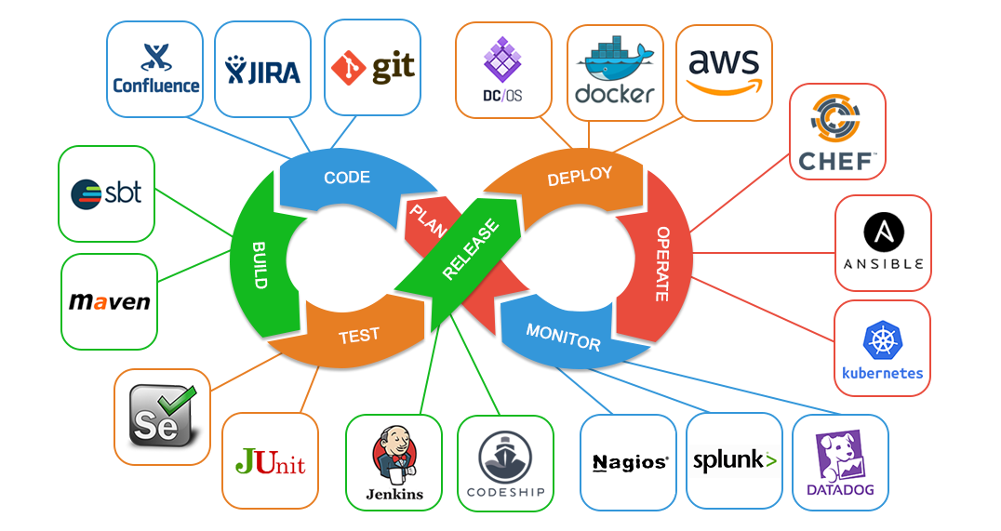
DevOps
Dev
Ops

Slide 41
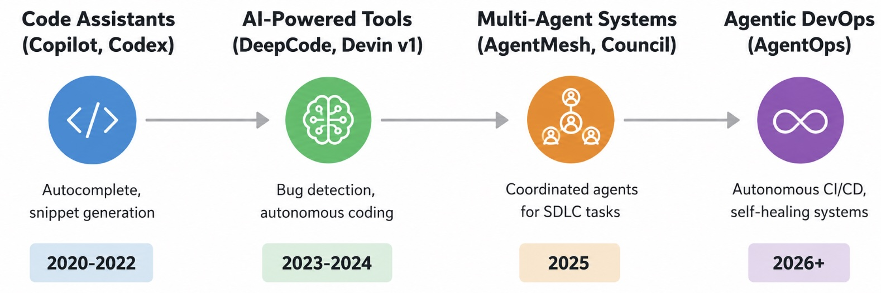
Agentic DevOps Evolution

Slide 42
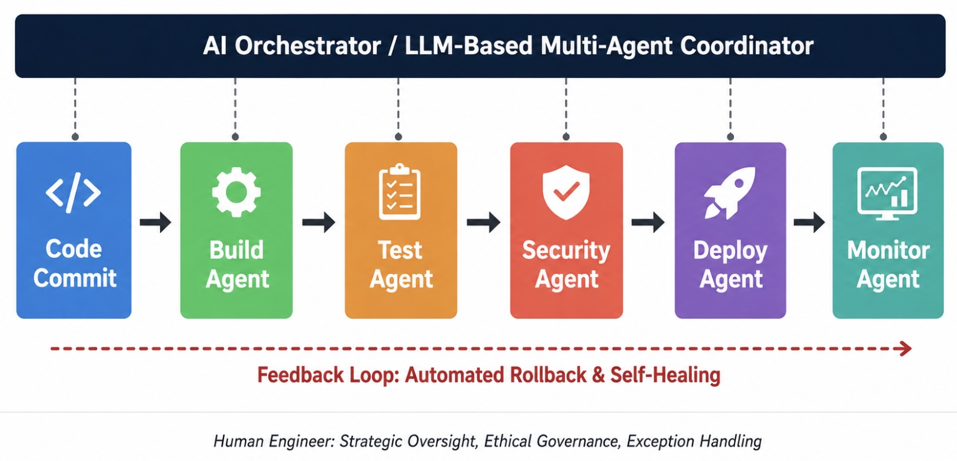
Agentic DevOps (AgentOps)
Pipeline Architecture

Slide 43
Agnetic DevOps (AgentOps)
Dimension | Traditional DevOps | Agentic DevOps (AgentOps)
Pipeline Logic | Pre-defined, scripted steps | Dynamic, goal-oriented reasoning
Failure Handling | Stops pipeline; alerts human | Diagnoses root cause; attempts self-repair
Test Selection | Runs full or pre-configured suite | Dynamically selects tests based on changes
Deployment Strategy | Fixed rollout plan | Adaptive (canary, blue-green) based on telemetry
Security Scanning | Scheduled or triggered scans | Continuous, context-aware vulnerability analysis
Human Role | Pipeline designer and operator | Strategic overseer and governor
Scalability | Linear (more scripts, more effort) | Exponential (agents learn and adapt)

Slide 44
Software Professionals in the Agentic Era
Role | Traditional Focus | Agentic Era Focus
Software Developer | Writing code, debugging, unit testing | Designing systems, training AI agents, reviewing AI output
QA Engineer | Writing test scripts, manual testing | Defining test strategies, training QA agents, quality governance
DevOps Engineer | Writing pipeline scripts, managing infra | Orchestrating AI agents, strategic oversight, reliability governance
Security Engineer | Manual audits, configuring scanners | Training security agents, ethical AI auditing, compliance
Engineering Leader | Team management, sprint planning | AI integration strategy, ethical framework development, upskilling

Slide 45
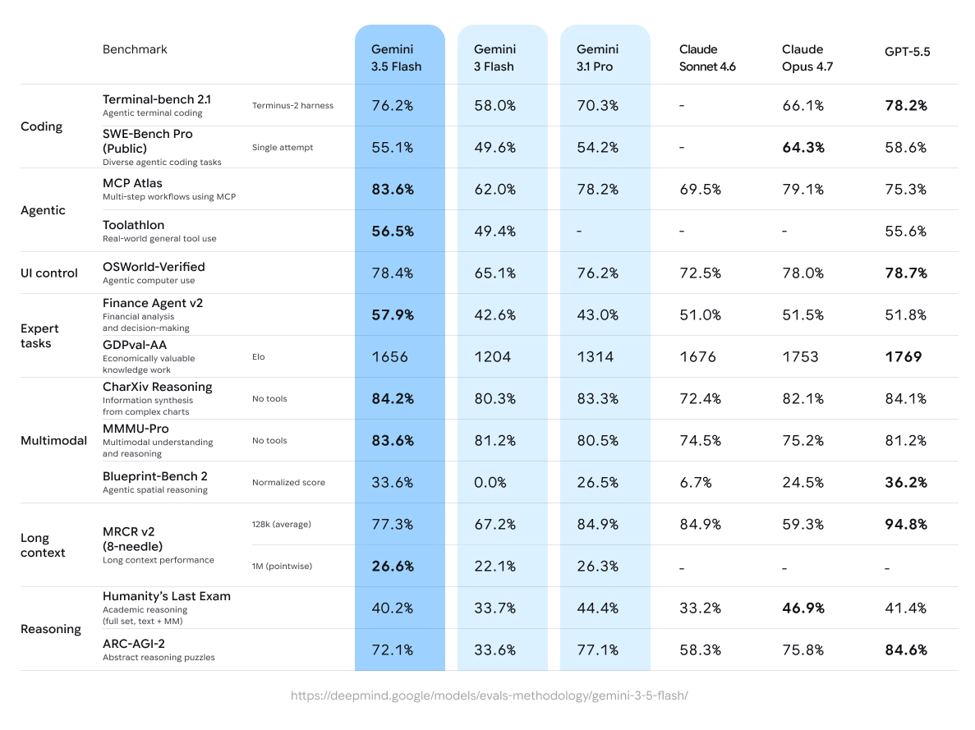
Google Gemini 3.5, Claude Opus 4.7, GPT 5.5
Source: https://blog.google/innovation-and-ai/models-and-research/gemini-models/gemini-3-5/#frontier-intelligence

Slide 46
Google Gemini 3.5, Claude Opus 4.7, GPT 5.5
Source: https://blog.google/innovation-and-ai/models-and-research/gemini-models/gemini-3-5/#frontier-intelligence

Slide 47
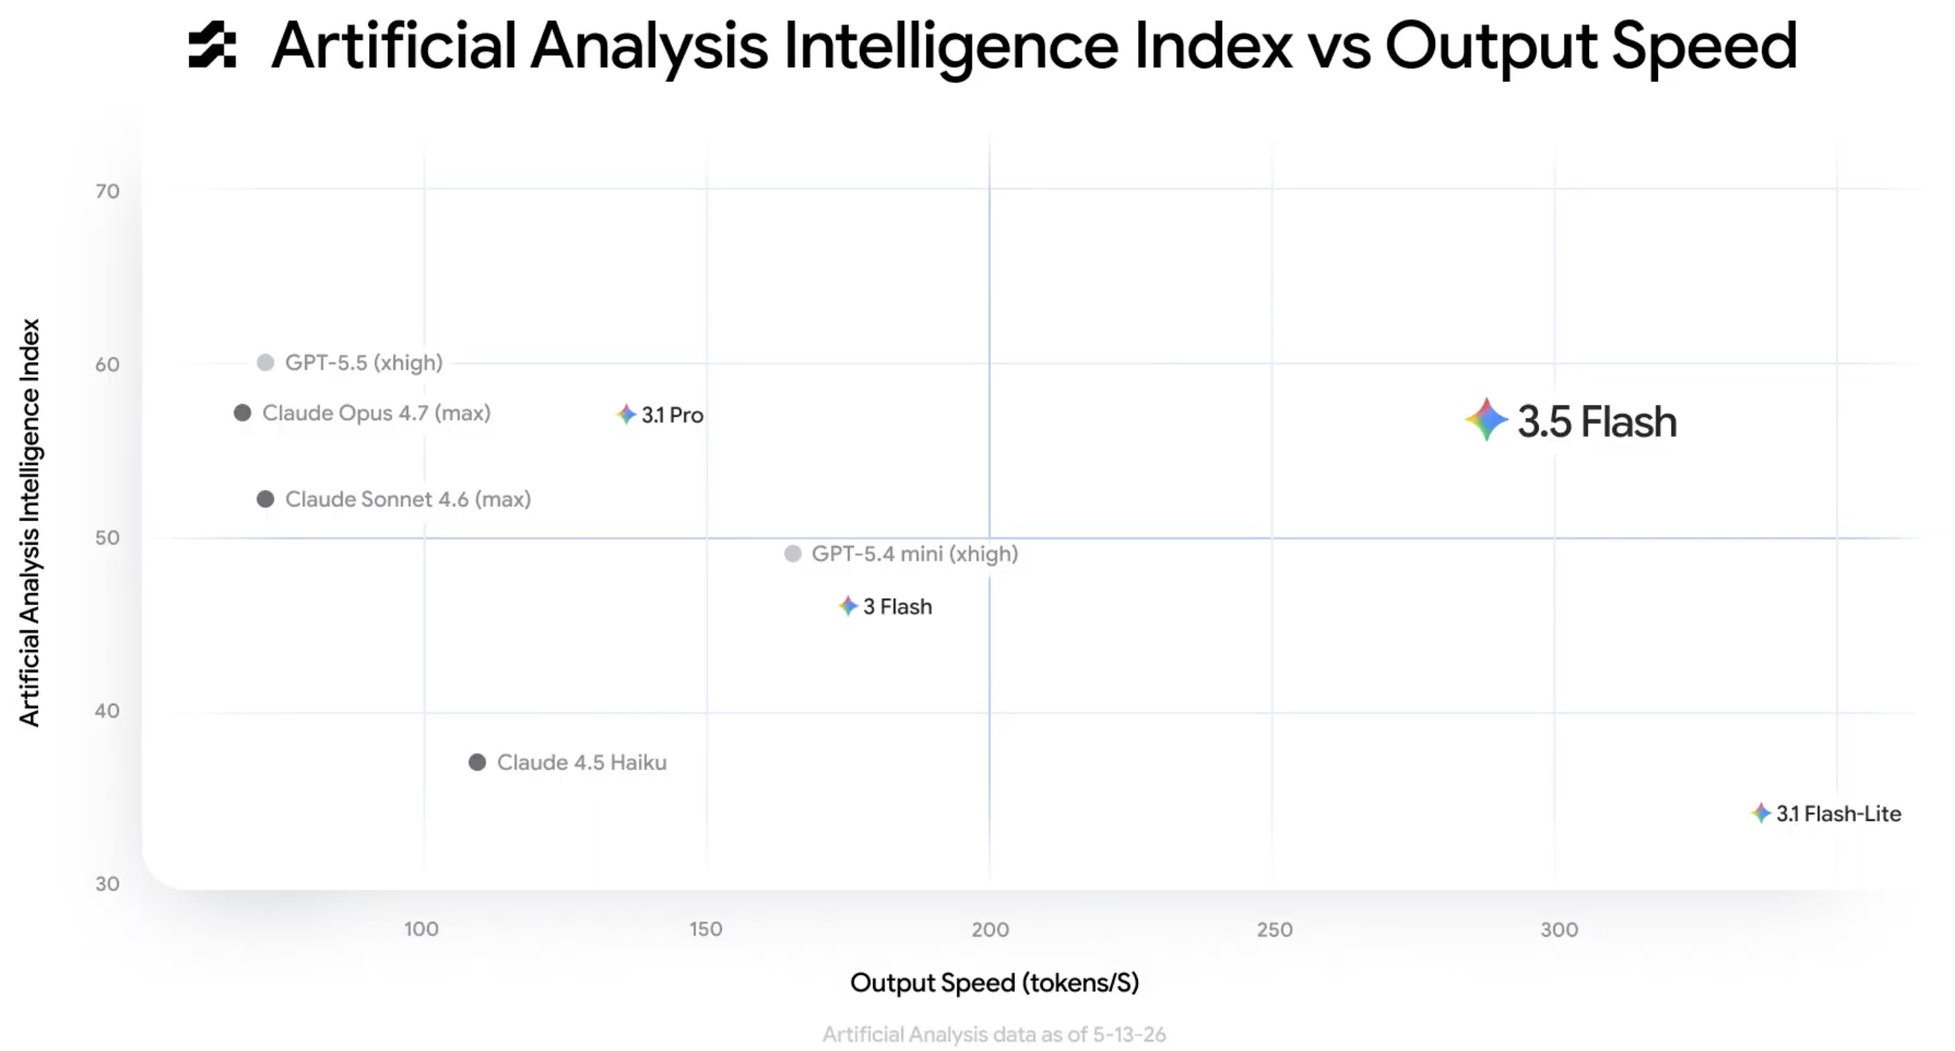
Google Gemini 3.5, Claude Opus 4.7, GPT 5.5
Source: https://blog.google/innovation-and-ai/models-and-research/gemini-models/gemini-3-5/#frontier-intelligence

Slide 48
Google I/O 2026
1
1
The Agentic Gemini Era
From standard chatbots to persistent, multi-step AI agents that automate full workflows in the background.
Core Models & Frameworks
Gemini 3.5 Flash is positioned as the speed-first foundation for tool handling, long-horizon tasks, and agentic workflow execution.
Benchmark
Gemini 3.5 Flash
Gemini 3.1 Pro
Claude Opus 4.7
GPT-5.5
Terminal-Bench 2.1
76.2%
70.3%
66.1%
78.2%
MCP Atlas
83.6%
78.2%
79.1%
75.3%
Finance Agent v2
57.9%
43.0%
51.5%
51.8%
SWE-Bench Pro
55.1%
54.2%
64.3%
58.6%
Positioning: bridges lightweight speed with frontier-level agent reasoning.

Slide 49
Google I/O 2026
2
2
Consumer & Workspace Agents
Everyday productivity agents designed to act on your behalf across apps and services.
Gemini Spark
Daily Brief
Gemini Omni (Flash)
Always-on personal cloud agent that automates recurring workflows, monitors email, and works with third-party tools like Canva and OpenTable under user supervision.
Localized Workspace agent that proactively pulls from Gmail, Calendar, and connected apps to synthesize contextual morning summaries.
Multimodal world-model agent for conversational video editing: motion, gravity, characters, backgrounds, and cinematic elements.
Focus: proactive assistance across everyday apps, personal context, and media workflows.

Slide 50
Google I/O 2026
3
Developer & Enterprise Platforms
Two pathways for building and running agentic workflows: visual orchestration plus code-first backend integration.
Google ADK 1.0
Google Antigravity 2.0
Best for GCP-native infrastructure and multi-language enterprise backends.
Core advantage: no Python dependency needed in Java/Go microservices.
• Standalone desktop & web orchestration platform
• Visually build, manage, and scale specialized agents
• Schedules autonomous subagent background workflows
OpenAI Agents SDK
Best for quick prototyping in Python-exclusive environments.
Core advantage: deep integration with OpenAI primitives.
Powered by ↓
Agent Development Kit (ADK) 1.0
LangGraph
• Python, TypeScript, Java, and Go
• AgentTeam API coordinates multiple specialists
• A2A protocol streams real-time task progress
Best for complex graph-based custom orchestration chains.
Core advantage: flexible structured workflow paths.

Slide 51
Google I/O 2026
4
The Agentic Web
Browser integration turns passive web browsing into an active transactional environment.
WebMCP
Chrome Auto Browse
New proposed open web standard that exposes structured JavaScript functions and HTML forms as machine-readable toolkits. Browser-based agents can interact with web components natively and execute bookings, checkouts, and other transactions reliably.
Chrome and DevTools capability that allows Gemini to autonomously navigate, debug, optimize code bases, and complete end-user web tasks natively within the browser window.
Big Takeaway
Google’s 2026 strategy centers on persistent agents across models, consumer products, enterprise frameworks, and the web.
The shift: agents become persistent workflow operators — not just chat interfaces.

Slide 52
Google Antigravity, Claude Code, OpenAI Codex
Gemini Spark, Claude Cowork
Antigravity / Claude Code / Codex: writing software.
Gemini Spark / Claude Cowork: commercialized knowledge work and personal assistance.
OpenClaw: open-source personal-assistant entry points and communication-channel integration.
Hermes Agent: long-term memory, self-learning, and skill accumulation.
Architecture for Agentic AI:
  Use commercial agents for high-quality task execution
  Use open-source agents for self-hosting, communication channels, memory, workflows, and data control

Slide 53
Need | Commercial Products | Open-Source Alternatives / Complements
Software development | Claude Code, OpenAI Codex, Google Antigravity | OpenCode, Aider, Cline, OpenHands, SWE-agent
Multi-agent development platform | Google Antigravity 2.0 | OpenHands SDK, LangGraph, CrewAI
Knowledge-work coworker | Claude Cowork | Hermes Agent, Dify, n8n
24/7 personal assistant | Gemini Spark | OpenClaw, Hermes Agent
Messaging-app interface | Gemini Spark has partial support | OpenClaw is the strongest fit
Long-term memory / self-improvement | Claude / Gemini products may include this, but in a closed way | Hermes Agent is the most representative option
Self-hosting and data control | More complete mainly through enterprise plans | OpenClaw, Hermes Agent, Dify, n8n

Slide 54
Software support
Traditionally, separate teams were responsible software development, software release and software support.
The development team passed over a ‘final’ version of the software to a release team.
  Built a release version, tested this and prepared release documentation before releasing the software to customers.
A third team was responsible for providing customer support.
  The original development team were sometimes also responsible for implementing software changes.
  Alternatively, the software may have been maintained by a separate ‘maintenance team’.

Slide 55
Software Development, release and support
Problem and bug
reports
Software
Development
Software
Release
Software
Support
Tested software
ready for release
Deployed software
ready for use

Slide 56
DevOps
There are inevitable delays and overheads in the traditional support model.
To speed up the release and support processes, an alternative approach called
DevOps (Development + Operations)
has been developed.

Slide 57
DevOps
Three factors led to the development and widespread adoption of DevOps:
  Agile software engineering reduced the development time for software, but the traditional release process introduced a bottleneck between development and deployment.
  Amazon re-engineered their software around services and introduced an approach in which a service was developed and supported by the same team. Amazon’s claim that this led to significant improvements in reliability was widely publicized.
  It became possible to release software as a service, running on a public or private cloud. Software products did not have to be released to users on physical media or downloads.

Slide 58
DevOps
Development
Deployment
Support
Multi-skilled DevOps team

Slide 59
DevOps principles
Everyone is responsible for everything
All team members have joint responsibility for developing, delivering and supporting the software.
Everything that can be automated should be automated
All activities involved in testing, deployment and support should be automated if it is possible to do so. There should be minimal manual involvement in deploying software.
Measure first, change later
DevOps should be driven by a measurement program where you collect data about the system and its operation. You then use the collected data to inform decisions about changing DevOps processes and tools.

Slide 60
Benefits of DevOps
Faster
deployment
Software can be deployed to production more quickly
because communication delays between the people
involved in the process are dramatically reduced.
Reduced
risk
The increment of functionality in each release is small
so there is less chance of feature interactions and
other changes causing system failures and outages.
Faster
repair
DevOps teams work together to get the
software up and running again as soon as possible.
More
productive
teams
DevOps teams are happier and more productive
than the teams involved in the separate activities.

Slide 61
Code management
Code management is a set of software-supported practices that is used to manage an evolving codebase.
During the development of a software product, the development team will probably create tens of thousands of lines of code and automated tests.
These will be organized into hundreds of files. Dozens of libraries may be used, and several, different programs may be involved in creating and running the code.

Slide 62
Code management
You need code management to ensure that changes made by different developers do not interfere with each other, and to create different product versions.
Code management tools make it easy to create an executable product from its source code files and to run automated tests on that product.

Slide 63
Code management and DevOps
Source code management, combined with automated system building, is essential for professional software engineering.
In companies that use DevOps, a modern code management system is a fundamental requirement for ‘automating everything’.
Not only does it store the project code that is ultimately deployed, it also stores all other information that is used in DevOps processes.
DevOps automation and measurement tools all interact with the code management system

Slide 64
Code management and DevOps
DevOps automation
Continuous
integration
Continuous
deployment
Continuous
delivery
Infrastructure
as code
Code management system
Branching and merging
Recover
version
information
Code
repository
Save and
retrieve
versions
Transfer code to/from developer’s filestore
DevOps measurement
Data
collection
Data
analysis
Report
generation

Slide 65
Code management fundamentals
Code management systems provide a set of features that support four general areas:
Code transfer
  Developers take code into their personal file store to work on it then return it to the shared code management system.
Version storage and retrieval
  Files may be stored in several different versions and specific versions of these files can be retrieved.
Merging and branching
  Parallel development branches may be created for concurrent working. Changes made by developers in different branches may be merged.
Version information
  Information about the different versions maintained in the system may be stored and retrieved

Slide 66
Code repository
All source code management systems have the general form with a shared repository and a set of features to manage the files in that repository:
  All source code files and file versions are stored in the repository, as are other artefacts such as configuration files, build scripts, shared libraries and versions of tools used.
  The repository includes a database of information about the stored files such as version information, information about who has changed the files, what changes were made at what times, and so on.

Slide 67
Code repository
Files can be transferred to and from the repository and information about the different versions of files and their relationships may be updated.
  Specific versions of files and information about these versions can always be retrieved from the repository.

Slide 68
Features of code management systems
Version and release identification
Change history recording
Independent development
Project support
Storage management

Slide 69

Git
In 2005, Linus Torvalds, the developer of Linux, revolutionized source code management by developing a distributed version control system (DVCS) called Git to manage the code of the Linux kernel.
This was geared to supporting large-scale open source development. It took advantage of the fact that storage costs had fallen to such an extent that most users did not have to be concerned with local storage management.
Instead of only keeping the copies of the files that users are working on, Git maintains a clone of the repository on every user’s computer

Slide 70
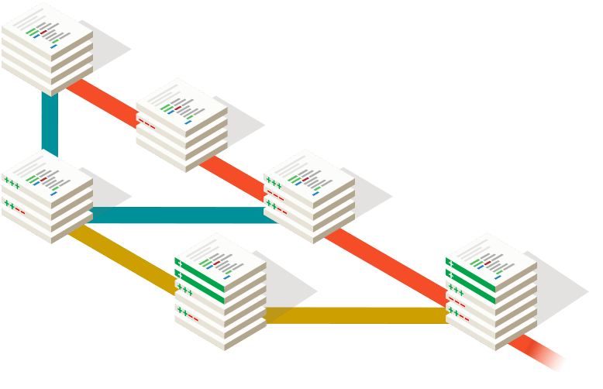
Source: https://git-scm.com/

Slide 71
Benefits of distributed code management
Resilience
Speed
Flexibility

Slide 72
Branching and merging
Branching and merging are fundamental ideas that are supported by all code management systems.
A branch is an independent, stand-alone version that is created when a developer wishes to change a file.
The changes made by developers in their own branches may be merged to create a new shared branch.
The repository ensures that branch files that have been changed cannot overwrite repository files without a merge operation.

Slide 73
Branching and merging
Feature experiment branch
Alice
Master branch
Merge
Bob
Bug fix branch

Slide 74
DevOps automation
By using DevOps with automated support, you can dramatically reduce the time and costs for integration, deployment and delivery.
Everything that can be, should be automated is a fundamental principle of DevOps.
As well as reducing the costs and time required for integration, deployment and delivery, process automation also makes these processes more reliable and reproducible.
Automation information is encoded in scripts and system models that can be checked, reviewed, versioned and stored in the project repository.

Slide 75
Aspects of DevOps automation
Continuous
integration
Each time a developer commits a change to the
project’s master branch, an executable version
of the system is built and tested.
Continuous
delivery
A simulation of the product’s operating environment
is created and the executable software version is tested.
Continuous
deployment
A new release of the system is made available
to users every time a change is made to the
master branch of the software.
Infrastructure
as code
Machine-readable models of the infrastructure
(network, servers, routers, etc.)
on which the product executes are used by configuration
management tools to build the software’s execution platform.

Slide 76
Characteristics of infrastructure as code
Visibility
Reproducibility
Reliability
Recovery

Slide 77
DevOps measurement
After you have adopted DevOps, you should try to continuously improve your DevOps process to achieve faster deployment of better-quality software.
There are four types of
software development measurement:
  Process measurement
  Service measurement
  Usage measurement
  Business success measurement

Slide 78
Automating measurement
As far as possible, the DevOps principle of automating everything should be applied to software measurement.
You should instrument your software to collect data about itself and you should use a monitoring system to collect data about your software’s performance and availability.
Some process measurements can also be automated.
  However, there are problems in process measurement because people are involved. They work in different ways, may record information differently and are affected by outside influences that affect the way they work.

Slide 79
Metrics used in the
DevOps scorecard
Process metrics
Deployment
frequency
Change
volume
DevOps
metrics
Percentage of
failed deployment
Lead time from
development to
deployment
Mean time
to recovery
Percentage
increase in
customer numbers
Performance
Number of customer
complaints
Availability
Service metrics

Slide 80
Summary
DevOps is the integration of software development and the management of that software once it has been deployed for use. The same team is responsible for development, deployment and software support.
The benefits of DevOps are faster deployment, reduced risk, faster repair of buggy code and more productive teams.
Source code management is essential to avoid changes made by different developers interfering with each other.

Slide 81
Summary
All code management systems are based around a shared code repository with a set of features that support code transfer, version storage and retrieval, branching and merging and maintaining version information.
Git is a distributed code management system that is the most widely used system for software product development. Each developer works with their own copy of the repository which may be merged with the shared project repository.

Slide 82
Summary
DevOps is the integration of software development and the management of that software once it has been deployed for use. The same team is responsible for development, deployment and software support.
The benefits of DevOps are faster deployment, reduced risk, faster repair of buggy code and more productive teams.
Source code management is essential to avoid changes made by different developers interfering with each other.

Slide 83
Summary
Continuous integration means that as soon as a change is committed to a project repository, it is integrated with existing code and a new version of the system is created for testing.
Automated system building tools reduce the time needed to compile and integrate the system by only recompiling those components and their dependents that have changed.
Continuous deployment means that as soon as a change is made, the deployed version of the system is automatically updated. This is only possible when the software product is delivered as a cloud-based service.

Slide 84
Summary
Infrastructure as code means that the infrastructure (network, installed software, etc.) on which software executes is defined as a machine-readable model. Automated tools, such as Chef and Puppet, can provision servers based on the infrastructure model.
Measurement is a fundamental principle of DevOps. You may make both process and product measurements. Important process metrics are deployment frequency, percentage of failed deployments, and mean time to recovery from failure.

Slide 85
References
Ian Sommerville (2019), Engineering Software Products: An Introduction to Modern Software Engineering, Pearson.
Ian Sommerville (2015), Software Engineering, 10th Edition, Pearson.
Titus Winters, Tom Manshreck, and Hyrum Wright (2020), Software Engineering at Google: Lessons Learned from Programming Over Time, O'Reilly Media.
Project Management Institute (2021), A Guide to the Project Management Body of Knowledge (PMBOK Guide) – Seventh Edition and The Standard for Project Management, PMI.
Project Management Institute (2017), A Guide to the Project Management Body of Knowledge (PMBOK Guide), Sixth Edition, Project Management Institute.
Project Management Institute (2017), Agile Practice Guide, Project Management Institute.
Nesreen Otoum and Nuha Elkhalili.(2026) "Methods and Techniques of Agentic Software Engineering: A Systematic Literature Review." IEEE Access 14 (2026): 7443-7465.
Lakshana Iruni Assalaarachchi, Zainab Masood, Rashina Hoda, and John Grundy. (2026) "Toward Agentic Software Project Management: A Vision and Roadmap." arXiv preprint arXiv:2601.16392 (2026).
Deepak Babu Piskala. (2026) "Spec-Driven Development: From Code to Contract in the Age of AI Coding Assistants." arXiv preprint arXiv:2602.00180 (2026).
NVIDIA DLI (2026), Building RAG Agents with LLMs,
https://learn.nvidia.com/courses/course-detail?course_id=course-v1:DLI+S-FX-15+V1
NVIDIA DLI (2026), Generative AI with Diffusion Models,
https://learn.nvidia.com/courses/course-detail?course_id=course-v1:DLI+S-FX-14+V1
NVIDIA DLI (2026), Building Agentic AI Applications with LLMs,
https://learn.nvidia.com/courses/course-detail?course_id=course-v1:DLI+S-FX-41+V1

